Slide 1
Calorimeter Design
for SoLID Project
Jin Huang, Mehdi Meziane, Zhiwen Zhao
Physics Division Review Session on SoLID Project
Sept 30, 2011, Jefferson Lab

Slide 2
Outline
Requirement
Conclusion
Budget Estimation
Design Progress
Shashlyk calorimeter
Preshower/shower separation
Clear fiber connector

Slide 3
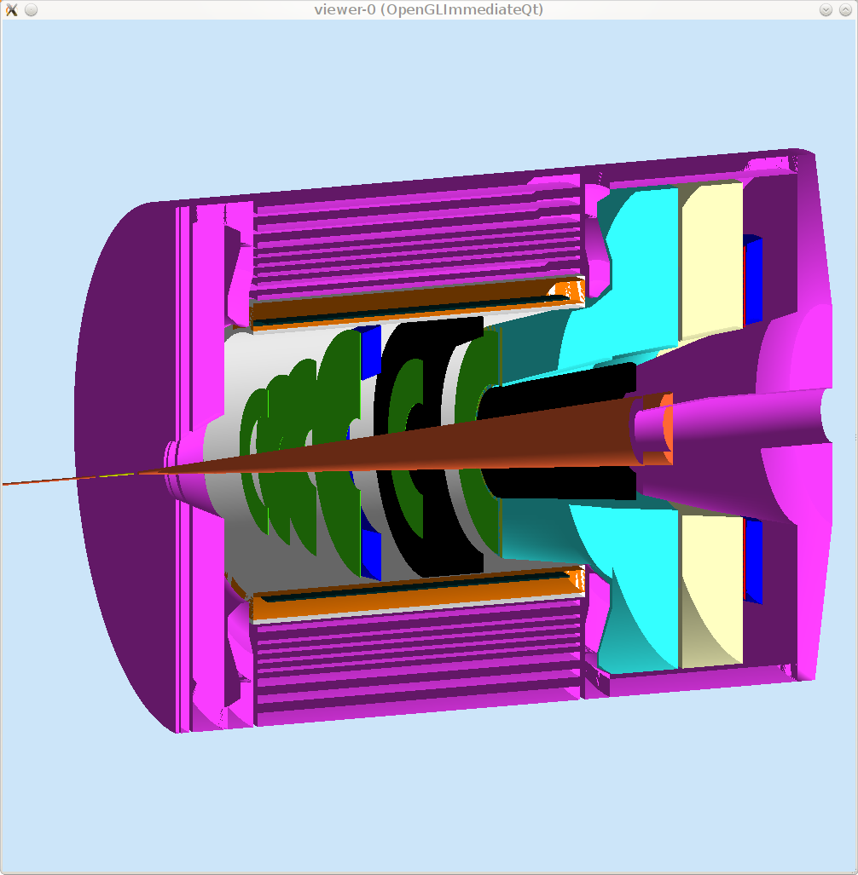
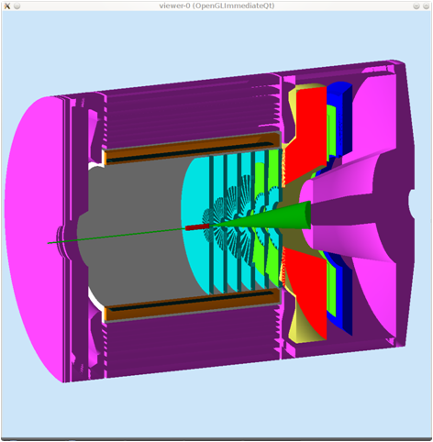
Calorimeters for SoLID experiments
PVDIS forward angle
SIDIS forward angle
SIDIS large angle

Slide 4
Requirement
Electron-hadron separation
  100:1 pion rejection in electron sample
  Energy resolution: σ(E)/E ~ 6%/√E
Provide shower Position
  σ ~1cm, for tracking initial seed / suppress background
Time response
  σ <~ few hundreds ps
  provide trigger/identify beam bunch (TOF PID)
Radiation resistant
  PVDIS forward angle
    EM <=2k GeV/cm²/s + pion (GeV/cm²/s), total ~<60 krad/year
  SIDIS forward angle
    EM <=5k GeV/cm²/s + pion , total, total ~<100 krad/year
  SIDIS large angle
    EM <=20k GeV/cm²/s + pion, total, total ~<400 krad/year
Notes:
Back up slides pion/electron rate

Slide 5
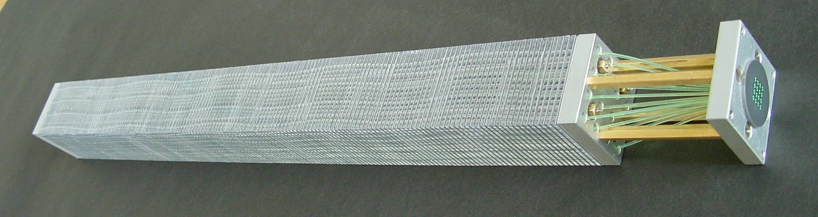
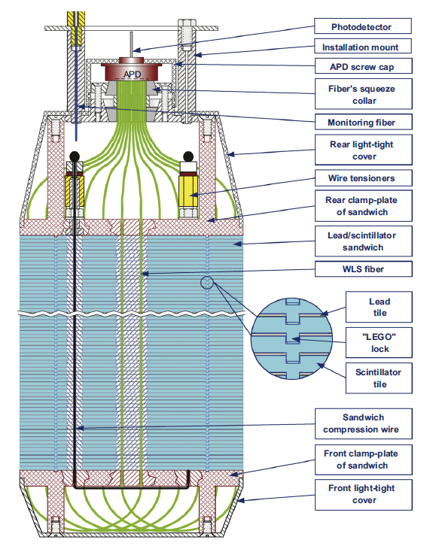
Best option: Shashlyk calorimeter
KOPIO
Typical Shashlik
Polyakov, COMPASS Talk, 2010
Shashlyk calorimeter
  Lead-scintillator sampling calorimeter
  Fiber collects and reads out light
Satisfy the SoLID requirement
  Good energy resolution (tunable)
  Radiation hardness ~ 500kRad
Easier to collect and read out the light
Well developed technology, many experiments

Slide 6
Flexible Design of Shashlyk Detectors
Flexible design to customize for exp. needs
Experience collaborations contacted
  IHEP@Protvino (design & production),
  INR@Trozik (design), Uniplast (production)
  200 module/month mass production (~1500 needed)
Experiment | COMPASS | PANDA | KIPIO
Pb Thick/ Layer (mm) | 0.8 | 0.3 | 0.28
Sci Thick/ Layer (mm) | 1.5 | 1.5 | 1.5
Energy Res. a/sqrt(E) | 6.5% | ~3% | ~3%
Rad. Length, X₀ (mm) | 17.5 | 34 | 35
Total Rad. Length (X₀) | 22.5 | 20 | 16
Moliere radius (mm) | 36 | 59 | 60
Typical Detecting Energy | 10¹~10²GeV? | <10GeV | <1GeV
Trans. Size (cm) | ~4x4 | 11x11 | 11x11
Active depth(cm) | 400 | 680 | 555

Slide 7
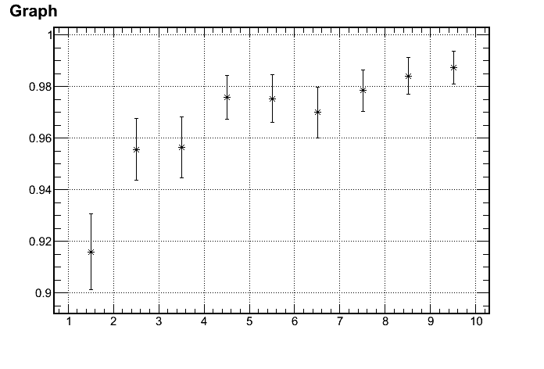
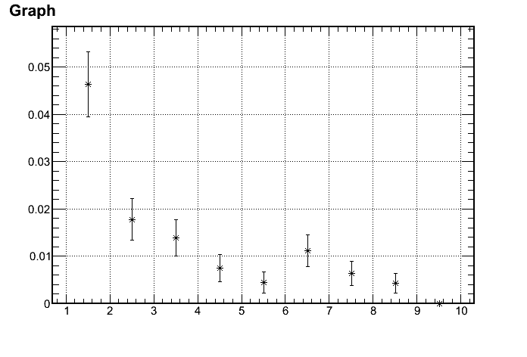
Tuning for SoLID/Lead-Sci Ratio
  Dedicated Geant4 MC developed
  Reach 100:1 pion rejection w/ Pb thick =0.6mm/Layer
Electron Efficiency
1/(Pion rejection)
97%
100:1 Rejection
p (GeV)
p (GeV)
Active:
3~7 GeV

Slide 8
Tuning for SoLID/Lateral Size
Rough numbers
Good Balance
block Size (cm)

Slide 9
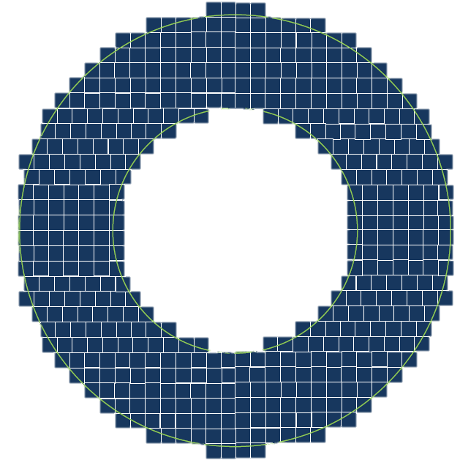
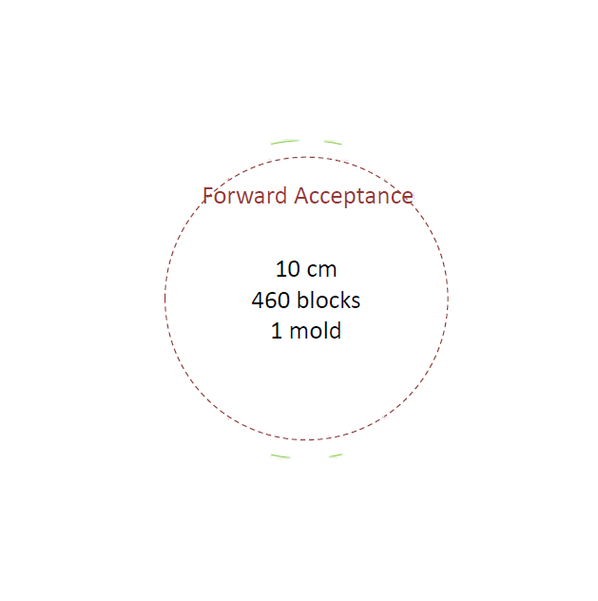
Layout map
Preferred
Also studied
Hexagon
Square 10*10 cm
Square 10*10 cm
Ring Sector

Slide 10
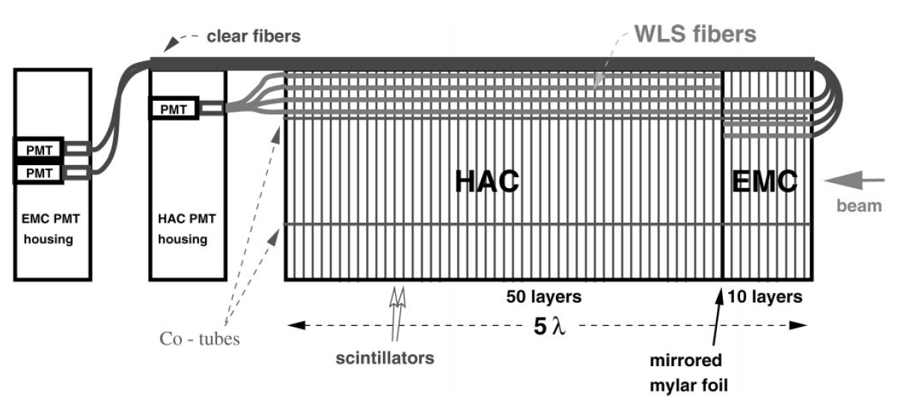
Preshower/shower
Preshower-shower separation for better electrion ID
Options
  Curve fiber from front, example (ZEUS) below
  Run fiber through shower part within light-protected tube
  Run preshower fiber (separately) to outside magnetic field
ZEUS forward Cal.
Bamberger, NIM, 2000

Slide 11
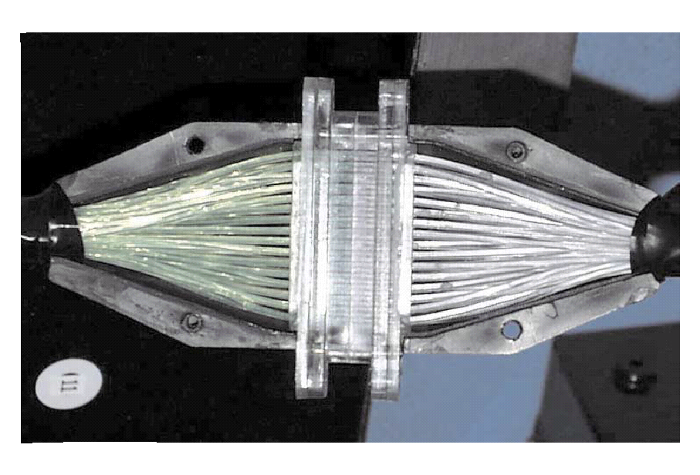
Photon Readout Options
Large angle calorimeter
  Prefer transporting photons to outside magnetic field
  No field/PMT read out/easy to maintain
Forward calorimeter
  In field readout (<~100G), PMT with mu-metal shielding
  Transport photons to outside end cap
  Options still under study.
Fiber connectors and clear fiber
  Clear fiber are cheaper, w/ longer attenuation length
128-fiber connector
LHCb

Slide 12
Budget (preliminary)
Experiment | Angle(degree) | Radius(cm) | Area(m²) | Number of modules | Module cost (M$) | Fiber Extension (M$) | PMT+ support (M$) | Total cost
PVDIS (forward angle) | 22-35 | 110-258 | ~10 | 1000? ~Baffle design | 1.5 | 0 | 0.6 | 2.1
SIDIS (forward angle) | 9-15 | 107-202 | 11 | 948
SIDIS (large angle) | 17-24 | 82-141 | 5 | 460 | 0.8 | 0.3(?) | 0.3 | 1.4
+Support structure: 0.2M$ (?)
10x10cm Shashlyk module costs about $1~1.5K each
PVDIS : factor 0.5 reduction due to only covers ~half of azimuthal angle, which depends on baffle design.
PVDIS and SIDIS forward angle calorimeter will rearrange modules

Slide 13
Summary
Shashlik calorimeter is the best option
  Good energy resolution/Radiation resistant/Concentrated photon output/Matured production
Tuning the design for SoLID
  Tuning Pb-Sci ratio/Preshower-shower thickness/lateral size and shape/layout
Exploring new features
  Preshower/shower splitting/clear fiber extensions

