Slide 1
SoLID DAQ for Transversity and PVDIS
Alexandre Camsonne
Rory Miskimen
Yi Qiang

Slide 2
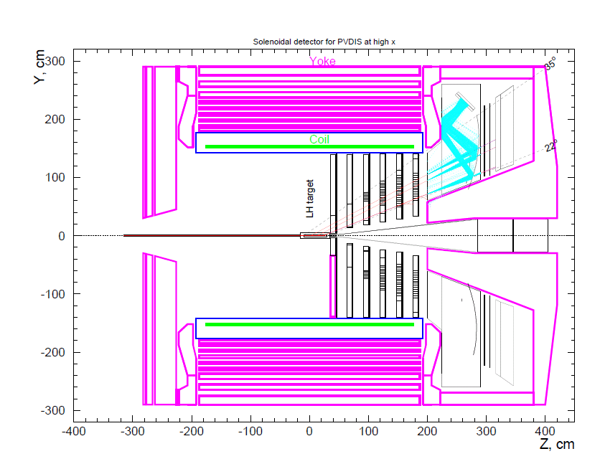
Detector layout and trigger for PVDIS
Trigger
Calorimeter
+
Cerenkov
200 to 500 KHz of electrons
30 individual sectors
Max 17 KHz/sector

Slide 3
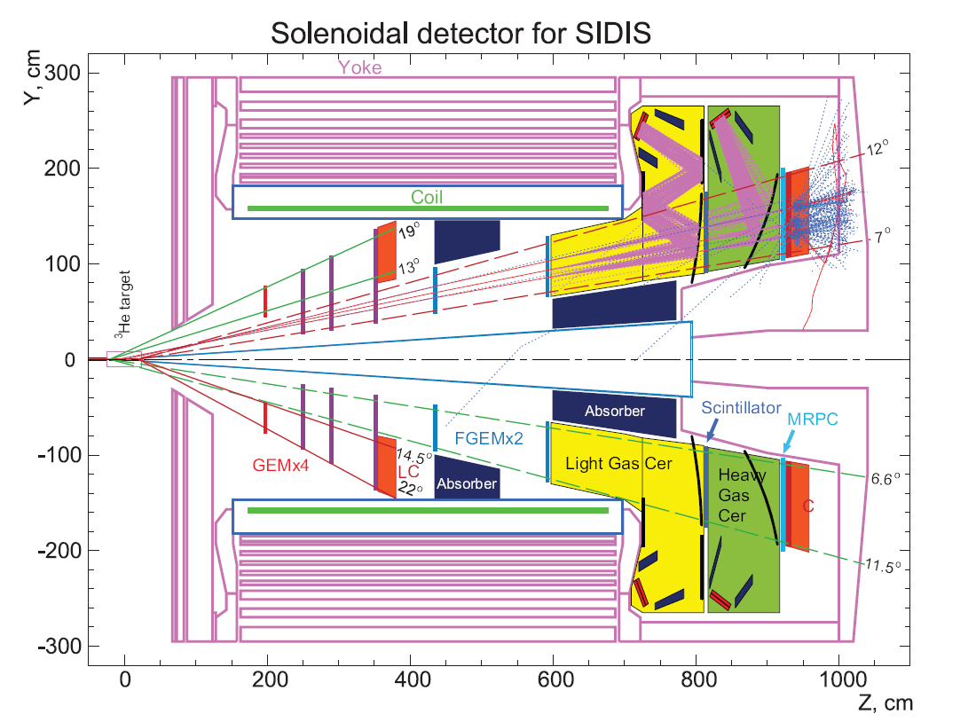
Detector layout and trigger for SIDIS
Trigger
Calorimeter
+
Cerenkov
+
MRPC
30 sectors
Combined
in
10 regions of interests
Max rate 300 KHz
10 KHz/sector

Slide 4
GEM readout
APV25 + VME module based
Up to 164 000 channels
APV 25 : 128 channels
VME readout : 4 APV25 = 512 channels
1 separate VXS crate for GEM readout
2 crates per sectors for FADC and GEM

Slide 5
SoLID SIDIS Detector Rates
In 50 ns windows, 11 GeV
Detector | Rate | Hits | Type | Data Size per hit
GEM | 4.4 GHz | 220 | Hits (time) | 4 Byte x 2 (X/Y)
LC | 120 kHz | 1 | Energy, Hits | 8 Byte x 2 (PS/SH)
FC | 200 MHz | 10 | Energy, Hits | 8 Byte x 2 (PS/SH)
LGC | 40 MHz | 3 | Energy, Hits | 8 Byte x 2 (split)
HGC | 60 MHz | 4 | Energy, Hits | 8 Byte x 2 (split)
MRPC | 850 MHz | 45 | Hits | 4 Byte
SC | 300 MHz | 15 | Energy, Hits | 8 Byte
Total |  |  |  | 2.5 kB
With header and other over head
event size is ~ 4 kB

Slide 6
Pipelined Hall D DAQ
Virtually dead time less
Flexibility in L1
Data online filtering with L3 farm
Reduce data to from 800 Mb/s to 50 Mb/s

Slide 7
L3 Farm
Determine data reduction algorithm
  Crude tracking
  Geometrical region on interests
  Downsampling
Determine number of nodes needed for required performance

Slide 8
Flash ADC work
PEPPO : injector positron experiment
  2 prototype FADC
  2 New Hall D FADC
  Test pipelining
  Goal : reach 100 KHz similar to Hall A Compton DAQ
  Some beam maybe available in October
Umass :
  test setup for Hall D electronics
  Can develop PVDIS electronics

Slide 9
Hall D developments
Elliot Wollin and Vardjan
  Cosmics test stand this fall using CODA 3 alpha
  CODA 3 support L3 farm nodes
    All events go through L3 when going to Event Recorder
    Events transferred using ET between nodes
    Nodes and process managing being worked out by Vardjan
  CODA 3 Alpha available after Thanksgiving

Slide 10
JLAB electronics PVDIS
Detector | Channel | Module | Unit price | Total price sector | Total price 30 sectors
Calorimeter | 84 | 6 | 4500 | 27000 | 810000
LC | 9
TID |  | 2 | 3000 | 6000 | 180000
SD |  | 2 | 2500 | 5000 | 150000
VXS |  | 2 | 11500 | 23000 | 690000
VME CPU |  | 2 | 3400 | 6800 | 204000
CTP |  | 2 | 5000 | 10000 | 300000
Total price |  |  |  | 77800 | 2334000

Slide 11
SIDIS channel count
Detector | Module type | Number of channels | Number of modules
Forward Calorimeter | FADC+TDC | 1896 | 119
Large angle calorimeter | FADC+TDC | 920 | 58
Light Gas Cerenkov | FADC+TDC | 120 | 8
Heavy Gas Cerenkov | FADC+TDC | 270 | 17
Scintillator | FADC+TDC | 120 | 8

Slide 12
PVDIS+SIDIS electronics required
Module | Unit price | Number of modules | Price
FADC 250 | 4500 | 210 | 945000
F1 | 4000 | 105 | 420000
Discriminator | 2500 | 122 | 525000
VME crate | 5000 | 11 | 55000
CTP | 5000 | 60 | 300000
SSP | 5000 | 8 | 40000
VXS crate | 11500 | 1 | 11500
GTP | 5000 | 1 | 5000
VXS crate | 11500 | 1 | 11500
TS | 3500 | 1 | 3500
TID | 3000 | 60 | 180000
SD | 2500 | 60 | 150000
VXS crate | 11500 | 60 | 690000
VME CPU | 3400 | 73 | 248200
L3 farm node | 5000 | 12 | 60000
 |  | Total detectors | 3644700
High
Res
timing

Slide 13
Time line
2011
  Hall A computer upgrade
  FADC tests
  Intel VME CPU test : reach 10 KHz rate with fastbus for g2p
2012
  GEM + APV25 GEM tests during g2p
  FADC tests ( achieve 100 KHz trigger rate for Compton for PEPPO )
  HCAL Trigger development
  4 JLAB FADC250
2013
  Small scale setup for testing : FADC + trigger + fastbus + APV25
2014
  A1n :
    Full scale test of GEM
    Digital Trigger electronics test parasitic
2015
  Full scale system

Slide 14
Conclusion
SoLID requires high rate capability and advanced trigger capability
SoLID benefits from Hall D development
  Trigger using FADC
  L3 farm
Electronics and performance to be tested in the next few years
SoLID electronics for both experiment around 4 M$

Slide 15
Backup slides

Slide 16
SIDIS channel count
Detector | Module type | Number of channels | Number of modules
Forward Calorimeter | FADC+TDC | 1896 | 119
Large angle calorimeter | FADC+TDC | 920 | 58
Light Gas Cerenkov | FADC+TDC | 120 | 8
Heavy Gas Cerenkov | FADC+TDC | 270 | 17
Scintillator | FADC+TDC | 120 | 8
GEM | VME | 164K | 321

Slide 17
JLAB electronics PVDIS
Detector | Channel | Module | Unit price | Total price sector | Total price 30 sectors
Calorimeter | 84 | 6 | 4500 | 27000 | 810000
LC | 9
GEM | 4700 | 10 | 5000 | 50000 | 1500000
TID |  | 2 | 3000 | 6000 | 180000
SD |  | 2 | 2500 | 5000 | 150000
VXS |  | 2 | 11500 | 23000 | 690000
VME CPU |  | 2 | 3400 | 6800 | 204000
CTP |  | 2 | 5000 | 10000 | 300000
Total price |  |  |  | 127800 | 3834000

Slide 18
Level-1 Trigger Electronics
Front-End Crate
Trigger Distribution Crate
Custom Designed
Boards at JLAB
VXS Crate
VXS Crate
Detector
Signals
TD
TS
Fiber Optic Links
Clock/Trigger
(16bits @ 62.5MHz
TS
(16)
(12)
(1)
(1)
(1)
(1)
(1)
VXS Crate
( ) – Number in parentheses
refer to number of modules
Fiber Optic Link
(~100 m)
(64bits @ 125 MHz)
SSP
GTP
fADC250
(8)
CTP Crate Trigger Processor
(2)
(1)
Copper Ribbon Cable
(~1.5 m)
(32bits @ 250 MHz)
SD Signal Distribution
Global Trigger Crate
TI Trigger Interface
Trigger Latency ~ 3 μs
(F1TDC pipeline ~3.9 μs)
Pipelined detector readout electronics:
fADC and F1TDC
VXS Backplane

Slide 19
Detector layout and trigger for SIDIS
Trigger
Calorimeter
+
Cerenkov
+
MRPC
30 sectors
combine

Slide 20
Pipelined Hall D DAQ
FADC
Calorimeter
CTP
L1 trigger
Calorimeter
+
Cerenkov
+
Pion
In
3 us
CTP
FADC
Light Gas Cerenkov
SSP
GTP
CTP
CTP
Heavy Gas Cerenkov
FADC

Slide 21
Pipelined Hall D DAQ
Electron shower
accidental
accidental
3 us latency
Σ
Above
threshold

Slide 22
L3 Farm
blocked event fragments
partially recombined event fragments
full events
All nodes connected with 1GB/s links
Switches connected with 10GB/s fiber optics
ROC
EB1
Event Builder
stage 1
ROC
L3 Farm
EB2
Event Builder
stage 2
ROC
node
node
ROC
EB1
Event Builder
stage 1
node
Read Out Controllers
ER
Event Recorder
ROC
Raid Disk
ROC
EB2
Event Builder
stage 2
node
node
ROC
node
EB1
Event Builder
stage 1
node
ROC
ROC
Front-End Crates
Staged Event Building
Level-3 Trigger and monitoring
Event Recording
~60 crates
~50MB/s out per crate
N x M array of nodes (exact number to be determined by available hardware at time of purchase)
300MB/s in
300MB/s out

Slide 23
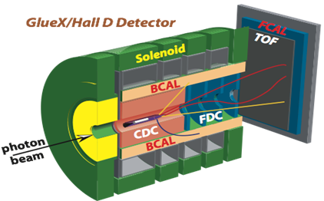
Hall D L1 Trigger-DAQ Rate
Low luminosity (10⁷ γ/s in 8.4 < E_{γ} < 9.0 GeV)
  20 kHz L1
High luminosity (10⁸ γ/s in 8.4 < E_{γ} < 9.0 GeV)
  200 kHz L1
  Reduced to 20 kHz L3 by online farm
Event size: 15 kB; Rate to disk: 3 GB/s
SC
Detectors which can be used in the Level-1 trigger:
Forward Calorimeter (FCAL) | Energy
Barrel Calorimeter (BCAL) | Energy
Start Counter (SC) | Hits
Time of Flight (TOF) | Hits
Photon Tagger | Hits
Electromagnetic background
Hadronic E_{γ} < 8 GeV
Hadronic E_{γ} > 8 GeV
Energy BCAL (GeV)
Energy BCAL (GeV)
Energy BCAL (GeV)
Basic Trigger Requirement:
E_{BCAL} + 4 ∙ E_{FCAL} > 2 GeV
and a hit in Start Counter
Energy FCAL (GeV)
Energy FCAL (GeV)
Energy FCAL (GeV)

Slide 24
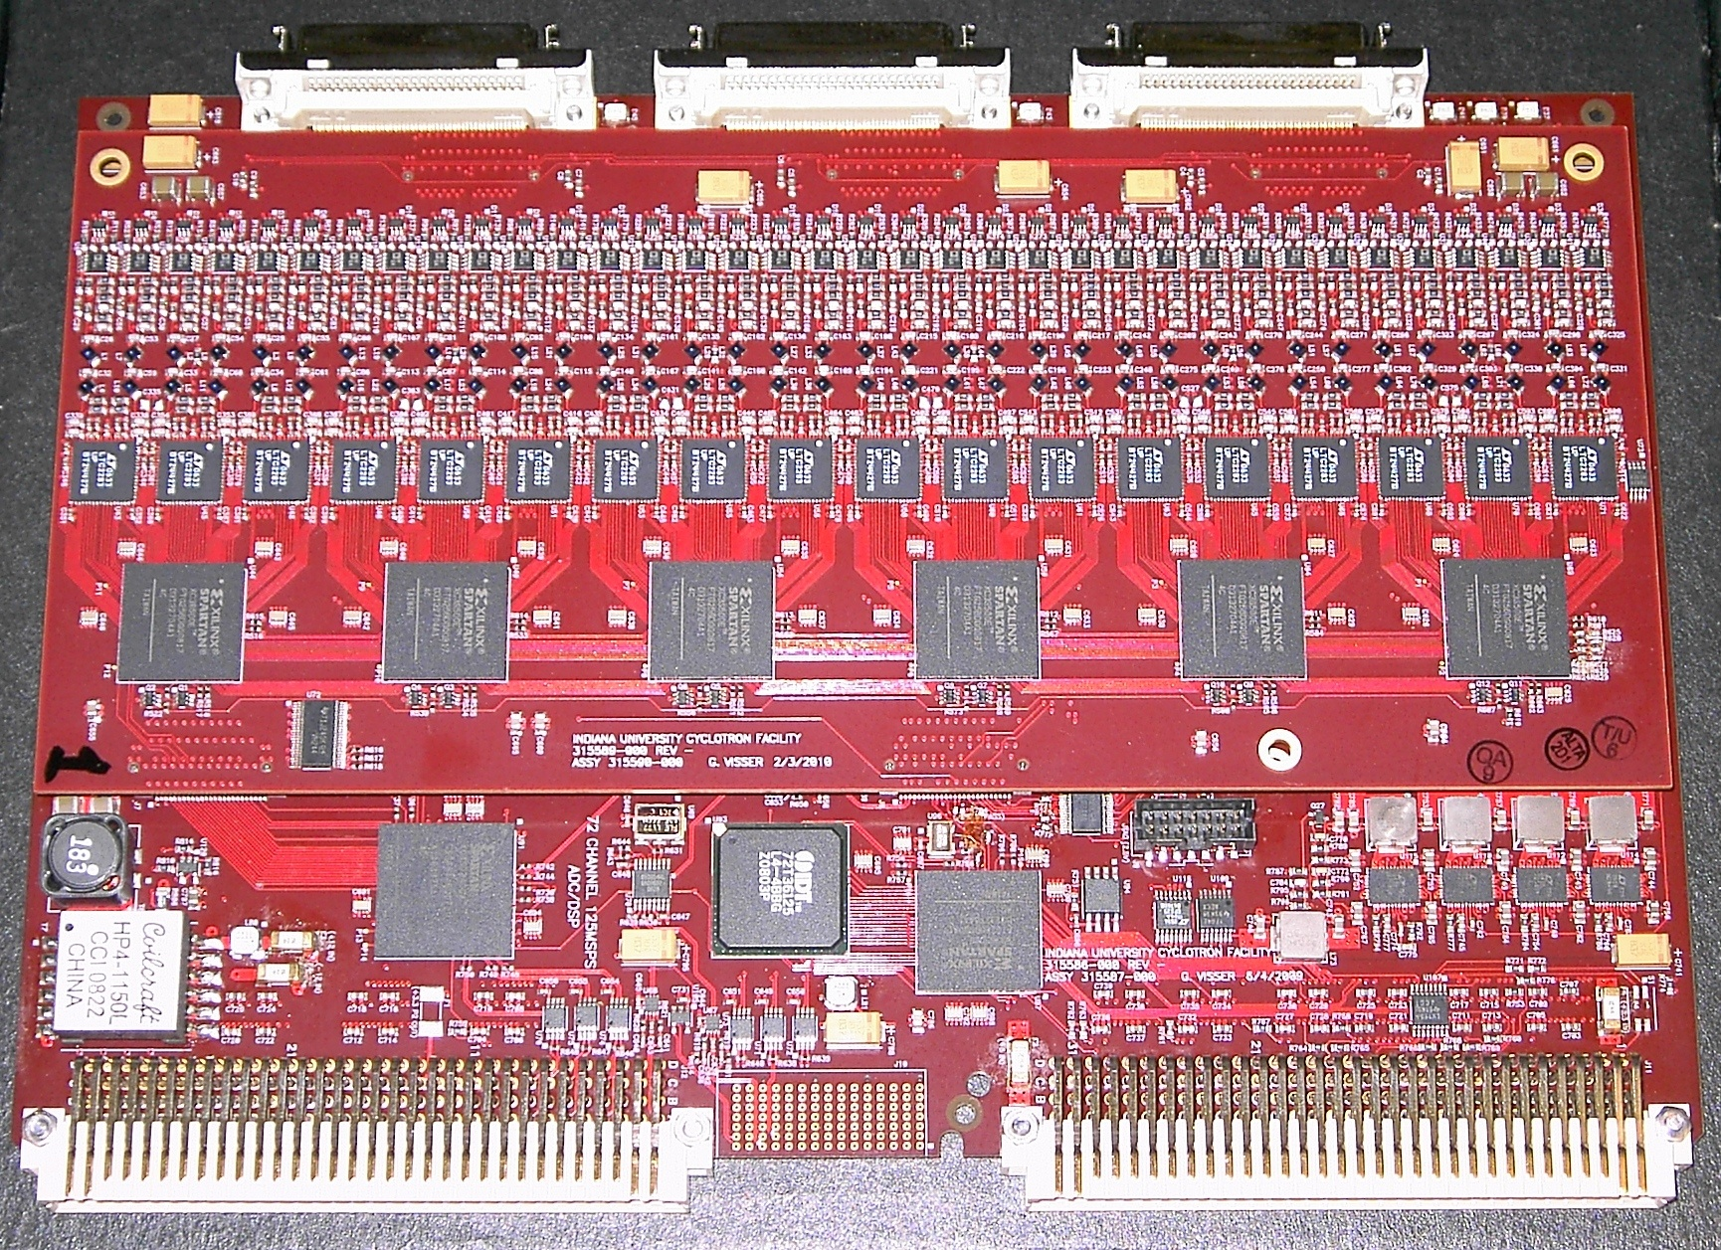
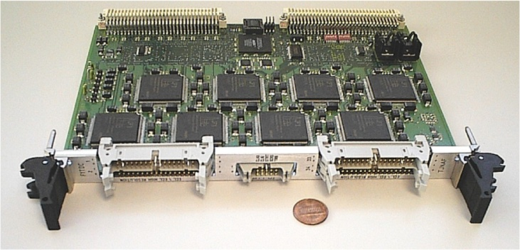
Custom Electronics for JLab
VME Switched Serial (VXS) backplate
  10 Gbps to switch module (J₀)
  320 MB/s VME-2eSST (J₁/J₂)
All payload modules are fully pipelined
  FADC125 (12 bit, 72 ch)
  FADC250 (12 bit, 16 ch)
  F1-TDC (60 ps, 32 ch or 115 ps, 48 ch)
Trigger Related Modules
  Crate Trigger Processor (CTP)
  Sub-System Processor (SSP)
  Global Trigger Processor (GTP)
  Trigger Supervisor (TS)
  Trigger Interface/Distribution(TI/D)
  Signal Distribution (SD)
FADC125
F1-TDC

Slide 25
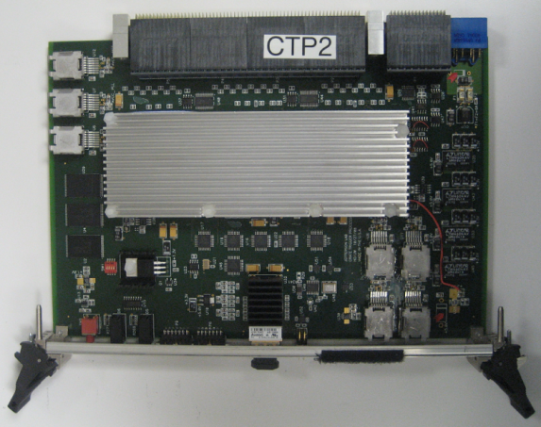
L1 Trigger Diagram
CPU
SSP
SSP
SSP
SSP
SSP
SSP
SSP
GTP
SD
SSP
SSP
SSP
SSP
SSP
SSP
SSP
TI
CPU
TD
TD
TD
TD
TD
TD
SD
SD
TD
TD
TD
TD
TD
TD
TS
VXS Crate
CTP
VXS Crate
FADC250
12 bit @ 250 MHz, 16 ch
Sums amplitude from all channels
Transfer total energy or hit pattern to CTP
Fiber Optics
64 bit @ 125 MHz
CPU
FADC
FADC
FADC
FADC
FADC
FADC
CTP
SD
FADC
FADC
FADC
FADC
FADC
FADC
TI
Crate Trigger Processor
Sums energies from FADCs
Transfer total energy or hit pattern to SSP
VXS Serial Link
16 bit @ 250 MHz: 4 Gbps
VXS Crate

Slide 26
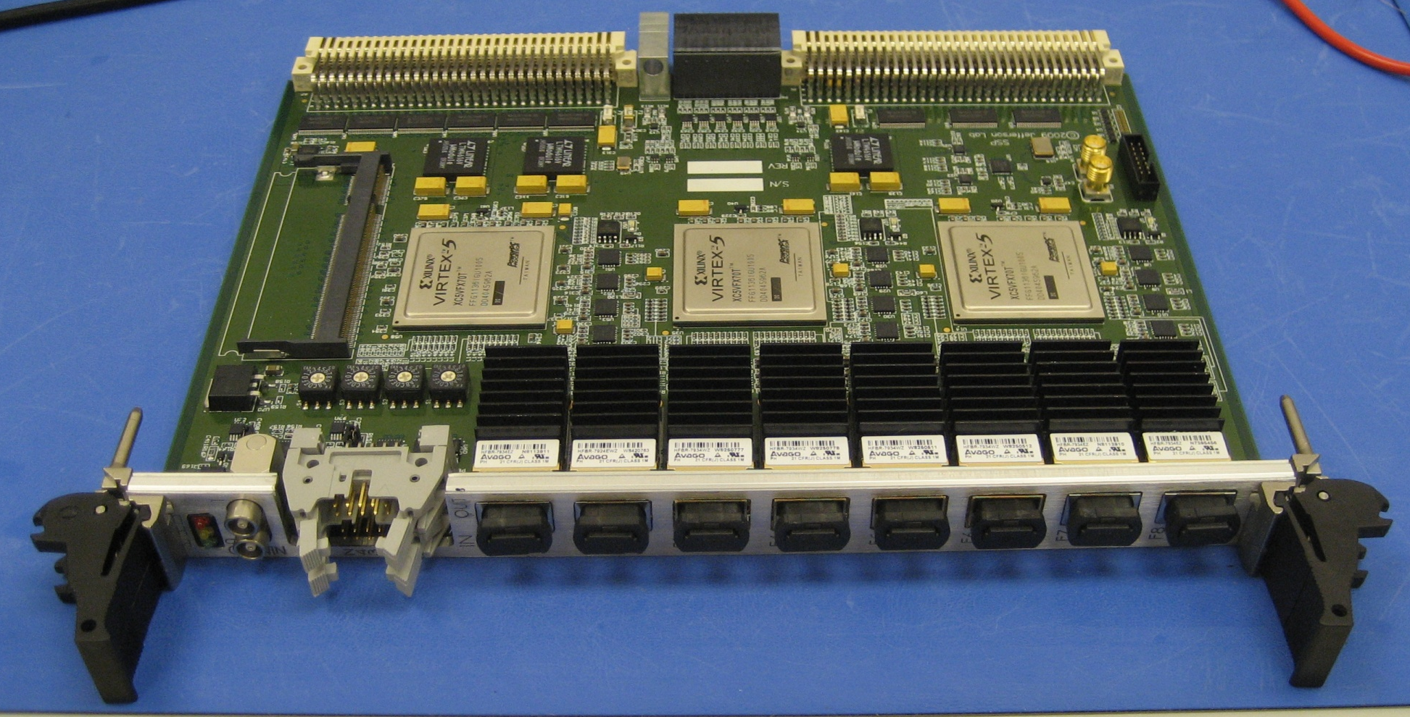
L1 Trigger Diagram
CPU
SSP
SSP
SSP
SSP
SSP
SSP
GTP
SD
SSP
SSP
SSP
SSP
SSP
SSP
SSP
TI
CPU
TD
TD
TD
TD
TD
TD
SD
SD
TD
TD
TD
TD
TD
TD
TS
TS
SSP
VXS Crate
VXS Crate
Sub-System Processor
Consolidates multiple crate subsystems
Report total energy or hit pattern to GTP
Copper Ribbon Cable
32 bit @ 250 MHz: 8 Gbps
CPU
FADC
FADC
FADC
FADC
FADC
FADC
CTP
CTP
SD
FADC
FADC
FADC
FADC
FADC
FADC
TI
Global Trigger Processor
Collect L1 data from SSPs
Calculate trigger equations
Transfer 32 bit trigger pattern to TS
VXS Serial Link
32 bit @ 250 MHz: 8 Gbps
VXS Crate

Slide 27
L1 Trigger Diagram
CPU
SSP
SSP
SSP
SSP
SSP
SSP
GTP
GTP
SD
SSP
SSP
SSP
SSP
SSP
SSP
SSP
TI
CPU
TD
TD
TD
TD
TD
TD
SD
SD
TD
TD
TD
TD
TD
TD
TS
VXS Crate
VXS Crate
Trigger Distribution
Distribute trigger, clock and synchronize signals to TI in each Crate
VXS Serial Link
16 bit @ 62.5 MHz: 1 Gbps
CPU
FADC
FADC
FADC
FADC
FADC
FADC
CTP
SD
FADC
FADC
FADC
FADC
FADC
FADC
TI
TI
Trigger Supervisor
Calculate 8 bit trigger types from 32 bit trigger pattern
Prescale triggers
Transfer trigger and sync signal to TD (16 bit total)
Fiber Optics
16 bit @ 62.5 MHz: 1 Gbps
VXS Crate

Slide 28
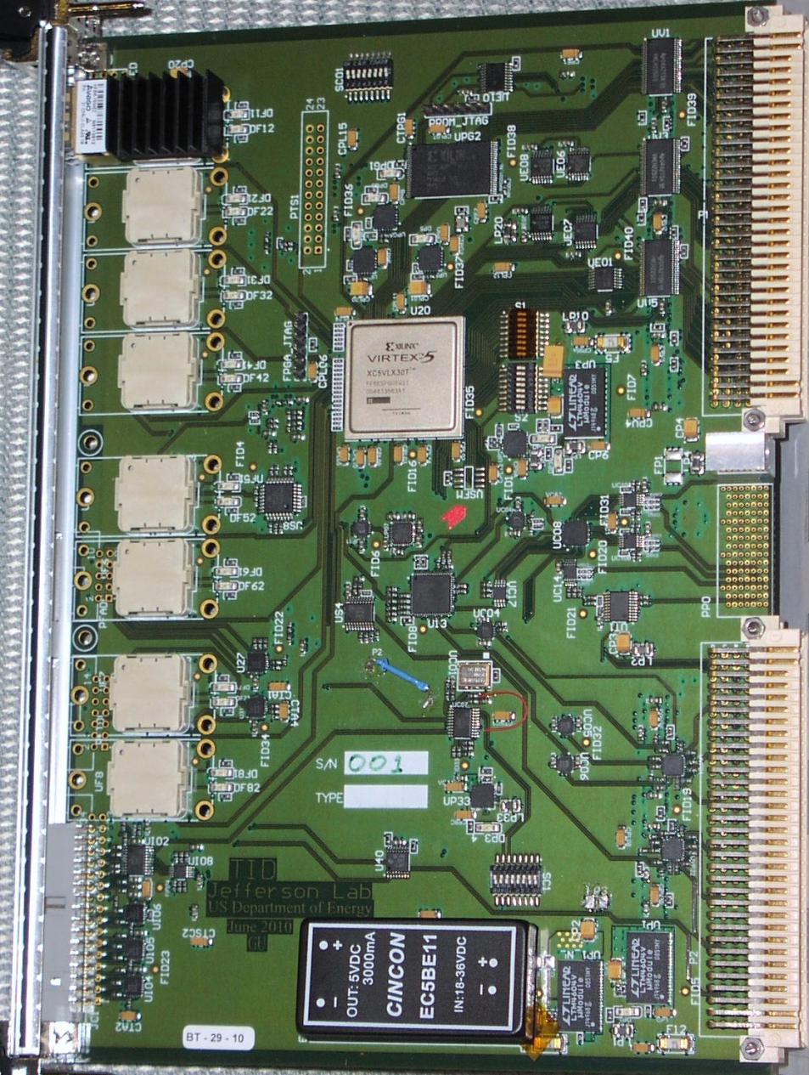
L1 Trigger Diagram
CPU
SSP
SSP
SSP
SSP
SSP
SSP
GTP
SD
SSP
SSP
SSP
SSP
SSP
SSP
SSP
TI
CPU
TD
TD
TD
TD
TD
TD
SD
SD
TD
TD
TD
TD
TD
TD
TD
TS
VXS Crate
VXS Crate
TID
VME Readout Controller
Gigabit ethernet
Trigger Interface
Receive trigger, clock and sync signals from TD
Make crate trigger decision
Pass signals to SD
CPU
FADC
FADC
FADC
FADC
FADC
FADC
CTP
SD
FADC
FADC
FADC
FADC
FADC
FADC
TI
Signal Distribution
Distribute common signals to all modules: busy, sync and trigger 1/2
VXS Crate
VXS Serial Link
4 bit @ 250 MHz: 1 Gbps

Slide 29
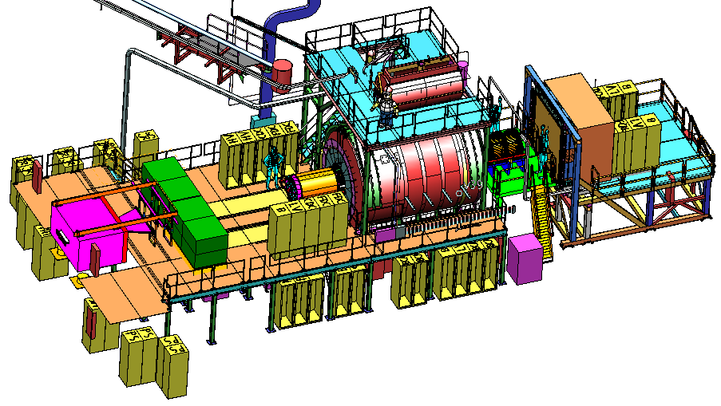
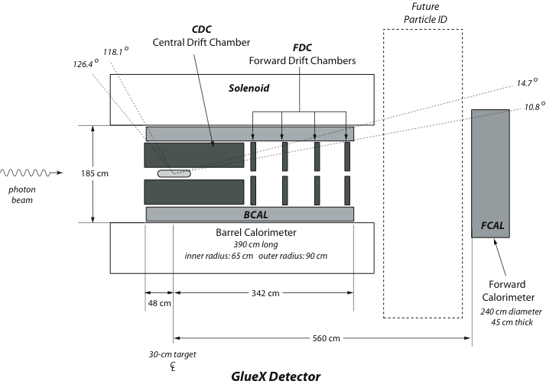
The GlueX Detector
2.2 Tesla
Solenoid
2.2T superconducting solenoidal magnet
Fixed target (LH₂)
10⁸ tagged γ/s (8.4-9.0GeV)
hermetic
TOF
time of flight
SC
start counter
Charged particle tracking
Central drift chamber (straw tube)
Forward drift chamber (cathode strip)
Calorimetry
Barrel Calorimeter (lead, fiber sandwich)
Forward Calorimeter (lead-glass blocks)
PID
Time of Flight wall (scintillators)
Start counter
Barrel Calorimeter

Slide 30
GlueX Data Rate
 | Front End DAQ Rate | Event Size | L1 Trigger Rate | Bandwidth to mass Storage
GlueX | 3 GB/s | 15 kB | 200 kHz | 300 MB/s
CLAS12 | 0.1 GB/s | 20 kB | 10 kHz | 100 MB/s
ALICE | 500 GB/s | 2,500 kB | 200 kHz | 200 MB/s
ATLAS | 113 GB/s | 1,500 kB | 75 kHz | 300 MB/s
CMS | 200 GB/s | 1,000 kB | 100 kHz | 100 MB/s
LHCb | 40 GB/s | 40 kB | 1000 kHz | 100 MB/s
STAR | 50 GB/s | 1,000 kB | 0.6 kHz | 450 MB/s
PHENIX | 0.9 GB/s | ~60 kB | ~ 15 kHz | 450 MB/s
private comm.
JLab
CHEP2007 talk
Sylvain Chapelin
LHC
BNL
*
**
* Jeff Landgraf Private Comm. 2/11/2010
** CHEP2006 talk MartinL. Purschke

Slide 31
CODA3 – What’s different
CODA 2.5 | CODA 3
Run Control (X, Motif, C++) (rcServer, runcontrol) | Experiment Control – AFECS (pure JAVA) (rcPlatform, rcgui)
Communication/Database (msql, cdev, dptcl, CMLOG) | cMsg – CODA Publish/Subscribe messaging
Event I/O C-based simple API (open/close read/write) | EVIO – JAVA/C++/C APIs Tools for creating data objects, serializing, etc…
Event Builder / ET System / Event Recorder (single build stream) | EMU (Event Management Unit) Parallel/Staged event building
Front-End – vxWorks ROC (Interrupt driven – event by event readout) | Linux ROC, Multithreaded (polling – event blocking)
Triggering: 32 ROC limit, (12 trigger bits -> 16 types) TS required for buffered mode | 128 ROC limit, (32 trigger bits -> 256 types) TI supports TS functionality. Timestamping (4ns)

Slide 32
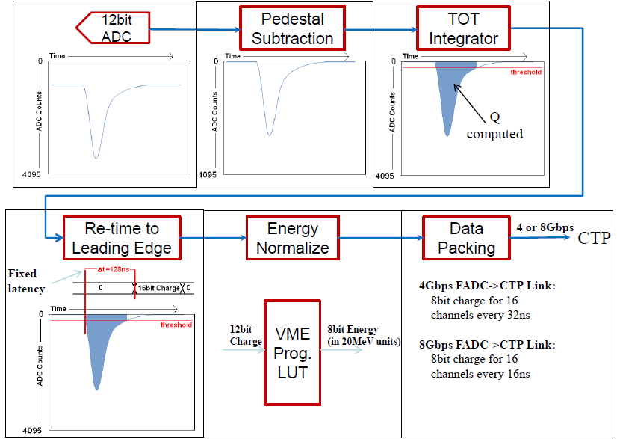
FADC Encoding Example

Slide 33
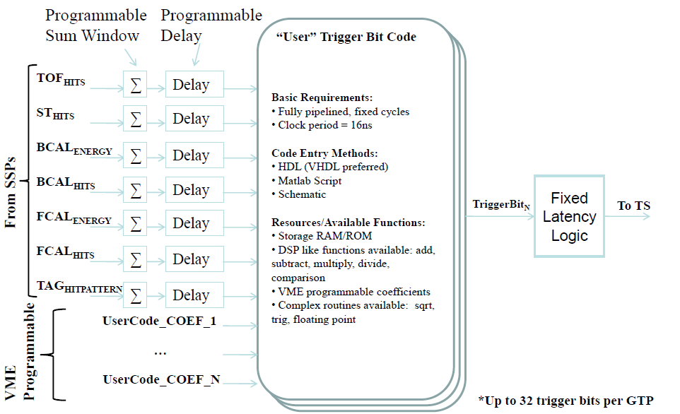
GTP Trigger Bit Example

