Slide 1
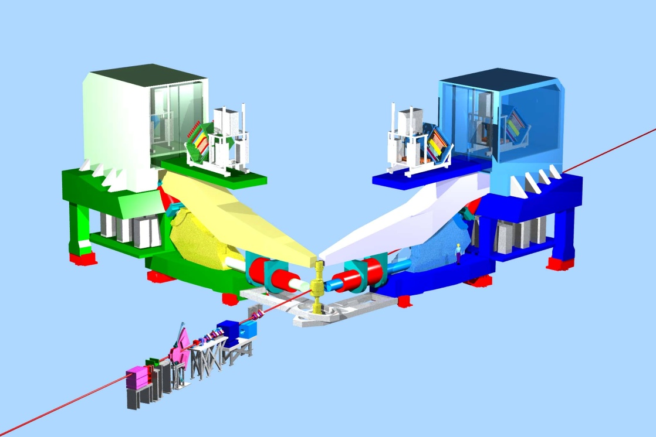
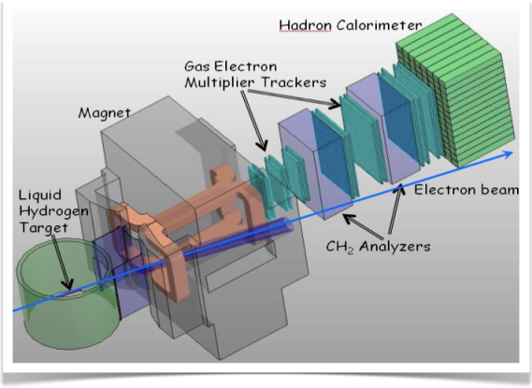
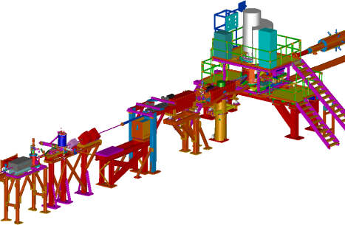
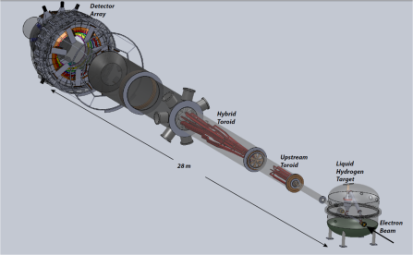
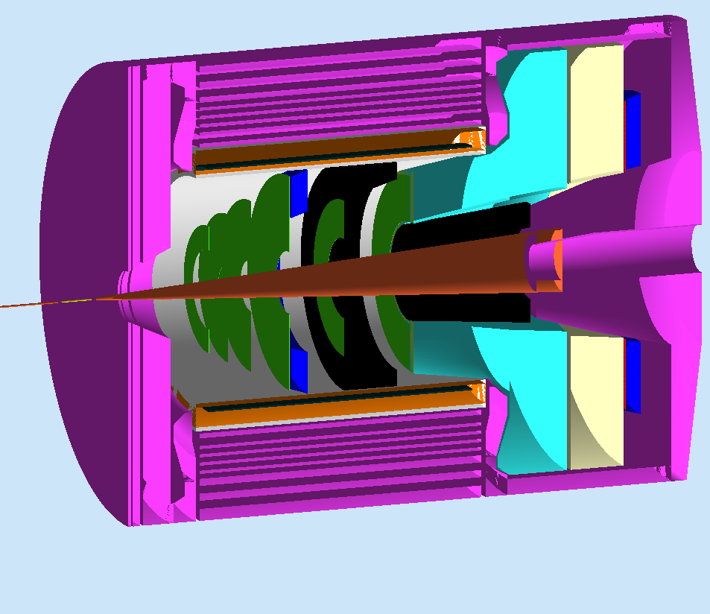
Future in Hall A at JLab
g2p/GEp
12 mo. Shutdown
Early Experiments
SuperBigbite
12 GeV Commissioning
Moller
Beam 1st to Hall A
SOLID
2011
2012
2013
2014
2015
2016
2017
2018
Thomas Jefferson National Accelerator Facility
Robert Michaels, Hall A

Slide 2
Program Prior to (or interleaved with) SBS Project
Approved Experiments
12 GeV Planning Committee
Hall A Collaboration Process
* A
* A -
Ron Gilman (chair)
Javier Gomez
Douglas Higinbotham
Charles Hyde
Nilanga Liyanage
Kent Paschke
Low Energy -- Commissioning
* Dark Matter APEX (1 – 4 GeV) 34 days
* Neutron Skin PREX (1 GeV) 35 days
Standard Equipment -- Early 12 GeV
* Proton Electromag. structure GMp 25 days
* Deeply Virtual Compton DVCS 100 days
* Neutron Spin Structure A1n 23 days
Tritium Target
* Valence quark ratio d/u 42 days
* Short-range nuclear structure (x > 1) 19 days
To recommend at our Winter 2011 collaboration meeting a sequence of experiments for commissioning and for early
11 GeV beam in Hall A
Suggestions to Lab Mgt
Present to 2012 PAC
Robert Michaels, Hall A

Slide 3
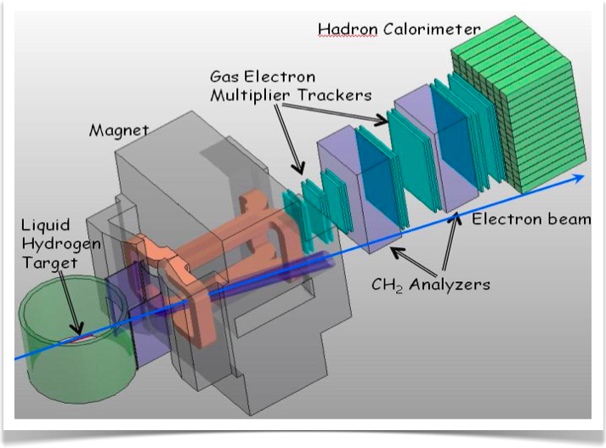
SuperBigBite in Hall A
Well-received by 2 internal technical reviews
3 A- and 1 B+ rated experiment
Separate projects connected to experimental capabilities
DOE Review (Science, Technical, Cost, Schedule)
Oct 13-14, 2011
@ JLab
SuperBigbite
2011
2012
2013
2014
2015
2016
2017
2018
Thomas Jefferson National Accelerator Facility
Robert Michaels, Hall A

Slide 4
MOLLER Experiment in Hall A
Fundamental electroweak e-e coupling
4th generation parity expt; exploit steady improvements in technical capabilities
A Rating, 344 days approved
Very favorable Director’s Review, Jan 14-15, 2010
Proposal submitted to DOE
Sept 2011
MOLLER
2011
2012
2013
2014
2015
2016
2017
2018
Thomas Jefferson National Accelerator Facility
Robert Michaels, Hall A

Slide 5
SOLID in Hall A
Solenoid Field, Detectors
Broad Physics Program: SIDIS, Parity Violation
3 A -rated experiments approved by PAC. (+1 cond. approved)
Project still at an early stage. Has a large interest from Chinese collaborators.
Studies of design options, manpower, and costs continue this Fall. Will plan for a Director’s review.
SOLID
2011
2012
2013
2014
2015
2016
2017
2018
Thomas Jefferson National Accelerator Facility
Robert Michaels, Hall A

