Slide 1
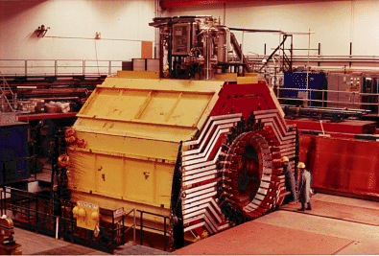
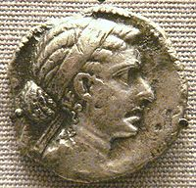
Searching for a Solenoid for SoLID
Paul E. Reimer
Physics Division
Argonne National Laboratory
15 October 2011
Choice of coil
Progress in obtaining coil
Field maps
  Discussion of issues

Slide 2
Magnet Comparison
 | BaBar | CLEO | ZEUS | CDF | Glue-X |  | New
 |  |  |  |  | Old SLAC | New
Cryostat Inner Radius | 150 cm | 150 cm | 86 cm | 150 cm |  |  | Whatever we need
Length | 345 cm | 350cm | 245cm | 500 cm
Central Field | 1.49T | 1.5T | 1.8T | 1.47T
Flux Return Iron | Yes | Yes | No | No
Cool Icon | Yes | Yes | Yes | No | No
Variation in Current density with z? | 2x more in end than central | 4.2% more in end than central | 40% more in end than central | No | Yes | Yes
Available | Probably Not?? | Probably | Probably | Probably | One will be available |  | Wild guess--$5M

Slide 3
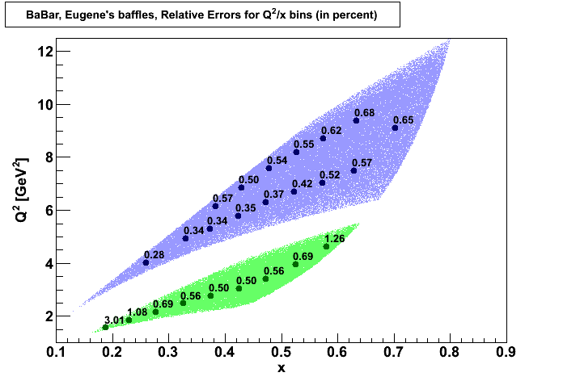
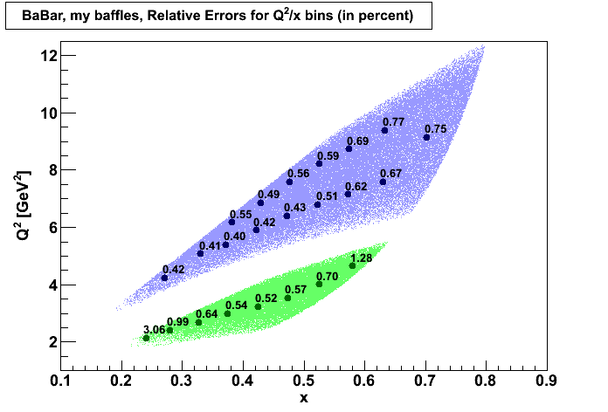
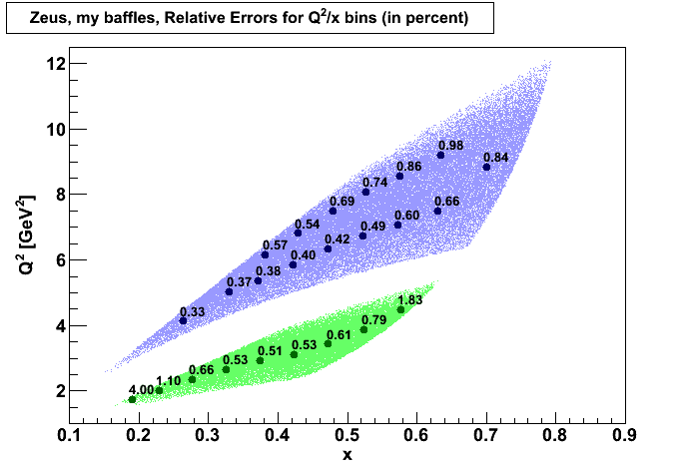

Choice of Coil--considerations
Can it do the physics?—At a reasonable cost?
  Significant work before the previous collaboration meeting
  Please see slides from Zhiwen Zhao, Seamus Riordan and Lorenzo Zana from the last collaboration meeting: https://hallaweb.jlab.org/wiki/index.php/Meeting_solid_coll_2011_06
  Similar studies were done for SIDIS as well.
  All proposed magnet coils seem to be workable
Is it likely to be available?
  Babar magnet going to b-factory?
Design time
  Most work done around Babar coil
  CLEO coil is very similar

Slide 4
Magnet Comparison
 | BaBar | CLEO | ZEUS | CDF | Glue-X |  | New
 |  |  |  |  | Old SLAC | New
Cryostat Inner Radius | 150 cm | 150 cm | 86 cm | 150 cm |  |  | Whatever we need
Length | 345 cm | 350cm | 245cm | 500 cm
Central Field | 1.49T | 1.5T | 1.8T | 1.47T
Flux Return Iron | Yes | Yes | No | No
Cool Icon | Yes | Yes | Yes | No | No
Variation in Current density with z? | 2x more in end than central | 4.2% more in end than central | 40% more in end than central | No | Yes | Yes
Available | Probably Not?? | Probably | Probably | Probably | One will be available |  | Wild guess--$5M

Slide 5
Obtaining the CLEO coil
We (Paul Souder) have begun discussions with Cornell faculty on the possibility of moving the magnet
Possible in 2013 CESR summer shutdown
  This is SOON!
  Where could we store the coil at JLab???)
  How much will this move cost?
  What level of CD* do we need from DOE to obtain money to pay for this?
Need to start Laboratory-to-Laboratory discussions now, rather than collaborator-to-collaborator as we are currently doing
  Point person (Rolf Ent???)
  For a DOE review:
    We need a cost estimate?
    Do we need a letter giving a firm commitment from CLEO/Cornell?

Slide 6
Magnet Yoke Considerations/Field Maps
EM Calo readout
Differences in SI/PV-DIS detector packages
Cherenkov PMT—shielding from magnetic field
SIDIS polarized target—shielding from magnetic field

Slide 7
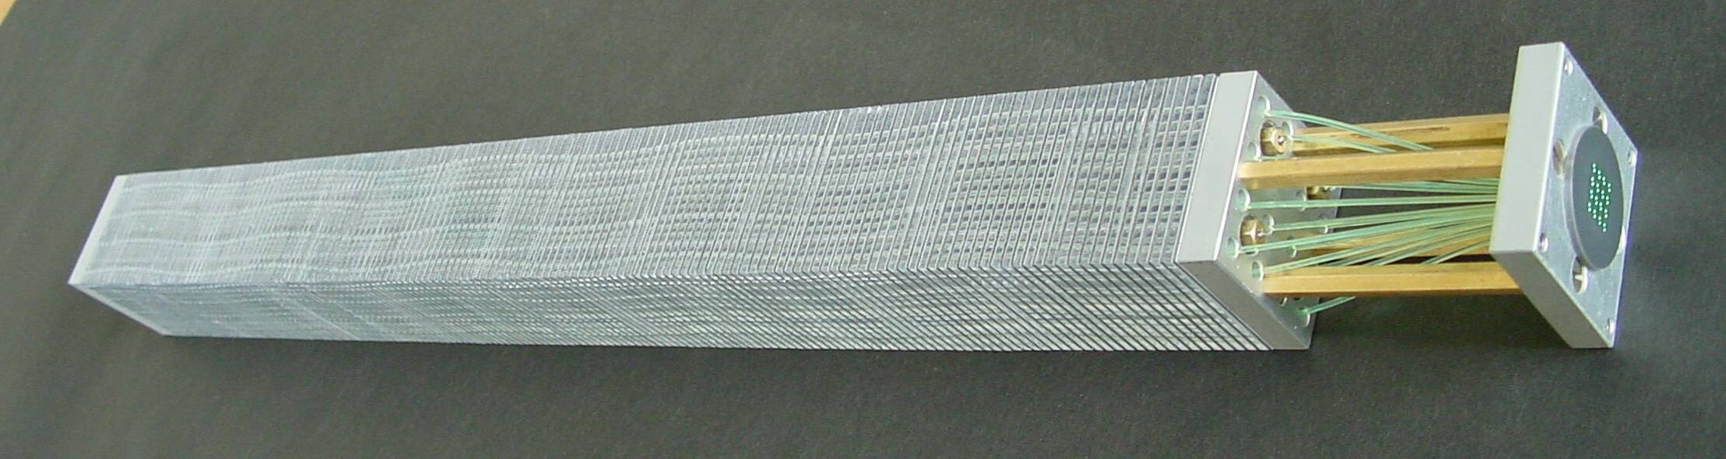
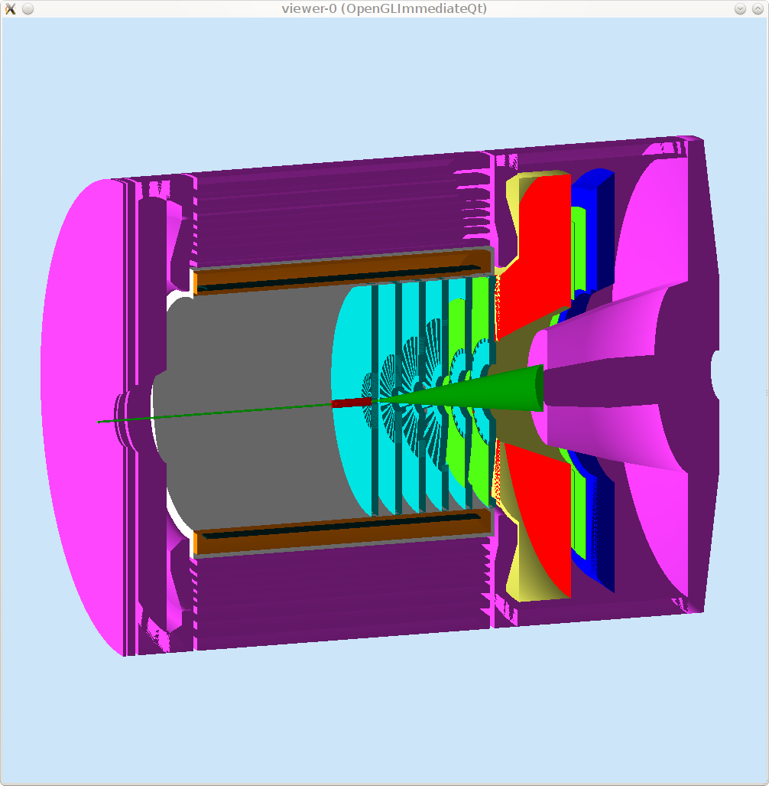
Size of End Cap—Calorimeter Readout Location
PMT
Typical Shashlik
Polyakov, COMPASS Talk, 2010
Flux Return
Flux Return
Typical Shashlik
Polyakov, COMPASS Talk, 2010
PMT
Place PMT’s in- or outside of flux return
  Magnetic field
  Servicing
  SI/PV DIS reconfiguration
  Light guide cost/holes in flux return

Slide 8
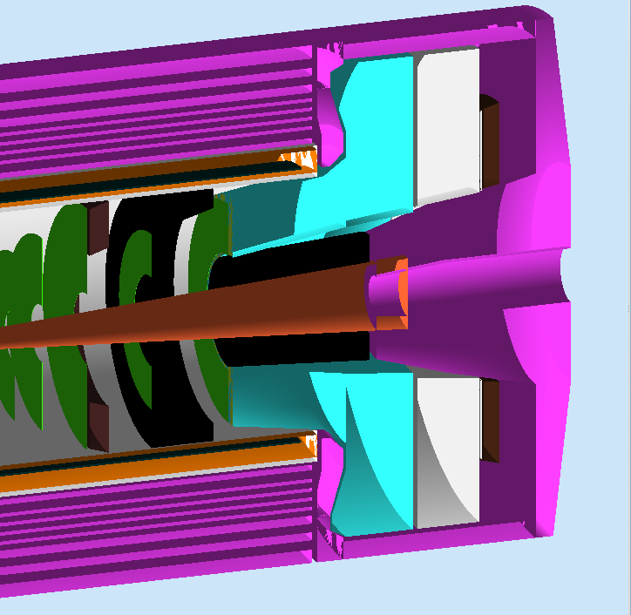
Different End Cap Detector Packages
SIDIS 2.80m
PVDIS 2.10m

Slide 9
Flux return for PVDIS and SIDIS
PVDIS
Attach EM calo to back wall
Readout outside of magnet w/light guides
SIDIS
Add “shim” or “donut” for additional detector space
Possibly use shim to house heavy gas Cherenkov—would require 2nd shim configuration

Slide 10
Common end cap to fit SIDIS
EM calorimeter could not be mounted to rear wall of end cap
Must be movable to match acceptance
PVDIS acceptance
SIDIS acceptance

Slide 11
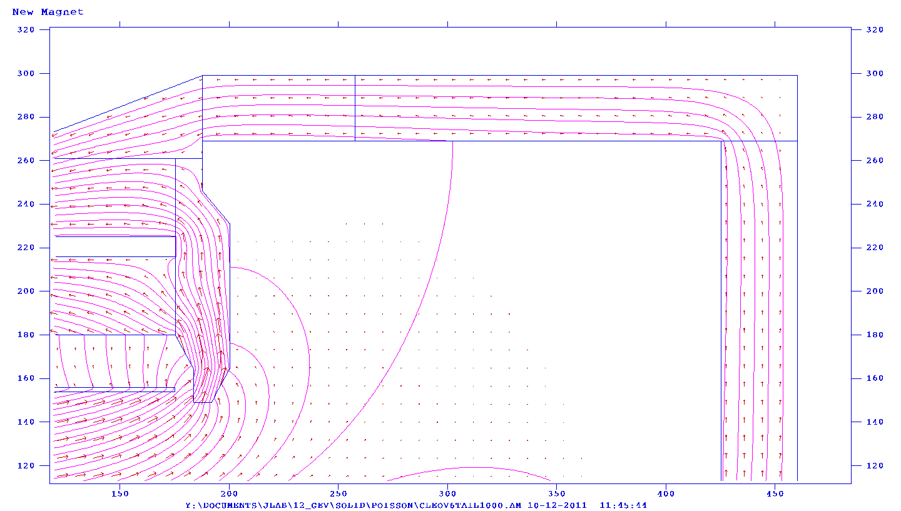
Field in Cherenkov PMT region
20-30 G
Light Cherenkov
90-150 G
Heavy Cherenkov

Slide 12
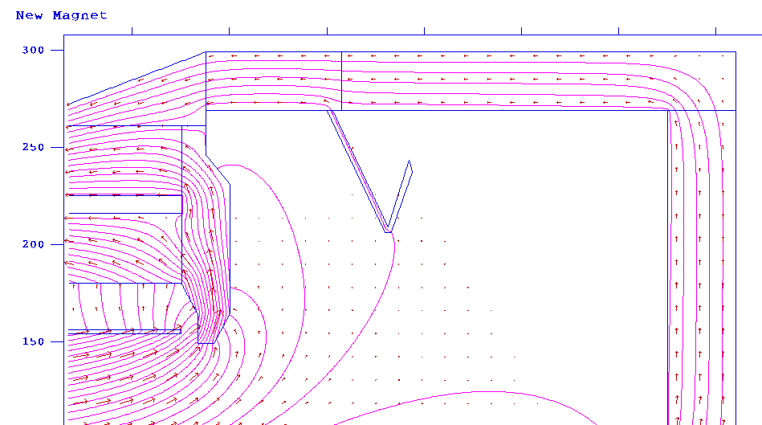
Field in Cherenkov PMT region
20-30 G
Light Cherenkov
10-30G
Heavy Cherenkov
Shielding Cherenkov PMT’s is possible
Should be done in 3d (Poisson with gap will give worst case

Slide 13
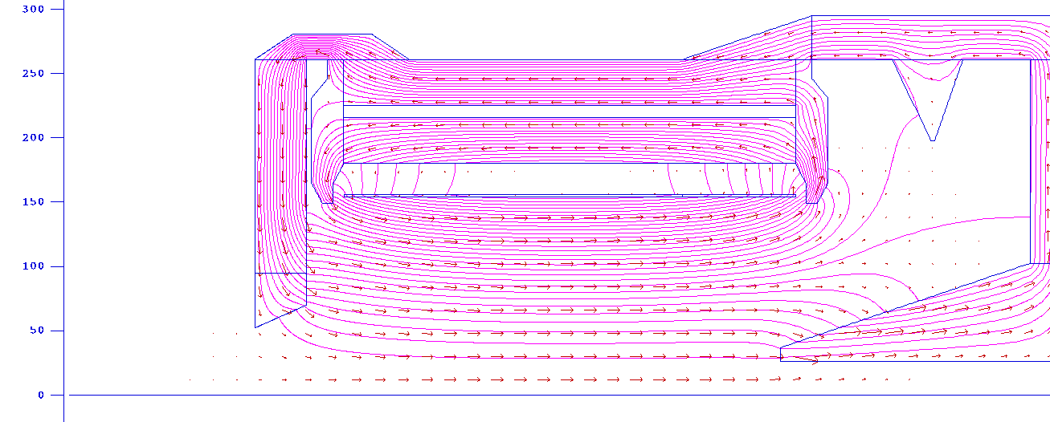
SIDIS Target region field
R | Z | Br | Bz | |B| | A
(cm) | (cm) | (G) | (G) | (G) | (G-cm)
0 | -350 | 0.00E+00 | 5.11E+01 | 5.11E+01 | 0.00E+00
1 | -350 | -7.98E-01 | 5.11E+01 | 5.11E+01 | 2.55E+01
2 | -350 | -1.60E+00 | 5.11E+01 | 5.11E+01 | 5.11E+01
3 | -350 | -2.39E+00 | 5.10E+01 | 5.11E+01 | 7.66E+01
4 | -350 | -3.18E+00 | 5.10E+01 | 5.11E+01 | 1.02E+02
5 | -350 | -3.85E+00 | 5.09E+01 | 5.11E+01 | 1.27E+02
What is the field in the SIDIS Target region?
What field can we stand?

Slide 14
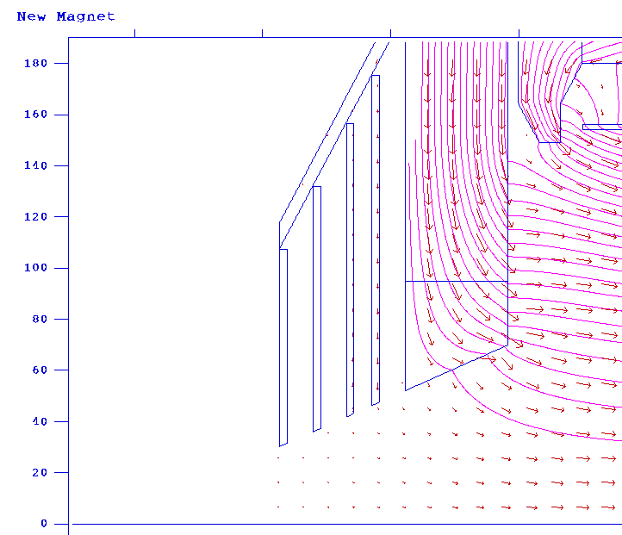
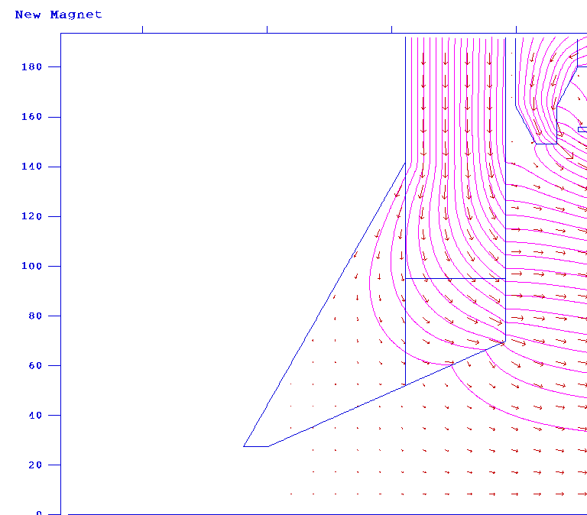
SIDIS Target region Can it be shielded?
Both configurations cut field by factor of (approximately) 5

Slide 15
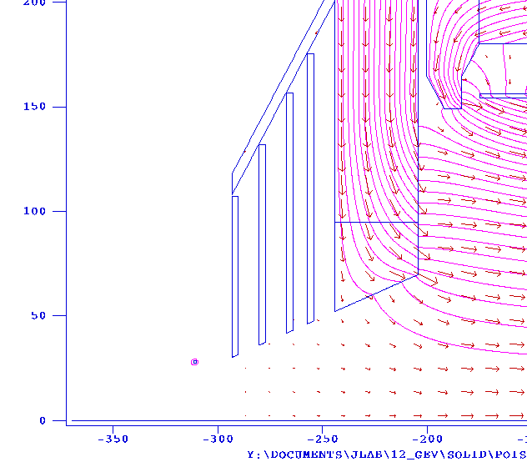
SIDIS Target region
Add compensating coil
1kA-turn
Reduce B to 5G
Is this good enough?
R | Z | Br | Bz | |B| | A
(cm) | (cm) | (G) | (G) | (G) | (G-cm)
0 | -350 | 0.00E+00 | 4.88E+00 | 4.88E+00 | 0.00E+00
1 | -350 | -7.79E-02 | 4.87E+00 | 4.87E+00 | 2.44E+00
2 | -350 | -1.56E-01 | 4.87E+00 | 4.87E+00 | 4.87E+00
3 | -350 | -2.33E-01 | 4.86E+00 | 4.87E+00 | 7.30E+00
4 | -350 | -3.10E-01 | 4.85E+00 | 4.86E+00 | 9.73E+00
5 | -350 | -3.85E-01 | 4.84E+00 | 4.85E+00 | 1.21E+01

Slide 16
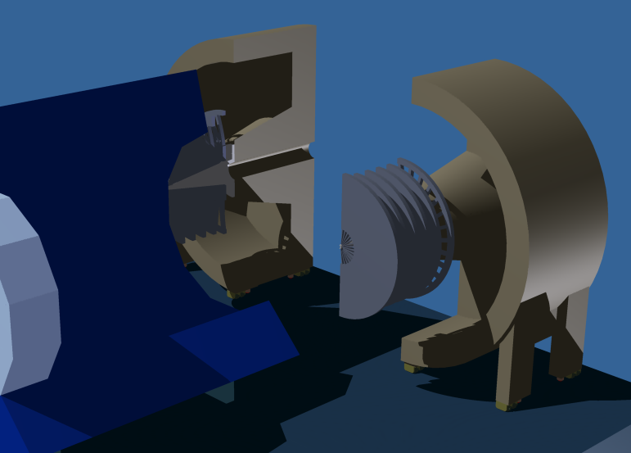
Remember the end cap splits open

Slide 17
Who are we?
Dear SoLID collaborators,
So far, we have been rather loosely organized. At this point in time, it would be nice to establish a collaboration list with institutes and collaborators. I am requesting that one person from each institution supply me with a list of collaborators from that institution, specifying each collaborators "level" (e.g. Postdoc, Graduate Student, Undergraduate Student, Professor/Staff Scientist). I would also like one person specified as the contact collaborator for that institution. This list is useful to demonstrate to funding agencies the strength of our collaboration.
Thanks,
Paul

Slide 18
Conclusions
SoLID is planning on using the CLEO magnet
Discussions are underway on how and when to move the magnet to JLab
Design options to be considered:
  SI/PV-DIS end cap differences
  Location of forward calorimeter readout
Yoke design considerations
  Possible to shield PMT’s for Cherenkov at 30 G level
  Possible to shield SIDIS target w/ additional coil at 5 G level
PMT

