Slide 1
Stony Brook Group
A brief introduction & our plans
October 14, 2011
SOLID Collaboration Meeting at JLab

Slide 2
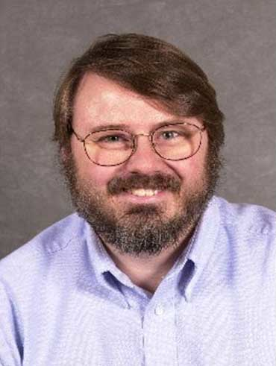
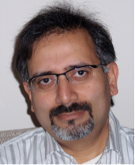
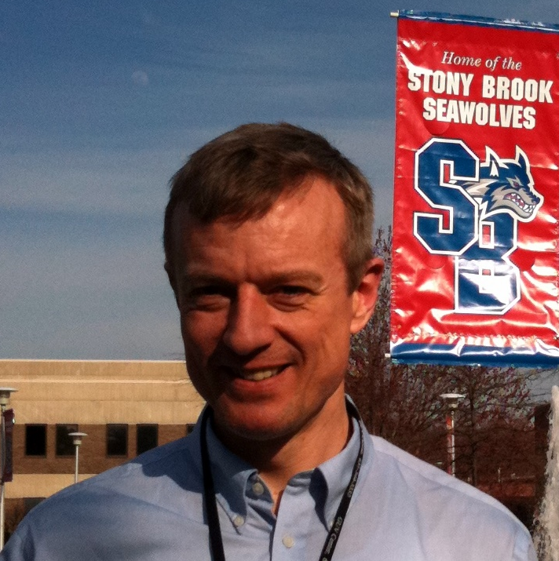
SBU NP Exp. Group
5 Faculty:
PHENIX Heavy Ion Physics: Axel Drees, Thomas Hemmick & Barbara Jack
PHENIX Spin Physics & Electron Ion Collider: Abhay Deshpande
1 Research Scientist:
Klaus Dehmelt
4 Post doctoral fellows
16 Graduate Students
5-7 Undergraduate Students
Notes:
One of the largest single university based experimental nuclear physics group

Slide 3
Dr. Klaus Dehmelt
Research Scientist @ Stony Brook (2011-present)
PHENIX, sPHENIX upgrades, EIC Detector R&D
Research Scientist at DESY (2007-2011)
Future Lepton Collider R&D, Linear Collider TPC, L3 Collaboration
Ph.D. Florida Institute of Technology, 2006
L3 and PHENIX collaboration
Pre-Ph.D. Research Associate Heidelberg & DESY
COMPASS & HERA-B, Detector R&D

Slide 4
Prof. Tom Hemmick
Faculty (1991-present)
Distinguished Teaching Professor of Physics
PHENIX Collaboration (founding member)
Hadron Blind Detector, Ring Imaging Cherenkov Detector, Drift Chamber, Electronics…
Analysis coordinator, Detector Council, Executive C.
BNL E814 Collaboration (Post Doc. Yale U. & SBU)
Design & construction of MWPCs DC, Pad Chamber, Au-beam Upgrade, Software Czar
Ph.D. Rochester University 1989

Slide 5
Prof. Abhay Deshpande
Faculty (2004-Present), RIKEN BNL Fellow (2000-2008)
PHENIX (2000-Present), EIC (1999-present)
Si VTX tracker, IR Local & RHIC Beam polarimetry, Norm. Trig. Cntr., Run Co-ord., Executive Council, Spin WG Co.
Electron Ion Collider: Studies, promotion & contact person
ZEUS (1998-2000, Yale)
QCD analysis Co. , EW Physics, Electron polarimetry
Spin Muon Collaboration (1995-1999, Yale)
Nucleon Spin: Analysis coordinator, Polarized target
BNL E851, (1994, Ph.D. Yale) Rare Kaon Decays

Slide 6
EIC Generic Detector R&D
BNL Established a peer reviewed program for R&D to enable EIC experiments
Develop detector concepts and technologies that have particular importance for experiments at the future EIC
Help ensure that the techniques and resources for implementing these technologies are well established within the EIC user community
Endorsed by DOE, BNL & JLab, Managed by BNL
Support Community wide development efforts:
New concepts & technologies
Adaptation of existing technologies
New design and simulation tools
New Computing and analysis techniques
$0.5 M available in FY11, Expect $1-1.5M/yr for ~ 5 years

Slide 7
EIC Detector R&D Advisory Committee: (meets twice a year to):
Hear presentation of new proposals and progress on approved projects
Evaluate the merits of proposal and the performance of ongoing efforts
Make funding recommendations
Website:https://wiki.bnl.gov/conferences/index.php/EIC_R%25D
Committee:
Marcel Demarteau (ANL), Rick Van Berg (Penn), Howards Weiman (LBNL), Robert Klanner (Hamburg), Jerry Va’vra (SLAC), Ian Shipsey (Purdue), Glenn Young (JLab)

Slide 8
Proposals, pre-proposals early 2011
Fiber sampling calorimetry for EIC & STAR (UCLA, Texas A&M, Penn State)
FEMs for DAQ and triggers (JLab)
DIRC based PID for EIC (CAU, ODU, JLab, GSI)
Liquid Scint. Calorimetry (Ohio State)
Improved radiation tolerant Si photomultipliers (JLab)
PID & Tracking Letter of Intent (BNL, FIT, Iowa State, LBNL, LANL, MIT, RIKEN-BNL, Stony Brook, UVa, Yale + Temple U.)

Slide 9
PID & tracking R&D group’s aims
EIC Detector Simulations:
Material and position resolution budgets,
Choices between Fast drift TPC & GEM tracking outside of thin micro-vertex tracking layers
High performance dE/dx measurements via cluster counting
Magnetic field configurations outside of central regions
What B-insensitive PID detectors?
Proximity focused RICH in central arm?
Understanding the limits of ring radius due to B field and multiple scattering

Slide 10
PID and tracking R&D Group’s Aim:
Hardware objectives in year 1:
Measurement of fast TPC performance characteristics (mainly BNL)
Development of GEM based CsI-Photocathod detector for PID in barrel and end-cap (mainly Stony Brook)
Develop methods to minimize electronics-induced gaps in large area GEM detectors (BNL, SBU, FIT)
Development of 3-coordinate strip pixel readout (Yale)
Development and tests of large area GEMs (UVa, FIT)

Slide 11
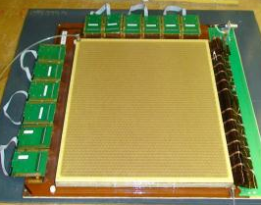
GEM Based CsI Photocathode detectors:
Used in the HBD for PHENIX effectively
EIC R&D initiated, needed a test beam environment
Learnt of high interest for SOLID at Jefferson Lab
Why not combine effort?
Stony Brook, BNL, FIT, UVa, + Temple U.
+ JLab (?)
STEP 1:
Test performance of (10cm x10 cm) size 3-GEM detector + analog SRS readout w/ APV25 hybrid card
How does it behave in the e-beam environment?
Consulted with JP & ZEM, test beam setup in November
30cm × 30 cm
Triple-GEM

Slide 12
GEM Based CsI Photocathode detectors:
STEP 2:
Make a telescope separated by a Cerenkov radiator and a GEM based CsI Photocathode and see if we can see rings in Hall A environment (along with minimal tracking and calorimetry)
Have initiated the CsI coating activities at Stony Brook
Plan to bring a telescope in March 2012 for the 2nd phase of test beam
Will visit Hall-A experimental hall tomorrow to see the experimental area: a scouting visit

Slide 13
Beyond Test Beam: SBU Plans
If these activities evolve in the direction of using CsI coated GEMs in SOLID and an HBD like detector, then we see a natural path towards getting involved in SOLID and its future continuation towards the EIC.
Abhay: Already interested in pursuing collaboration with SOLID for PVDIS and transverse Spin studies (independent of the CsI GEMs). These physics topics are well aligned with the path from “PHENIX spin” to the future “Electron Ion Collider”.
Like to add 1 post doc (soon ?) + student(s) later

Slide 14
Thank You
Klaus Dehmelt (klaus.dehmelt@stonybrook.edu)
Abhay Deshpande (abhay.deshpande@stonybrook.edu)
Thomas Hemmick (thomas.hemmick@stonybrook.edu)

