Slide 1
SoLID/EIC Test Beam Apparatus

Slide 2
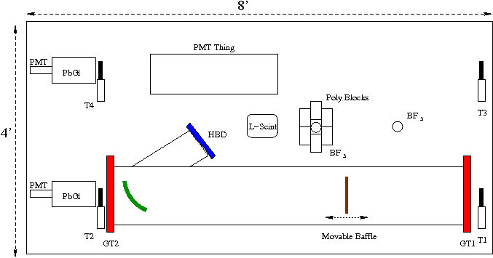
Proposed Layout
Side-by-side “spectrometers” (PMT vs HBD)
HBD can be full version (shown) or just a simple “Did it fire (November) version.
Attempts to also quantify the background conditions.

Slide 3
Deliverables
Background Estimators:
Bare BF₃ count rate.
Poly + BF₃ count rate.
Liquid Scintillator pulse height spectrum.
“Spectrometer” measurements:
Scintillator-coincidence triggers.
Scintillator && PbGl triggers
Self-triggered spectra.
Cherenkov pattern compared to GEM-guided track trajectory.
Issue(s):
Who provides auxiliary detectors?
Data acquisition?
Services installation/maintenance/control

Slide 4
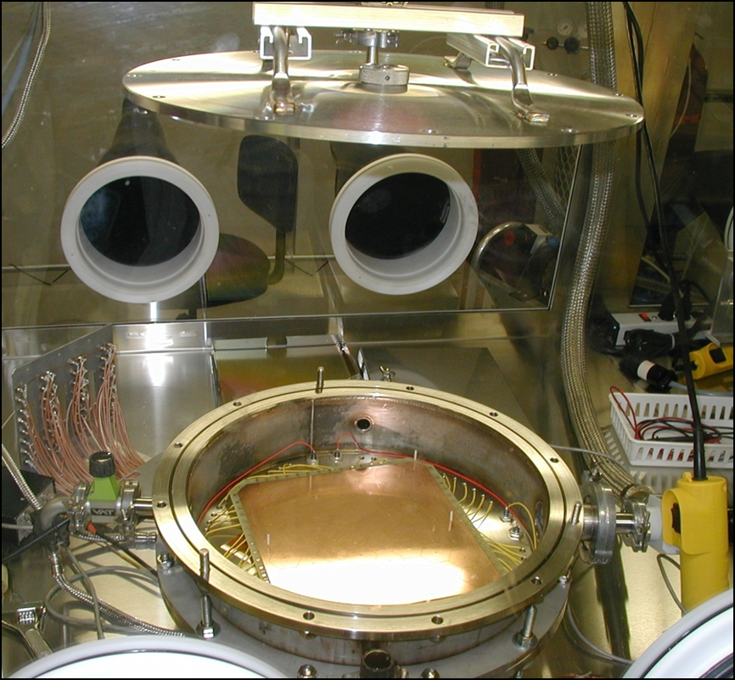
Simpler “November” Apparatus??
CsI Gemstack in CF4₄
Pad readout (~50 channels)
Are THICK (1/2” SS) walls an issue?
Is this viable?

