Slide 1
SoLID Simulation Update
Zhiwen Zhao
University of Virginia
SoLID Collaboration Meeting
2011/10/14
Introduction
GEMC Update
Simulation Study
Summary

Slide 2
Introduction
SoLID collaboration has successfully adopted GEMC as its Geant4 simulation framework and joined in GEMC development. The framework is used for various studies to help detector design.
A lot of subsystem design and simulation progresses have been made. More studies are under way.

Slide 3
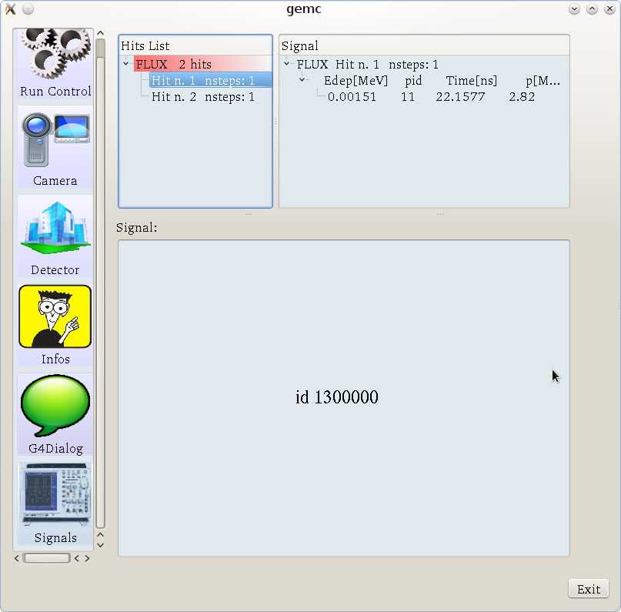
GEMC Update (Maurizio Ungaro)
GDML output support
Option to record passby particle or not
“Signal” interface for every step of each hit

Slide 4
SoLID Simulation Study
Ideal magnet design
CLEO magnet design and detector layout
Energy flux at EC
GEM response and digitazation

Slide 5
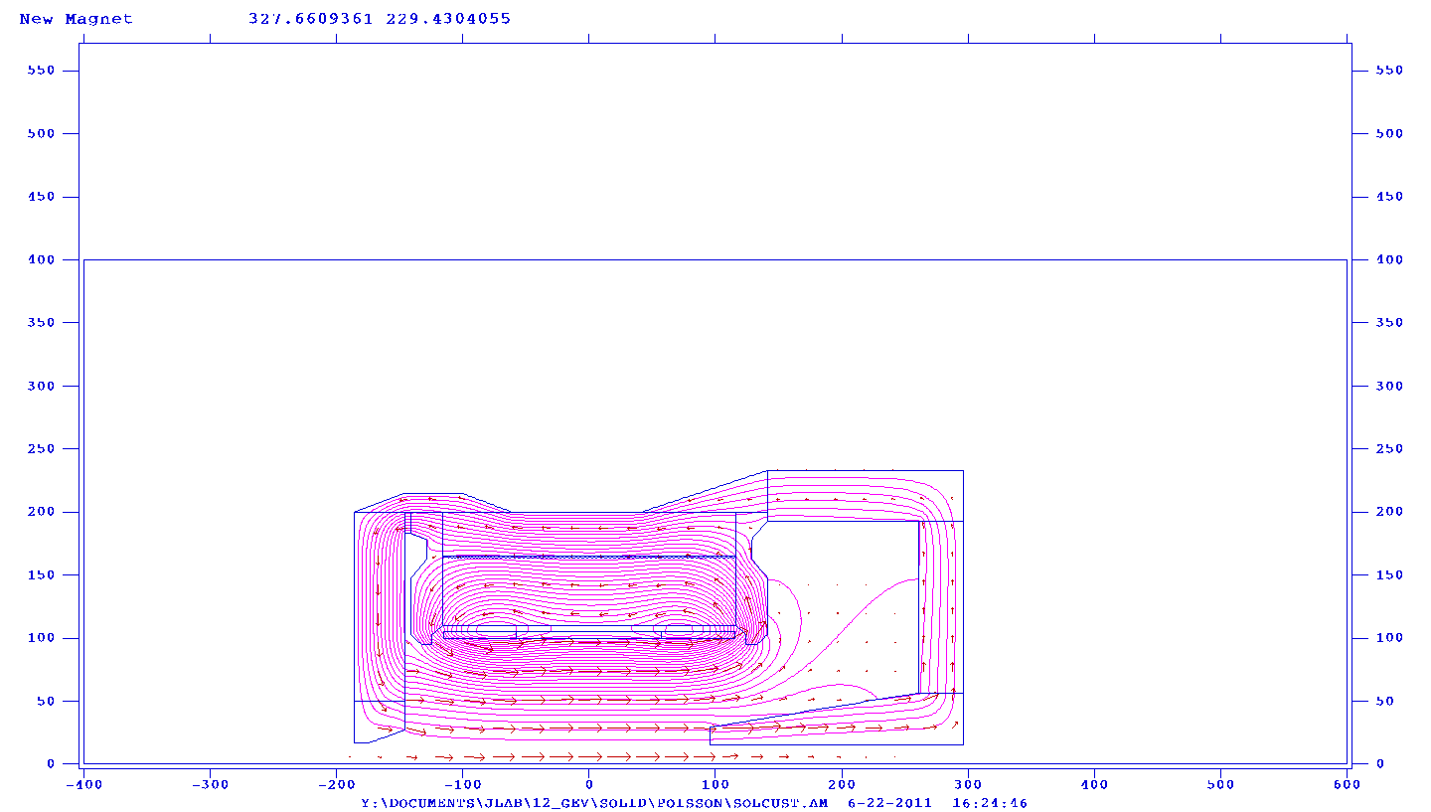
Ideal Magnet (Mehdi Meziane, Yang Zhang, Paul Reimer, Zhiwen Zhao)
An ideal (short and fat) magnet and yoke are produced.

Slide 6
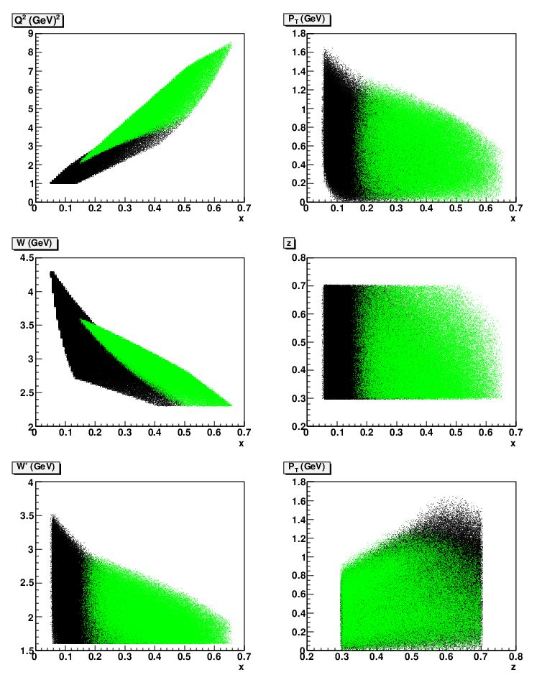
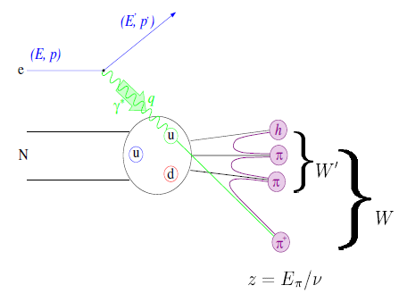
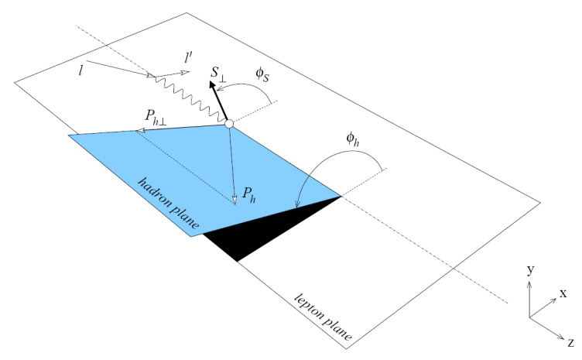
SIDIS Kinematic Coverage@11GeV (Mehdi Meziane, Yang Zhang, Paul Reimer, Zhiwen Zhao)
SIDIS kinematics for the ideal magnet is studied
Green area,
large angle coverage
Black area, forward angle coverage

Slide 7
SIDIS Kinematic Coverage@11GeV (Mehdi Meziane, Yang Zhang, Paul Reimer, Zhiwen Zhao)
The result of the ideal magnet is similar to BaBar/CLEO.
 | ZEUS | BaBar/CLEO | CDF | Glue-X | Ideal Magnet
x | 0.05-0.58 | 0.05-0.65 | 0.05-0.64 | 0.05-0.64 | 0.05-0.65
z | 0.3-0.7 | 0.3-0.7 | 0.3-0.7 | 0.3-0.7 | 0.3-0.7
Q² | 1-6 | 1-9 | 1-7.2 | 1-8 | 1-9
W | 2.3-4.2 | 2.3-4.4 | 2.3-4.2 | 2.3-4.2 | 2.3-4.3
W’ | 1.6-3.4 | 1.6-3.5 | 1.6-3.4 | 1.6-3.4 | 1.7-3.5
P_{T} | 0-1.45 | 0-1.7 | 0-1.45 | 0-1.45 | 0-1.6

Slide 8
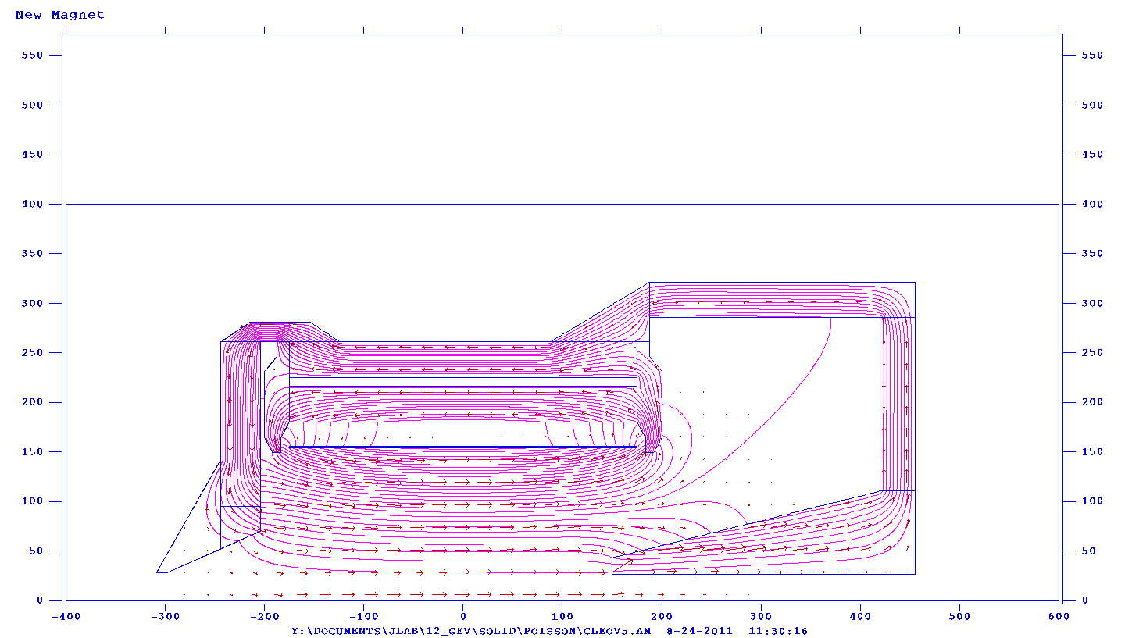
CLEO Magnet Yoke Design (Paul Reimer, Yang Zhang, Zhiwen Zhao, Eric Fuchey, Simona Malace)
A new yoke for CLEO magnet is designed.
NO Edge in endcup
YES Edge in endcup
Minimize field at endcup

Slide 9
CLEO Magnet Yoke Design (Paul Reimer, Yang Zhang, Zhiwen Zhao, Eric Fuchey, Simona Malace)
A new yoke for CLEO magnet is designed.
Minimize field in front near SIDIS 3He target

Slide 10
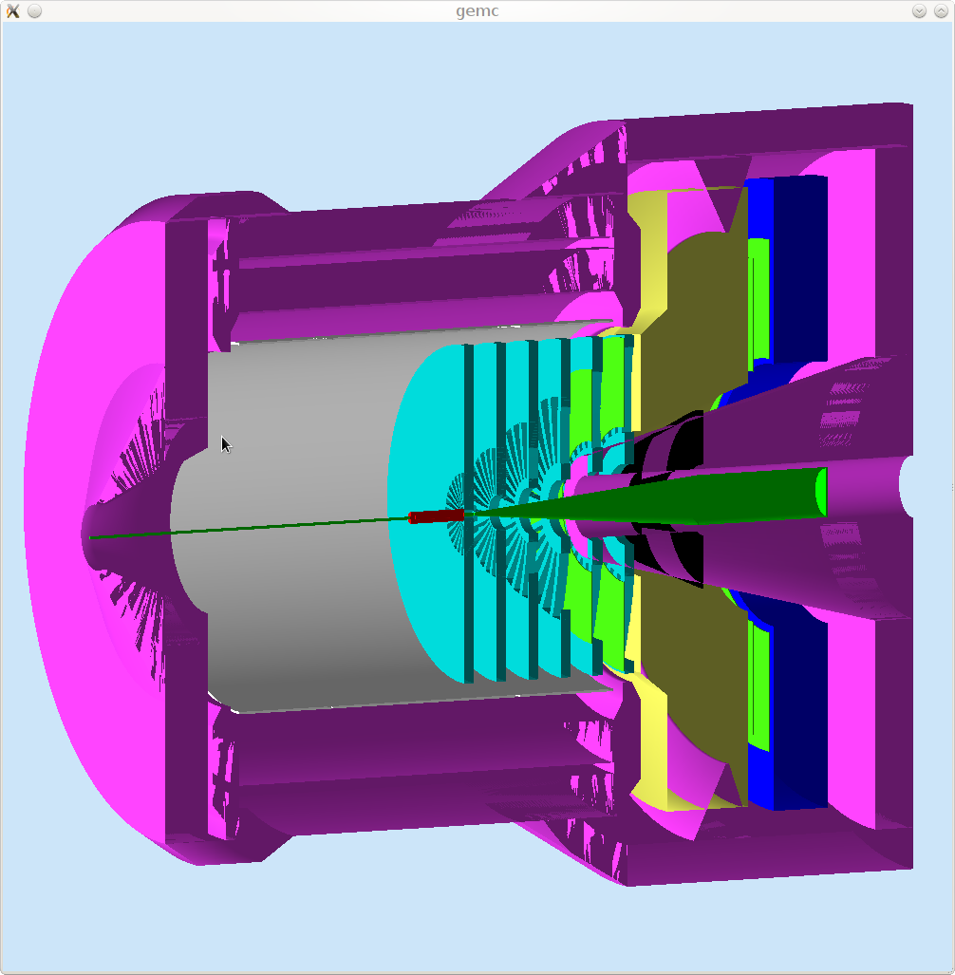
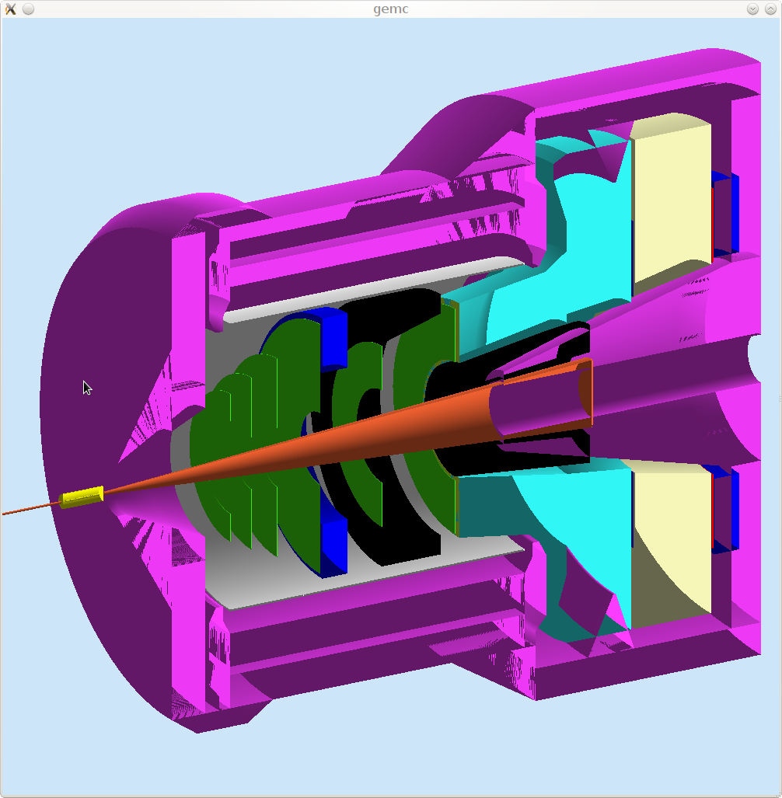
CLEO Magnet Yoke Design (Paul Reimer, Yang Zhang, Zhiwen Zhao, Eric Fuchey, Simona Malace)
Its field map and geometry are implemented in GEMC.
PVDIS
SIDIS

Slide 11
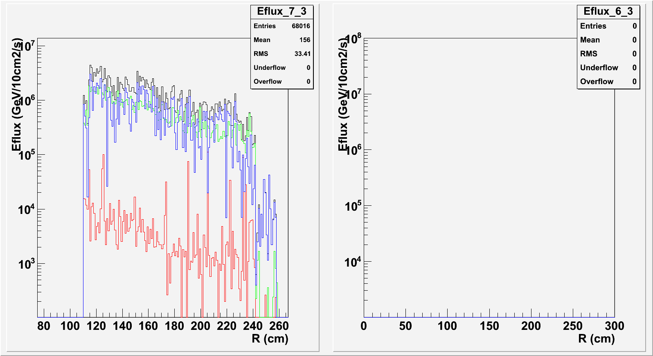
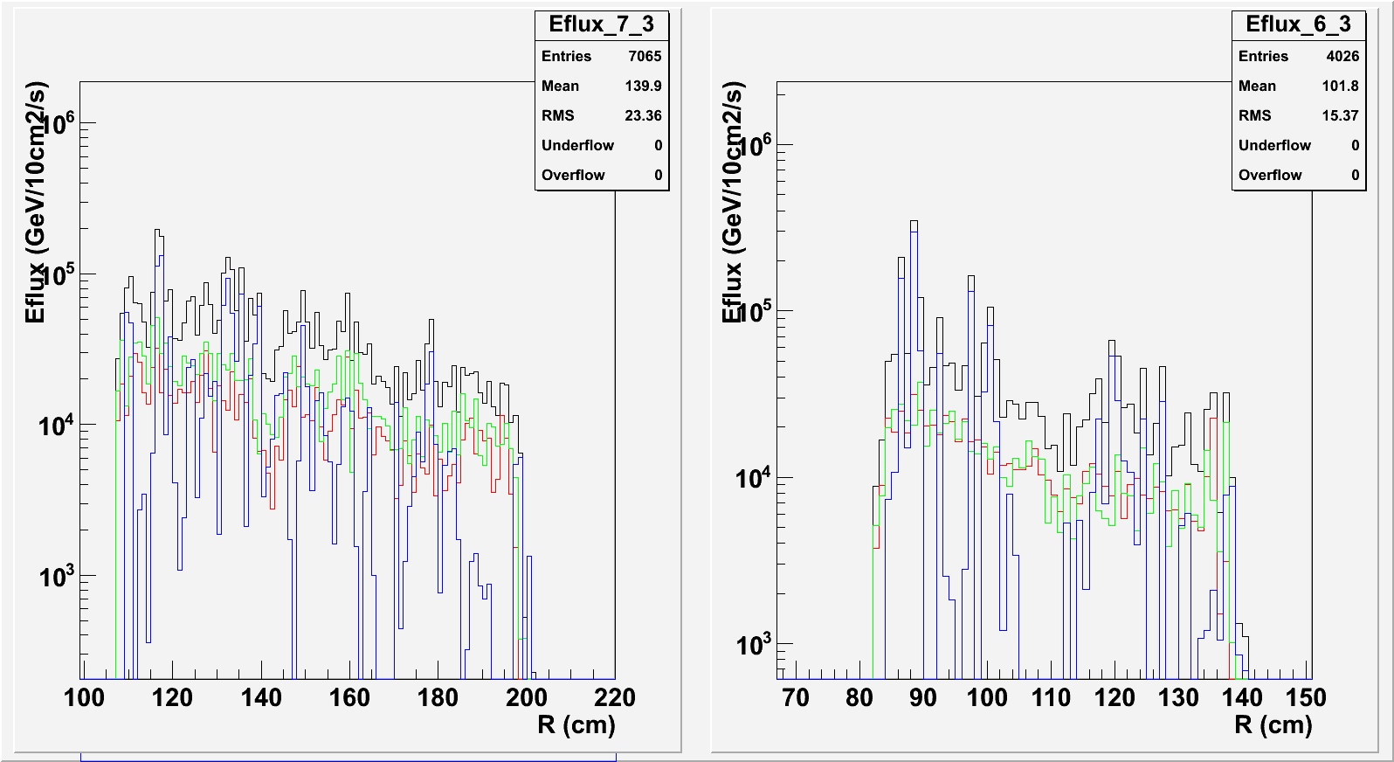
Background in EC (Zhiwen Zhao, Xin Qian)
PVDIS forward angle
GEMC electron and photon energy flux confirms Geant3 result.
Hadron energy flux is under study.
SIDIS forward angle
SIDIS lareg angle
Black: total
Red: electron
Green: photon
Blue: hadron

Slide 12
EC Radiation Resistant
PVDIS forward angle
EM <=2k GeV/cm²/s + pion, total ~<60 krad/year
SIDIS forward angle
EM <=5k GeV/cm²/s + pion , total ~<100 krad/year
SIDIS large angle
EM <=20k GeV/cm²/s + pion, total ~<400 krad/year
Typical Shashlik
Polyakov, COMPASS Talk, 2010
COMPASS module Radiation hardness ~ 500kRad,
See EC talk for improving the property

Slide 13
GEM Response (Zhiwen Zhao, Evaristo Cisbani)
# * HoneyComb
# * 0 NEMA G10 120 um
# * 1 NOMEX 3
# * 2 NEMA G10 120 um
# * Drift Cathode
# * 4 Kapton 50 um
# * 3 Copper 5 um
# * 5 Air 3 mm
# * GEM0
# * 6 Copper 5 um
# * 7 Kapton 50 um
# * 8 Copper 5 um
# * 9 Air 2 mm
# * GEM1
# * 10 Copper 5 um
# * 11 Kapton 50 um
# * 12 Copper 5 um
# * 13 Air 2 mm
# * GEM2
# * 14 Copper 5 um
# * 15 Kapton 50 um
# * 16 Copper 5 um
# * 17 Air 2 mm
# * Readout Board
# * 18 Copper 10 um
# * 19 Kapton 50 um
# * 20 G10 120 um + 60 um (assume 60 um glue as G10) # not implmented yet
# * Honeycomb
# * 21 NEMA G10 120 um
# * 22 NOMEX 3 um
# * 23 NEMA G10 120 um
To obtain more realistic GEM response, we borrow from SBS GEM simulation and the geometry and material of GEM module are realized in GEMC.
The EM background study is underway.
For GEM Digitization, see Tracking talk.

Slide 14
Summary
SoLID GEMC Framework is moving forward.
Many simulation study is well under way.
Several tutorials and hand on sessions have been given when I was in China at Tsinghua Univ., CIAE, USTC, and Huangshan Univ.

