Slide 1
Calorimeter Design
for SoLID Project
Mehdi MEZIANE, Jin HUANG, Zhiwen ZHAO
SoLID Collaboration Meeting
October 15th , 2011, Jefferson Lab

Slide 2
OUTLINE
Requirements
Calorimeter design
Best Option
Tunable design
Layout
Light Readout
Budget Estimate
Simulation Update
Conclusion

Slide 3
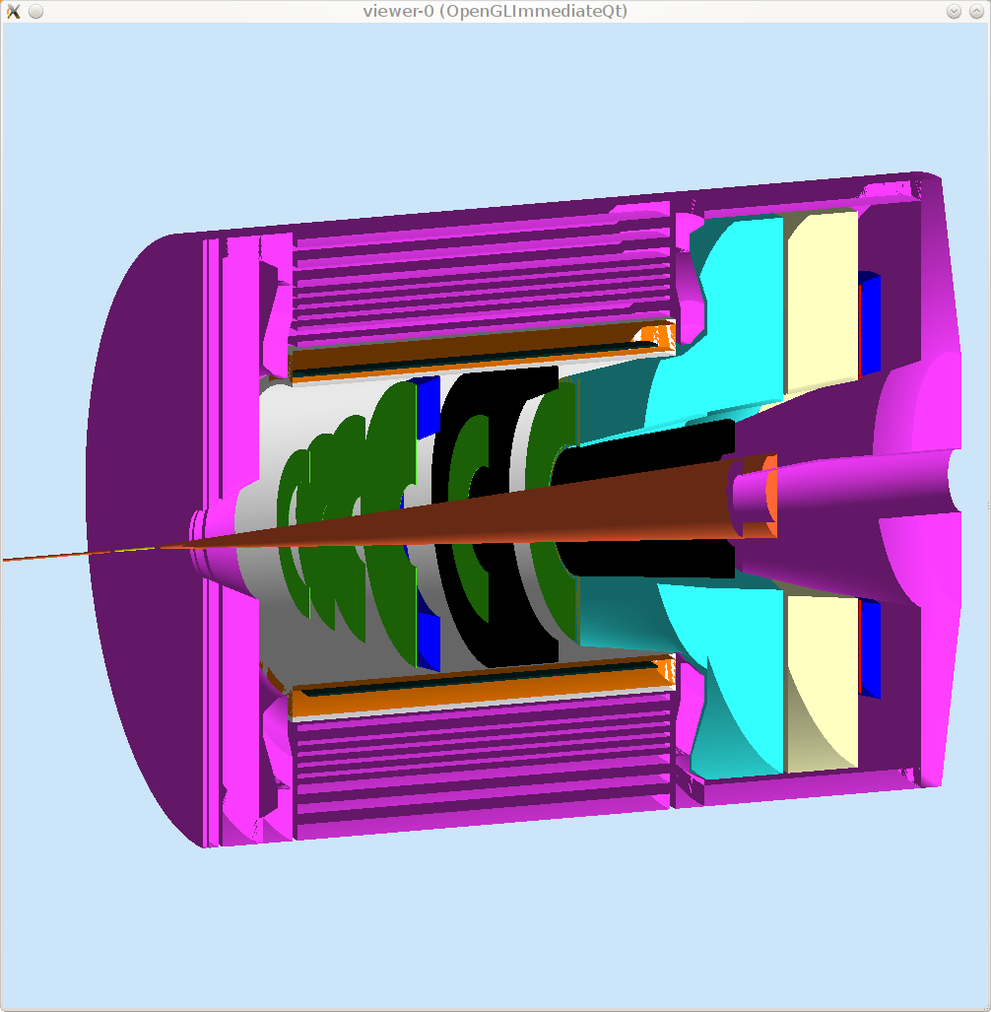
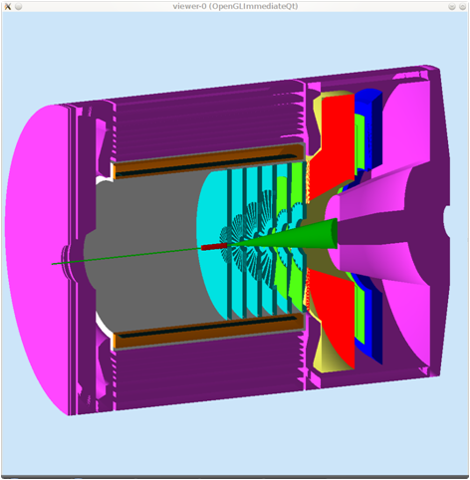
SIDIS/PVDIS CONFIGURATIONS
PVDIS Forward
Angle
SIDIS Forward
Angle
SIDIS Large Angle

Slide 4
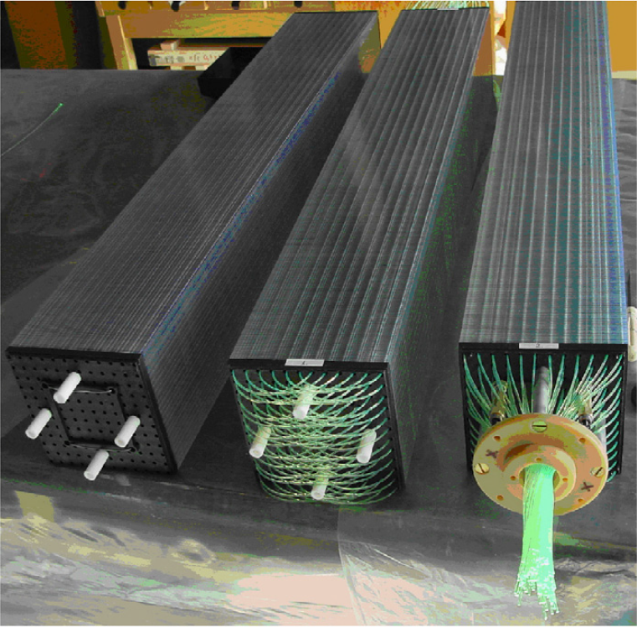
Calorimeter Design: Best Option
Lead-Scintillator Sampling Calorimeter:
Shashlyk Calorimeter
Fibers collect and read out the light
Great flexibility, tunable energy resolution: ~ 6%/√E is not a problem
Good radiation Hardness: ~ 500 krad/year
Well developed and mature technology: used previously
in other experiments

Slide 5
Calorimeter Design: Lateral Size
Good Balance
block Size (cm)

Slide 6
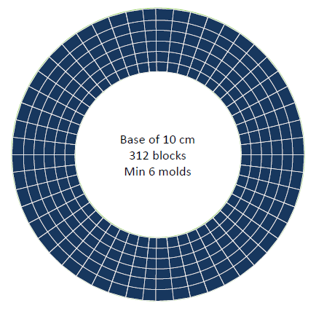
Calorimeter Design: Layout - Ring Sector
Excellent coverage
(no edge effect)
Small minimum number of
blocks but several molds
(~50 k each!)
Block size varies with the
radius, so does the position
resolution

Slide 7
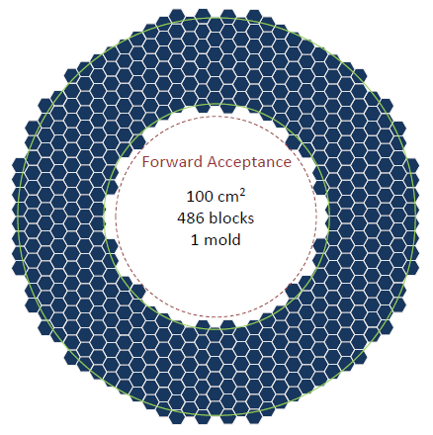
Calorimeter Design: Layout - Hexagon
Possible edge effects
Larger number of blocks but
one molds
Same block size
Only six direct neighbors for
each block, easier background
determination

Slide 8
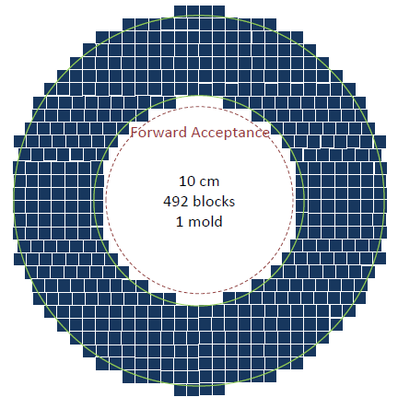
Calorimeter Design: Layout - Square
Possible edge effects
~ Same number of block as
the hexagon layout
Same block size
Easy assembly and mature
production

Slide 9
Calorimeter Design: Layout - Summary
Preferred configuration: Square
- Easy assembly
- Mature production
- Greater Flexibility (easier rearrangement)

Slide 10
Calorimeter Design: Light Read-out
Large Angle Calorimeter:
- Preferred option: transport light outside the magnetic field.
- PMT read out outside the magnet is easy to maintain.
Forward Angle Calorimeter:
- Option 1 : transport light outside the endcap, easy access
- Option 2 : in field light readout (<100G).
Need PMT with mu-metal shielding
Both options are under studies

Slide 11
Calorimeter Design: Fibers
Fibers:
Wave Length Shifting fibers (WLS):
KURARAY Y11: - good attenuation length (3.5-4m),
- good radiation hardness : <30% loss of
light output after a 693 krad irradiation.
- Recovery: few percents after 10 days
(M.J. Varanda et al. / NIM in Phys. Res. A 453 (2000) 255}258)
Clear Fibers:
KURARAY clear PS, Super Eska…, options under study.

Slide 12
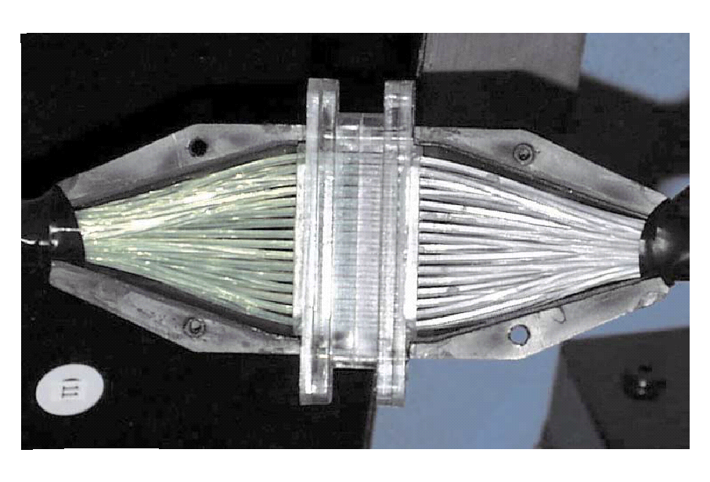
Calorimeter Design: Connectors
Option 1:
One to one WLS/clear fiber connector,
used in previous experiments (LHCb, Minos)
128-fiber connector
LHCb

Slide 13
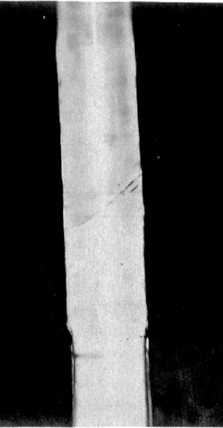
Calorimeter Design: Connectors
Option 2:
Thermal fusion: splice the WLS and clear fiber.
Giorgio Apollinari et al NIM in Phys. Research. A311 (1992) 5211-528
joint
Option 3:
Glue the WLS fibers to a lucite disk coupled to a lucite
Rod with optical grease or Si gel “cookie”.
Would reduce the cost significantly
Need more R&D to decide what is the best option.

Slide 14
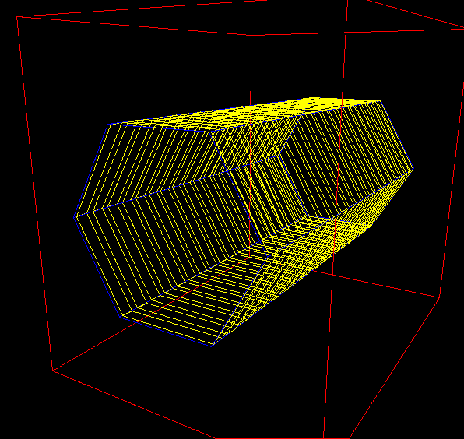
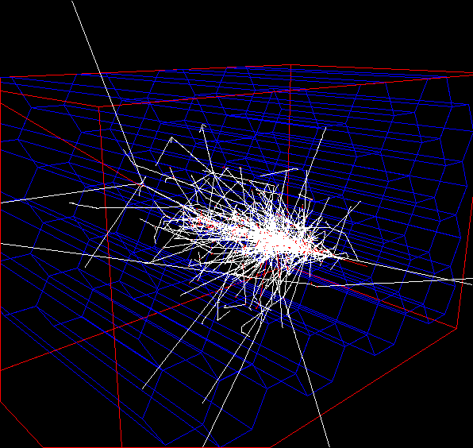
Hexagon Layout Simulation
Hexagon Shashlyk model
2 GeV electron shower
Energy weighted position resolution is about the same as
the square layout one: ~1cm

Slide 15
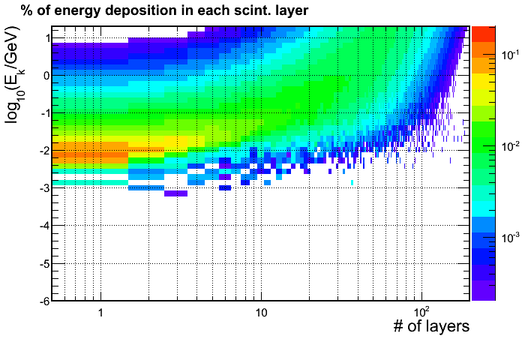
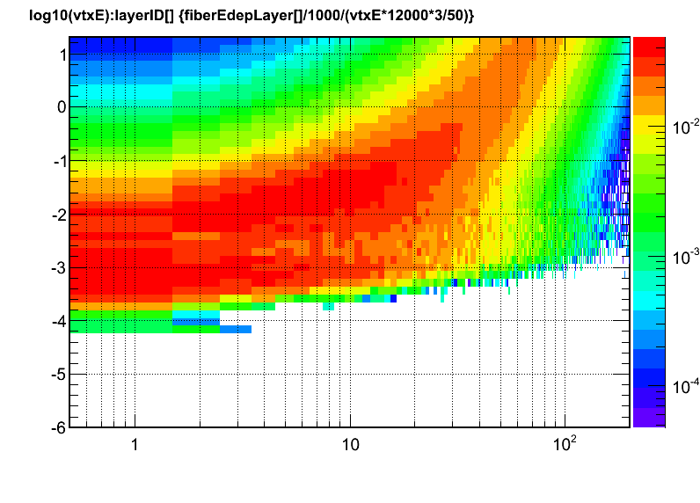
Background Simulation
The radiation dose for scintillators is 100krad~2Mrad, material dependent.
Doses on the fibers are similar to the doses on scintillator tiles (both are plastic based).
Energy deposition for e⁻
Dose = (fraction energy deposition for
each layer) *(energy flux)
(energy flux) is generated by using GEMC and Babar model.
(fraction energy deposition) is calculated using GEANT 4 simulation for each layer and different incoming particle kinematic energy.
Energy deposition for γ

Slide 16
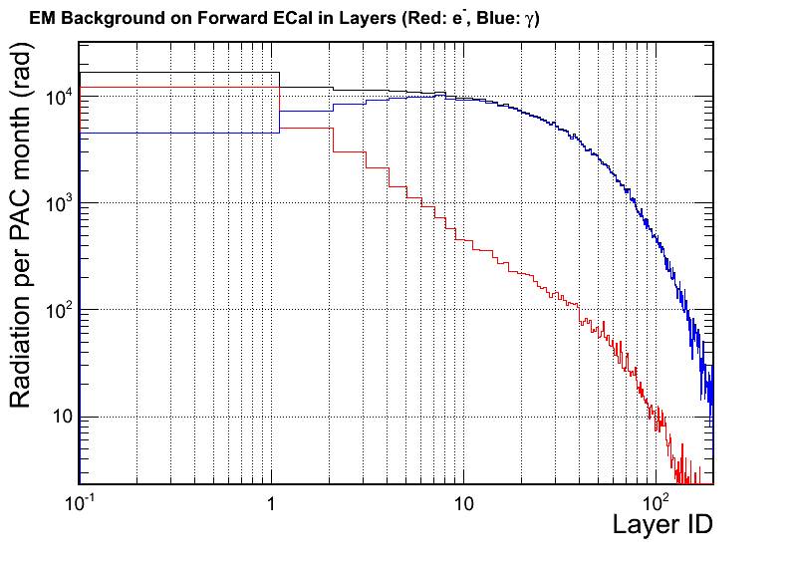
Background Simulation
The first 10 layers of scintillator have most of the radiation dose. Dominated by γ.
Not much safety margin to radiation limit for some scintillator.
Need to use radiation hard material.
Can add a front shielding of 1~2mm lead (equivalent to 2~3 layers) to reduce the radiation in the first few layers.
GEMC background model is being improved.

Slide 17
Budget Estimate
Experiment | Angle (degree) | Radius (cm) | Area(m²) | Number of modules | Module cost (M$) | Fiber Extension (M$) | PMT+ support (M$) | Total cost
PVDIS (forward angle) | 22-35 | 110-258 | ~10 | 1000? ~Baffle design | 1.5 | 0 | 0.6 | 2.1
SIDIS (forward angle) | 9-15 | 107-202 | 11 | 908
SIDIS (large angle) | 17-24 | 82-141 | 5 | 492 | 0.8 | 0.3(?) | 0.3 | 1.4
Support structure: 0.2M$ (?)
10x10cm Shashlyk module costs about $1~1.5K each
PVDIS : factor 0.5 reduction due to only covers ~half of azimuthal angle
Rearrangement of modules between PVDIS & SIDIS large angle calorimeters

Slide 18
TEST of the COMPASS modules
To gain direct experience with the modules.
To help parameterizing the light sampling for WSL fibers and anchor the simulation.
To study the position resolution at different incoming angles.
We will borrow 30(5x6) COMPASS module used for TPE@CLAS, but still need PMT, base and electronics.

Slide 19
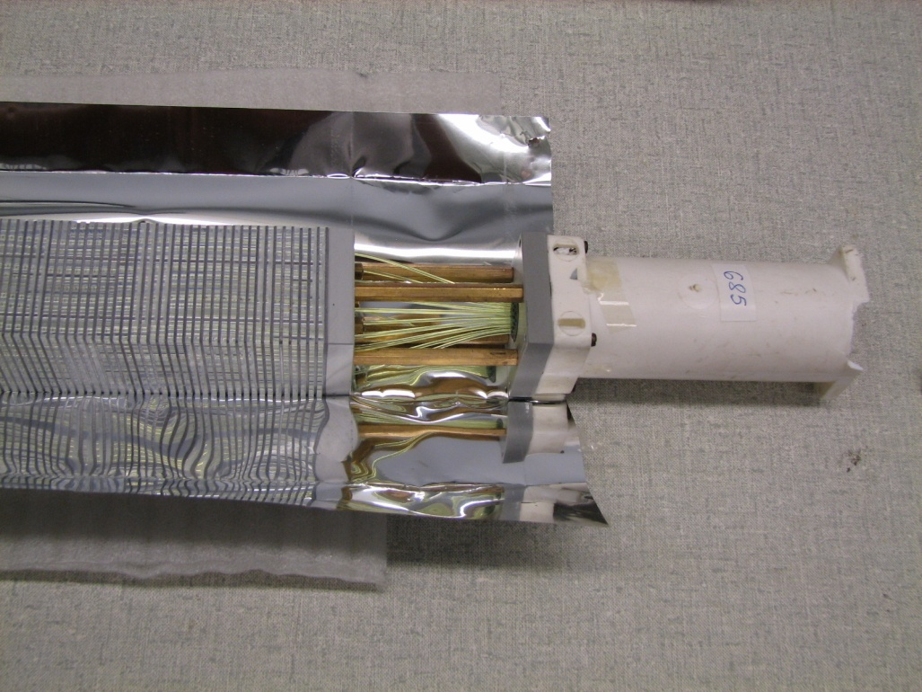
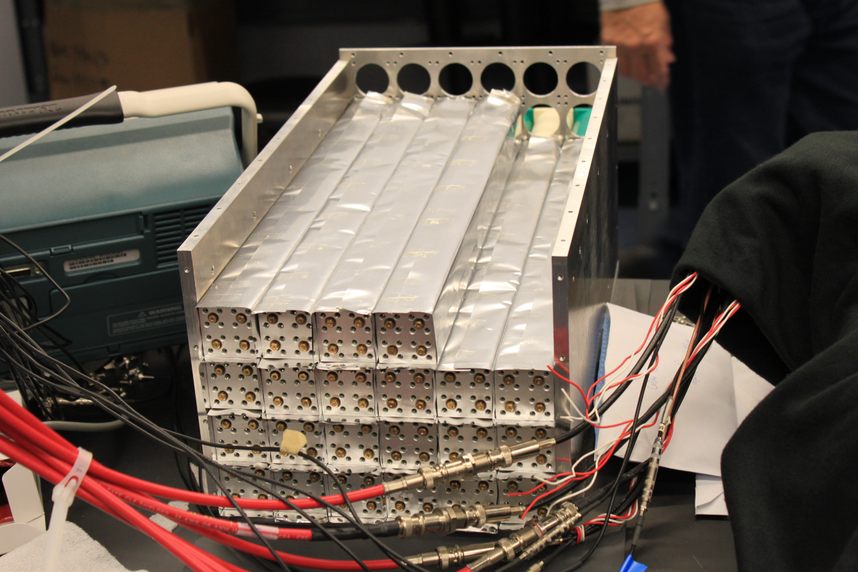
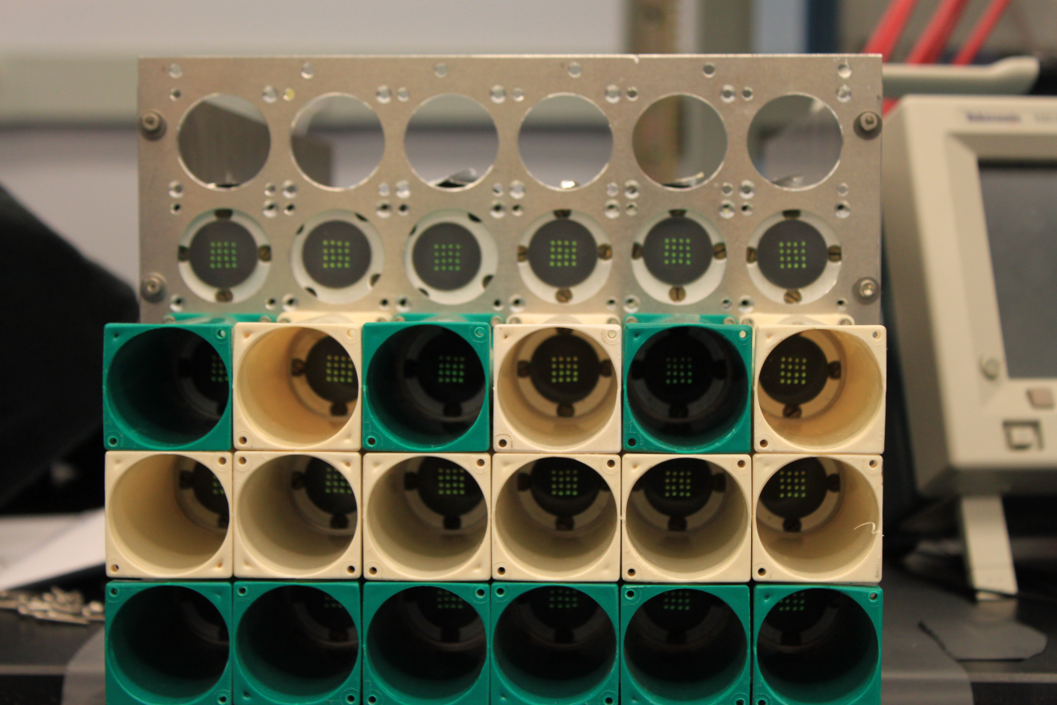
COMPASS modules used for TPE@CLAS

Slide 20
Beam Test Plan
Before the holiday, setup and bench test with cosmic ray for calibration
After the holiday, beam test in HallA
gain balance
sampling fraction
energy resolution
Timing
position resolution with angles

Slide 21
Conclusion
Square Layout preferred over hexagon and ring sector
Need more R&D on the WLS/clear fibers connection
(connectors, fusion, bundle…)
Background simulation is ongoing
Budget: $2.1 M for PVDIS + SIDIS large angle
$1.4 M for SIDIS forward angle
Plan for a beam test of the COMPASS modules

Slide 22
Backup Slides

Slide 23
REQUIREMENTS
Electron-hadron separation:
100:1 pion rejection in electron sample
Energy resolution: σ(E)/E ~ 6%/√E
Provide shower Position:
σ ~1cm, for tracking initial seed / suppress background
Time response:
σ <~ few hundreds ps, provide trigger/identify beam
bunch (TOF PID)

Slide 24
Calorimeter Design: Flexibility
Great design adaptability to match the experimental needs.
Two experienced providers contacted:
IHEP at Protvino for design & production
INR at Trozic for design & UNIPLAST for production
Experiment | COMPASS | PANDA | KIPIO
Pb Thick/ Layer (mm) | 0.8 | 0.3 | 0.28
Sci Thick/ Layer (mm) | 1.5 | 1.5 | 1.5
Energy Res. a/sqrt(E) | 6.5% | ~3% | ~3%
Rad. Length, X₀ (mm) | 17.5 | 34 | 35
Total Rad. Length (X₀) | 22.5 | 20 | 16
Moliere radius (mm) | 36 | 59 | 60
Typical Detecting Energy | 10¹~10²GeV? | <10GeV | <1GeV
Trans. Size (cm) | ~4x4 | 11x11 | 11x11
Active depth(cm) | 400 | 680 | 555

Slide 25
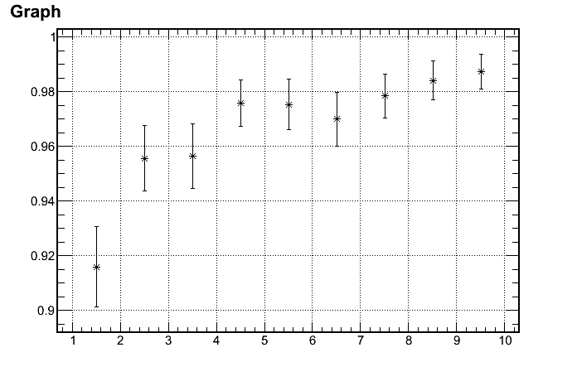
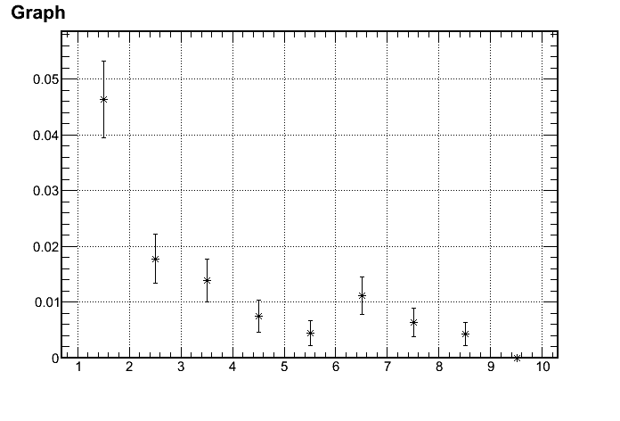
Calorimeter Design: Lead/Sci Ratio
Tuning of the ratio performed with a dedicated Geant 4 simulation.
Can reach a pion rejection factor of 100/1 with Pb thick. = 0.6 mm /layer
Electron Efficiency
1/(Pion rejection)
97%
100:1 Rejection
p (GeV)
p (GeV)
Range of interest: 3~7 GeV

Slide 26
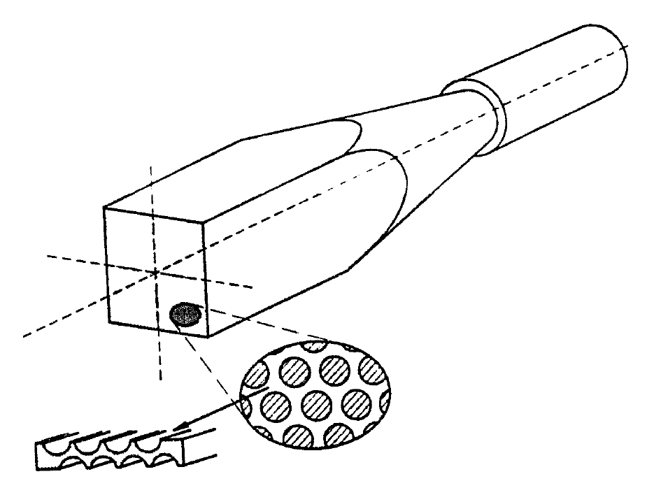
Compare of calorimeter types
Shashlik calorimeter
SciFi calorimeter – Pb
SciFi calorimeter – Fe
Combined with end cap
Typical Pb SciFi
Hertzog, NIM, 1990
Typical Shashlik
Polyakov, COMPASS Talk, 2010

Slide 27
Compare option A & B Shashlyk and SciFi-Pb
Similarity
Pb-scintillator based sampling calorimeter
Similar in resolution and radiation hardness
Both fit the need of SoLID
Choice : Shashlyk
Easier to read out light: Photon collection area 100 times smaller than SciFi
Matured production

Slide 28
Compare A & C for the forward Calo. The choice - Shashlik
Reason of choosing Shashlik over Scifi/Fe in endcup
Shashlik is cheaper.
It’s production module cost cheaper or similar to SciFi fiber cost alone.
Shashlik is more mature.
SciFi/Fe needs R&D
Shashlik is easier.
several suppliers with good experience are available.

