Slide 1


New Technologies for Cherenkov Light Detection:
Hadron Blind Detector
Thomas K Hemmick
Stony Brook University
SoLID Collaboration Meeting
October 14, 2011

Slide 2





The HBD Team
Brookhaven National Lab:
B. Azmoun, R. Pisani, T. Sakaguchi,
A. Sickles, C. Woody
Columbia University:
C.-Y. Chi
Stony Brook University:
W. Anderson, Z. Citron, M. Connors, J. M.
Durham, T.Hemmick, J. Kamin, B. Lewis, M.
Proissl, J. Sun, V. Pantuev,
University of California, Riverside:
A. Iordanova, S. Rolnick, R. Seto
Weizmann Institute of Science:
A. Dubey, Z. Fraenkel, A. Kozlov, A.Milov,
M. Naglis, I. Ravinovich, D. Sharma,
I. Tserruya

Slide 3
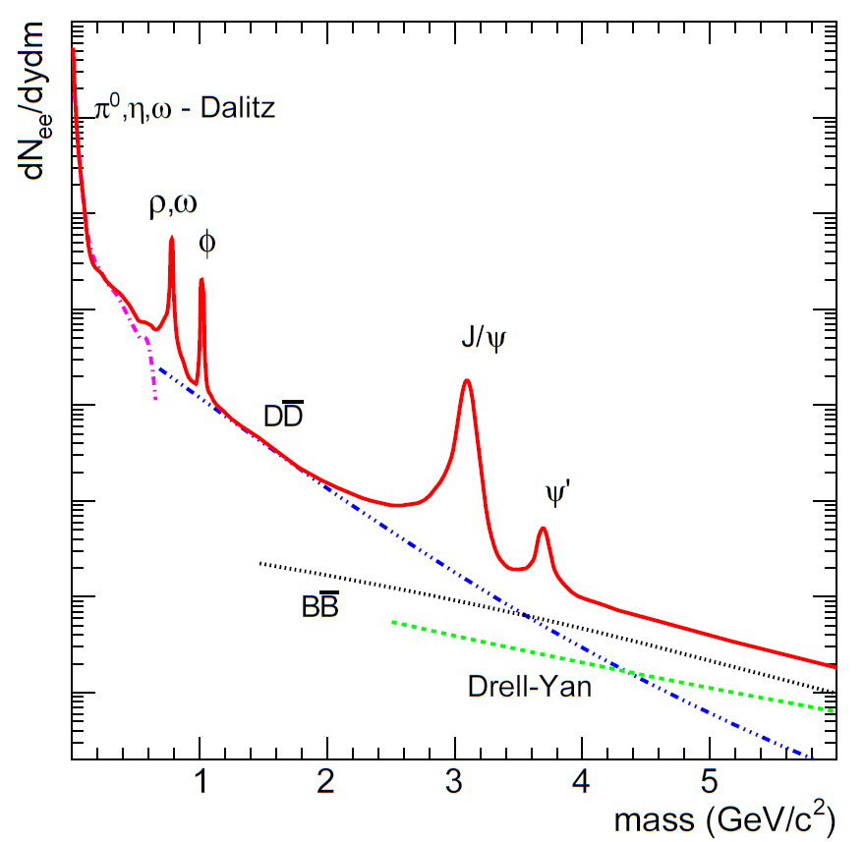
Lepton-Pair Continuum Physics
known sources of lepton pairs at √s = 200 GeV
Modifications due to QCD phase transition
Sources “long” after collision:
  π⁰, η, ω Dalitz decays
  (ρ), ω, φ, J/ψ, ψ‘ decays
Early in collision (hard probes):
  Heavy flavor production
  Drell Yan, direct radiation
Baseline from p-p
Thermal (blackbody) radiation
  in dileptons and photons
  temperature evolution
Medium modifications of meson
  ππ → ρ → l⁺l⁻
  chiral symmetry restoration
Medium effects on hard probes
  Heavy flavor energy loss
Chiral symmetry restoration
continuum enhancement
modification of vector mesons
thermal radiation
& modified heavy flavor
suppression
(enhancement)
3
Axel Drees

Slide 4
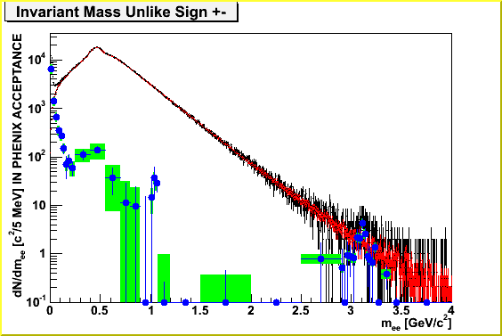
Key Challenge for PHENIX: Pair Background
No background rejection → Signal/Background ≥ 1/100 in Au-Au
Combinatorial background: e⁺ and e⁻ from different uncorrelated source
  Need event mixing because of acceptance differences for e⁺ and e⁻
  Use like sign pairs to check event mixing
>100x
4
Axel Drees

Slide 5
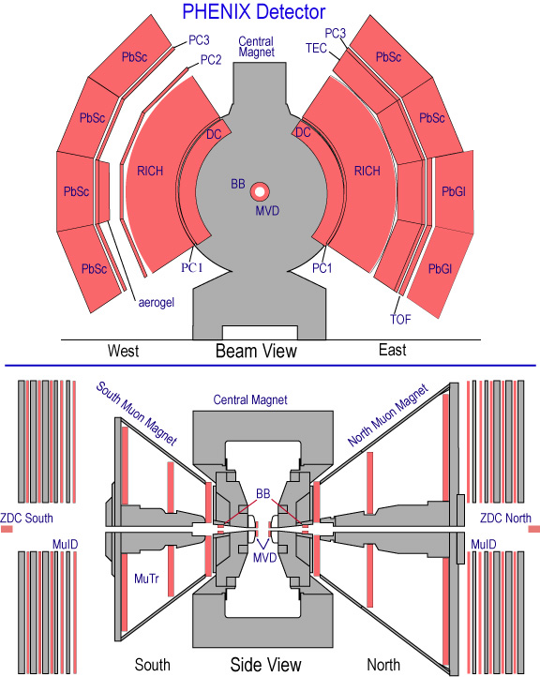
Why don’t we Spot Background?
Typically only 1 electron from a pair falls within the PHENIX acceptance.
  The magnetic field bends the pair in opposite directions.
  Some spiral in the magnetic field and never reach tracking detectors.
To eliminate these problems:
Detect electrons in field-free region near beampipe
Need >90% efficiency
~12 m

Slide 6

Separating Signal from “Background”
relativistic electrons
Mass spectrum from pion Dalitz decays peaked around 2m_{e}
pads
φ
π
Spectrum from photon conversion tightly peaked around 2m_{e}
Heavier meson decays have large opening angles
Opening angle can be used to cut out photon conversion and Dalitz decays
→MUST BE ABLE TO DISTINGUISH SINGLE HITS (“INTERESTING” ELECTRONS) FROM DOUBLE HITS (DALITZ AND PHOTON CONVERSION).

Slide 7
Looking Closer…
Inner coil can cancel B-field at r < 60 cm
Not enough room for traditional optics… mirrors won’t work.
Just put the detector right in the middle of things!
Has potential, but…
  must be thin
  must detect a single UV photon and still be blind to all ionizing particles passing through it!!!

Slide 8
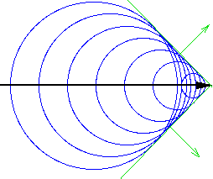

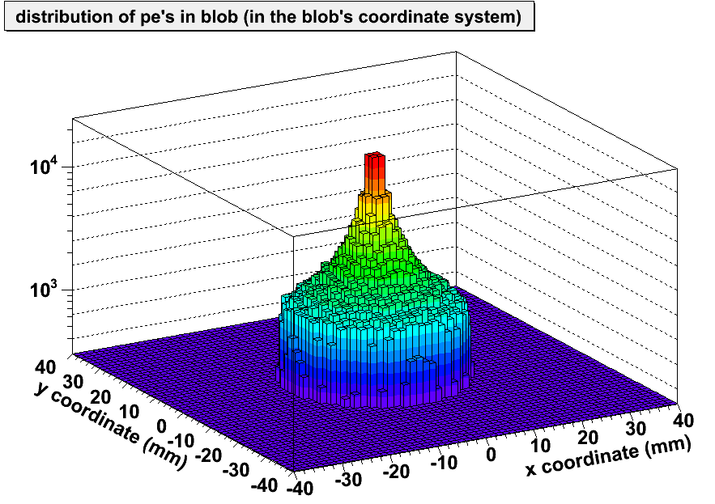
Unfocused Cherenkov “Blobs”
Windowless: Radiator Gas = Avalanche Gas
  CF₄ (n≈1.000620)
  Blind to hadrons w/ <4 GeV
Some challenges:
No room for traditional optics (ie. focusing mirror).
Cherenkov light collected as an unfocused blob.
1.5 m^2 photosensitive region
Low radiation length:
  minimize photon conversions.
Charged particles from collision will pass through:
  ionization must not interfere with photoelectron detection.
Cherekov Radiation
e⁻

Slide 9
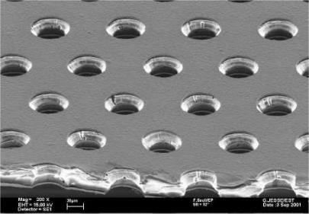
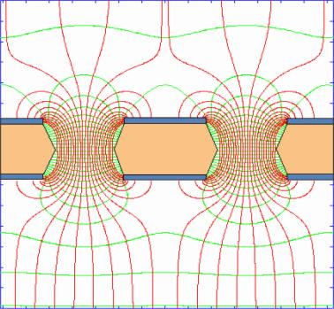
Gas Electron Multiplier (GEM)
The original idea by F.Sauli (mid 90s) US Patent 6,011,265
Traditionally CHARGED PARTICLE detectors (not photons)
150μ
80μ
Two copper layers separated by insulating film with regular pitch of holes
HV creates very strong field such that the avalanche develops inside the holes
Just add the photocathode
By the way: no photon feedback onto photocathode

Slide 10
Watch the Magic…
Start with a GEM
HV
Put a photocathode (CsI) on top
photoelectron from Cherenkov light avalanches in the high density E-field
~150 μm
Use more GEMs for larger signal
Pick up the signal on pads
What about ionizing particles (hadrons)?
We need a mesh with a reverse voltage on it to blow electrons away!!!
We have a detector sensitive to UV and blind to ionizing particles!

Slide 11
Ways to use GEM stacks
Reverse Bias (HBD)
Forward Bias
g
Mesh
photo
electron
primary
ionization
HV
^{charged}
^{particle}
^{or photon}
HV
e⁻
primary
ionization
CsI layer
Triple
GEM
Readout Pads
Readout Pads
Limited by the transparency of gas
CF4, ~1-12 eV photons
Limited by the absorption of gas
Lateral spread of avalanche is ~500 μm, thereby limiting resolution.
Single electron gain ~10⁴

Slide 12
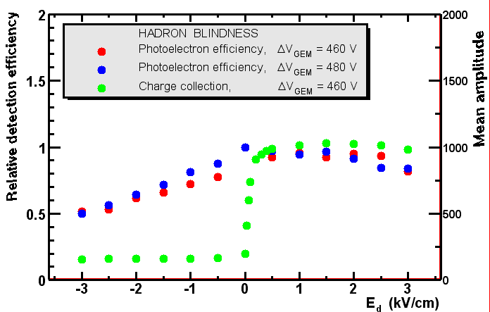
Hadron Blindness:
UV photons vs charged particles
Target E_{d} ~0.1 kV/cm
At slightly negative E_{d}, photoelectron detection efficiency is preserved whereas charge collection is largely suppressed.
Charge collected from ~150μ layer above top GEM

Slide 13
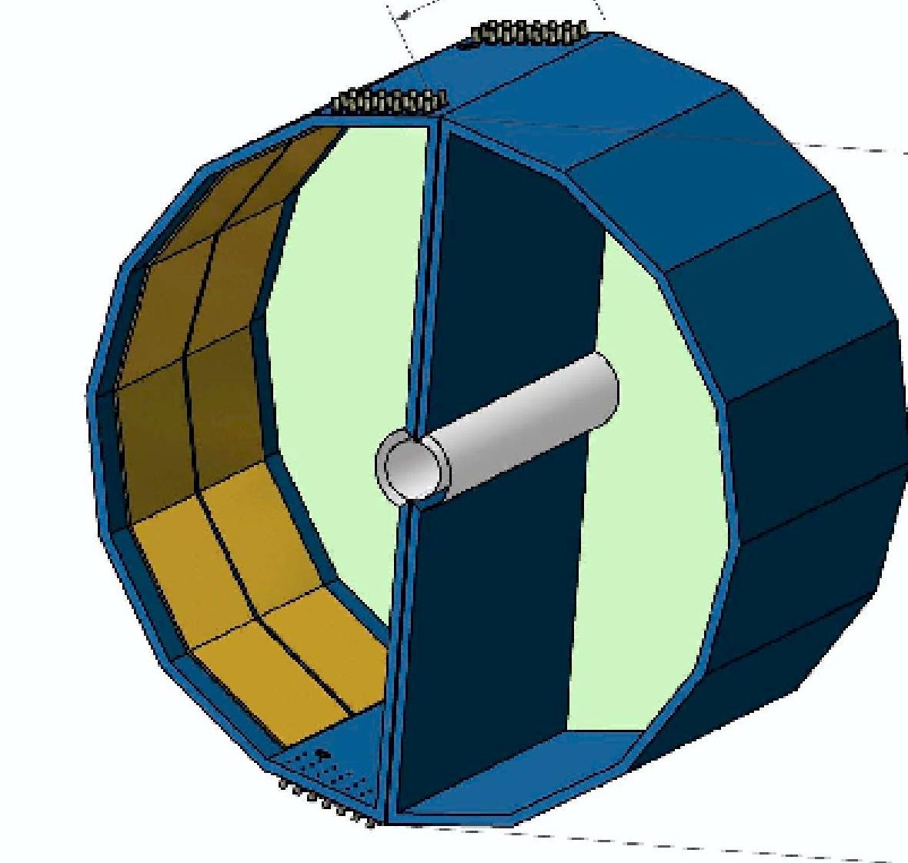
The HBD Detector
HBD Gas Volume: Filled with CF₄ Radiator (n_{CF4}=1.000620, L_{RAD}=50 cm)
Windowless Cherenkov Detector
Radiator gas = Avalanche Gas
Cherenkov light forms “blobs” on an image plane
(r_{BLOB}~3.36cm)
e⁺
e⁻
θ
Pair Opening
Angle
55 cm
Pcb pad readout (~ 2x2 cm²)
5 cm
Electrons radiate, but hadrons with
P < 4 GeV/c do not
CsI photocathode covering GEMs
Triple GEM detectors
(12 panels per side)
Space allocated for services
Dilepton pair
Beam Pipe

Slide 14
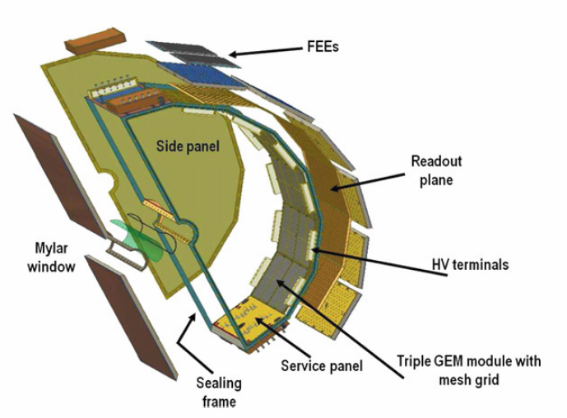
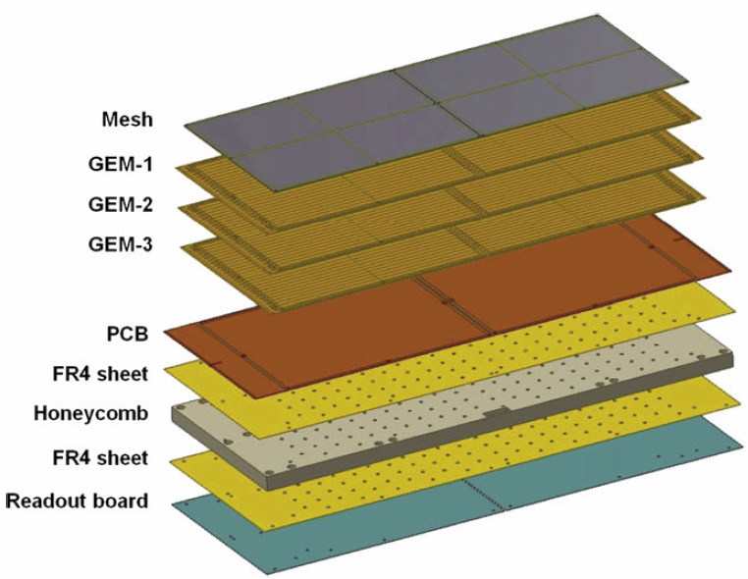
Mechanical Detail

Slide 15
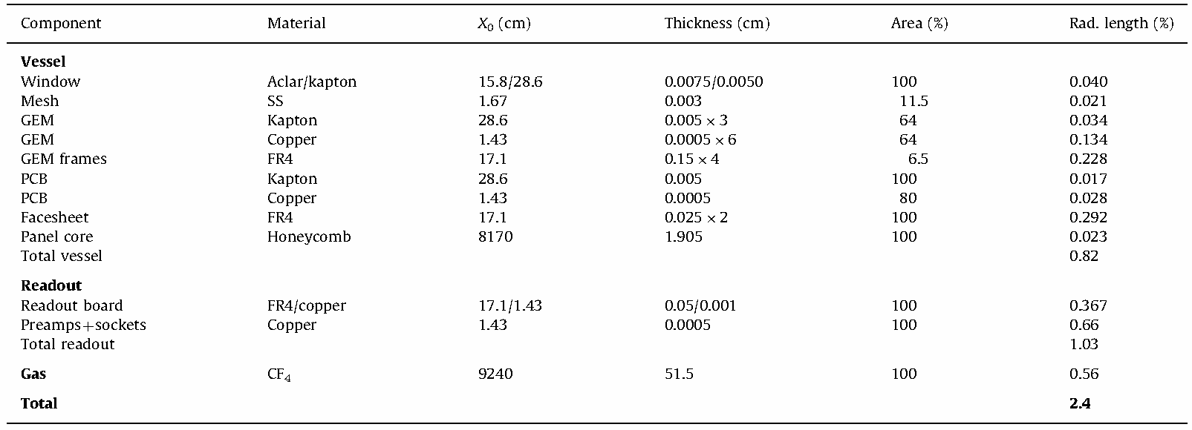
Radiation Budget

Slide 16
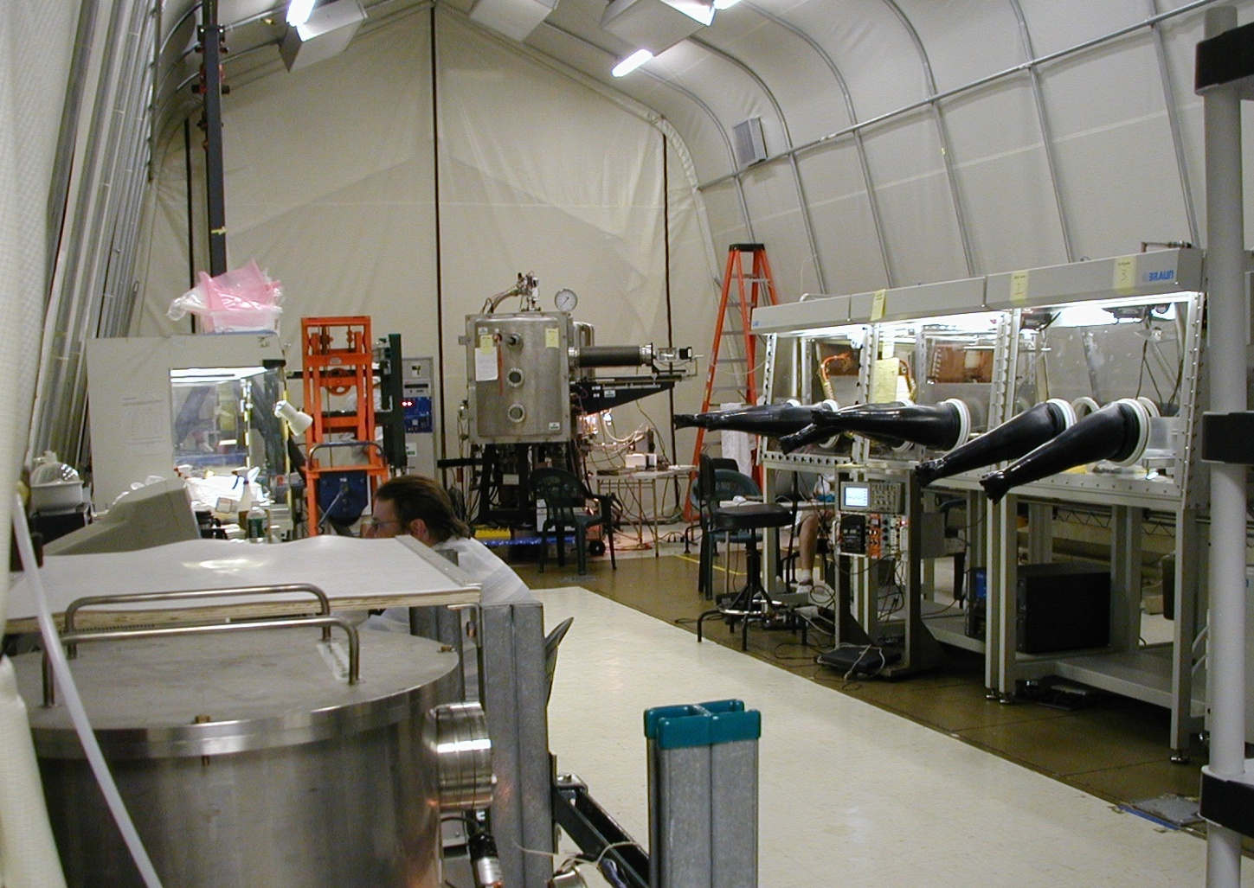
The Clean Tent at USB
(“Class”: number of ≤0.5 μm particles/m³)
“Class” of Clean Room
evaporator
glove box
GEM
storage vessel
laminar flow hood
Entrance Foyer

Slide 17
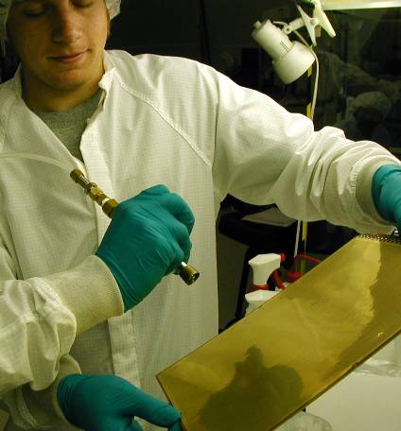
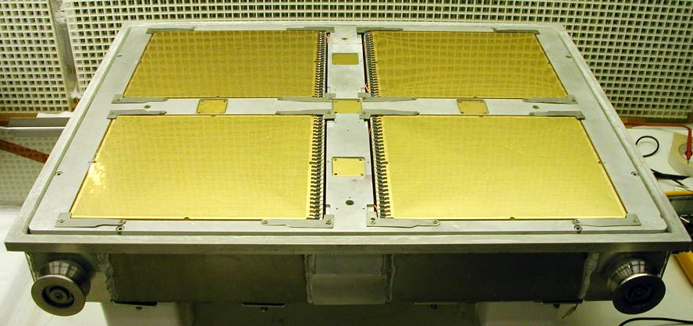
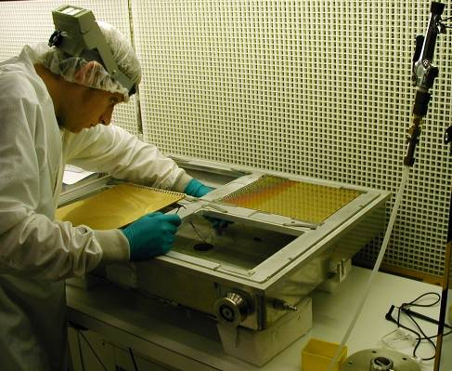
Preparation for Evaporation
Cleaning GEMs:
GEMs are “de-dusted” with Ar
Installation into Evaporation Box:
GEMs mounted in evap box
leads connected underneath
test-chicklets installed
READY FOR EVAPORATION

Slide 18
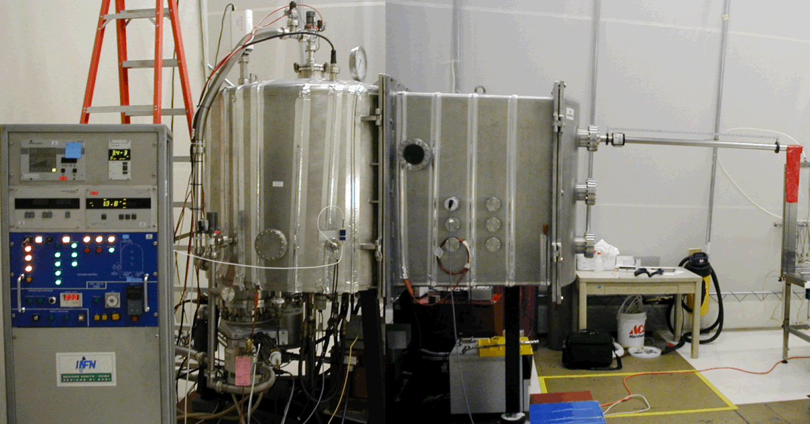
The Evaporator
on loan from INFN Roma
Magnetically coupled driver for moving the GEMs inside the vacuum.
Evaporation Chamber
Quantum Efficiency Station

Slide 19
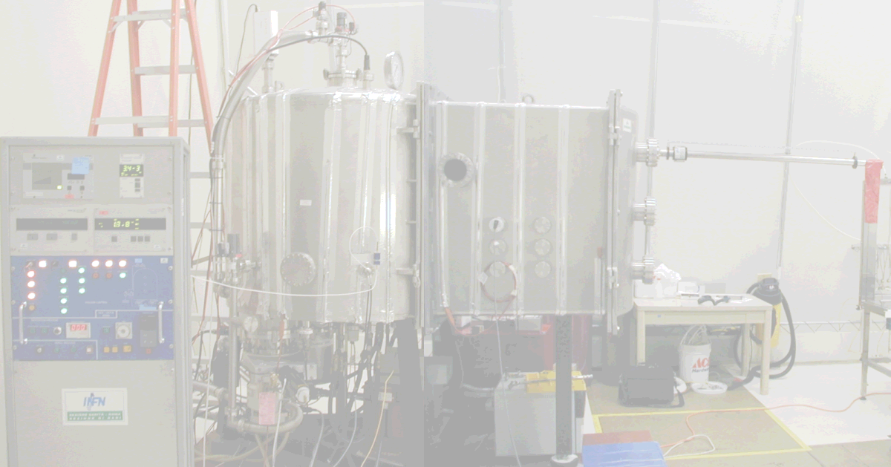
The Evaporation Chamber
Harpoon for moving mounting box
GEM mounting box w/ wheels on track
GEM
CsI
Molybdenum boats
Boats are in series so they must be brought up to temperature slowly (~10 min)
250 – 450 nm layer of CsI at rate of ~2 nm/sec
~24 hrs to pump down vessel
vacuum ~10⁻⁷ mbar
  no water!!
Evaporate 4 GEMs simultaneously
AC

Slide 20
The Quantum Efficiency Station
Harpoon for moving mounting box
GEM mounting box w/ wheels on track
GEM with CsI
GEM w/ CsI
Molybinum boats
~ 100 V
~ 2mm
e⁻
e⁻
ampmeter
mesh
(e⁻ collection)
D₂ lamp
(λ=160,185,200 nm)
γ
AC
mirror
reference PMT

Slide 21
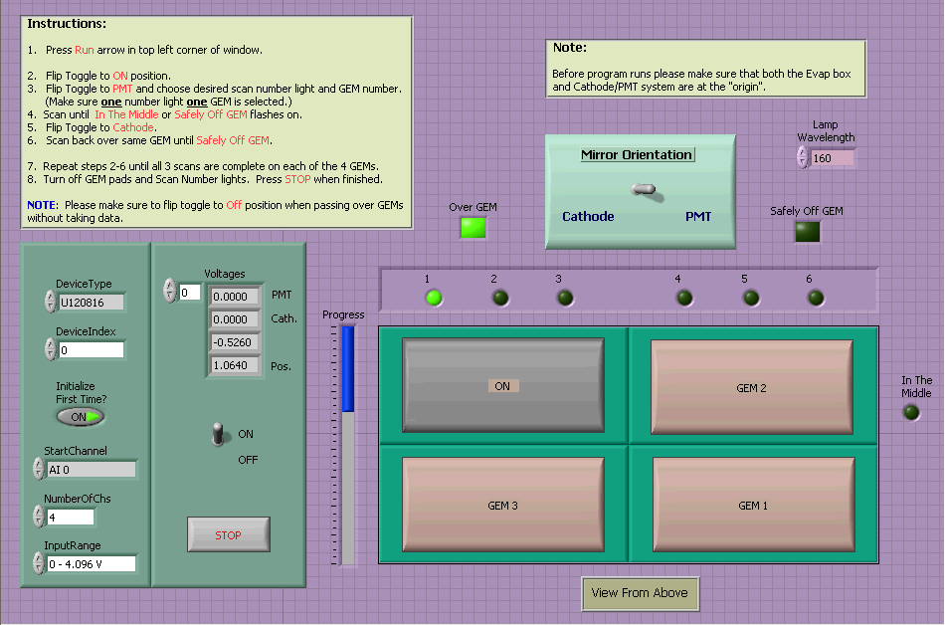

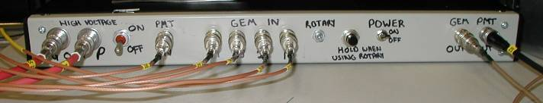
QE System
Revamped QE:
Can this system be made user-friendly??
Of Course!!
Quantum Efficiency:
LabView DAQ interface
records:
  Photocathode Current
  Reference PMT Current
  Mirror Orientation
  Y-coordinate (manually)
  X-coordinate (automatically)
String potentiometer

Slide 22
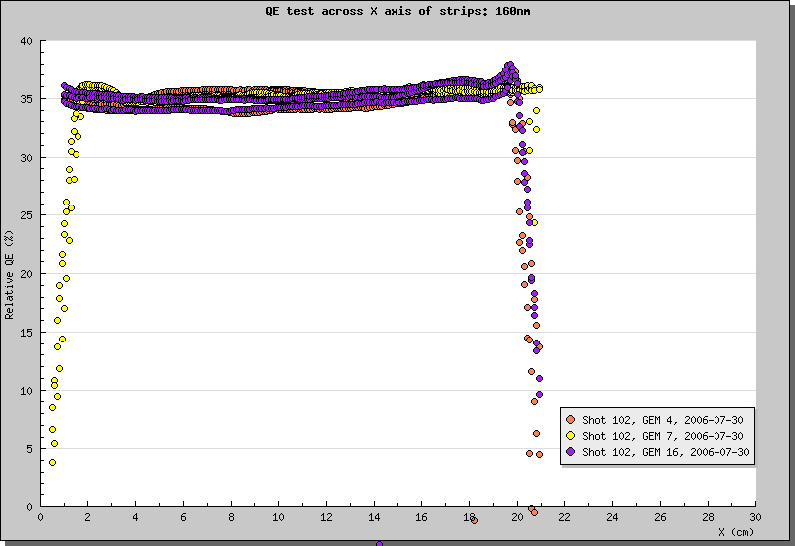
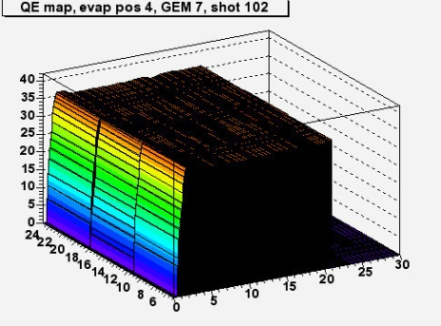
Relative QE
(results from the evaporator)
Encouraging results:
Highly uniform QE across GEMs.

Slide 23
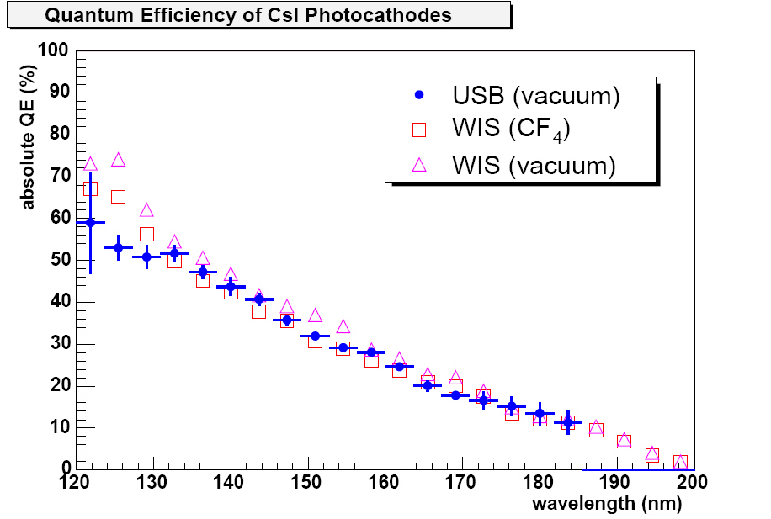
Absolute QE
(results from BNL)
10 eV
6 eV
Encouraging results:
Highly uniform QE across GEMs.
Chicklet results confirm high QE.

Slide 24
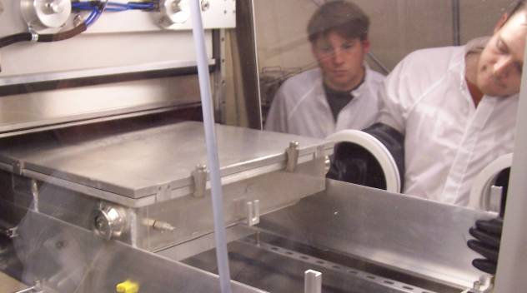
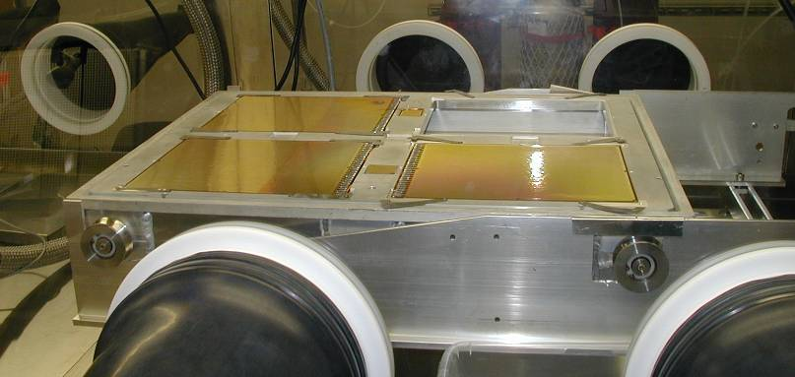
Railroad System
“low rider”
Chuggin’ along on the railroad:
After flushing the foyer,
Transport box rolls effortlessly out of the airlock...
…and into the glovebox.
To reach over the edge and inside transport box, the “low rider” system was developed.

Slide 25
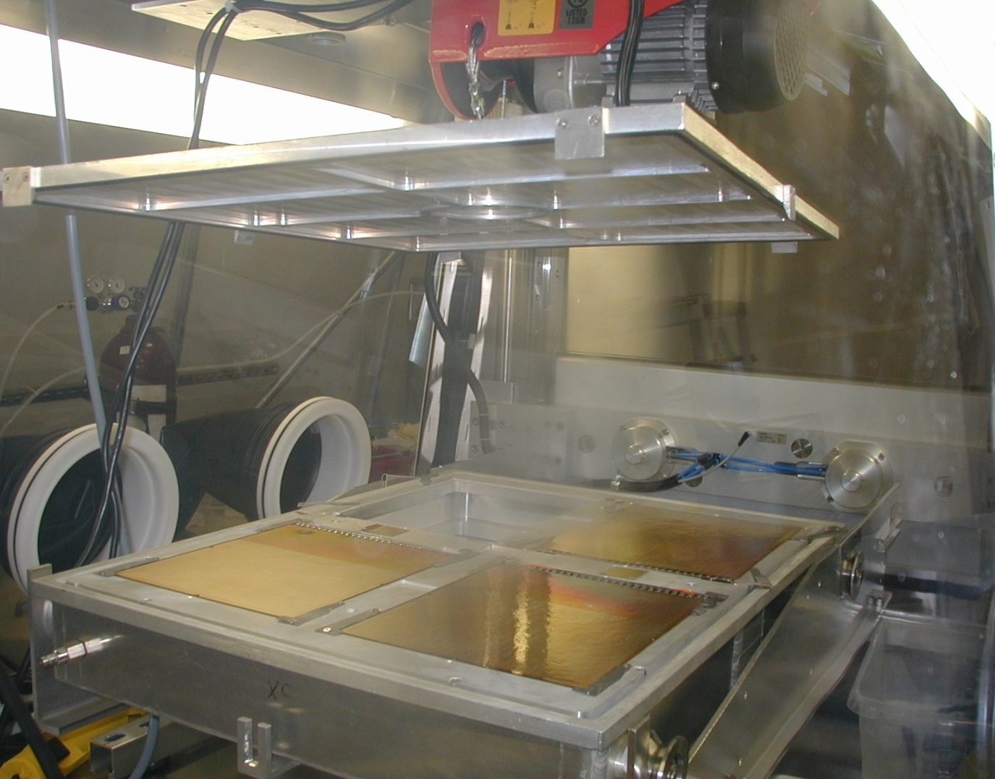
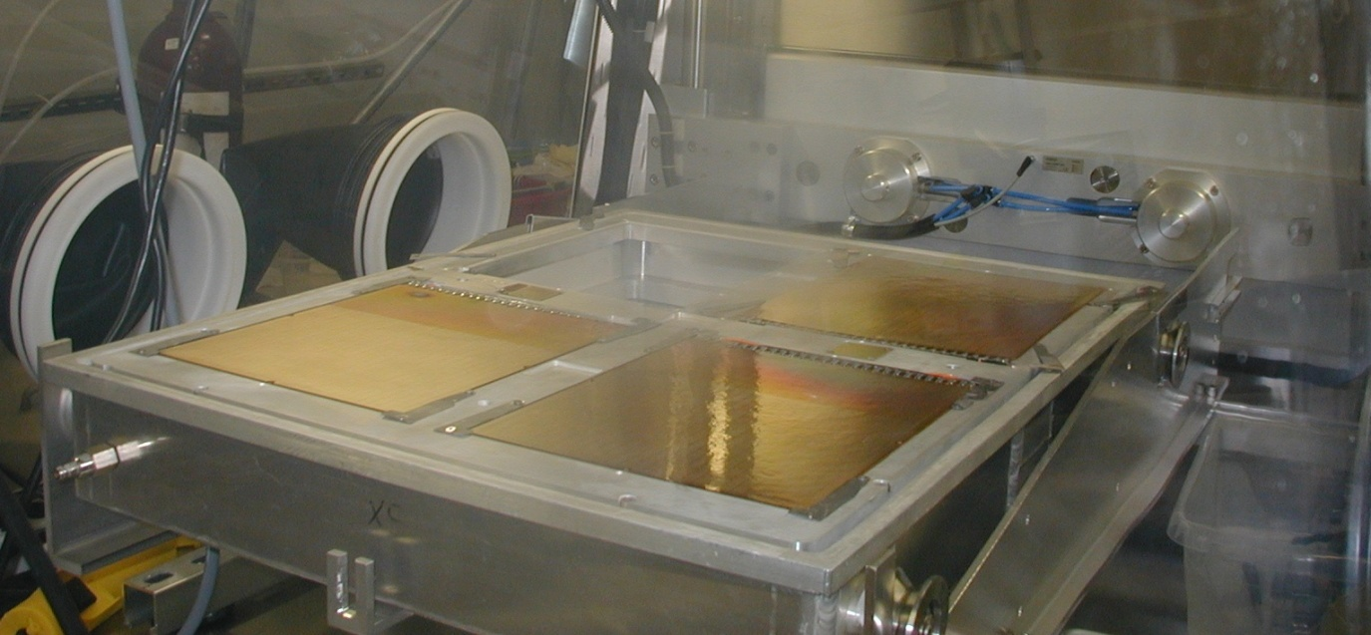
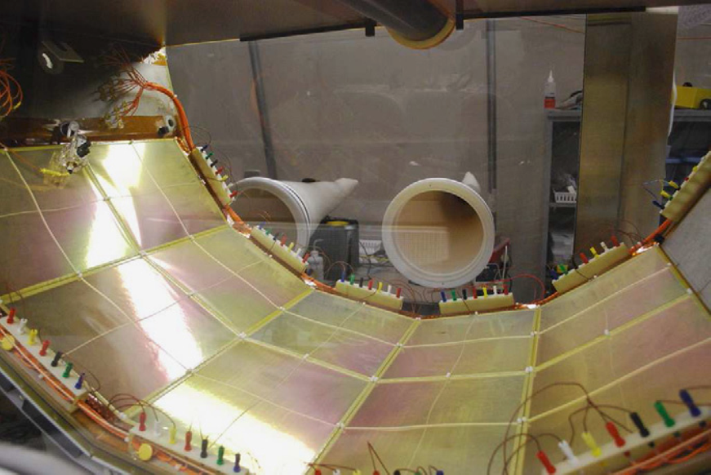
Electric Lift System (1)
Where to store the lid of the transport box??
Transport box lid is big and cumbersome.
Nowhere to set the lid down during GEM extraction.
…nowhere but UP, that is!!!
And, of course,
out of the transport box…
…and into the HBD!

Slide 26
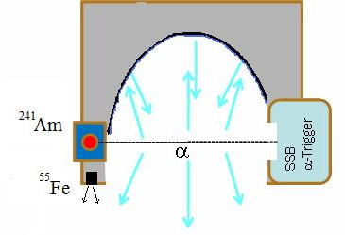
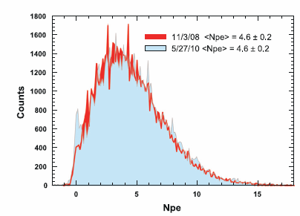
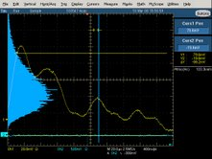
Monitoring QE over Time
Lucite with Al/MgF₂ coating
We can measure CF₄ scintillation at 160 nm.
Gain is calibrated using an ⁵⁵Fe source.
Coincidence of SSB and pads
No loss of QE over two year period!

Slide 27
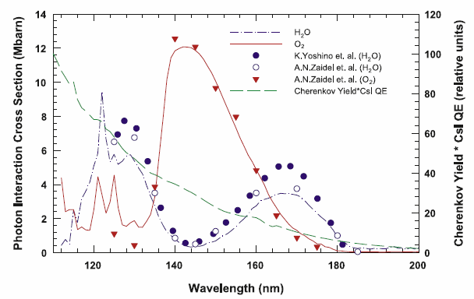
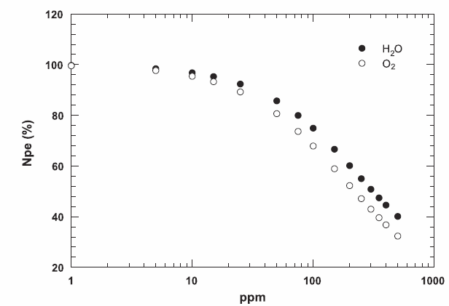
Gas System Quality VITAL!
Stay below 10 ppm
O₂ and H₂O
5 lpm!

Slide 28
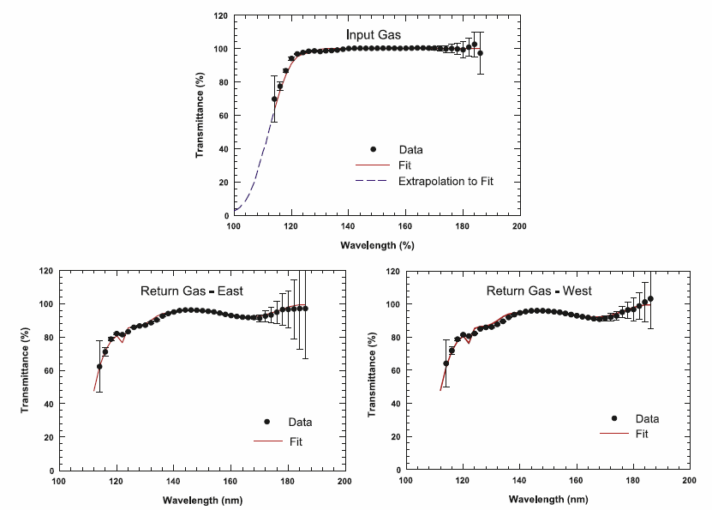
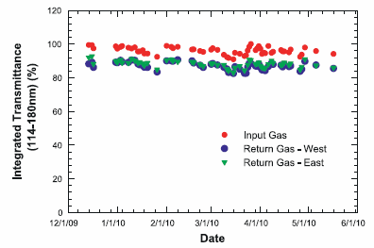
Transmission Scans
HBD-CF4 @ 4.5lpm (Recirculation mode, incl. scrubbing)
Maintained ~90% integrated transparency over full run.
Notes:
28

Slide 29
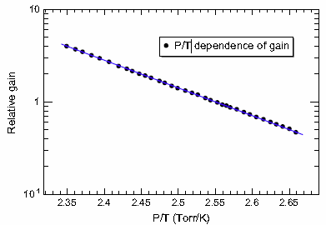
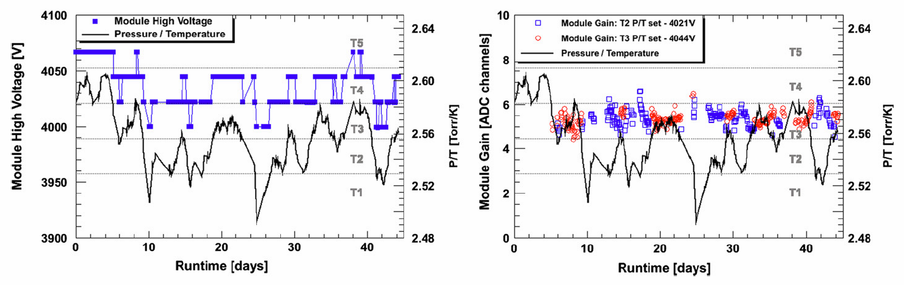
Gain Monitor/Stability
Gain is monitored live via scintillation.
P/T (n/V) corrections applied via High Voltage

Slide 30
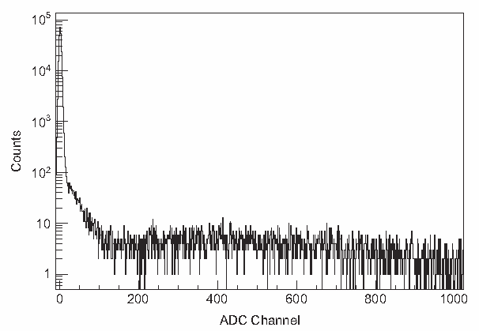
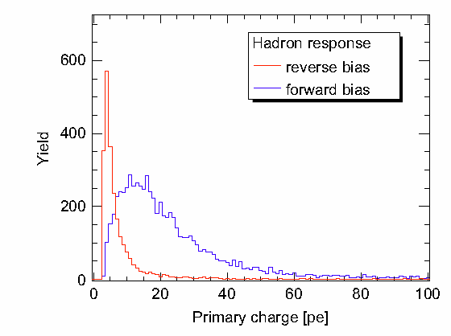
Hadron Response
Cosmic ray triggers
Pedestal
Scintillation
MIPs
Scintillation produces single photo-electron signals.
Provides ABSOLUTE gain measurement.
The HBD response to hadrons:
  Landau in Forward Bias
  “Blind” in reverse bias.

Slide 31
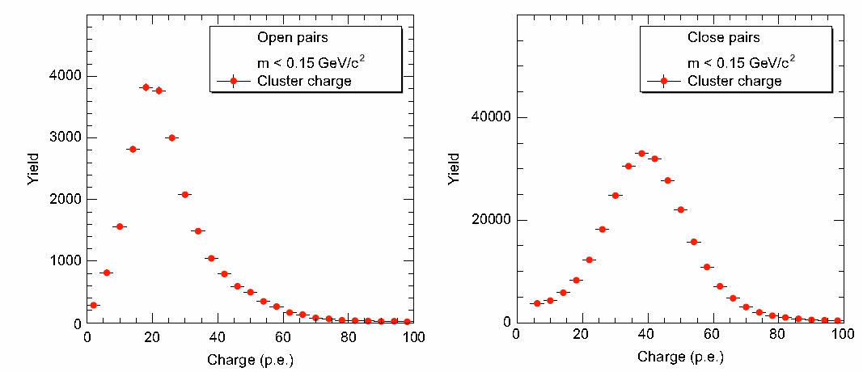
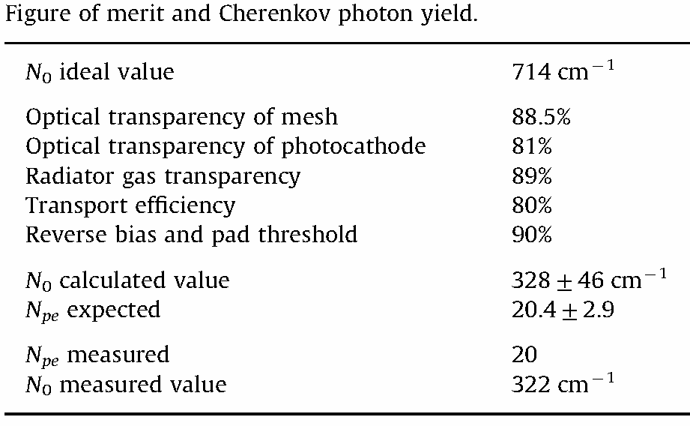
Electron Response

Slide 32
Letter of Intent for Detector R&D Towards an EIC Detector
TK Hemmick for the EIC Tracking R&D Group
Brookhaven National Laboratory
Florida Institute of Technology
Iowa State University
Lawrence Berkeley National Laboratory
Massachusetts Institute of Technology
Riken Research Center at BNL
Stony Brook University
Temple University
University of Virginia
Yale University

Slide 33
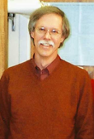





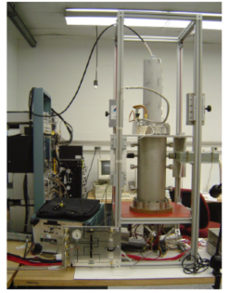
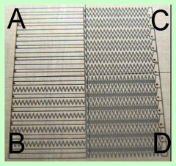
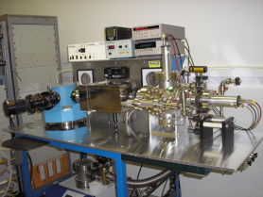
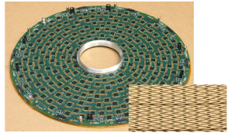
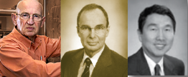
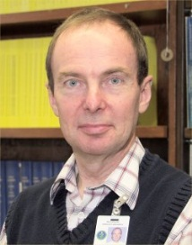
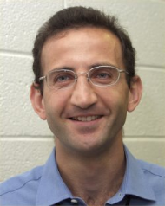
Brookhaven Lab
Hadron-Blind Detector
Chevron charge division
Fast drift/low mass TPC
ASIC development
VUV spectrometry

Slide 34
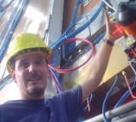




Florida Institute of Technology
CMS High-η GEM Upgrade
RD51 SRS readout System
Large-Area GEM production
CERN workshops
Single-mask GEM cross section

Slide 35






University of Virginia
Prototype GEM tracker tested at Jlab now
Super Big Bite
SoLID
prototype tracker prepared for beam test.

Slide 36







Yale University
Forward GEM Tracker
Developed Strip-pixel readout system.
Short term proposal:
  3-coordinate strip-pixel readout.

Slide 37



Strip-pixel R&D
PROPOSED
COMPASS
Position by charge division (~100 μm).
Readout count set by occupancy:
  2D uses X-Y charge matching allows
  up to 10 particles per “patch”
  3D uses chg & GEOMETRY matching
  requires R&D to determine limit.
STAR FGT
NOTE: Redundancy “hardens” detector against failure.

Slide 38






Stony Brook University
Hadron-Blind Detector
Large Clean Room
Gas Chromatography
CsI Photocathodes

Slide 39



PID via Cherenkov Angle
Ring Radius determines θ_{c}

Slide 40



Barrel Concept (‘ala ALICE HMPID)
Proximity-focused RICH.
Liquid Radiator.
New concept:
  CsI GEMs for readout instead of wire avalanche.
  Improved HV stability.
  Reduced Hadron response

Slide 41

Forward Concept 1…Multi-Radiator RICH
Windowless
Momentum | C₄F₁₀ | CF₄ | Particle id.
3 < p < 5 | 1 | 0 | Π
5 < p < 9 | 1 | 1 | Π
9 < p < 16 | 1 | 1 | Π
 | 1 | 0 | K
 | 0 | 0 | p
16 < p < 30 | 1 | 1 | Π,K
 | 1 | 0 | p
C₄F₈O
CF₄
CaF₂
Threshold Device.
BIG blob from C₄F₈O (~10 cm)
Small blob from CF₄
Even though concentric get two thresholds…

Slide 42

Forward Concept 2 – Forward RICH & Blob
Rings from CF₄…Blobs from C₄F₈O
PID to ~20 GeV.
Other variations possible including using liquid radiator for lower momentum PID.
CAUTION! Mirrors are not perfect!

Slide 43


Commercial (small) mirror Reflectivities
Bare aluminum mirrors no good (AlO…high cutoff).
Better has MgF₂ overcoat (right hand).
  Exists and has been made to large scale.
Thin film(?) goes REALLY low.
  Can this be made larger than 2” diameter?
 | n | lambda | p.e. per meter | p.e. MgF2 | p.e. quartz
CF4 | 1.00062 | 108 | 108 | 33 | 6.4
C2F6 | 1.00094 | 150 | 32 | 32 | 9.7
C4F10 | 1.001444 | 160 | 29 | 29 | 15
C4F8O | 1.001389 | 175 | 9.6 | 9.6 | 9.6
NOTE: Idealized…
reality is half

Slide 44

Particle ID…
C₄F₁₀ and CF₄ mixed radiator cherenkov angles.
E-pi separation clearly requires EMCal (not cherenkov).
Good pi-K-p PID to about 20 GeV.

Slide 45




The older unit with a mirror is better for next stage of R&D.
Larger rings will require some mods (or just capture a fraction of a ring.
OTHER EQUIPMENT:
  High Purity High Flow recirc. Gas system.
  Gas Chromatograph

Slide 46

Ideas for Hall A Testing
Replace entrance window with Al flange.
Attach to existing vacuum/gas vessels.
Blobs
Standard RD51 10x10 chamber
Comes with 4x128 channels readout.
Full SRS readout chain.
Total cost $4k
Rings

Slide 47
Summary
R&D will be done putting 10x10cm² GEMS paired with a mirror using vacuum vessels from prior efforts.
Test beam will be taken at J-Lab using
resources from our friends:
  J-Lab existing resources.
  SBU portable high purity gas system
  Perhaps SRS systems?
Clear interest for EIC.
Possible interest for SoLID
Join forces and address both needs!

Slide 48

Mesh to Top GEM Sparking
Two separate power supplies per stack
allows for flexibility between FB and RB
But following a GEM trip, a V gap built between the Mesh and top GEM creating a spark.
removed capacitors (reducing stored energy)
double zener diode btwn mesh-top GEM.
HV + bias
Optical coupling between modules led to multiple stacks tripping simultaneously.
TRIP!!
HV
R₁
R₁
R₁
R₂
R₂
R₂
R₂
Damage made GEM stacks inoperable
→Insufficient active area to do physics in Run 7.
→Forced us back into construction with new GEMs
Led to damage of top GEMs
Grid patterned “burns”
line up with mesh.
R₂
2R₂
R₁ = 2.2 MΩ, R2 = 10 MΩ, V_{in} = 3720 V, dV/GEM = 500V, I_{chain} = 150 μA

Slide 49


Improvements
Better understanding and control of the HV system.
  Adust transfer gap V (between GEMs), allows higher gain w/out increasing GEM voltage
  Improved trip procedure
Operating at a less severe reverse bias will allow us to improve the photoelectron yield.
Higher gas flow will improve transmission.
Drift gap
Transfer gap
Relative Gain
~25% gain increase w/out more GEM stress
~20% potential light gain
Photoelectrons

Slide 50


E-Field Line Directions
Line density does NOT represent field strength!
In this simulation…
electrons were created at the
surface of the GEM.
electron path follows E-Field
lines
recorded PE’s final destination.
Reverse Bias (-30V):
most (~91%) e’s from the
GEM surface end up on pads.
~3% are swept up to mesh.
~6% lost to GEM bottom.
Reverse Bias
Forward Bias
note:
field line destinations and actual
charge destinations are different
due to diffusion and avalanche.
Lines go to mesh
Lines go to pad
Lines go to GEM bottom

Slide 51



E-Field Line Directions
Reverse Bias
Line density does NOT represent field strength!
Lines go to mesh
Lines go to pad
Lines go to GEM bot
For an intuition of what different negative drift fields look like…
notice that “reverse bias” doesn’t turn on immediately

Slide 52

Experimental results
Hadrons (actually ⁵⁵Fe) drop suddenly in efficiency as bias goes reverse.
Photon-electrons fall off slowly with increasing reverse bias.
HBD will operate best when placed “just barely” into the reverse bias mode.
Since voltages are roughly 4000 V, need 0.1% precision to get bias correct to 4V!!!
⁵⁵Fe
Scintillation

Slide 53

Spectra in Beam
Scintillation
MIPs
FORWARD
REVERSE
Spectra show two components:
  Single Scintillation Electrons (expo)
  MIP (Landau)

Slide 54
Goal List for HBD
Forward/Reverse threshold (standalone):
  Change bias step-by-step.
  Search for loss of MIP peak.
  DONE (and we thought this would be hard)
Gain Calibration (Standalone):
  Observe scintillation signal in every channel.
  Fit scintillation slope to get gain.
  Adjust voltages to get nearly uniform gain.
  DONE (better than 10%...WOW)
High Statistics Reverse Bias (tracking)
  Determine Hadron Response.
  Determine isolated electron response.
  Determine “double” electron response.
  DONE (excellent Results)

Slide 55
DV Scan
Color scheme
RUN LINE COLOR BIAS
274058 Red +30V
059 Black 0V
060 Green -5V
061 Blue -10V
062 Yellow -15V
063 Magenta -20V

Slide 56




EN1 -15V
EN2 -10V
EN3 -15V
EN4 -10V

Slide 57
Important for Detector Design
Detector must be multi-purpose
  One detector for inclusive (ep -> e’X), semi-inclusive (ep->e’hadron(s)X), exclusive (ep -> e’πp) reactions in ep/eA interactions
  run at very different beam energies (and ep/A kinematics)
  E_{p/A}/E_{e} ~ 1 – 65 → HERA: 17 – 34; lepton beam energy always 27GeV
Inclusive DIS:
  with increasing center-of-mass energy lepton goes more and more in original beam direction
  high Q² events go into central detector
  low Q2 events have small scattering angle and close to original beam energy
  need low forward electron tagger for low Q² events
  low-mass high resolution trackers over wide angular acceptance
Semi-Inclusive DIS
  hadrons go from very forward to central to even backward with lepton beam energy increasing
  good particle-ID over the entire detector
Exclusive Reactions:
  decay products from excl. ρ / φ / J/ψ go from very forward to central to even backward with lepton beam energy increasing

Slide 58



Emerging Detector Concept
low Q² e’ Spectrometer:
high acceptance -5 < η < 5 central detector
good PID and vertex resolution (< 5μm)
tracking and calorimeter coverage the same → good momentum resolution, lepton PID
low material density → minimal multiple scattering and brems-strahlung
very forward electron and proton detection → dipole spectrometers

Slide 59
Why a LOI Response to a Call for Proposals?
Tracking and PID technologies must be driven by the physics goals of the EIC, not by the technology du jour.
Detector performance a “coupled problem”
  E vs hadron for Q^2
  Tracking provides “some” PID.
  Cherenkov is velocity measure through BOTH TOF and Ring
Success will be defined by
  Gathering a community that cross-cuts R&D with physics.
  Use diverse experience to formulate reasoned plans.
Our Letter of Intent:
  Announces a fledgling community taking on this task.
  Contains requests for small scale “seed grant” work.
  Promises a full R&D tracking proposal in one year’s time.

Slide 60



CsI Photocathode Research
The Stony Brook group wishes to investigate the feasibility of CsI-coated GEMs as a large area, B-field tolerant solution for RICH work.
Operating in CF₄ the PHENIX HBD detector demonstrated the highest measured N₀ (327)
of any large Cherenkov Detector.
However, there are limitations due to the
sensitivity range of CsI (110 – 200 nm).
  Windows provide
  provide higher cutoff.
  Most (not all) optics for
  reflection provide higher
  cutoff.
  Aerogel opaque in VUV

