Slide 1
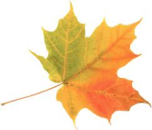
SIDIS Cherenkov Detectors
Haiyan Gao, Gary Swift, Simona Malace (Duke U.)
Zein-Eddine Meziani, Eric Fuchey (Temple U.)
SoLID Collaboration Meeting, October 14-15 2011, JLab

Slide 2
Outline
Requirements: 2 Cherenkov detectors for positive identification of electrons and pions
Design
→ Mirrors
→ Photon detector options: GEMs + CsI , PMTs
Detectors performance
→ The electron Cherenkov: collection efficiency and signal
→ The pion Cherenkov: work in progress

Slide 3
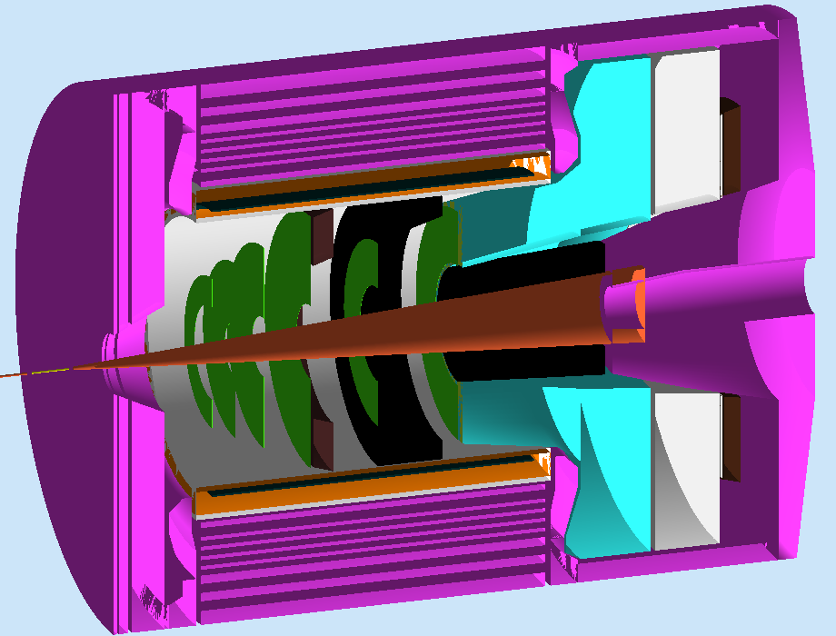
Requirements
electron-pion separation
Threshold Cherenkov:
pion-kaon/proton separation
SIDIS electron Cherenkov: 1.5 – 4.5 GeV
positive identification of electrons
don’t care about performance below 1.5 GeV
CO₂, CF₄ would work as radiator
gas length available: ~ 2 m (kinematics dependent)
SIDIS pion Cherenkov: 2.5 – 7.5 GeV
positive identification of pions
C₄F₈O at 1.5 atm would work as radiator
gas length available: ~ 0.9 m (kinematics dependent)
2π coverage (SIDIS)
Perform in non-negligible magnetic field environment
Simple design: cost effective, easy to install, operate

Slide 4
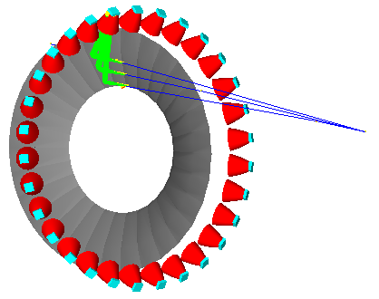
Optics: Spherical Mirrors
Purpose: focus on small size photon detectors + ensure good 2π coverage
How we “make” them: using the “small spread around the central ray” approximation
Input: x_{i} (central ray) and x_{r} (the photon detector coordinates)
Output: radius of sphere (mirror curvature) and position of its center
The mirror size is defined by the polar angular acceptance that needs to be covered and number of sectors (30)*
Cone section with size defined by the min and max polar angles intersects sphere of radius R to cut out one of the 30 spherical mirrors
*SIDIS doesn’t need sectoring but PVDIS does

Slide 5
Photon Detectors
GEMs + CsI (used by PHENIX)
→ Insensitive to magnetic field
→ CsI: sensitive to deep UV light, high quantum efficiency (up to 60-70% at 110 nm)
Pure gas transparent to UV light
We need:
Mirrors with good reflectivity in deep UV
PMTs
→ Sensitive to magnetic field
→ Photocathodes typically sensitive to visible light mostly
Resistant in SoLID magnetic field
We need PMTs:
Suitable for tilling
H8500C-03
Other: we ‘ll keep looking

Slide 6
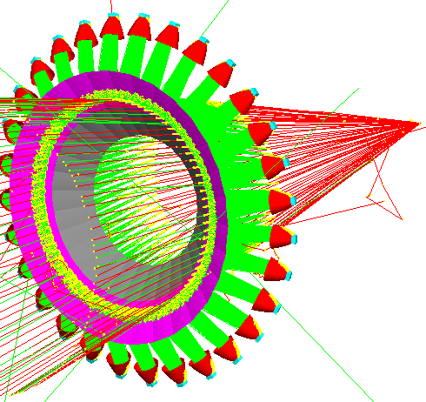
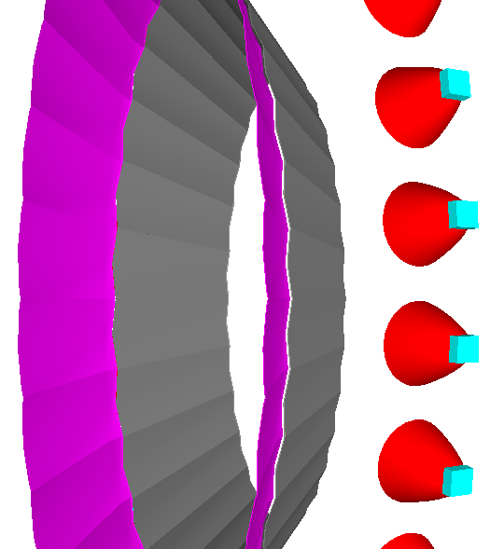
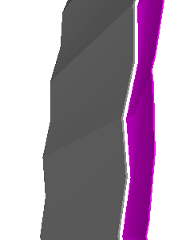
The Electron Cherenkov (PMTs): Design
Radiator: CO₂
Mirror: 30 spherical mirrors in 2 parts each* → 2 rings of mirrors: inner and outer
Photon detector: now 4 2” H8500C-03 per sector in 2 by 2 arrays
Winston cones
*mirror splitting for manufacturing & coating purposes (see Eric’s talk)
→ benefit: make each part of different curvature; went from 9 to 4 PMTs per sector (saves cost: 1 PMT = $3000)
4”
4”
→ “exciting opportunity”: make them of light and rigid material to remove the need for double edge support
No impact on physics phase space

Slide 7
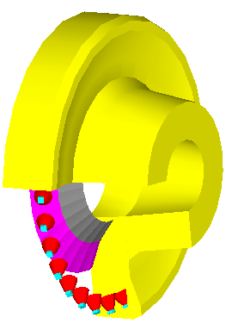
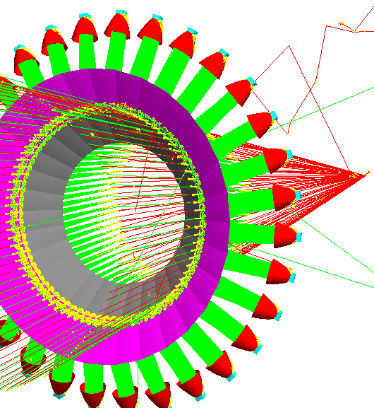
Cherenkov Mirrors: Material & Support
Mirrors: light & rigid material so no double-edge support would be needed
12 deg: cone of photons reflect on both mirrors (boundary)
support
no support
Options: glass-coated beryllium technology & carbon fiber technology
Both extensively studied/tested at CERN for the RICH LHCb
(the carbon fiber was chosen: delivery time and cost)

Slide 8
Cherenkov Mirrors: Material & Support
Mirrors: glass-coated beryllium
Prototype for LHCb
Nuclear Instruments and Methods in Physics Research A 595 (2008) 197–199
0.4 m x 0.6 m
R = 2.7 m
Advantages: radiation hard, fluorocarbon compatibility, non-magnetic, light-weight, good rigidity
3 mm beryllium
0.5 mm glass
Without glass (+ Al) coating, poor reflectivity in visible and UV: 50%;
with glass (+ Al) coating: 90% for λ > 200 nm
LHCb prototype (made in Russia): central point support on the beryllium rim (single bolt) → maximum deflection of the mirror due to gravity = 160μm
Disadvantages: high manufacturing costs + high toxicity (requires special safety measures during manufacturing and handling)
20 mm thick beryllium rim at one edge to support it

Slide 9
Cherenkov Mirrors: Material & Support
Mirrors: carbon fiber reinforced polymer (CFRP)
LHCb mirrors
70% carbon-fiber (reinforcement material) + 30% resin (binds the fibers together)
Nuclear Instruments and Methods in Physics Research A 593 (2008) 624– 637
Advantages: same as glass-coated beryllium + considerably cheaper, with no safety implications
LHCb mirrors (made by CMA, US):
sandwich honeycomb structure: two outer CFRP layers (1.5 mm) + core cells in-between as reinforcement
reflectivity with Al + MgF₂ coating: ~90% for λ > 200 nm
May be a good choice for SoLID Cherenkovs
We need to:
Find best way of supporting CFRP mirrors (Gary)
Ask CMA (for example) for a quote
get good reflectivity below 200 nm as well
0.835 m x 0.64 m
33 mm thick
R = 2.7 m

Slide 10
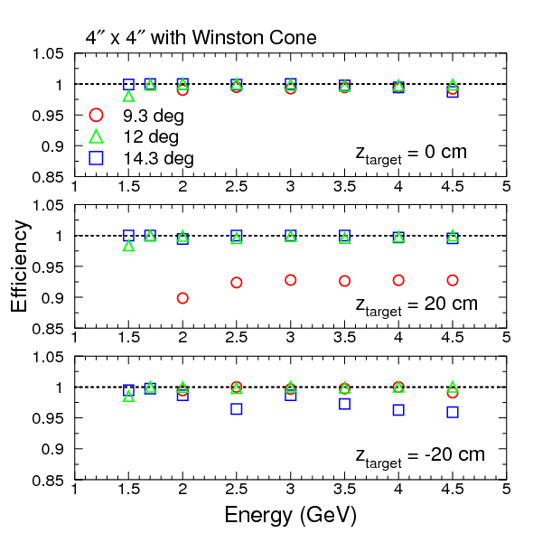
The Electron Cherenkov (PMTs): Collection Efficiency
Good collection efficiency with 4 PMTs per sector + no support between the 2 mirror rings
12 deg
Over 98% regardless of the kinematics
Over 98% at most kinematics; ~90% at the lowest polar angle
Over 98% at most kinematics; over 95% at the highest polar angle

Slide 11
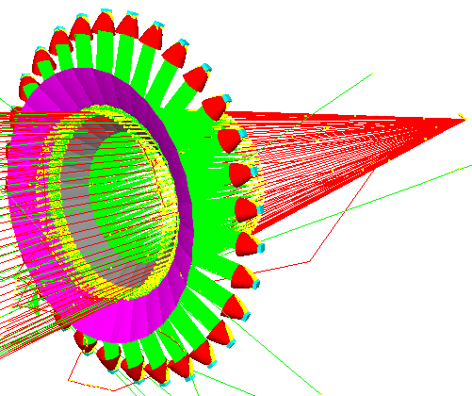
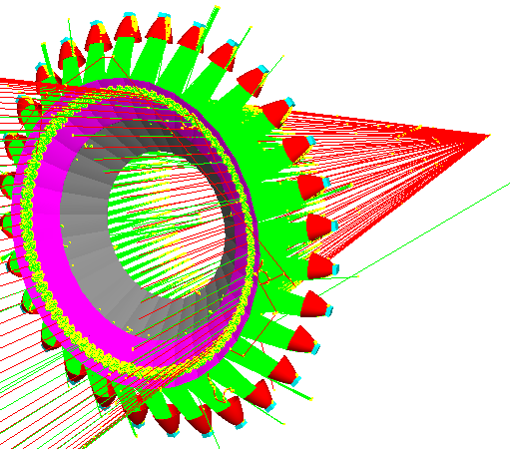
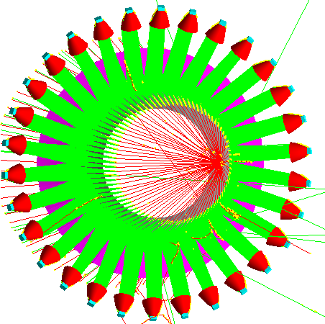
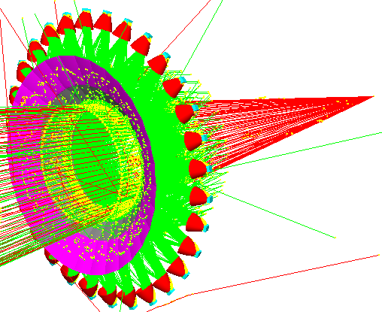
The Electron Cherenkov (PMTs): Focusing
Examples
2 ways of loosing light

Slide 12
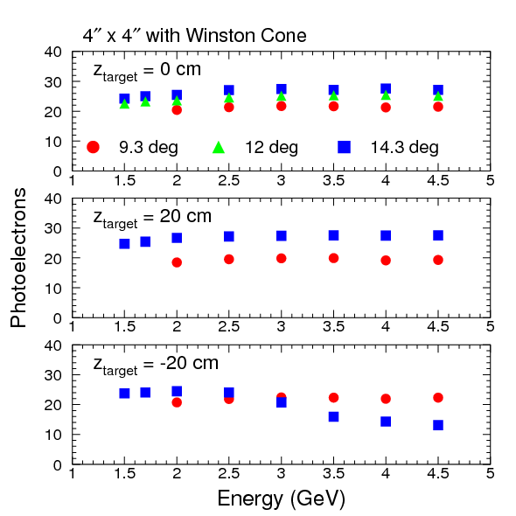
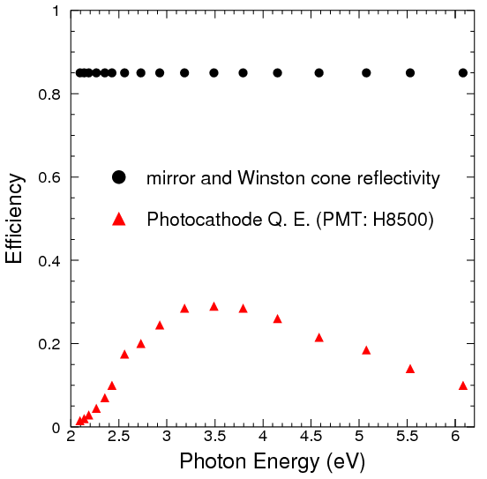
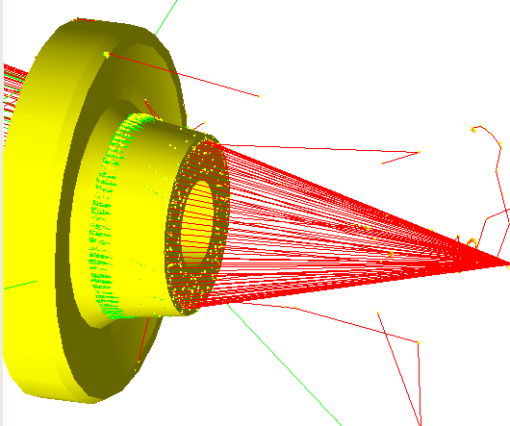
The Electron Cherenkov (PMTs): Signal
Estimates include:
wavelength dependent corrections (Q.E. of H8500C-03 + mirror/Winston cone reflectivity)
effect of PMT window (Eric implemented that)
tile
additional overall reduction of 0.7
(accounts for dead zone that result from tiling +…)

Slide 13
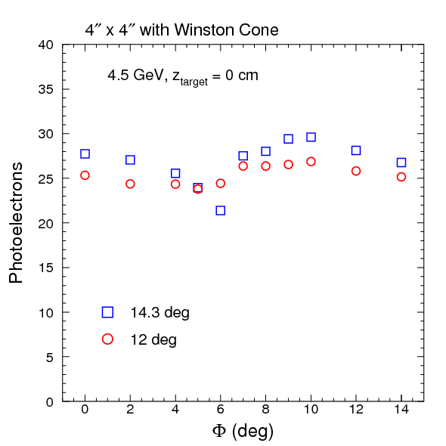
The Electron Cherenkov (PMTs): Performance vs. Φ
Fairly small effect at the “edge” of angular acceptance
click me
12 deg
click me
14.3 deg

Slide 14
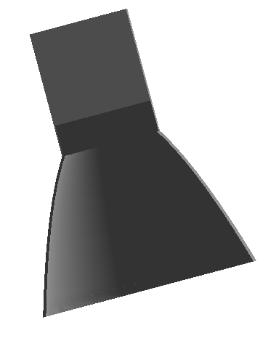
H8500C-03 in SoLID Magnetic Field
From H8500C field tests at Temple U.
at 20 G (longitudinal field): < 10% signal loss
at 70 G: 30%
Request sent to Amuneal for “ideal” shield which will incorporate the Winston cones
longitudinal component of the magnetic field from 150 G to < 20 G
transverse component of the magnetic field from 70 G to 0 G
Dark area inside the shield = PMT array location
Estimates based on BaBar v4 field map
Ideal
could be higher though
(< 50 G)
Amuneal:
possible with a 2 layer shield
Winston cone substantially more expensive than straight cone ($1350 per cone)
→ inner: Amumetal 0.04”
→ outer: 1008 carbon steel 1/8”
→ mylar in between 0.062”
Need to check with simulation if we could use straight cones

Slide 15
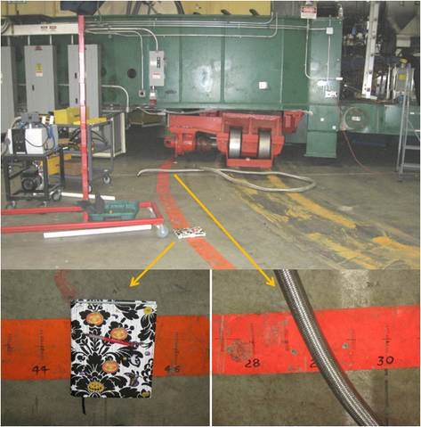
H8500C-03: Tentative Plan for Test in Hall A
Background on PMT window of concern
sum over all anodes would be fine but we could also take advantage of the pixeling and use coincidence between pixels to “cut” background
would like to test this approach during g₂^{p}
Place the PMT in a dark box with some shielding somewhere between 29 and 45 deg

Slide 16
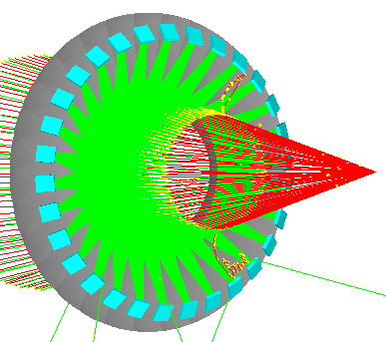
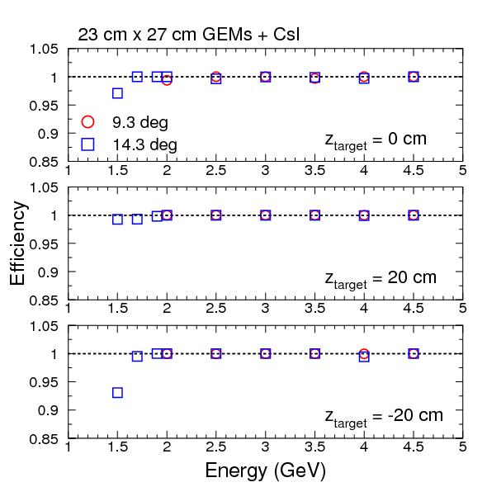
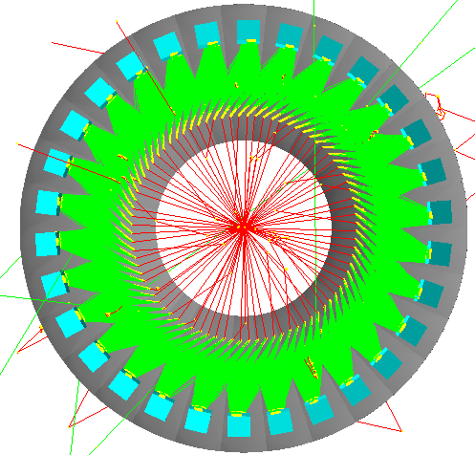
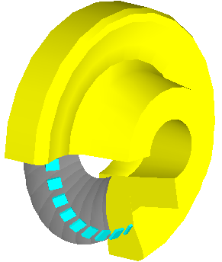
The Electron Cherenkov (GEMs+CsI): Design
Very similar configuration possible for SIDIS and PVDIS
same tank except for additional piece for SIDIS
same mirrors, mounted at the same location
same GEMs + CsI, mounted at different locations
same gas: CF₄
23 cm X 27 cm
(PHENIX size)
Not cost efficient to make mirrors of different curvatures
14.3 deg, z_{target} = -20 cm, p = 1.5 GeV

Slide 17
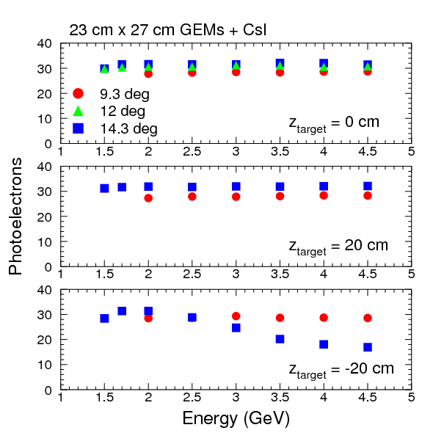
The Electron Cherenkov (GEMs+CsI): Signal
Takes into account wavelength dependent corrections (mirrors reflectivity, gas absoption, Q.E. of CsI)
+
an additional multiplicative correction of 0.5 – the PHENIX factor - (optical transparency of mesh and photocathode, radiator gas transparency, transport efficiency etc.)

Slide 18
The Electron Cherenkov (GEMs+CsI): CsI Q.E.
Wavelength-dependent corrections: CsI Q.E. + gas transparency
arXiv:1103.4277v1
B. Azmoun et al., IEEE TRANSACTIONS ON NUCLEAR SCIENCE, VOL. 56, NO. 3, JUNE 2009
Used in our simulation
PHENIX
65%
48%
38%
45%
We stop here

Slide 19
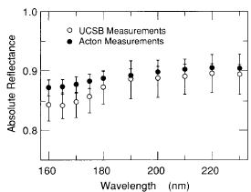
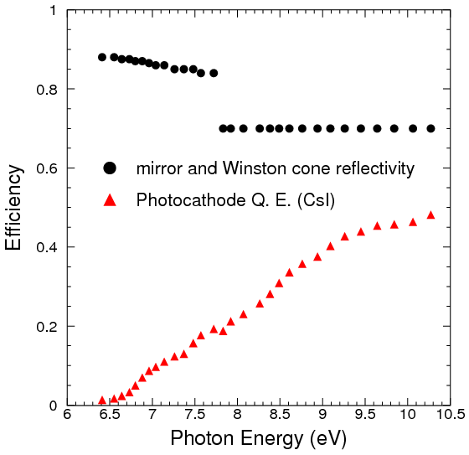
The Electron Cherenkov (GEMs+CsI): Mirror Reflectivity in far UV
Wavelength-dependent corrections: mirror reflectivity
Used in simulation
NIM A300 (1991) 501-510
1971 / Vol. 10, No. 3 / APPLIED OPTICS

Slide 20
Mirrors Reflectivity in far UV
Depends on angle of incidence and thickness of protective layer
Depends on protective layer material
We DO need to test a prototype with mirror, CF₄ and GEM+CsI (see Eric’s talk)

Slide 21
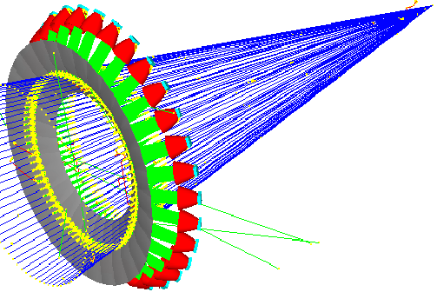
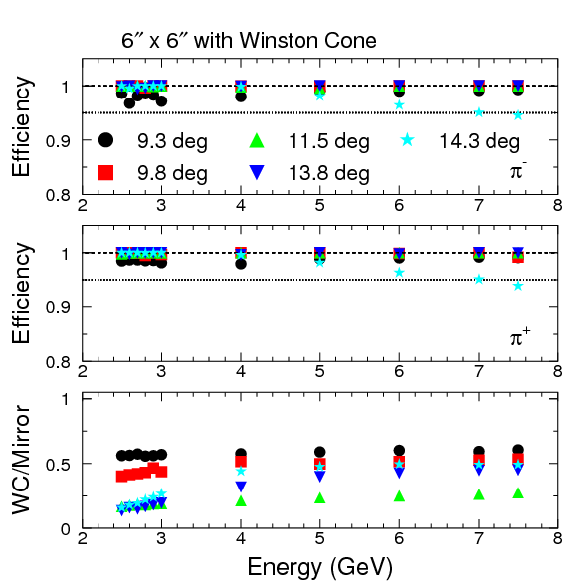
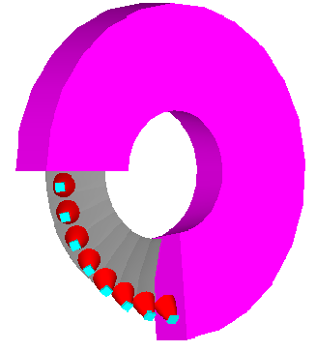
The Pion Cherenkov (PMTs): Design
Similar design as for electron Cherenkov, the PMT option
gas: C₄F₈O
→ Before we knew we have to split the mirrors: very good collection efficiency with one mirror and 9 2” PMTs per sector

Slide 22
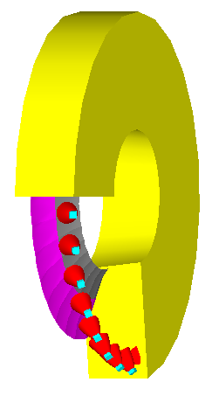
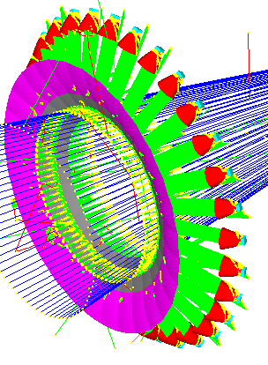
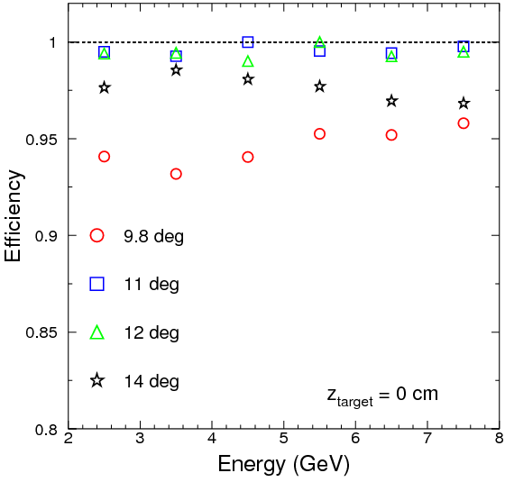
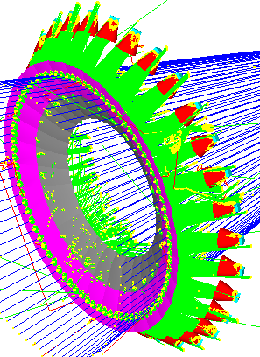
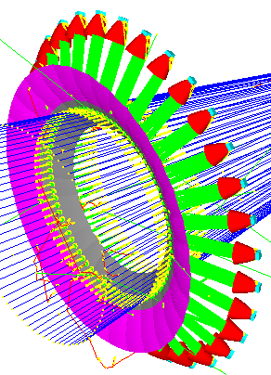
The Pion Cherenkov (PMTs): Design
Similar design as for electron Cherenkov, the PMT option
gas: C₄F₈O
→ We split the mirrors (different curvature) + went to 4 PMTs per sector
Work in progress

Slide 23
Summary
Simulation and design: iterate!
→ “finalize” the Cherenkovs design
→ switch to CLEO when available and re-optimize
→ migrate to GEMC
→ …
Tests:
→ test H8500C-03 during g₂^{p}
→ test GEMs + CsI prototype during g₂^{p}: see next talk for details
→ …

