Slide 1
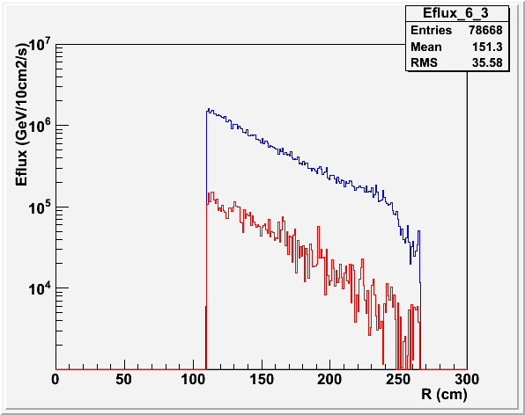
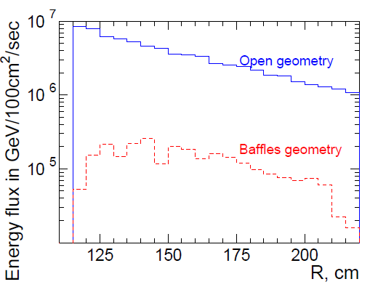
PVDIS EM Background (on EC) red with Baffle, black without Baffle
Baffle has factor 50 reduction for Geant3, but only factor 12 reduction for Gean4. Still looking into this.
Geant4
Geant3

