Slide 1
SoLID EC Design
Xiaochao Zheng(UVa)
Mehdi Meziane (Duke), Jin Huang (LANL),
Zhiwen Zhao (UVa), Paul Reimer (ANL),
Nuclear Physics Group (W&M)
SoLID Jlab Physics Division
Brainstorming Session
2012/01/06

Slide 2
Outline
Requirement
Todo List
Design Progress
Choosing Shashlyk
Preshower/shower
Fiber connection
Beam test plan
Background Simulation
Our Design

Slide 3
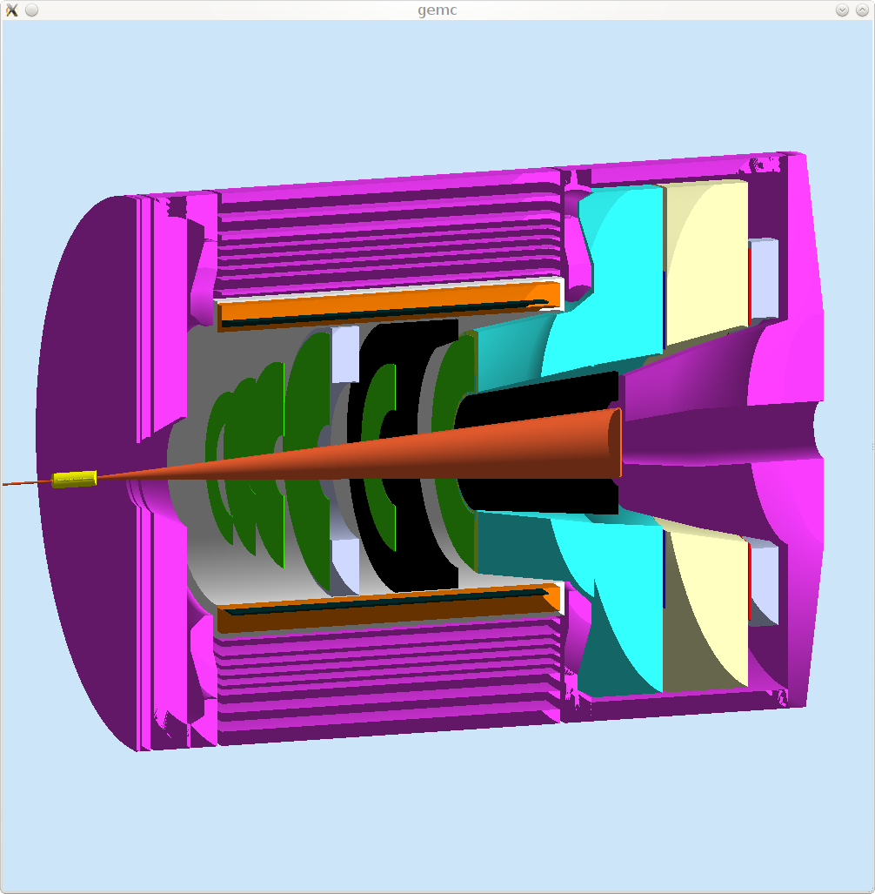
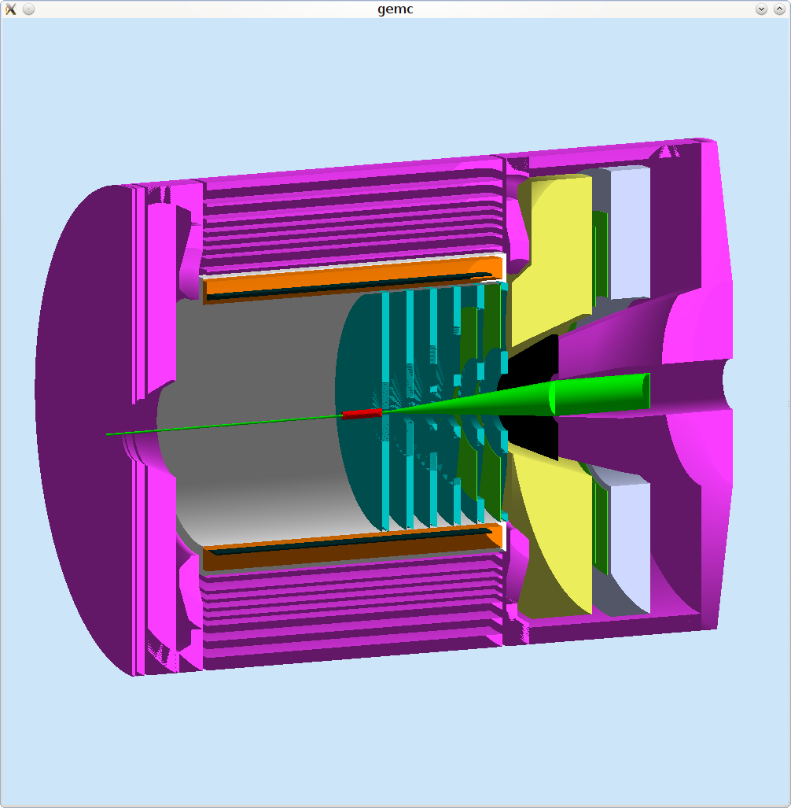
EC Configuration
PVDIS forward angle
SIDIS forward angle
SIDIS large angle

Slide 4
Physics Requirement
Electron-hadron separation
100:1 pion rejection in electron sample
Energy resolution: σ(E)/E ~ 5%/√E
Provide shower Position
σ ~ 1 cm, for tracking initial seed / suppress background
Time response
σ <~ few hundreds ps
provide trigger/identify beam bunch (TOF PID)
Radiation resistant
PVDIS forward angle
EM <=2k GeV/cm²/s + pion (GeV/cm²/s), total ~<60 krad/year
SIDIS forward angle
EM <=5k GeV/cm²/s + pion , total, total ~<100 krad/year
SIDIS large angle
EM <=20k GeV/cm²/s + pion, total, total ~<400 krad/year
Notes:
Back up slides pion/electron rate

Slide 5
Other Requirement
The Layout need to satisfy 2-fold rotation symmetry for SIDIS.
Modules can be easily swapped and rearranged for different configuration.
Photonsensors located outside of magnet yoke, fiber connection is one solution.
A reasonable cost, strongly affected by the number of modules/channels, to cover the same acceptance area, we need the module transverse size not too small.
Notes:
Back up slides pion/electron rate

Slide 6
Choosing EC Type
PVDIS and SIDIS radiation level (400krad per year) is too high for lead glass and crystals (1krad), both Shashlyk or SPACAL/SciFi (0.5-1M rad) will work.
Both Shashlyk and SciFi have good energy, position and time resolution.
SciFi costs more
SciFi needs about half volume being scintillation fibers for good energy resolution.
1mm diameter fibers cost $1/m.
Forward angle EC (10m² area, 0.4m depth), Large angle EC (5m² area, 0.4m depth)
SciFi , total $4M for the fiber alone.
Shashlyk , total from $1.5M to $2.2M for produced modules of 10x10cm from IHEP.

Slide 7
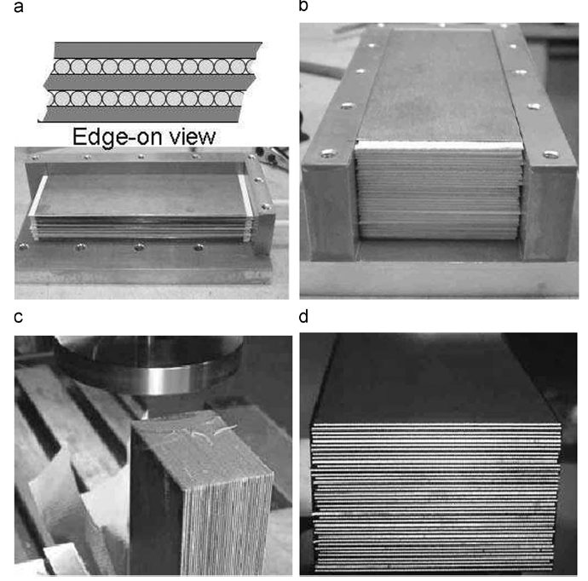
Choosing EC design
Scifi/Fe combined with flux return
- Simulation shows feasibility.
- Need significant R&D effort.
Scifi/Pb standalone
10M of scintillation fibers,connect
to outside for readout by light guide.
Shashlyk standalone
Mature production at IHEP@Russia
150k of WLS fibers,connect to
outside for readout by light guide
or fiber connection.
PMT in >10 G
Calorimeter

Slide 8
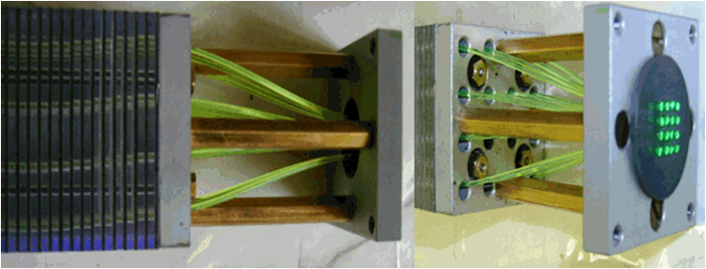
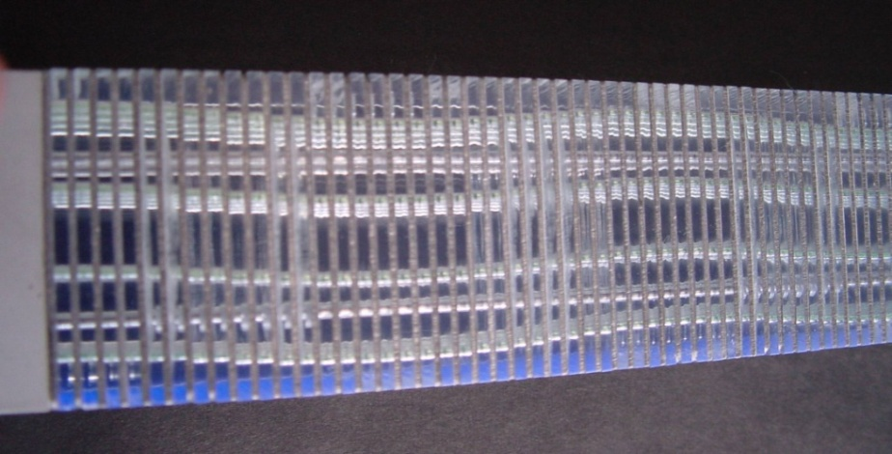
Best option: Shashlyk Calorimeter
IHEP, COMPASS Shashlik, 2010
Shashlyk calorimeter
Lead-scintillator sampling calorimeter
WLS Fiber collects and reads out light
Satisfy the SoLID requirement
Good energy resolution (tunable)
transverse size can be customized
Radiation hardness ~ 500kRad (improvable)
Easier to collect and read out the light
Well developed technology, used by many experiments
IHEP production rate about 200 per month

Slide 9
Basics Features of Preliminary Design
Based on COMPASS Shashlyk module.
0.6mm lead/1.5mm scintillator, 200 layers, 42cm in length (20 X₀)
Balance between longitudinal size and pion rejection
~100:1 pion rejection
10x10cm of transverse size in square shape
Balance between cost and resolution/background
1000 modules for forward angle EC, 500 modules for large angle EC
Splitting : ~4 X₀ for preshower and ~16 X₀ for shower
Maximizing e-pi separation
MIP energy deposition: ~60MeV (preshower)/300 MeV (TotalShower)
~100 WLS fibers/module (KURARAY Y11)
Same fiber density (1/cm²) to sample the EM shower

Slide 10
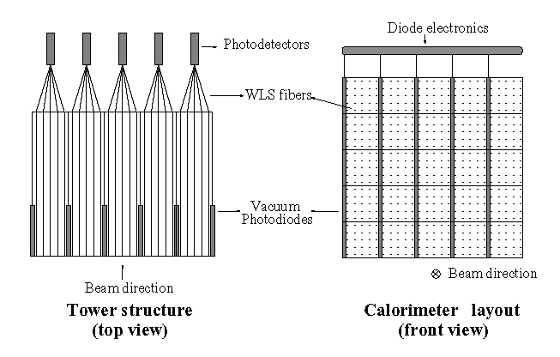
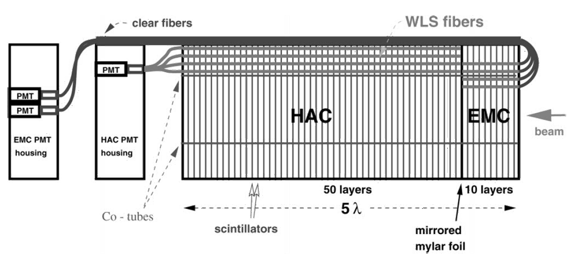
Preshower/shower
Preshower-shower separation for better electron PID
4 RL as preshower, 16 RL as shower
Readout option 1, separate readout
Run preshower fiber through shower part with light-protection
Run preshower fiber (separately) to outside magnetic field
Curve fiber from front, ZEUS example below
Readout preshower by photodiode, example on right.

Slide 11
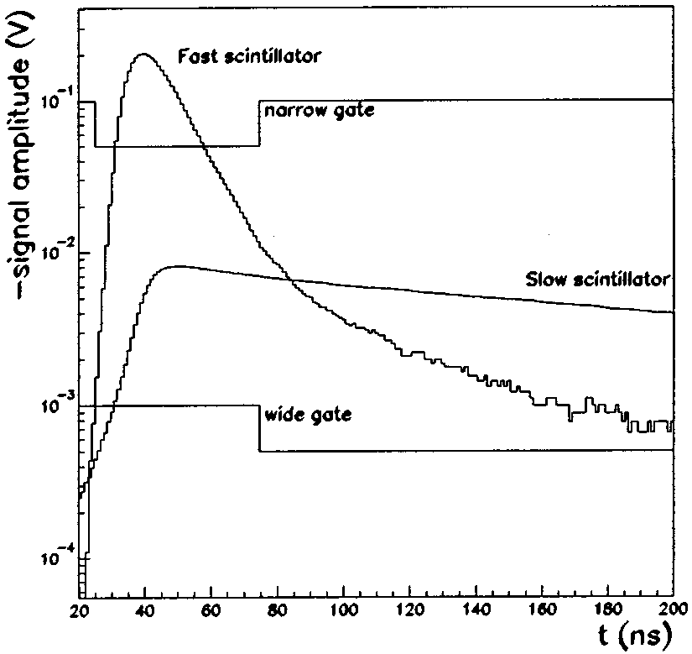
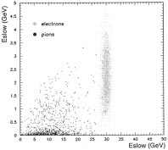
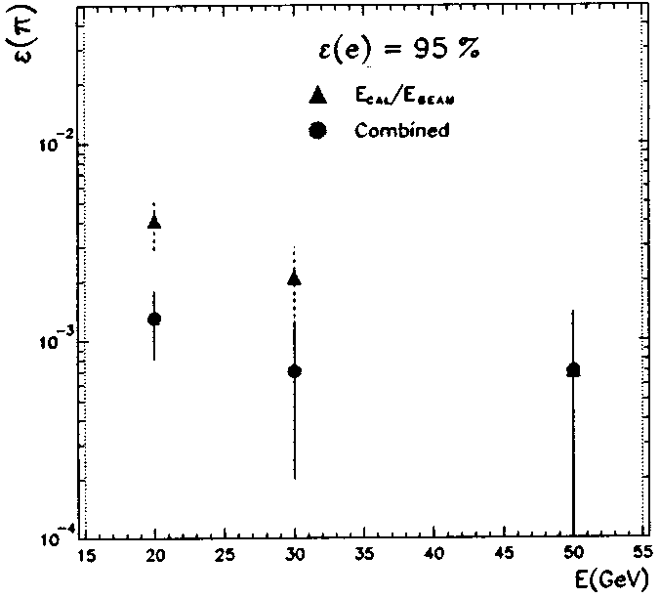
Preshower/shower
Readout option 2, same readout
slow response scintillator for preshower and fast scintillator for shower.
Use flashADC (4us) to fit line shape, could shorten the required time.
Simple design and production, half number of fibers to connect, half number of channels for readout.
High pion background may affect PID. SIDIS largeangle EC have low pion background
CALEIDO has successfully built and tested prototype with traditional ADC

Slide 12
Calorimeter Design: Fibers
Fibers:
Wave Length Shifting fibers (WLS):
KURARAY Y11
Clear Fibers:
KURARAY clear PS, Super Eska…,
Connectors
One to one WLS/clear fiber connector, used in previous experiments (LHCb, Minos,…) light loss studies and design well documented
Lucite rod to couple the fibers option would reduce the cost, no information about the light loss
Fiber bunch diameter for one module 100 mm
For 1500 modules, min. length of WLS: 150 km!
Clear fiber length depends on the readout option ~500km?
Ongoing work: study of the fiber bundling design

Slide 13
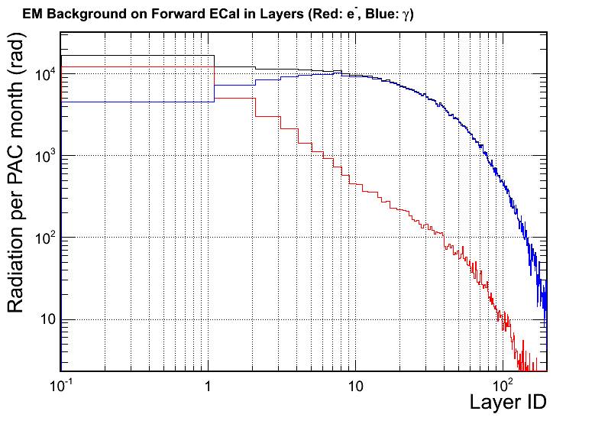
Background Simulation
The first 10 layers of scintillator have most of the radiation dose. Dominated by γ.
Not much safety margin to radiation limit for some scintillator.
Need to use radiation hard material.
Can add a front shielding of 1~2mm lead (equivalent to 2~3 layers) to reduce the radiation in the first few layers.
GEMC background model is being improved.

Slide 14
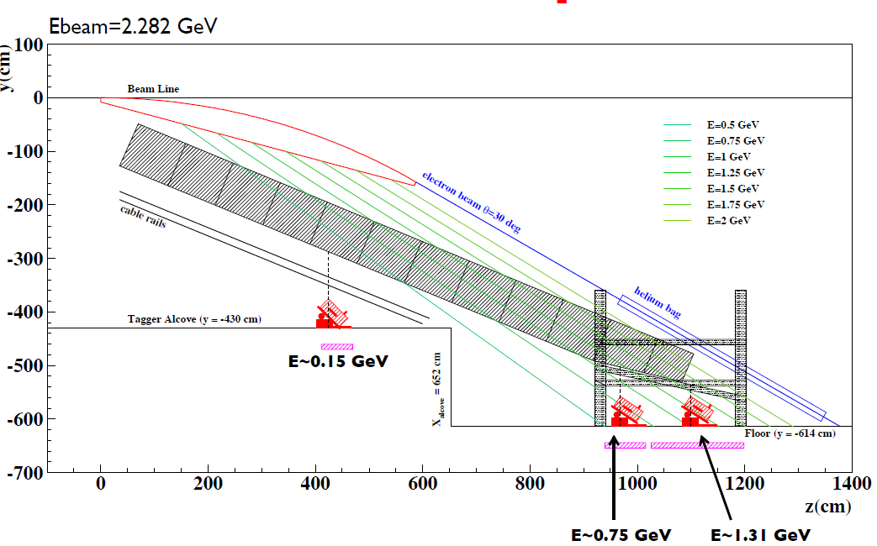
Beam test TPE caloriemeter under CLAS tagger during g14 photon run
Gain direct experience with the modules.
Test energy, position, time resolution
Study position resolution at different incoming angles.
Use test results to anchor the simulation.

Slide 15
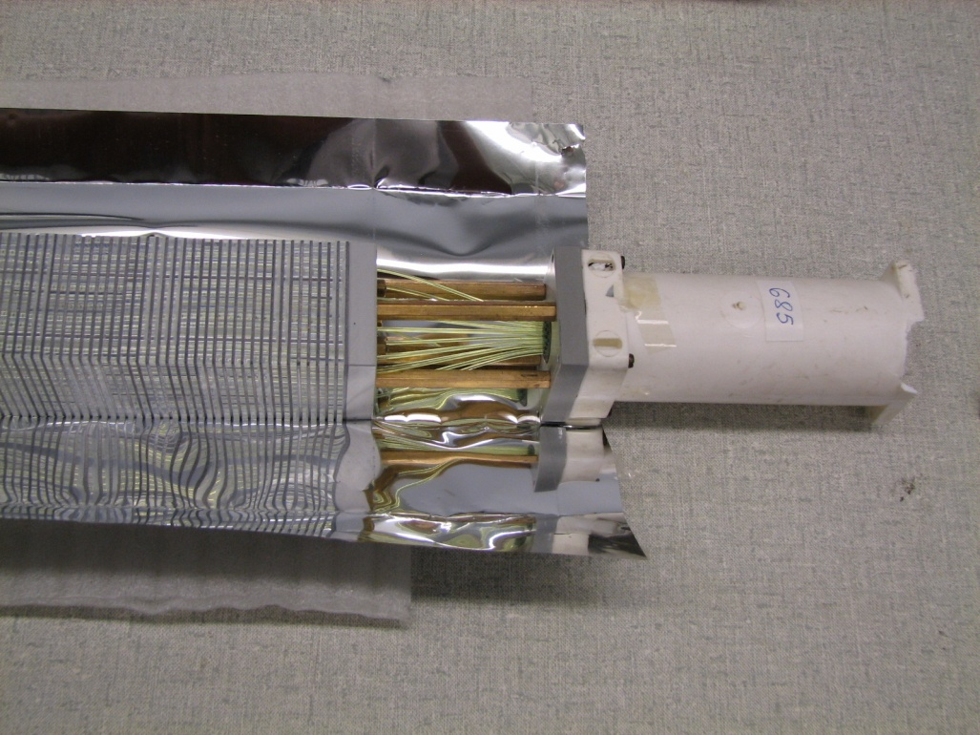
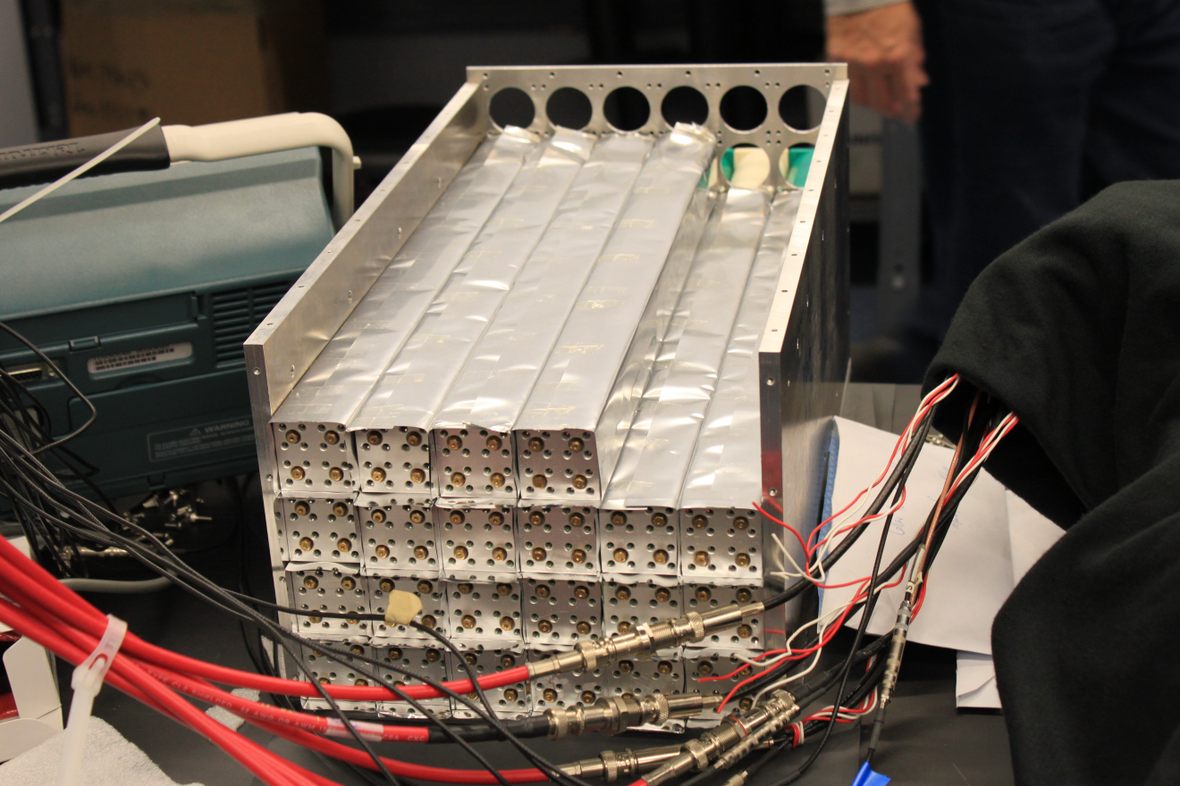
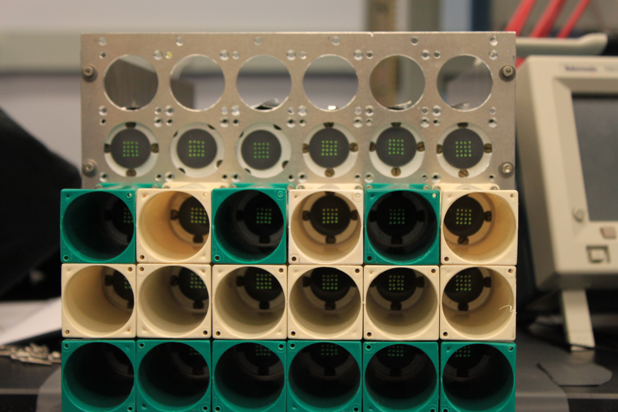
COMPASS modules used for TPE@CLAS

Slide 16
Todo List
Beam test COMPASS modules
Fine tuning simulation
Prototyping module with preshower/shower and further test
Further background study
Fibers attenuation length and radiation hardness study
Fiber connection study
layout and engineering

Slide 17
Backup

Slide 19
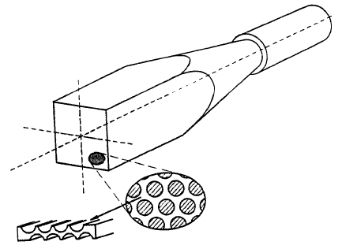
Calorimeter in Solenoid Flux Return
Open Questions:
What does magnetic field do the shower?
My guess is that charged particles in the EM shower will curl up causing the shower to become shorter and wider
How does magnetic field affect resolution in Energy and in space? Is this a strong function of field strength or direction?
What resolution do we need? [Pb:SciFi at ~1:1 gives 4.5%/sqrt(E)]
Is Iron dense enough?
How does the fiber affect the Magnetic flux return?
My guess is that we use and “effective” μ which is about half that of Fe.
Require detailed MC; Have contacted D. Hertzog about simulations.
How do we cost this?
D Hertzog—driving cost is amount of fiber—Fe less dense than Pb thus need more fiber.
PMT in >10 G
Calorimeter

Slide 20
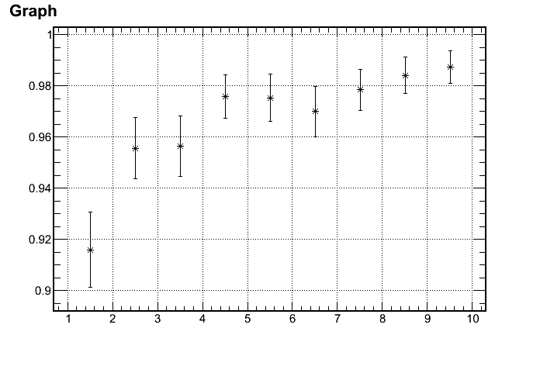
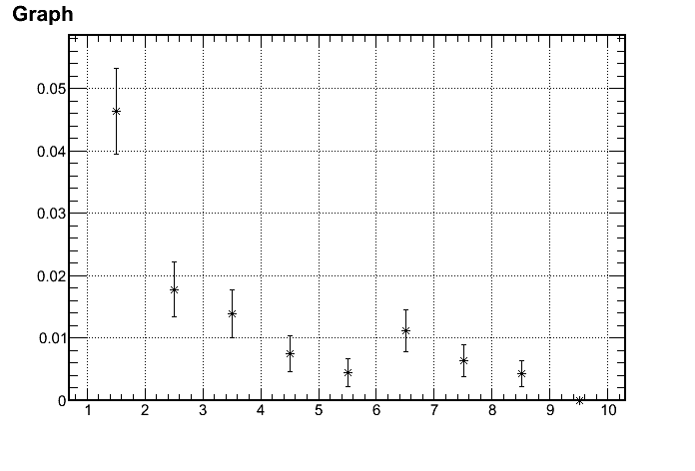
Calorimeter Design: Lead/Sci Ratio
Tuning of the ratio performed with a dedicated Geant 4 simulation.
Can reach a pion rejection factor of 100/1 with Pb thick. = 0.6 mm /layer
Electron Efficiency
1/(Pion rejection)
97%
100:1 Rejection
p (GeV)
p (GeV)
Range of interest: 3~7 GeV

Slide 21
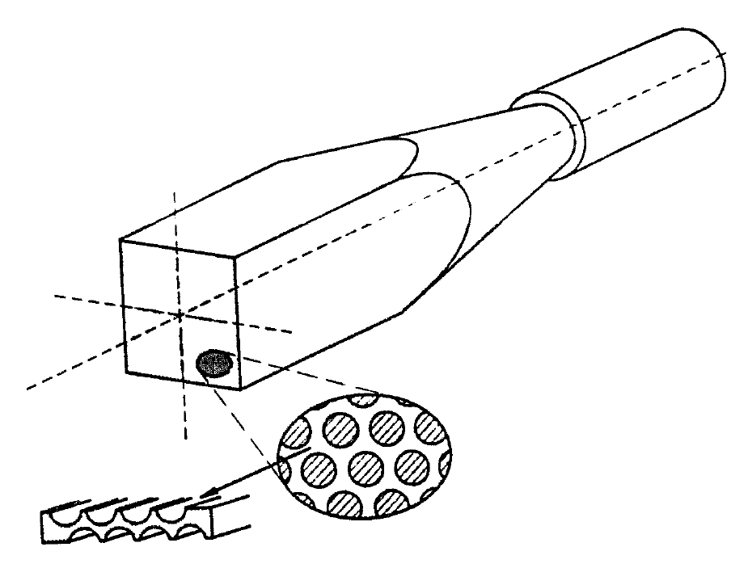
Compare of calorimeter types
Shashlik calorimeter
SciFi calorimeter – Pb
SciFi calorimeter – Fe
Combined with end cap
Typical Pb SciFi
Hertzog, NIM, 1990
Typical Shashlik
Polyakov, COMPASS Talk, 2010

Slide 22
Compare option A & B Shashlyk and SciFi-Pb
Similarity
Pb-scintillator based sampling calorimeter
Similar in resolution and radiation hardness
Both fit the need of SoLID
Choice : Shashlyk
Easier to read out light: Photon collection area 100 times smaller than SciFi
Matured production

Slide 23
Compare A & C for the forward Calo. The choice - Shashlik
Reason of choosing Shashlik over Scifi/Fe in endcup
Shashlik is cheaper.
It’s production module cost cheaper or similar to SciFi fiber cost alone.
Shashlik is more mature.
SciFi/Fe needs R&D
Shashlik is easier.
several suppliers with good experience are available.

Slide 24
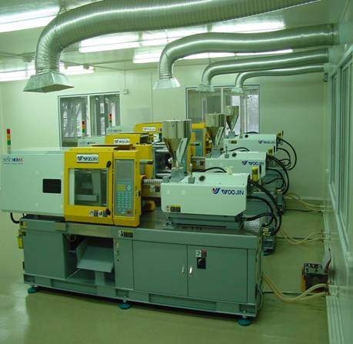
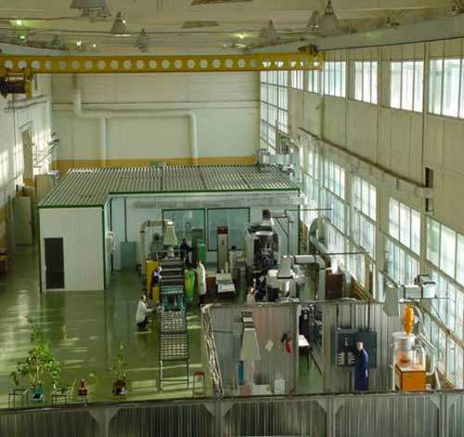
IHEP Scintillator Fasilities
www.ihep.ru/scint/index-e.htm

Slide 25
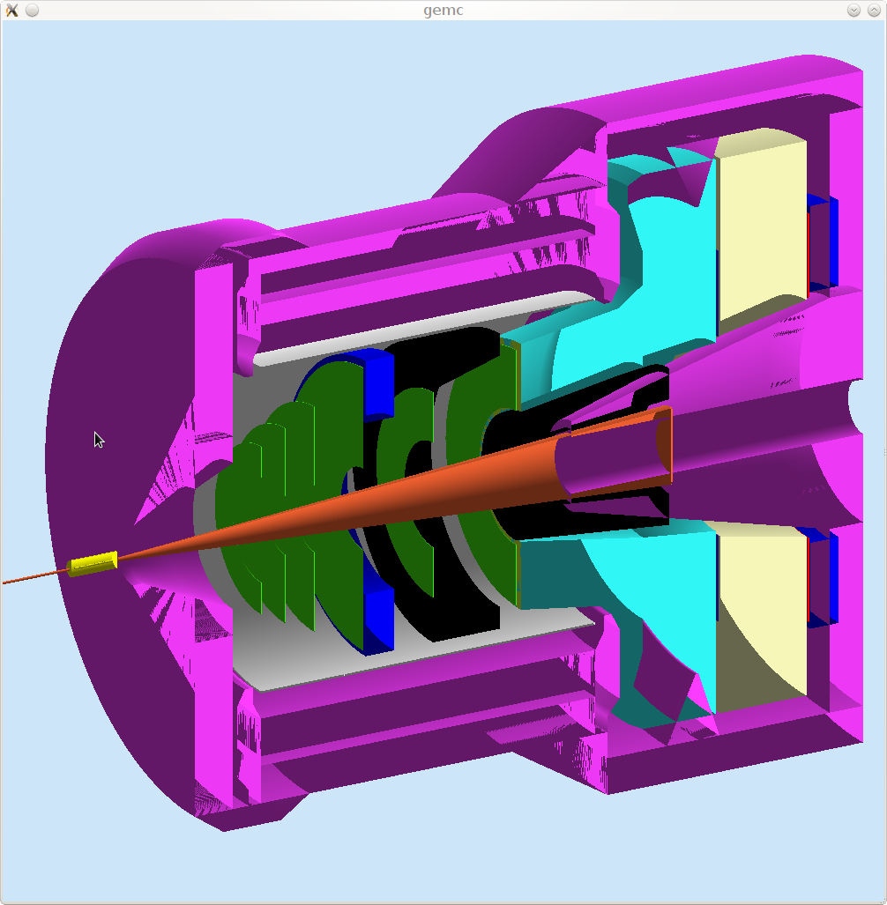
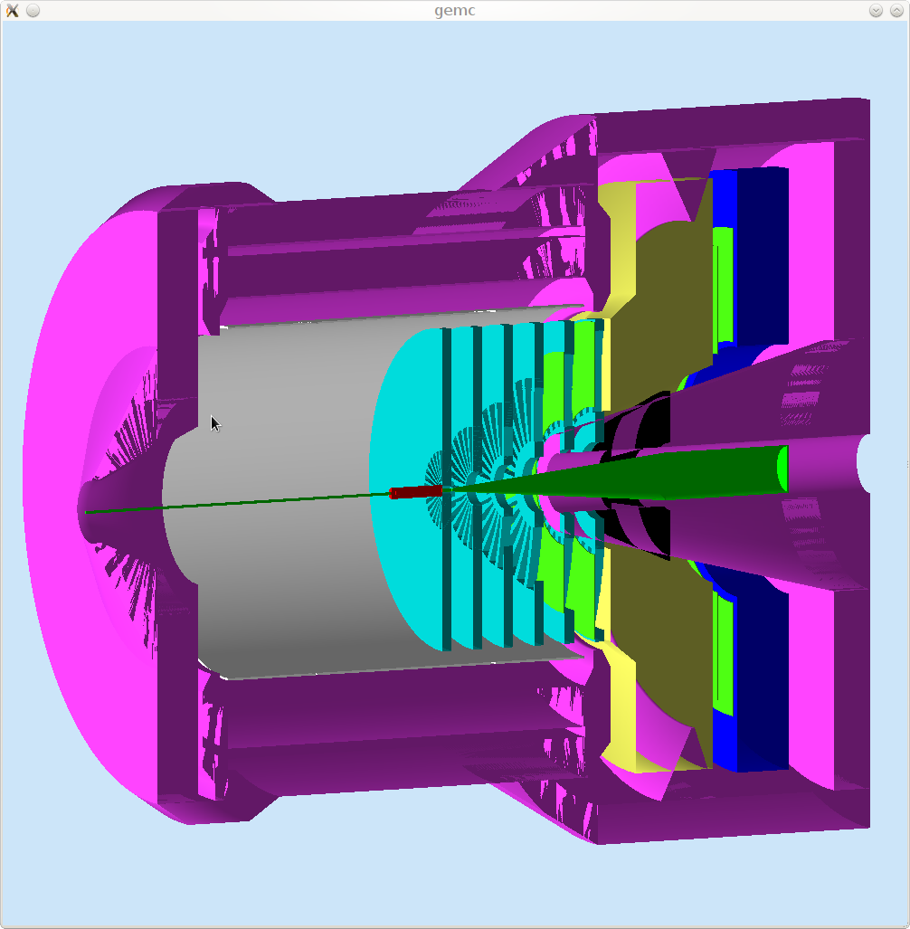
ECAL Configuration
PVDIS Forward
Angle
SIDIS Large Angle
SIDIS Forward
Angle

Slide 26
ECAL Choice
IHEP 2010 module
Lead-Scintillator Sampling Calorimeter: Shashlyk Calorimeter
Fibers collect and read out the light
Great flexibility, tunable energy resolution: ~ 6%/√E is not a problem
Good radiation Hardness: ~ 500 krad
Well developed and mature technology: used previously
in other experiments

Slide 27
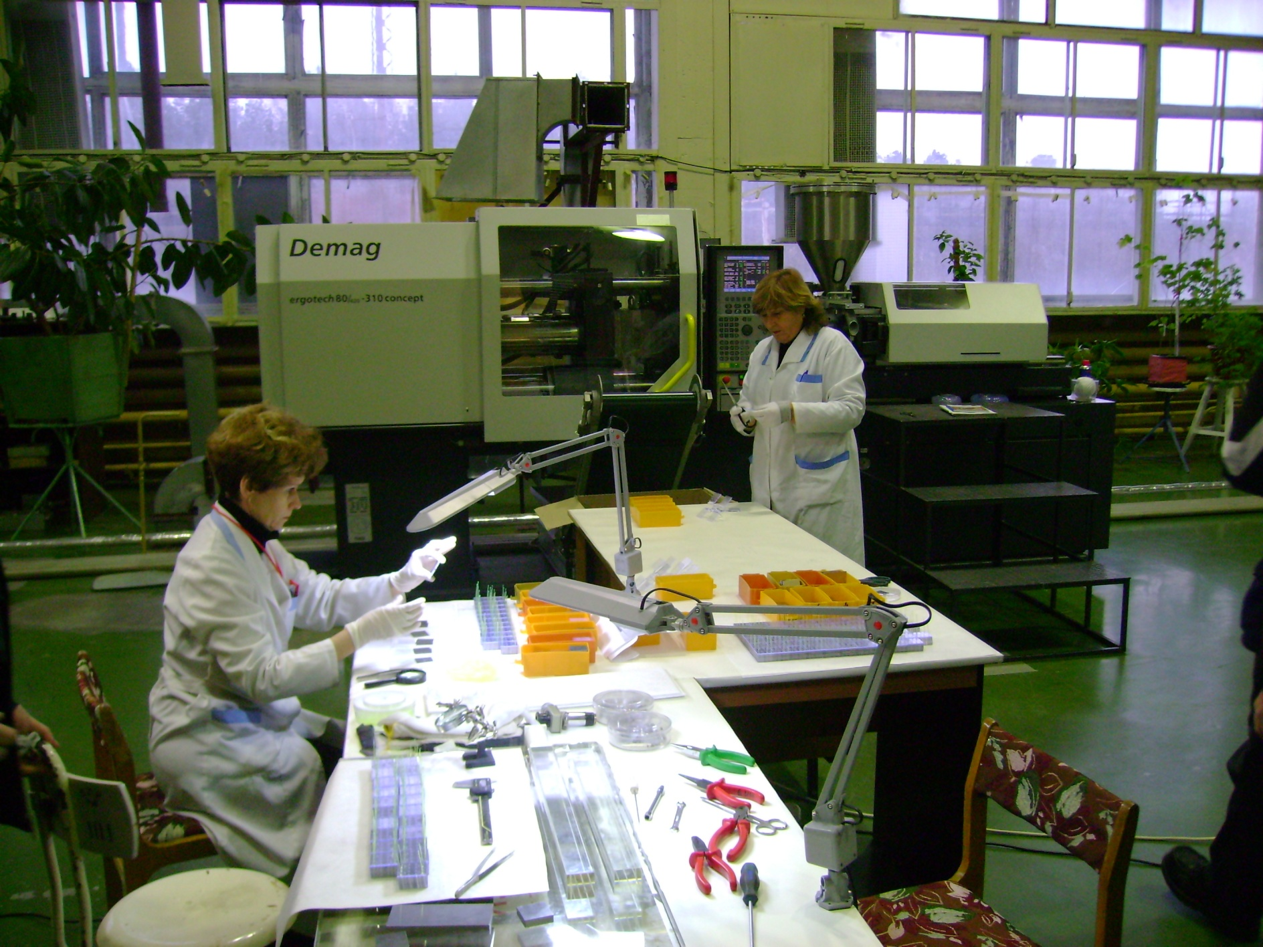
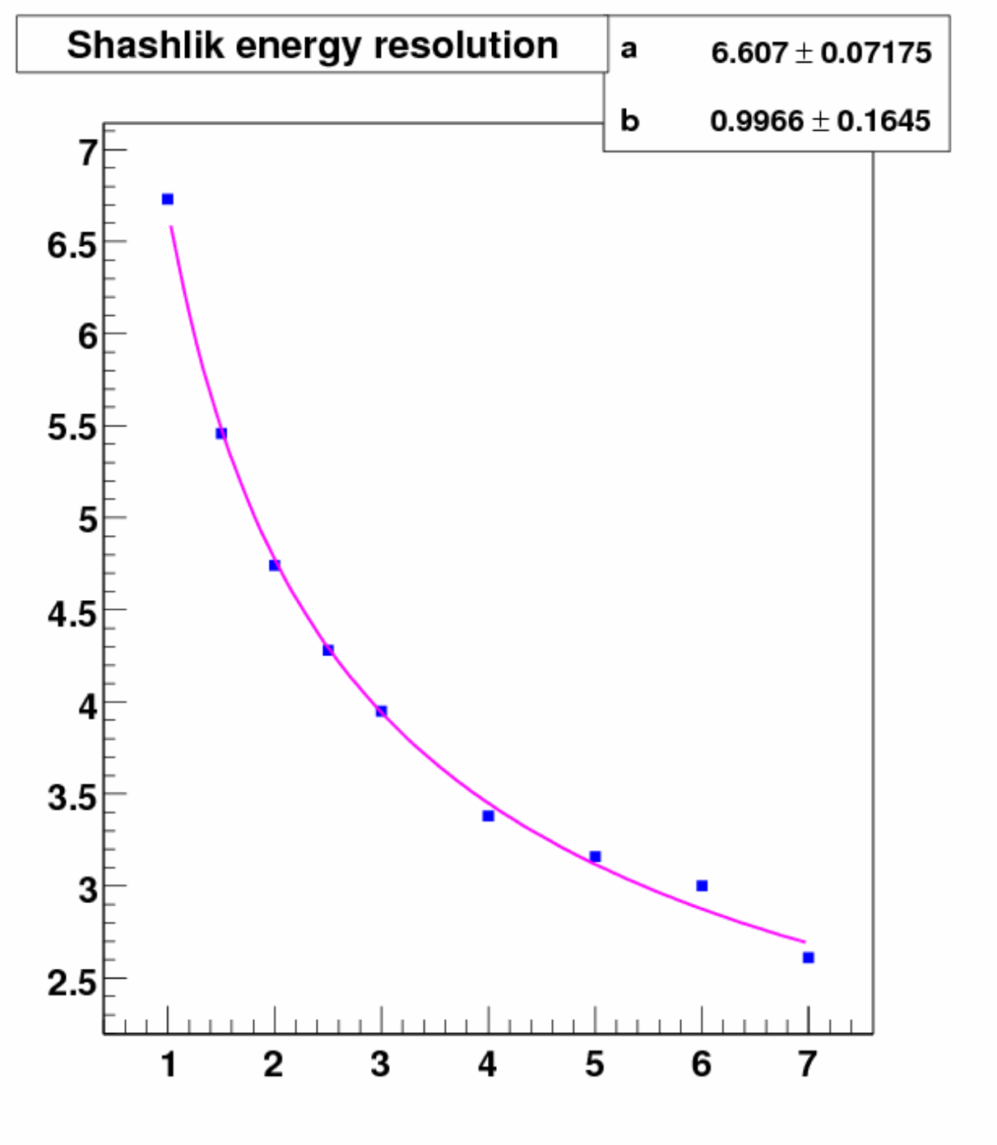
ECAL Shashlik
Dimensions 38.2x38.2 mm²
Radiation length 17.5mm
Moliere radius 36mm
Radiation thickness 22.5 X₀
Scintillator thickness 1.5mm
Lead thickness 0.8mm
Radiation hardness 500 krad
Energy resolution 6.5%/√E 1%

Slide 28
ECAL Design: Lateral Size
Good Balance
block Size (cm)

Slide 29
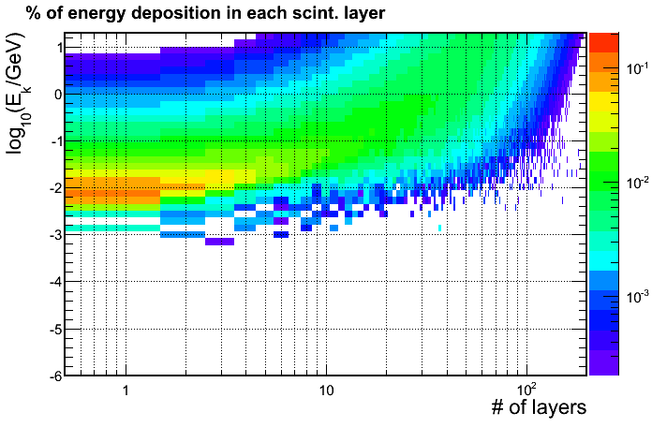
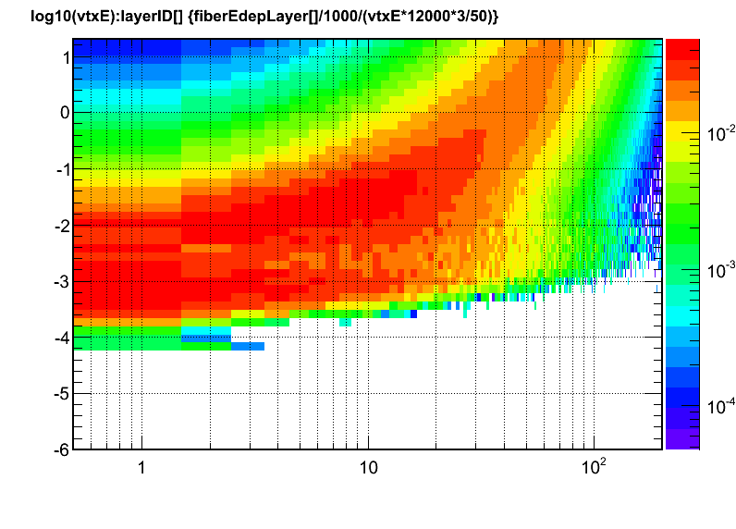
Background Simulation
The radiation dose for scintillators is 100krad~2Mrad, material dependent.
Doses on the fibers are similar to the doses on scintillator tiles (both are plastic based).
Energy deposition for e⁻
Dose = (fraction energy deposition for
each layer) *(energy flux)
(energy flux) is generated by using GEMC and Babar model.
(fraction energy deposition) is calculated using GEANT 4 simulation for each layer and different incoming particle kinematic energy.
Energy deposition for γ

Slide 30
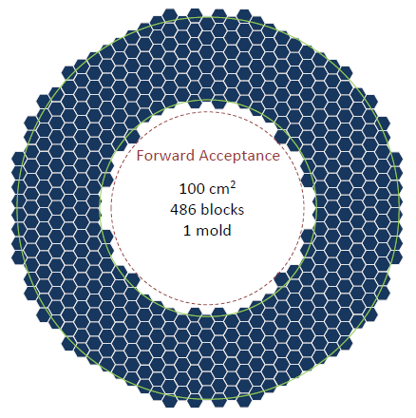
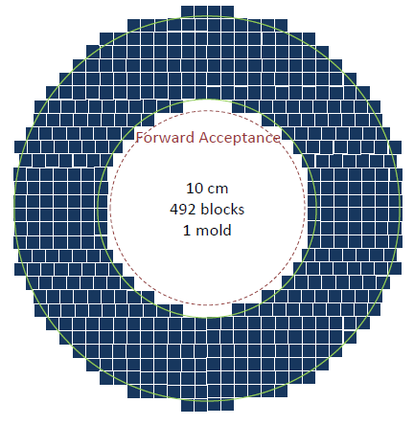
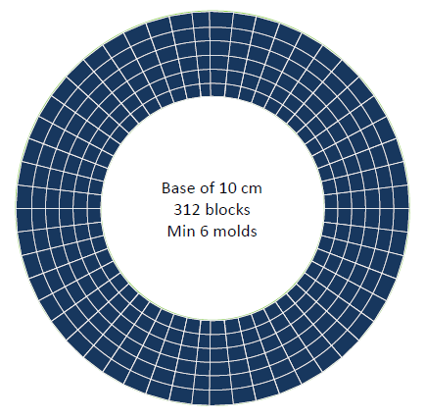
ECAL Design: Layout
Preferred Square
- Easy assembly
- Mature production
- Easier rearrangement

Slide 31
Calorimeter Design: Fibers
Fibers:
Wave Length Shifting fibers (WLS):
KURARAY Y11: - good attenuation length (3.5-4m),
- good radiation hardness : <30% loss of
light output after a 693 krad irradiation.
- Recovery: few percents after 10 days
(M.J. Varanda et al. / NIM in Phys. Res. A 453 (2000) 255}258)
Clear Fibers:
KURARAY clear PS, Super Eska…, options under study.

Slide 32
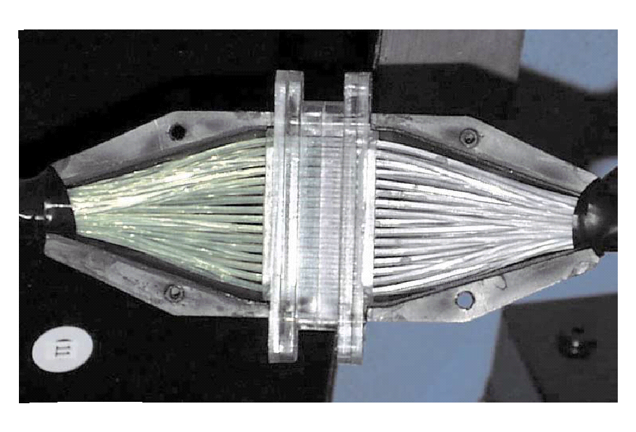
Calorimeter Design: Connectors
Option 1:
One to one WLS/clear fiber connector,
used in previous experiments (LHCb, Minos)
128-fiber connector
LHCb

Slide 33
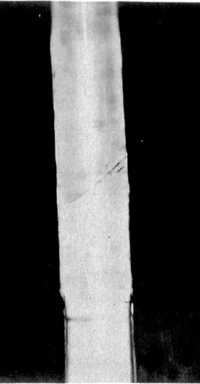
Calorimeter Design: Connectors
Option 2:
Thermal fusion: splice the WLS and clear fiber.
Giorgio Apollinari et al NIM in Phys. Research. A311 (1992) 5211-528
joint
Option 3:
Glue the WLS fibers to a lucite disk coupled to a lucite
Rod with optical grease or Si gel “cookie”.
Would reduce the cost significantly
Need more R&D to decide what is the best option.

Slide 34
https://hedberg.web.cern.ch/hedberg/home/caleido/caleido.html

Slide 35
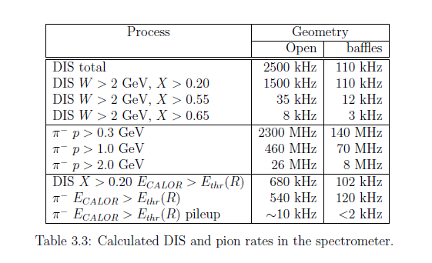
PVDIS rate

Slide 36
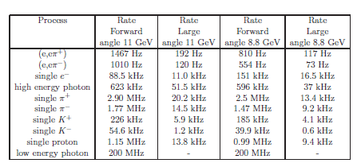
SIDIS rate

