Slide 1
SoLID Simulation
Zhiwen Zhao (UVa)
SoLID Jlab Physics Division
Brainstorming Session
2012/01/06

Slide 2
Outline
History
SoLID GEMC simulation framework
Simulation study
Choosing Magnet
PVDIS Baffle Design
EM background
Neutron background
Summary

Slide 3
History
Comgeant, Geant3 based simulation program.
geometry/sensitivity/digitization/field as input files and detached from main code, run different settings without recompilation.
Successfully used for PVDIS and SIDIS proposals.
As Geant3 development has stopped, we want to move on from Geant3, Fortran based framework to Geant4, C++ based framework for the next 10 years of design, running and analysis.

Slide 4
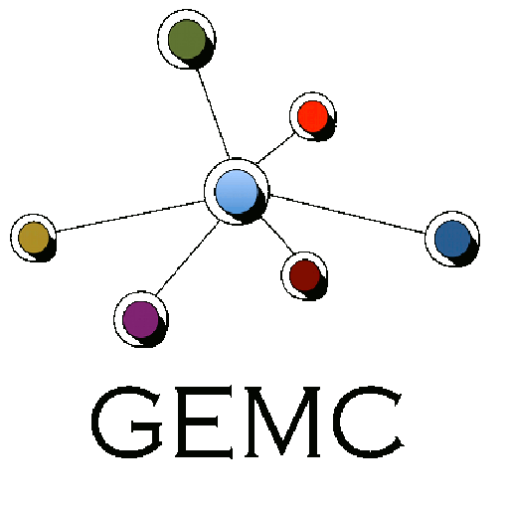
GEMC (GEant4 MonteCarlo)
C++ program that simulates particles through matter using the Geant4
Detector information are stored in mysql database. configuration changes are immediately available to users without need of recompiling the code.
Hit process factory: associate detectors with external digitization routines at run time.
perl script I/O to database, no need to know C++ or Geant4 to build detector and run the simulation.
Used by CLAS12
GEOMETRY, BANKS, DIGITIZATION DATABASE
network
GEMC
Notes:
The main feature of gemc is the ability to read, as input:
The software being developed in the framework of these objectives is called gemc
Well defined objects to not only to compartmentalize software, but also big advantage: once code is debugged for one object, we’re done. Example: detector objects.
Change geometry w/o accessing or even knowing the code.
Processes are like “plugins”: external and easily maintainable pieces of code
I/O formats are plugins as well
Adding, removing plugins is very easy

Slide 5
GEMC interface
Batch mode

Slide 6
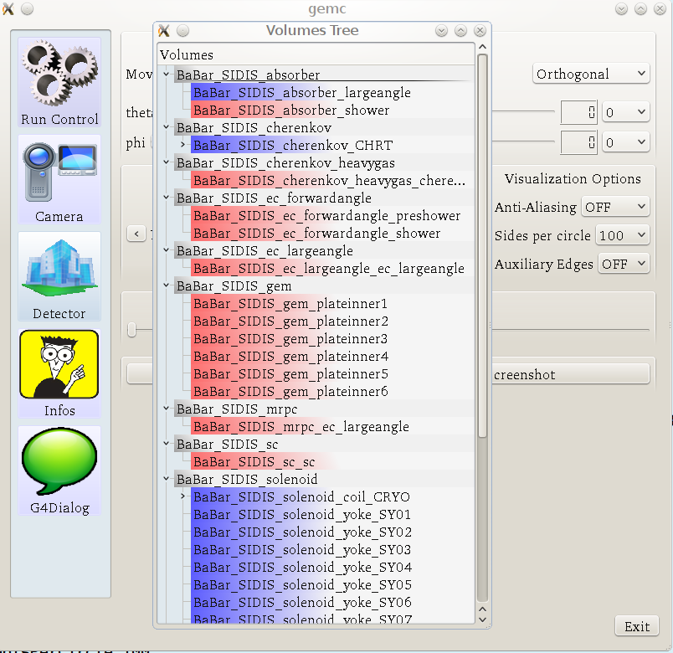
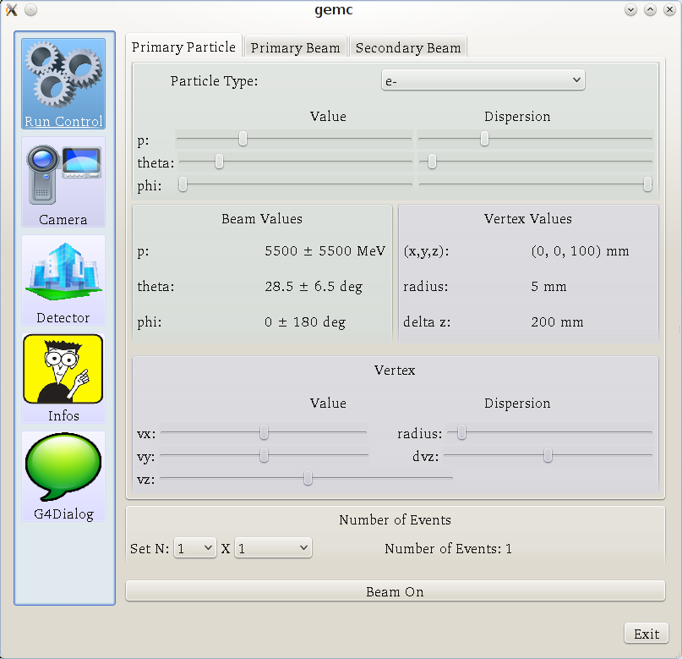
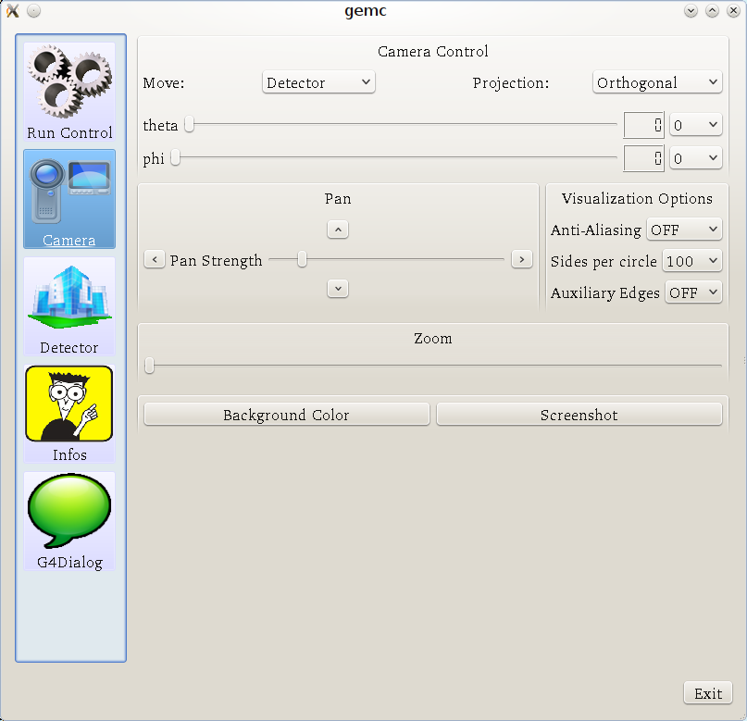
GEMC interface
Detector
Interactive mode
Run Control
Camera

Slide 7
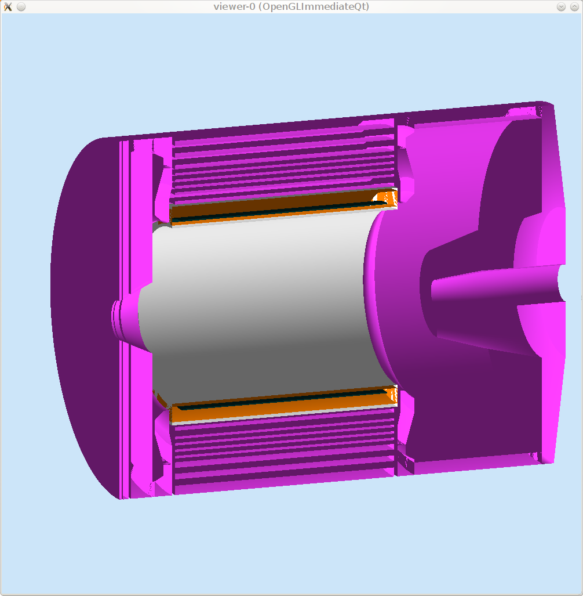
Magnet/coil/yoke
SIDIS with BaBar Magnet

Slide 8
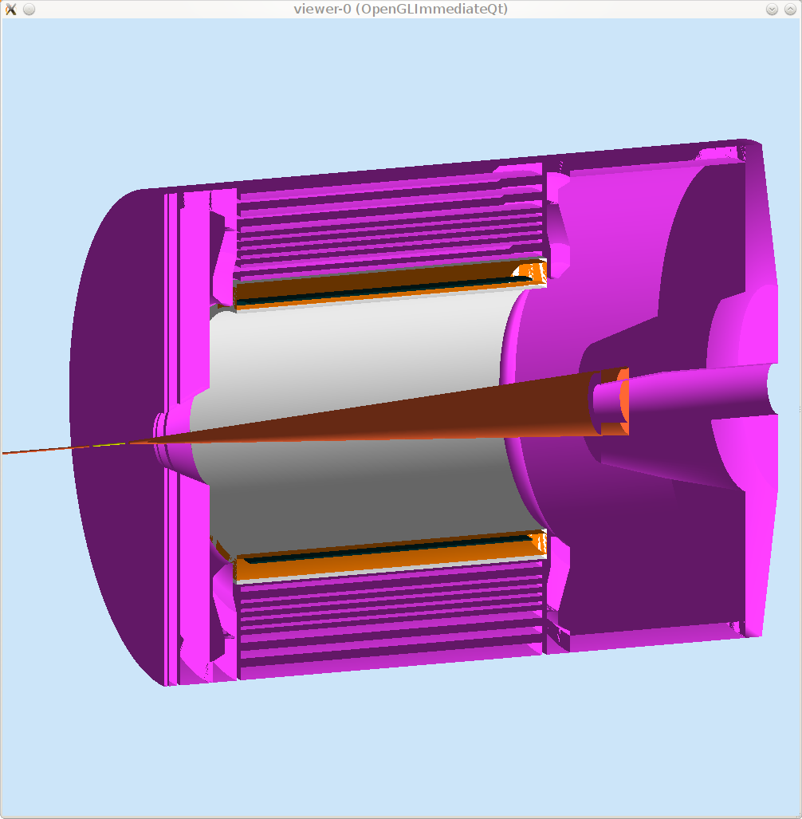
Target/Beam line
SIDIS with BaBar Magnet

Slide 9
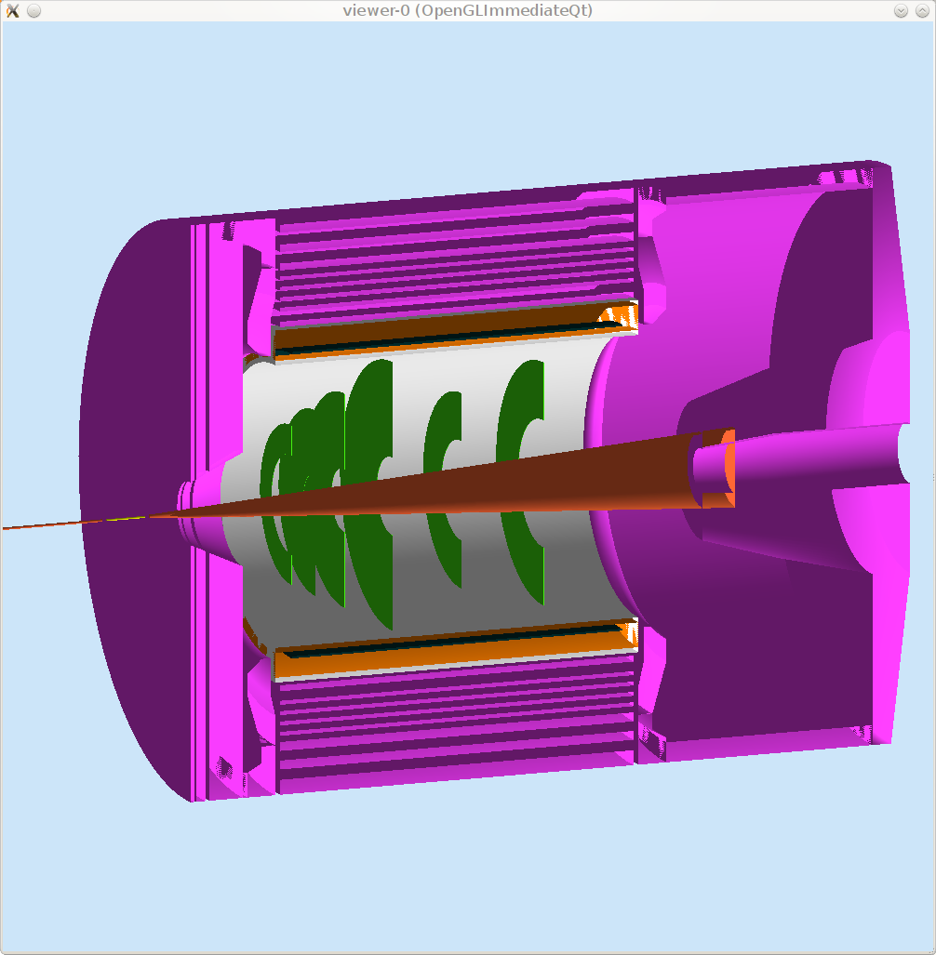
GEM
SIDIS with BaBar Magnet

Slide 10
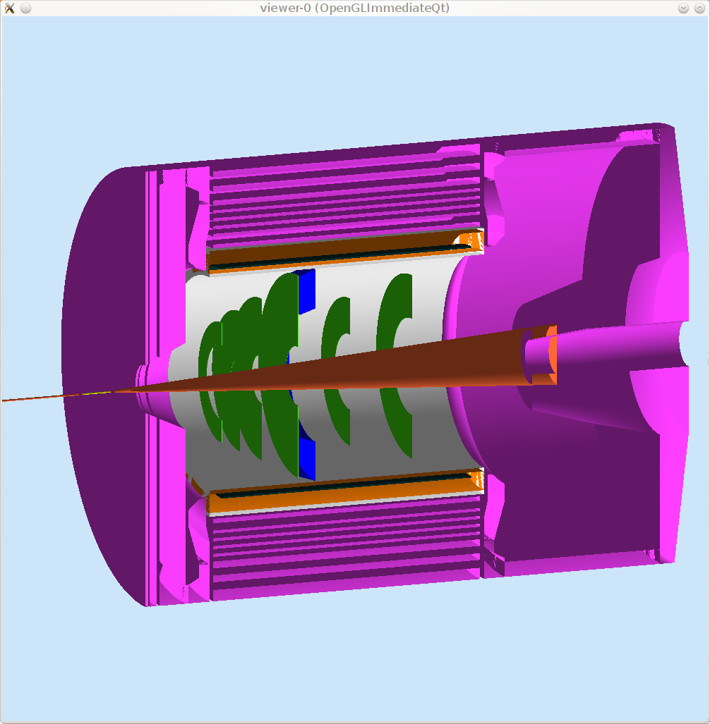
EC, large angle
SIDIS with BaBar Magnet

Slide 11
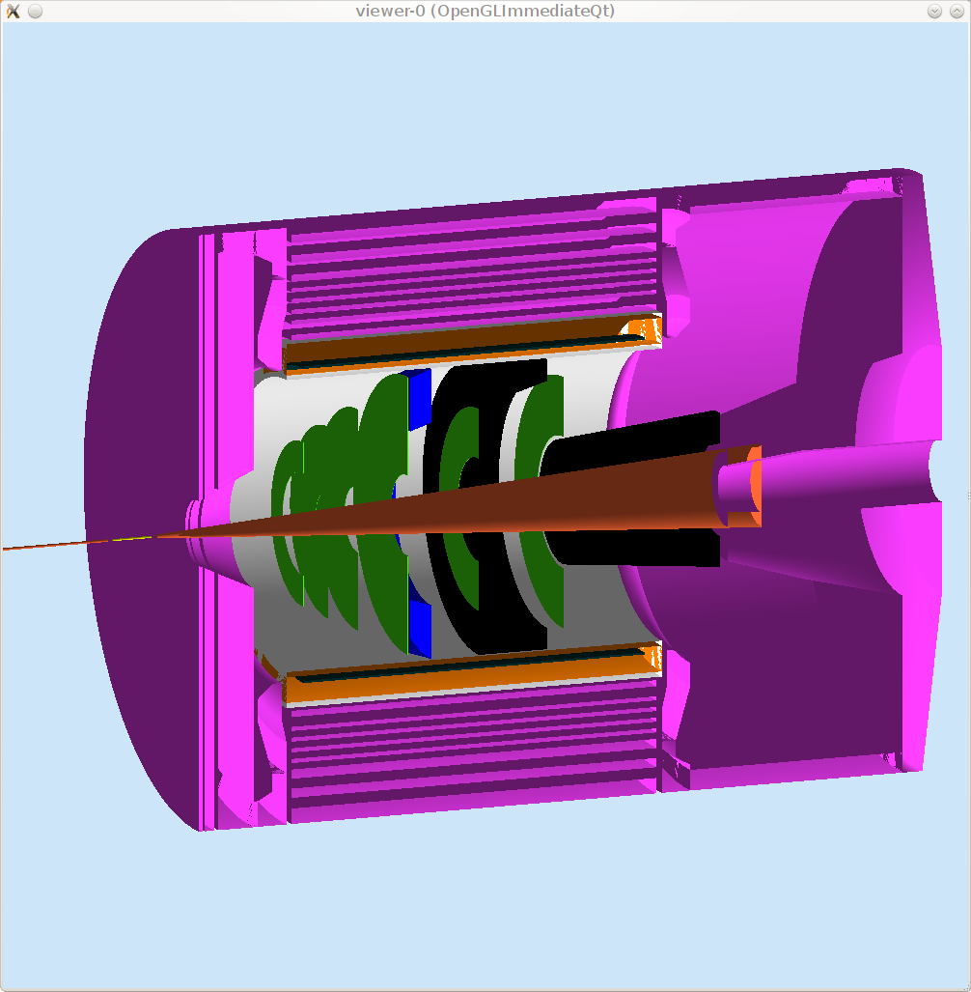
Collimator
SIDIS with BaBar Magnet

Slide 12
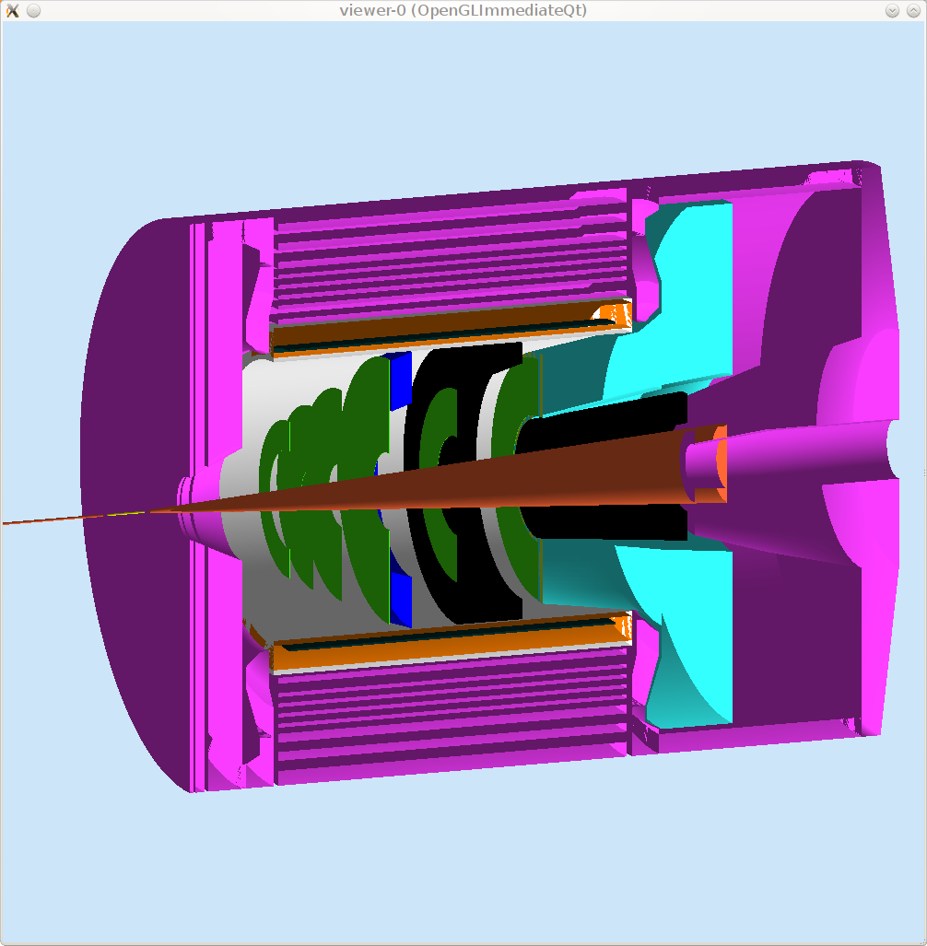
Cherenkov, light gas
SIDIS with BaBar Magnet

Slide 13
Scintillator
SIDIS with BaBar Magnet

Slide 14
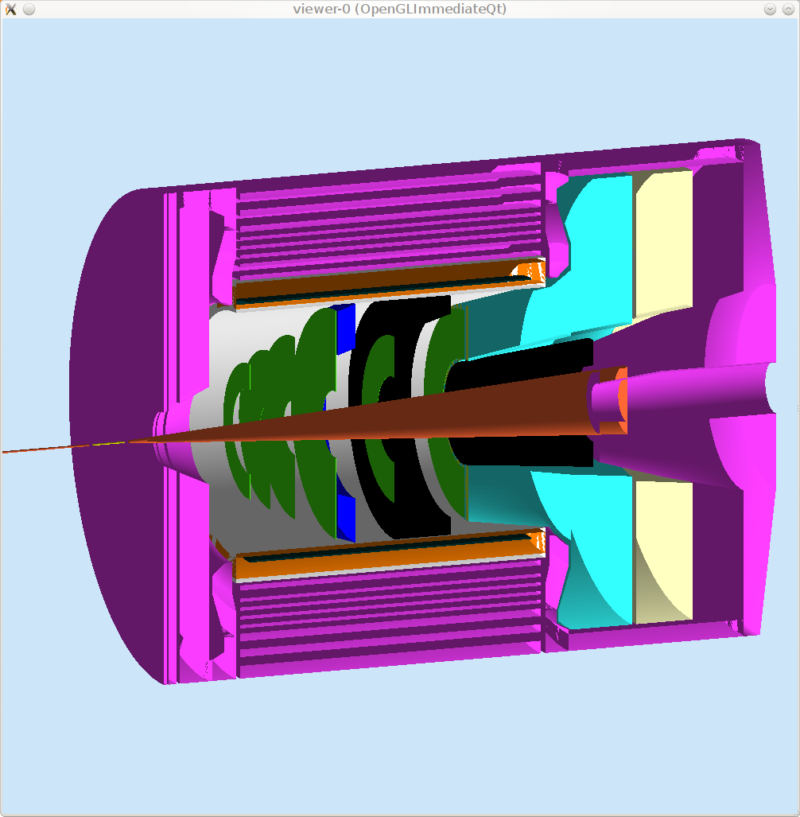
Cherenkov, heavy gas
SIDIS with BaBar Magnet

Slide 15
MRPC (Multigap Resistive Plate Chambers)
SIDIS with BaBar Magnet

Slide 16
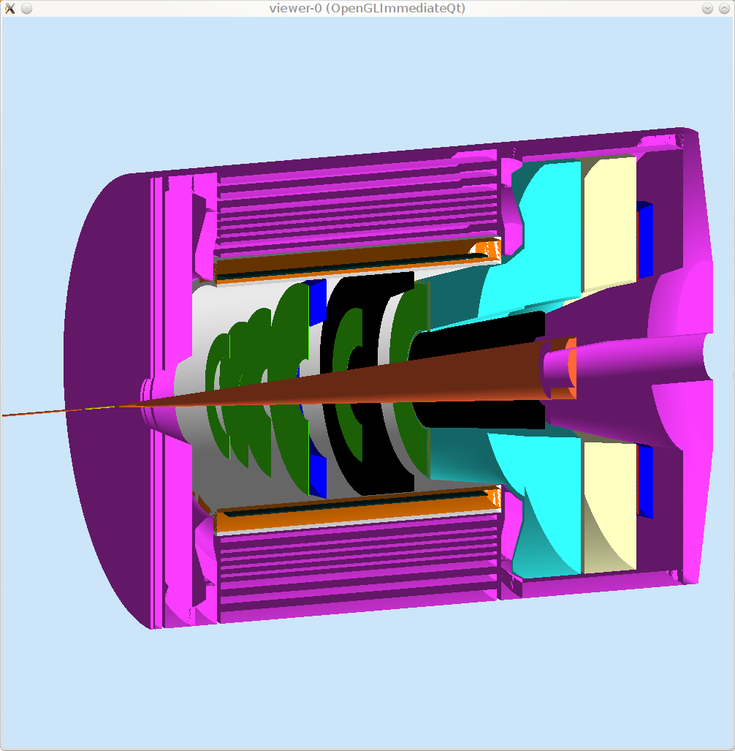
EC, forward angle
SIDIS with BaBar Magnet

Slide 17
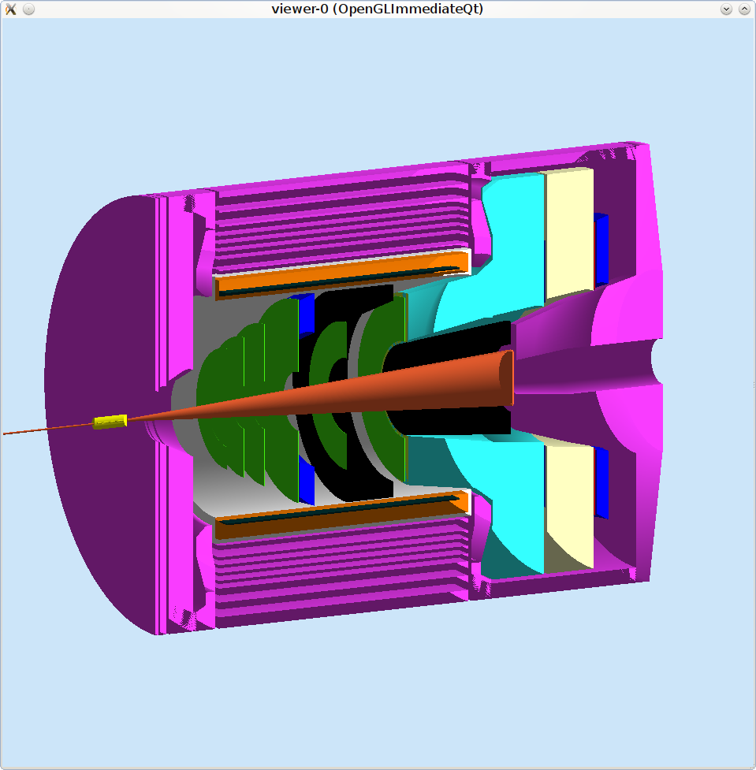
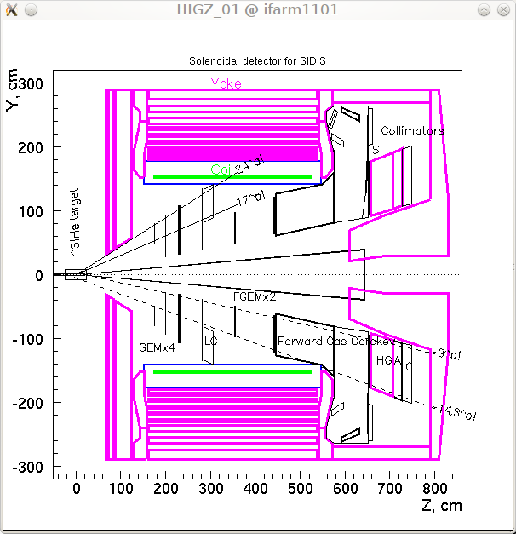
SIDIS with BaBar Magnet
3D Geant4
2D Geant3

Slide 18
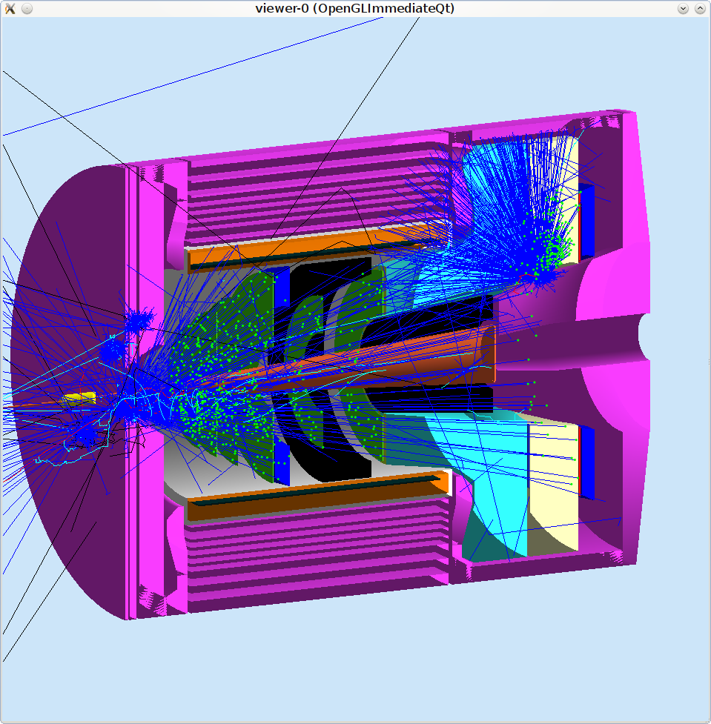
SIDIS with BaBar Magnet
3D Geant4
2D Geant3

Slide 19
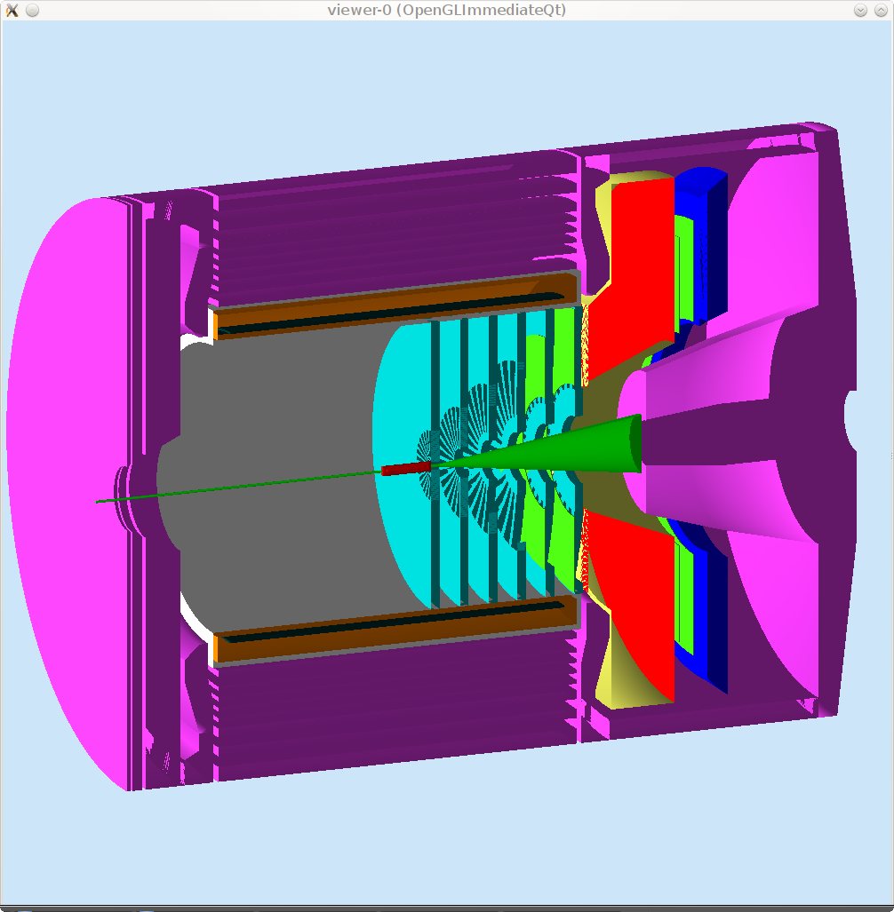
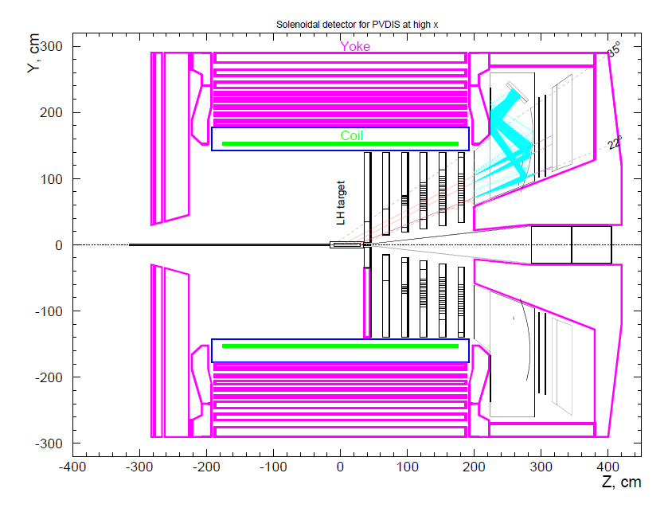
PVDIS with BaBar Magnet
3D Geant4
2D Geant3
Baffle

Slide 20
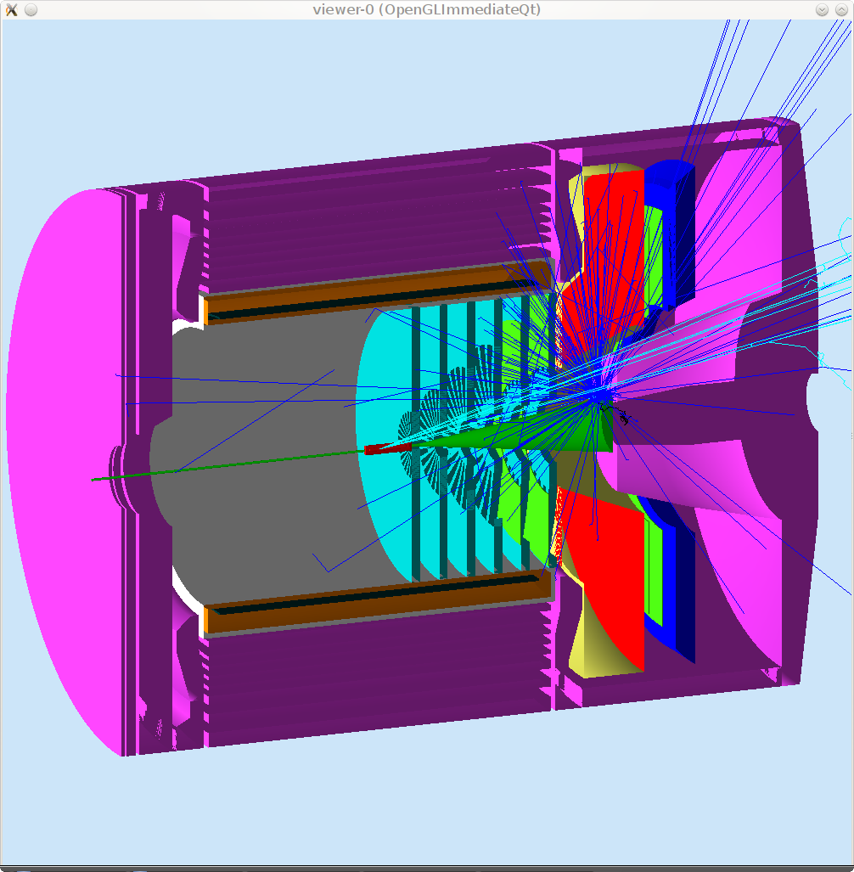
PVDIS with BaBar Magnet
3D Geant4
2D Geant3
Baffle

Slide 21
SoLID Simulation Framework (GEMC)
gemc.jlab.org
Geant4, C++, Qt, OpenGL
geometry/sensitivity/digitization/field in mysql databases (soliddb.jlab.org)
Customized hit processing for various detectors.
Unified individual detector simulation and the whole SoLID simulation.
It can be used for other projects.

Slide 22
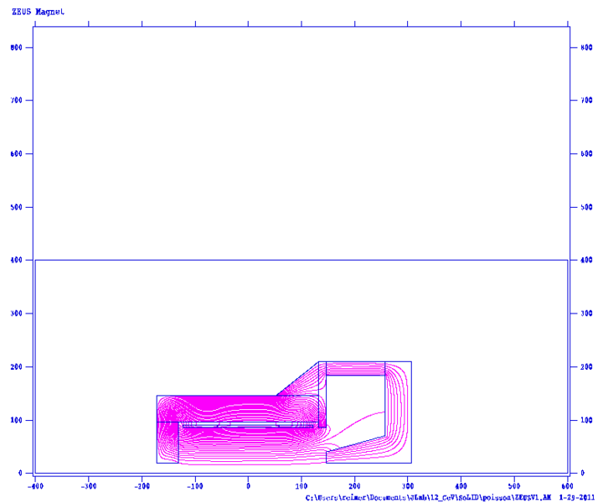
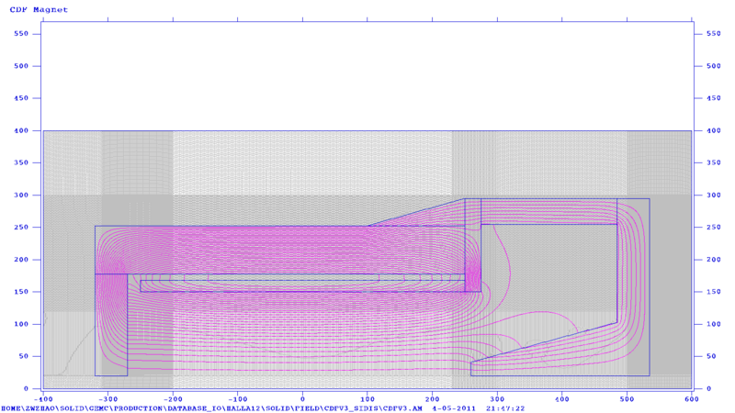
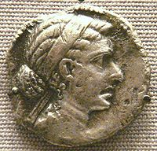
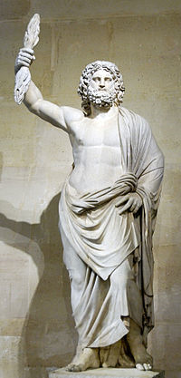
Magnet Option
Poisson 2D
BaBar
CDF
CLEO
ZEUS

Slide 23
Magnet Comparison
 | BaBar | CLEO | ZEUS | CDF | Glue-X |  | Ideal
 |  |  |  |  | Old SLAC | New
Cryostat Inner Radius | 150 cm | 150 cm | 86 cm | 150 cm | 90 cm |  | 100 cm
Length | 345 cm | 350cm | 245cm | 500 cm | 350 cm |  | 250 cm
Central Field | 1.49T | 1.5T | 1.8T | 1.47T | 2 T |  | 1.5T
Flux Return Iron | Yes | Yes | No | No | No
Cool Icon | Yes | Yes | Yes | No | No
Variation in Current density with z? | 2x more in end than central | 4.2% more in end than central | 40% more in end than central | No | Yes | Yes
Available | Probably Not?? | Probably | Probably | Probably | One will be available

Slide 24
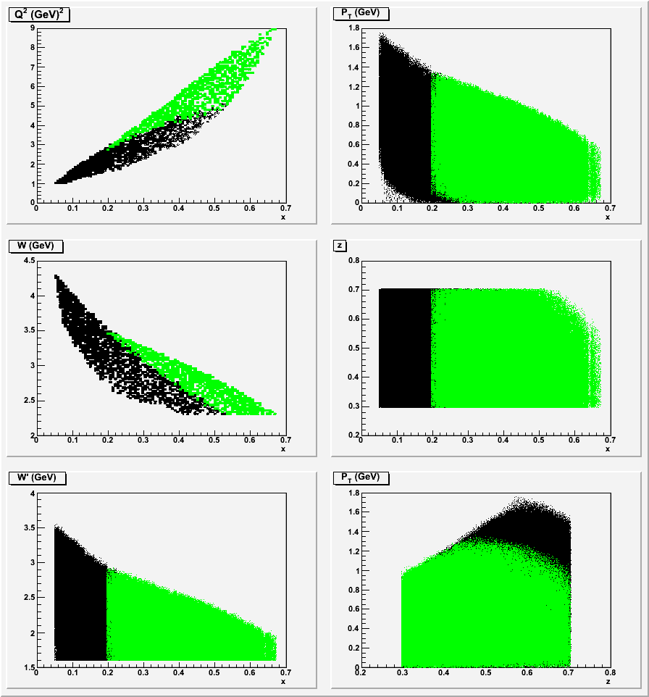
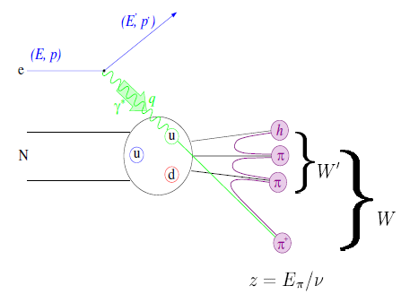
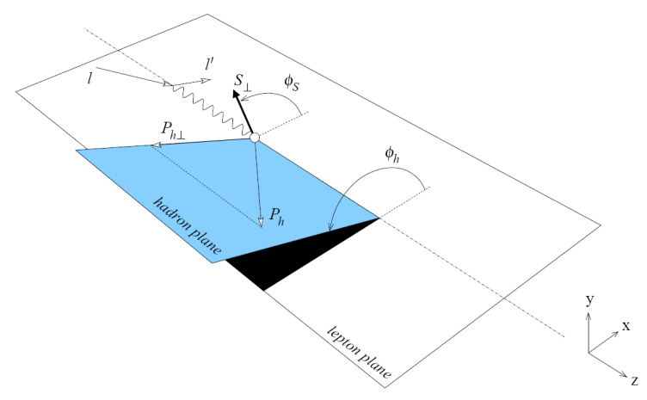
SIDIS Kinematic Coverage@11GeV
BaBar
Green area,
large angle coverage
Black area, forward angle coverage

Slide 25
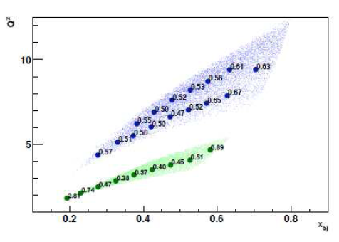
Magnet Choice
PVDIS FOM is not sensitive to different magnet option.
SIDIS Kinematic Coverage@11GeV favors BaBar/CLEO.
 | ZEUS | BaBar/CLEO | CDF | Glue-X | Ideal
x | 0.05-0.58 | 0.05-0.65 | 0.05-0.64 | 0.05-0.64 | 0.05-0.65
z | 0.3-0.7 | 0.3-0.7 | 0.3-0.7 | 0.3-0.7 | 0.3-0.7
Q² | 1-6 | 1-9 | 1-7.2 | 1-8 | 1-9
W | 2.3-4.2 | 2.3-4.4 | 2.3-4.2 | 2.3-4.2 | 2.3-4.3
W’ | 1.6-3.4 | 1.6-3.5 | 1.6-3.4 | 1.6-3.4 | 1.7-3.5
P_{T} | 0-1.45 | 0-1.7 | 0-1.45 | 0-1.45 | 0-1.6

Slide 26
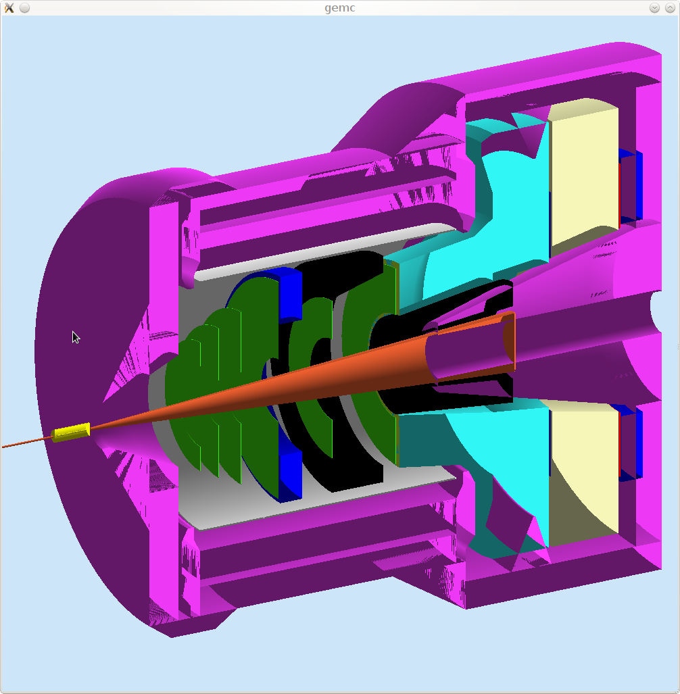
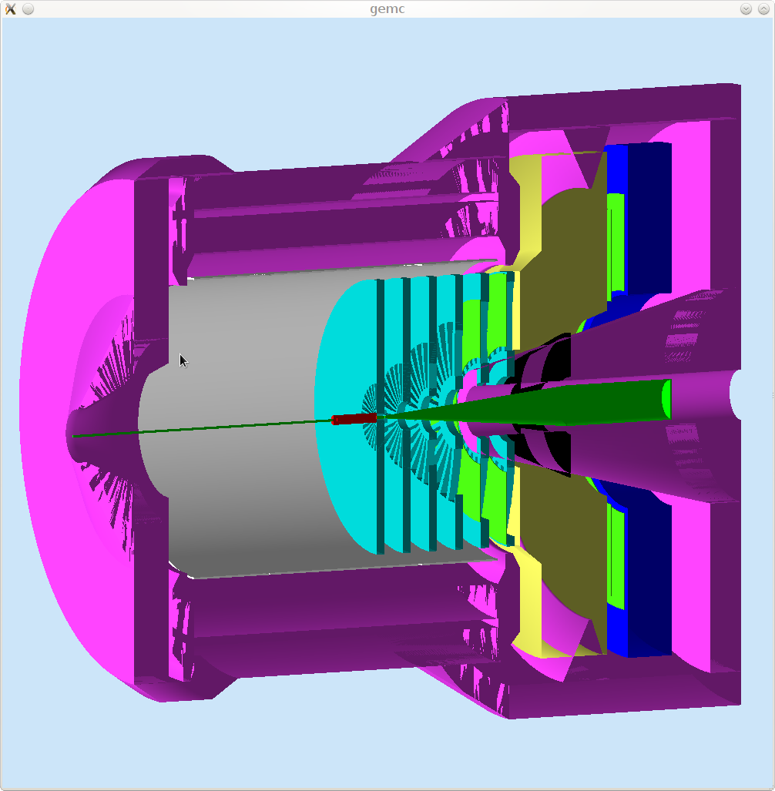
CLEO magnet and yoke
design in progress
SIDIS
PVDIS

Slide 27
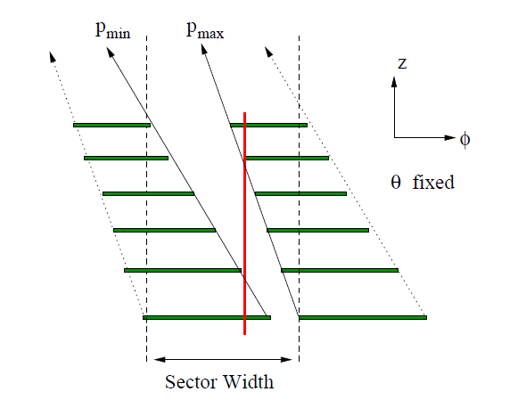
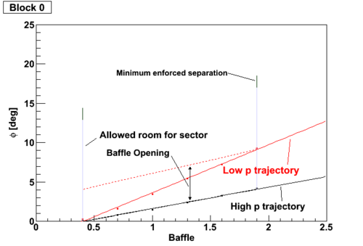
PVDIS Baffle Design
Luminosity 10³⁹/s/cm²

Slide 28
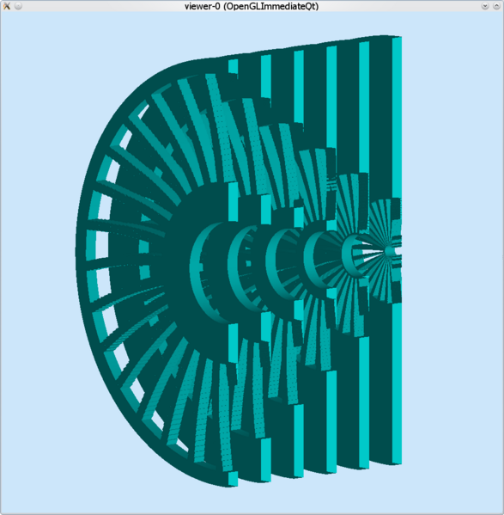
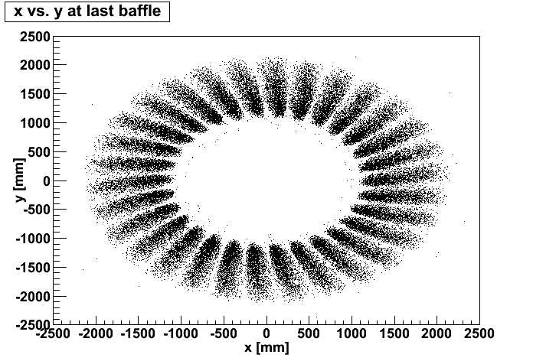
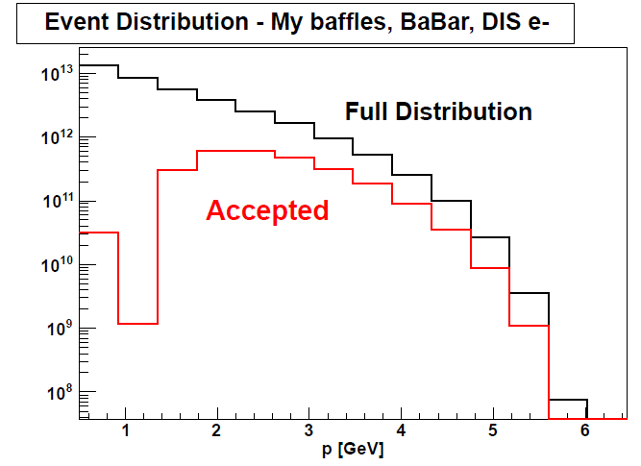
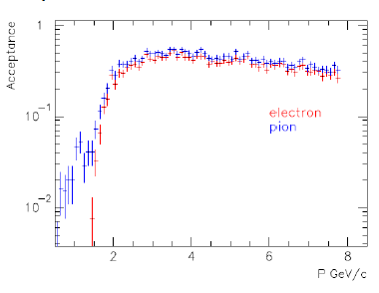
PVDIS Baffle
Reduce background by 50

Slide 29
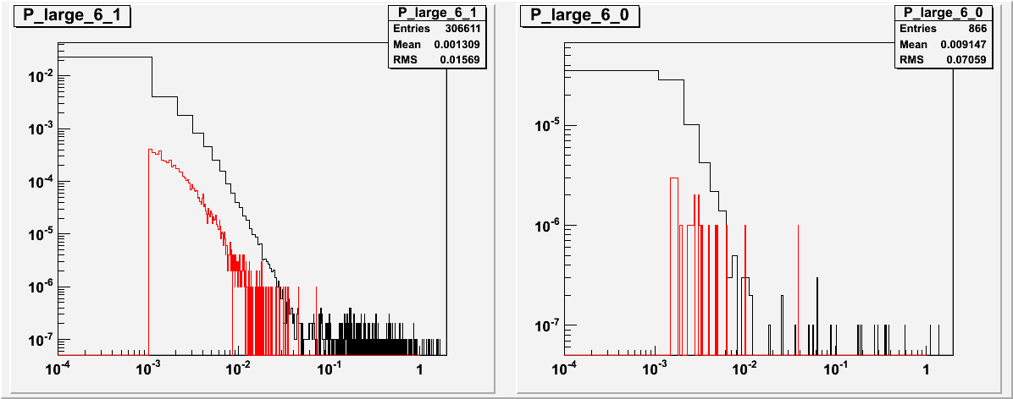
PVDIS EM Background (on EC, no baffle) red Geant3, black Geant4
Both
photon
electron
VS
Energy Flux VS R
For Energy Flux, Geant4 shows ~30% larger than Geant3
photon
electron
Momentum Distribution

Slide 30
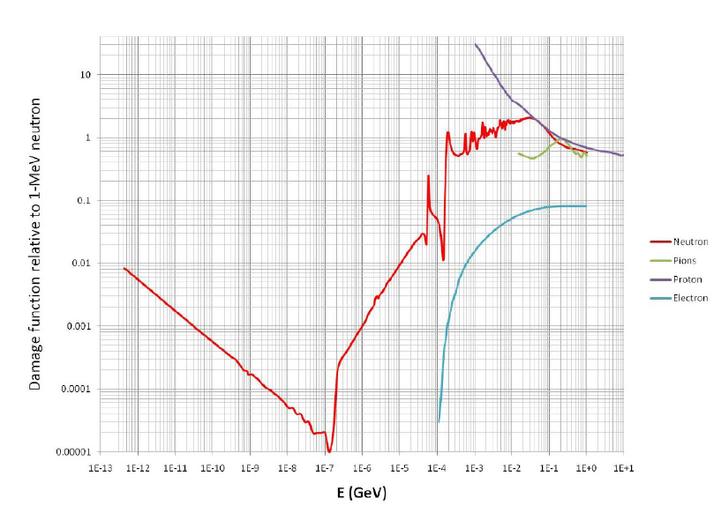
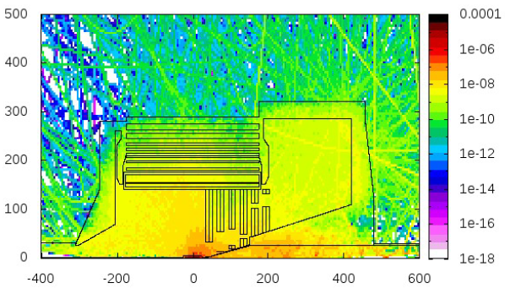
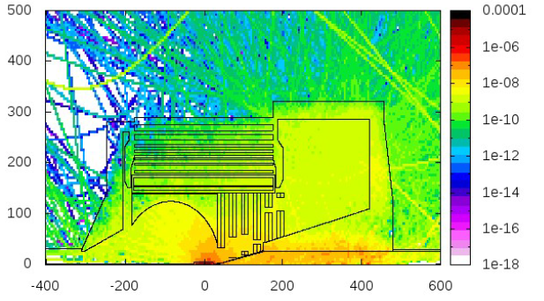
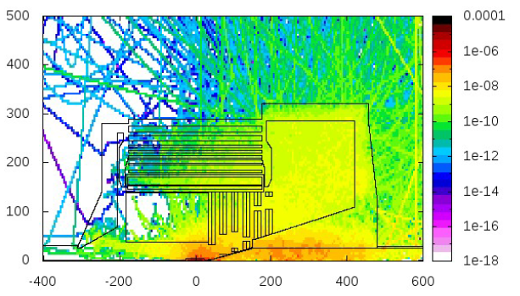
Neutron Shielding
Use FLUKA for study
boron polyethylene shielding

Slide 31
Summary
SoLID simulation framework is successfully built base on GEMC with Geant4 and C++.
A lot of subsystem design and simulation progresses have been made. More studies are under way.
In preparation for the director review.

Slide 32
Thanks
Maurizio Ungaro
Paul Reimer
Seamus Riordan
Lorenzo Zana
Simona Malace
Eric Fuchey
Yang Zhang
Eugene Chudakov
Xin Qian

