Slide 1
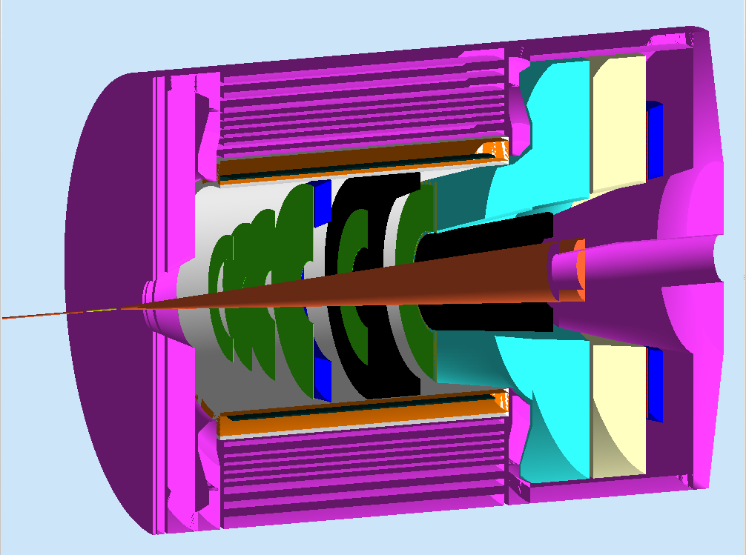
Summary of Requirements and Special Considerations
Xin Qian
KRL
Caltech

Slide 2
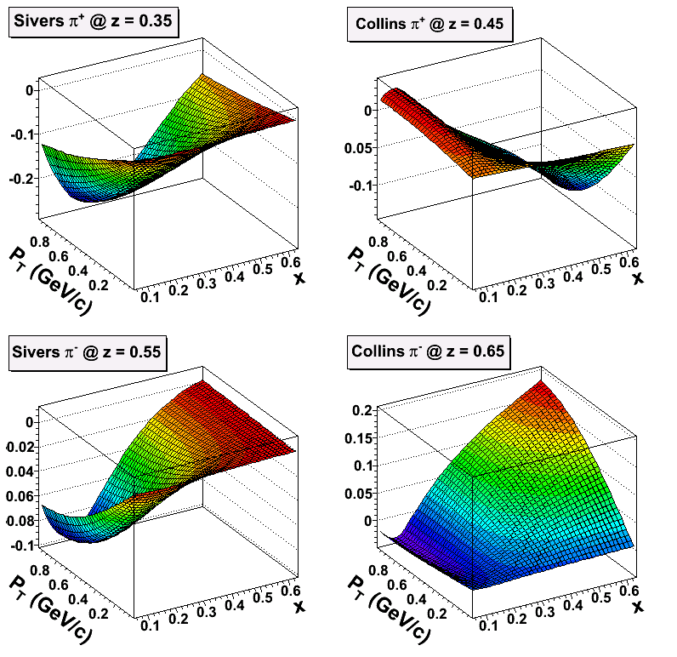
SoLID-Spin (SSA + DSA on n)
We measure asymmetries (a few 10⁻⁴ → a few 10⁻²)
Total statistical precision <10⁻⁵, Systematic: ~ 6% x A
Keys of SoLID:
Large Acceptance + High Luminosity → 4-D mapping of asymmetries → Tensor charge, TMDs …
Lattice QCD, QCD Dynamics, Models.
Experimental Side:
Full Azimuthal Angular Coverage
→ Double Cancellation in Asymmetries (both acceptance and luminosity fluctuation)
+ Fast Spin Flip for SSA
Control False Asymmetry
Challenges:
→ Detectors Performance in high luminosity environment (GEM…)
→ Fast DAQ (Hall D Standard, Other Halls)

Slide 3
Requirement of SIDIS
Kinematics Coverage:
0.05 ~ 0.6 in x (valence)
0.3 ~ 0.7 in z (factorization region)
P_{T} up to ~ 1 GeV (TMD Physics)
Fixed target → Q² coverage 1-8 GeV² (~ 2 GeV² in ΔQ² at fixed x)
Luminoisity:
Unpolarized ~ 10³⁷ N/cm²/s
Polarized ³He Target:
~ 60% higher polarization
Fast spin flip (<20 mins)
Electron PID:
<1% Pion contamination (asymmetry point of view)
Pion PID:
<1% Kaons and Protons
<1% electron contamination
Optics of Reconstruction:
< a few % in δP/P.
< a few mr in polar angle.
< a few 10s mr in azimuthal angle
~ a few cm vertex resolution
Similar precision required.
A factor of 2-3 better already achieved in MC.
DAQ:
~ 3kHz Physics Coincidence
~ 200 kHz Single electron
~ 50 kHz Coincidence
Limits: 300 MB/s to tape.

Slide 4
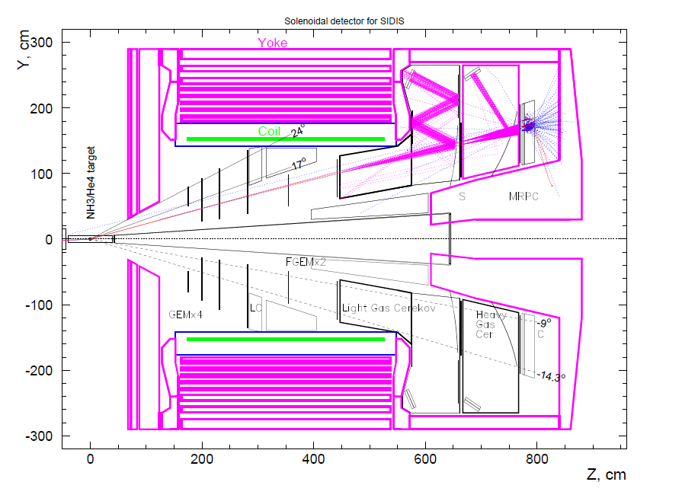
Conceptual Design with BaBar

Slide 5
Special Considerations
Uniformity:
E.g. Design of Detector Support Structure to minimize holes in acceptance (especially in azimuthal angle)
Background in Detectors
Radiation:
Design of Detector front end electronics and calorimeter
Minimize radiation damage
Maximize radiation hardness of design.
Multiple New Detectors:
Need dedicated time to commission detectors and system integration.
Multiple/Staged beam tests needed for detector R&D.
Detailed Integration Plan.
Mechanical Design:
Compact
Detector maintenance
Cable layout
Switch plan among different configurations:
Transverse vs. Longitudinal
SIDIS vs. PVDIS
Strong Engineering Support
Procedure to quick establishment of detector performance.
Position of Tracking detectors
Energy response in Calorimeter
Background/Gain in Gas Cerenkov.
Physics asymmetry in single hadron, and zero PV will help in this.

Slide 6
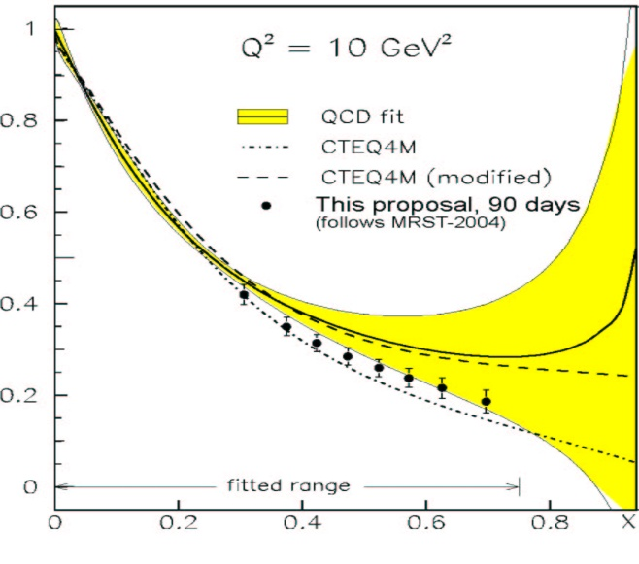
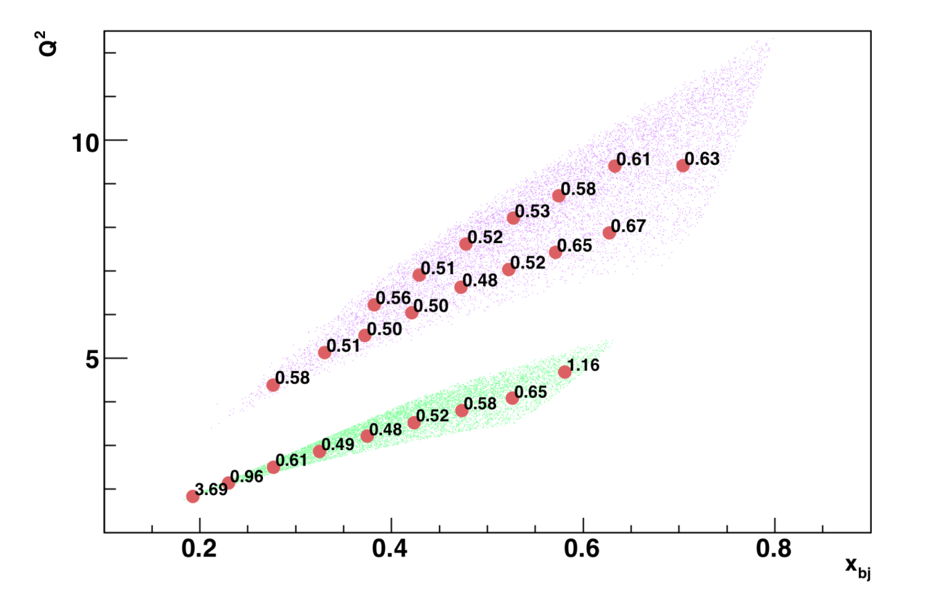
Motivation for PVDIS
d/u for Hydrogen
Di-quarks in
the nucleon
(Q² Dependence)
Standard Model
CSV at Quark Level
Error bar σ_{A}/A(%) shown at center of bins in Q², x
4 months at 11 GeV
2 months at 6.6 GeV

Slide 7
Summary of Requirement
0.5% precision over broad kinematics range.
Beam Polarimetry (Paschke )
Control false asymmetries in PID/Tracking.
New Cryotarget Design (Chen)
Challenges in mechanical engineering.
Control of false asymmetry.
High luminosity 10³⁹ N/cm²/s
Sieve to block direct photons
Effectively reduce luminosities on detectors.
Background in Cerenkov.
Radiation dose in Calorimeter.
Similar to SIDIS requirement
Electron PID:
< ~1% Pion contamination
Gas Cerenkov + E&M Calorimeter for < 3.0 GeV
Calorimeter alone for high Momentum
GEM for tracking
30 sectors, each employs an independent DAQ system.
Simpler design than SIDIS.
< 10 kHz per sector
Require L3 farm and online tracking.
Proof-of-principle of tracking was achieved.
2.5 kHz per sector @ 1 CPU @ 3.0 GHz.

Slide 8
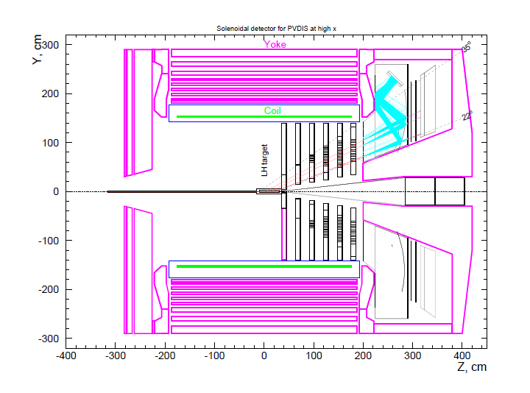

Slide 9
Special Considerations
Q² Determination
Elastic scattering Need Mont Carlo
4.4 + 6.6 GeV?
How clean are the peaks?
How can they be centered? (not symmetric)
Sieve Slits (Optics)
Run with lower B and B=0
Rotate one or more baffles to get straight path
Install slit with holes to calibrate angles
Pile-up and Dead Time
Dither Intensity: ~10⁻²
Empirically measure all effects.
Reduce Acceptance and vary Intensity by 20%
Correct for density variation
Calibrate BCM
Solid target
Linear Luminosity Monitor
Other considerations similar to that of SIDIS: Mechanical Design

Slide 11
Conceptual Design (I)
Kinematics Coverage:
Preference of Magnet
Limited by SoLID geometry
Data taking at 8.8 GeV for radiative corrections and expand Q² coverage.
Luminoisity:
Requirement on GEMs, Cerenkov.
Radiation dose on E&M Calorimeter and front end electronics.
Requirement on DAQ system.
Polarized ³He Target:
Achieved performance assumed for this experiment
Magnetic field shielding design and correction coils are keys for performances.
Possibly benefits from new techniques developed for earlier 12 GeV experiments
Electron PID:
Combination of E&M calorimeter + Gas Cerenkov (shared equipments with PVDIS)
Advantage of coincidence measurement in SIDIS (additional Pion suppression)
Pion PID:
Gas Cerenkov + E&M Calorimeter to suppress electron.
TOF (MRPC) at low momentum to suppress kaons/protons
Heavy Gas Cerenkov to suppress kaons in high momentum.

Slide 12
Conceptual Design (II)
Optics of Reconstruction:
Already demonstrated in MC, 200 um resolution in GEM leads to resolution performance.
~ 1% in δP/P
< 6 mr in azimuthal angle
< 0.5 mr in polar angle
~ 1 cm vertex resolution
Calibration Plan:
2.2, 4.4 and 6.6 GeV beam
Multi-Carbon Foils for Vertex.
Elastic Hydrogen for momentum.
Sieve Slit for angles.
Varying strength of SoLID magnetic field. (e.g. No Field Run + Survey …)
Very experienced team in optics calibration.
DAQ:
JLab customized pipeline technology.
Fast Tracking:
Demonstrated tracking in expected experimental environment.
Already achieved 1 kHz per 3.0 GHz CPU.
Plenty of room to improve e.g. Multi-thread + Sectors + Algorithm Improvement (e.g. GPUs)
Additional Goals to be studied:
Neutral Pion Identification (Limited by E&M calorimeter granularity)
Two Hadron SIDIS (multiplicity at high W + acceptance)
Complemantary Transversity Measurement

Slide 13
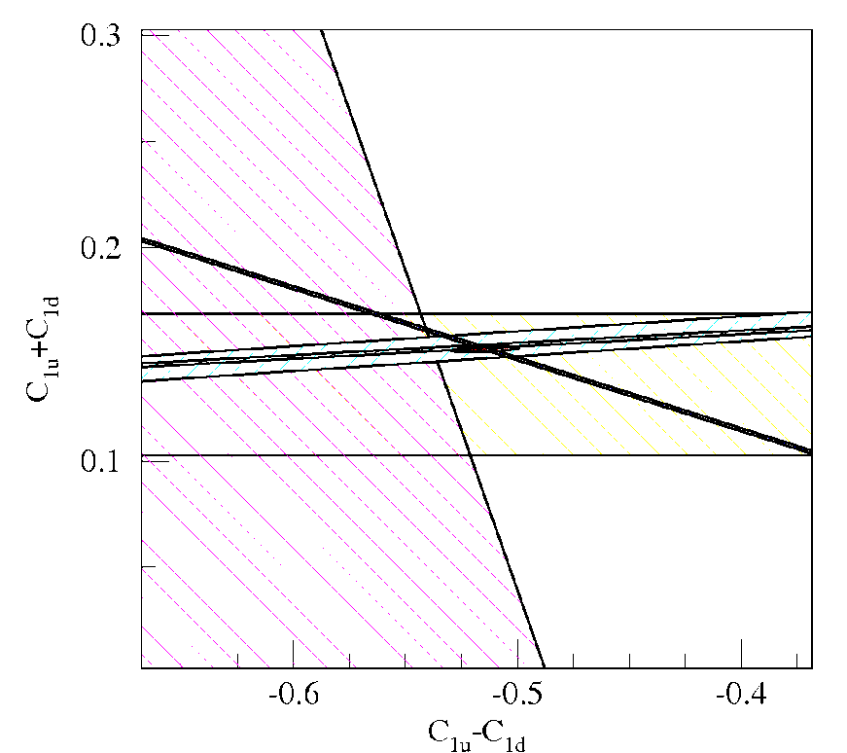
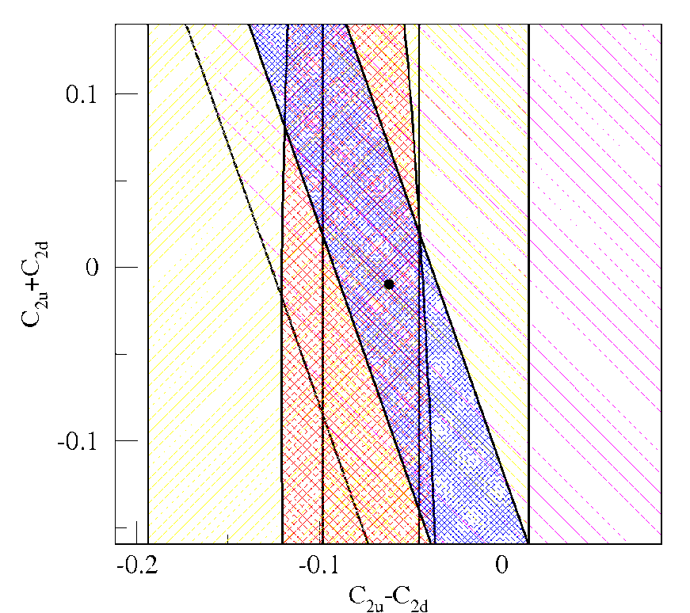
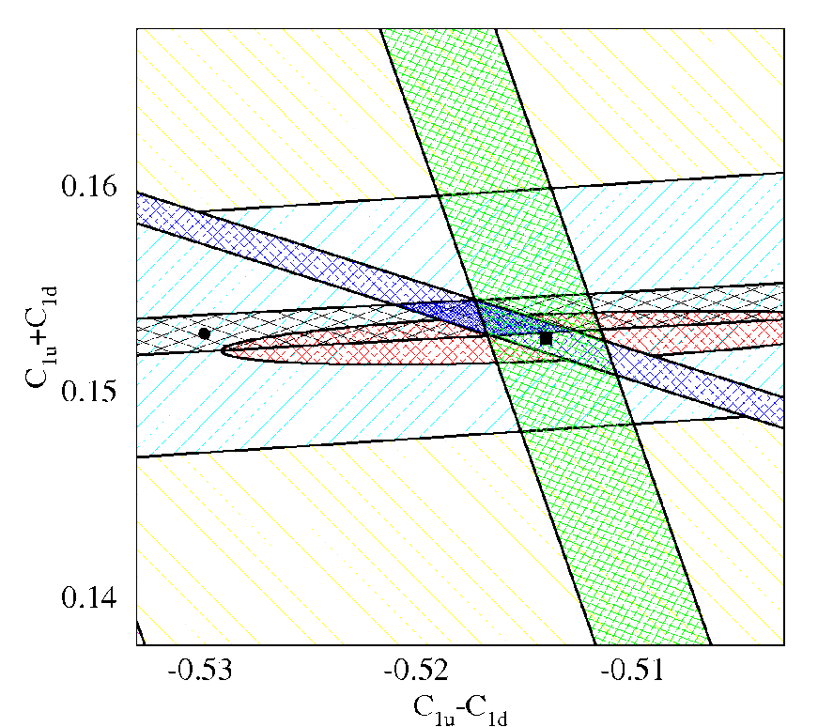
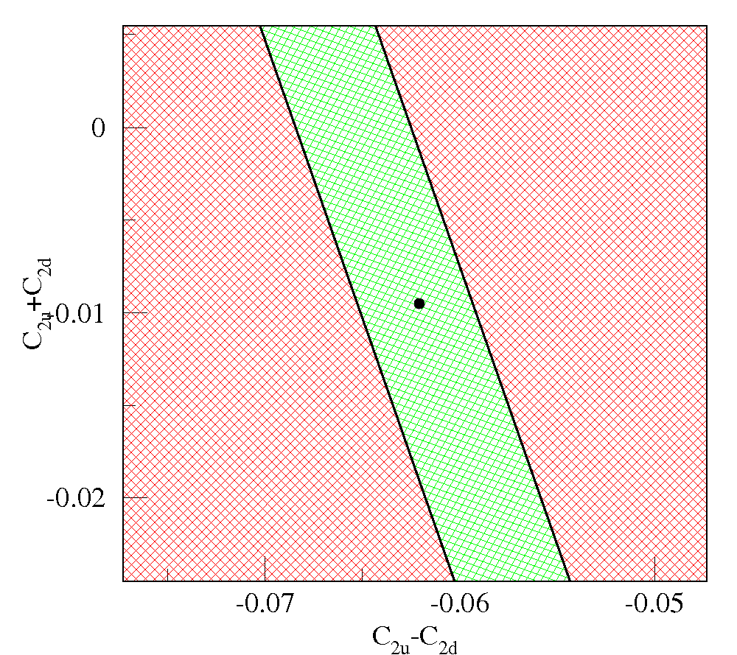
Sensitivity: C₁ and C₂ Plots
World’s data

Slide 14
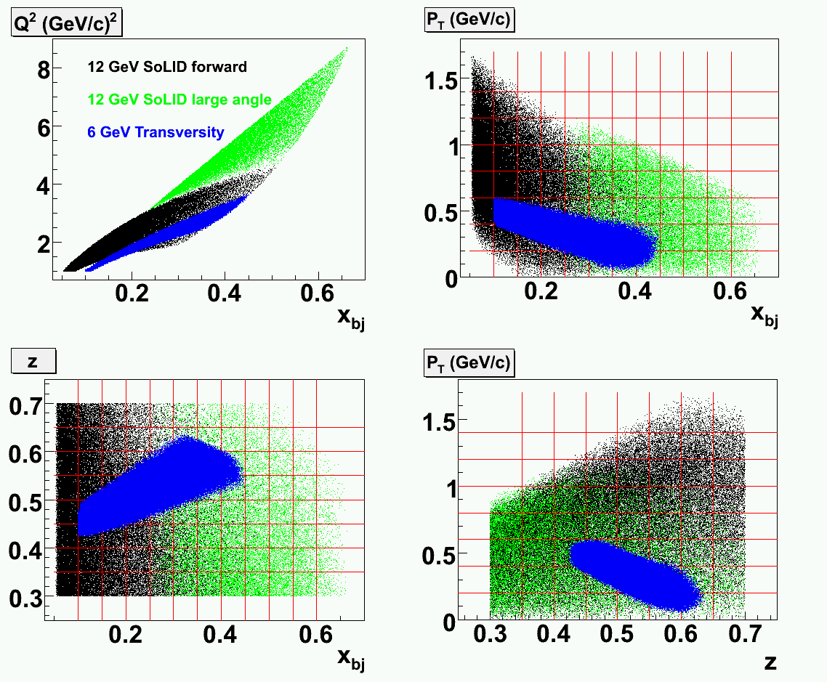
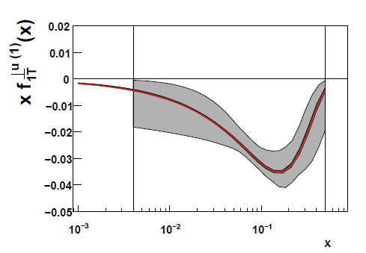
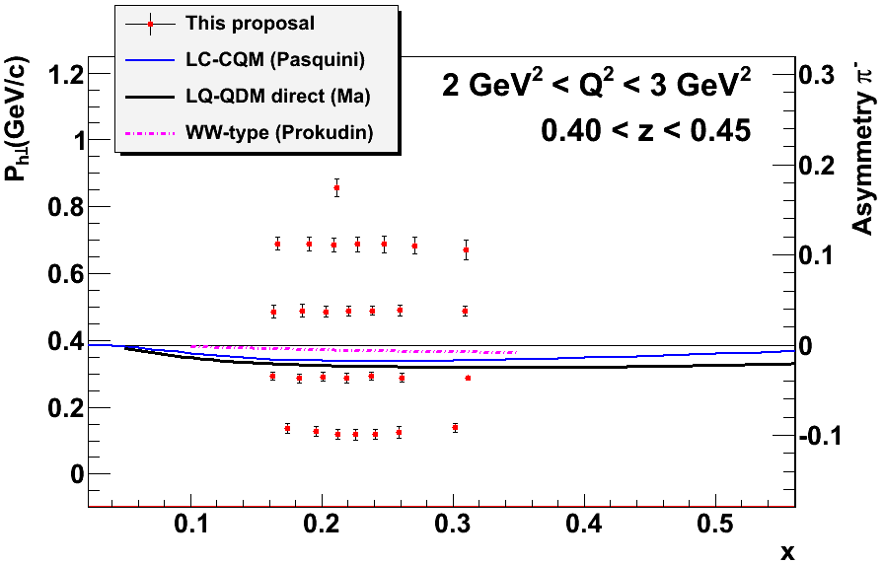
Expected Improvement of Sivers Function
<10% d quark tensor charge Collins Effect
Sys.: 0.1% (abs.) + ~6% (rel.) + Nuclear Effect/FSI
50 days @ 11 GeV + 22 days @ 8.8 GeV (Coverage + RC) + 10 days on H/D (Dilution, FSI, Mechanism) + 8 days on calibration of new device + 35 days with longitudinal target spin
First Neutron (³He) Data
These data will provide ultimate precision mapping of Neutron SSA/DSA in the valence region at low Q²!
Example projections of Neutron A_{UL} moments, 1/48 bins in z vs. Q².
Notes:
Top Right Plot used as place holder (to be replaced with results from A. Prokudin)

