Slide 1
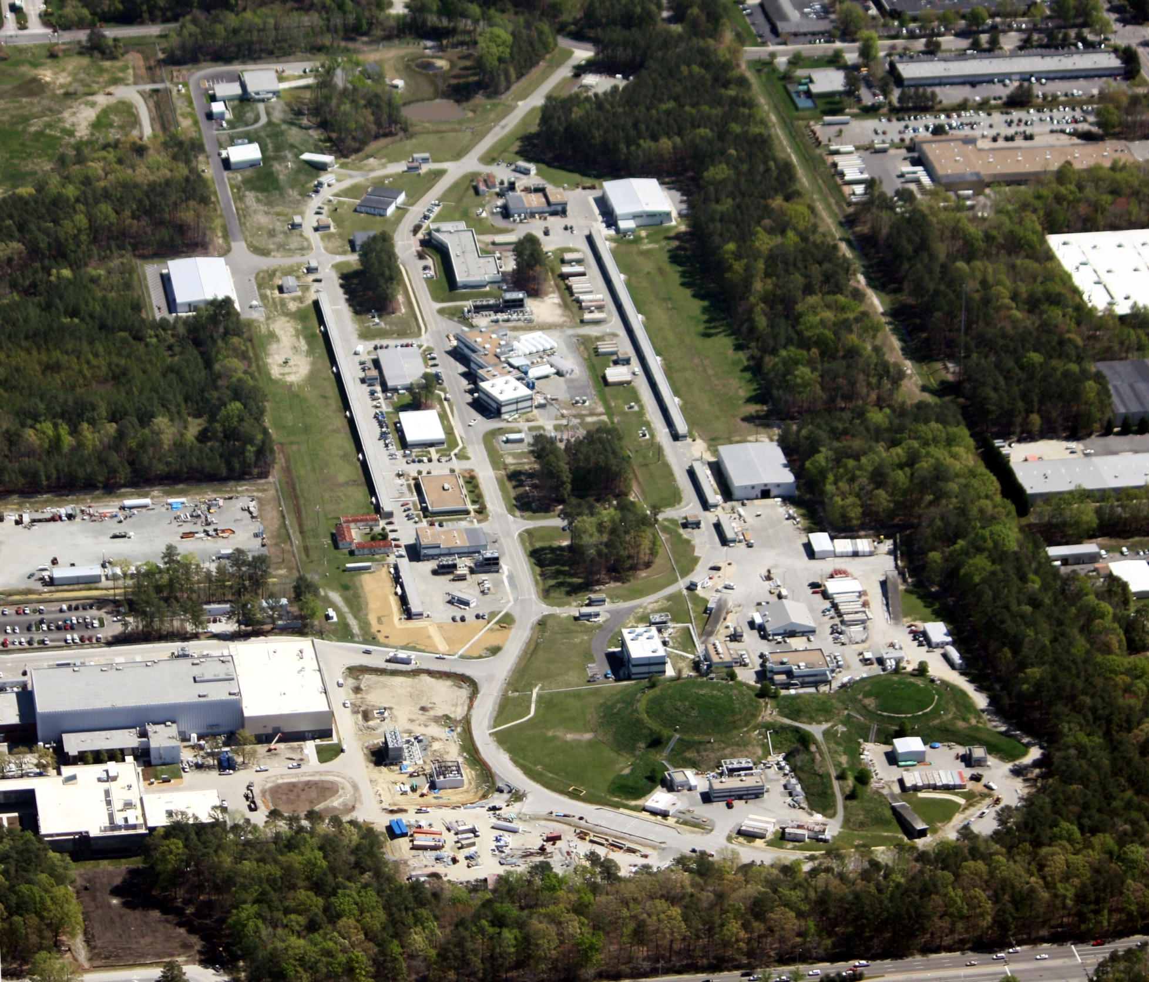
Report to SoLID Collaboration
R. D. McKeown
April 13, 2012

Slide 2
PAC39
Scheduled for week of June 18, 2012
- proposals due May 4.
Consider new proposals and letters of intent
Hall Leaders to present “early running” plans
Discussion of priorities, jeopardy, etc.

Slide 3
12 GeV Software Review
Purpose: To ensure that detector software will be ready for science, facilitating timely reporting of physics results for the 12 GeV program.
Consideration by an external review committee will give us greater confidence that we are on the right path.
Joint planning with IT, Physics, Directorate.
Presently envisioned time frame: early June 2012 (committee, charge, etc. under development)

Slide 4
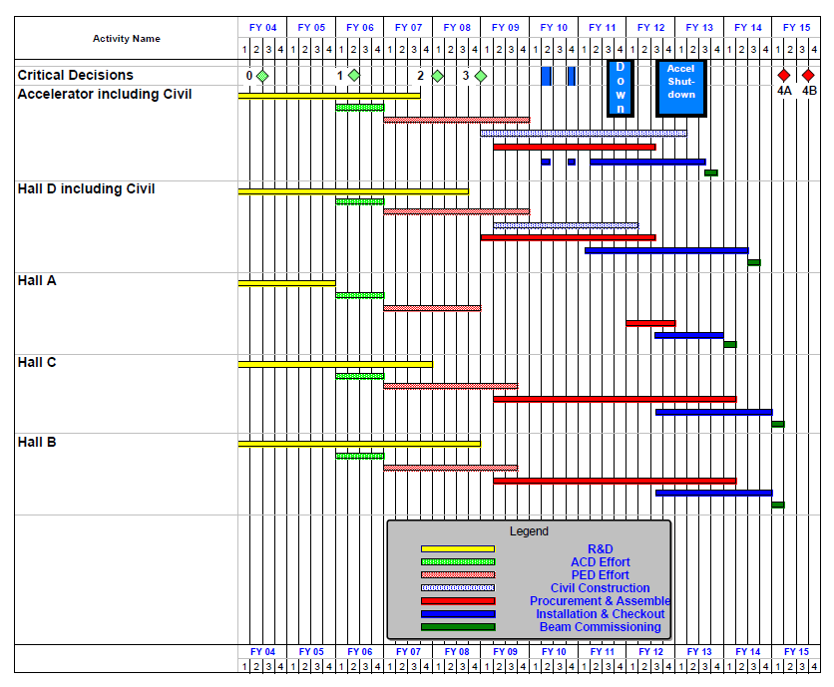
12 GeV Upgrade Schedule
Two short parasitic installation
periods in FY10
6-month installation
May – Oct 2011
12-month installation
May 2012 – May 2013
Hall A commissioning start
October 2013
Hall D commissioning start
April 2014
Halls B/C commissioning start
October 2014
Project Completion
June 2015
✓
✓
16

Slide 5
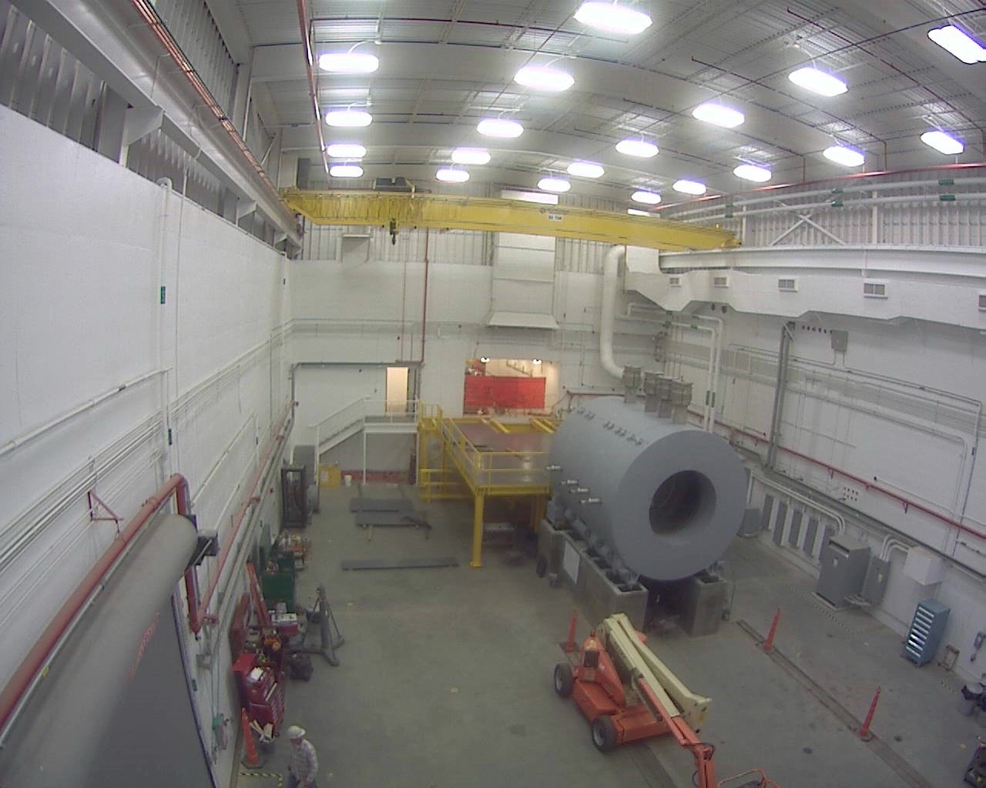
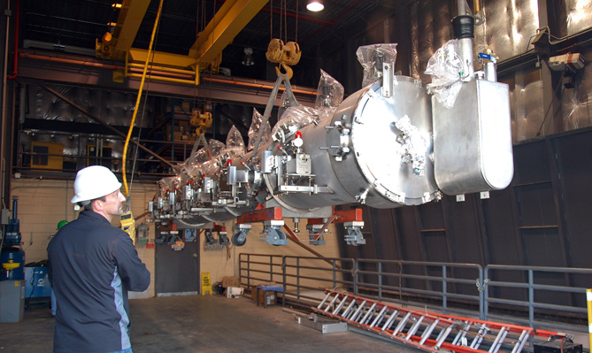
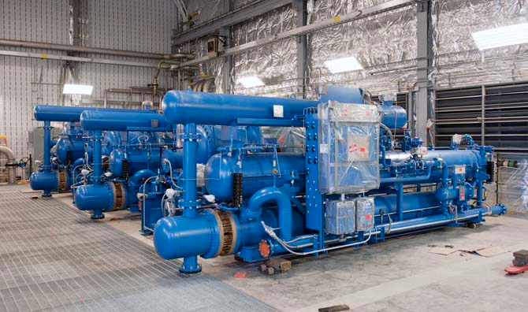
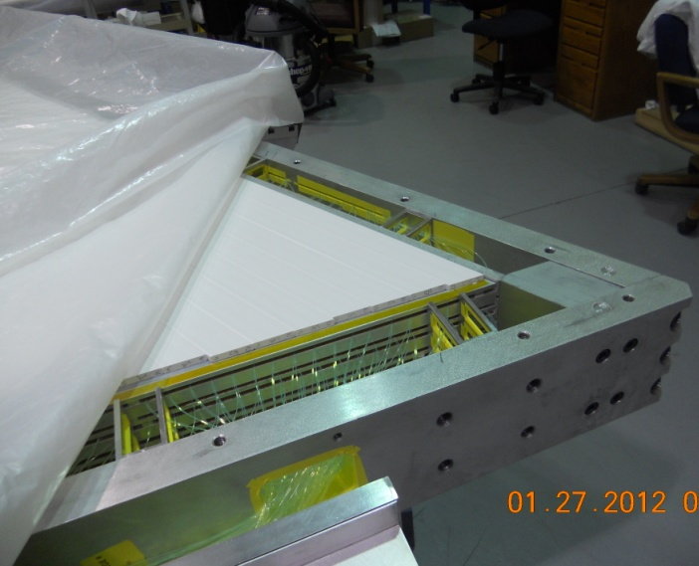
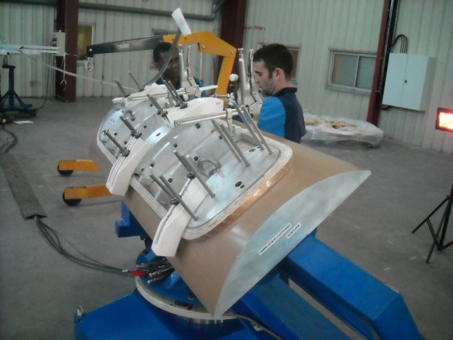
12 GeV Upgrade – Highlights
Hall D Interior
Hall D – equipment installation in progress
Two high-gradient 12 GeV cryomodules installed
and delivering high quality beam; third moved to tunnel
CHL-2 compressors/coolers/skids in place
Superconducting magnets under construction
All major detector systems under construction
All 48 Hall D BCAL modules on site (U. Regina)
Performance Index: schedule 95% ; cost 96%
Third C-100 Cryomodule
transferred to tunnel
Central Helium Liquefier-2
installation
Hall B Pre-Shower
Calorimeter
Hall C Dipole
Prototype Coil

Slide 6
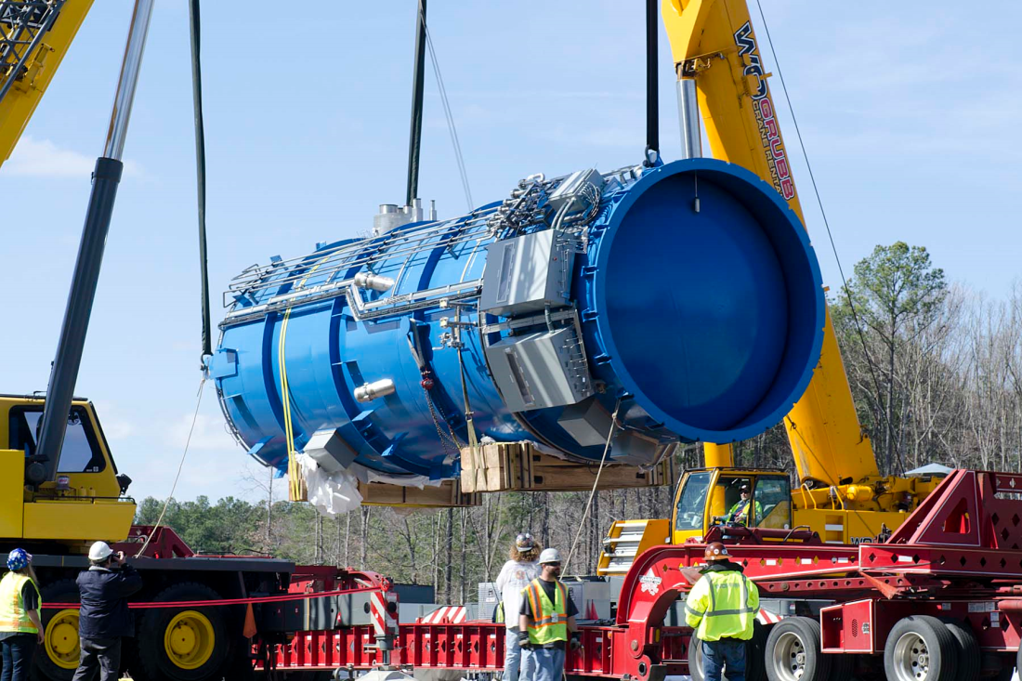
12 GeV Project: CHL-2 Cold Box Delivery (50T)

Slide 7
Future Projects
Super Bigbite Spectrometer (SBS)
Successful review in Oct. 2011
Updated project management plan submitted Dec. 2011
- Approval to proceed from DOE-ONP, Mar. 2012
MOLLER (PV e⁻ - e⁻ scattering)
- Submitted to DOE-ONP Sept. 2011
SoLID (PVDIS + SIDIS)
- Chinese collaboration still developing
- CLEO solenoid under negotiation
- Directors review in Fall 2012?
HPS (Conditional approval - HEP)
- Parasitic test run in progress

Slide 8
Strategic Plan Status
Held town meetings with Physics, Theory, Accelerator, FEL divisions
Also held one for “Technology Development and Technical Infrastructure” – cryo, accelerator R&D, detector development, etc.
Open town meeting with users March 16
Lab leadership retreat in Summer 2012
JSA Science Council: Recommend broader scope

Slide 9
12 GeV “White Paper”
Preparation for 2012 NSAC activity
Update physics case for “NSAC audience”
Small group of writers/editors
Broader review team
First draft almost ready

Slide 10
“White Paper” Outline
Physics Opportunities with the
12 GeV Upgrade at Jefferson Lab
Overview (3) – Pennington/Ent/BMcK
Meson Spectroscopy and Structure (5) – Meyer, Dudek
Nucleon Structure and Spectroscopy (10) – Meziani, Richards
QCD and Nuclei (5) – Weinstein, Miller
The Standard Model and Beyond (5) – Kumar, Essig
Appendix A: Experimental Equipment (10) – Young

Slide 11
Budget Situation
FY 12 Budget
- Ops OK, run in progress
- 12 GeV project $50M (Baseline = $66M)
FY13 President’s Budget
- Ops ~constant
- 12 GeV project $43M
- UIM start $2.5M
Mar 9 NSAC meeting
Expected subcommittee to consider priorities under budget constraints
No charge…

Slide 12
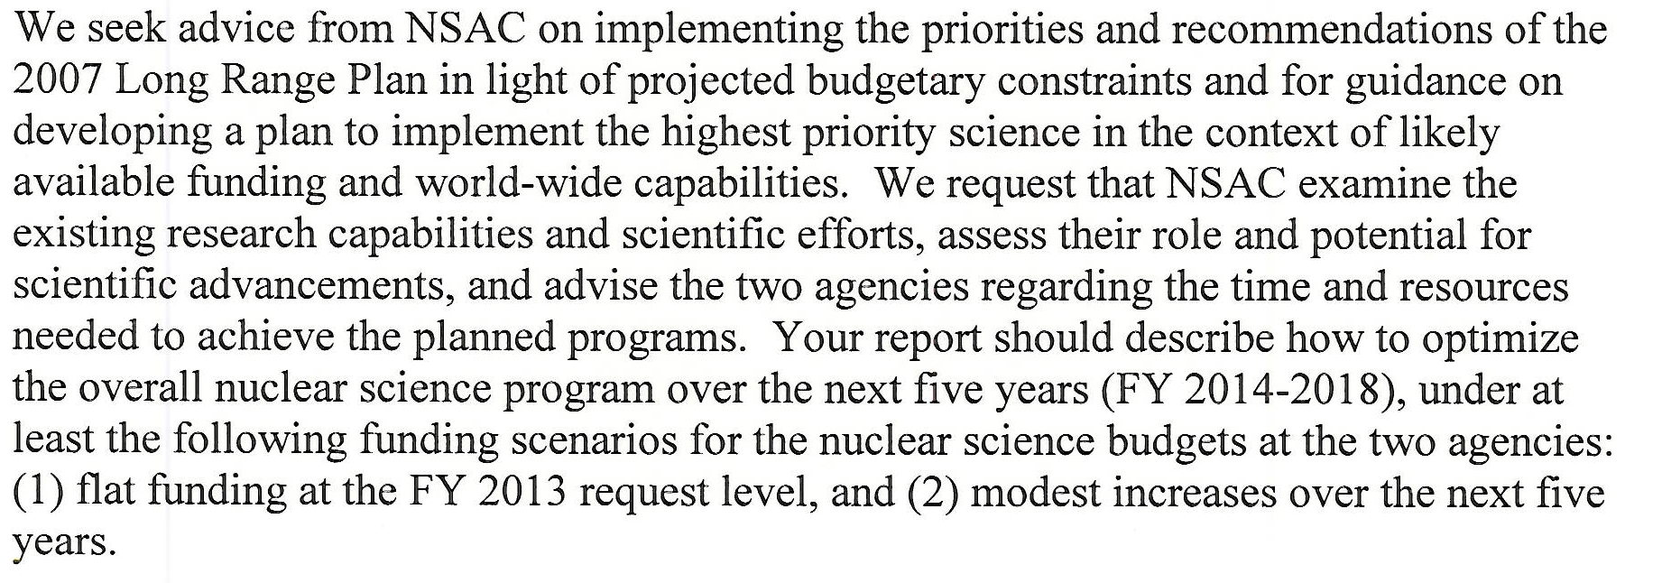
Charge to NSAC (4-5-2012)

Slide 13
Outlook
12 GeV Project going well – budget profile a major challenge in near future
Addn’l NP projects forming a queue
12 GeV white paper for NSAC underway
Strategic plan: Planning retreat for summer

