Slide 1
Update on EM Calorimeter for SoLID
Jin Huang
Los Alamos National Lab
Z. Zhao
University of Virginia

Slide 2
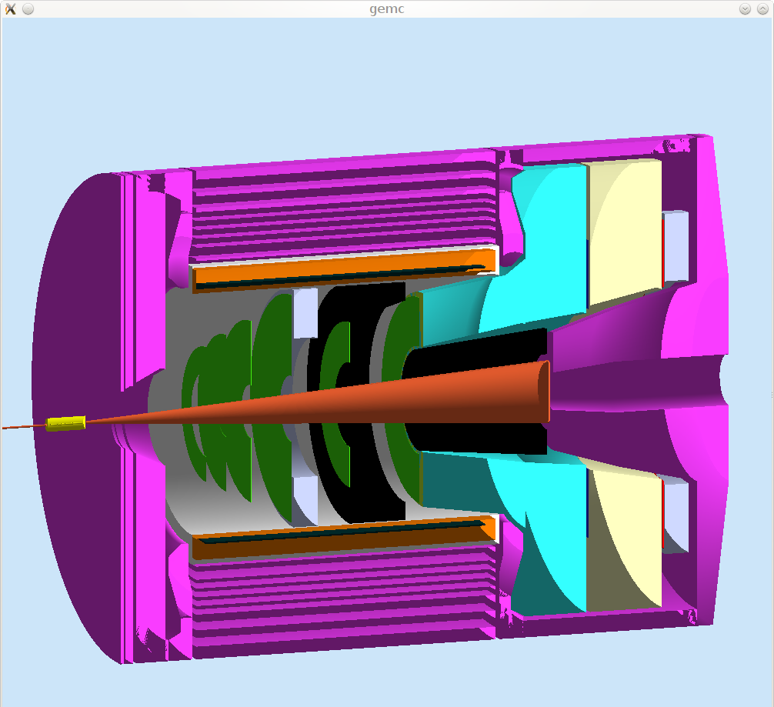
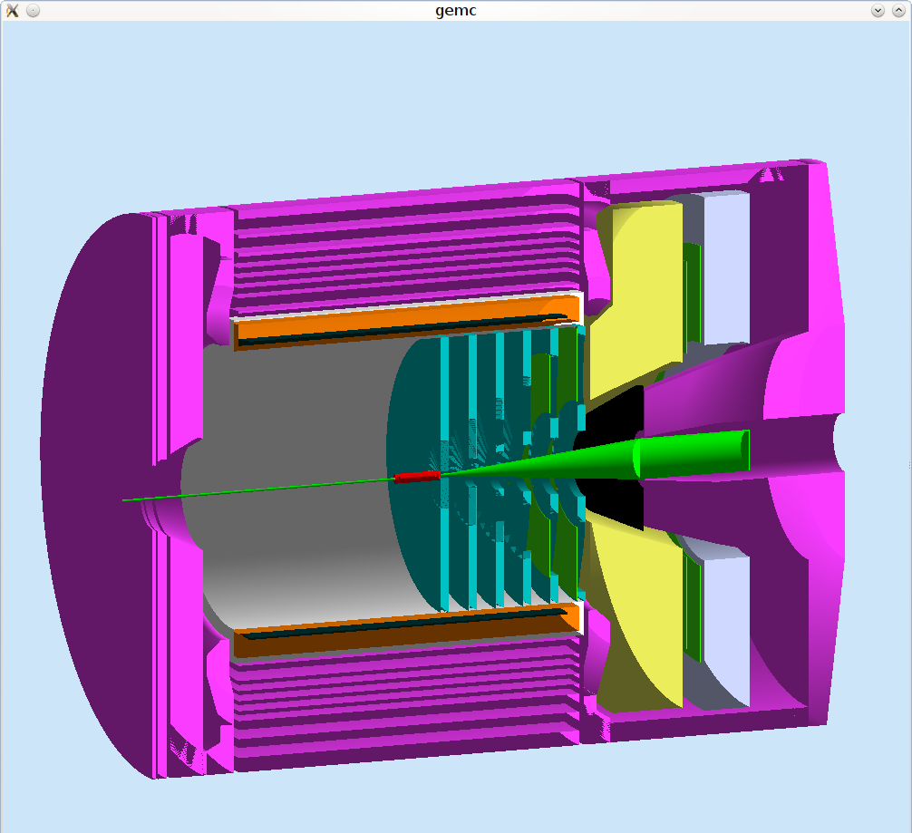
SoLID Calorimeter Overview
PVDIS forward angle
SIDIS forward angle
SIDIS large angle
Electron-hadron separation
~100:1 pion rejection in electron sample
Energy resolution: σ(E)/E ~ 5%/√E
Provide shower Position
σ ~ 1 cm, for tracking initial seed / suppress background
Time response
σ <~ few hundreds ps
provide trigger/identify beam bunch (TOF PID)

Slide 3
Radiation dose update for PVDIS
Total
EM Part
γ dominant
Pi-
Updated dose with baffle made of Pb
Similar level to SIDIS now

Slide 4
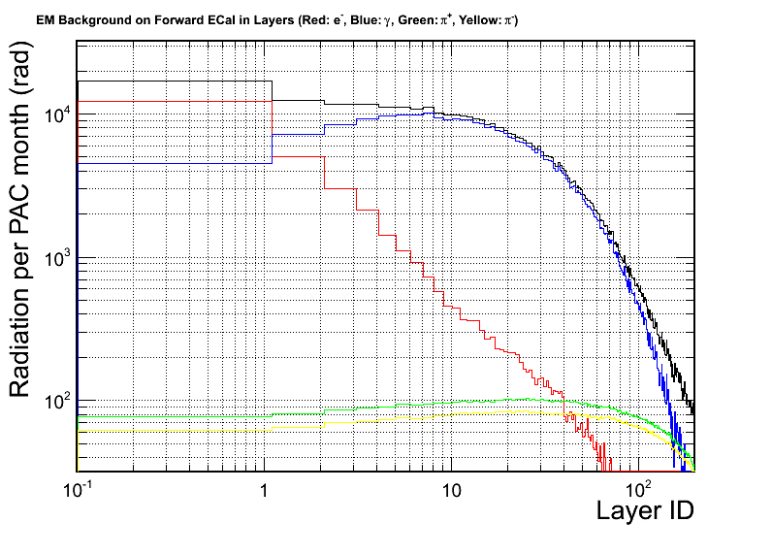
Radiation on fiber path
Preshower
Preliminary
SIDIS
Two dominant effects:
Radiation effect
Worse case: before calorimeter ~10⁴ rad similar to 1st layer of scintillator, Y11 take to 10⁵
False signal in fiber
Wavelength shifting fiber change scintillator photo, not effective scintillator
Main signal are constant background from low energy electron/photon, -> shifting in pedestal
Should try beam tests
Can run fiber from backside of calorimeter and avoid direct view of target
Total
Electron
Photon
Pi+
Pi-

Slide 5
Radiation on preshower
Reaching radiation limit (30% reduction in light output) for current approved experiments
A few possible solutions
Swapping modules between large R-inner R
Radiation dose varies by factor of ~10
Keep searching for high radiation-resistant fiber/scintillator
Replacing the preshower part of calorimeter
Redesign preshower with PbWO4 crystal with wavelength shifting fiber read out

Slide 6
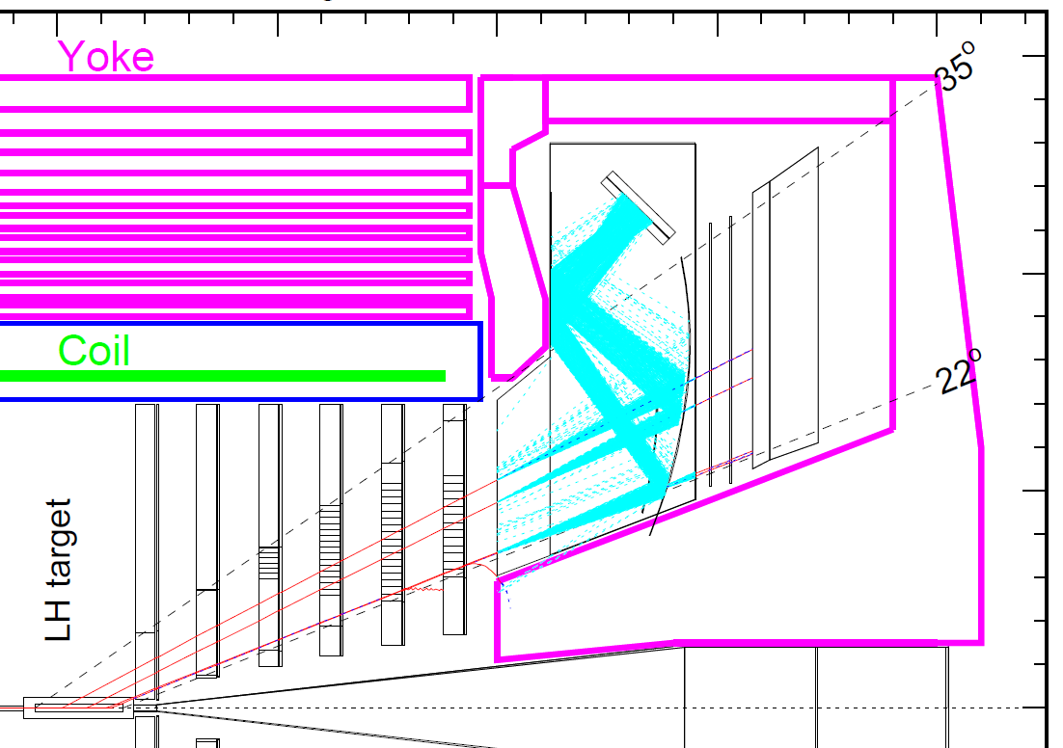
Positioning calorimeter for PVDIS
PVDIS calorimeter have largest polar angle
22 – 35 degree
Not full azimuthal coverage, possible to rotate
Two main factor relates resolution with larger indenting angle
Variation in shower position along track translates into transvesre position
Spread charge into more module -> less discretization effect

Slide 7
Tested in specialized Geant4 simulation with SIMC inputs of realistic tracks
Default layout
Rotated to face central track
Track from target

Slide 8
Corrections
Shower location at predefined plane of nominal max shower =
Center of gravity
Average position with energy weighting
Energy/slope correction
Shifting of shower center with energy, fitted from simulation
Information available from calorimeter only
Discretization correction
Position readout discredited to center of each module
Can be corrected to some extent (see later slides)
Plane of nominal max shower

Slide 9
Effect 1: Probing shower longitudinal size effect w/ very fine segmentation
Nominal layout
Facing track
Residual for corrected shower position (mm)
Residual for corrected shower position (mm)
At nominal of 28 degree, variation of shower translate to 1 cm of uncertainty from the detector intrinsic best ~0.3 cm

Slide 10
Effect 2: Probing shower longitudinal size effect w/ very fine segmentation
Residual (mm) of center of of gravity for 8x8 cm module = 12 mm
Reconstructed location VS track projection
Corrected residual, improved by 2
Fit and correct discretization effect
(Based on calorimeter response only)

Slide 11
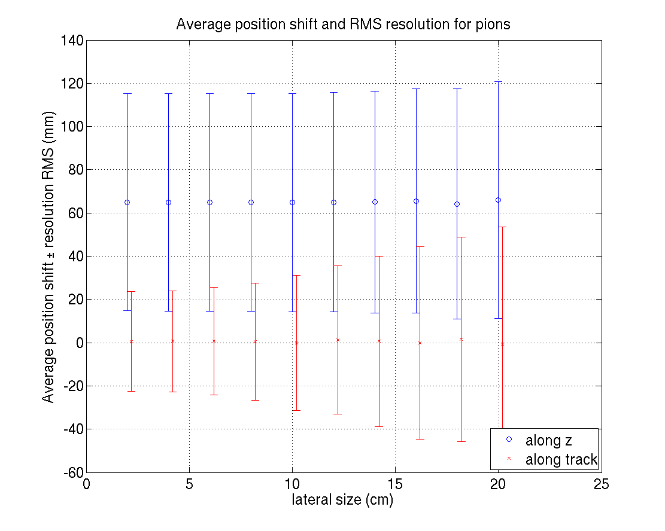
Position resolution VS lateral size
Blue: calorimeter modules along z axis
Red: calorimeter modules along central track
Electron
Hadron
Shifted pion ΔR

Slide 12
Comparison between two choise
No show stopper in either case
Simple to support
Less discretization error
Better resolution after correction
Better pion reconstruction
Smaller size in R
Personal preferable
Nominal layout (along z)
Rotated to face track

Slide 13
Discussions
More discussions
Cable layout
Need R&D on WLS-clear fiber connector
EM energy measurement
5%/Sqrt(E) as baseline + constant term (calibration, etc.)
Constant online calibration with electrons of known momentum
Pion rejection w/ Cherenkov detector
Finalizing pi/e ratio map in CLEO geometry
How much Cherenkov can deliver?
Radiation dose is challenging
Prefer rotated calorimeter to track direction for PVDIS
Next stage of simulation to come w/ background, tower searching
Calorimeter test in the following section

Slide 14
COMPASS Shashlik Module Test
Gain experience with the COMPASS Shashlik module.
Determine energy resolution at different energies and different impact angles.
Determine position resolution at different energies and different impact angles.
Anchor simulation with data.

Slide 15
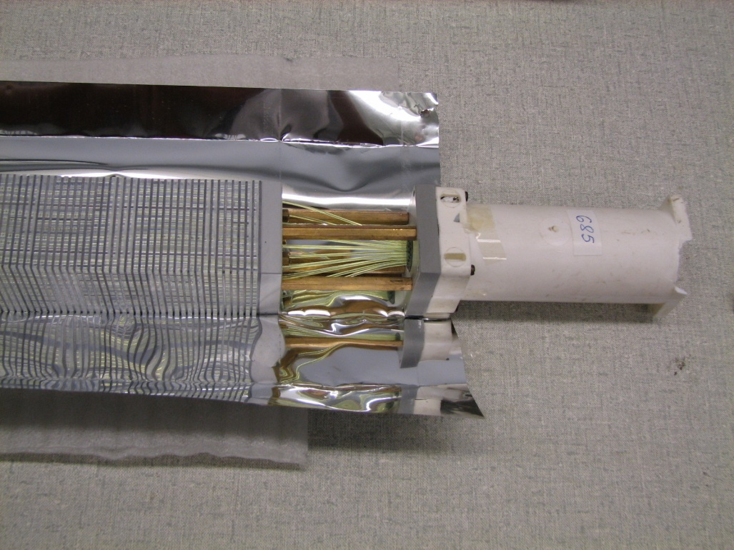
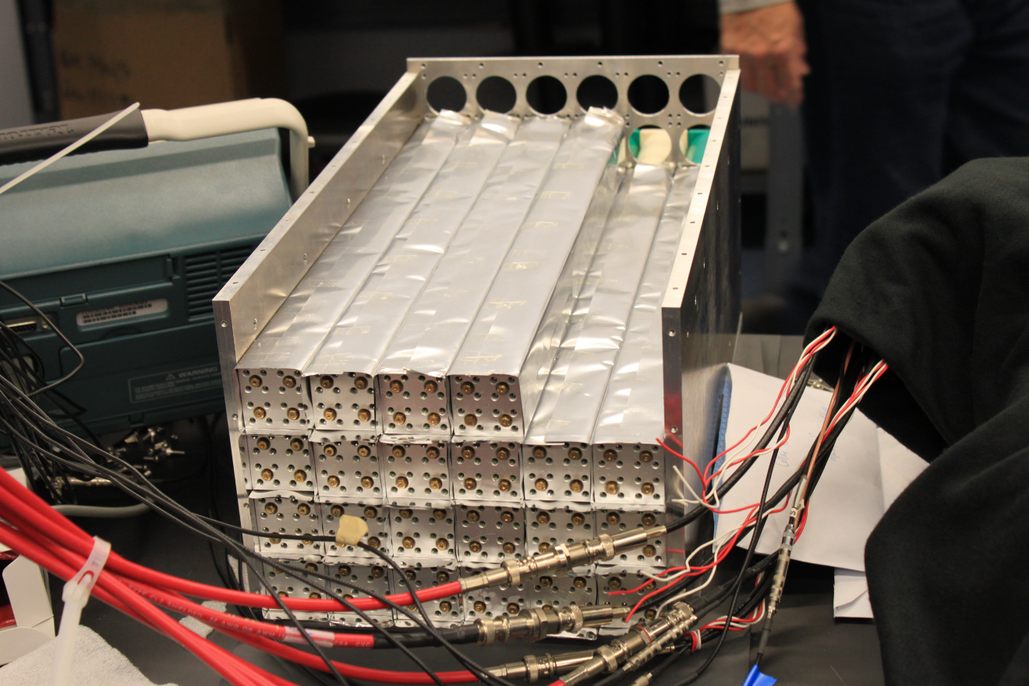
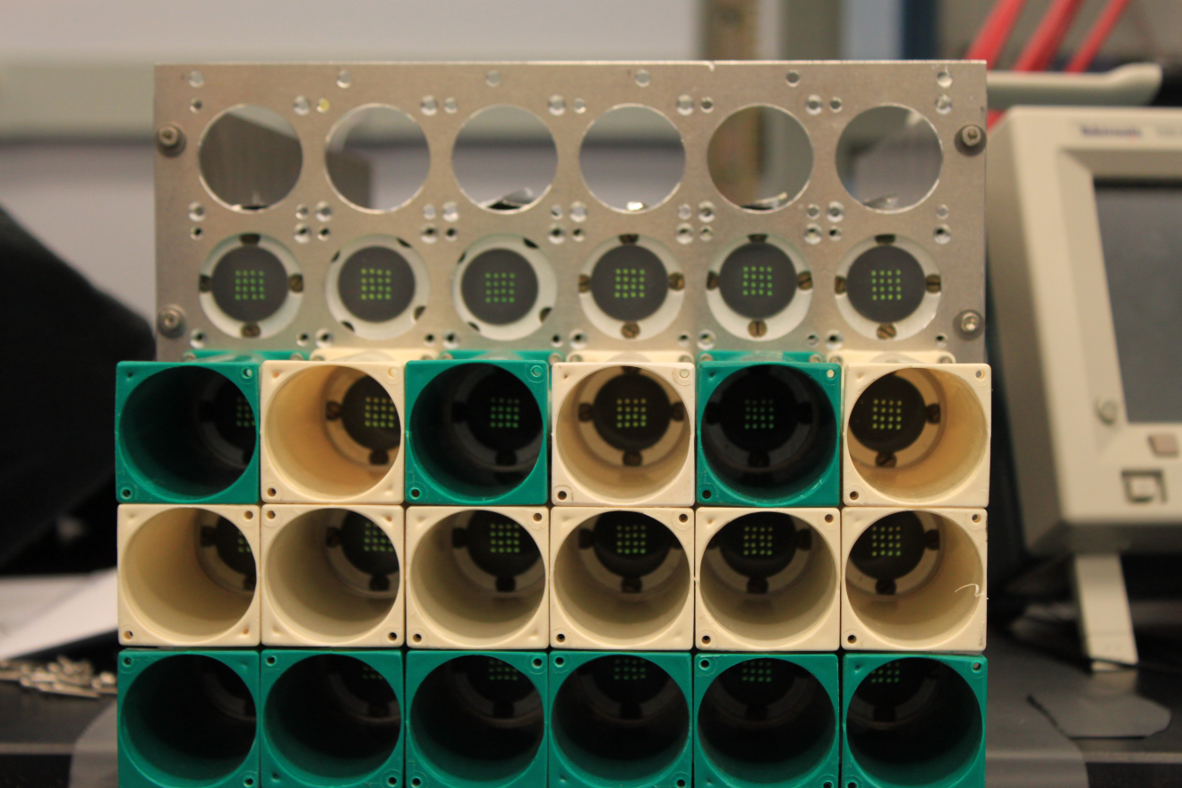
COMPASS modules used for TPE@CLAS

Slide 16
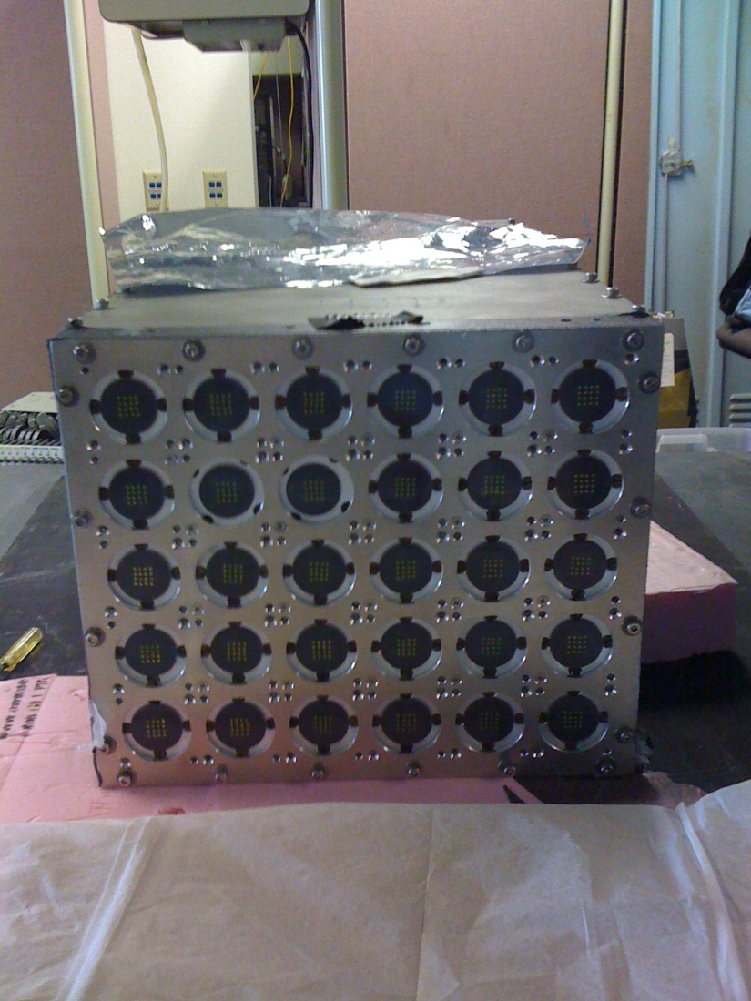
Module and readout
Module is in TPE frame with original PMT removed. 30 of 3.8x3.8cm modules in 6x5 array.
Readout: 1.1"D Photonis
XP2972 PMTs, used in HallA
DVCS proton array.

Slide 17
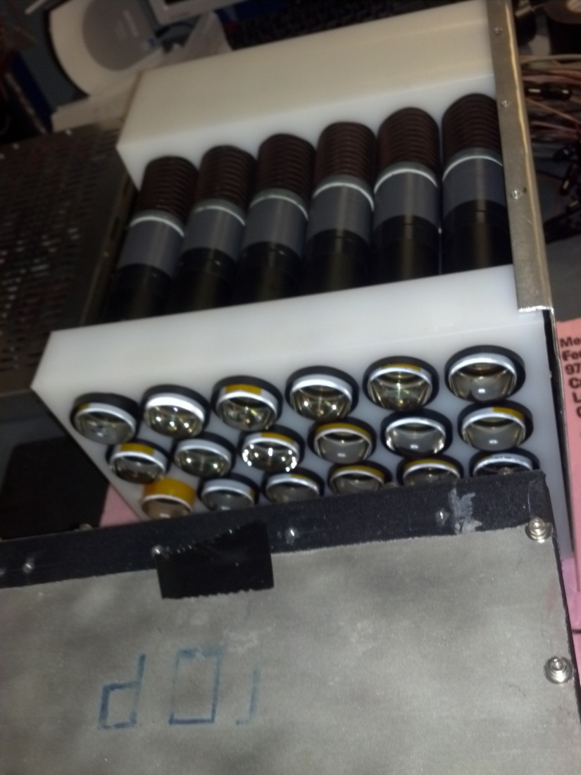
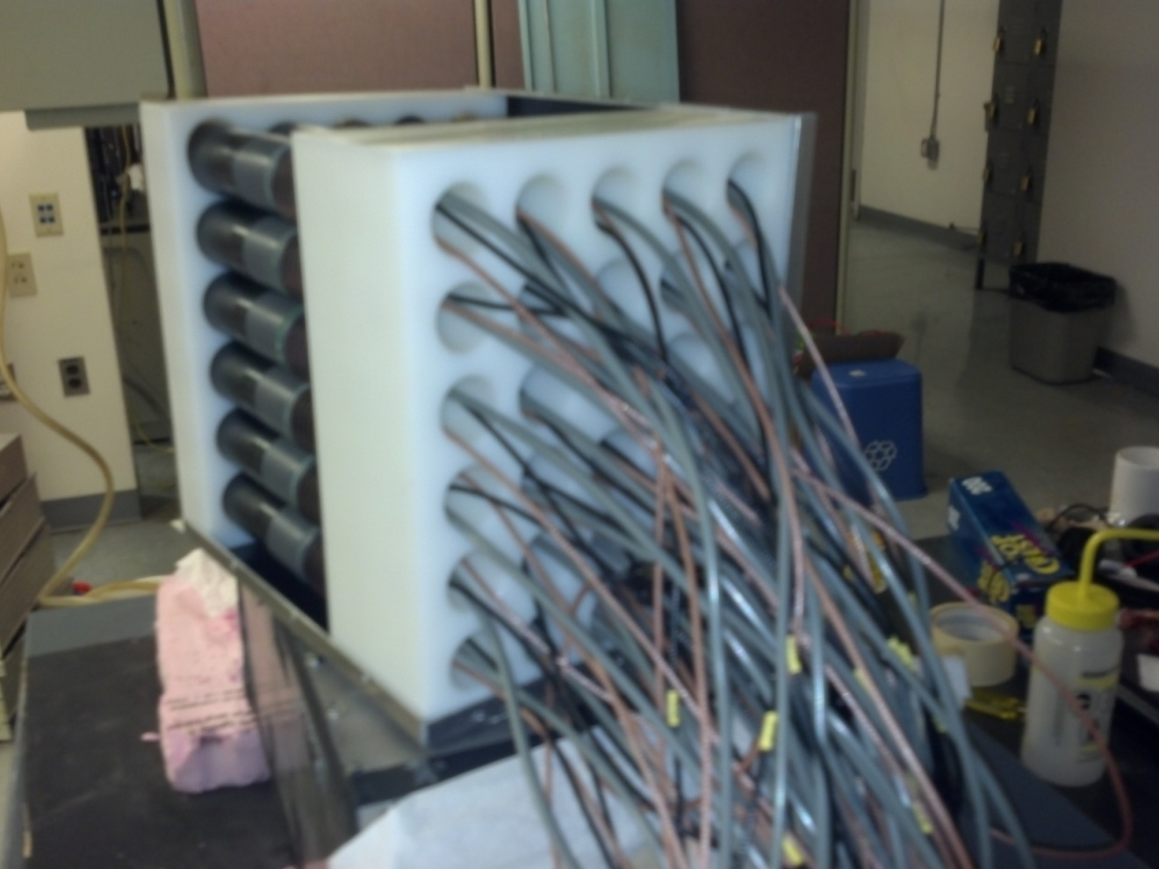
Mounting the two

Slide 18
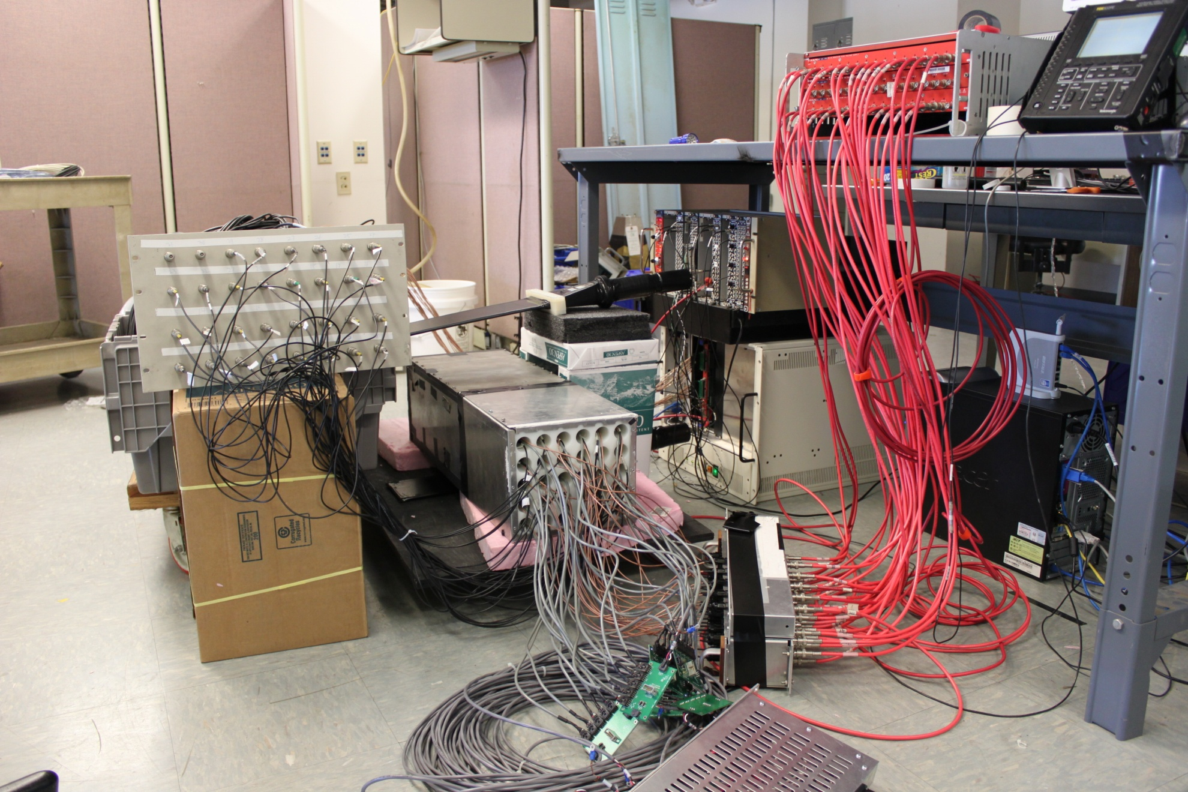
Cosmic ray test (horizontal setup)
HV power supply
Scope
Two scintillation paddle
as coincidence trigger
VME & NIM
module
Delay cable
DAQ computer, coda 2.5
LV power supply

Slide 19
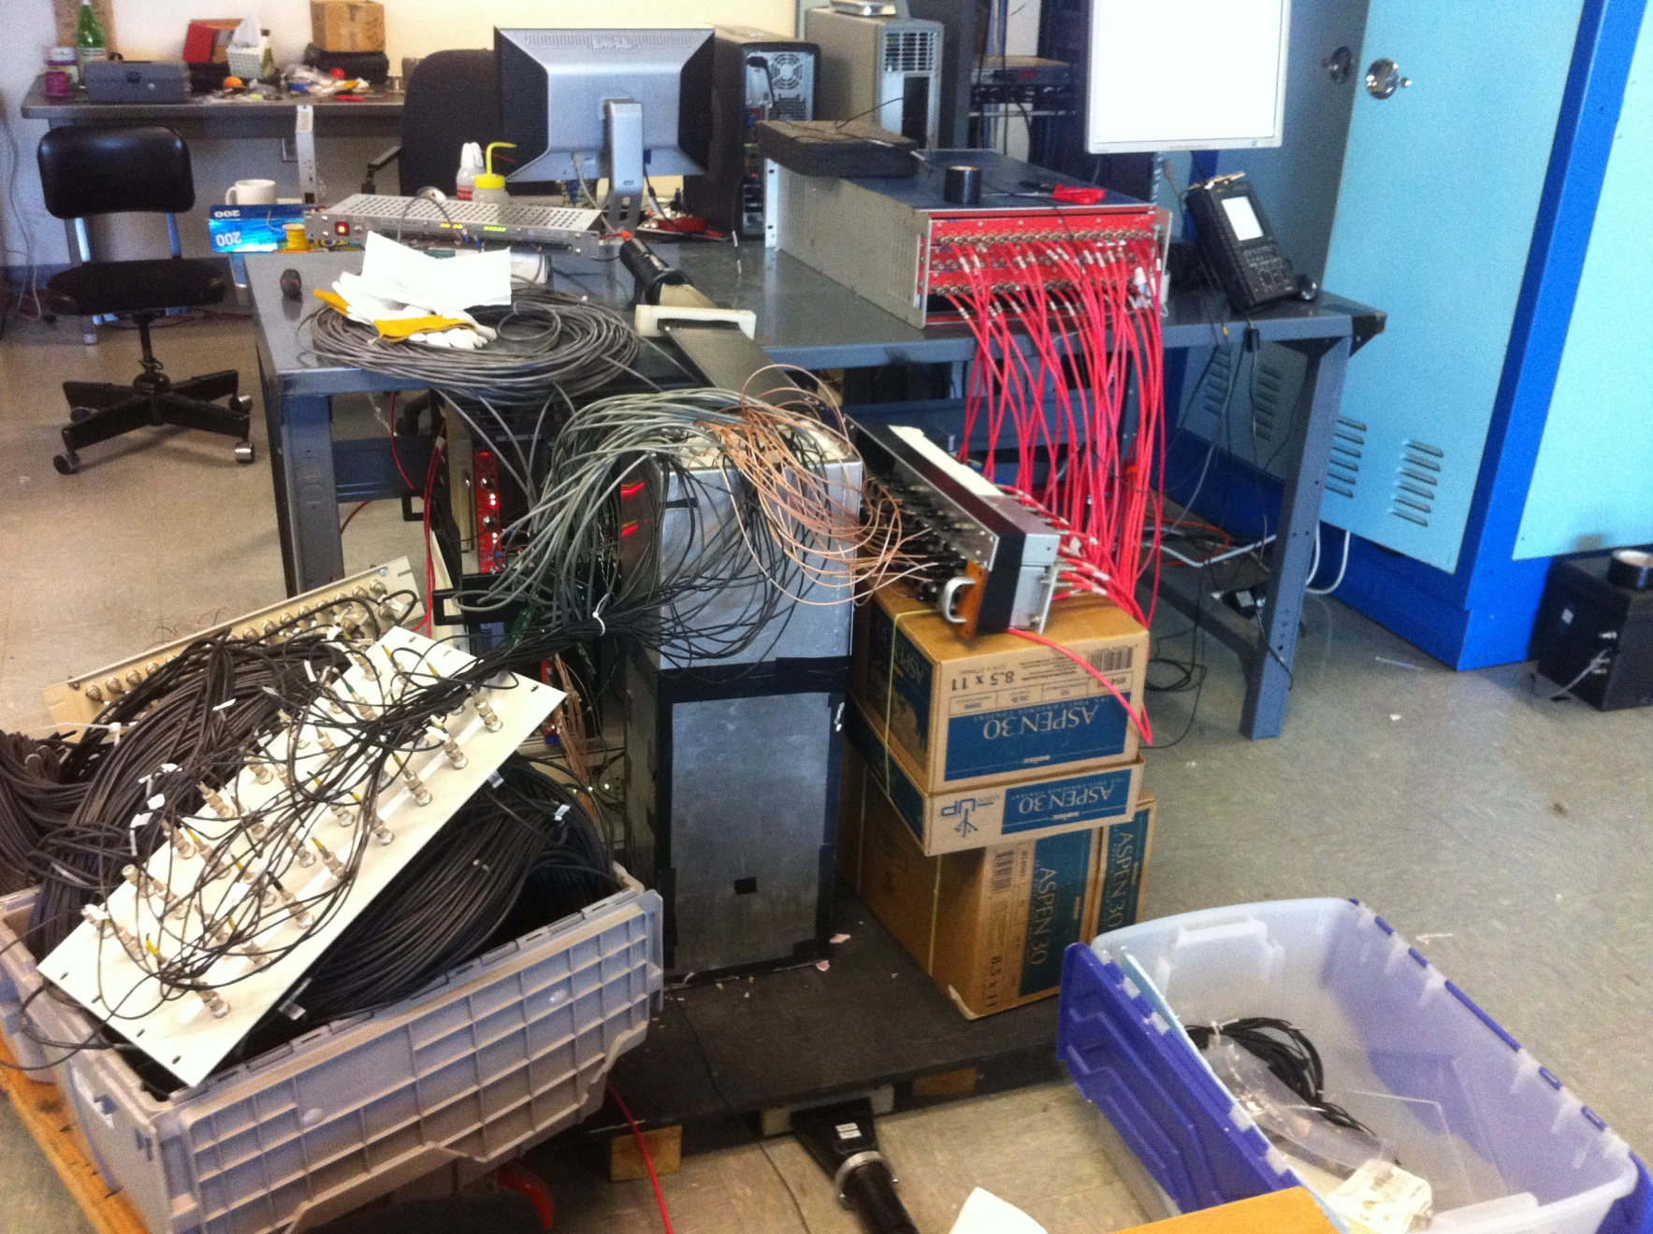
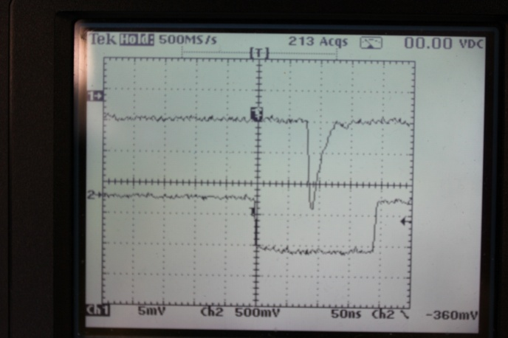
Cosmic ray test (vertical setup)

Slide 20
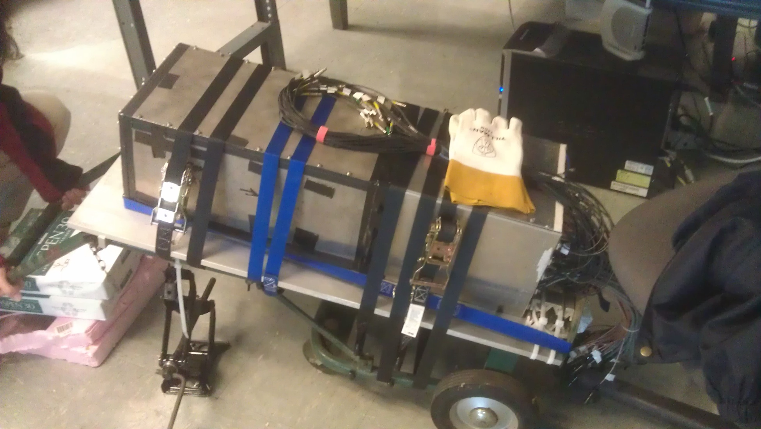
Moving and Support

Slide 21
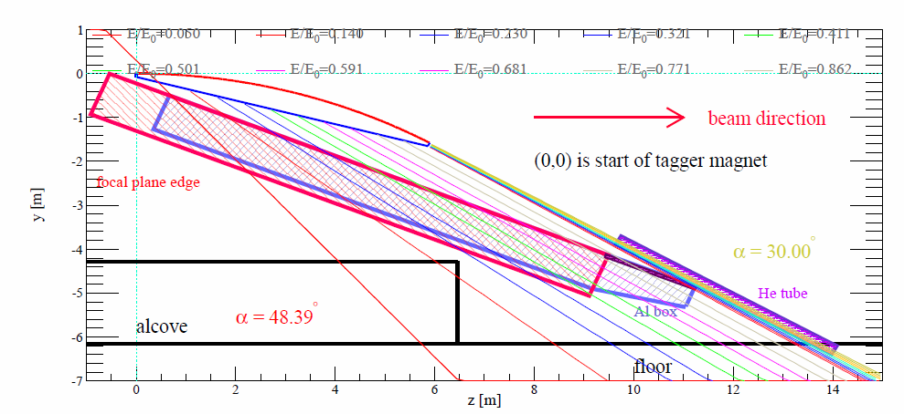
Test under CLAS photon tagger
Electron with known energy and impact angle
Variable energy, variable impact angle
Possibility to use Hall B DAQ resource
HallD FCAL
SoLID EC
HallD BCAL

Slide 22
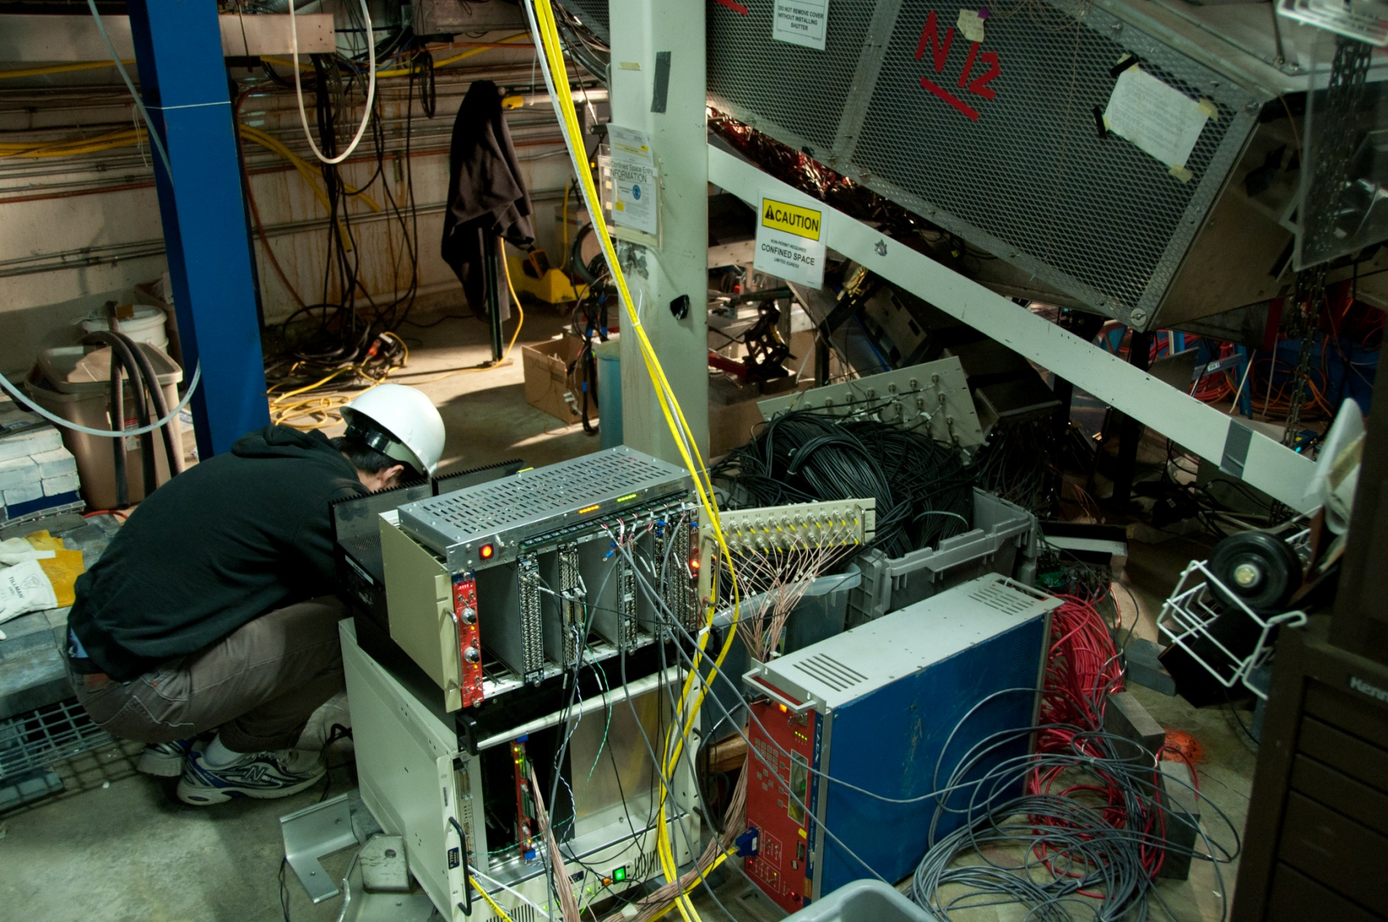
In HallB, under Photon Tagger
electron
tagger
SoLID EC
worker
Tagger dump

Slide 23
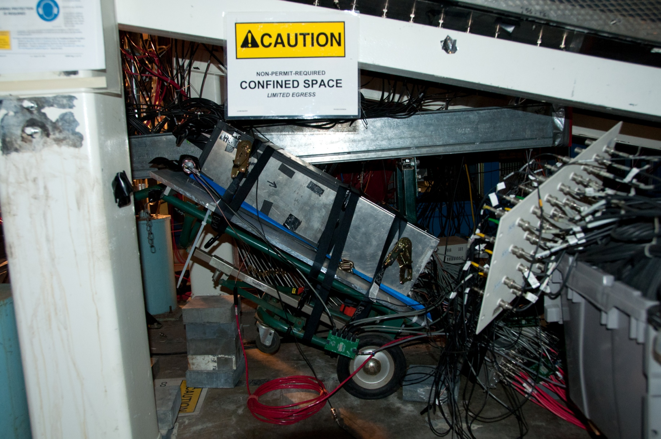
Tilting at about 32 degree to start with small angle beam impact
Electrons

Slide 24
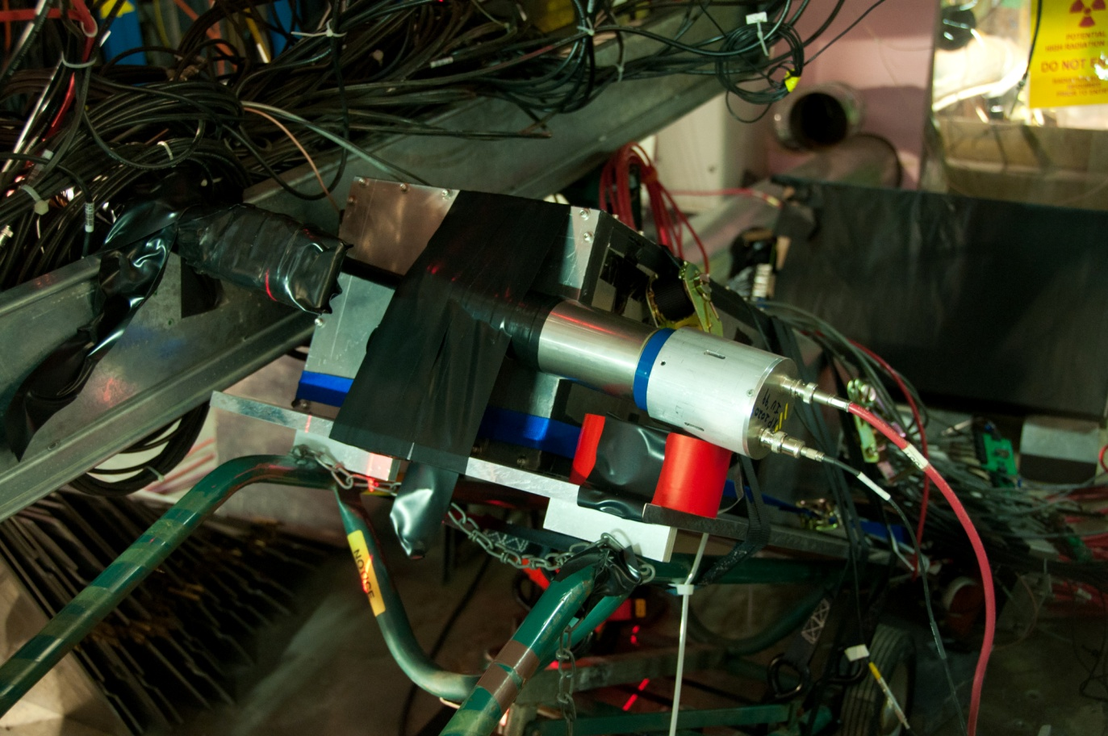
Two small scintillatiors as coincidence trigger
size 1x5x15cm, upstream
size 0.5x1.5x10cm, downstream
electron
SoLID EC

Slide 25
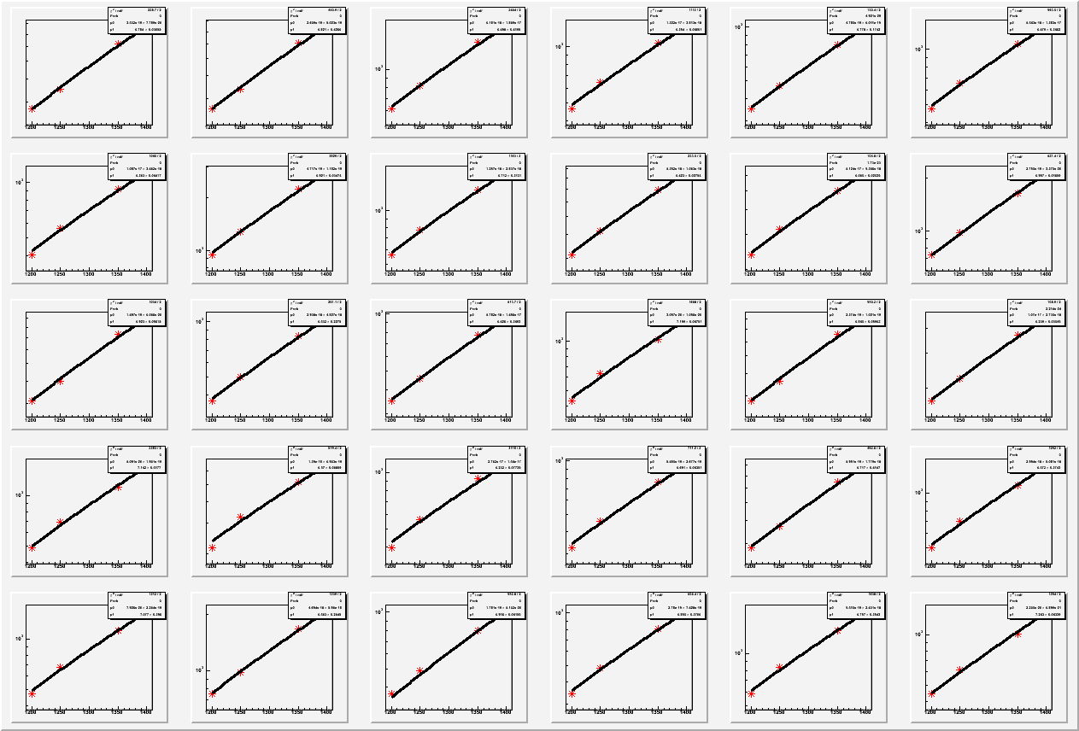
Cosmic ray gain match ( ADC-Ped : Voltage)

Slide 26
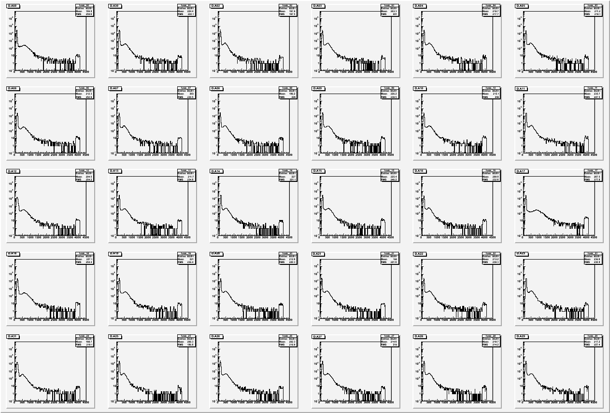
Cosmic ray gain match after matching, most signals are within factor of 0.7-1.5

Slide 27
Backup Slides
(summary on page 13)

Slide 31
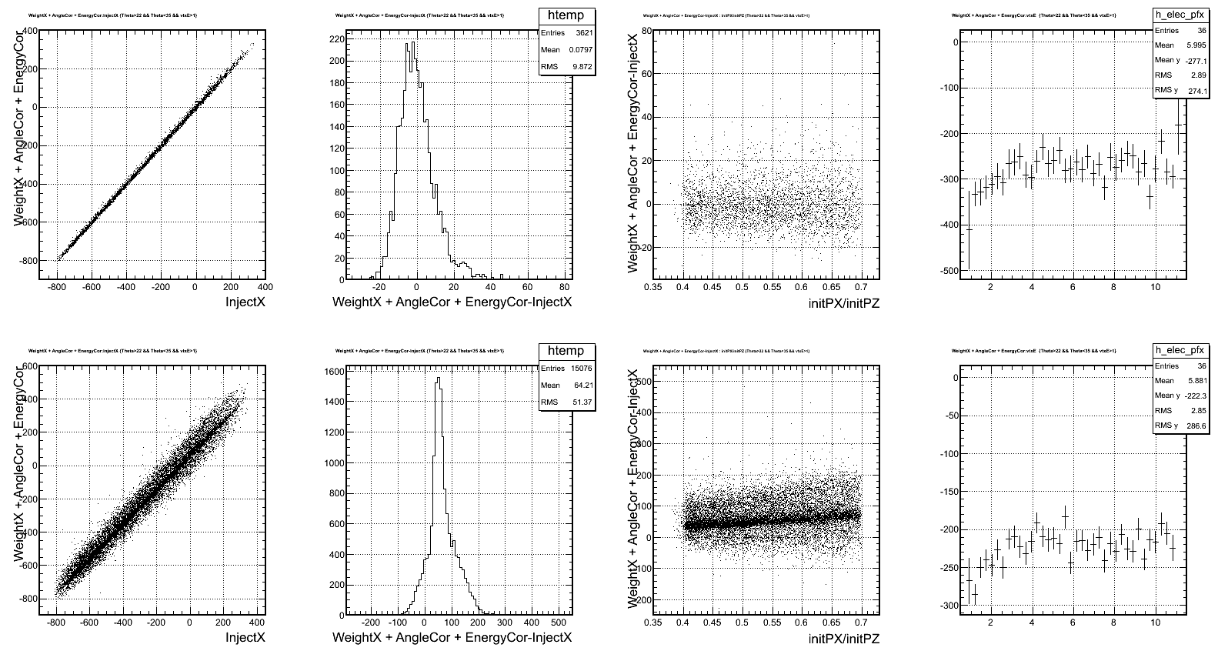

Slide 32
Requirement
Radiation resistant
PVDIS forward angle
EM <=2k GeV/cm²/s + pion (GeV/cm²/s), total ~<60 krad/year
SIDIS forward angle
EM <=5k GeV/cm²/s + pion , total, total ~<100 krad/year
SIDIS large angle
EM <=20k GeV/cm²/s + pion, total, total ~<400 krad/year
Overall dose shown above, better inspected
The Layout need to satisfy 2-fold rotation symmetry for SIDIS.
Modules can be easily swapped and rearranged for different configuration.
Photonsensors located outside of magnet yoke, fiber connection is one solution.
A reasonable cost, strongly affected by the number of modules/channels, to cover the same acceptance area, we need the module transverse size not too small.
Depending on baffle design

Slide 33
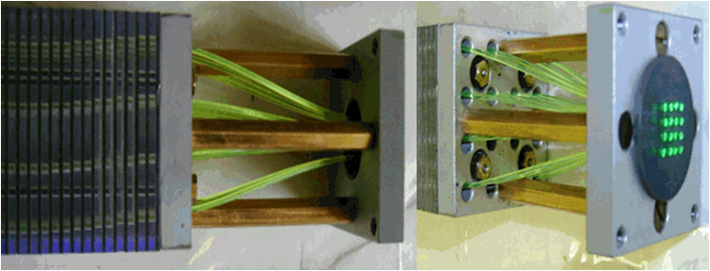
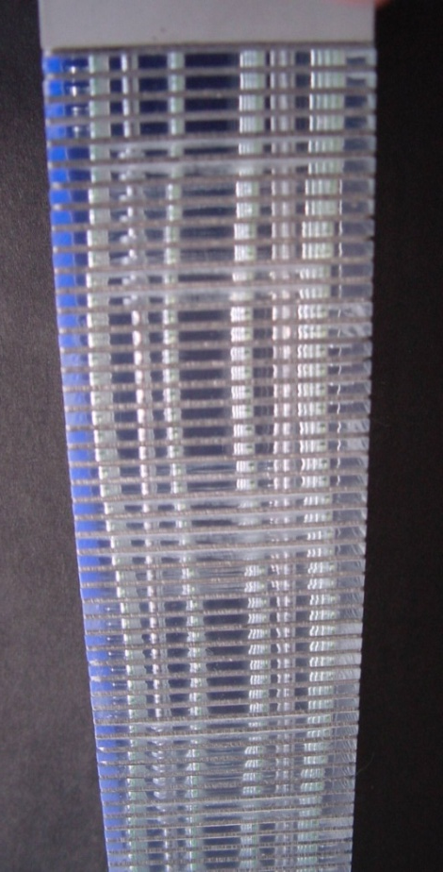
Best option: Shashlyk Calorimeter
IHEP, COMPASS Shashlik, 2010
Shashlyk calorimeter
Lead-scintillator sampling calorimeter
WLS Fiber collects and reads out light
Satisfy the SoLID requirement
Good energy resolution (tunable)
Radiation hardness ~ 500kRad (improvable)
Good time resolution (100ps)
Easier to collect and read out the light
Well developed technology, used by many experiments
IHEP production rate about 200 per month

Slide 34
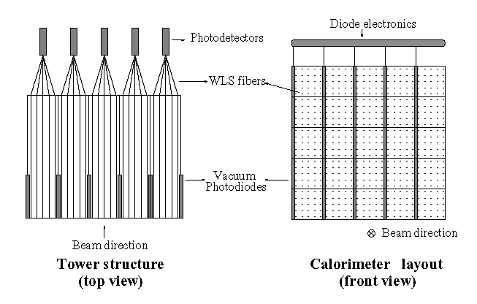
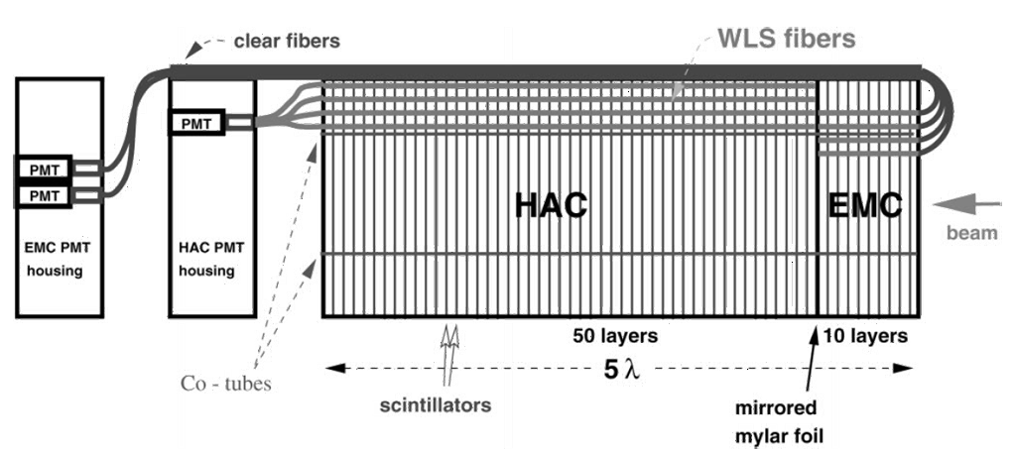
Preshower/shower
Preshower-shower separation for better electron PID
4 RL as preshower, 16 RL as shower
Readout option 1, separate readout
Run preshower fiber through shower part with light-protection
Run preshower fiber (separately) to outside magnetic field
Curve fiber from front, ZEUS example below
Readout preshower by photodiode, example on right.

Slide 35
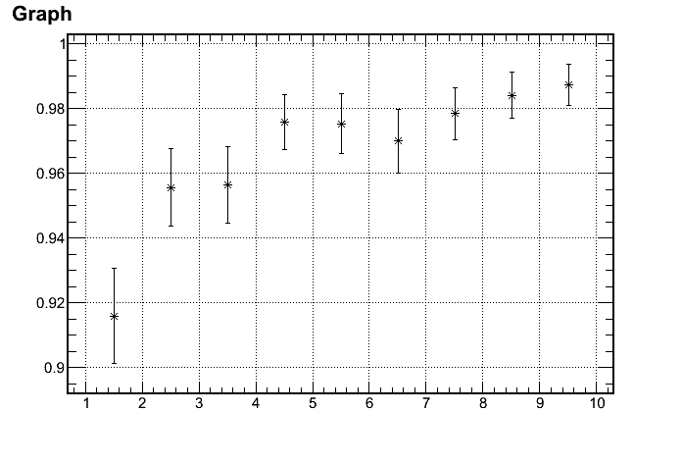
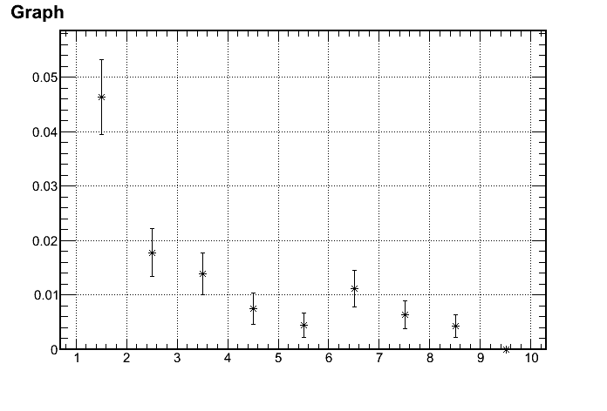
Pion rejections leads the design
Reach 100:1 pion rejection
0.6mm lead/1.5mm scintillator 200 layers, 42cm in length (20 X₀)
Electron Efficiency
1/(Pion rejection)
97%
1/100 Rejection
p (GeV)
p (GeV)
Active:
3~7 GeV

Slide 36
Thickness optimized
Reach Best rejection @ ~20 rad length
Preshower + Shower
Can not contain EM shower
More hadron shower
Total rad length
Reach Best rejection @ 3~5rad length
Preshower part
MIP energy deposition: ~60MeV (preshower) 300 MeV (TotalShower)
Preshower length

Slide 37
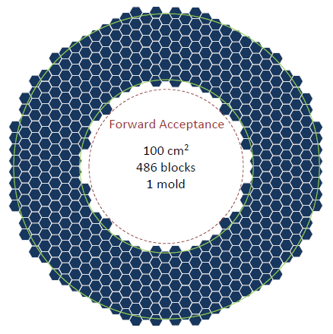
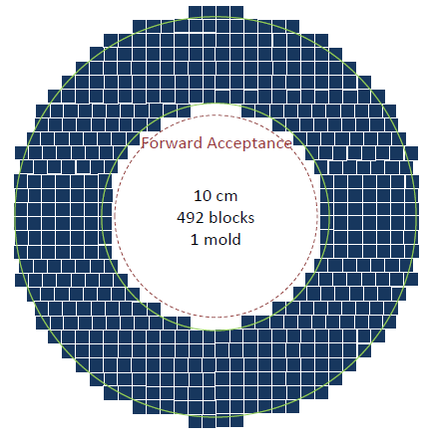
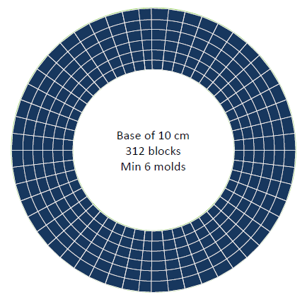
ECAL Design: Layout
Preferred Square
- Easy assembly
- Mature production
- Easier rearrangement

Slide 38
Calorimeter Design: Fibers
Fibers:
Wave Length Shifting fibers (WLS):
KURARAY Y11, ~150 fibers/module
Clear Fibers: KURARAY clear PS, Super Eska…,
Connectors
Optical WLS/clear fiber connector, used in previous experiments (LHCb, Minos) light loss studies and design well documented
Clear Fiber in 24 wide ribbon cables by Mitsubishi, coated with black Tedlar for protection and light tightness
24 wide connectors from DDK to link WLS and clear fiber ribbon cables
Fibers are fly cut and polished with diamond fly cutter, possible use
of an optical couplant to reduce light loss.
Fiber bunch diameter for one module 10 mm
For 1500 modules, min. length of WLS: ~100 km!
Clear fiber length depends on the readout option ~500km?
Ongoing work: study of the fiber bundling design

Slide 39
Preliminary Budget Estimate
Experiment | Angle (degree) | Radius (cm) | Area(m²) | Number of modules | Module cost (M$) | Fiber Extension (M$) | PMT+ support (M$) | Total cost
PVDIS (forward angle) | 22-35 | 110-258 | ~10 | 1000? ~Baffle design | 1.5 | 0 | 0.6 | 2.1
SIDIS (forward angle) | 9-15 | 107-202 | 11 | 908
SIDIS (large angle) | 17-24 | 82-141 | 5 | 492 | 0.8 | 0.3(?) | 0.3 | 1.4
+ Support structure: 0.2M$ (?)
10x10cm Shashlyk module costs about $1~1.5K each
Rearrangement of modules between PVDIS & SIDIS large angle calorimeters
PVDIS : factor 0.5 reduction due to only covers ~half of azimuthal angle

Slide 40
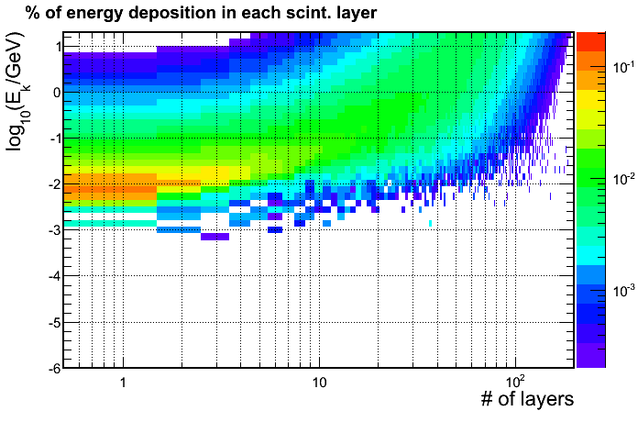
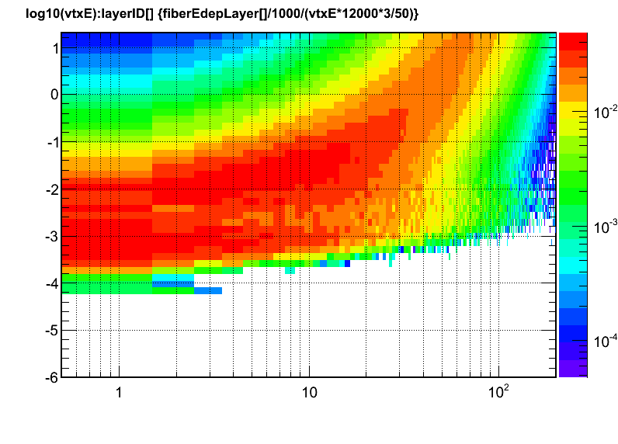
Simulate the radiation level
Overall dose close the calorimeter limit -> inspect radiation inside calo.
The radiation dose for scintillators is 100krad~2Mrad (material dependent)
Use Geant3/Wiser tools to simulate radiation background
Use Geant4 simulate energy deposition in each layer for various background
Energy deposition for e⁻
Energy deposition for γ

Slide 41
Detailed dose - SIDIS
Low E photon dominant
Total
Electron
Photon
Pi+
Pi-
Preliminary
Can be shielded 2mm-Pb equivalent
Background model still under verification

Slide 42
Detailed dose - PVDIS
Total
Total EM
Pi-
Very Preliminary
Background and baffle model still under verification

Slide 43
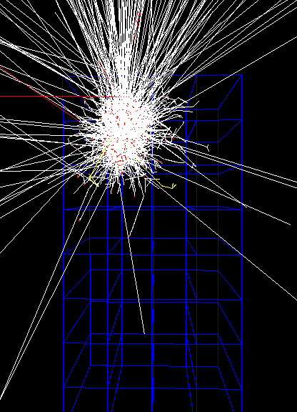
Simulate edge effect
Calorimeter module laid long z direction
Particle impacts to calorimeter with an angle to normal direction
Edge event can not be fully contained in calorimeter
How wide is this edge region?

Slide 44
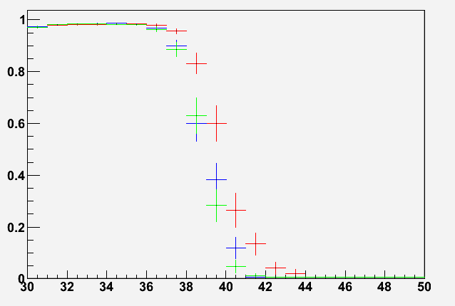
The edge effect - PVDIS
Have largest indenting angle
Calorimeter edge to target center -> 40 degree
P<4GeV
4GeV<P<8GeV
P>8GeV
Electron energy deposition in EC
Physics Need
Geometric limit
95% Contain
Azimuthal angle at target

Slide 45
COMPASS modules used for TPE@CLAS

Slide 46
COMPASS Calorimeter in the Shashlik produce line
Experiment | COMPASS | PANDA | KIPIO
Pb Thick/ Layer (mm) | 0.8 | 0.3 | 0.28
Sci Thick/ Layer (mm) | 1.5 | 1.5 | 1.5
Energy Res. a/sqrt(E) | 6.5% | ~3% | ~3%
Rad. Length, X₀ (mm) | 17.5 | 34 | 35
Total Rad. Length (X₀) | 22.5 | 20 | 16
Moliere radius (mm) | 36 | 59 | 60
Typical Detecting Energy | 10¹~10²GeV? | <10GeV | <1GeV
Lateral Size (cm) | ~4x4 | 11x11 | 11x11
Active depth(cm) | 400 | 680 | 555
Close to the layer configuration that we need
Less sampling and worse energy resolution
Finer lateral size

Slide 47
Proposed floor Plan @ Hall B photon tagger
Electron with known energy and impact angle
Variable energy
Possibility to use Hall B DAQ resource

Slide 48
Beam Test Status Thanks to the hard work of Z. Zhao
Module and readout (PMT, base etc) are in Jlab
Working on connecting PMT to module
Working on supporting structure by using Unistruct parts
Bench test and move into HallB around March.
Take advantage of the experience
of other calorimeter test under the
CLAS tagger.
F
Side view
E
C
E
D
G
B
G
A
A

Slide 49
Calorimeter box and support
A: 4 wheels to move around
B: 2 long bars for bottom support
G: 2 short bars for bottom support
C: 2 bars for vertical support
D: 2 bars to lift the box
E: 2 bars to connect the box
F: the box with size about (30x25x80cm) and weight about 250lb)
The main features of the support:
It can support the box and be stable
D can move along C, so the box can be tilted at different angles.
F
Side view
E
C
E
D
G
B
G
A
A
C
C
F
Bottom view
E
E
D
D

Slide 50
Conclusion
Keep pursuing the Shashlyk calorimeter design
Studied sampling/thickness/size/layout
Budget ~ 3.5 M$
Beam test on the way
Hands-on experience.
Anchor the simulation to finalize parameters
Many open questions
Finalize background radiation simulation
Preshower and shower segmentation
Fiber connectors
Detecting pi-0? $$ needed
Fund the detector!

Slide 51
Choosing EC Type
PVDIS and SIDIS radiation level (400krad per year) is too high for lead glass and crystals (1krad), both Shashlyk or SPACAL/SciFi (0.5-1M rad) will work.
Both Shashlyk and SciFi have good energy, position and time resolution.
SciFi costs more
SciFi needs about half volume being scintillation fibers for good energy resolution.
1mm diameter fibers cost $1/m.
Forward angle EC (10m² area, 0.4m depth), Large angle EC (5m² area, 0.4m depth)
SciFi , total $4M for the fiber alone.
Shashlyk , total from $1.5M to $2.2M for produced modules of 10x10cm from IHEP.

Slide 53
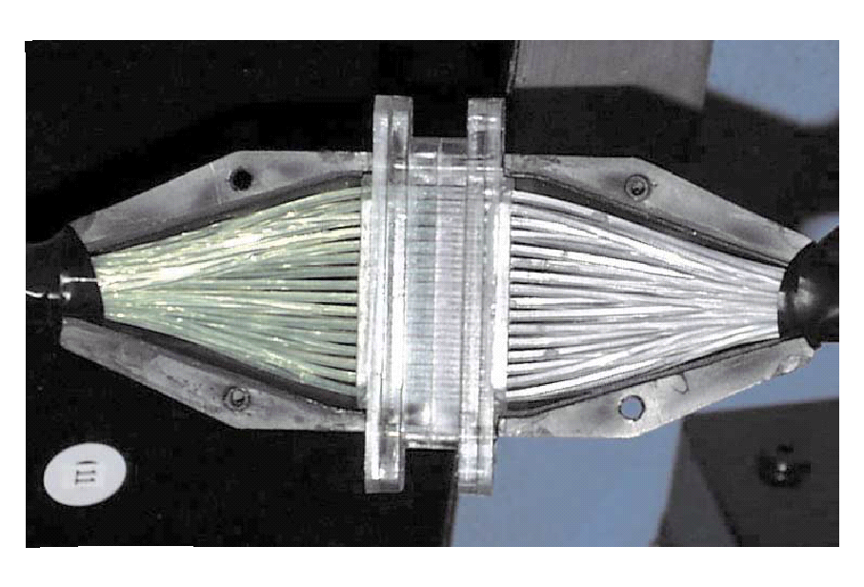
Calorimeter Design: Connectors
Option 1:
One to one WLS/clear fiber connector,
used in previous experiments (LHCb, Minos)
128-fiber connector
LHCb

Slide 54
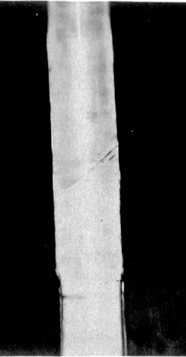
Calorimeter Design: Connectors
Option 2:
Thermal fusion: splice the WLS and clear fiber.
Giorgio Apollinari et al NIM in Phys. Research. A311 (1992) 5211-528
joint
Option 3:
Glue the WLS fibers to a lucite disk coupled to a lucite
Rod with optical grease or Si gel “cookie”.
Would reduce the cost significantly
Need more R&D to decide what is the best option.

Slide 55
https://hedberg.web.cern.ch/hedberg/home/caleido/caleido.html

Slide 56
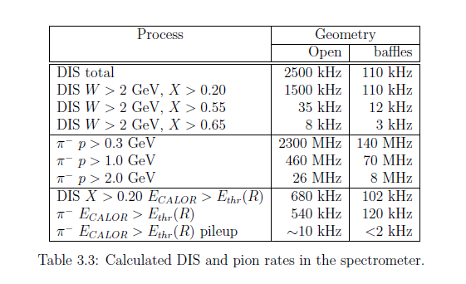
PVDIS rate

Slide 57
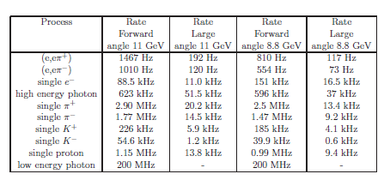
SIDIS rate

Slide 58
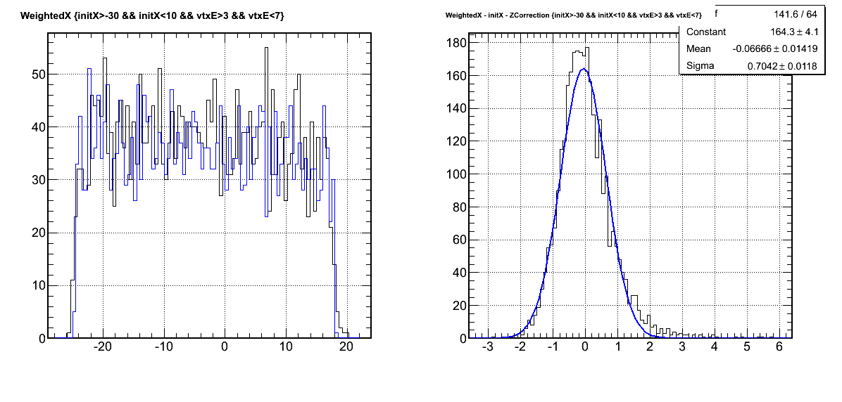
Transverse Size
Larger Transverse Size means
Less position resolution, position become discrete
More background
Less Cost
Illustration w/ 2x2cm model (intrinsic res.)
Energy deposition weighted position average
Integrated over working momentum range
Reconstructed
– (Track projection)
σ(ΔR)~0.7cm
Electron Track Projection
Reconstructed
R (cm)-1(cm)
ΔR (cm)

Slide 59
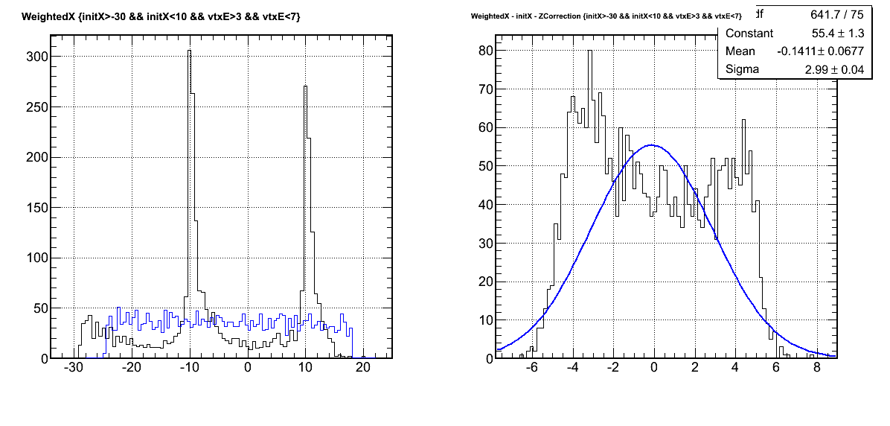
Electron Track Projection
Reconstructed
Difference
10x10 cm block size
Noticeably discrete
σ(ΔR)~1.0cm
R (cm)-1(cm)
ΔR (cm)
Electron Track Projection
Reconstructed
Difference
20x20 cm block size
Discrete effect dominant
σ(ΔR)~3.0cm
R (cm)-1(cm)
ΔR (cm)

Slide 60
More consideration on transverse size Rough numbers only
w/ 50ns ADC gate
block Size (cm)

