Slide 1
Update on GEM R&D at UVa
Kondo GNANVO
University of Virginia

Slide 2
Outline
Update on Construction of SBS GEM prototype
New Design for the SBS GEM
Toward the Large Area GEM for SoLID

Slide 3
Outline
Update on Construction of SBS GEM prototype
New Design for the SBS GEM
Toward the 0Large Area GEM for SoLID

Slide 4
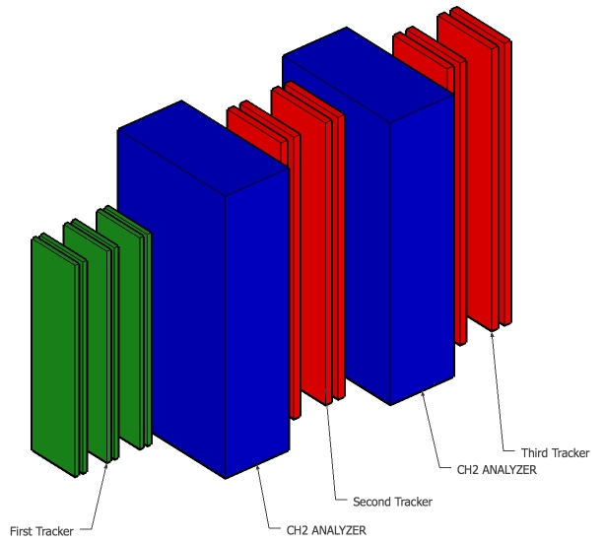
Jefferson Lab SBS Trackers – Front Tracker
Front Tracker
Geometry
18 modules
In Italy
x6
50 cm x 40 cm Modules are assembled to form
larger chambers with different sizes
Front tracker: Six 40 cm x 150 cm GEM layers
  INFN Funding: to be built in Italy
Polarimeter trackers: Eight 50 cm x 200 cm GEM layers
  to be built in Virginia
76 modules
In Virginia

Slide 5
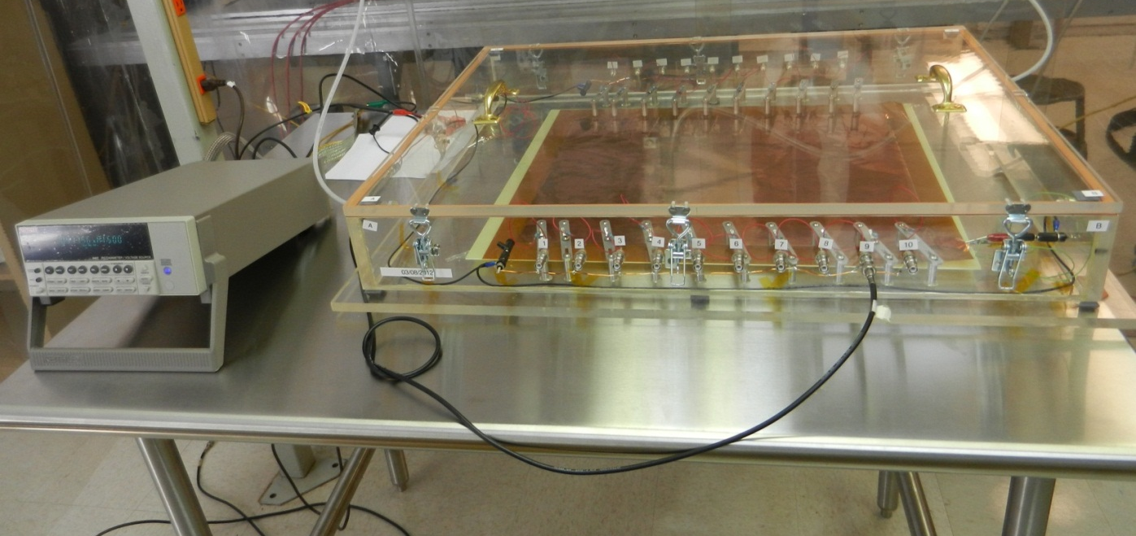
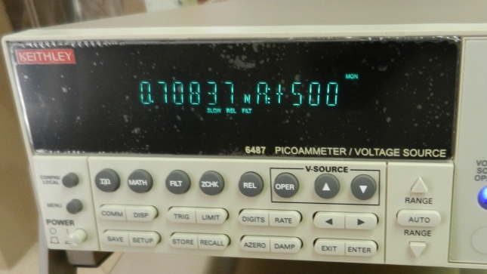
HV Test of the GEM foils
Nitrogen Box with 20 connectors for the HV sectors on the GEM foil
Keithley Picoammeter 6487
  Voltage Source 505 V ➔ Ohmmeter
Criteria for good HV sector on the foil
  < 5 nA leakage current @ 500 V in Nitrogen
Nitogen box Box for HV Test
Leakage current 0.7 nA
HV
Keithley 6457

Slide 6
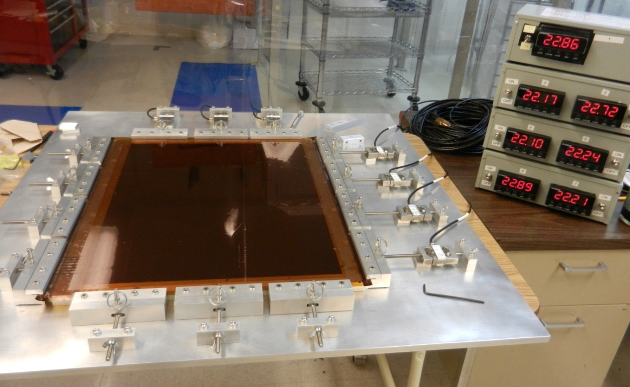
The Stretcher device for the SBS GEM foils
Load cells
Dry test on a bad GEM foil
UVa Stretcher device upgraded from Benciveni (LNF. Italy) and Cisbani (Roma, Italy)
Improvement ➔ Easy to handle and fast ➔ a foil is stretched in less than 30 min
7 Load cells (max 23 kg over 13 cm, ➔ max 1.78kg/cm)
  Test foils stretched at 0.25kg/cm, 0.35kg/cm, 0.75kg/cm
Monitoring displays of the measured tension

Slide 7
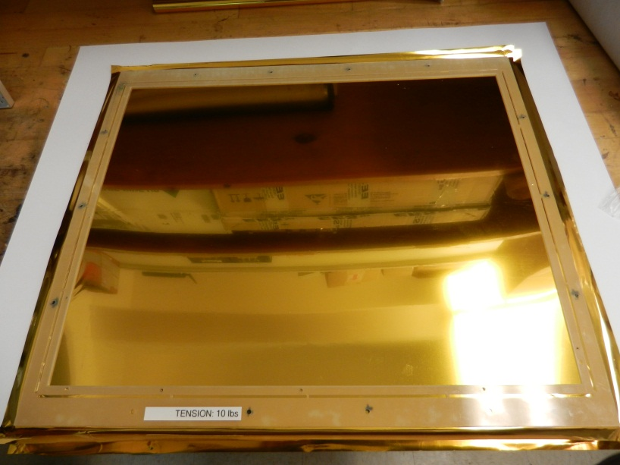
Gluing GEM foil to its frame
Stretched foil glue to the spacer frame
Glue Epoxy: Araldite 103-1 + Hardener HY 991 (100:40 ratio in weight)
Recommended by RD51 and used for COMPASS, TOTEM GEMs …
Main deformation of the frame after gluing in vertical direction
  agreement with simulations
We are working to prevent this effect
Dry test on a mylar foil stretched at 0.34kg/cm and glued to a frame

Slide 8
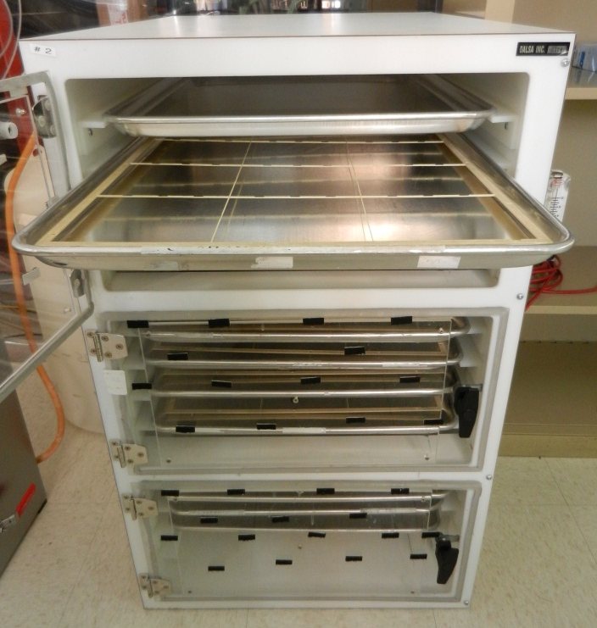
Preparing the frame before gluing …
Step 1: Polishing of the frame and the inner spacer
Step 2: Cleaning in Ultra Sonic Bath (USB)
Step 3: Drying the frame in a storage cabinet with Nitrogen flowing inside
Nitrogen Cabinet for drying and storage

Slide 9
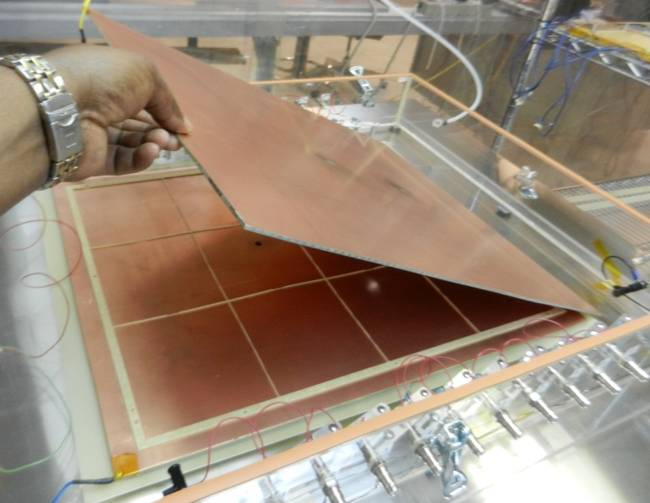
Preparing the frame before gluing …
Step 4: HV test of the dry frame at 4kV
12 frames tested ➔ 2 two of them spark ➔not properly dry
HV Box for both the Frames and GEM foils

Slide 10
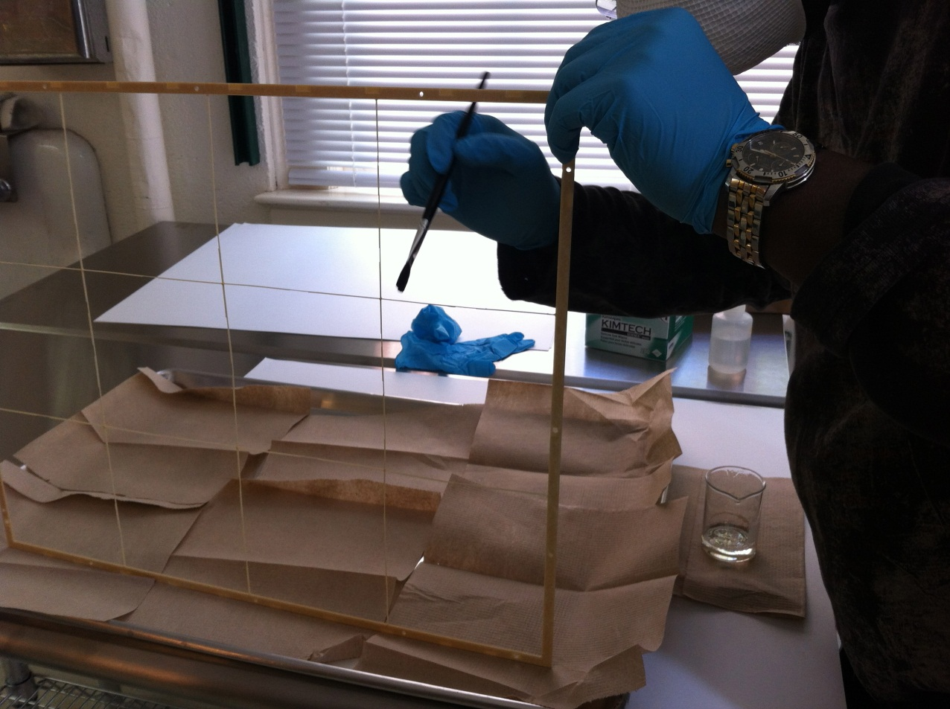
Preparing the frame before gluing …
Step 5: Coating of the inner part of the frames
Varnish: Nurovern LW + hardener
Supplier: Walter Mader (Switzerland)

Slide 11
Next step: Full assembly of the SBS GEM
The stretcher for the GEM foils produced and tested
The full procedure for testing the GEM foil is in place and validated
We went to all the steps to prepare the spacer frames for the gluing
Next delicate step: Solder the protection resistors on the foil
We are just waiting for the readout boards from CERN
  (At last check it was supposed to be delivered end March …)
As soon as we get them, we are ready to fully assemble the first SBS prototype

Slide 12
Outline
Update on Construction of SBS GEM prototype
New Design for the SBS GEM
Toward the Large Area GEM for SoLID

Slide 13
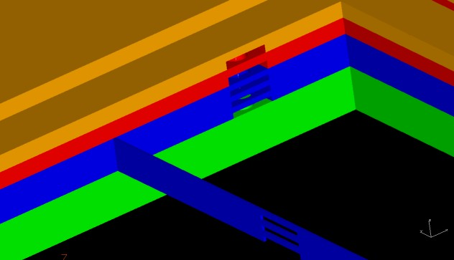
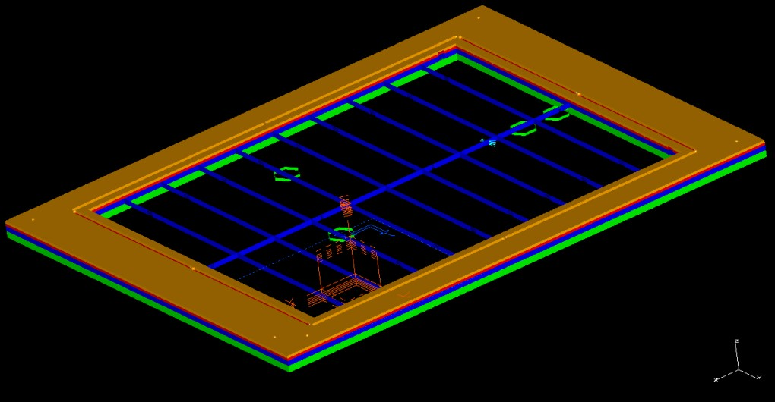
Current frame design with the gas distribution
Spacer
Support frame
cover
drift
3 x GEM
Honeycomb with readout
In the current design, the gas flows laterally in each region of the chamber
3 gas inlets and 3 outlets on each frames to allow a uniform distribution (same design for all the frames)
Aperture in the spacers on each frame to allow the lateral flow
Concern about the uniform gas distribution in the GEM holes level at high rate

Slide 14
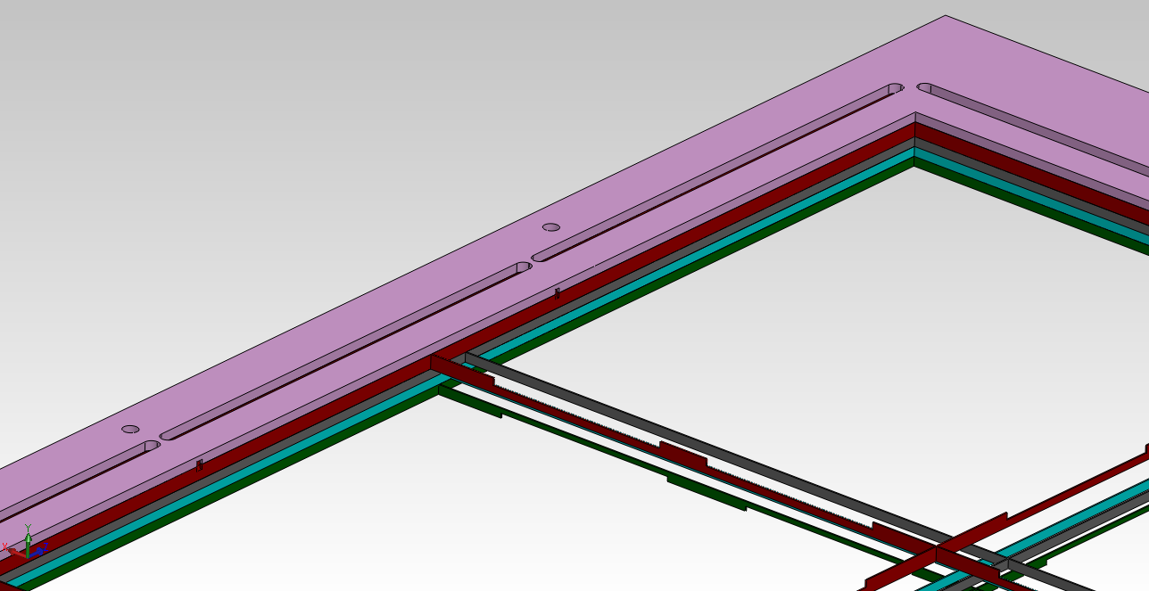
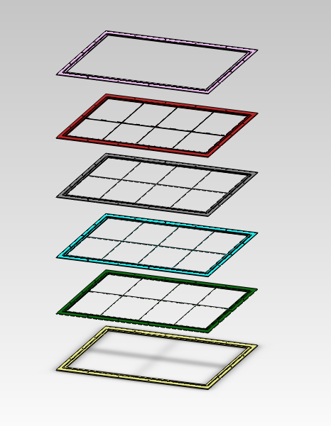
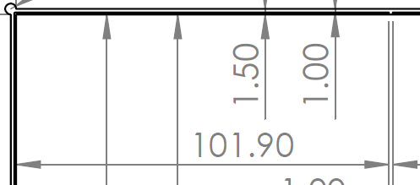
New frame design with gas distribution
In the new design, the gas flows laterally in drift region and vertically in the GEM transfer regions through the GEM holes (5 different frame designs)
1 gas inlet in the window frame and 1 outlet in the readout frame at the opposite corner
Large aperture in the spacers only in the drift frame and the last GEM3 frame
We are also making modification to be able to mount the chambers on the external support frames
Window
Gas inlet
Drift
GEM1
Gas entrance in the chamber
GEM2
GEM3
Readout
Large aperture in the
drift and GEM3 spacers

Slide 15
New design of the GEM foil
Redesign the HV sectors ➔ No resistors soldered directly on the foils
  Allow testing the GEM HV sector after frame is glued
  Allow replacement or disabling of a bad HV sector after assembly
  Avoid soldering in the clean room
The new foil will have 20 electrodes strips for the HV sectors coming out of the frames on the smaller side of the chamber
External PCB with the HV divider and the protection resistors

Slide 16
Outline
Update on Construction of SBS GEM prototype
New Design for the SBS GEM
Toward the Large Area GEM for SoLID

Slide 17
Large Area GEM R&D at UVa
We are involved in 3 R&D efforts for large area GEM chambers
  CMS High Eta Muon Chamber Upgrade
  EIC Forward Tracker
  SoLID Large GEM Tracker
All 3 chambers will have similar size GEM foil (~100 cm × 50 cm) and trapezoidal shape chambers
The readout board is the only major difference between the 3 at this step of prototyping stage
We expect to be able to build on such large prototype by the end of this year

Slide 18
Common development for the 3 Chambers
Build a larger stretcher for 1 × 0.5 m² This is an extension of the SBS stretcher
Build for the HV test Nitrogen box
Setup for gain uniformity measurement of large GEM foil
Setup with IR lamp structure for heating and preparing large spacer frames ➔ replacement of the Nitogen Cabinet

Slide 19
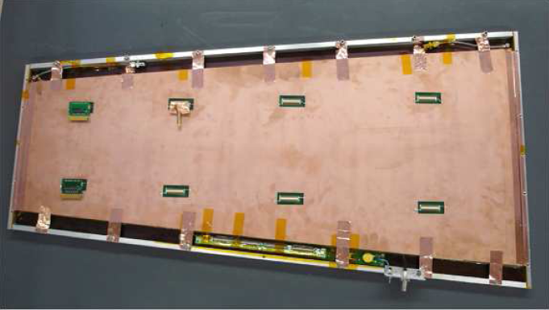
Common development for the 3 Chambers
Large prototype GEM module for CMS: 99 cm x (22 – 45.5) cm

Slide 20
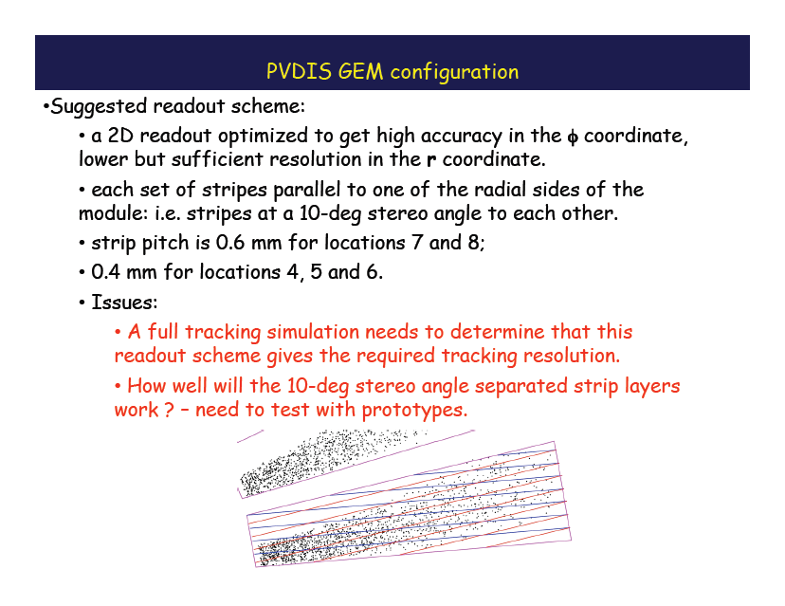
Specific Readout and Electronics for SoLID
Readout board for SoLID
Need to start the design of the readout
Establish the contact with Tech Etch to study the single layer 2D readout
Beyong APV25 electronics, looking at other SRS alternatives
BNL chip VMM1 for ATLAS Muon Chamber Upgrade might be a good candidate

Slide 21
Personnel at UVa
Senior Research Scientist:
  Prof. Nilanga Liyanage
  Vladimir Nelyubin
Research Scientist:
  Kondo Gnanvo
Graduate Students:
  Kiadtisak Saenboonruang (small GEM tracker, analysis
Undergraduate Student
  Taylor Sholz (drawngs for the stretcher and new GEM design)
  Seth Saher (Test and assembly of SBS GEM)

