Slide 1


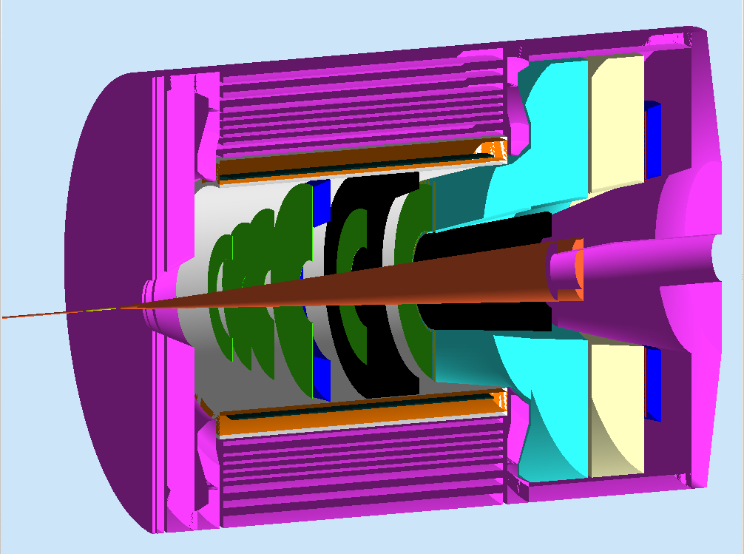

Overview of SIDIS
Xin Qian
Caltech

Slide 2
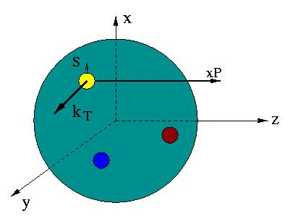
Transverse Momentum Dependent PDFs
TMD
Nucleon Spin
QCD Dynamics
Quark OAM/Spin
QCD Factorization
3-D Tomography
Lattice QCD
Models
TMD f₁^{u}(x,k_{T})‏
Longitudinal Direction z
Transverse Plane x-y
Notes:
Transverse + longitudinal

Slide 3
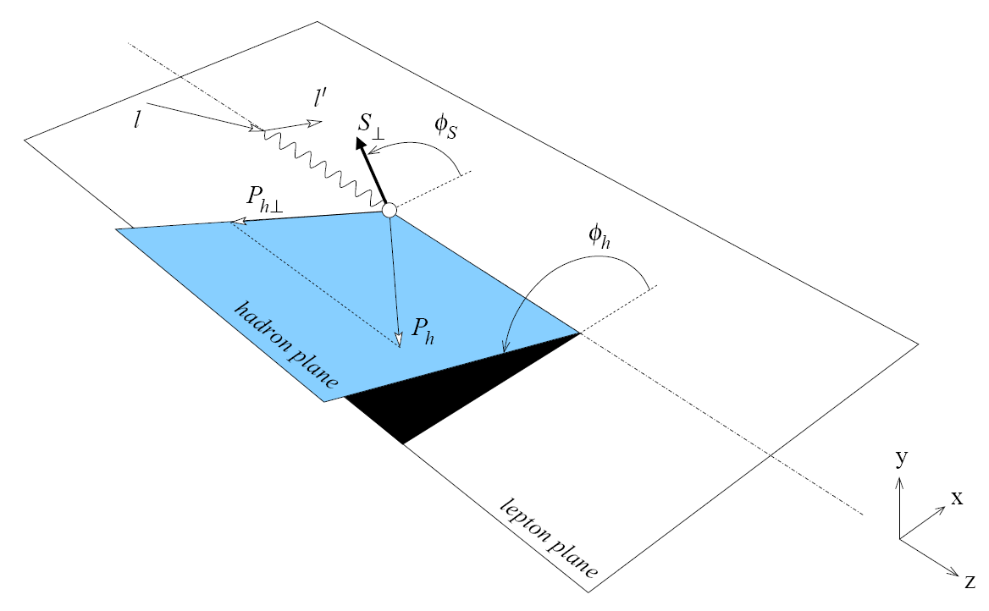
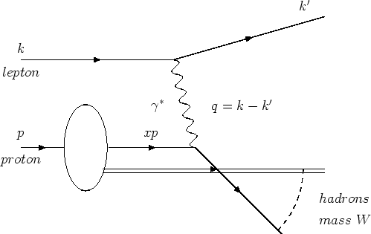
Golden Channel of TMD: Semi-Inclusive DIS
h tags struck quark’s
flavor, spin and
transverse momentum
z: energy fraction of the leading hadron w.r.t virtual photon’s energy
P_{T}: transverse momentum w.r.t. virtual photon’s direction
Fragmentation
function (FF)‏
h
Parton distribution
function (PDF)‏
Notes:
Explain a little bit more SIDIS,

Slide 4




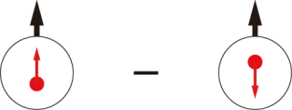
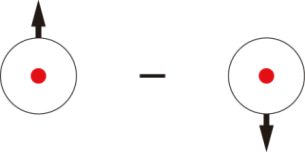
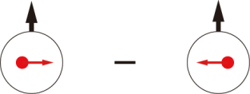
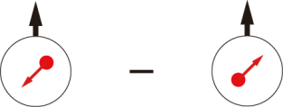
Leading-Twist TMD PDFs
Nucleon Spin
Quark Spin
 |  | Quark polarization
 |  | Unpolarized (U) | Longitudinally Polarized (L) | Transversely Polarized (T)
Nucleon Polarization | U
 | L
 | T
Very well
known
h₁⊥ =
f₁ =
Boer-Mulders
Reasonably known
h_{1L}⊥ =
g₁ =
Worm Gear
(Kotzinian-Mulders)
Helicity
h₁ =
f _{1T}⊥ =
Transversity
g_{1T} =
Sivers
h_{1T}⊥ =
Worm Gear
Pretzelosity
Spin-orbital (trans. mom.) correlation is important!
Notes:
Collinear PDF
Explain the directions of TMDs, slow down! Explain x and y
Explain more correlation.

Slide 5
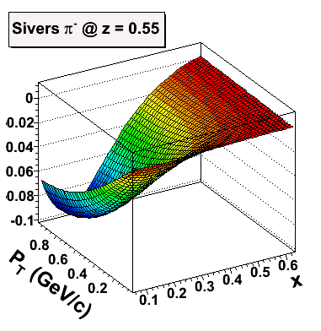
SoLID-Spin: SIDIS on ³He/Proton @ 11 GeV
E12-10-006: Single Spin Asymmetry on Transverse ³He @ 90 days
E12-11-007: Single and Double Spin Asymmetry on ³He @ 35 days
PR12-11-108: Single and Double Spin Asymmetries on Transverse Proton (conditionally approved)
White paper: Eur. Phys. J. Plus (2011) 126:2
Key of SoLID-Spin program:
Large Acceptance
+ High Luminosity
→ 4-D mapping of asymmetries
→ Tensor charge, TMDs …
Lattice QCD, QCD Dynamics, Models.

Slide 6
Requirement of SIDIS
Kinematics Coverage:
  0.05 ~ 0.6 in x (valence)
  0.3 ~ 0.7 in z (factorization region)
  P_{T} up to ~ 1 GeV (TMD Physics)
  Fixed target → Q² coverage 1-8 GeV² (~ 2 GeV² in ΔQ² at fixed x)
Luminoisity:
  Unpolarized ~ 10³⁷ N/cm²/s
Polarized ³He Target:
  ~ 60% higher polarization
  Fast spin flip (<20 mins)
Electron PID:
  <1% Pion contamination (asymmetry point of view)
Pion PID:
  <1% Kaons and Protons
  <1% electron contamination
Optics of Reconstruction:
  < a few % in δP/P.
  < 1 mr in polar angle.
  < 10 mr in azimuthal angle
  ~ 1-2 cm vertex resolution
  Similar precision required.
  A factor of 2-3 better already achieved in MC.
DAQ:
  ~ 3kHz Physics Coincidence
  ~ 200 kHz Single electron
  ~ 50 kHz Coincidence
  Limits: 300 MB/s to tape.

Slide 7
Special Considerations (I)
SIDIS Trigger:
  With the current rate estimation, we should work out a detailed trigger design.
  Goal: running at 1e37 N/cm^2/s ~ 200 MB/s to tape.
  Identify a clear list of risks and develop a detailed plan for the roadmap toward a full DAQ system.
Target System:
  Design Shielding and Correction Coil for SoLID Magnets
  Lab tests/demonstration of design
  Method to reduce target endcap thickness?

Slide 8
Special Consideration (II)
GEM Chamber:
  Common sets of GEM chamber +reconfiguration
  Or different sets of GEM chamber
  Pad readout to replace the thin scintillator plane.
Gas Cerenkov:
  How to reconfigure the mirror between PVDIS setup and SIDIS setup?
  What is the risk of the background level ?
Calorimeter:
  Radiation Level: How will calorimeter survive SIDIS + PVDIS + additional experiments?
  Additional layers of preshower?
  R&D on cable layout (large angle + forward angle)
  Improve energy resolution at high momentum?

Slide 9
Special Considerations (III)
Risk in Backgrounds:
  For Low energy backgrounds:
    Is the additional shielding necessary (GEANT4)?
  Roadmap towards background validation
Calibration and Analysis:
  Developing detailed optics calibration plan.
  Plan to get a desired TOF calibration.
  Test of online farm and fast tracking.

Slide 10
Update on Resolution

Slide 11
Summary of Table
 | Radiation Length | Polar Angle | Azimuthal Angle | Momentum
1 mm Cell Wall + 2 m Air before SoLID | 3.7% @ 15 degrees | 1.6 mr | 6.2 mr | Resulting ~0.2% @ 4.4 GeV calibration
No GEM position resolution | N/A | 0.1 mr | 3 mr | 0.5%
100 um + 10 degree readout | N/A | 0.6 mr | 6mr | 1.8%
Additional Multiple scattering | 0.76% per layer Equivalent to 170 um smearing | 0.6 mr | 6mr | 2%

Slide 12
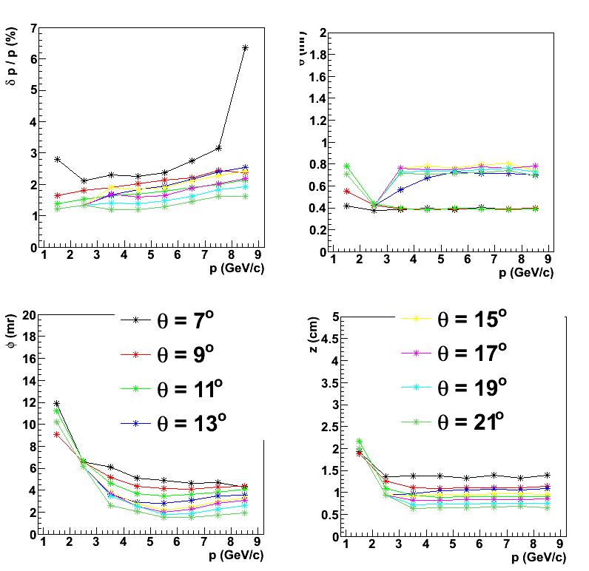
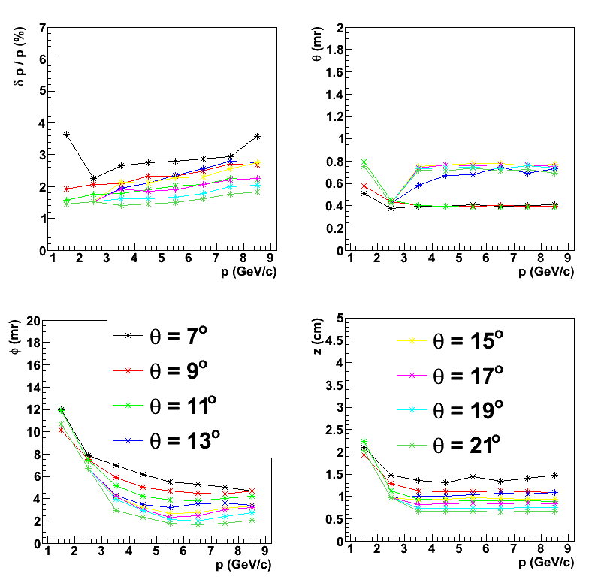
Comparison of No Multiple Scattering vs. Multiple Scattering
Without Multiple Scattering
With Multiple Scattering
The effect due to multiple scattering is negligible.

Slide 13
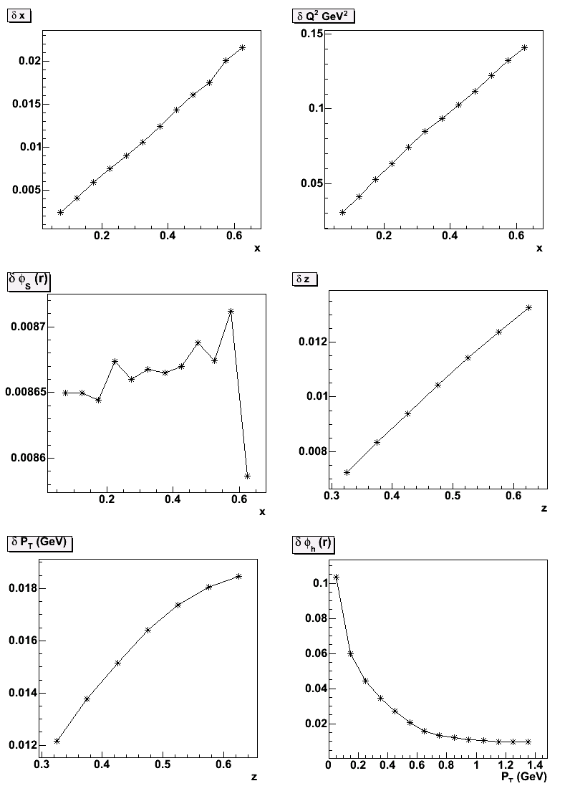
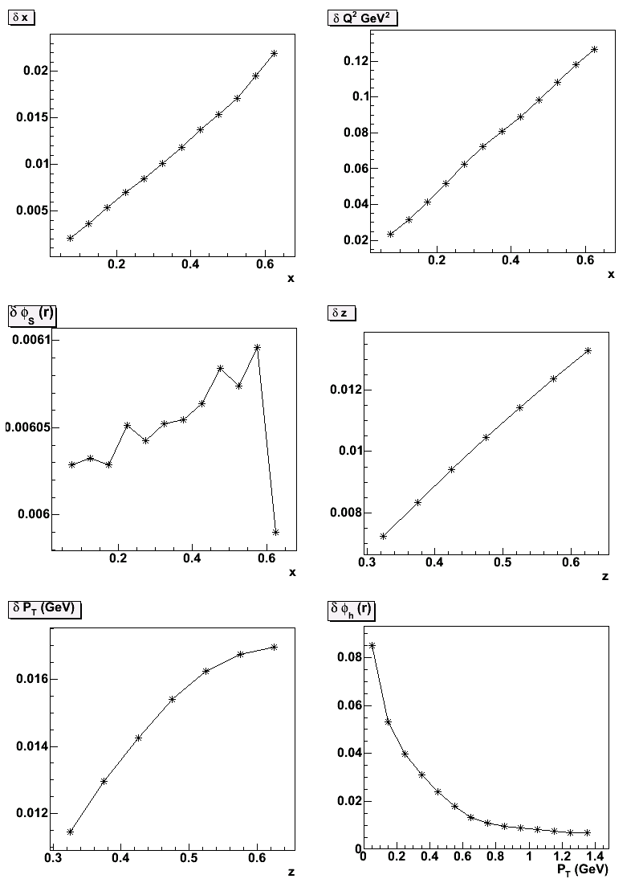
Impact on High Level Variables
With Target In
Impact are acceptable.
Intrinsic resolution from SoLID

Slide 14
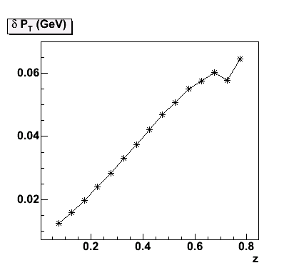
Issue I: About P_{T} resolution
The cross section falls as exp(-bP_{T}²)
The Asymmetry expect to increase as P_{T} (for Collins and Sivers)
PT resolution increase
vs. z (shown right)
What about PT
resolution vs. PT?
What about PT2?

Slide 15
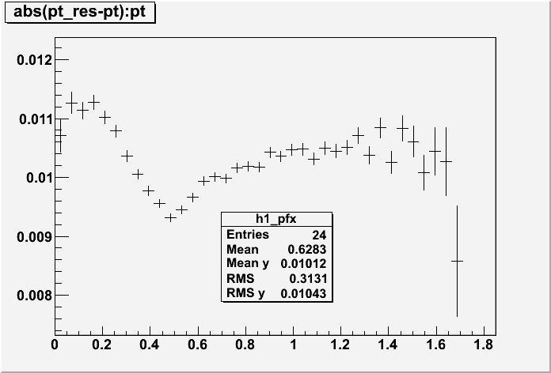
PT res. Vs. PT
As shown in the right plot, resolution in PT does not have strong dependence with PT.
X-axis: PT
Y-axis: mean of abs(pt_smeared –pt_true)

Slide 16
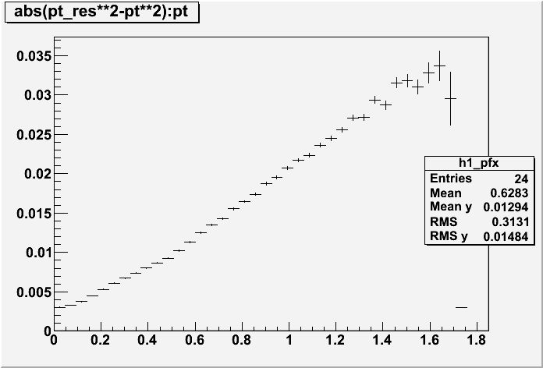
PT2 resolution vs. PT
Resolution in PT2 does have strong dependence with PT, because
The resolution is suppressed at small PT for PT^2.
Therefore, although the cross section drops fast at small PT, the effect of PT resolution is still small.
X-axis: PT
Y-axis: mean of difference in smeared pt2 and true pt2.
Note: this is the simulated PT2 and smeared PT2 (smearing the individual momentum and angles for electrons and pions.

Slide 17
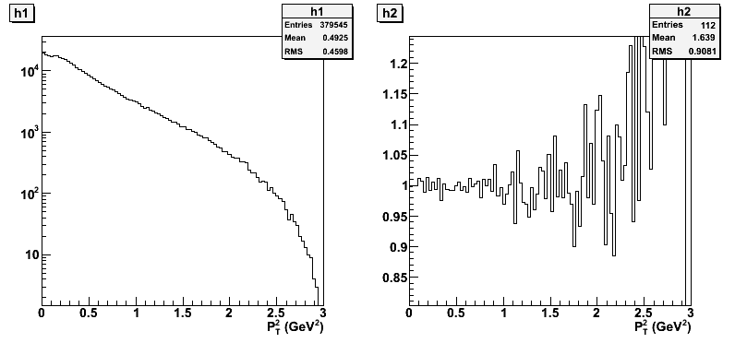
Simulation Results of (N_smear/N_nosmear)
Gaussian Fall Off
Here are the real full simulation with smearing on angles and momentum at GEM configuration of 175 um, 12 degrees readout. Same results as the toy model that we had before. A small visible effect is shown on the right.

Slide 18
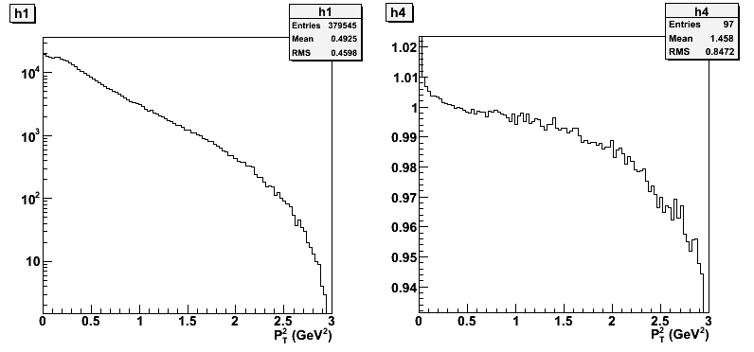
Estimate of Impact
Assume asymmetry is proportional to PT, then we can calculate the asymmetry ratio of two cases, (with smearing and without smearing).
Asymmetry ratio
A_smear/A_nosmear
As shown, the effect in asymmetry is smaller than 1% in the region of interests,

Slide 19
PV Pion Asymmetry

Slide 20
Neutral Current
The Asymmetry for PVDIS electron is about 100 ppm * Q² ~ Q²/Mz²
So one also expected that for the single pion production, the asymmetry is about Q²/Mz²
Then the central question is to calculate the average Q² for the eletro-pion production.

Slide 21
For Electro-Pion Production
One can use equivalent
photon flux
The average Q2 can be
obtained as
Here, we assume the same photon-N scattering total cross section.

Slide 22
Simulation
Uniform sample electron momentum and solid angle.
Make sure the kinematics permit a pion to reach the desired kinematics:
  12.9 degrees @ 3.66 GeV
Weighted by Gamma Flux and calculate average Q2.
  Obtained <Q2> ~ 0.264 ~ 32 ppm
  Assuming a 120 pm in PVDIS electron for Q2 @ 1 GeV^2.

Slide 23
Additional Contribution for Real Photon Production
The internal radiation has already been taken into account in previous formula.
The external radiation is 0.5 * 15 / 866 ~0.87%
  Comparing to ~2% effective radiation length, we will have additional dilution of 32 ppm * 2 / (2+0.87) ~ 22 ppm
For 40 cm long target, the external radiation length is about 2.3%, so the dilution is about 0.5.
Same method can be used to estimate the asymmetry of PV Pion for SoLID-PVDIS.

