Slide 1
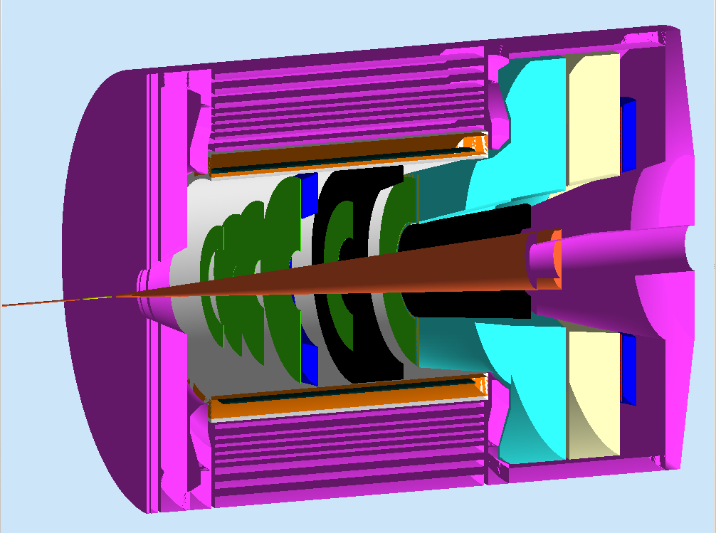

SoLID-J/ψ: Near-Threshold
Electro/Photo-Production of J/ψ
Xin Qian
Caltech
Collaboration with K. Hafidi,
Z.-E. Meziani, N. Sparveris and Z. Zhao

Slide 2
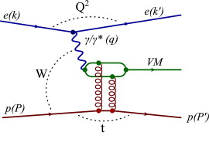
Outline
Motivation:
  With Proton Target
  With Deuteron Target
Experimental Details:
  SoLID-J/ψ Setup
  Backgrounds
  Trigger Setup
Summary/Plan/Comparison with Hall B/C
ZEUS, PLB 708, 14 2012

Slide 3
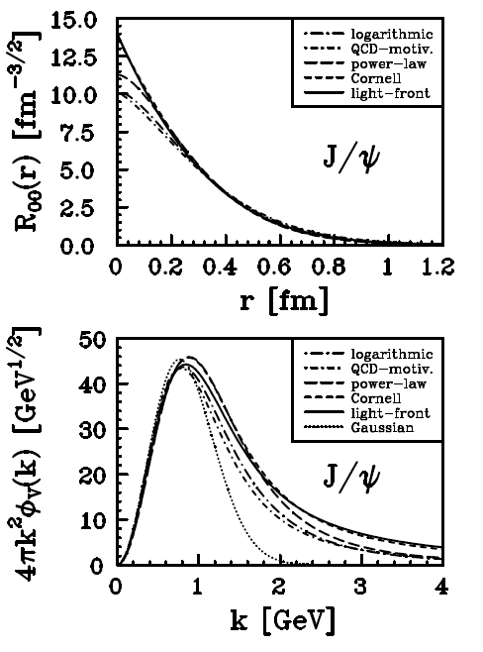
Introduction:
J/ψ is a compact relativistic system.
  Quark component ccbar
  Typical ccbar distance 0.2-0.3 fm
J/ψ-N interaction
  Quark exchange are strongly suppressed
  An unique place to study multi-gluon
  interactions.
Detecting J/ ψ
  Large BR ~ 6% to e⁺e⁻
  3.097 GeV mass → Small background
Exclusive Channel
  Benefit in PID/Trigger/Background
Frankfurt, Koepf and Strikman hep-ph: 9702216

Slide 4
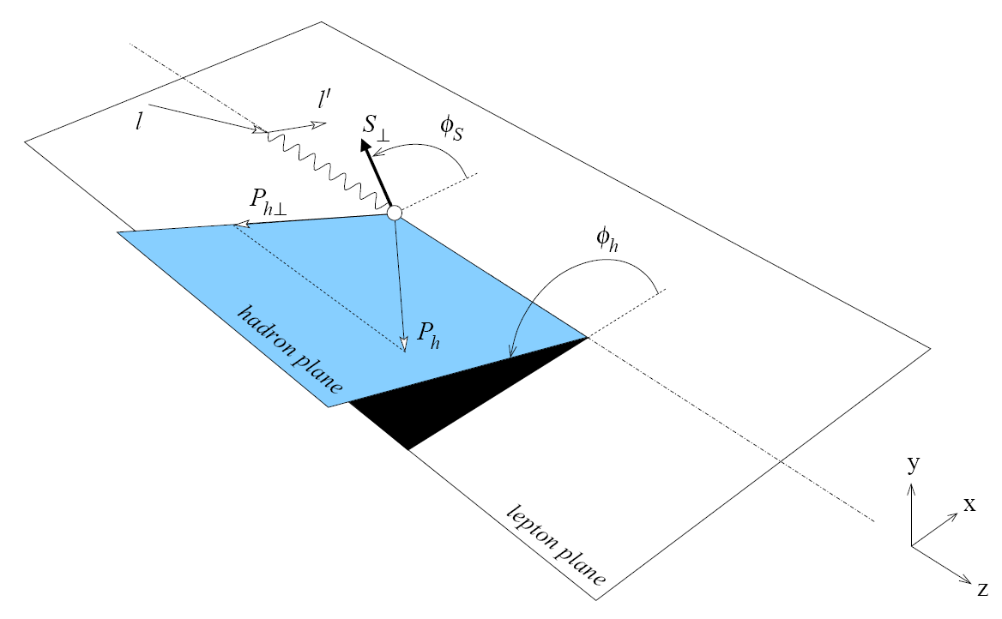
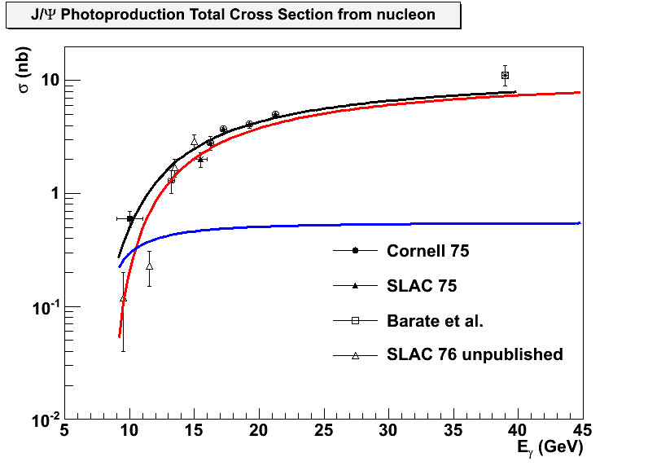
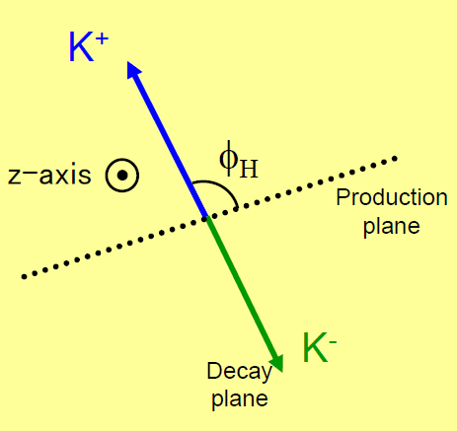
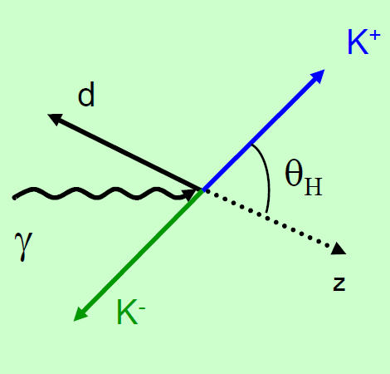
Near Threshold Production On Proton
Motivation:
  Search for threshold
  enhancement
  Study the angular distribution
  of J/ψ production
  Study the J/ ψ decay
  angular distribution
2-g exchange
3-g exchange
Change Kaon to electron for this case.
Brodsky et al PLB 498 23 (2001)

Slide 5
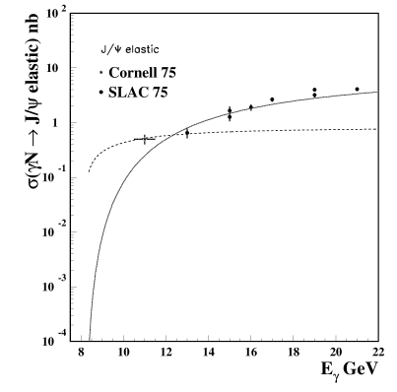
Search for Threshold Enhancement
Threshold enhancement has been widely observed in:
A threshold enhancement in J/ψ photo/electro-production would indicate existence of multi-gluon interaction (>2)
  Non-perturbative gluon interaction!
As an example:
  Brodsky et al proposed the 3-gluon interaction:

Slide 6
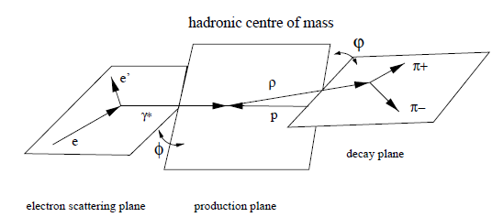
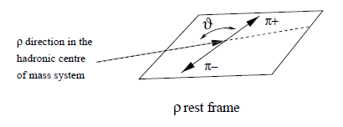
Study the Decay Angular Distribution of J/ψ
The decay angular distribution of J/ψ would reveal important information of the production mechanism.
  Test s-channel helicity conservation (SCHC) near threshold.
EPJC 13 371 (2000) change pions to electrons

Slide 7
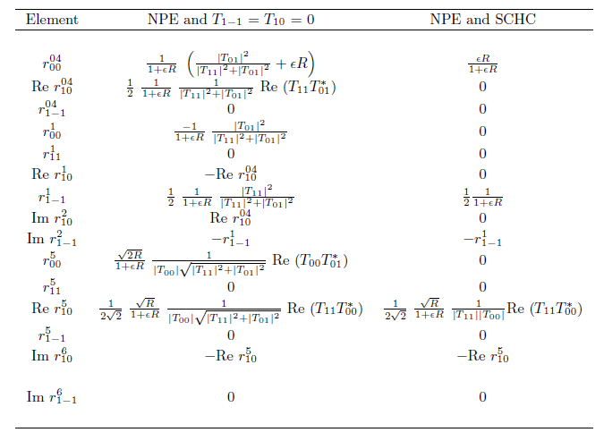
Expectation: Natural Parity Exchange
M. Vanderhaeghen: SCHC well tested at HERA energy, no systematic tests near threshold. Natural vs. unnatural parity exchange.
Working in progress

Slide 8
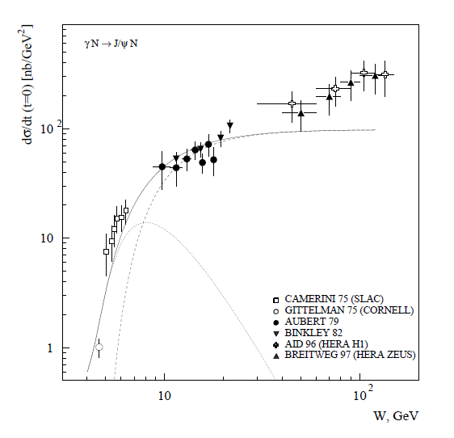


Study the Angular Distribution of J/ψ Production
Imaginary Part
Real Part Dominates near threshold
M. Vanderhaeghen:
  Disentangle Re/Im part using interference with Bethe-Heitler
  Measure angular dependence (lepton vs. hadron plane)
  Working in progress to estimate size of asymmetry
Real Part
D. Kharzeev et al. EPJC 9, 459 (1999)

Slide 9
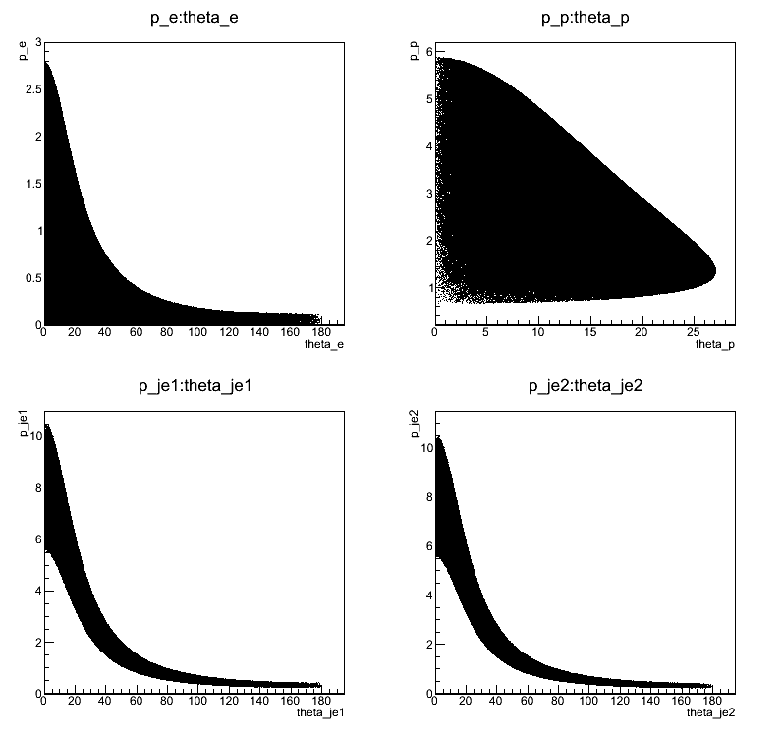
Looking at Phase Space @ 11 GeV
Scattered electrons at forward angle (low Q²)
Only forward angle has the hadron PID capability
Large angle and forward angle detection for decay electrons and positrons.
Recoil proton
Scattered electron
Electron from Jpsi
Positron from Jpsi

Slide 10
Current SoLID SIDIS Setup
Recoil Proton
Decay e⁻/e⁺
Scattered Electron

Slide 11
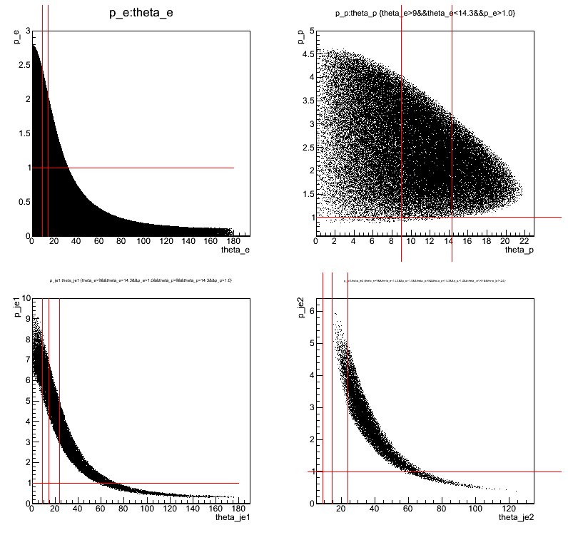
Looking at Phase Space @ 11 GeV
Scattered electrons at forward angle (low Q²)
Only forward angle has the hadron PID capability
Large angle and forward angle detection for decay electrons and positrons.
Cuts are applied one by one.
Recoil proton
Recoil proton
Scattered electron
Scattered electron
Decay Electron from J/Ψ
Positron from Jpsi
Electron from Jpsi
Decay Positron from J/Ψ

Slide 12
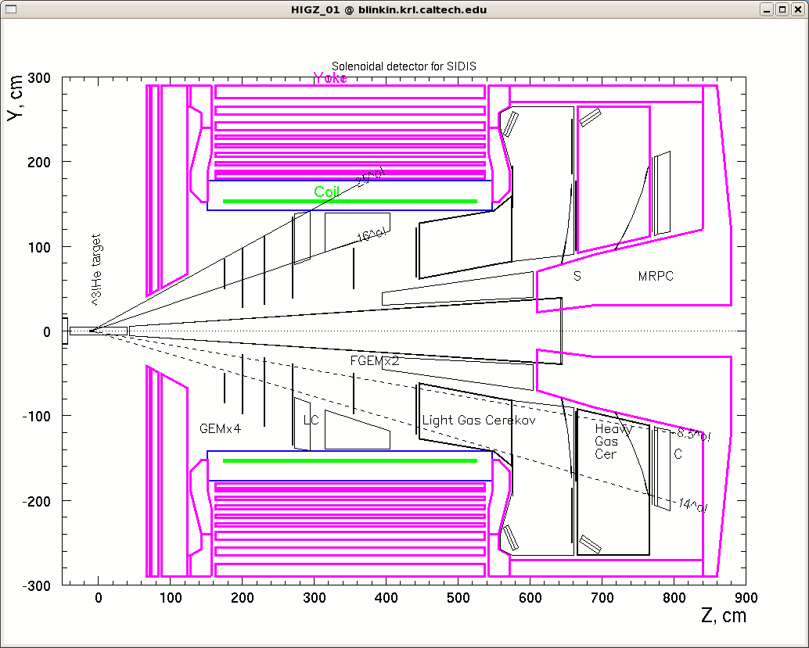
Modification of Setup
Need larger large-angle detection for decay electron/positron:
Larger opening angle for front yoke.
Slightly more forward for large angle calorimeter and 4th layer of GEM chamber. Larger GEM Chamber would needed for 1st-3rd chamber.
Need forward angle
detection of scattered
electron and recoil
proton:
Move 4 cm target
to -10 cm (compared
to SIDIS setup.
Luminosity:
~10³⁷ N/cm²/s
~10 uA on 4 cm
LH₂ target

Slide 13
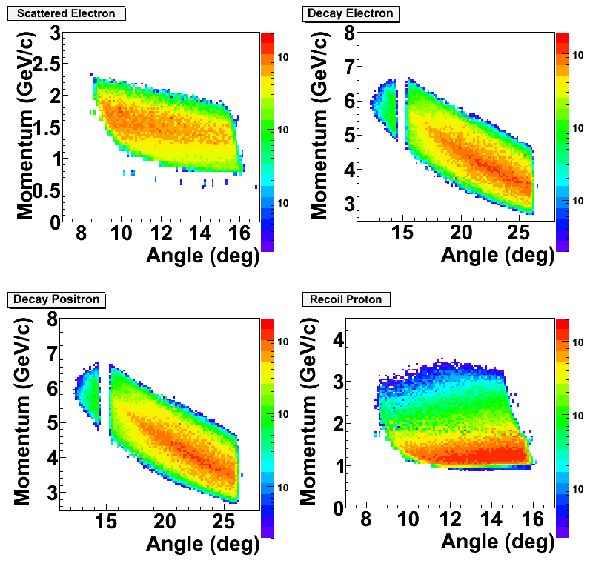
Acceptance from GEANT3
Scattered Electron:
GC + Calorimeter @ forward angle
Decay Electron/Positron:
Calorimeter only @ large angle
GC+Calorimeter at forward angle
Recoil Proton:
100 ps TOF: 2 ns separation between p/K @ 2 GeV/c + 8 m
Exclusivity will further strength PID with kinematics fitting.

Slide 14
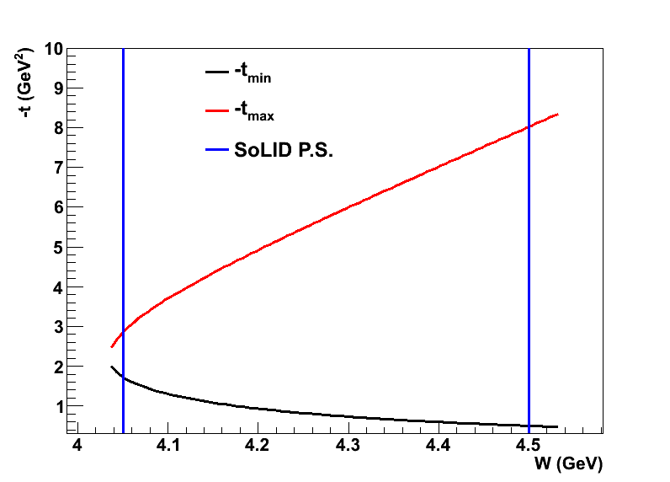
Strategy of SoLID-JPsi
Map the near-threshold region:
Electro-production:
  4-fold + 3 fold n.p.
Photo-production:
  3 fold n.s.e
4-fold
3-fold n.p.
3-flod n.s.e.
Advantages of electro-production:
  Since the scattered electron is detected, the W (thus tmin) is well determined.
  3-fold will have larger
  statistics.
  Background can be understood
  with 4-fold exclusive channel
  Also Q² →0.5-1 GeV²
  Suitable to study L-T interference
  and helicity-flip amplitude through J/ψ decay
  Suitable to study B-H, J/ψ interference.
Advantages of photo-production:
  Large statistics at Q² ~ 0, well suited to study t-dependence at high W.
  Comparison between electro-production vs. photo-production.
  Suitable to study Ratio of Longitudinal vs. Transverse Cross Section.

Slide 15
Rates Estimation
Use Equivalent Photon Approximation

Slide 16
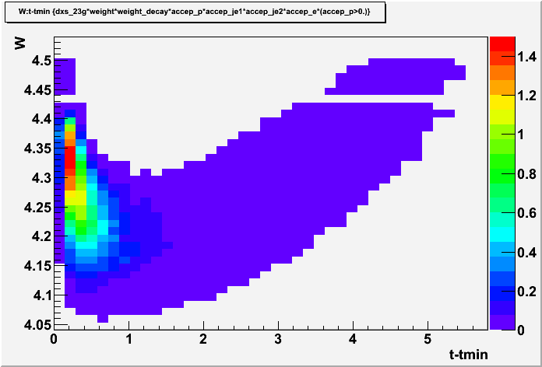
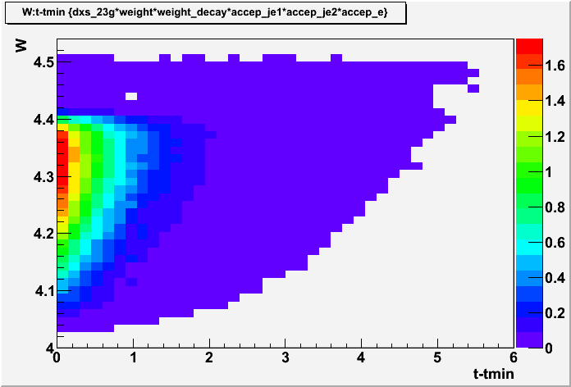
Event Rates @ 1e37 @ 50 days
4-fold coincidence:
  0.94 * exp(0.97 t): 4.5 k
  2g-only: 0.68 k events
  2g + 3g: 2.9 k events
3-folid n.p.:
  0.94*exp(0.97 t): 12 k
  2g-only: 2.1 k events
  2g+3g: 8.08 k events
Good to study a ~10% asymmetry of B-H & J/ψ interference
4-fold
3-fold n.p.

Slide 17
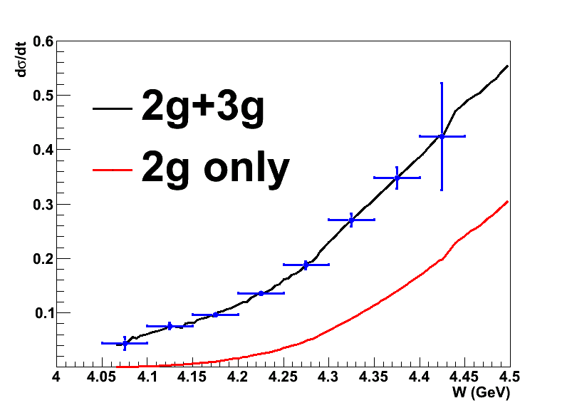
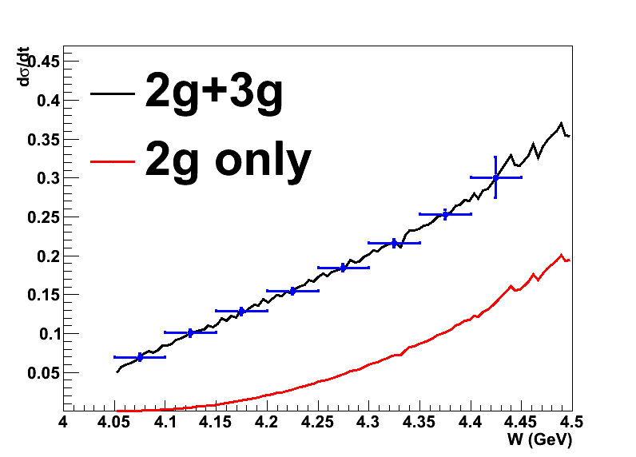
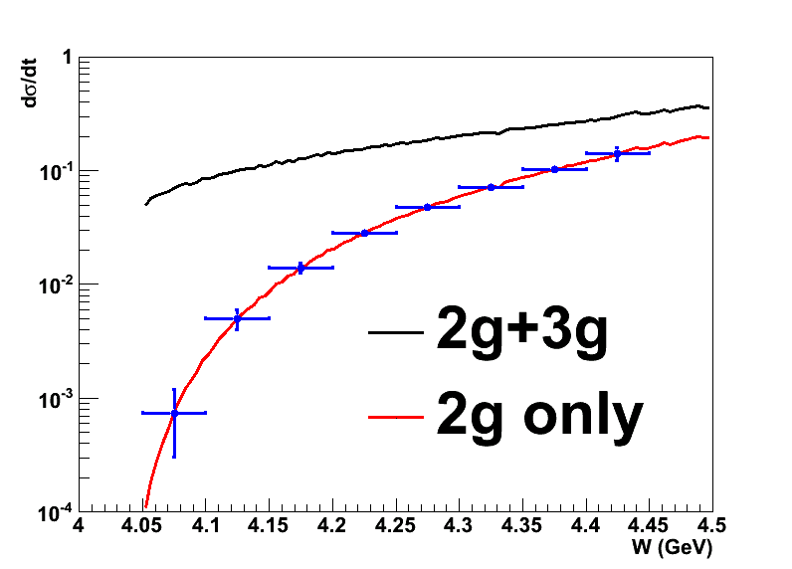
Projections
3-fold n.p.
4-fold
For W < 4.12 GeV
  3-fold n.p.
    2-3g: 342 events
  4-fold
    2-3g: 50.8 events
3-fold n.p.

Slide 18
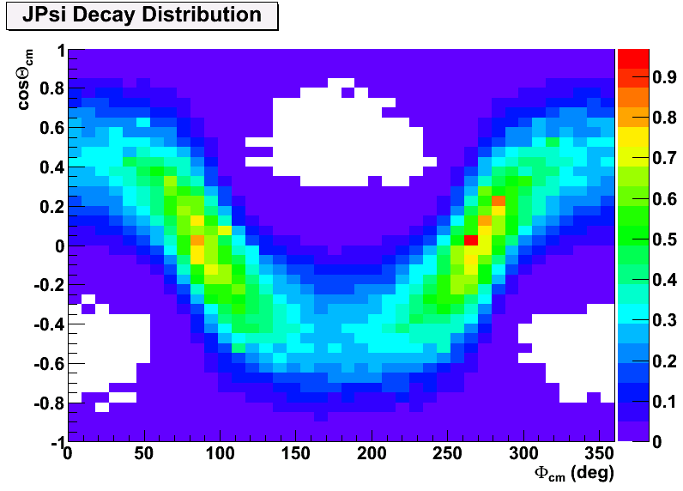
Angular Coverage
Also good coverage of azimuthal angle of J/ψ production angle due to 2π azimuthal coverage in the lab frame.
One can study the J/Ψ Decay Distributions at different kinematics.

Slide 19
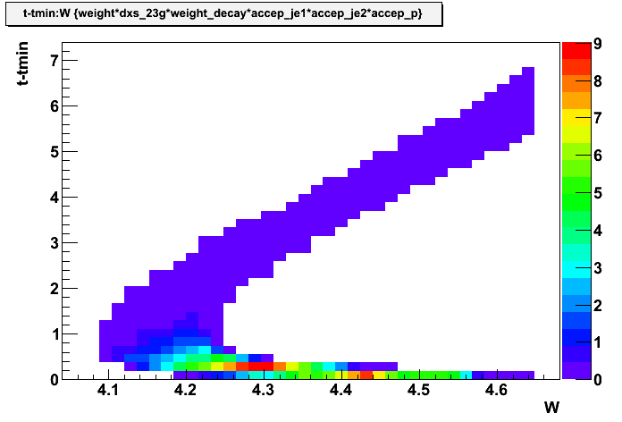
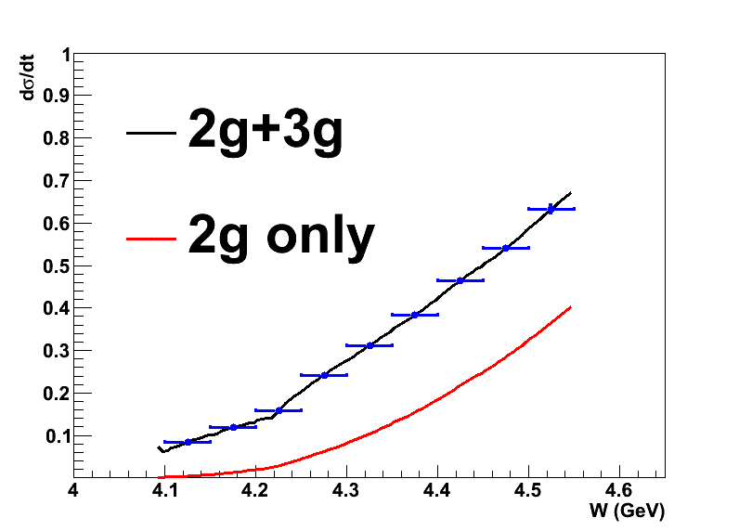
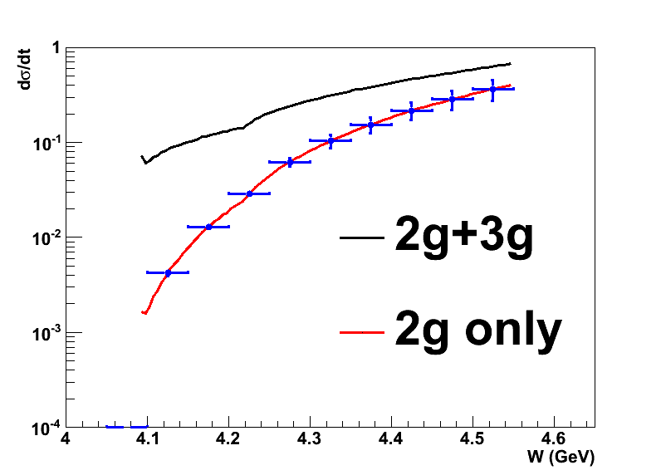
3-fold n.s.e.
2-3g: 70 k events
2 g: 20 k events
For |t-tmin|>0.5 GeV² or W<4.25
2-3g: 25.4 k events
2g: 3.8 k events
Decay Angular distribution at low t
Cross check eletro-production + threshold enhancement
All Events
High t events

Slide 20
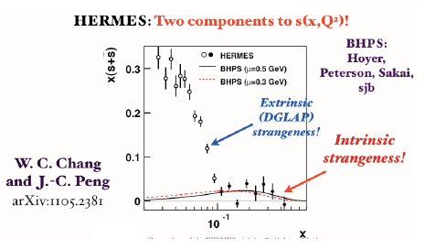
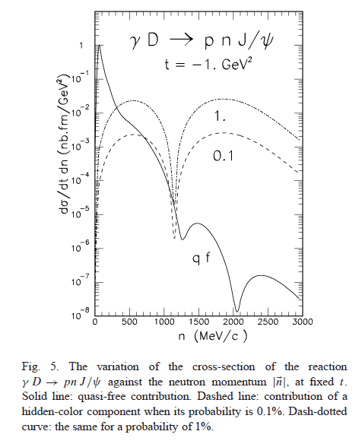
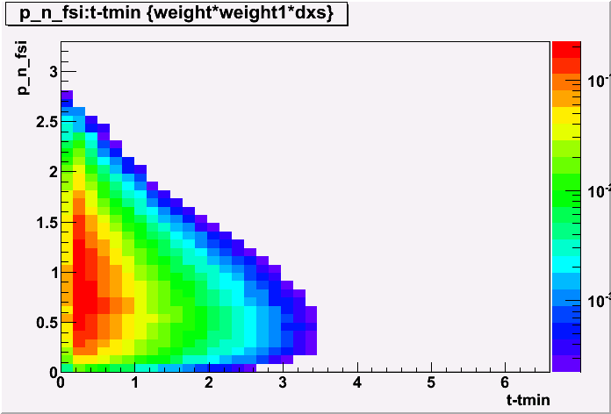
Physics with Deuteron (incoherent)
Suggest a 1% intrinsic charm.
J/Ψ-N FSI
Looking at high missing momentum region to study the interaction
Brodsky et al PLB 498 23 (2001)
Also

Slide 21
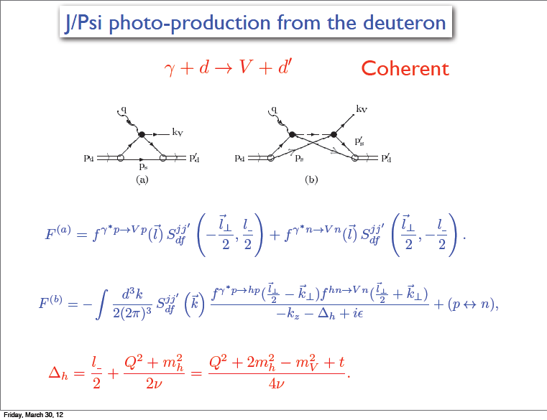
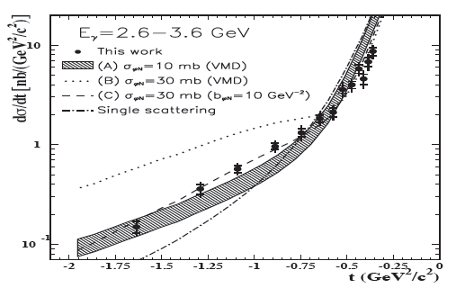
Physics with Deuteron (Coherent)
Search for the change of slope in coherent deuteron production
Enough Rate?
Work in progress
Also Physics with nuclear target
Medium propogation of J/ψ (existing Hall C proposal)
Eugene: SoLID is the ideal device to do this study.

Slide 22
Backgrounds
Random Coincidence
(e.g. e⁻p + e⁺e⁻)
  Multiple combinations
  Suppressed by exclusive condition
  (detector resolution)
Physics Backgrounds
Single rate
  Rate comparison with Pythia
  Design of trigger and DAQ
Background Rate on Detectors
@ 1e37 N/cm²/s
Pythia
Wiser/QFS
GEANT3

Slide 23
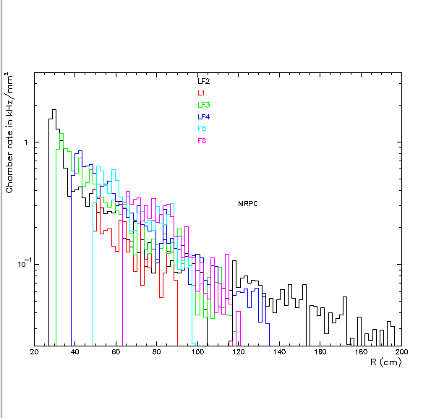
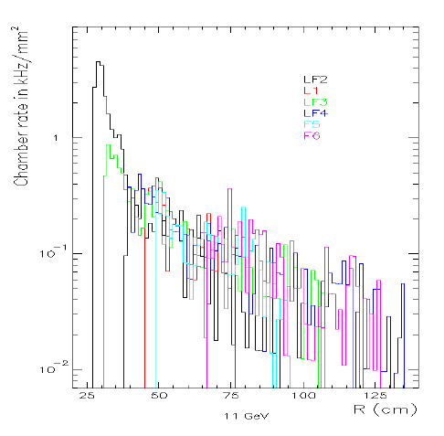
Backgrounds (GEM + MRPC)
Background Rate SoLID-J/Ψ-CLEO
Background Rate SoLID-Spin-CDF
Background rates on GEM are very close to the SoLID-Spin Setup.

Slide 24
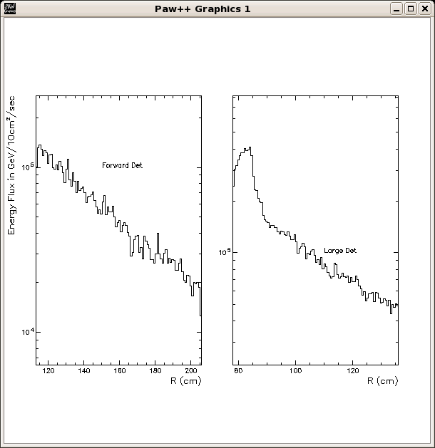
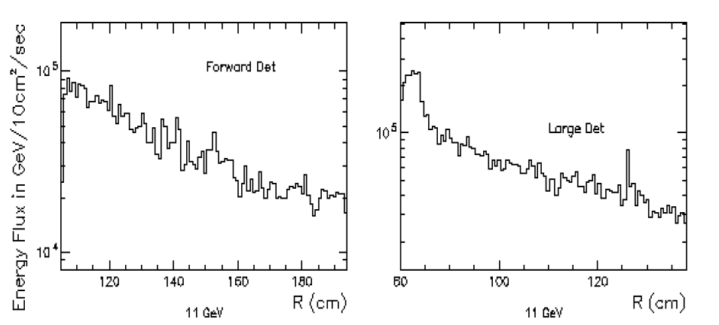
Backgrounds (Calorimeter)
Background Rate SoLID-J/Ψ-CLEO
Background Rate SoLID-Spin-CDF
Background rates on Calorimeter are slightly higher without the target collimator.

Slide 25
Trigger Design
We potentially have the following physics topics:
A triple coincidence of scattered electron, decay electron and positrons from J/Ψ will be good enough for both channels.
Trigger Rate < 1 kHz @ 1e37 N/cm²/s
Compare to SIDIS ~50 kHz L2 rate

Slide 26
Backgrounds (Random Coincidence)
We used e (scattered electron), p (recoil proton), Je (decay electron from J/Ψ) and Jp (decay positron from J/Ψ).
2-fold coincidence includes: (e,p)+(Je,Jp), (e,Je)+(p,Jp), (e,Jp)+(Je,p) and (e,Je,Jp)+(p), (e,Je,p)+(Jp), (e,Jp,p)+(Je), (p,Jp,Je)+(e)
3-fold coincidence includes: (e,p)+(Je)+(Jp), (e,Je)+(p)+(Jp), (e,Jp)+(p)+(Je), (Je,Jp)+(e)+(p), (Je,p)+(e)+(Jp), (Jp,p)+(e)+(Je)
4-fold coincidence is (e)+(p)+(Je)+(Jp)

Slide 27
Pythia (11 GeV e+p)
Use PYTHIA exclusive event generator.
  Input file (HERMES tuned, from H. Avakian)
  SIDIS (e,eπ) rates are in reasonable agreement with data/calculations.
  Event range
    0.05 < y < 0.95 and 0.1 < Q² < 1500 GeV²
  Event Selection (mimic SoLID acceptance):
    Recoil Proton: P > 1 GeV, 8→15 degrees
    Scattered Electron: 2.5 > P > 1 GeV, 8→ 15 degrees
    Decay Electron: P > 2.5 GeV 8→25 degrees
    Decay Positron: P > 2.5 GeV 8→25 degrees

Slide 28
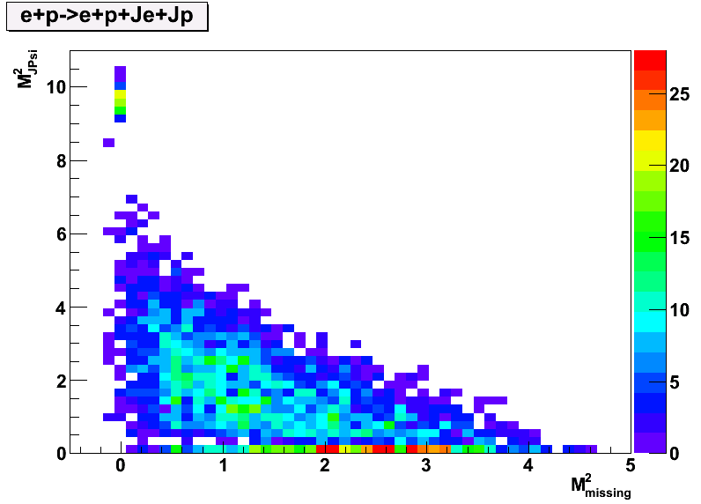
This channel is selected using invariant mass of J/Ψ, and missing mass.
With momentum/angles smeared according to expected detector resolution.
No physics background for this channel in Pythia. Preliminary study of B-H show small contamination.
Very Clear Separation!

Slide 29
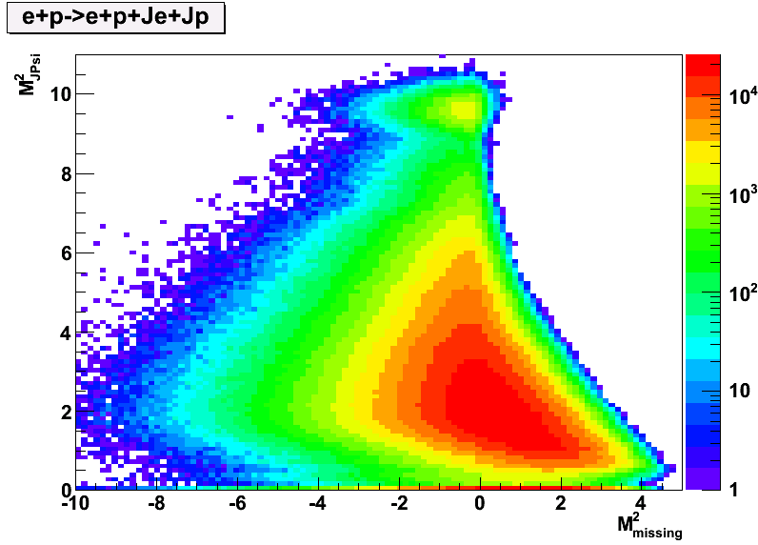
Suppression Factor is 8e-5 for (e,p) + (Je,Jp)
Random Coincidence Rate is then: 4.3 e-7 Hz
Physics Rate is 0.015 Hz in Pythia

Slide 30
2-Fold Random Coincidence (Subtractable)
Channel | Rate of first | Rate of second | Suppression Factor | Effective Rate (Hz)
(e,Je)+(Jp,p) | 0.28 kHz | 67 kHz | 3e-7 | 3.4e-8
(e,Jp)+(Je,p) | 0.035 kHz | 67 kHz | 5e-8 | 7.0e-10
(e,p)+(Je,Jp) | 22.3 kHz | 0.04 kHz | 8e-5 | 4.3e-7
(e,Je,Jp)+(p) | 0.01 kHz | 306 kHz | 9.3e-5 | 1.7e-6
(e,Je,p)+(Jp) | 0.04 kHz | 0.13 kHz | 1.3e-8 | 4e-13
(e,Jp,p)+(Je) | 0.0037 kHz | 460 kHz | 4.7e-7 | 4.8e-9
(Je,Jp,p)+(e) | 0.0048 kHz | 165 kHz | 1.75e-3 | 8.3e-6
Physics Rate is 0.015 Hz in Pythia, 1.2e-3 in our calculation
The background is expected to be < 1% level for (e,Je,Jp,p).
Long extended target at low beam current would help.
Random Coincidence should not be a problem.

Slide 31
Comparison
SoLID-Jpsi will emphasize the electro-production and related mechanism.
Complementary to other Halls
  Hall B will only do photo-production of J/ψ
    SoLID will win in luminosity (x50), probably ran later though.
  Hall C will have 1 or 2 points in W (100→200 events with 2-3 g)
    SoLID will do a thorough scan in the near-threshold W range.
We shoot to finish draft proposal by 24th this month. We will circulate draft proposal in SoLID collaboration shortly after that.

Slide 32
Summary
Near-threshold electro/photo J/ψ production would reveal the role of the non-perturbative gluon interaction.
  Search for threshold enhancement.
  J/ψ Decay angular distribution
  Measure interference with B-H (real vs. imaginary part of amplitude)
  Also physics with deuteron/nuclei (hidden color, Jpsi-N interaction etc.) to be carefully studied
SoLID is a near ideal device for this study
  High luminosity + Large acceptance → Rare signal.

