Slide 1
Progress/Status on Cherenkov Beam Test 4-14-2012
TK Hemmick

Slide 2
Reminder: Spring Test Config
“Beam” consists of scattered electrons & pions.
Particles must be “collimated”.
Need to point detector at target.
Slide jack post back&forth via remote control.

Slide 3
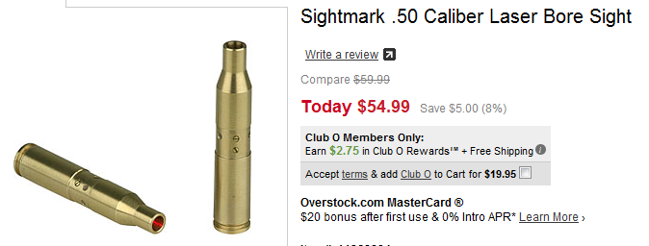
Reminder: Layout
All aboard!
Quintuple GEMstack (can always “shrink”).
Need trackers to know each particle’s trajectory.
PbGl is used to identify electrons.
Bore site laser for initial alignment.
Coarse pads in case scintillators fire too fast.
MRCP??

Slide 4
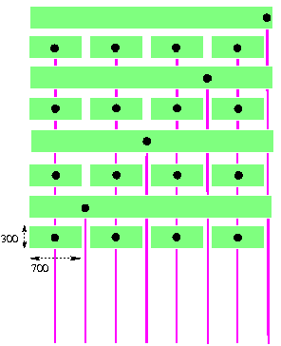
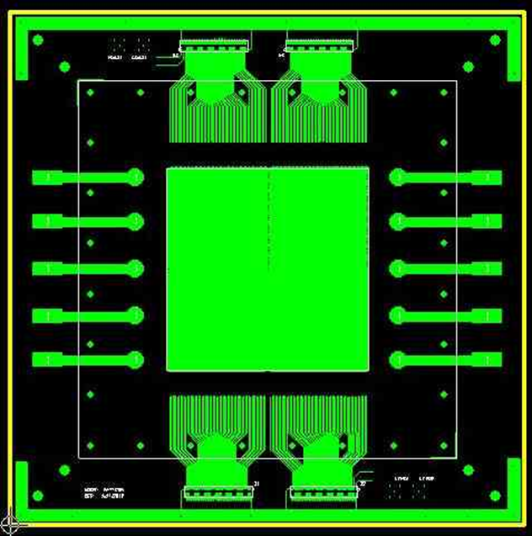
Reminder: Segmentation
RING images produce POSITION CORRELATION!
Ambiguity for Compass (Cartesian) Coordinates
SOLN: New pad plane
¼ rings in four quadrants
STAR-style strip-pixels.

Slide 5
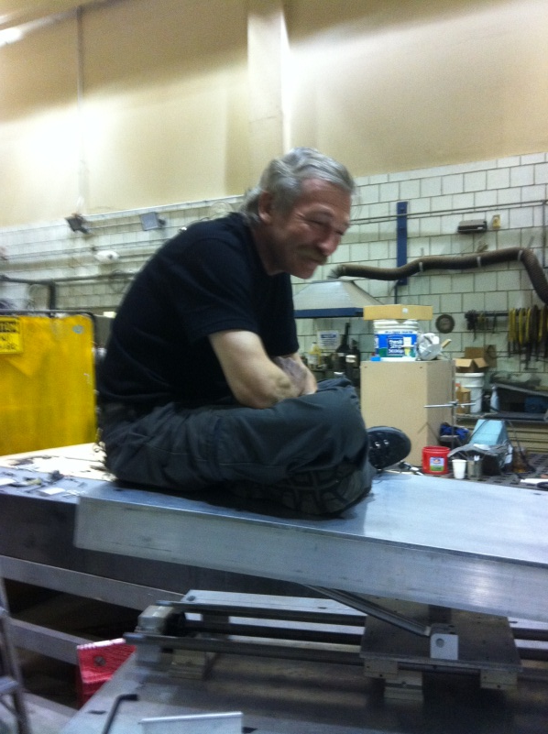
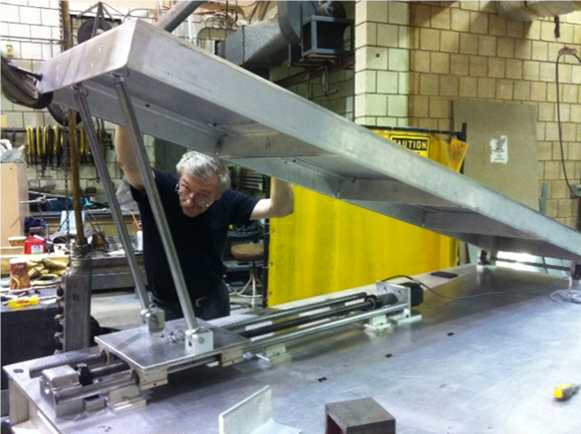
Progress: Lift Table
Lift Table design: Benji Lewis (postdoc)
Lift Table build by SBU Machinists.
Required: ~10 degrees.
Lifts machinist for 7 degrees and above.

Slide 6
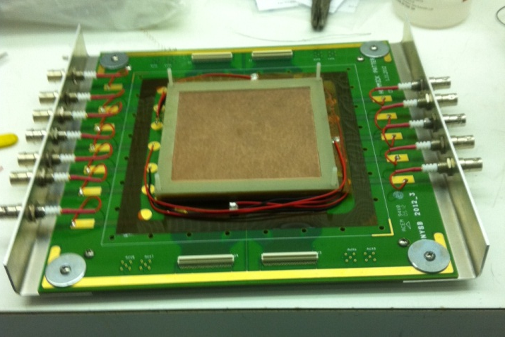
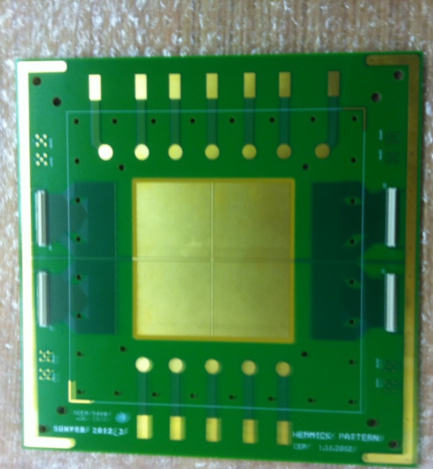
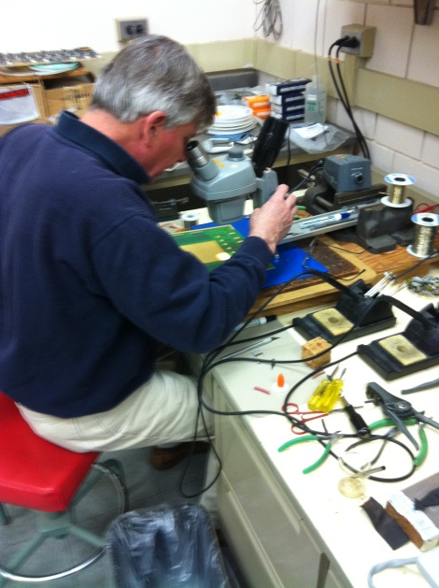
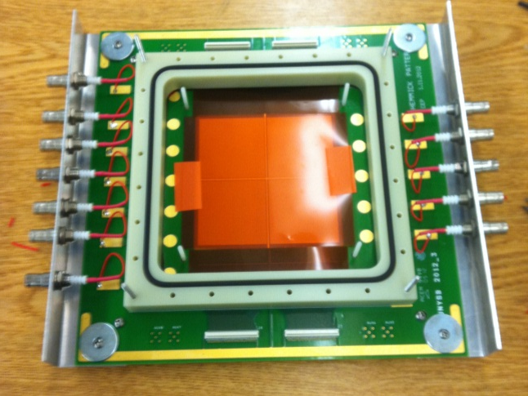
Progress: Pad Plane
Pad Plane Design, SBU Engineer Chuck Pancake.
Pad Plane(s) delivered 3 weeks late.
Good News: Pin test was free.

Slide 7
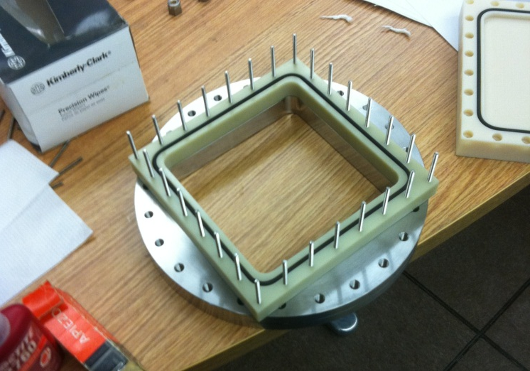
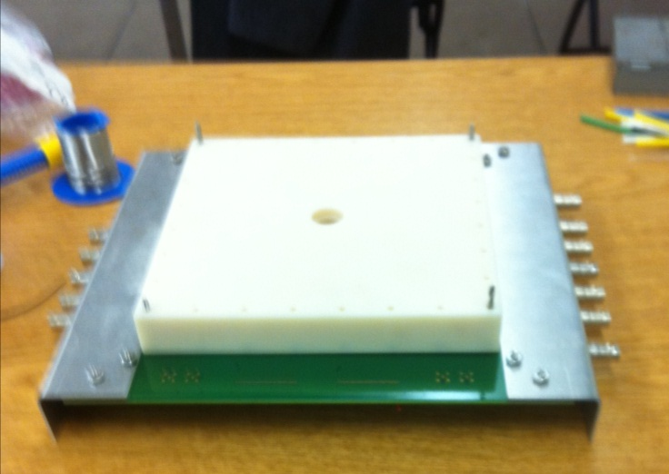
Pad Plane Vacuum System
Desire: Pump to change gas.
Challenge: Pad plane can’t withstand diff. pressure of 1 atm.
Solution: Pump both sides using removable flange.

Slide 8
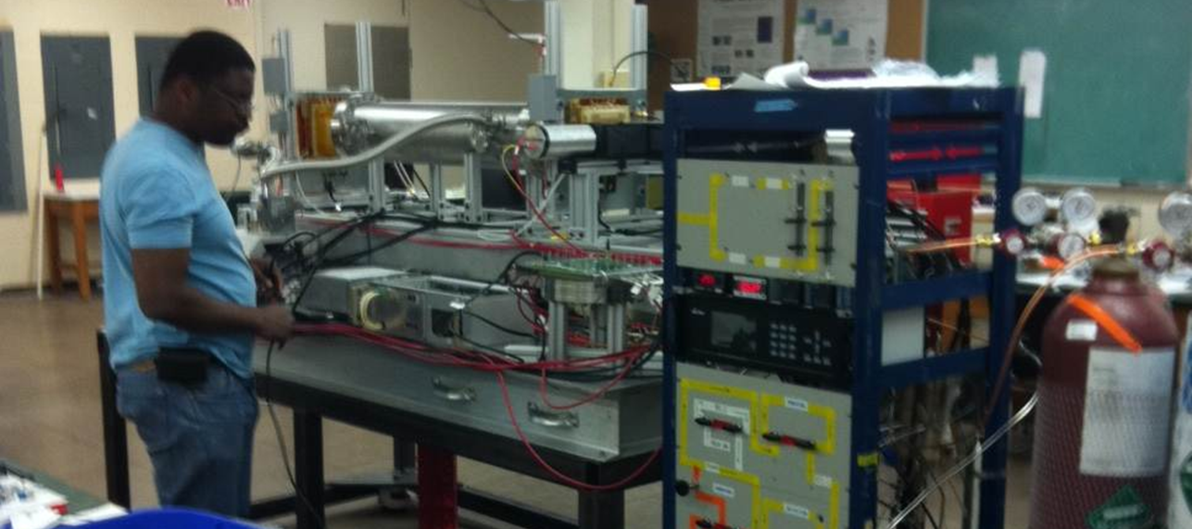
System Assembly
Kondo and Kiad (UVA) bring trackers & DAQ.
Calorimeter from M. Jones.
Gas System running: 1ppm O₂ 0.23 ppm H₂O

Slide 9
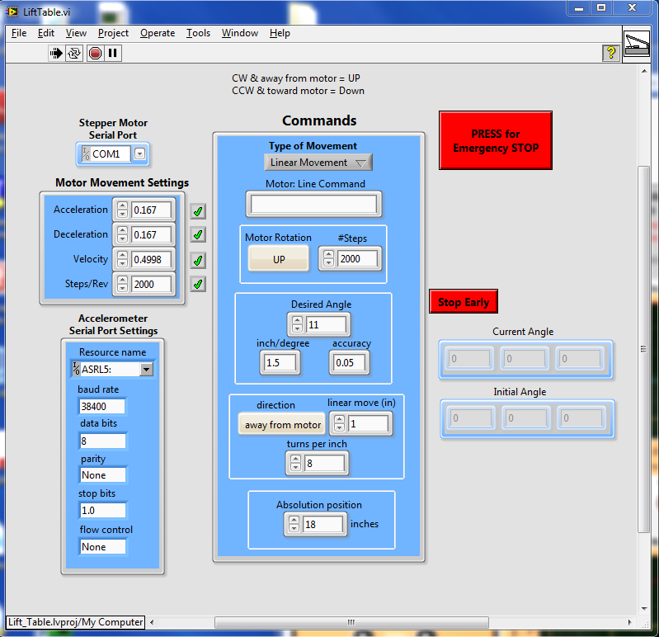
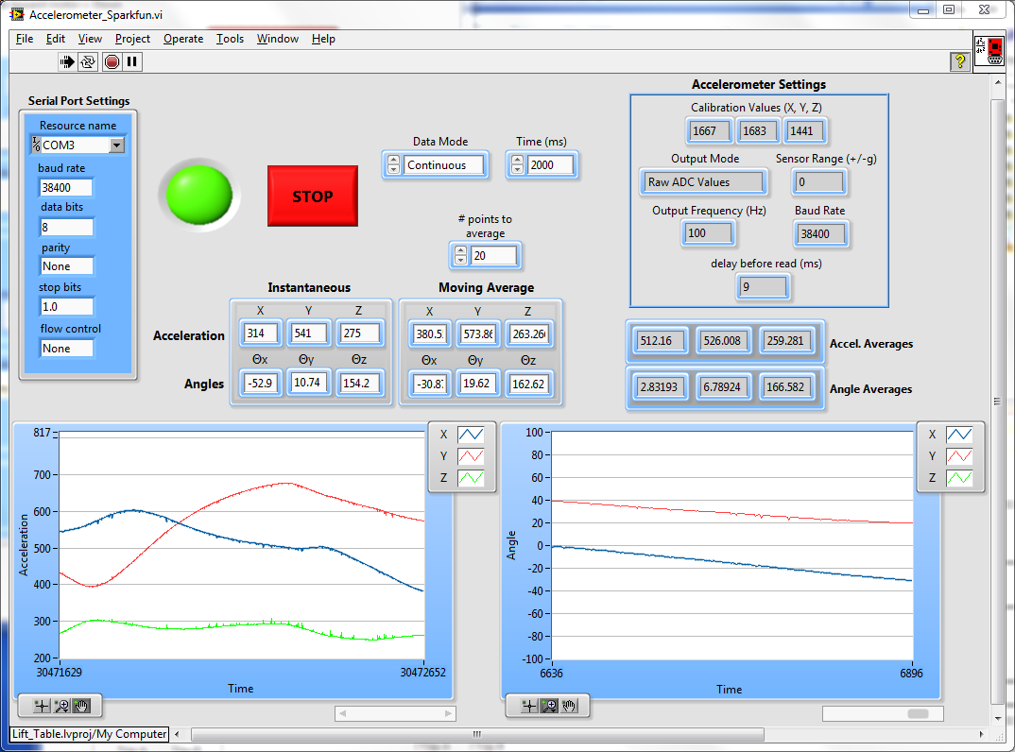
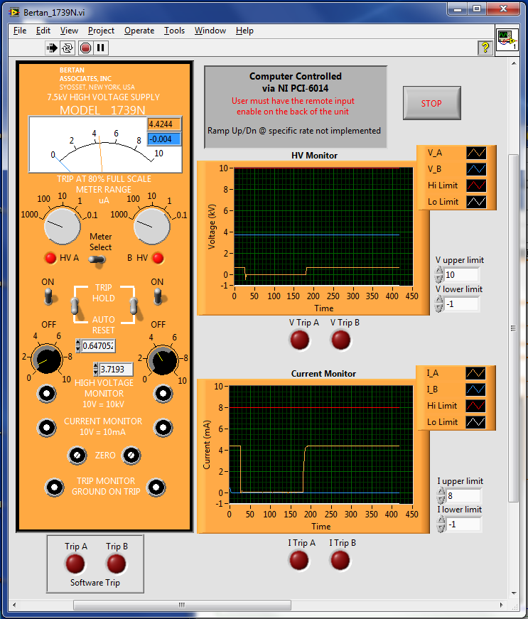
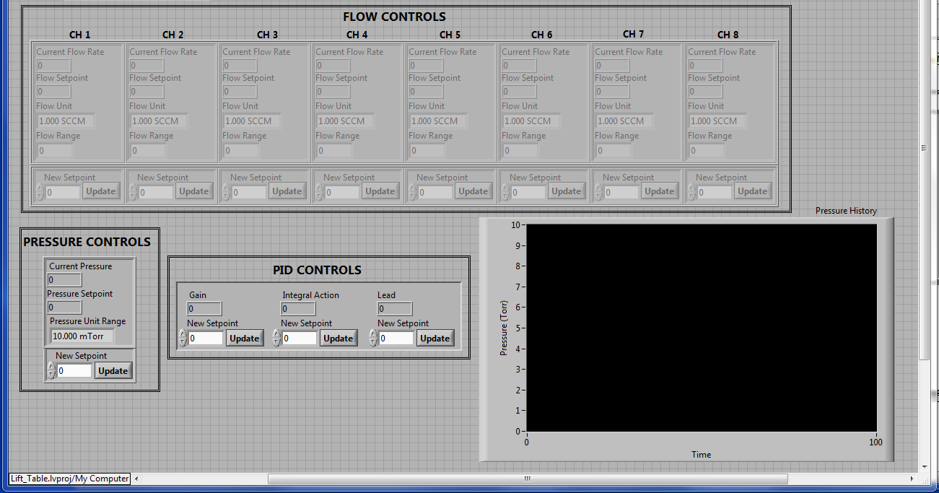
Remote Control Software
Lift Table
Lift Table
Tracker HV
Author mostly Benji Lewis
Gas System: Ben Chonigman.

Slide 10
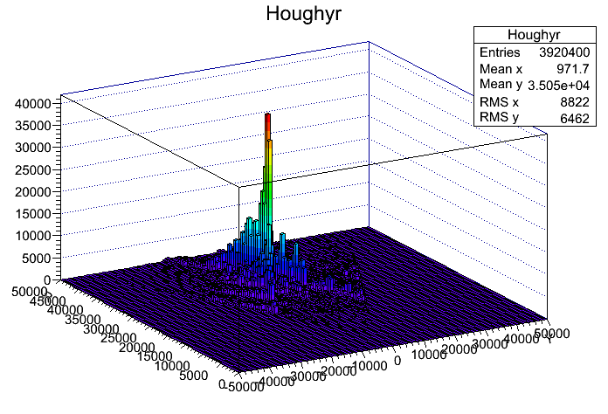
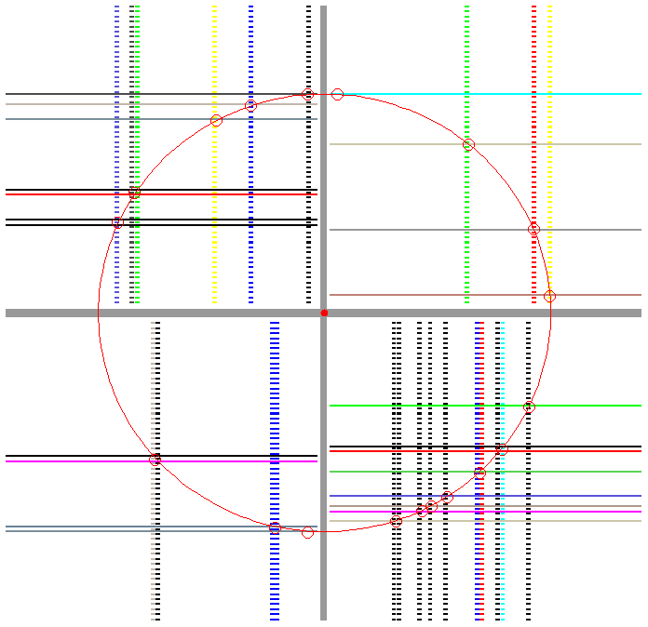
Analysis Software
Combinatorial Hough Transform:
Any three points define X_{center}, Y_{center}, R
Pseudo-points: all X/Y combinations in a quadrant.
Fill 3D histogram with X,Y,R…peak bin = ring.
Graduate Student: Huijun Ge
What could be missing?

Slide 11
Mirror, Mirror
Finally arrived!
2 mirrors… reflectivity (>80% down to 120 nm)
Aligned in two steps:
Laser hits mirror center & reflects back to itself.
Laser hits target in Hall A.

Slide 12
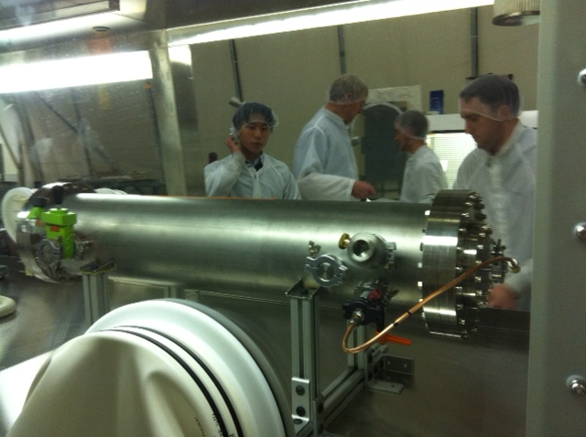
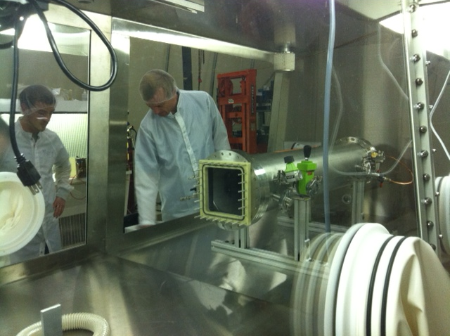
CsI cathode done.
Vessel goes into Glovebox
Installed Thursday night.
Tests Friday
CONCERN:
One GEM started to draw current last night

Slide 13
April 15 (if GEM recovers)
Drive on Sunday.
Work with Kondo more on DAQ Monday.
Install Tuesday.
If GEM requires replacement.
Have spares.
Place vessel in glovebox.
2 days to get below 10 ppm water.
1 day to replace & start CF4.
1 day to test.
Delivery next week only ☹…

