Slide 1
Magnet Update
Zhiwen Zhao (UVa)/Paul Reimer (Argonne)
SoLID Collaboration Meeting
2012/04/13

Slide 2
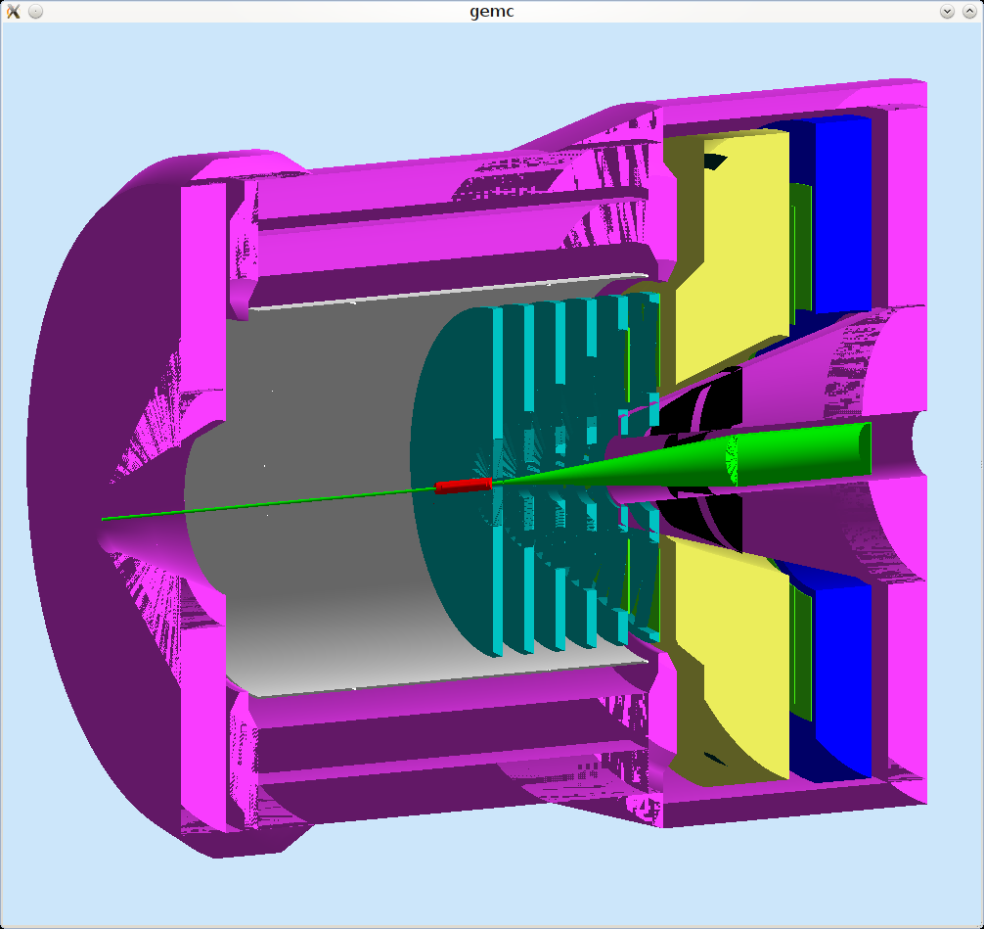
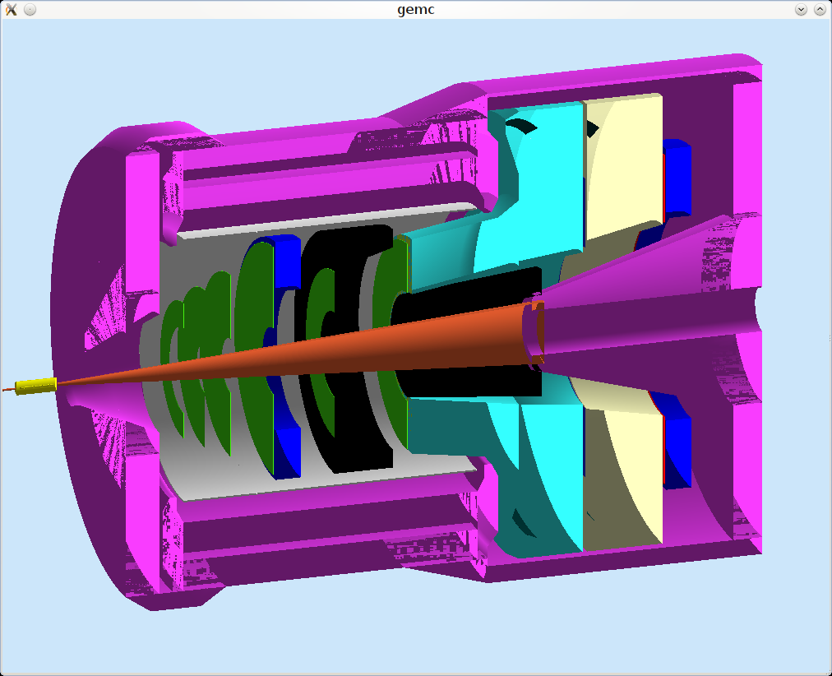
CLEOv6 with detectors
Only small change comparing to BaBar magnet, Including longer Cherenkov, longer EC, end cup radius reaching max allowed due to HallA beam line height about 10 feet
PVDIS (short nose)
SIDIS (short nose)

Slide 3
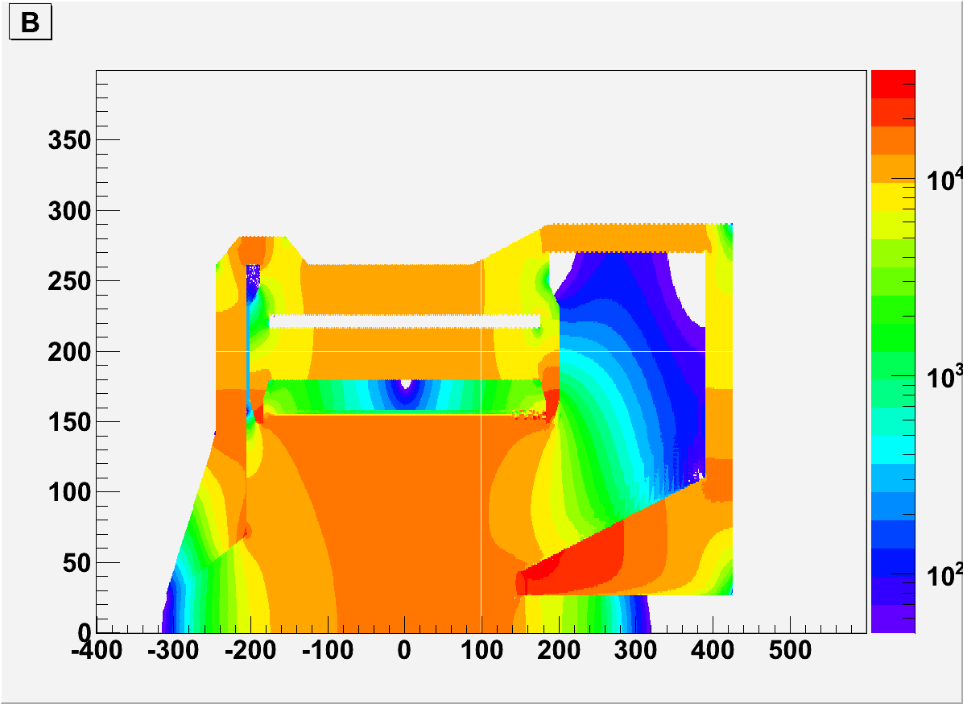
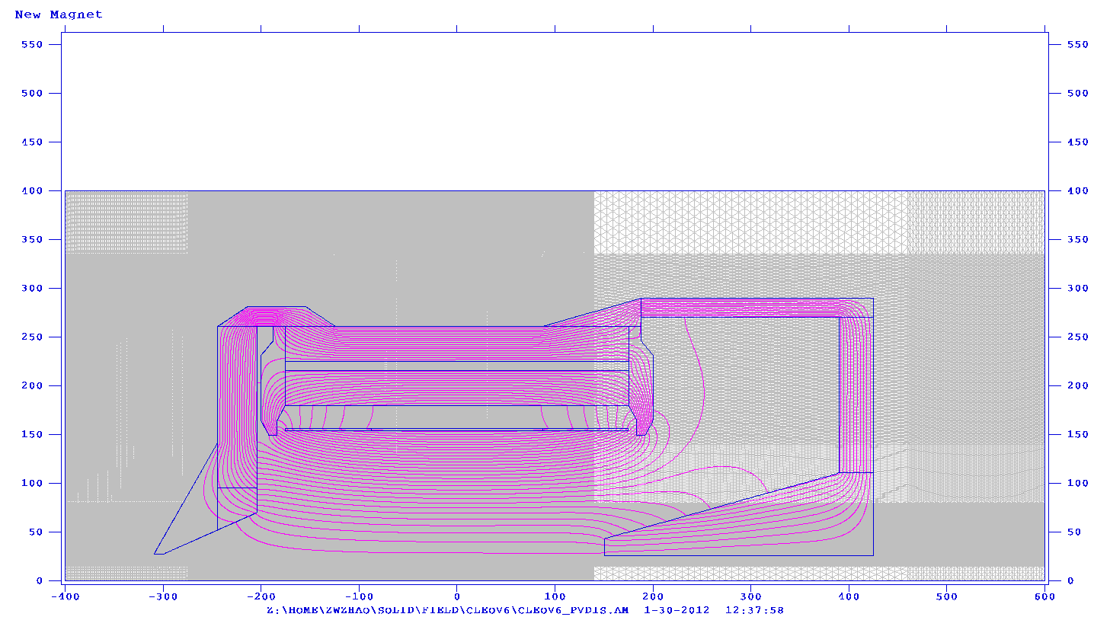
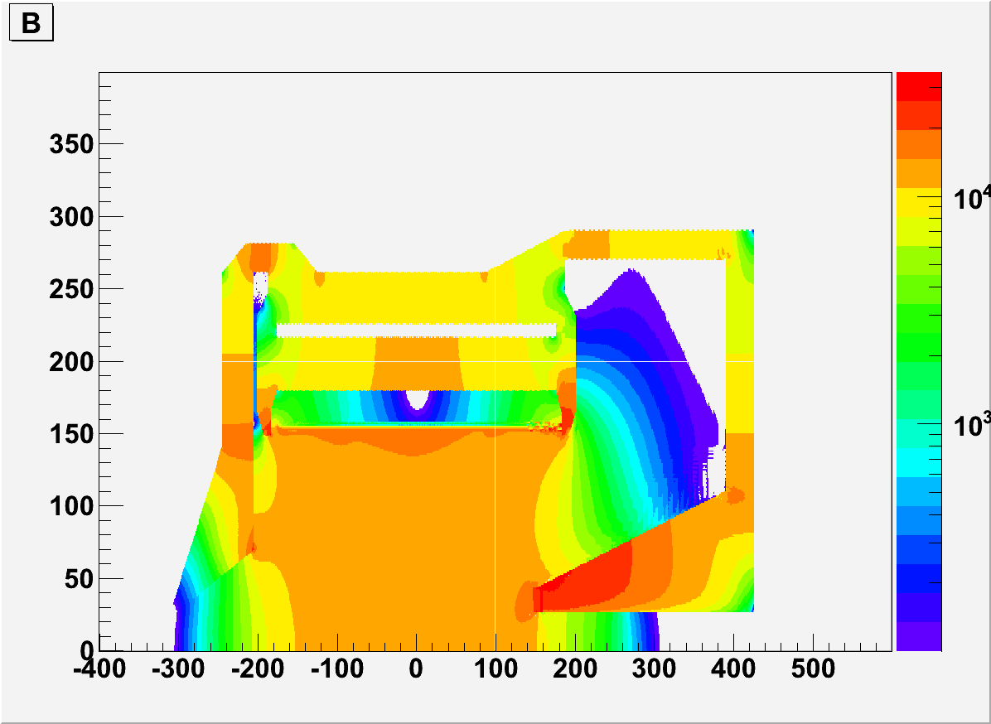
PVDIS
B
PVDIS (short nose)
Short nose, >50G
B
PVDIS has nose further into the solenoid to make field homogeneous at baffle region.
Short nose, >100G

Slide 4
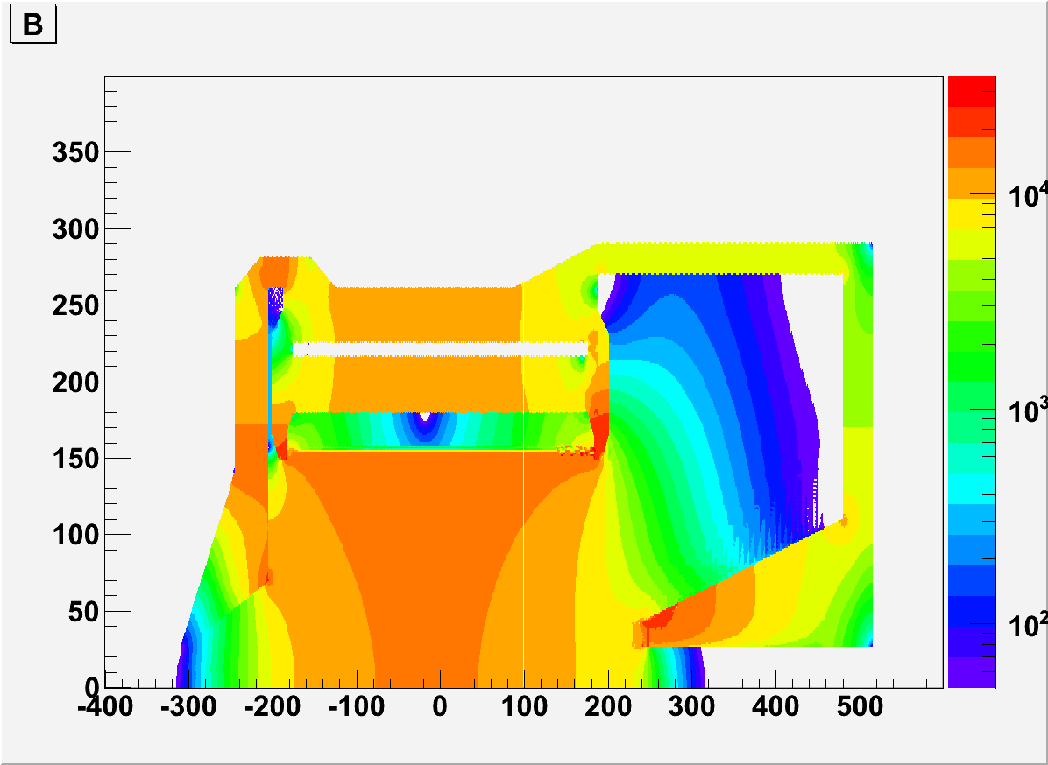
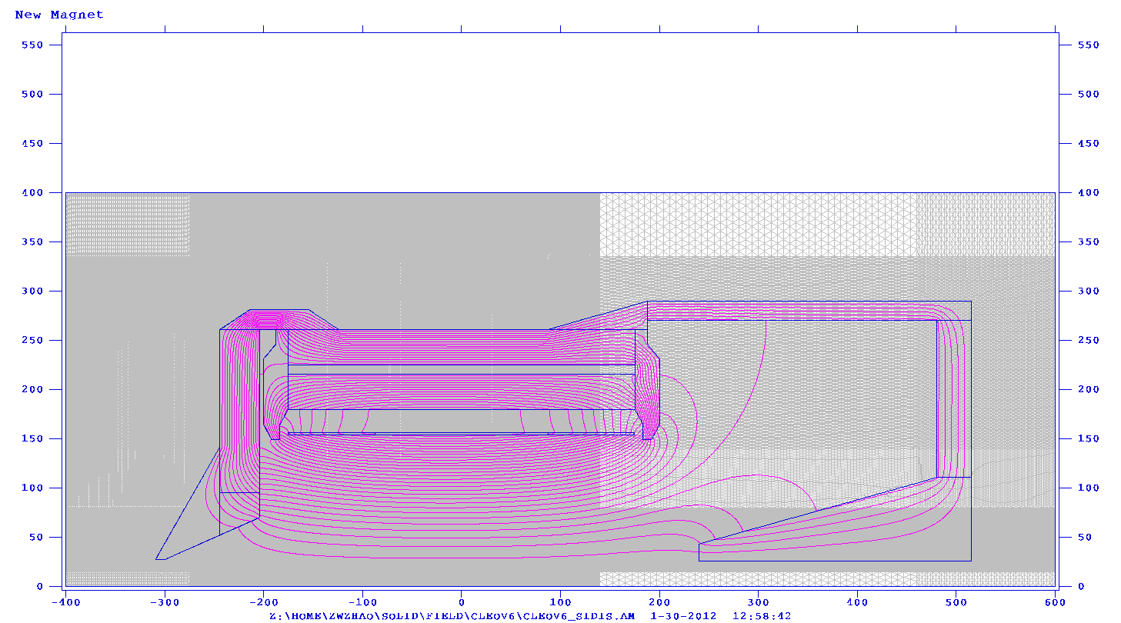
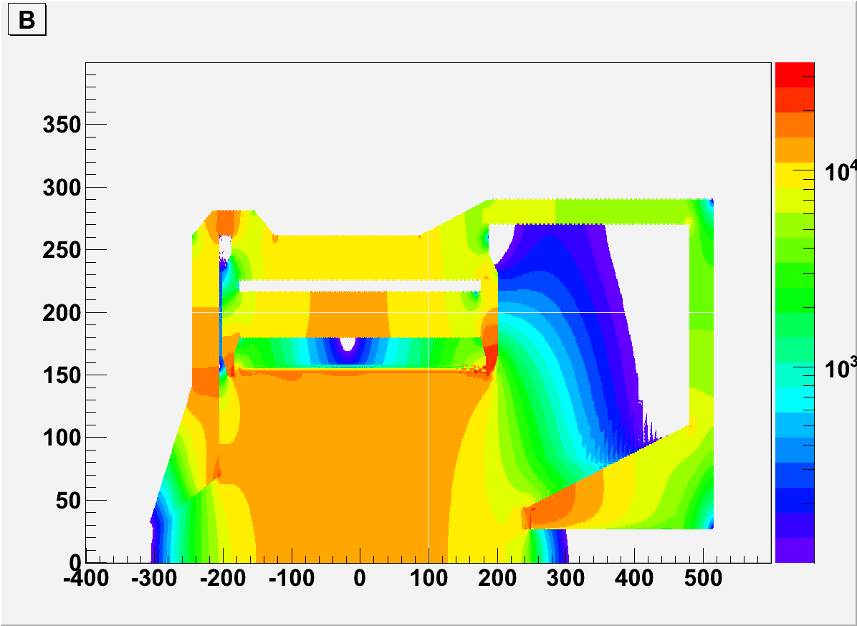
SIDIS
B
Short nose, >50G
SIDIS (short nose)
B
Short nose, >100G
SIDIS has an additional 90cm wide donut shape which holds the heavy gas Cherenkov.

Slide 5
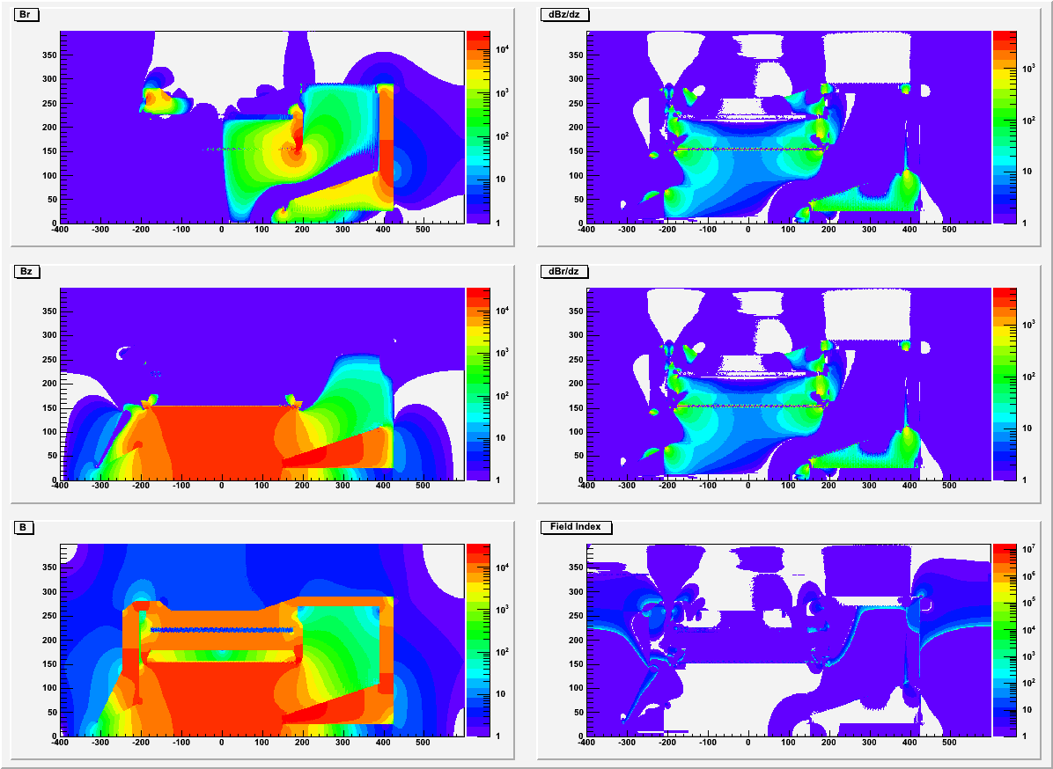
CLEOv6 PVDIS (short nose)
Br
dBz/dz
Bz
dBr/dz
B
Field index

Slide 6
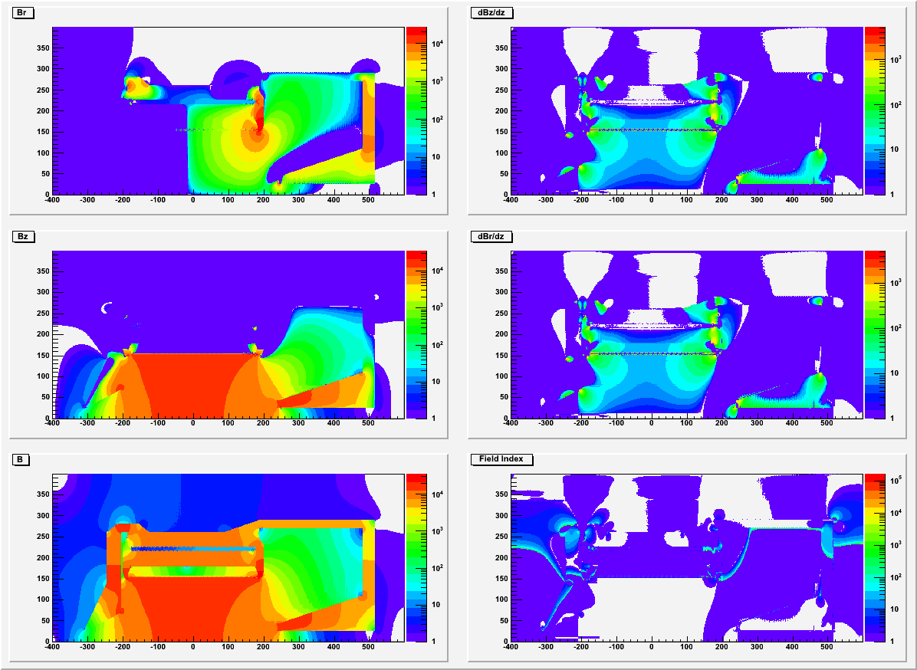
CLEOv6 SIDIS (short nose)
Br
dBz/dz
Bz
dBr/dz
B
Field index

Slide 7
Summary
CLEOv6 may small field at the region where Cherenkov detectors will be. We need to look at field strength relative to photon sensor orientation.
CLEOv6 PVDIS has homogeneous region where the baffle is. We will test how BaBar baffle design give acceptance.
Short nose has better homogeneous region around baffle and better force balance than long nose.
The large Br could be a concern for the GEM, we need to look into it.
Magnetic Force and supporting structure need to be checked to make sure it’s ok for engineering.
Use CLEO iron around coil , then make our front and end cups?

Slide 8
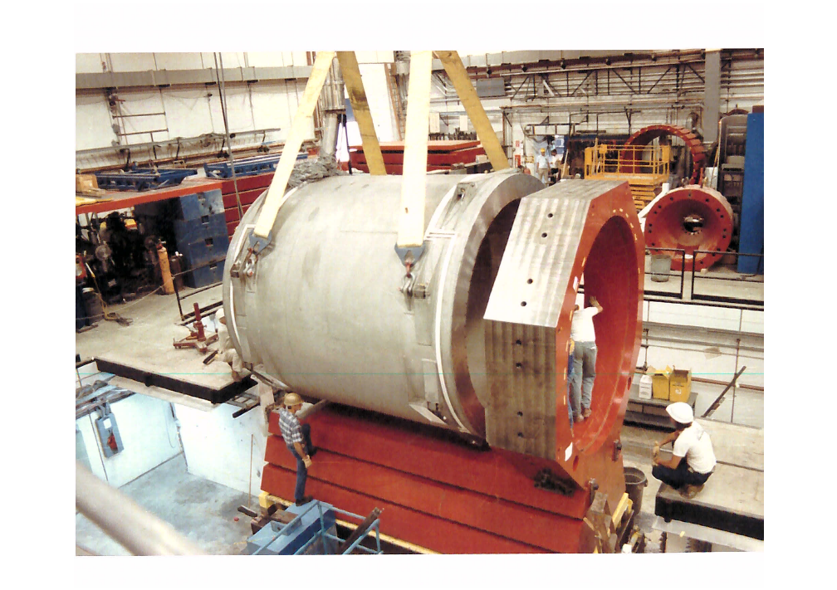
backup

Slide 9
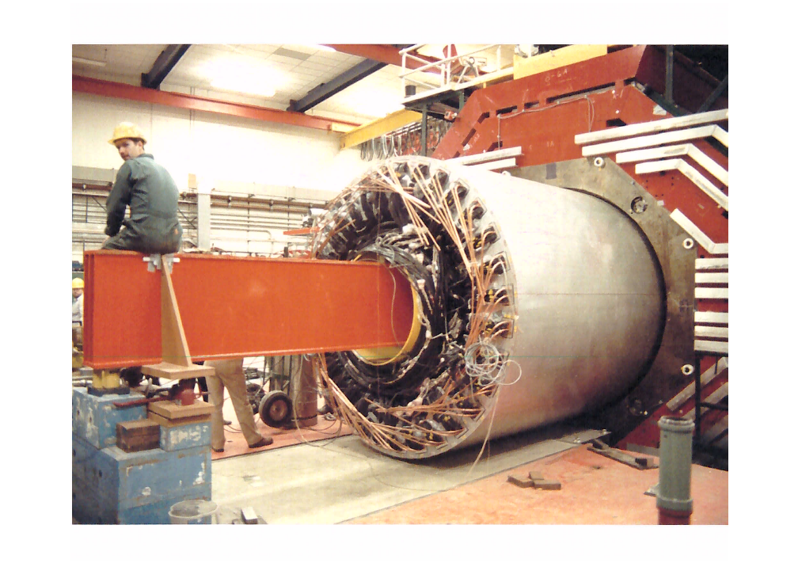

Slide 10
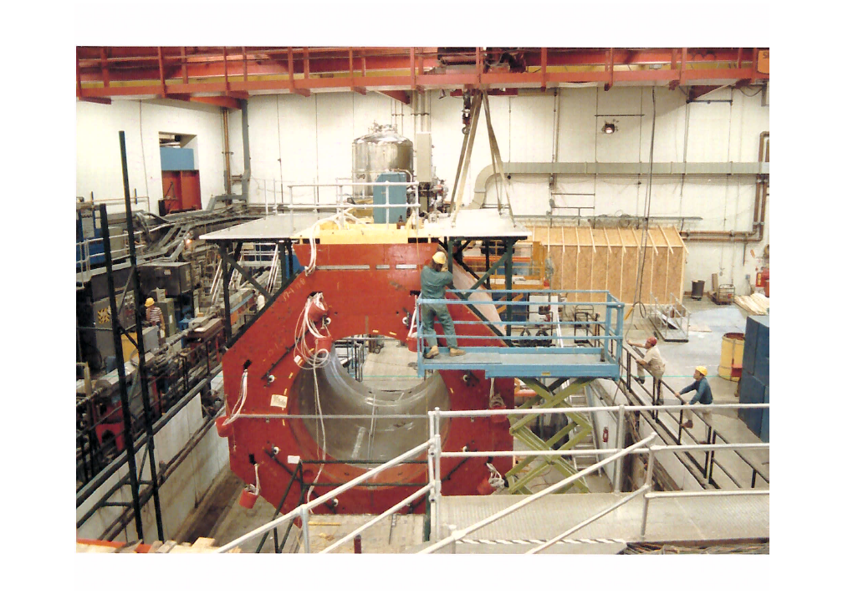
free iron around the coil?

Slide 11
backup

Slide 12
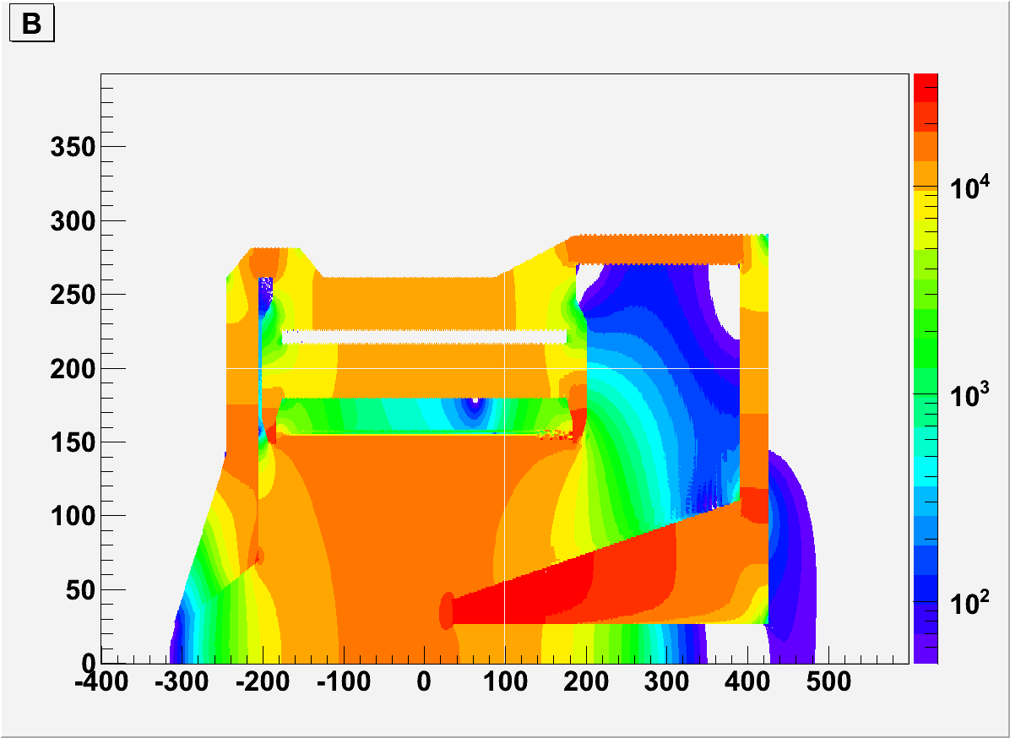
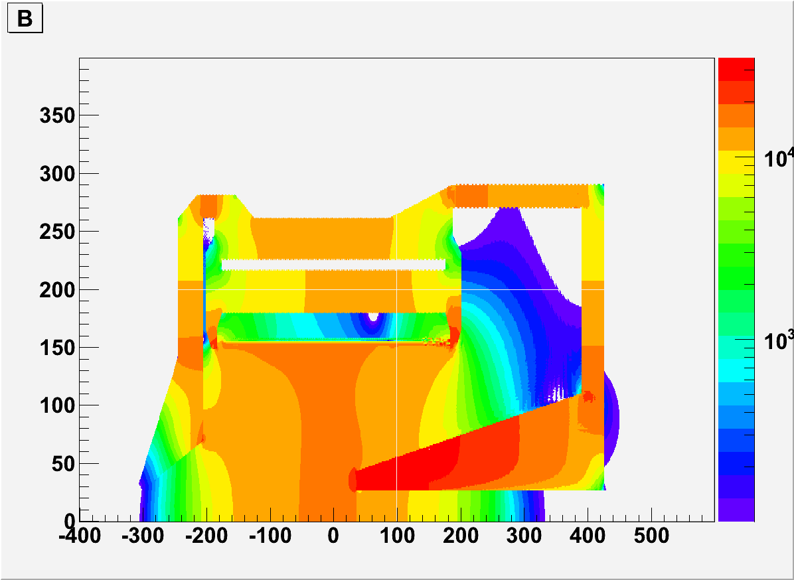
CLEOv6 PVDIS
Short nose, >50G
Long nose, >50G
Short nose, >100G
long nose, >100G

Slide 13
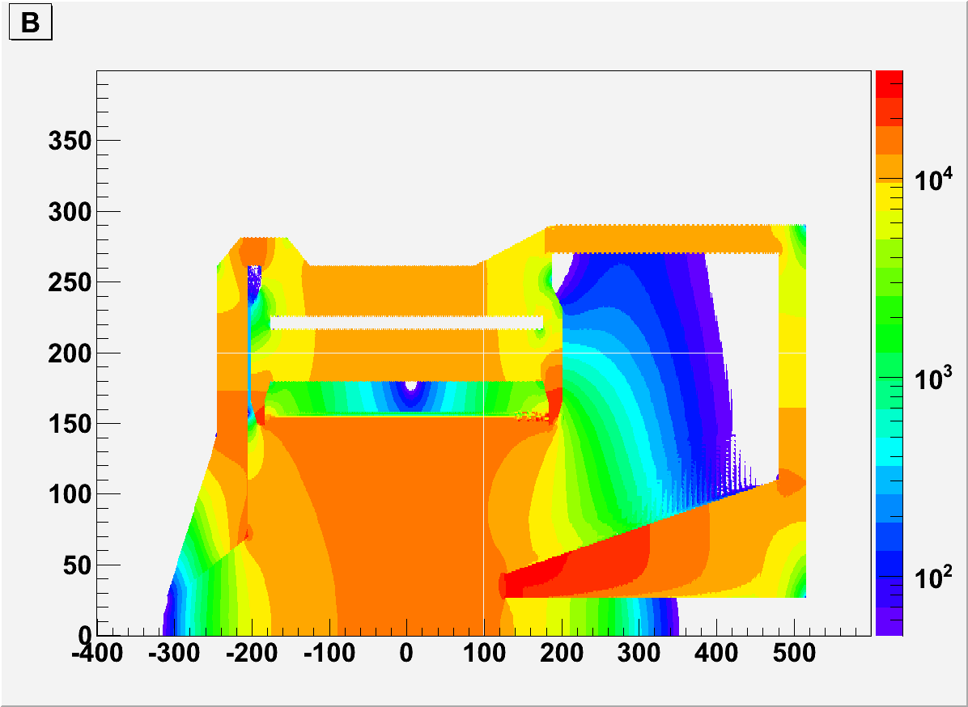
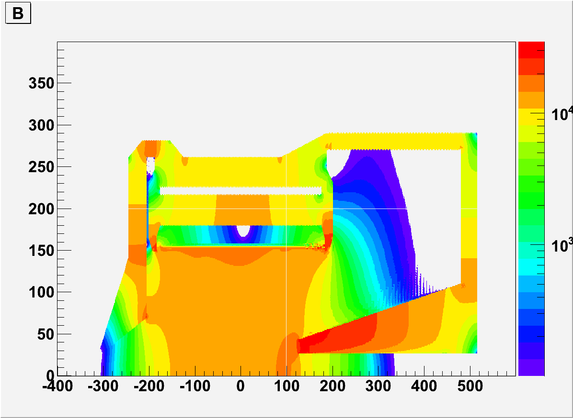
CLEOv6 SIDIS
Short nose, >50G
Long nose, >50G
Short nose, >100G
long nose, >100G

Slide 14
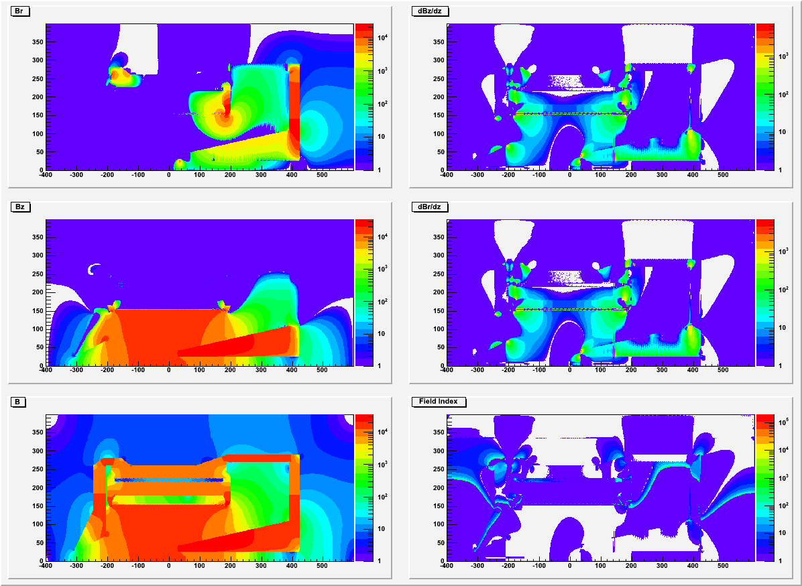
CLEOv6 PVDIS (long nose)

Slide 15
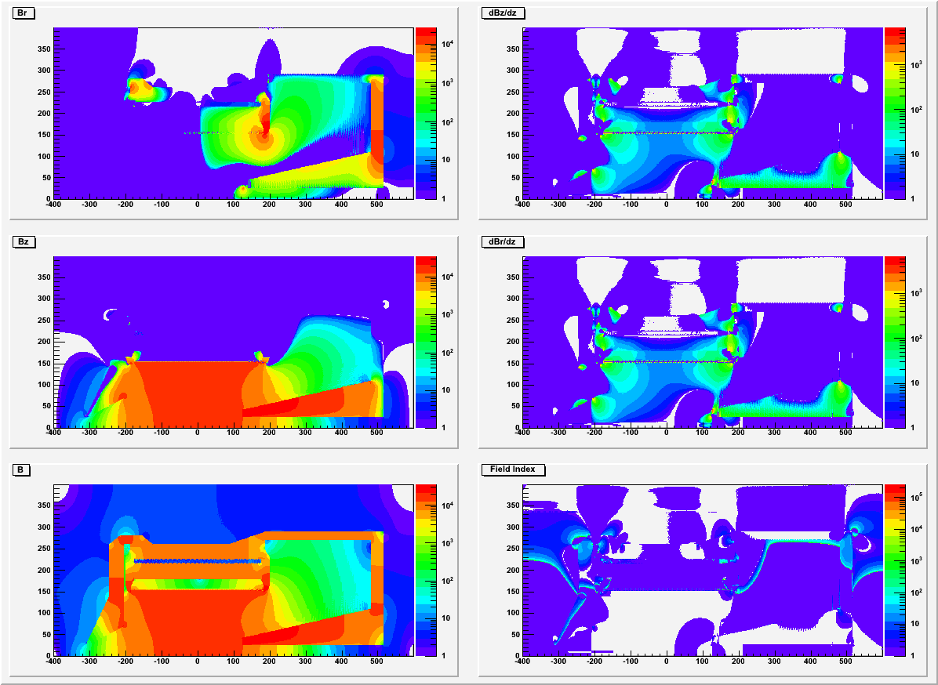
CLEOv6 SIDIS (long nose)

Slide 16
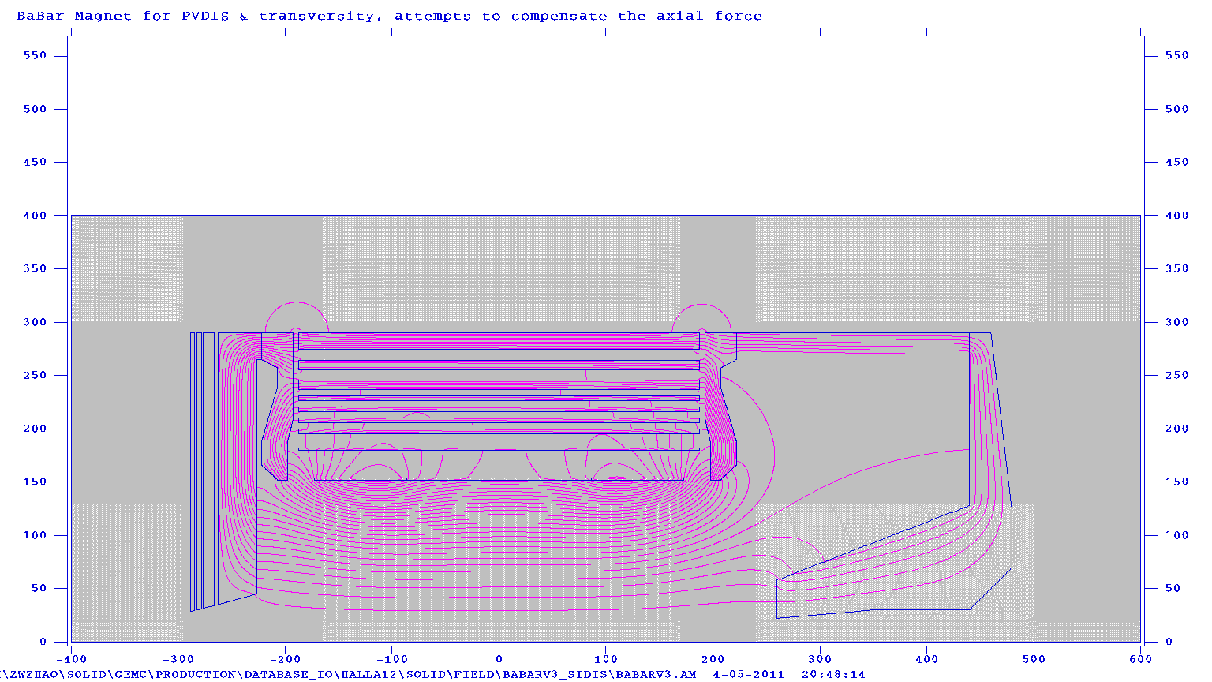
BABARv4

Slide 17
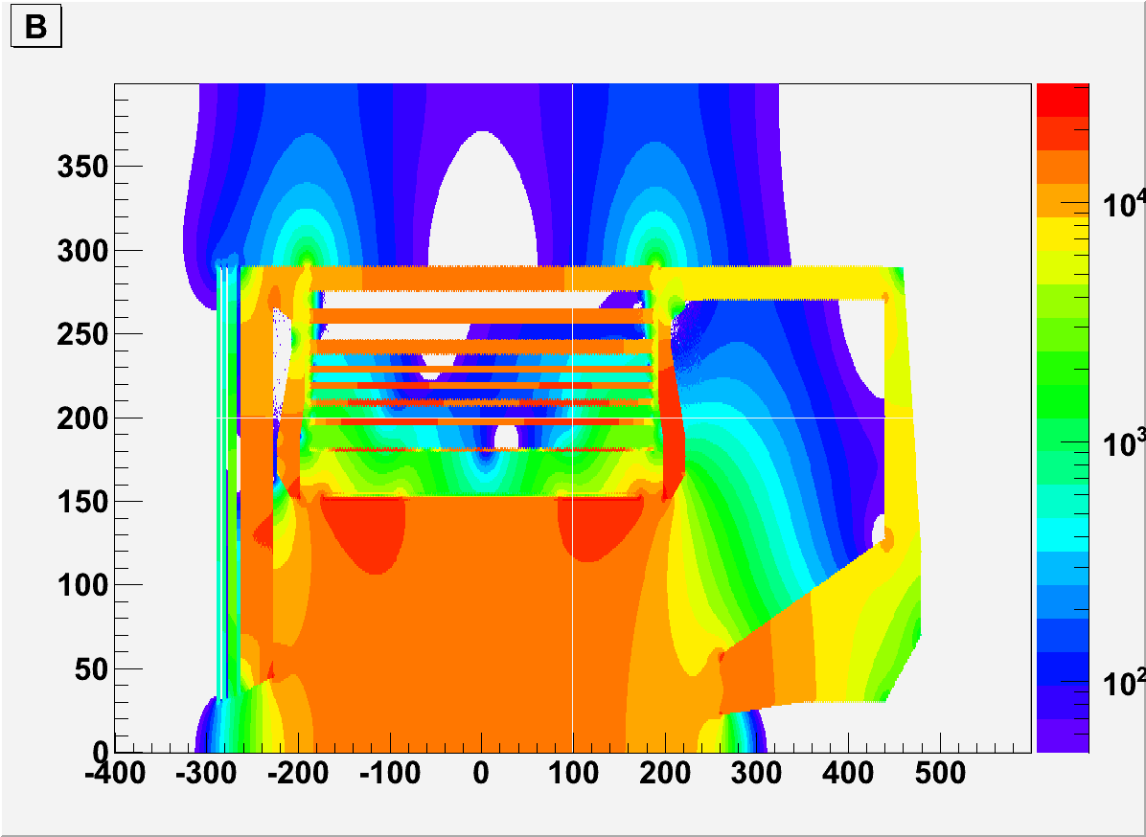
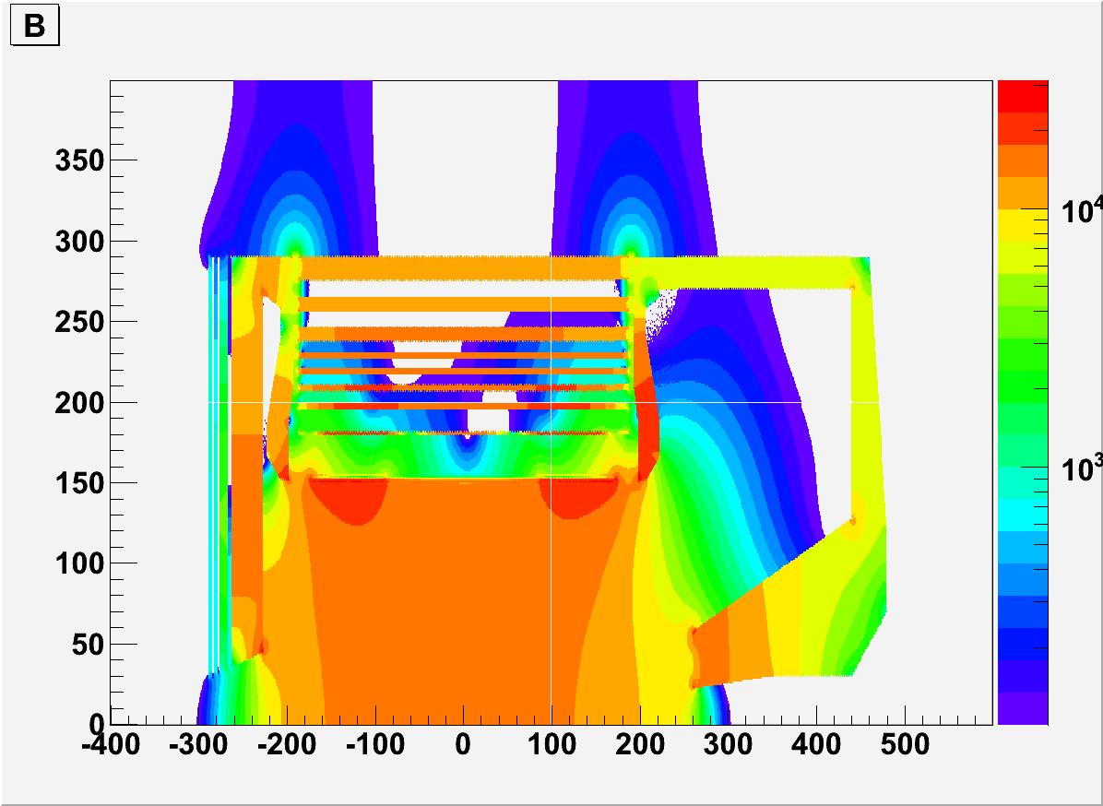
BABARv4
>50G
>100G

Slide 18
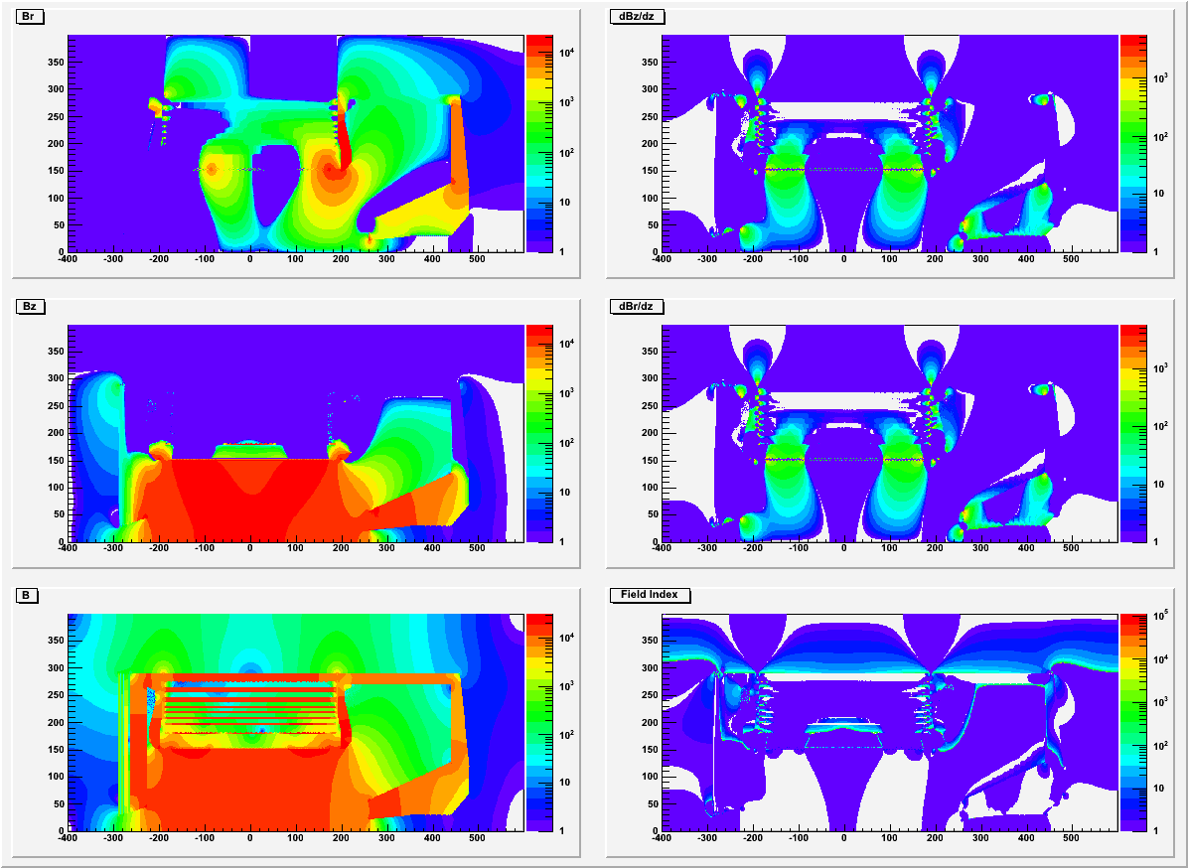
BABARv4

