Slide 1
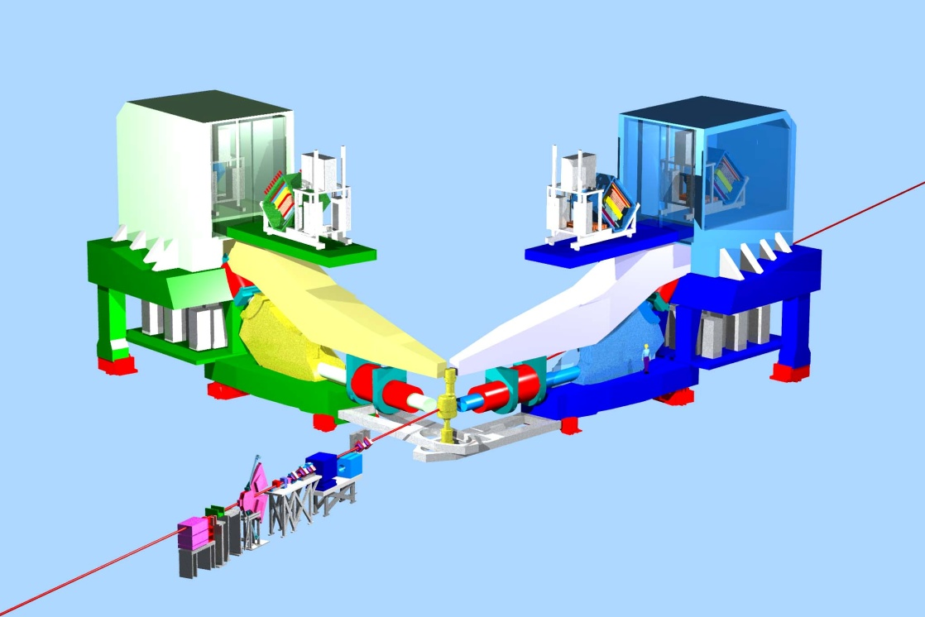
Hall A Status
SOLID Collaboration Meeting
June 13-14, 2012
Robert Michaels
Acting Hall A Leader
for 2 more weeks, and then: new Hall A Leader
Cynthia Keppel
starts July 1
Recent Activity
PAC39 Proposals
g2p / GEp
Future Physics Program
Strawman Schedule for Commissioning and Early 12 GeV

Slide 2
Recent Activity in Hall A (since Dec 2011 collab. mtg.)
Jan - Feb Recovered the polarized target for g2p/GEp .
Repairs went well. Achieved 90% polarization at 5T.
Have a robust, long-lifetime target that is easier to service.
( → see talk by Josh Pierce)
Mar 1 – May 18 Ran g2p/Gep. Collected ~60% data,
but no “septum out” (higher Q²) points.
Mar 17 - 27 Septum magnet failure and repair (or “workarounds”).
outstanding effort by Jack Segal and the technical crew
Apr 12 DOE approval of the SBS Project Management Plan
with glowing physics endorsement.
Proj. Mgt. Team: John LeRose, Bogdan Wojtsekhowski , Gordan Cates,
Kees deJager + Hall A Leader
Jan - now Local discussions re: APEX/PREX for commissioning,
plus other plans for early 12 GeV running.
Thanks to Ron Gilman & the 12 GeV Planning Committee

Slide 3
PAC 39 Proposals
for Hall A
C12 – 11 – 108 SOLID / SIDIS with polarized proton target
“An Update to Proposal PR12-11-108: Target Single Spin Asymmetry in Semi-Inclusive Deep-Inelastic (e,e’pi+/-) Reaction on a Transversely Polarized Proton Target”
Kalyan Allada, Jian-Ping Chen, Haiyan Gao, Xiaomei Li, Zein-Eddine Meziani
PR12-12-005 C-REX: ⁴⁸Ca Parity
“C-REX: A Parity-Violating Measurement of the Weak Charge Distribution of ⁴⁸Ca to 0.03 fm Accuracy”
Seamus Riordan, Juliette Mammei, Robert Michaels, Kent Paschke, Paul Souder
PR12-12-006 J/Psi with SOLID
“Near Threshold Electroproduction of the J/Psi at 11 GeV”
Kawtar Hafidi, Zein-Eddine Meziani, Xin Qian, Nikos Sparveris, Zhiwen Zhao
PR12-12-012 GEn / GMn on d with SBS
“Measurement of the Ratio Gen/GMn by the Double-polarized 2H(e,e’n) Reaction”
John Annand, Bogdan Wojtsekhowski, Nikolay Piskunov, Vincenzo Bellini

Slide 4
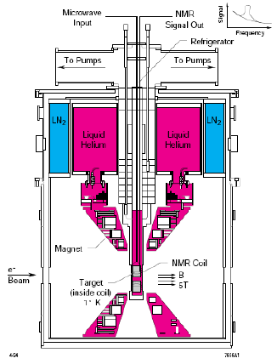
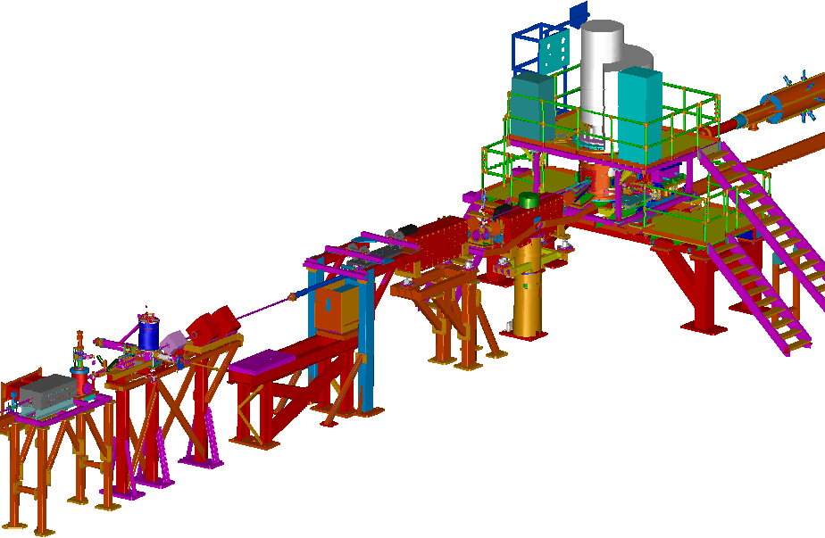
Low Q² g^{p}₂ and G^{E}_{p} Experiments (6 GeV)
Jian-Ping Chen
A. Camsonne
K. Slifer
D. Crabb
R. Gilman
G. Ron
D. Day
A. Sarty
J. Arrington
Uva/Jlab Polarized NH₃ Target
0.02 < Q² < 0.30 GeV²
Production Mar - May 2012
+ test run Dec 13 – 22, 2011
Overcame problems with target magnet, late beamline instrumentation, bracing of bellows, and septum failure
Modified Beamline in Hall A
^{Chicane Magnets}
^{Septum}
^{Low-current Monitors}
^{Local Beam dump}
Slow Raster

Slide 5
g2p / Gep (cont)
60% of data collected, but no “septum-out” (higher Q²) running
Students:
University of New Hampshire University of Virginia
Toby Badman Chao Gu
Ryan Zielinksi Jie Lieu
College of William and Mary Duke University
Melissa Cummings Min Huang
University of Science and Technology of China Hebrew University of Jerusalem
Pengjia Zhu Moshe Friedman
Septa
New Beam Diagnostics
(BPM,BCM,Harps,Tungsten Calo)
Chicane
Local Dump
Polarized Target

Slide 6
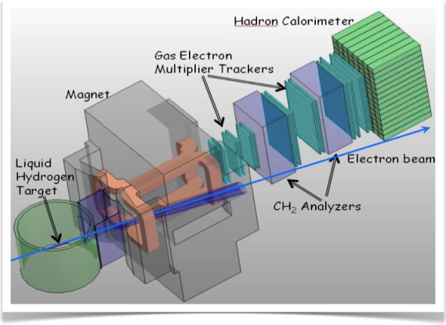
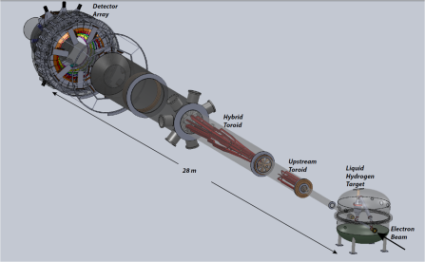
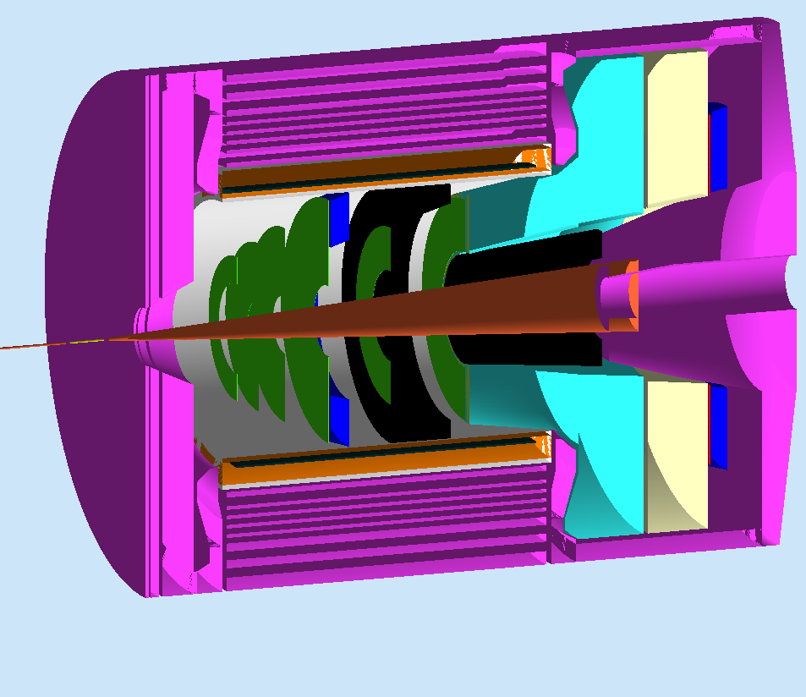
11 year view of Hall A
12 GeV Planning Committee
Ron Gilman (chair), Javier Gomez
Douglas Higinbotham, Charles Hyde
Nilanga Liyanage, Kent Paschke
SuperBigbite
SuperBigbite
MOLLER
g2p/GEp
16 mo. Shutdown
Early 12 GeV
Experiments
12 GeV Commissioning
MOLLER
-- Tritium --
Physics Beam to Hall A
SOLID
fiscal year
~Feb 2014
2011
2012
2013
2014
2015
2016
2017
2018
2019
2017
2021
2020
Thomas Jefferson National Accelerator Facility

Slide 7
Preliminary Plans for Early Beam in Hall A
Decisions (soon) → affects FY13 budget (this Oct)
16 mo. Shutdown
12 GeV Commissioning
Early Experiments
APEX and/or PREX
A1n / DVCS
Dark Matter
Neutron Skin
Neutron Spin
Structure
Deeply Virtual Compton Scatt.
12 GeV Projects: 1. Moller pol (J. Gomez)
2. Compton pol
(S. Nanda)
3. Energy Meas.Upgrade (D. Higinbotham)
SBS Experiments
EM Form Factors
at high Q²
SBS Project
SuperBigbite
11 GeV
Beam 1st to Hall A
FY 2013
FY 2014
FY 2015
FY 2016
FY 2017
Thomas Jefferson National Accelerator Facility
Robert Michaels, Hall A

Slide 8
Hall A Publications in 2012
H. Fonvielle, et.al. Virtual Compton Scattering and Generalized Polarizabilities of the Proton at
Q² = 0.92 and 1.76 GeV² arXiv:1205.3387 [nucl-ex]
S. Abrahamyan, et.al. Neutron Radius of 208Pb (PREX) PRL 108 (2012) 112502
C.J. Horowitz, et.al. Weak Charge Form Factor and Radius of 208Pb (PREX) PRC C85 (2012) 032501.
S. Ban et.al.. Parity Violating Electron Scattering Measurements of Neutron Densities J. Phys.
G39 014104 , 2012
N. Fomin et.al.. New measurements of high-momentum nucleons and short-range structures in nuclei PRL 108 (2012) 092502
Z. Ahmed et.al.. New Precision Limit on the Strange vector Form Factors of the Proton PRL 108 (2012) 102001
J. Huang, et.al. Beam-Target Double Spin Asymmetry A_LT in Charged Pion Production from Deep Inelastic Scattering on a Transversely Polarized He-3 Target at 1.4 < Q² <2.7 GeV². PRL 108 (2012) 052001
A.J.R. Puckett, et.al., Reanalysis of Proton Form Factor Ratio Data at Q² = 4.0, 4.8, and 5.6 GeV² PRC 85 (2012) 045203
M. Friend, et.al.. Upgraded photon detector with integrating readout NIM A676 (2012) 96

Slide 9
Hall A Publications in 2011
X. Qian, et.al., Single Spin Asymmetries in Charged Pion Production from Semi-Inclusive Deep Inelastic Scattering on a Transversely Polarized ³He Target. Phys.Rev.Lett.107:072003,2011
S. Abrahamyan, et.al. Search for new gauge boson in the A‘ Expt (APEX). Phys. Rev. Lett 107:191804, 2011
G. Ron et al. Low Q² measurements of the proton form factor ratio $mu_p G_E / G_M$. PRC 84 (2011) 055204
J. Arrington et al. Short-Range Nucleon-Nucleon Correlations arXiv:1104.1196 [nucl-ex]
L. B. Weinsten, et.al., Short Range Correlations and the EMC Effect Phys. Rev. Lett. 106: 052301, 2011
X. Zhan et al. Proton Elastic FF Ratio at low Q² Phys. Lett. B705 59 (2011)
M. Meziane et al. Effects Beyond Born in Pol. Transf. Obs. ep Elastic Phys. Rev. Lett 106. 132501, 2011
S. P. Malace, et.al. A precise extraction of the induced polarization in the ⁴He(e,e'p)³H reaction Phys.Rev.Lett.106:052501,2011
G.D. Cates, et.al., Flavor decomposition of elastic nucleon E&M form factors Phys.Rev.Lett.106:252003,2011
E. Fuchey, et.al., Exclusive Neutral Pion Electroproduction in the Deeply Virtual Regime Phys.Rev.C83:025201,2011
J. Glister, et.al. Polarization Obs in Deuteron Photodisintegration below 360 MeV Phys.Lett.B697:194-198,2011.

Slide 10
Expected Future Publications of Hall A
Transverse asymmetries from 4 nuclei (a byproduct of HAPPEX, PREX)
NIM article about PREX detector
PVDIS at 6 GeV, both a PRL and a longer archival article (Xiaochao Zheng)
NIM article about PVDIS DAQ (Xiaochao Zheng)
9Be(e, e'k+) from the hypernuclear collaboration (Franco Garibaldi).
E08-005: Transverse QE 3He(e,e'n)
E05-102: GEn (e,e')
E05-102: QE 3He(e,e'p) & 3He(e,e'd)
E05-015: Transverse QE (e,e') (J.P.Chen)
E04-007: pi0
E07-006: Short Range Correlations 4He
E08-008: D(e,e'p) with Focal Plane Polarimeter
E08-009: 4He(e,e'p)
E08-010: H(e,e'p) N->Delta
E08-014: x>2 SRC with 48Ca & 40Ca (Arrington, Solvignon)
He-3(e,e'n) GEn – PRC paper with all four data points
GEn polarized He3 target – PRC or NIM paper
NIM paper about S1m s-shape counter
PRL on H(gamma,p+\pi^{^0})
Single Spin Asymmetry in DIS (E07-013)
SSA in inclusive hadron (Part of E06-010)
SSA in SIDIS production of K+- and proton (Part of E06-010)
Polarized 3He target for transversity (NIM)
E08-007: pol H(e,e') elastic – ran this Spring using polarized NH3 target
g2p experiment – ran this Spring using polarized NH3 target

Slide 11
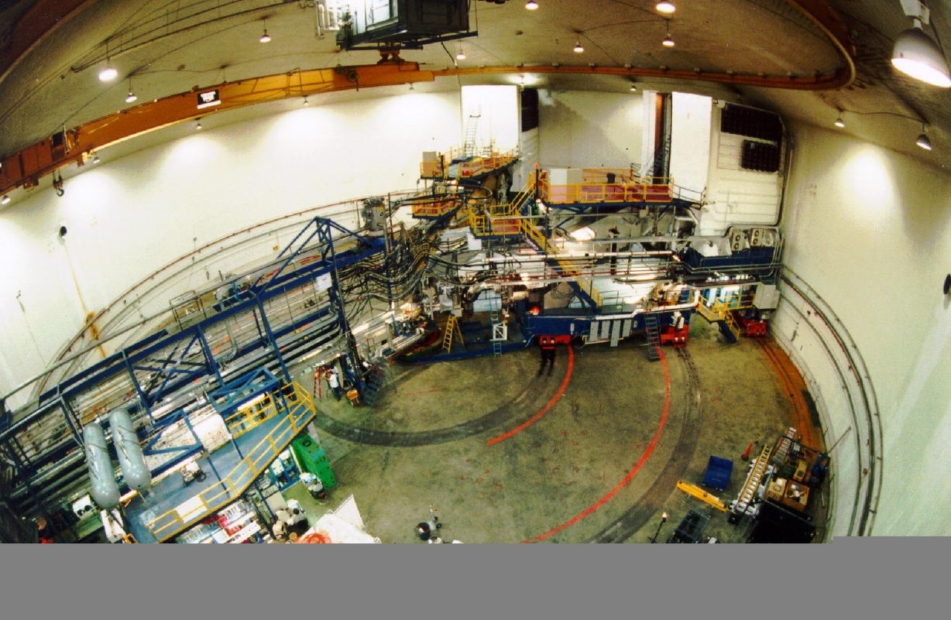
Summary : Hall A Status
Publications : ~10 per year recently
Timely publications and Archival Papers are important !
g2p / GEp has been completed. End of 6 GeV era.
Bright future for the 12 GeV era
Looking forward to working on SOLID
R. Michaels
Hall A Collab. Mtg.
June 13, 2012

