Slide 1
PVDIS at 11 GeV with SoLID

Slide 2
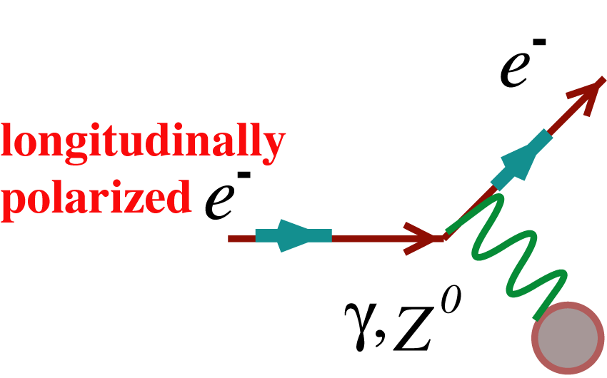
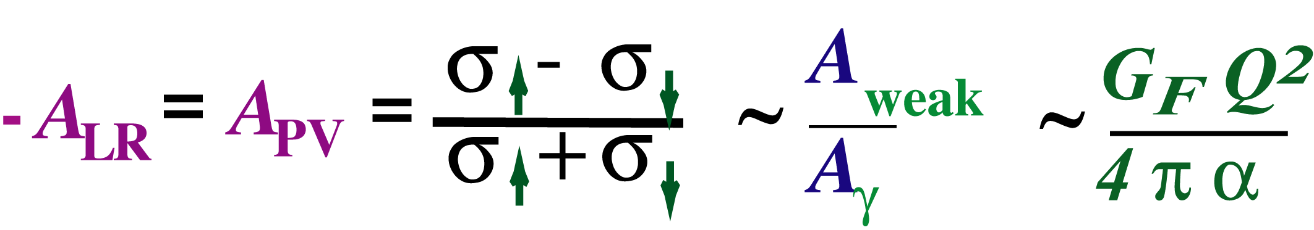
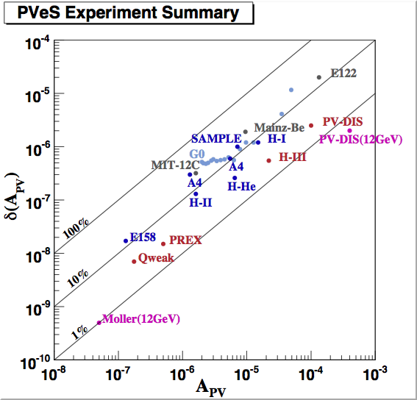
PV Electron Scattering
Continuous interplay between probing hadron structure and electroweak physics
(g_{A}^{e}g_{V}^{T} +β g_{V}^{e}g_{A}^{T})
g_{V} is a function of sin²θ_{W}
to
Parity-violating electron scattering has become a precision tool
Physics beyond Standard Model
Strange quark form factors
Neutron skin of a heavy nucleus
QCD structure of the nucleon in PV DIS
SLAC
MIT-Bates
Mainz
JLab
part per billion systematic control
1% normalization control
photocathodes, polarimetry, high power cryotargets, nanometer beam stability, precision beam diagnostics,
low noise electronics, radiation hard detectors

Slide 3


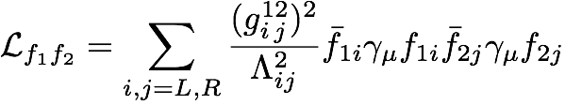
Indirect Clues to TeV Physics
Electroweak Interactions at scales much lower than the W/Z mass
Many theories predict new forces that disappeared when the universe cooled
E
Dynamics involving
particles with m > Λ
Λ (~TeV)
courtesy
V. Cirigliano
H. Maruyama
M_{W,Z}
(100 GeV)
higher dimensional operators can be systematically classified
Heavy Z’s and neutrinos, technicolor, compositeness, extra dimensions, SUSY…
flavor changing as well as flavor diagonal
charged current as well as neutral current
new contact interactions
Consider or
must reach Λ ~ several TeV

Slide 4


Neutral Currents at Low Energy
Colliders AND Fixed Target
One goal of neutral current measurements at low energy AND colliders:
Access Λ > 10 TeV for as many different flavor & L,R combinations as possible
Colliders access scales Λ’s ~ 10 TeV
- L,R combinations accessed are mostly parity-conserving
Tevatron, LEP, SLC, LEP200, HERA
Z boson production accessed some parity-violating combinations but…
on resonance:
AZ imaginary
no interference!
Low Energy: New Physics/Weak-Electromagnetic Interference
opposite parity transitions in heavy atoms
Spin-dependent electron scattering
Electromagnetic amplitude interferes with Z-exchange as well as any new physics

Slide 5
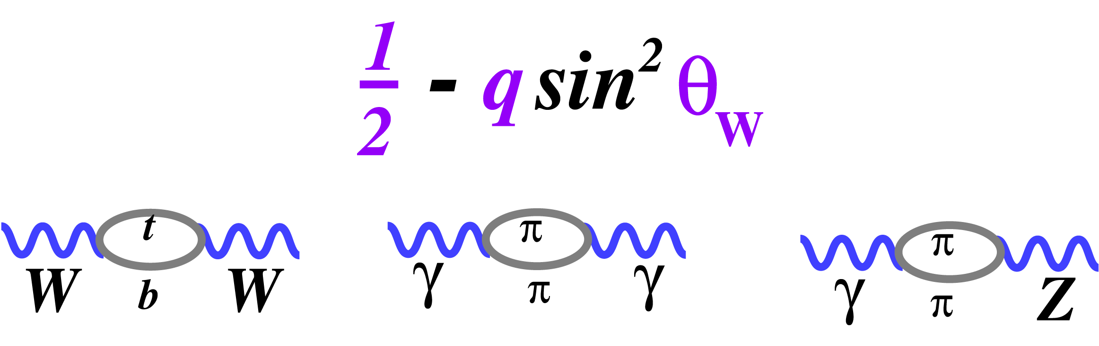
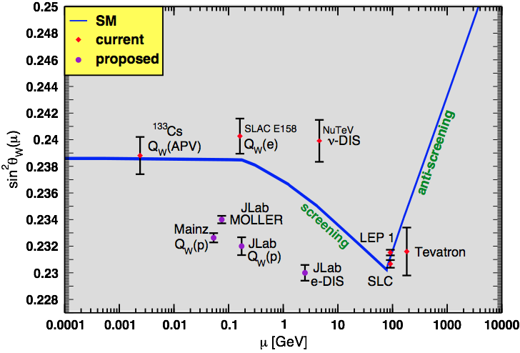

The Weak Mixing Angle
Running of θW : Bookkeeping to check consistency of various measurements
T
γ-γ loop is the running of αEM
W-W loop provides indirect mt
γ-Z loop is the running of sin²θW
Published Measurements
  SLAC E158
  ¹³³Cs Atomic Parity Violation (APV)
  NuTeV result requires careful consideration of nuclear corrections
Current/Future PV Electron Scattering Measurements at JLab
  e-q measurements: QWeak (elastic e-p) and SOLID (DIS)
  Improve on E158 by a factor of 5 (MOLLER)
SOLID

Slide 6
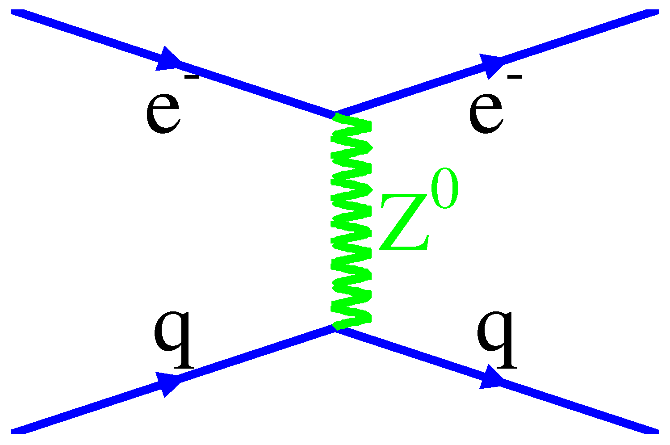
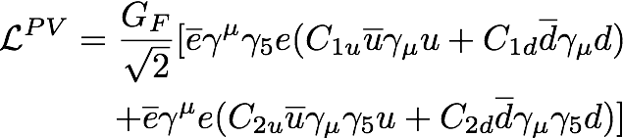
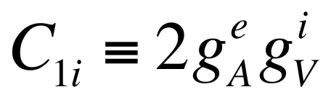
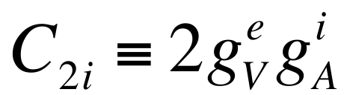
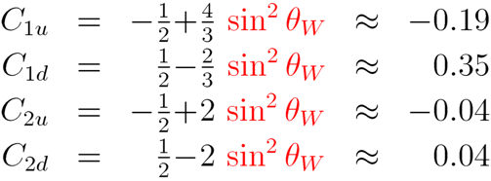

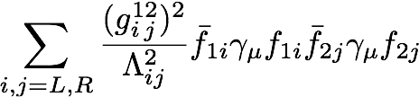
e-q coupling constants
4 phenomenological couplings: V, A & u, d combinations
A
V
V
A
new physics
+
PV elastic e-p scattering, Atomic parity violation
PV deep inelastic scattering
C2q’s involve axial hadronic currents:
large theoretical uncertainties when accessed via elastic scattering

Slide 7
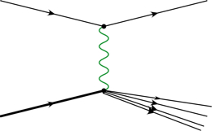

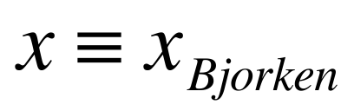
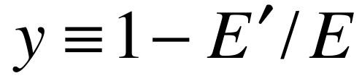
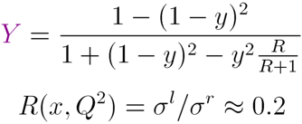
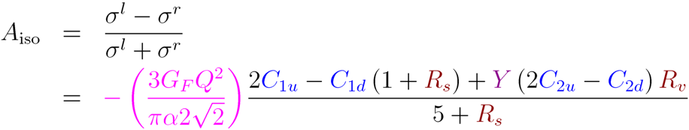
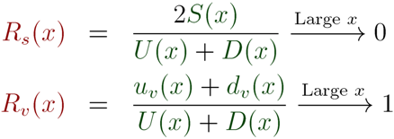
PV Deep Inelastic Scattering
off the simplest isoscalar nucleus and at high Bjorken x
e⁻
e⁻
Z*
γ*
Q² >> 1 GeV² , W² >> 4 GeV²
N
X
At high x, A_{iso} becomes independent of pdfs, x & W, with well-defined SM prediction for Q² and y
Interplay with QCD
Parton distributions (u, d, s, c)
Charge Symmetry Violation (CSV)
Higher Twist (HT)
Nuclear Effects (EMC)

Slide 8
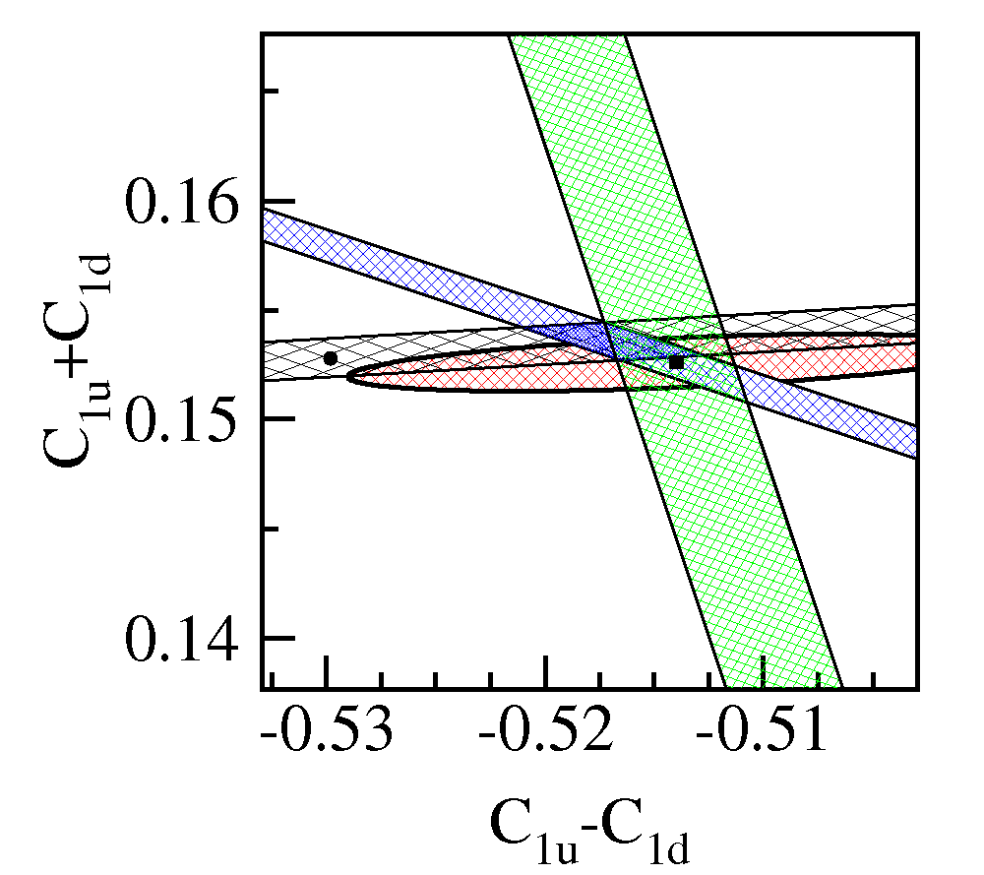
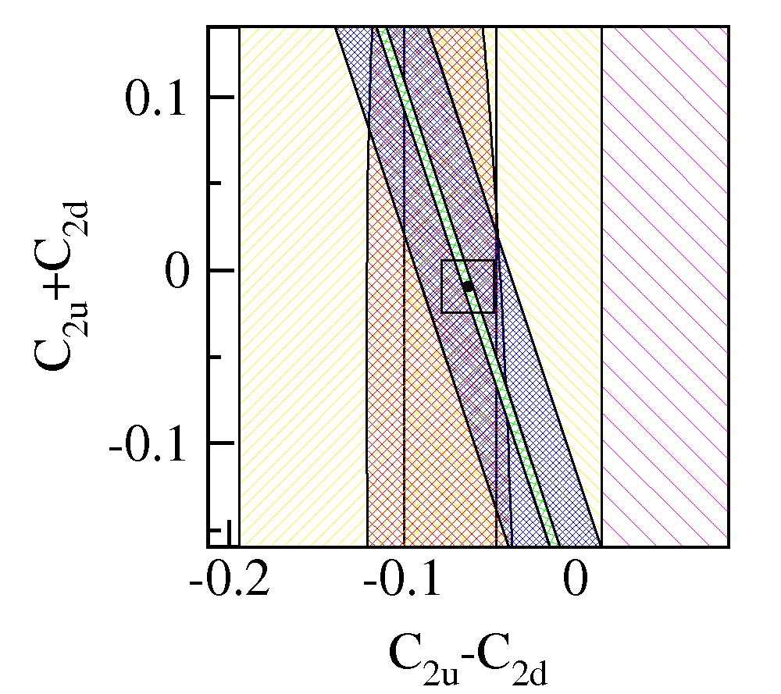
SOLID Goal on Couplings
Measure APV for e-²H DIS to 0.6% fractional error (stat + syst + theory) at high x, y
C2q’s largely unconstrained
11 GeV SOLID
E122
Qweak
SAMPLE
Cs
Red ellipses are PDG fits
This box matches the scale of the C1q plot
Blue bands represent expected data: Qweak (left) and PV-DIS-6GeV (right)
Green bands are the proposed measurement of SOLID
unique TeV-scale sensitivity

Slide 9
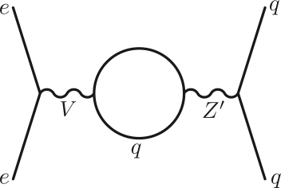
New Physics Examples
Leptophobic Z’
Virtually all GUT models predict new Z’s
LHC reach ~ 5 TeV, but....
Little sensitivity if Z’ doesnt couple to leptons
Leptophobic Z’ as light as 120 GeV could have escaped detection
Since electron vertex must be vector, the Z’ cannot couple to the C1q’s if there is no electron coupling:
can only affect C2q’s
SOLID can improve sensitivity:
100-200 GeV range
arXiv:1203.1102v1
Buckley and Ramsey-Musolf

Slide 10
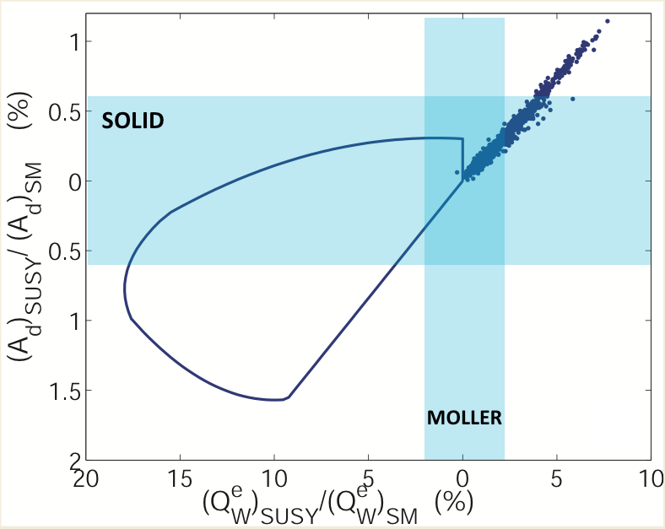
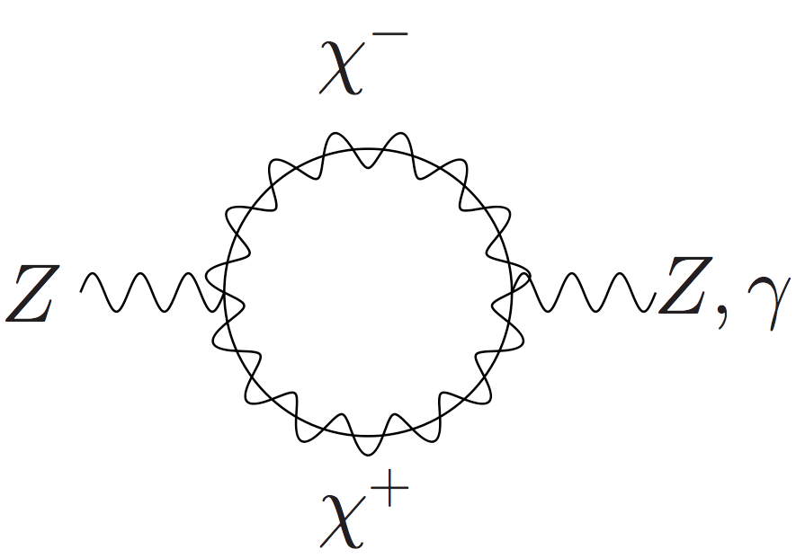
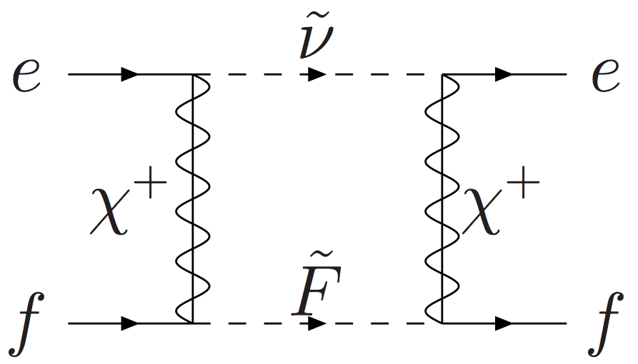
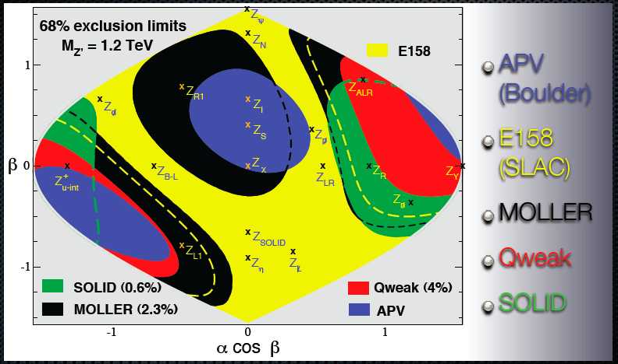
Other New Physics Examples
MSSM sensitivity if light super-partners, large tanβ
MSSM
SUSY loops
Does Supersymmetry provide a candidate for dark matter?
B and/or L need not be conserved: neutralino decay
B or L violation
(R-parity violation)
Depending on size and sign of deviation: could lose appeal as a dark matter candidate
Ramsey-Musolf
and Su, Phys. Rep. 456 (2008)
Extra Z’s can have
Different couplings
(Yens Erler)

Slide 11
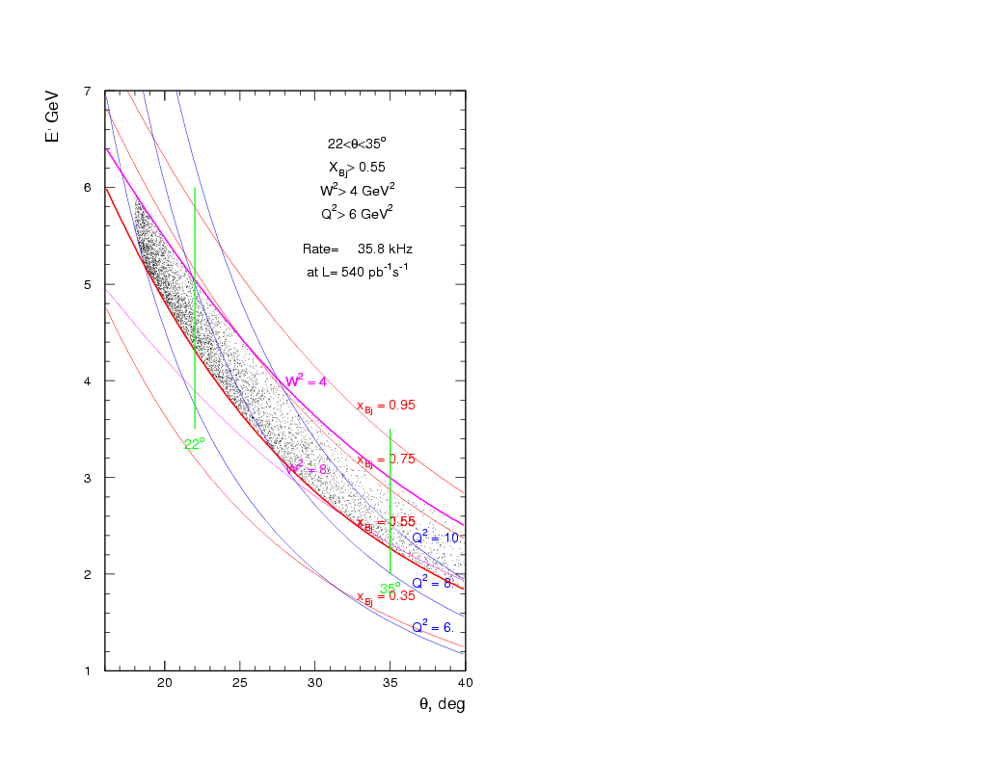
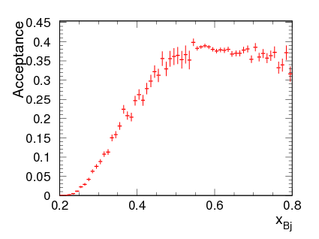
Spectrometer Acceptanace

Slide 12
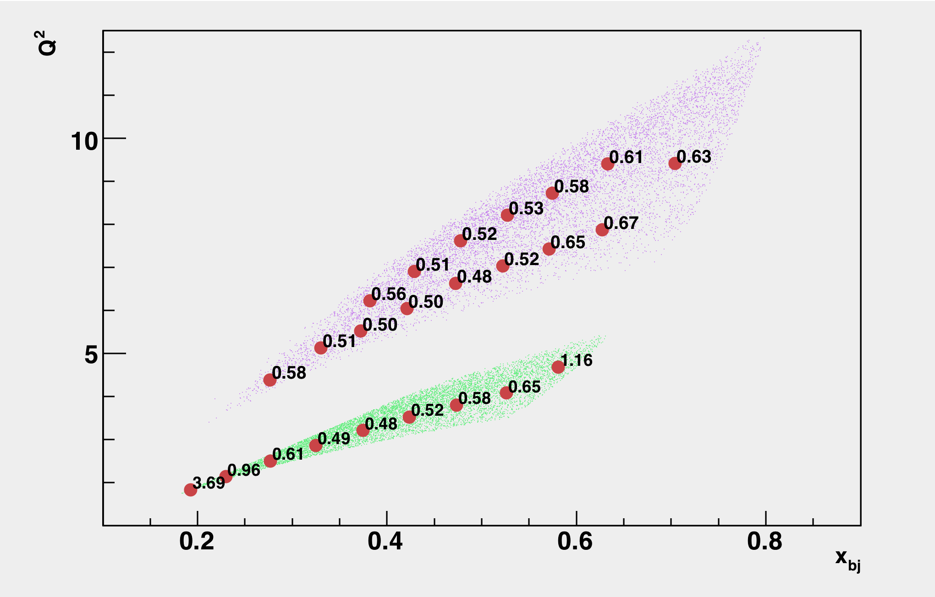




Program of Measurements
Requires 12 GeV upgrade of JLab and a large superconducting solenoid
Requirements
statistical error bar σ_{A}/A (%)
shown at center of bins
in Q², x
High Luminosity with E > 10 GeV
Large scattering angles (for high x & y)
Better than 1% errors for small bins
x-range 0.25-0.75
W² > 4 GeV²
Q² range a factor of 2 for each x
(Except at very high x)
Moderate running times
charge
symmetry
violation
standard model test
4 months at 11 GeV
higher twist
sea
quarks
2 months at 6.6 GeV
Strategy: sub-1% precision over broad kinematic range: sensitive Standard Model test and detailed study of hadronic structure contributions
If no CSV, HT, quark sea or nuclear effects, ALL Q², x bins
should give the same answer within statistics modulo kinematic factors!

Slide 13



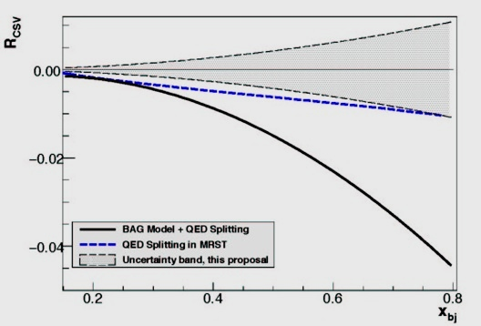
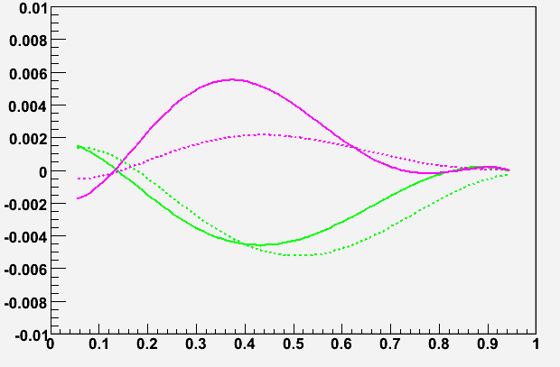
Charge Symmetry Violation
We already know CSV exists:
u-d mass difference δm = m_{d}-m_{u} ≈ 4 MeV
δM = M_{n}-M_{p} ≈ 1.3 MeV
electromagnetic effects
Direct sensitivity to parton-level CSV
Important implications for PDF’s
Could be partial explanation of the NuTeV anomaly
For A_{PV} in electron-²H DIS
Sensitivity will be enhanced if u+d falls off more rapidly than δu-δd as x → 1
SOLID sensitivity
bag model (solid) Radionov et al.
QED splitting (dashed) Glueck et al.
δd
δu
x
Significant effects are predicted at high x

Slide 14
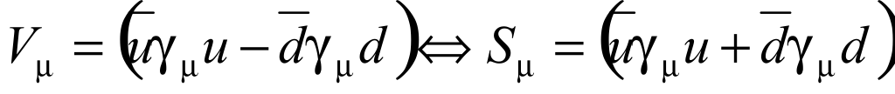
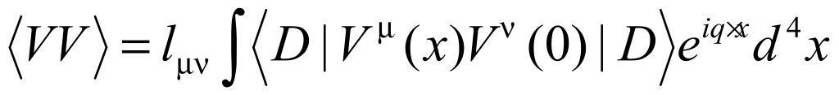


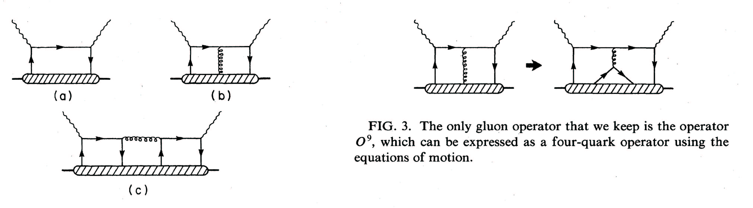
A Special HT Effect
The observation of Higher Twist in PV-DIS would be exciting direct evidence for diquarks
following the approach of
Bjorken, PRD 18, 3239 (78),
Wolfenstein, NPB146, 477 (78)
Isospin decomposition
before using PDF’s
Higher-Twist valence quark-quark correlation
Zero in quark-parton model
(c) type diagram is the only operator that can contribute to a(x) higher twist: theoretically very interesting!
σL contributions cancel
Castorina & Mulders, ‘84
Use ν data for small b(x) term.

Slide 15
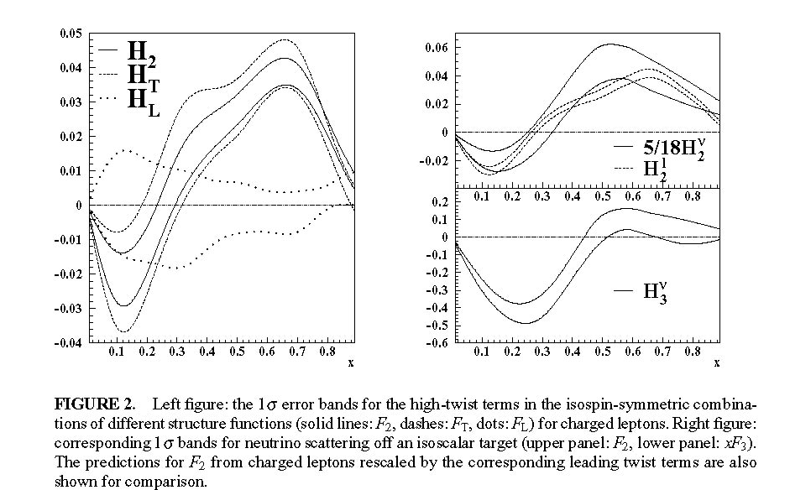
a₃ Term and Neutrino’s
These hadronic corrections can be
obtained from charged-current
neutrino scattering data

Slide 16
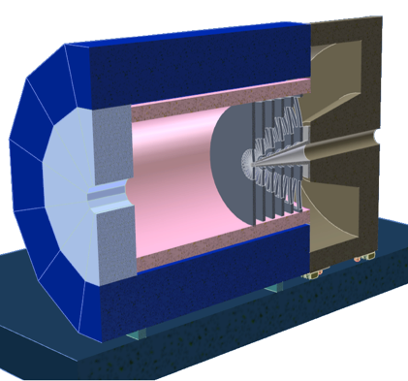
SOLID Apparatus
Moderate running times
Large Acceptance
High Luminosity on LH2 & LD2
Better than 1% errors for small bins
Kinematics:
Large Q² coverage
x-range 0.25-0.75
W² > 4 GeV²
Requirements:
Solenoid contains low energy backgrounds (Møller, pions, etc)
Baffling to cut backgrounds: significant engineering
Trajectories measured after baffles
Fast tracking—GEM, particle ID, calorimetry, and pipeline electronics
Precision polarimetry (0.4%) Compton and atomic hydrogen Moller

Slide 17
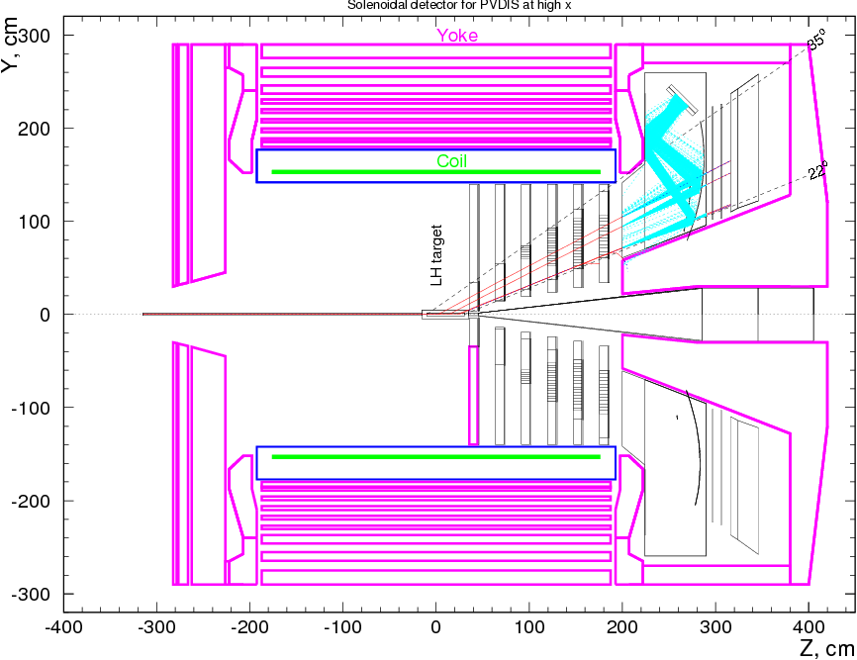
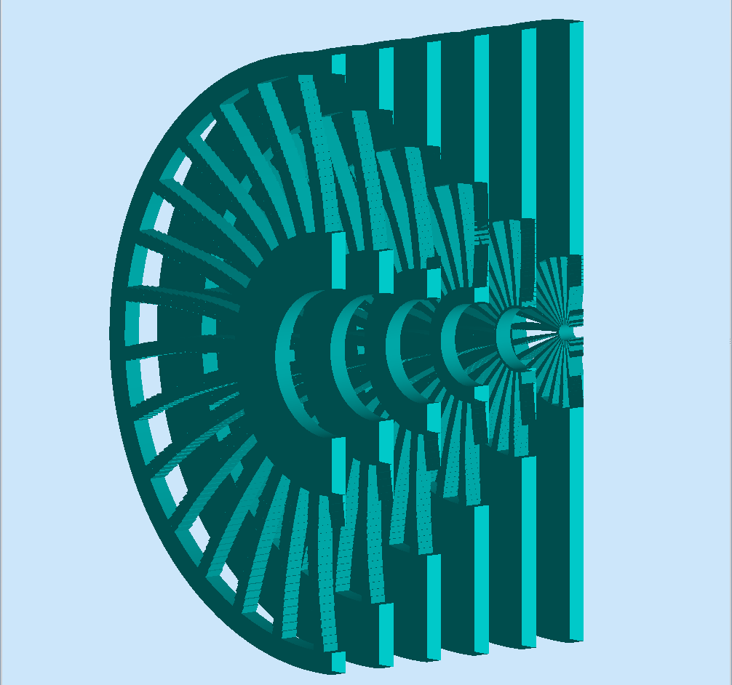
SOLID Apparatus Overview
GEM
Sashlyk
gas Cerenkov
collimator
20º - 35º, E’~ 1.5 - 5 GeV δp/p ~ 2%
some regions 10’s of kHz/mm², Pion rejection with Cherenkov + segmented calorimeter
Several large solenoids would work (Zeus, Babar): present design focuses on CLEO-II

Slide 18
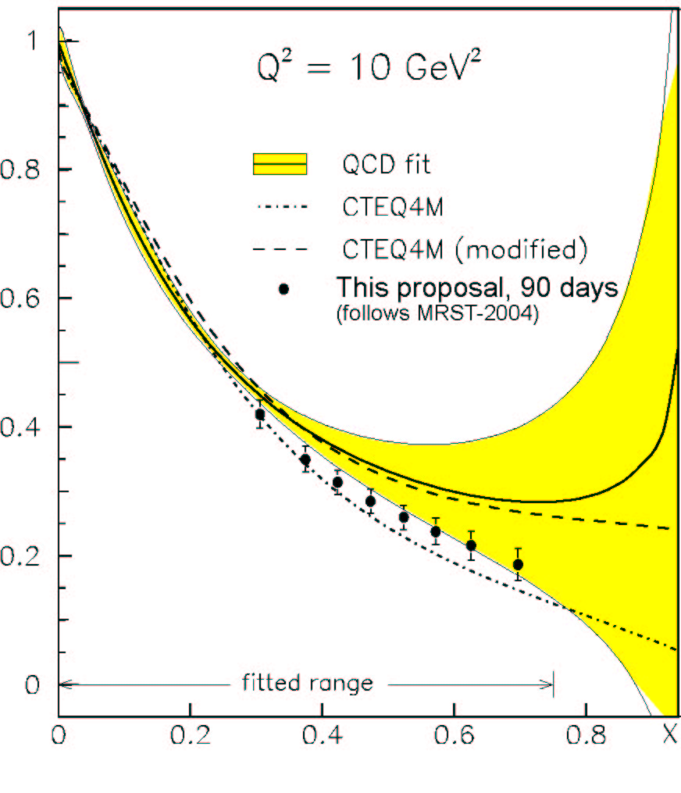
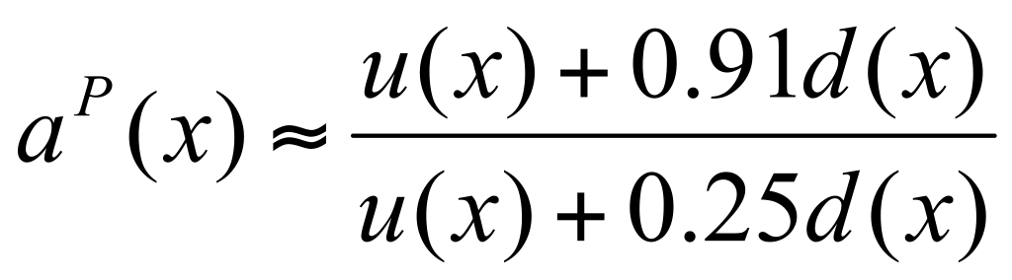
Physics with Hydrogen
d(x)/u(x) as x→1
SU(6):
d/u~1/2
Longstanding issue in proton structure
Valence Quark:
d/u~0
Perturbative QCD:
d/u~1/5
PV-DIS off the proton (hydrogen target)
Deuteron analysis has large
nuclear corrections (Yellow)
3-month run
A_{PV} for the proton has no such corrections
The challenge is to get statistical and systematic errors ~ 2%

Slide 19

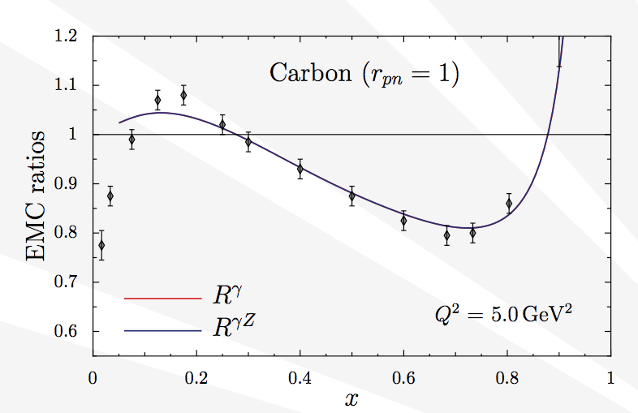
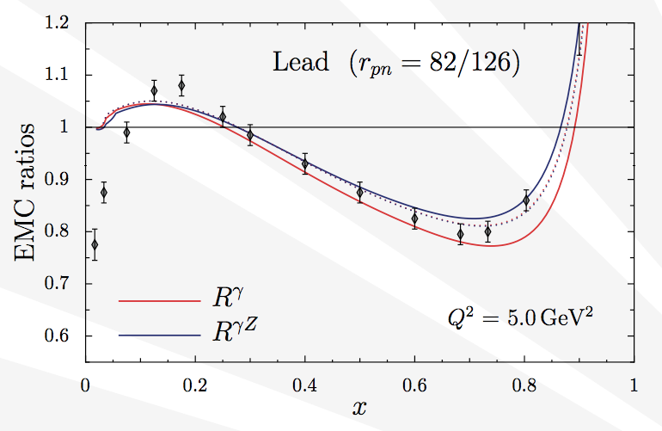
Nuclear Medium Modification
Cloet, Bentz, Thomas, arXiv 0901.3559
They propose that a neutron or proton excess in nuclei leads to an isovector-vector mean field dominated by ρ exchange
shifts quark distributions: “apparent” CSV violation
Isovector EMC effect: explain 2/3 of NuTeV anomaly

Slide 20
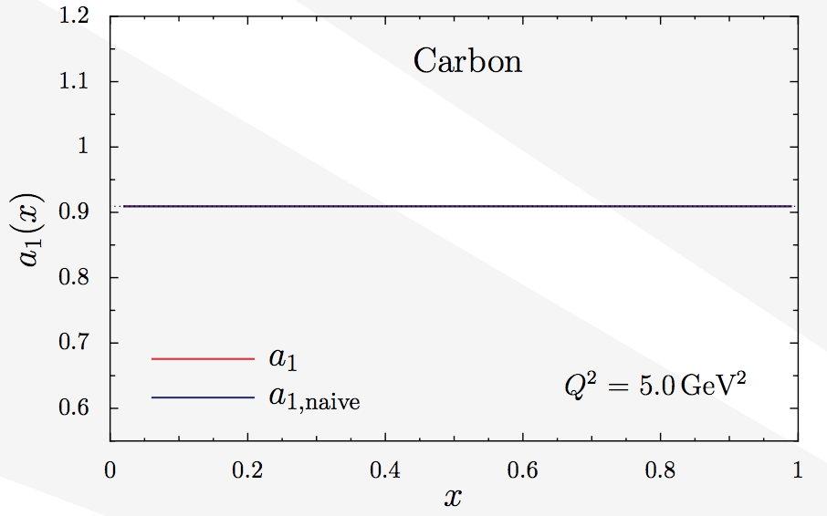
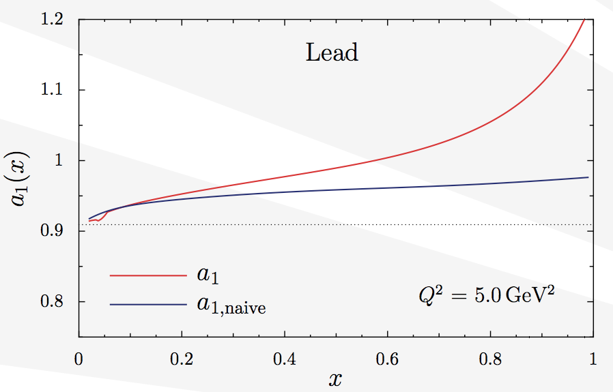
Apparent CSV in Nuclei
Suppose one completes a ²H APV measurement, then repeat with ²⁰⁸Pb
  The ratio of ratios (heavy nucleus vs deuterium) as a function of x should show a measurable effect if model is correct
  Measuring the EMC effect along a different isospin axis
5%
Would be a smoking gun demonstration of nuclear medium modification of quark distributions
Another classic example of interplay between EW and QCD physics

Slide 21
Error Budget (%)
Statistics
0.3
Polarimetry
0.4
Q2
0.2
Radiative Corrections
0.3
Total
0.6

Slide 22
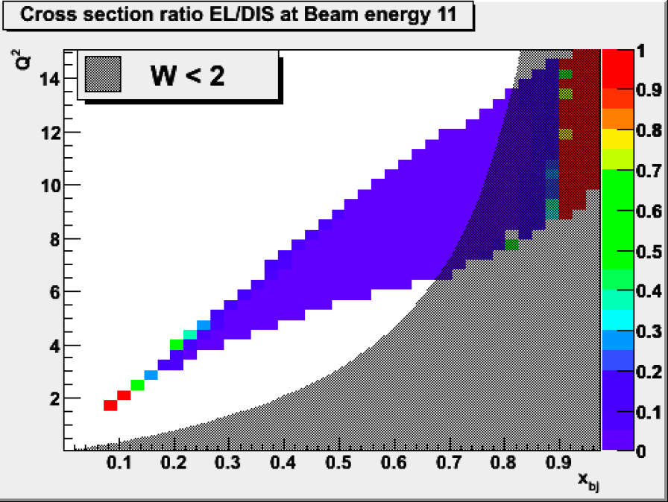
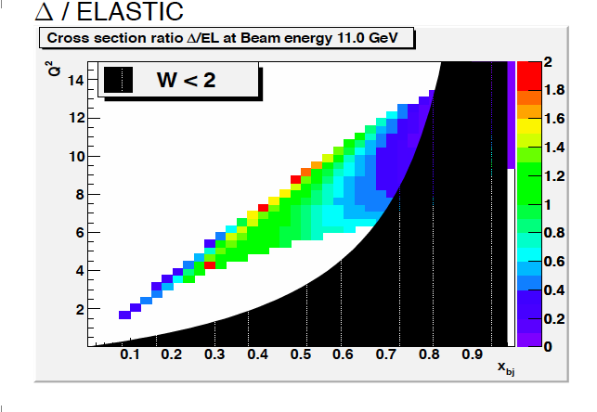
Radiative Corrections
Need coherent theory of all electromagnetic and elecroweak corrections at finite Q2.
Radiative correction theory group is being assembled.
Preliminary estimates have been made.

Slide 23
Running time
Strategy: sub-1% precision over broad kinematic range for sensitive
Standard Model test and detailed study of hadronic structure contributions
Untangle Physics with fit:
Error bar σ_{A}/A (%)
shown at center of bins
in Q², x
Beam Time Request:
LD₂: 245 Days
LH₂: 113 Days
4 months at
11 GeV
Energy(GeV) Days(LD2) Days(LH2) | 4.4 18 9 | 6.6 60 - | 11 120 90 | Test 27 14
2 months at 6.6 GeV

Slide 24
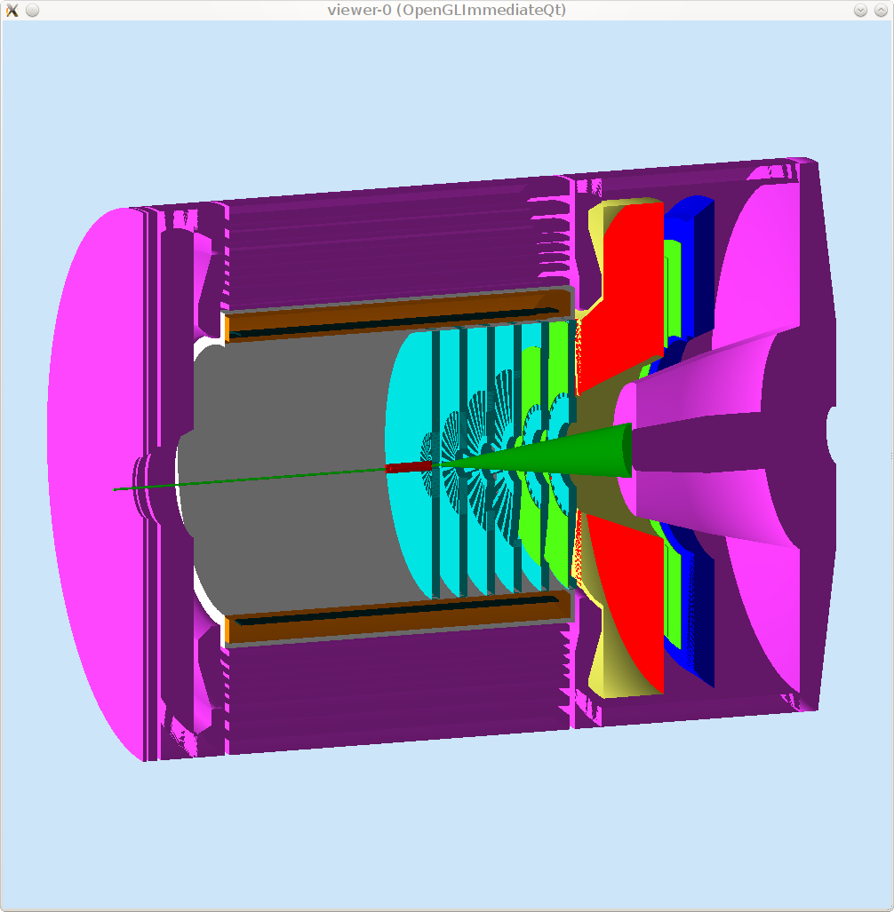
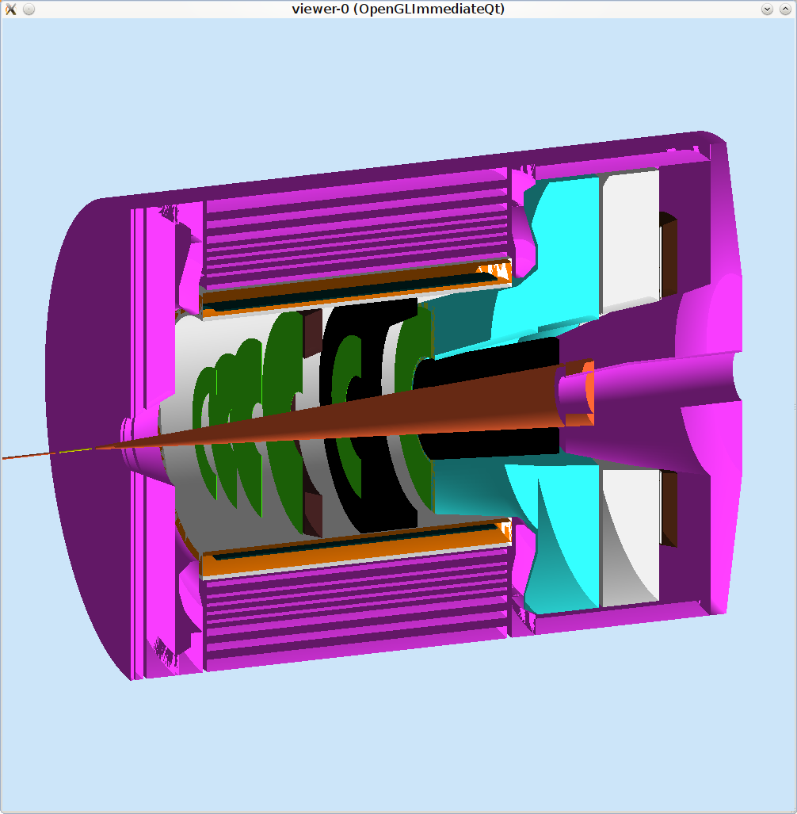
PVDIS vs SIDIS
PVDIS
SIDIS
Can you find six differences between these panels?
Target Location, Baffles (PVDIS), Cerenkov’s,
GEM Layout, Extra E-Cal, End Cap Longer

Slide 25
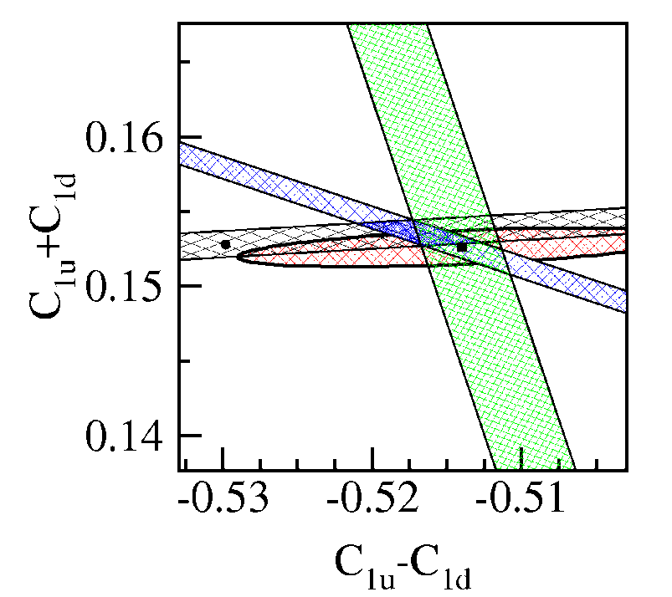
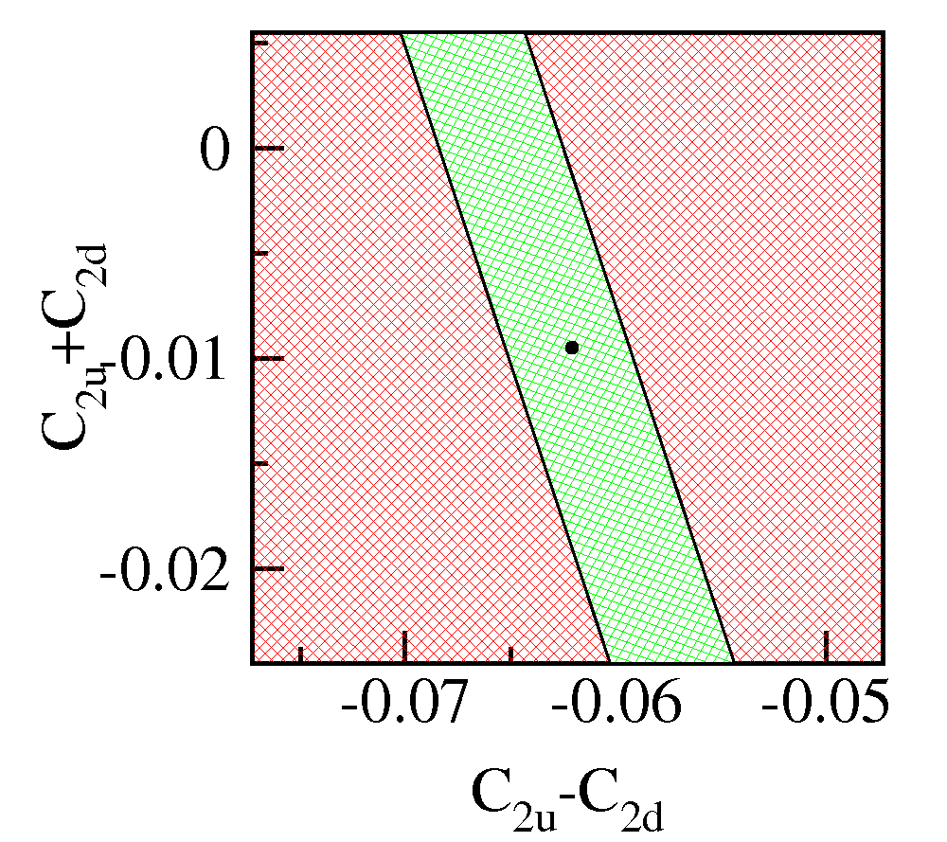
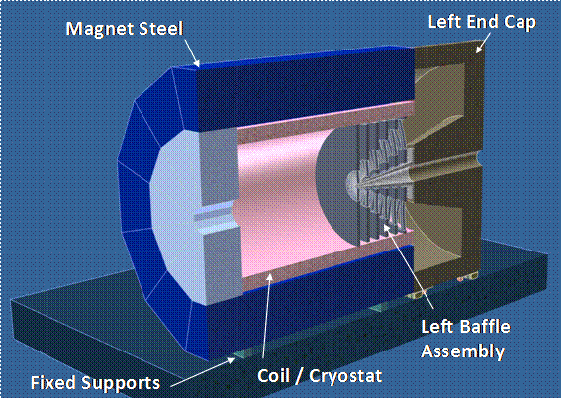


Summary
Precision Data
Qweak
PVDIS
PVDIS
Uncertainty from PDG fit
Cs
Measurements of Parity Violation in Deep Inelastic Scattering contain a wealth of information about:
  The Standard Model
  Charge Symmetry (CSV)
  Higher Twist (HT)
For the complete picture—to unravel the full richness of the physics reach of this process a dedicated—a large-acceptance spectrometer is needed.
SoLID will also provide critical nuclear structure test (NuTeV sin²θ_{W})
Large additional program of SI-DIS planned for SoLID spectrometer
MRST global fit
12 GeV
90% CL
x_{Bj}

Slide 26



SOLID-Spin
Double-Polarized Semi-Inclusive DIS on ³He & ¹H at 11 GeV
E12-10-006: Single Spin Asymmetry on Transverse ³He @ 90 days
E12-11-007: Single and Double Spin Asymmetry on ³He @ 35 days
PR12-11-108: Single and Double Spin Asymmetries on Transverse Proton (conditionally approved)
White paper: Eur. Phys. J. Plus (2011) 126:2
Key of SoLID-Spin program:
Large Acceptance
+ High Luminosity
→ 4-D mapping of asymmetries
→ Tensor charge, TMDs …
Lattice QCD, QCD Dynamics, Models.

Slide 27

SOLID Status
neutron background study
Strong collaboration being formed
  ~ 130 collaborators, ~ 35 institutions
  Parity and DIS expertise
  Significant international participation: Italy, Germany, China
  ~ 5 Postdoc FTEs now focused on simulation and R&D
Significant hardware R&D potential
  GEMs, Shashlyk, pipeline electronics, collimator engineering....
Timeline
  Would run in Hall A on and off between 2016 and 2022
  JLab is currently negotiating with Cornell to move CLEOII magnet ~ 2014
  R&D and Design ~ 2-3 years
  Funding strategies (total cost 20-25 M$)
    unlikely to be a one CD-funded project
    must consist of several sub-projects
    JLab wants to single out hardware that might be of multi-purpose use

Slide 28



Elastic Radiative Tail

Slide 29
SoLID and extra Z’s

