Slide 1
SoLID DAQ for Transversity and PVDIS
Alexandre Camsonne, Rory Miskimen
Yi Qiang
SoLID Dry Run
June 13th 2012

Slide 2
Overview
Requirements overview
Hall D electronics
GEM
Electronics layout
Budget
Test stands and timeline
Conclusions

Slide 3
Requirements for
SOLID DAQ

Slide 4
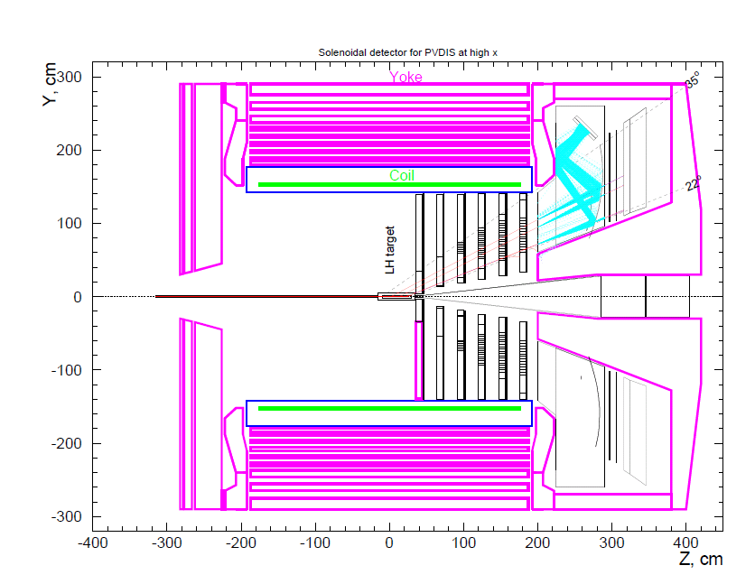
Detector layout and trigger for PVDIS
Trigger
Calorimeter
200 to 500 KHz of electrons
30 individual sectors
to reduce rate
Max 17 KHz/sector

Slide 5
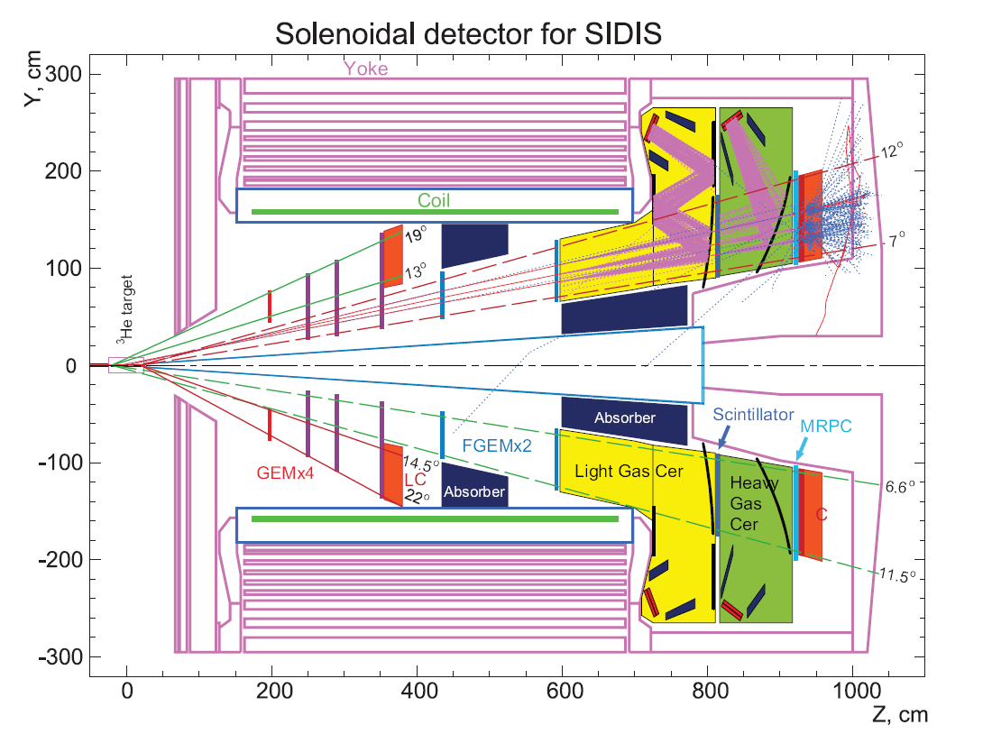
Detector layout and trigger for SIDIS
Trigger
Calorimeter
+
Cerenkov
+
MRPC
Max rate 200 KHz
With tuning of threshold and coincidence
50 KHz

Slide 6
120 KHz
65 KHz
7 MHz pions

Slide 7
SIDIS rates Summary
 | Rates @ 11 GeV
Large Angle > 3.0 GeV | 44 kHz
Large Angle with GEM Pad | 13 kHz
Forward Angle: | 125 kHz
Forward Angle @ 2 GeV | 64 kHz
Forward Angle with P.D.S. Cut | 77 kHz
Forward Angle with P.D.S. Cut + 2.0 GeV | 51 kHz
P.D.S: position dependent shower cut.
Recommendation I: GEM Pad R&D is important to DAQ
Recommendation II: 2 GeV cutoff or P.D.S. would reduce single rate by ½. Both can work for us
Recommendation III: Coincidence trigger would improve by a 70% at full luminosity. (More effective, if one has to reduce current.)

Slide 8
SIDIS: Hadron trigger
Calorimeter + MRPC + Scintillator
Hadron rate : 7.7 MHz
  Charged hadron: 6.1 MHz (dominated)
  Electron: 0.1 MHz
  Photon: 1.5 MHz (after MRPC and Scintillator)
Dominated by inclusive hadrons

Slide 9
SoLID SIDIS Detector Rates
In 50 ns windows, 11 GeV
Detector | Rate | Hits | Type | Data Size per hit
GEM | 4.4 GHz | 220 | Hits (time) | 4 Byte x 2 (X/Y)
LC | 120 kHz | 1 | Energy, Hits | 8 Byte x 2 (PS/SH)
FC | 200 MHz | 10 | Energy, Hits | 8 Byte x 2 (PS/SH)
LGC | 40 MHz | 3 | Energy, Hits | 8 Byte x 2 (split)
HGC | 60 MHz | 4 | Energy, Hits | 8 Byte x 2 (split)
MRPC | 850 MHz | 45 | Hits | 4 Byte
SC | 300 MHz | 15 | Energy, Hits | 8 Byte
Total |  |  |  | 2.5 kB
With header and other over head
event size is ~ 4 kB

Slide 10
SIDIS: Coincidence @ 35 ns window
Coincidence rate: 7.7MHz x 200KHz x 35 ns = 54 kHz
Given the safety margin, expected to handle about 100 kHz.
  Include some single trigger to study detector performance etc.
4kB * 100 kHz ~ 400 MB/s to disk
  Goal to reduce things to 50 MB/s by L3 farm

Slide 11
Requirements
High rates and no dead time
  Up to 100 KHz
Coincidence between detectors
  PID
  Local thresholds
Need to reduce event size to put on tape
Hall D pipeline electronics with CODA 3

Slide 12
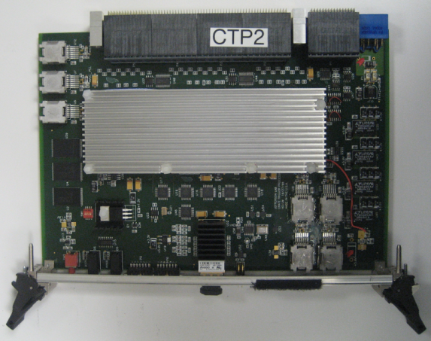
L1 Trigger Diagram
CPU
SSP
SSP
SSP
SSP
SSP
SSP
SSP
GTP
SD
SSP
SSP
SSP
SSP
SSP
SSP
SSP
TI
CPU
TD
TD
TD
TD
TD
TD
SD
SD
TD
TD
TD
TD
TD
TD
TS
VXS Crate
CTP
VXS Crate
FADC250
12 bit @ 250 MHz, 16 ch
Sums amplitude from all channels
Transfer total energy or hit pattern to CTP
Fiber Optics
64 bit @ 125 MHz
CPU
FADC
FADC
FADC
FADC
FADC
FADC
CTP
SD
FADC
FADC
FADC
FADC
FADC
FADC
TI
Crate Trigger Processor
Sums energies from FADCs
Transfer total energy or hit pattern to SSP
VXS Serial Link
16 bit @ 250 MHz: 4 Gbps
VXS Crate

Slide 13
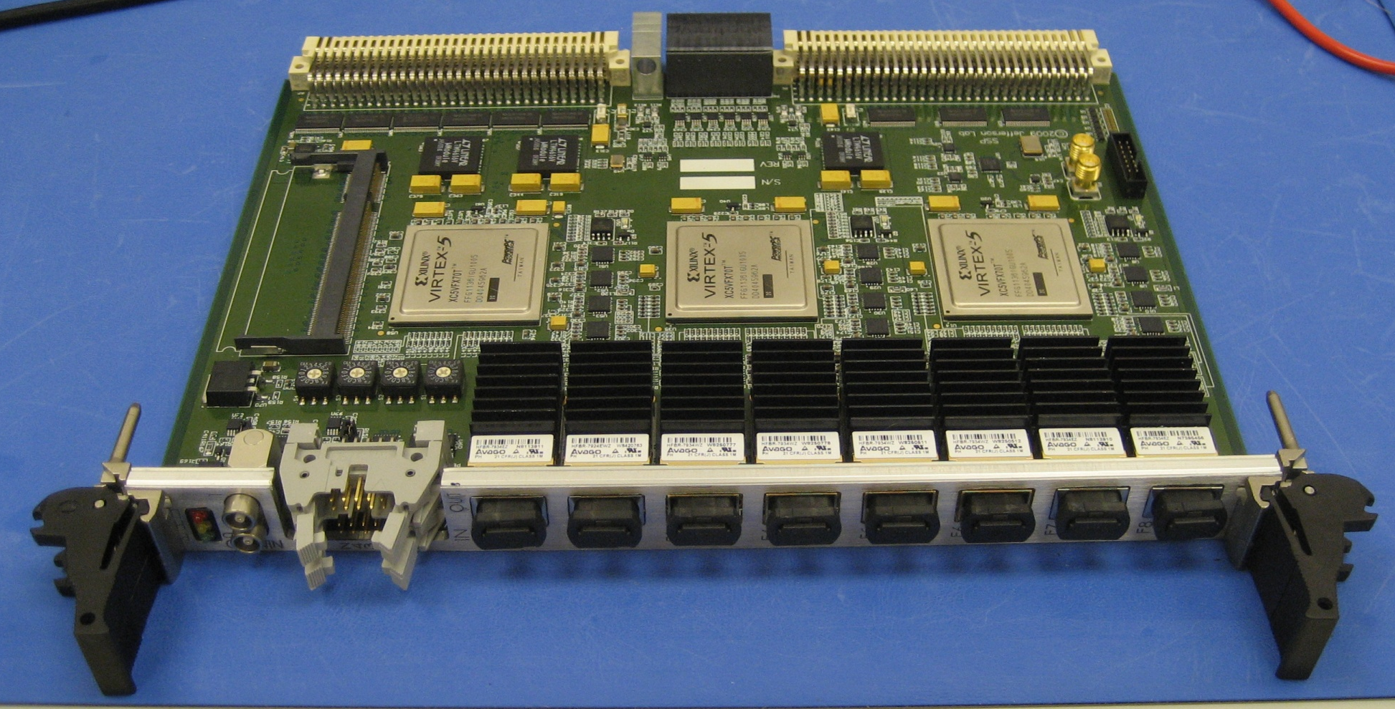
L1 Trigger Diagram
CPU
SSP
SSP
SSP
SSP
SSP
SSP
GTP
SD
SSP
SSP
SSP
SSP
SSP
SSP
SSP
TI
CPU
TD
TD
TD
TD
TD
TD
SD
SD
TD
TD
TD
TD
TD
TD
TS
TS
SSP
VXS Crate
VXS Crate
Sub-System Processor
Consolidates multiple crate subsystems
Report total energy or hit pattern to GTP
Copper Ribbon Cable
32 bit @ 250 MHz: 8 Gbps
CPU
FADC
FADC
FADC
FADC
FADC
FADC
CTP
CTP
SD
FADC
FADC
FADC
FADC
FADC
FADC
TI
Global Trigger Processor
Collect L1 data from SSPs
Calculate trigger equations
Transfer 32 bit trigger pattern to TS
VXS Serial Link
32 bit @ 250 MHz: 8 Gbps
VXS Crate

Slide 14
Level-1 Trigger Electronics
Front-End Crate
Trigger Distribution Crate
Custom Designed
Boards at JLAB
VXS Crate
VXS Crate
Detector
Signals
TD
TS
Fiber Optic Links
Clock/Trigger
(16bits @ 62.5MHz
TS
(16)
(12)
(1)
(1)
(1)
(1)
(1)
VXS Crate
( ) – Number in parentheses
refer to number of modules
Fiber Optic Link
(~100 m)
(64bits @ 125 MHz)
SSP
GTP
fADC250
(8)
CTP Crate Trigger Processor
(2)
(1)
Copper Ribbon Cable
(~1.5 m)
(32bits @ 250 MHz)
SD Signal Distribution
Global Trigger Crate
TI Trigger Interface
Trigger Latency ~ 3 μs
Pipelined detector readout electronics:
fADC
VXS Backplane

Slide 15
Pipelined Hall D DAQ
FADC
Calorimeter
CTP
L1 trigger
Calorimeter
+
Cerenkov
+
Pion
In
3 us
CTP
FADC
Light Gas Cerenkov
SSP
GTP
CTP
CTP
Heavy Gas Cerenkov
FADC

Slide 16
Pipelined Hall D DAQ
Electron shower
accidental
accidental
3 us latency
Σ
Above
threshold

Slide 17
L3 Farm
blocked event fragments
partially recombined event fragments
full events
All nodes connected with 1GB/s links
Switches connected with 10GB/s fiber optics
ROC
EB1
Event Builder
stage 1
ROC
L3 Farm
EB2
Event Builder
stage 2
ROC
node
node
ROC
EB1
Event Builder
stage 1
node
Read Out Controllers
ER
Event Recorder
ROC
Raid Disk
ROC
EB2
Event Builder
stage 2
node
node
ROC
node
EB1
Event Builder
stage 1
node
ROC
ROC
Front-End Crates
Staged Event Building
Level-3 Trigger and monitoring
Event Recording
~60 crates
~50MB/s out per crate
N x M array of nodes (exact number to be determined by available hardware at time of purchase)
300MB/s in
300MB/s out

Slide 18
GEM READOUT

Slide 19
GEM readout
APV25 + VME module based
Up to 164 000 channels
APV 25 : 128 channels
Readout
  VME based readout : 8 APV25 = 2048 channels
  SRS readout : ethernet /PC based = 2048 channels
1 crate per sectors for FADC and GEM

Slide 20
Other GEM readout chips
APV25 limiting factor
  Need to evaluate
  Optimize
Chip in development
  CLAS12 Dream CEA/Saclay
  ATLAS VMM1 BNL
  ….
SRS readout compatible with other chips
  Ethernet + PC based

Slide 21
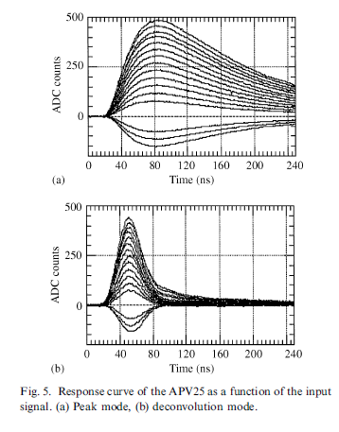
APV25 readout
Buffer length 192 samples : 4.8 us Look back 160 samples : 4 us
Estimated occupancy : 220 hits per trigger, X Y data, 440 strips
GEM : 6 Layers 164 000 channels total, 28 000 channels per planes
Occupancy : 1.6 %
APV readout time :
t_APV = 141 x number_of_sample / 40 MHz
t_APV(1 sample) = 3.7 us.
Max rate APV front end :
270 KHz in 1 sample mode
90 KHz in 3 samples mode
Will be triggered by coincidence trigger around 50 KHz

Slide 22
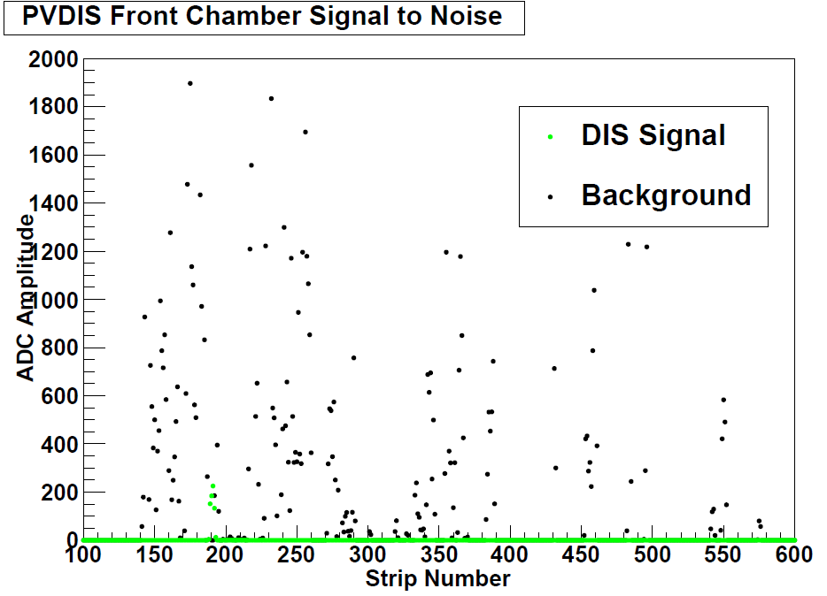
Chamber occupancy

Slide 23
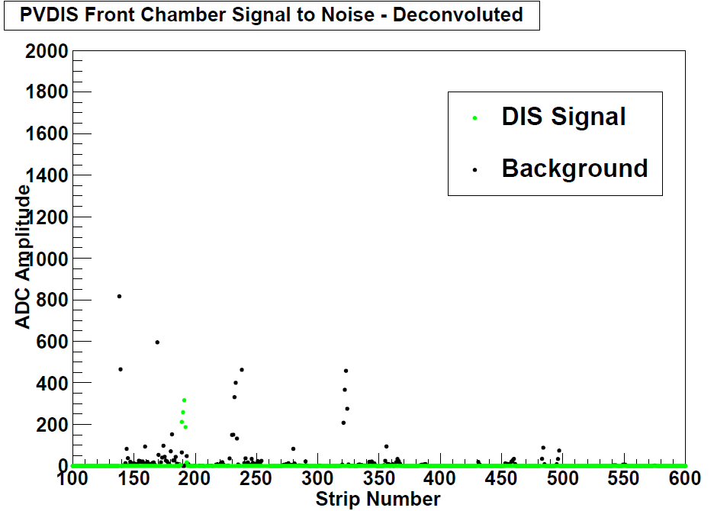
Chamber occupancy using APV25 deconvolution

Slide 24
GEM in trigger
Use signal of last GEM plane HV for fast trigger
  Large angle trackers
  GEM based Cerenkov
Quality of signal to be tested ( signal / background )
Could reduce rate in Large Angle from photon calorimeter by 50 KHz
Additional FADC or discriminator channels to put in trigger

Slide 25
Chamber occupancy
About 20 hits per planes
6 planes
Use Shower information
3 samples would be useful, but 1 sample with seem sufficient
See tracking talk (Ole Hansen), simulation talk (Seamus Riordan)
All software ready : final results within a month

Slide 26
ElectrONICS layout and budget

Slide 27
SIDIS channel count
Detector | Module type | Number of channels | Number of FADC
Forward Calorimeter | FADC | 1896 | 119
Large angle calorimeter | FADC(+TDC) | 920 | 58
Light Gas Cerenkov | FADC | 120 | 8
Heavy Gas Cerenkov | FADC | 270 | 17
Scintillator | FADC | 120 | 8
MRPC | Custom TDC | 2550
The FADC of LC can be programmed to produce timing signals with ~400ps resolution (already demonstrated by simulation) to remove the needs of TDC.

Slide 28
DAQ/Trigger for SoLID SIDIS
Trigger Crate
LC Trigger Crate x4
CPU
SSP x3:
LC x1 +
FC x2
GTP
TS
TD X4+1
CPU
FADC x15
CTP
SD
TI
FC/GC/HG/SC/MRPC Crate x15
Total Crate + CPU: 31+4
FADC: 210
DIS: 0+60
F1TDC: 0+30
CTP: 19
SD: 30+1
CPU
FADC X10:
GC x8 +
GC/HG/SC x2
MRPC
?
CTP
SD
TI
TI: 30+1
SSP: 3
GTP: 1
TS: 1
TD: 4+1
GEM Tracker Crate x11
CPU
APV25 X 16
SD
TI
+ ?
LC Discriminator VME64X Crate x3
LC Timing Crate x1
CPU
DIS x20
CPU
V1190
x15
SD
TI

Slide 29
SIDIS electronics
Module | Unite price | Quantity
FADC 250 | 4500 | 210 | $945,000
CTP | 5000 | 19 | $95,000
SSP | 5000 | 3 | $15,000
GTP | 5000 | 1 | $5,000
VXS crate | 11500 | 1 | $11,500
TS | 3500 | 1 | $3,500
TI | 3000 | 30 | $90,000
TD | 3000 | 4 | $12,000
SD | 2500 | 30 | $75,000
VXS crate | 11500 | 30 | $345,000
VME CPU | 3400 | 31 | $105,400
L3 farm node | 5000 | 12 | $60,000
 |  | Total detectors | $1,762,400
VXS crate | 11500 | 1 | $11,500
Discriminators | 2500 | 60 | $150,000
VME64X crate | 8100 | 3 | $24,300
V1190 | 11010 | 15 | $165,150
VME CPU | 3400 | 4 | $13,600
TID | 3000 | 1 | $3,000
SD | 2500 | 1 | $2,500
 |  |  | $370,050
 |  | Grand Total | $2,132,450

Slide 30
JLAB electronics PVDIS
Detector | Channel | Module | Unit price | Total modules | Total price sector | Total price 30 sectors
Calorimeter | 84 | 6 | 4500 | 180 | 27000 | 810000
Cerenkov | 9
TID |  | 1 | 3000 | 30 | 3000 | 90000
SD |  | 1 | 2500 | 30 | 2500 | 75000
VXS |  | 1 | 11500 | 30 | 23000 | 345000
VME CPU |  | 1 | 3400 | 30 | 3400 | 102000
CTP |  | 1 | 5000 | 30 | 5000 | 150000
GEM | 4700 | 3 | UVA | 90 | UVA/China | UVA/China
Total price |  |  |  |  | 52,400$ | 1,572,000$

Slide 31
DAQ/Trigger for SoLID PVDIS
VXS crate + CPU: 30
FADC: 210
CTP: 30 CTP SD: 30
GC/ GEM
TI: 30
CPU
FADC X6:
GC 9 +84 SH/PS
CTP
APV25 X3
SD
TI
30 individual DAQ systems : only 20 KHz trigger rates
No major issues

Slide 32
SIDIS + PVDIS electronics
Module | Unite price | Quantity
FADC 250 | 4500 | 210 | $945,000
CTP | 5000 | 30 | $150,000
SSP | 5000 | 3 | $15,000
GTP | 5000 | 1 | $5,000
VXS crate | 11500 | 1 | $11,500
TS | 3500 | 1 | $3,500
TI | 3000 | 30 | $90,000
TD | 3000 | 4 | $12,000
SD | 2500 | 30 | $75,000
VXS crate | 11500 | 30 | $345,000
VME CPU | 3400 | 31 | $105,400
L3 farm node | 5000 | 12 | $60,000
 |  | Total detectors | $1,817,400
VXS crate | 11500 | 1 | $11,500
Discriminators | 2500 | 60 | $150,000
VME64X crate | 8100 | 3 | $24,300
V1190 | 11010 | 15 | $165,150
VME CPU | 3400 | 4 | $13,600
TID | 3000 | 1 | $3,000
SD | 2500 | 1 | $2,500
 |  |  | $370,050
 |  | Grand Total | $2,187,450

Slide 33
Other projects
SuperBigBite
  242 hadron calorimeter
    16 FADC
Hall A BIA
  VDC 2944 channels
    24 V1190 TDC
  34 FADC
  CTP, TS, TD,SD, 2 VXS crates

Slide 34
Production Board Quantities – per C. Cuevas
Board ID | Hall D (Spare) | Hall B (Spare) | Hall A | Hall C | ‘Physics’ FEG DAQ | Totals $FY12 | SOLID
FADC250 | 350 * (36) | 310 ** (25) | 4 | 46 | 16 | 726 | 210
Trigger Interface | 57 (8) | 64 (8) | 2 | 2 | 6 | 131 | 30
Signal Distribution | 57 (8) | 49 (9) | 2 | 2 | 2 | 112 | 30
Crate Trigger Processor | 23 | 21 | 1 | 2 | 2 | 49 | 30
Sub-System Processor | 8 | 14 | 1 | 1 | 1 | 25 | 3
Global Trigger Processor | 2 | 2 | 1 | 1 | 1 | 7 | 1
Trigger Distribution | 10 | 10 | 1 | 1 | 2 | 24 | 4
Trigger Supervisor | 2 | 2 | 1 | 1 | 1 | 7 | 1
50
50 → Hall A DAQ upgrade (16 of which used for SBS)

Slide 35
Production Board Notes – per Chris Cuevas
Other 12GeV Proposed Detectors
** CLAS12 ‘baseline’ FADC250 board count is 239
  Central Neutron Detector is 288 channels or 18 boards
  Forward Tagger (PbWO4) calorimeter is 424 channels or 28 boards
  Total on previous page is 310 boards
  So, 25 boards are spare
* Hall D ‘baseline’ FADC250 board count is 282
  - BCAL readout Change Request adds one layer or 32 boards
  - Total on previous page is 350
  - So, 36 boards are spare
+ Hall C ‘baseline’ FADC250 board count for SHMS is 16
  - HMS is 13 boards, plus 2 spares → ordered 15 spares
  - User request of ~40 boards through NSF/MRI for (PbWO4) π⁰ spectrometer
Note: In FY12 thirty-five (35) Pre-Production units were purchased and will most likely
not be used for the final hall installations. These units are functionally equal to the
production units, but need a few very minor circuit corrections.
Potentially : 25 + 36 + 15 + 50 +35 = 161 = 145 FADCs ( 10 % spare )

Slide 36
SoLID electronics
Modules | Unit price | Quantity | Price | Borrow
FADC 250 | 4500 | 66 | $297000 | JLAB
CTP | 5000 | 28 | $140,000 | HRS
SSP | 5000 | 2 | $10,000 | HRS
GTP | 5000 | 0 | $0 | HRS
VXS crate | 11500 | 0 | $0 | SBS
TS | 3500 | 0 | $0 | HRS
TI | 3000 | 24 | $72,000 | HRS
TD | 3000 | 2 | $6,000 | HRS
SD | 2500 | 24 | $60,000 | HRS
VXS crate | 11500 | 24 | $276,000 | HRS
VME CPU | 3400 | 19 | $64,600 | HRS
L3 farm node | 5000 | 12 | $60,000
 |  | Total | $985,600
VXS crate | 11500 | 0 | $0 | HRS
Discriminators | 2500 | 50 | $125,000 | HRS
VME64X crate | 8100 | 0 | $0 | HRS
V1190 | 11010 | 0 | $0 | HRS
VME CPU | 3400 | 0 | $0 | HRS
TID | 3000 | 0 | $0 | HRS
SD | 2500 | 0 | $0 | HRS
 |  | Total timing | $125,000
 |  |  |  | With 10 % spare
 |  | Total detectors | $1,110,600 | $1,332,720

Slide 37
Man power / Ressources
JLAB
  Alexandre Camsonne
  Yi Qiang
UMass
  Rory Miskimen

Slide 38
Time line
2012
  5 intel VME CPU received
  GEM + APV25 GEM tests during g2p (SRS data taken , CODA with INFN MPD , CODA with SRS in progress, FPGA data processing)
  FADC tests PEPPO experiment
  HCAL Trigger development ( SBS funding accepted )
  UMASS Hall D test stand ( 380 FADC to be tested )
  4 JLAB FADC250
2013
  Small scale setup for testing : FADC + trigger + fastbus + APV25 + L3 farm
2014
  A1n :
    Full scale test of GEM
    Digital Trigger electronics test parasitic
  DVCS : test intel VME CPU for large amount of data
2015
  Full scale system

Slide 39
Conclusion
SoLID requires high rate low dead time, flexible trigger capability
Rates optimization for SIDIS but push for highest rate depending of GEM chip performances
Hall D electronics perfectly suited
  Total cost around 2.5 M$
  shared resources between experiments can save significant amount of money reduce to 1 M$
GEM electronics R&D
PVDIS has no major issue, SIDIS limited by GEM readout but could work with APV25 with no major loss
On going testing

Slide 40
Backup slides

Slide 41
Production Board Notes – per Chris Cuevas
Other 12GeV Proposed Detectors
** CLAS12 ‘baseline’ FADC250 board count is 239
  Central Neutron Detector is 288 channels or 18 boards
  Forward Tagger (PbWO4) calorimeter is 424 channels or 28 boards
  Total on previous page is 310 boards
  So, 25 boards are spare
* Hall D ‘baseline’ FADC250 board count is 282
  - BCAL readout Change Request adds one layer or 32 boards
  - Total on previous page is 350
  - So, 36 boards are spare
+ Hall C ‘baseline’ FADC250 board count for SHMS is 16
  - HMS is 13 boards, plus 2 spares → ordered 15 spares
  - User request of ~40 boards through NSF/MRI for (PbWO4) π⁰ spectrometer
Note: In FY12 thirty-five (35) Pre-Production units were purchased and will most likely
not be used for the final hall installations. These units are functionally equal to the
production units, but need a few very minor circuit corrections.

Slide 42
SIDIS: Singles Electron Trigger
Large Angle: 65 kHz @ 11 GeV
  Calorimeter only
  Electron: 11 kHz
  High energy photon: 51.5 kHz
    (possible to be rejected by including GEM in trigger, need study)
  Hadron: <3 kHz (energy cut)
Small angle: 120 kHz @ 11 GeV
  Calorimeter + Gas Cherenkov
  Electron: 90 kHz
  High energy photon: 16 kHz (after Gas Cherenkov)
  Hadron: 15 kHz (after Gas Cherenkov and Calorimeter)
8.8 GeV gives about 240 kHz

Slide 43
DAQ electronics projects at UMass: spring and summer 2012
R.Miskimen
UMass is responsible for the final assembly and testing of all 380 FADC modules for Hall D. This activity will take place at UMass summer 2012, probably stretching into the fall.
An undergraduate, Fabien Ahmed, spent the summer of 2011 at JLab working with the electronics group on FADC tests. A graduate student, Bill Barnes, and team of undergraduates will work on the electronics tests at UMass.
Operations at UMass will include mechanical assembly of the VME boards, programming the FPGA’s, verifying board operation, measuring and recording noise levels.
Readout through a Wiener USB board in the VXS crate, connected to PC

Slide 44
DAQ electronics projects at UMass: connection to SOLID
This activity helps Hall D, only helps SOLID by building expertise in the collaboration for working with and debugging DAQ electronics
With support from Hall A, we would develop a CODA based DAQ test station at UMass: replicate the one VXS crate/sector readout for PVDIS/SOLID
Need CODA, and to borrow CTP, SSP, and CPU
Test DAQ rates, triggers, software for FADC

Slide 45
Hall A HRS DAQ Test stand
Injector Compton
  2 FADC and SD boards
Ordered parts
  2 VXS crates
  4 FADC
  2 TI, SD, TD
  CODA3 still in the work ( maybe out at end of February) : test L3 Farm

Slide 46
L1 Trigger
Electron Singles Trigger:
  LC > 400 MeV|| (FC > 400 MeV && LGC)
  Total event rate: 190 - 240 kHz
  Frontend data rate: 800 – 1000 MB/s
  ROCs can barely handle this rate
    Assuming 10 VME crates, 100 MB/s per ROC
    add more crates since PVDIS uses > 30
  Maybe a little bit too much to write to the tape
  Not much room for improvement, already very close to electron yield.

Slide 47
Reduce L1 Trigger: Two Options
Make coincidence with another charged particle in Forward detector
  FC > 200 MeV && MRPC && Scintillator
  Coincidence rate with 35 ns window ~ 50 kHz
Use L3 farm
  With powerful parallelism computing, we can easily reduce the rate by a factor of 5
  Reduce the difficulty to put MRPC (customized VME board) into the trigger logic
Both options give 200 MB/s data rate to the tape

Slide 48
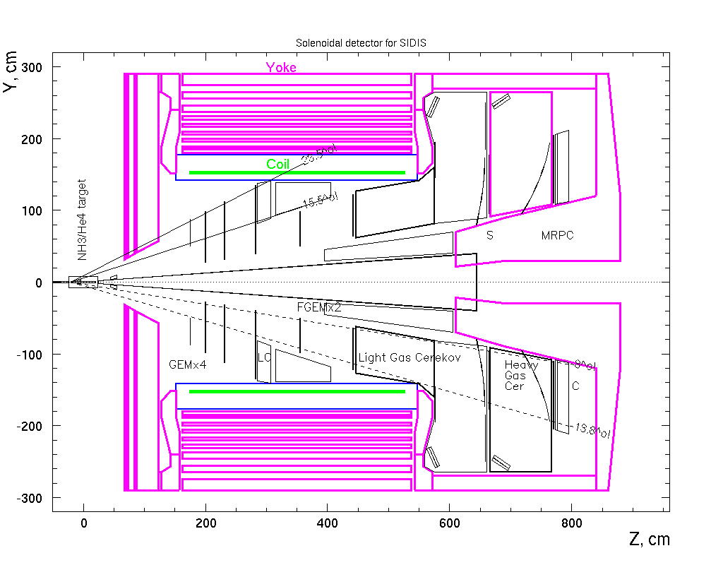
BABAR Setup With Collimator
Note the opening angle of front yoke is determined by target, It is OK to cut some large angle acceptance. PAC34 proposal.

Slide 49
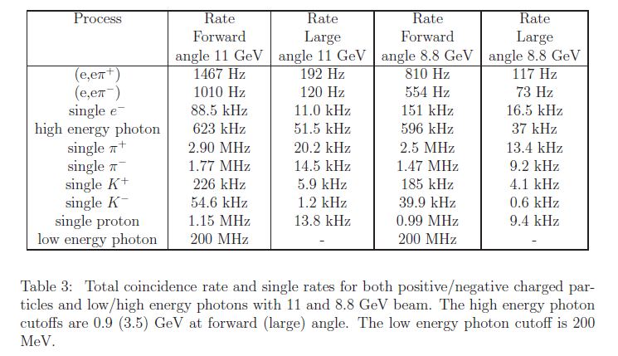
SIDIS rates

Slide 50
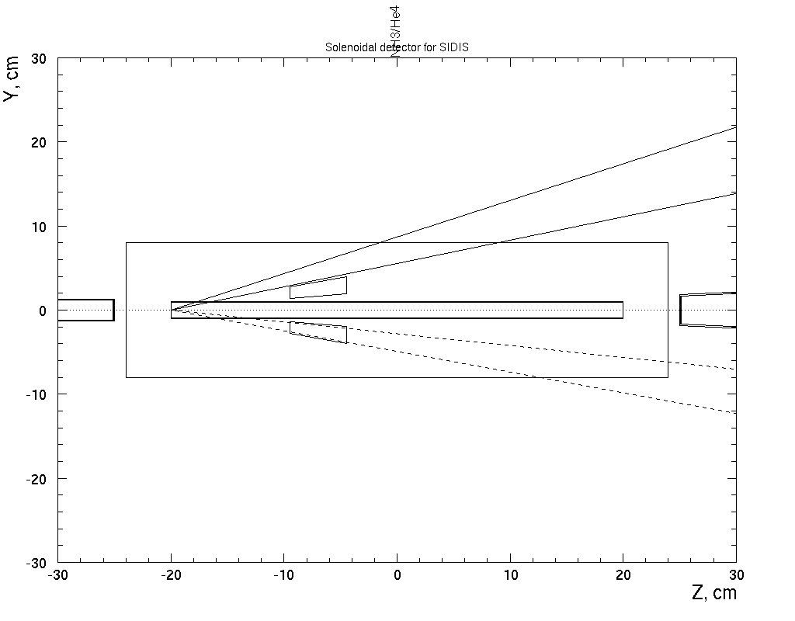
Zoom in for collimator part
Block the forward angle, since it is limited our rates and background.

Slide 51
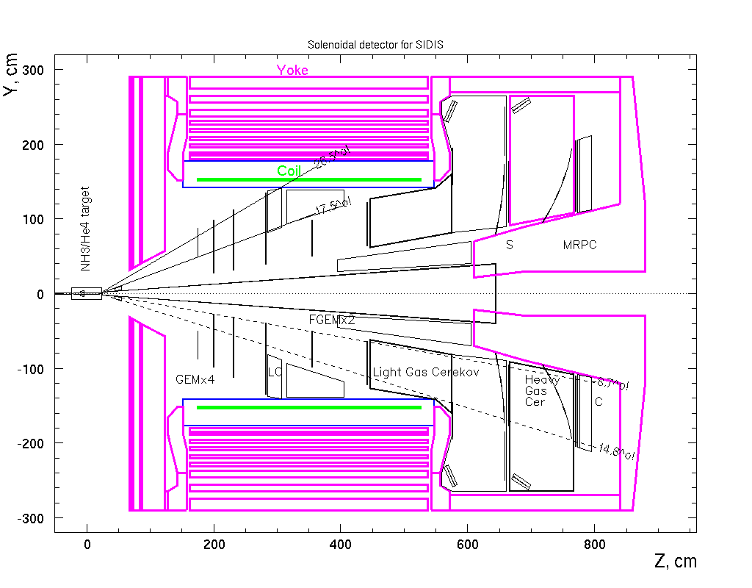
Down stream part

Slide 52
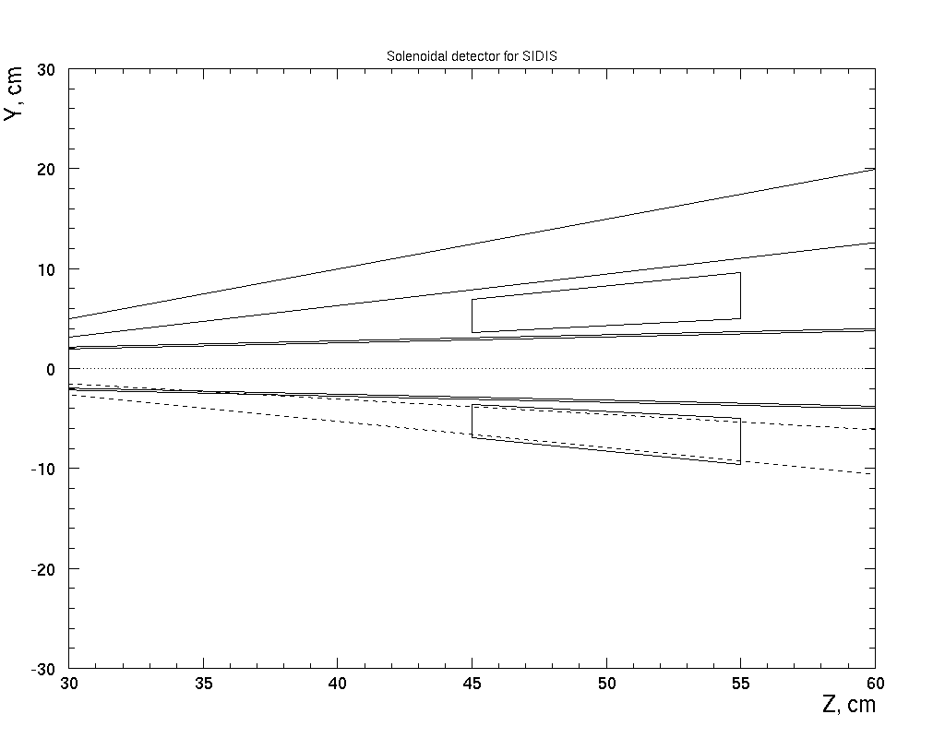
Downstream with collimator

Slide 53
Calculate Single Rate
Electron:
  Conditions:
    Turn off most physics processes
    Black hole treatment for collimator and magnets etc.
  Rate calculation: QFS/whitlow
  Each target wall is assume to be the same thickness as 3He gas.
  Results:
    Forward angle @ 11 GeV: 55 kHz
    Large angle @ 11 GeV: 13.0 kHz with 3.0 GeV cutoff
    Forward angle @ 8.8 GeV: 91 kHz
    Large angle @ 8.8 GeV: 14.3 kHz with 3.0 GeV cutoff

Slide 54
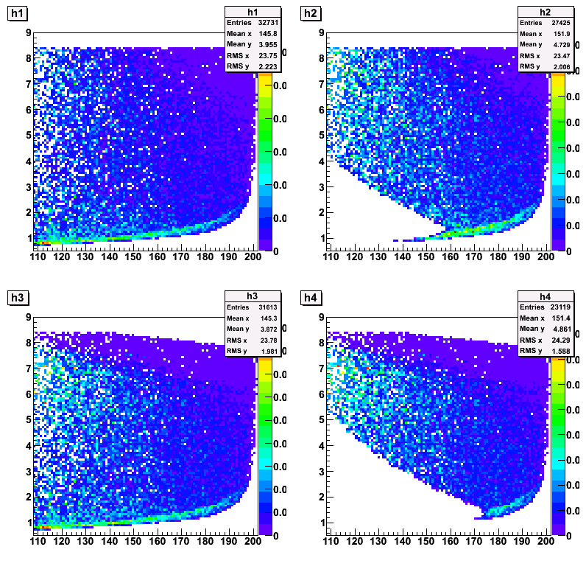
Look the hit position in forward angle
X: position in forward angle calorimeter
Y: momentum
Top two: 11 GeV
Bottom two : 8.8 GeV
Left panels: no cut on Q2
Right panels: Q2 > 0.9
Rates:
11 GeV: 55 kHz
11 GeV with Cut: 41 kHz
Large Angle: 13.0 kHz
8.8 GeV: 91 kHz
8.8 GeV with Cut: 61 kHz
Large angle: 14.3 kHz
This would require a position dependence threshold cut.

Slide 55
Calculate Pion Rate
Similar as Electron except
  Collimator is not a black hole now
  Turn off hadronize process, the rest is same.
Results:
  11 GeV forward: 9 MHz (+) 5.4 MHz (-)
  8.80 GeV forward: 7.9 MHz, 4.6 MHz (-)
    Pion are higher for two reasons:
      Larger acceptance for CLEO vs. CDF
      The suppression factor from collimator was under-estimated.
  11 GeV large @ p_e>3.0: 58 kHz (+) 41 kHz (-)
  8.80 GeV large @ p_e>3.0 : 40 kHz (+) 27 kHz (-)
  Here for large angle, we expect to have a 20 from calorimeter rejection for “electron” trigger.

Slide 56
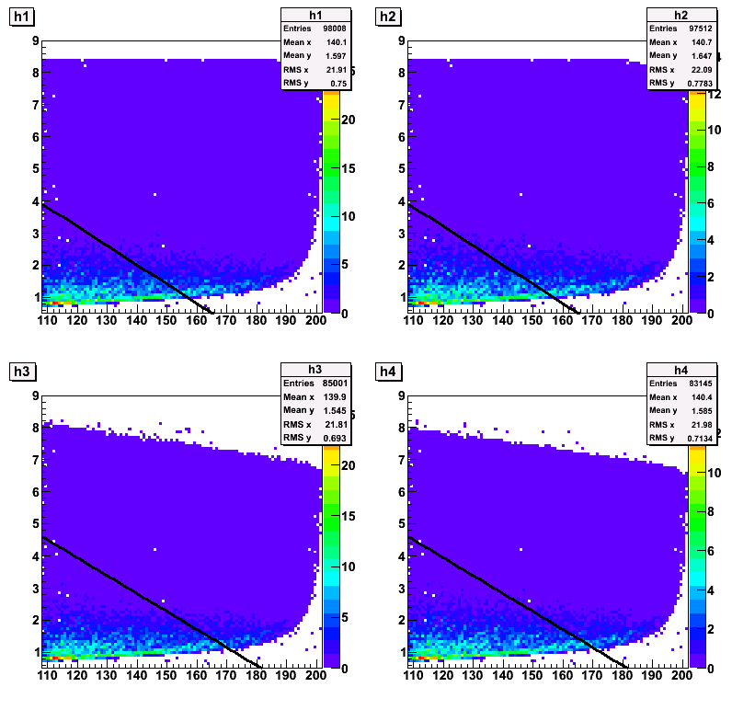
Forward Angle Pion which can mimic electron.
Top Left: Pip @ 11 GeV
Top Right: Pim @ 11 GeV
Bottom Left Pip @ 8.8 GeV
Bottom Right Pim @ 8.8 GeV
We can add a cut to mimic cut shown in slide 6.
Shown as black lines.
The remaining rates are:
11 GeV pip: 4.8 MHz
11 GeV pim: 2.9 MHz
8.8 GeV pip: 3.1 MHz
8.8 GeV pim: 1.8 MHz
We can add the position cut as well.

Slide 57
Calculate Hadron Rate
Same as Pion Case, tread proton as 1/3. of pion case
Treat Kaons as 5% of Pions.
Total 40%.
Then the hadron rate which might mimic electons are:
  11 GeV hp: 6.7 MHz
  11 GeV hm: 3.0 MHz
  8.8 GeV hp: 4.3 MHz
  8.8 GeV hm: 1.9 MHz
The Full hadron rate:
  11 GeV hp: 12.6 MHz
  11 GeV hm: 5.7 MHz
  8.8 GeV hp: 11 MHz
  8.80 GeV hp: 4.8 MHz

Slide 58
Calculate Photon Rate
Calculate Pio, treat collimator as black hole again. Go back to electron situation.
  Turn on Decay processes.
  We loop through each decay particles, so the rate can be a double-counted (over estimated).

Slide 59
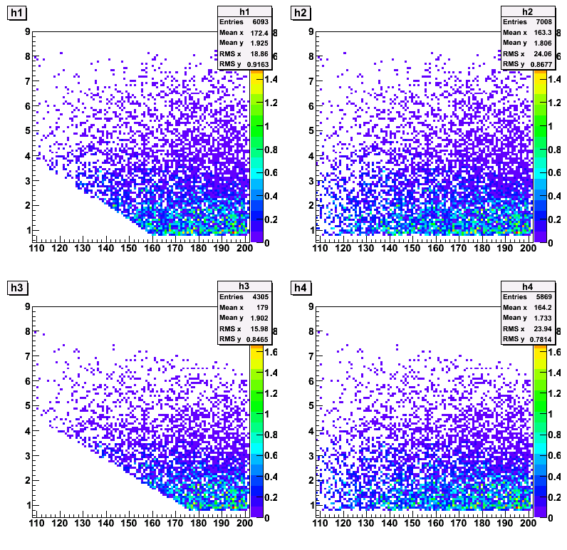
Pion Rate @ forward angle
11 GeV: 462 kHz with cut
8.8 GeV: 362 k Hz with cut
11 GeV without cut: 605 kHz
8.8 GeV without cut 612 kHz

Slide 60
Large Angle Side
11 GeV: 31 kHz.
8.8 GeV side: 21 kHz.

Slide 61
Following Arguments from Proposal.
Single electron trigger @ 11 GeV:
  Forward angle: 41 kHz (electron) + 9.7 MHz (hadron)/ 400 + 462 (photon)/40 ~ 77 kHz.
  Large angle: 14.3 kHz (electron) + 31 kHz (photon) ~ 44 kHz.
    Total: 121 kHz.
Single hadron trigger @ 11 GeV:
  ~20 MHz
Coincidence Trigger (35 ns)
  121e3*20e6 * 35e-9 ~ 85 kHz

Slide 62
8.8 GeV
Single electron trigger @ 11 GeV:
  Forward angle: 61 kHz (electron) + 6.2 MHz (hadron)/ 400 + 362 (photon)/40 ~ 86 kHz.
  Large angle: 13 kHz (electron) + 21 kHz (photon) ~ 34 kHz.
    Total: 120 kHz.
Single hadron trigger @ 11 GeV:
  ~20 MHz
Coincidence Trigger (35 ns)
  120e3*18e6 * 35e-9 ~ 76 kHz

Slide 63
Thoughts on DAQ
Idea I: Single-trigger alone:
  If the GEM pad readout is successful, we can reduce the direct photon at large angle, so that the total rate:
    11 GeV: 90 kHz
    8.8 GeV: 100 kHz
    @ SoLID-3He woth CLEO magnet setup with collimator.
  Here, we assume a position dependent energy threshold cut.

Slide 64
Idea II: Coincidence Trigger
At full luminosity, coincidence trigger is
  11 GeV: 63 kHz
  8.8 GeV: 63 kHz
Since Coincidence Trigger Rate goes with 1/L^2 and single trigger rate goes 1/L
Assume DAQ limit is 40 kHz, then we can
  Case 1, reduce overall rate by 2-2.5 for single trigger.
  Case 2, reduce rate by 25% for coincidence trigger.
  We assume that GEM read out is good for large angle detection.

Slide 65
Discussion
The advantage of coincidence trigger is that it decrease with L^2, so can be more effective if reducing luminosity.
The advantage of single trigger is that it is Simple, but one may lose more if one have to reduce the luminosity.

Slide 66
Idea III: Threshold Effect
At low Q2, the momentum is low, so the rates is high for background, also rates of single electron, pion etc are high.
  SIDIS rate is also much higher at low Q2 region.
Therefore, we can divide the running into a two period:
  1. at high threshold, run full or even higher luminosity to get better data at high Q2.
  2. at low threshold, run with less luminosity to get enough data at low Q2.
Let’s look at this idea with MC.

Slide 67
Pi^+ Case (For example)
Let’s assume that we are going to cut at p_e == 2 GeV @ 11 GeV.
  Then Single electron rate becomes: 40 kHz
  Single Photon rate: 199 kHz
  Single Hadron rate: 3.8*1.4 + 2.5 ~ 7.8 MHz
  Final single electron rate becomes: 64 kHz
In additional to position dependent energy cut:
  Single electron: 36 kHz
  Single Photon: 178 kHz
  Single Hadron: 4.4 MHz
  Final single rate: 51 kHz

Slide 68
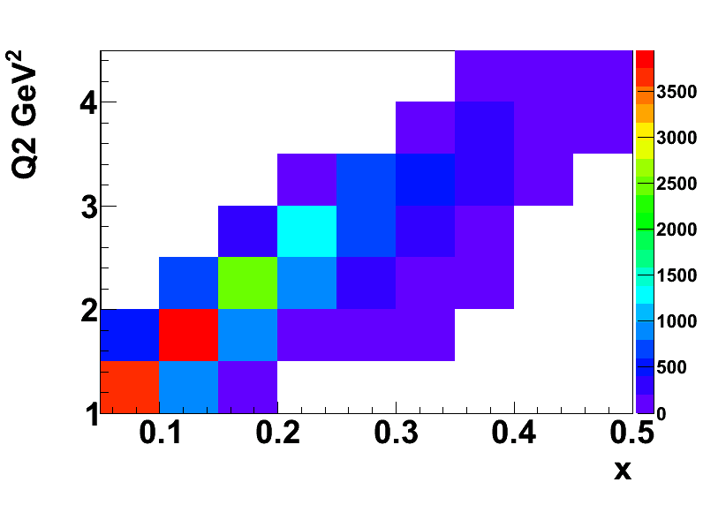
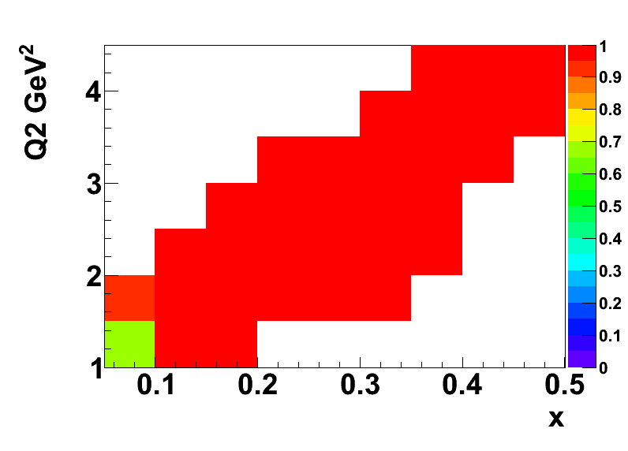
What about the x-Q2 Bin with 2.0 GeV Cut.
Ratio with Cut vs. Without cut
Distribution with Cut directly
Loss about 30% at low xQ2 bin due to cut
Note: this is simplified picture, since the physics is in 4-D (x,Q2, z, Pt)
Combine these two plots, we lose about 1200 events (arbitrary unit)
While the effect at high Q2 is about 100 events.
For example, in total we have 48 days, we can run at ½. Current for the low threshold setting with 8 days → 100 events (similar to the high Q2 case).
At High threshold, we can run at a higher luminosity (etc. 1.5 or twice)
We can optimize the cut vs. rate to balance low and high Q2 (or low x and high x division)

Slide 69
Summary
The considering options are:
  GEM Pad R&D is important to DAQ
  ~2 GeV cutoff.
    Two running period, higher luminosity with high threshold (high x and high Q2) and low luminosity with low threshold (low x, low Q2)
  Position dependent Shower Cut
  Coincidence Trigger (more effective if one have to reduce luminosity)
An example of two runing periods is discussed here (2 GeV cutoff example)

Slide 70
SIDIS channel count
Detector | Module type | Number of channels | Number of modules
Forward Calorimeter | FADC+TDC | 1896 | 119
Large angle calorimeter | FADC+TDC | 920 | 58
Light Gas Cerenkov | FADC+TDC | 120 | 8
Heavy Gas Cerenkov | FADC+TDC | 270 | 17
Scintillator | FADC+TDC | 120 | 8
GEM | VME/SRS | 164K
MRPC | VME | 2550

Slide 71
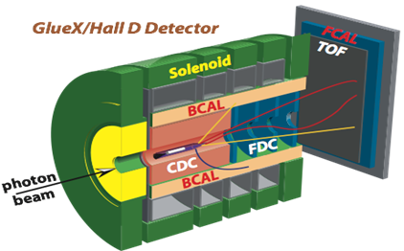
Hall D L1 Trigger-DAQ Rate
Low luminosity (10⁷ γ/s in 8.4 < E_{γ} < 9.0 GeV)
  20 kHz L1
High luminosity (10⁸ γ/s in 8.4 < E_{γ} < 9.0 GeV)
  200 kHz L1
  Reduced to 20 kHz L3 by online farm
Event size: 15 kB; Rate to disk: 3 GB/s
SC
Detectors which can be used in the Level-1 trigger:
Forward Calorimeter (FCAL) | Energy
Barrel Calorimeter (BCAL) | Energy
Start Counter (SC) | Hits
Time of Flight (TOF) | Hits
Photon Tagger | Hits
Electromagnetic background
Hadronic E_{γ} < 8 GeV
Hadronic E_{γ} > 8 GeV
Energy BCAL (GeV)
Energy BCAL (GeV)
Energy BCAL (GeV)
Basic Trigger Requirement:
E_{BCAL} + 4 ∙ E_{FCAL} > 2 GeV
and a hit in Start Counter
Energy FCAL (GeV)
Energy FCAL (GeV)
Energy FCAL (GeV)

Slide 72
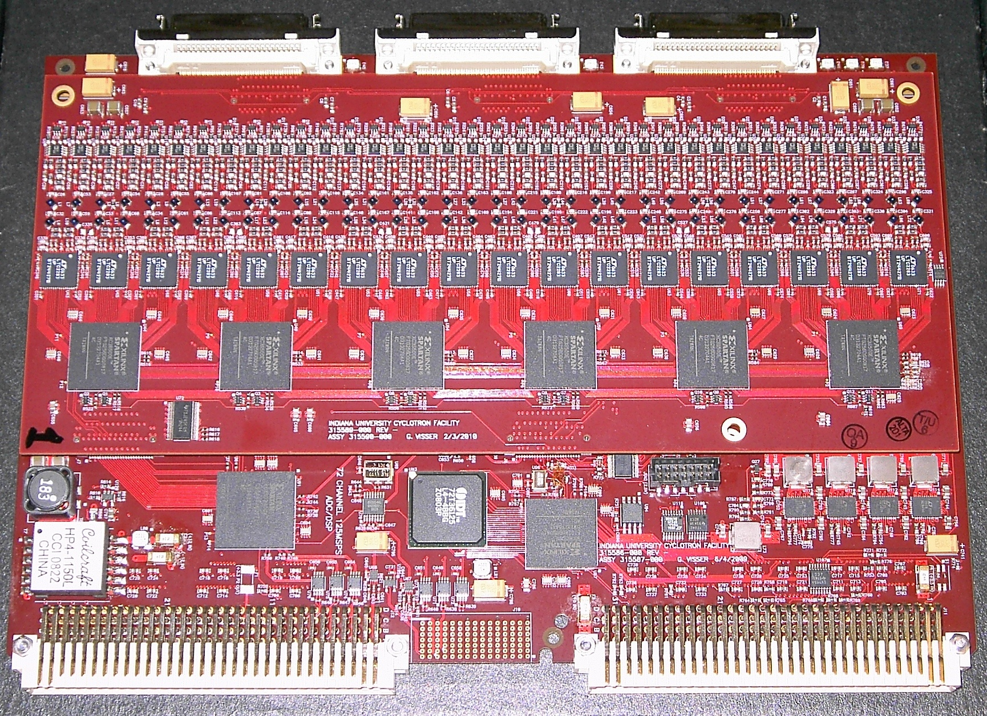
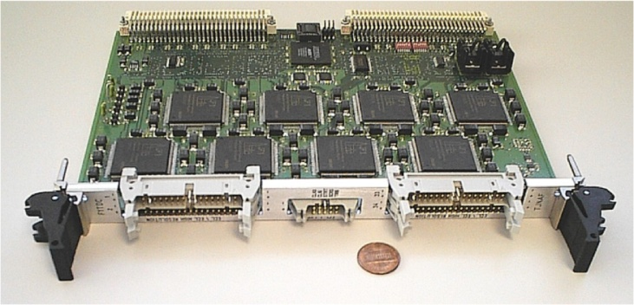
Custom Electronics for JLab
VME Switched Serial (VXS) backplate
  10 Gbps to switch module (J₀)
  320 MB/s VME-2eSST (J₁/J₂)
All payload modules are fully pipelined
  FADC125 (12 bit, 72 ch)
  FADC250 (12 bit, 16 ch)
  F1-TDC (60 ps, 32 ch or 115 ps, 48 ch)
Trigger Related Modules
  Crate Trigger Processor (CTP)
  Sub-System Processor (SSP)
  Global Trigger Processor (GTP)
  Trigger Supervisor (TS)
  Trigger Interface/Distribution(TI/D)
  Signal Distribution (SD)
FADC125
F1-TDC

Slide 73
L1 Trigger Diagram
CPU
SSP
SSP
SSP
SSP
SSP
SSP
GTP
GTP
SD
SSP
SSP
SSP
SSP
SSP
SSP
SSP
TI
CPU
TD
TD
TD
TD
TD
TD
SD
SD
TD
TD
TD
TD
TD
TD
TS
VXS Crate
VXS Crate
Trigger Distribution
Distribute trigger, clock and synchronize signals to TI in each Crate
VXS Serial Link
16 bit @ 62.5 MHz: 1 Gbps
CPU
FADC
FADC
FADC
FADC
FADC
FADC
CTP
SD
FADC
FADC
FADC
FADC
FADC
FADC
TI
TI
Trigger Supervisor
Calculate 8 bit trigger types from 32 bit trigger pattern
Prescale triggers
Transfer trigger and sync signal to TD (16 bit total)
Fiber Optics
16 bit @ 62.5 MHz: 1 Gbps
VXS Crate

Slide 74
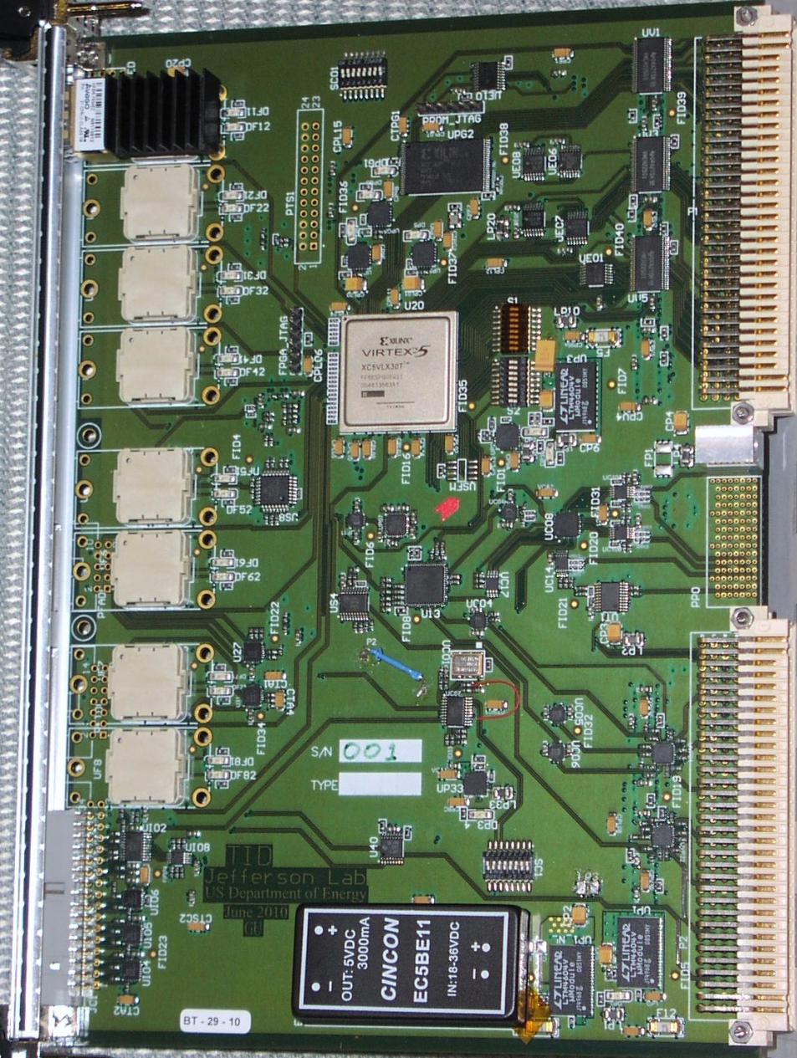
L1 Trigger Diagram
CPU
SSP
SSP
SSP
SSP
SSP
SSP
GTP
SD
SSP
SSP
SSP
SSP
SSP
SSP
SSP
TI
CPU
TD
TD
TD
TD
TD
TD
SD
SD
TD
TD
TD
TD
TD
TD
TD
TS
VXS Crate
VXS Crate
TID
VME Readout Controller
Gigabit ethernet
Trigger Interface
Receive trigger, clock and sync signals from TD
Make crate trigger decision
Pass signals to SD
CPU
FADC
FADC
FADC
FADC
FADC
FADC
CTP
SD
FADC
FADC
FADC
FADC
FADC
FADC
TI
Signal Distribution
Distribute common signals to all modules: busy, sync and trigger 1/2
VXS Crate
VXS Serial Link
4 bit @ 250 MHz: 1 Gbps

Slide 75
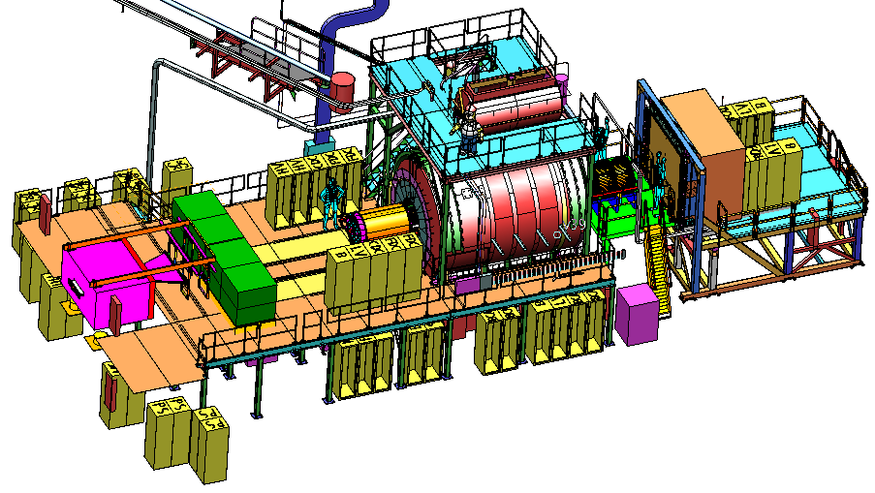
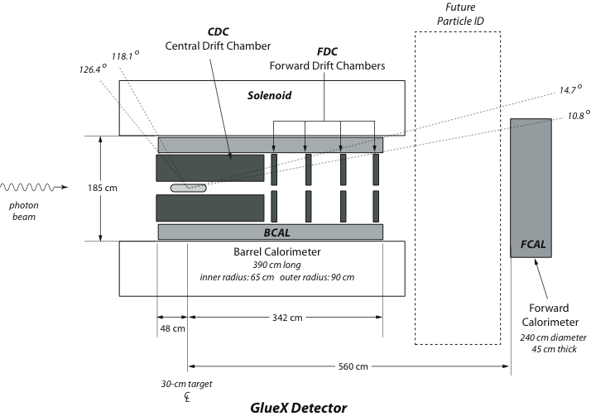
The GlueX Detector
2.2 Tesla
Solenoid
2.2T superconducting solenoidal magnet
Fixed target (LH₂)
10⁸ tagged γ/s (8.4-9.0GeV)
hermetic
TOF
time of flight
SC
start counter
Charged particle tracking
Central drift chamber (straw tube)
Forward drift chamber (cathode strip)
Calorimetry
Barrel Calorimeter (lead, fiber sandwich)
Forward Calorimeter (lead-glass blocks)
PID
Time of Flight wall (scintillators)
Start counter
Barrel Calorimeter

Slide 76
GlueX Data Rate
 | Front End DAQ Rate | Event Size | L1 Trigger Rate | Bandwidth to mass Storage
GlueX | 3 GB/s | 15 kB | 200 kHz | 300 MB/s
CLAS12 | 0.1 GB/s | 20 kB | 10 kHz | 100 MB/s
ALICE | 500 GB/s | 2,500 kB | 200 kHz | 200 MB/s
ATLAS | 113 GB/s | 1,500 kB | 75 kHz | 300 MB/s
CMS | 200 GB/s | 1,000 kB | 100 kHz | 100 MB/s
LHCb | 40 GB/s | 40 kB | 1000 kHz | 100 MB/s
STAR | 50 GB/s | 1,000 kB | 0.6 kHz | 450 MB/s
PHENIX | 0.9 GB/s | ~60 kB | ~ 15 kHz | 450 MB/s
private comm.
JLab
CHEP2007 talk
Sylvain Chapelin
LHC
BNL
*
**
* Jeff Landgraf Private Comm. 2/11/2010
** CHEP2006 talk MartinL. Purschke

Slide 77
CODA3 – What’s different
CODA 2.5 | CODA 3
Run Control (X, Motif, C++) (rcServer, runcontrol) | Experiment Control – AFECS (pure JAVA) (rcPlatform, rcgui)
Communication/Database (msql, cdev, dptcl, CMLOG) | cMsg – CODA Publish/Subscribe messaging
Event I/O C-based simple API (open/close read/write) | EVIO – JAVA/C++/C APIs Tools for creating data objects, serializing, etc…
Event Builder / ET System / Event Recorder (single build stream) | EMU (Event Management Unit) Parallel/Staged event building
Front-End – vxWorks ROC (Interrupt driven – event by event readout) | Linux ROC, Multithreaded (polling – event blocking)
Triggering: 32 ROC limit, (12 trigger bits -> 16 types) TS required for buffered mode | 128 ROC limit, (32 trigger bits -> 256 types) TI supports TS functionality. Timestamping (4ns)

Slide 78
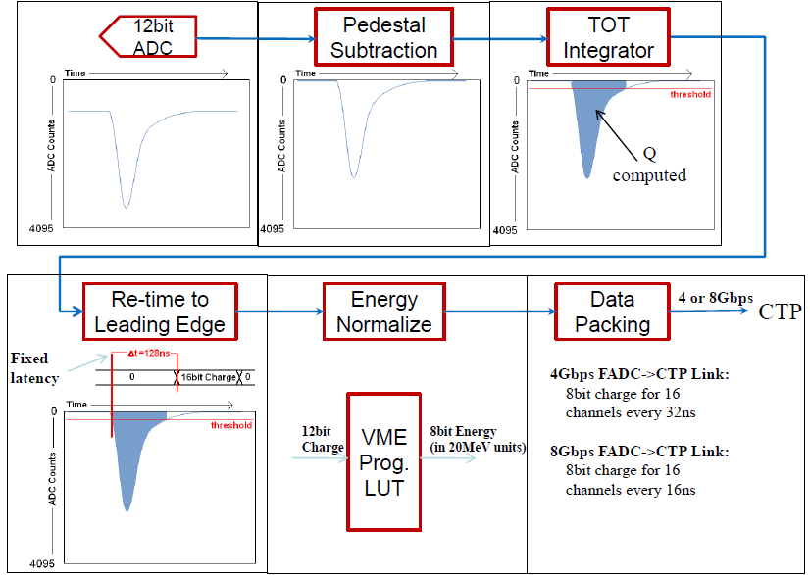
FADC Encoding Example

Slide 79
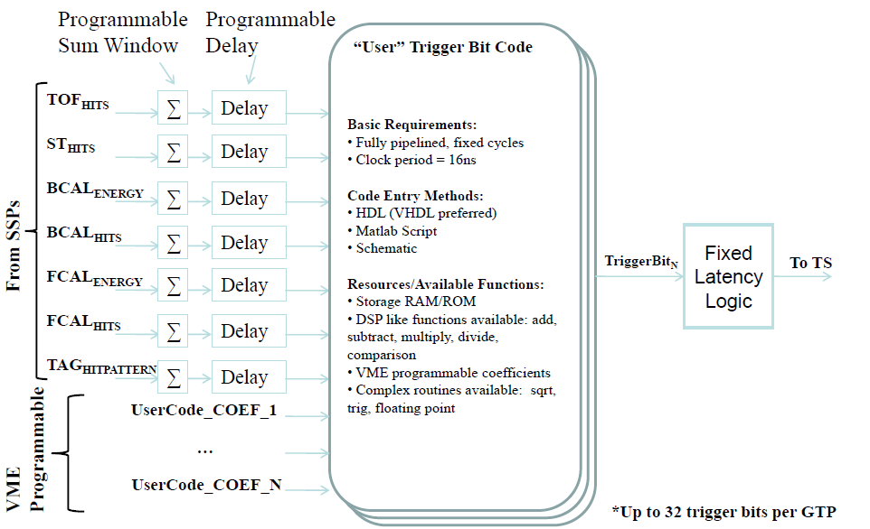
GTP Trigger Bit Example

