Slide 1
Cherenkov Counters for SoLID
Z.-E. Meziani
on behalf of
Simona Malace & Haiyan Gao (Duke University)
Eric Fuchey (Temple University)

Slide 2
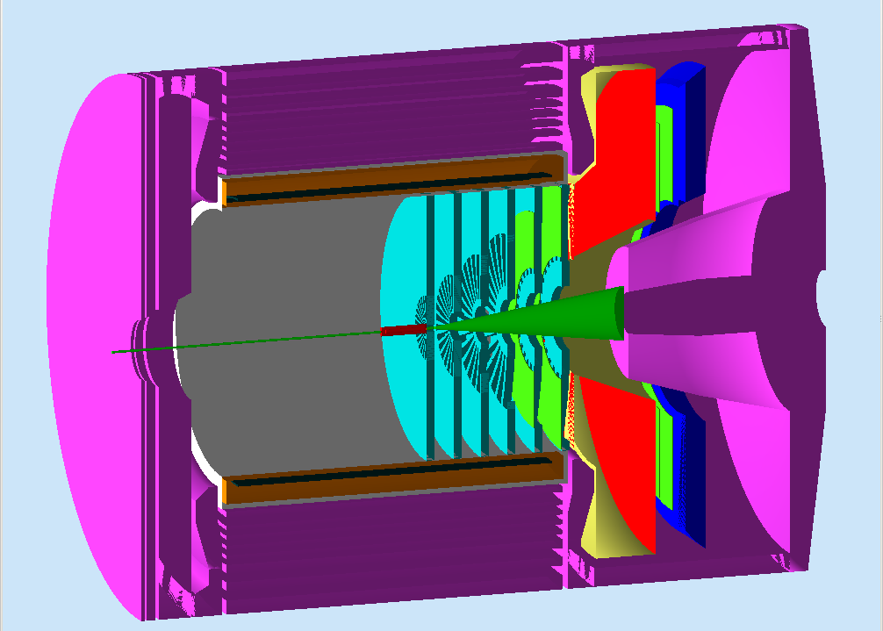
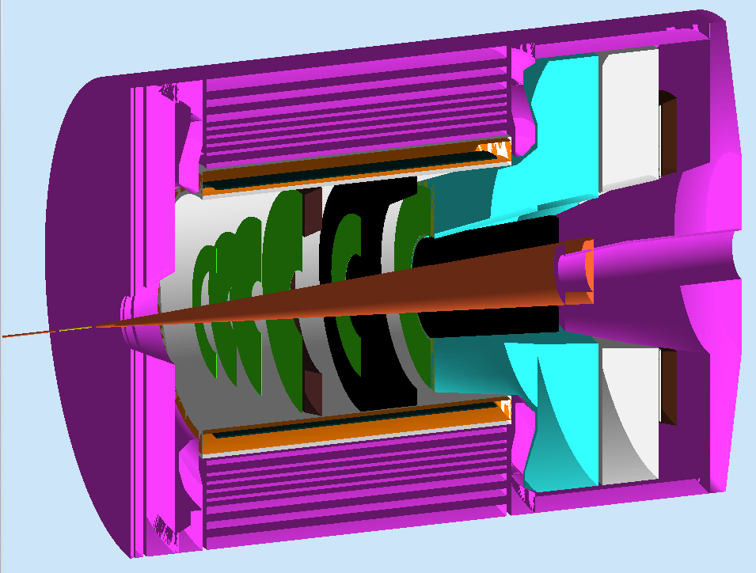
PVDIS versus SIDIS Configurations
PVDIS
SIDIS
One Cherenkov Counter
Gas length constrained due to baffles
Highest luminosity
Calorimeter and Cherenkov for pion rejection: goal contamination less than 1%
Two Cherenkov Counters
Gas length extended in the magnet for the e- Cherenkov
Highest luminosity
Calorimeter and Cherenkov for pion rejection: goal contamination less than 1%

Slide 3
Simulations
Optics simulation using GEANT4
Present simulations uses BABAR magnet but CLEO magnet simulations are underway
Target length and beam raster effects included in optics optimization
Gas transparency + mirror reflectivity + cone reflectivity + photocathode response + UV glass transparency included

Slide 4
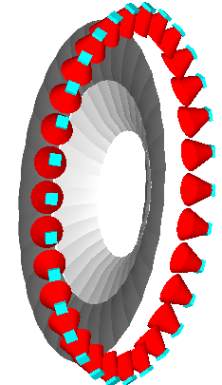
Reference Design: PVDIS electron Cherenkov
Radiator: C₄F₈O/N₂ mix
Length: ~ 1 m
Useful momentum range: 2-4 GeV
Pion rejection goal ~ 100
Photodetectors: Hamamatsu H8500C maPMTs (2”x2” size) tiled in 3x3 per sector
maPMTs array shielded with a mu-metal cone that is reflective.
Mirrors: spherical in 2 parts, inner and outer. Material: CFRP (70% Carbon fiber, 30% resin bond). Al_MgF₂ reflective coating: > 85% for wavelengths greater than 200 nm
Inner: L = 75.6 cm, R= 268.7 cm
Outer: L =78.6 cm, R= 178.4 cm
Mirrors support

Slide 5
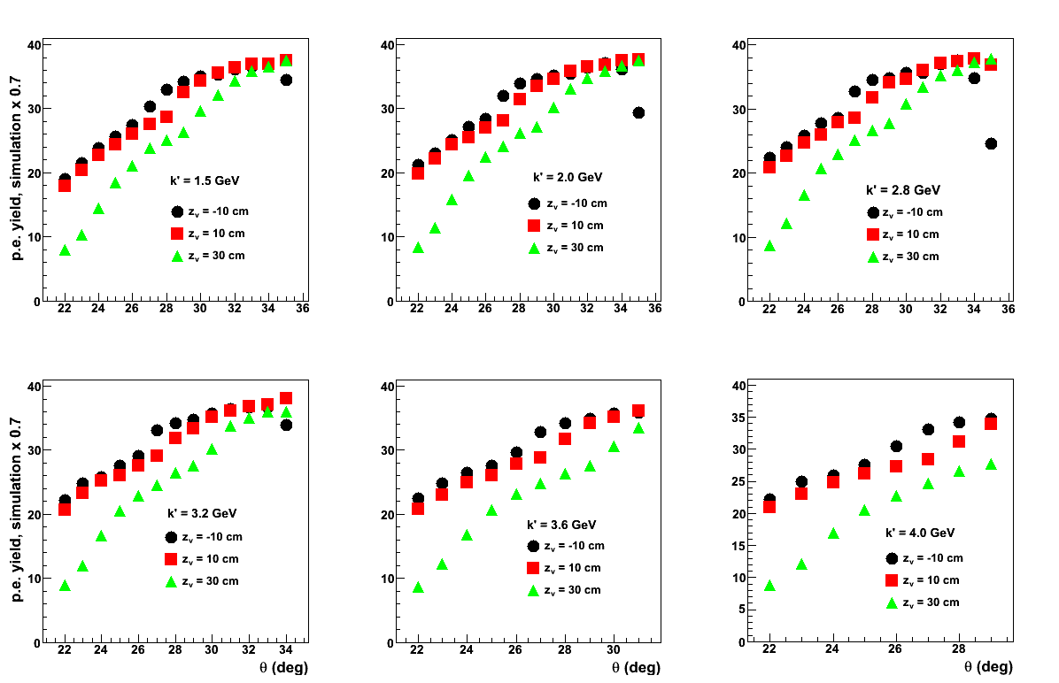
Projected performance with safety margin

Slide 6
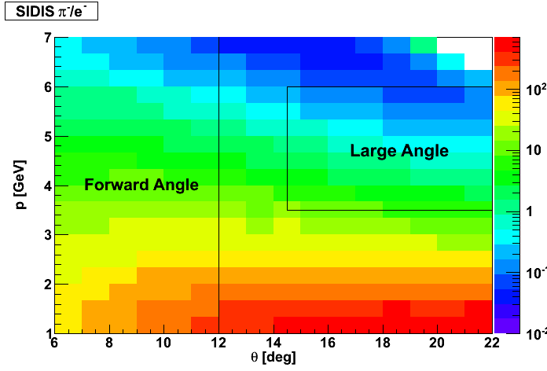
Pion background
PVDIS
Goal is to keep the pion contamination less than 1% when combining the Cherenkov counter and the calorimeter
SIDIS

Slide 7
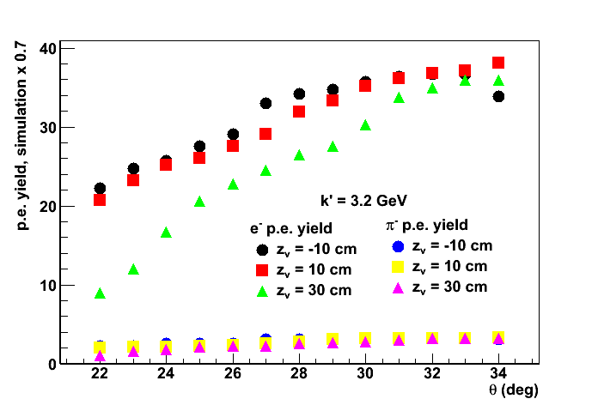
Performance: PVDIS Cherenkov (continued)
The photo-detector per sector is tiled in a 3x3 maPMTs configuration, a compromise of cost and efficiency

Slide 8
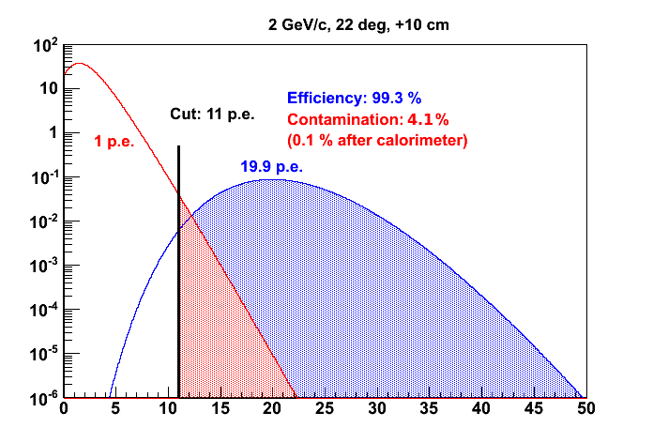
Projected Performance

Slide 9
Hamamatsu H8500C

Slide 10
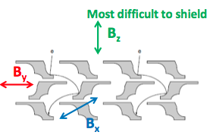
H8500C maPMTs performance in magnetic field
Extensive study of magnetic field effects on the performance of the H8500C Hamamatsu maPMT (S. Malace, in collaboration with B. Sawatzsky & H. Gao)
Conclusions:
Single photoelectron resolved
Loss due to magnetic field mainly due to gain loss in the multiplication chain not at the first dynode for the longitudinal field
Largest losses experienced when the magnetic field is parallel to the face of the PMT which can be easily shielded

Slide 11
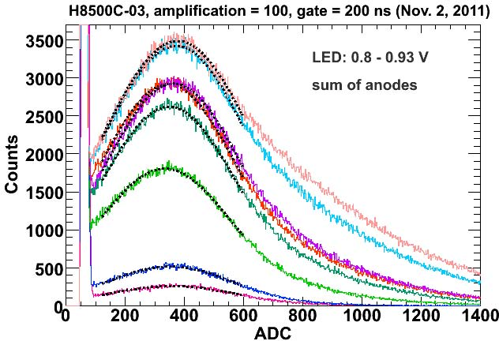
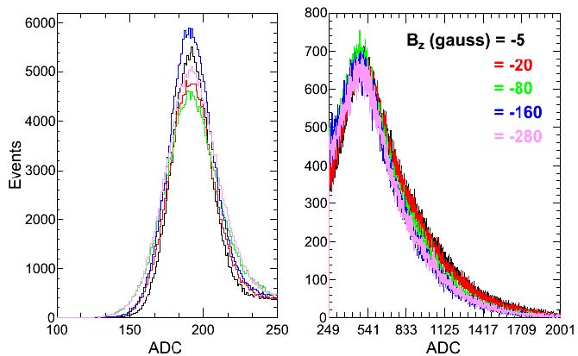
maPMT performance (continued)
Single photoelectron can be resolved
When the field is perpendicular to the face of the PMT small one photoelectron losses are observed.

Slide 13
Shielding of the photo-detectors in a sector

Slide 14
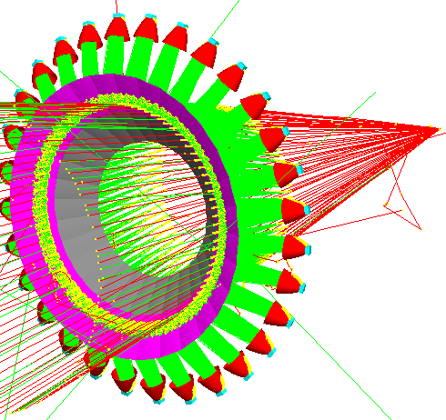
Reference design: SIDIS electron Cherenkov
Radiator: CO₂ at ~1 atm
Radiator length: ~ 2 m
Useful momentum range: 1.5- 4.5 GeV
Pion rejection goal ~ 100
Photodetectors: maPMTs tiled 2x2 per sector with a total of 30 sectors
maPMTs array per sector shielded with mu-metal straight reflective cone to enhance the collection efficiency
Mirrors: spherical split in two with different radii of curvature to optimize the size of the photodetector array.
Material and reflectivity of mirrors similar to PVDIS description
Note: Radii of curvature different from PVDIS
4”
4”
Extension of gas tank
Mirrors support

Slide 15
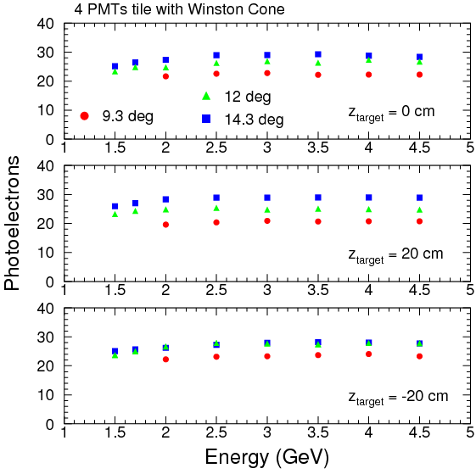
Projected Performance of SIDIS Electron Cherenkov
Large # of photoelectrons ~25 across electron energies and scattering angles

Slide 16
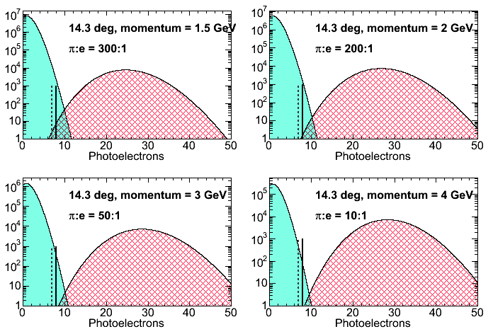
Projected performance
Keep pion contamination below 1%, achieved with an 8 p.e. cut leaving a
high e⁻ efficiency
pion distribution
electron distribution

Slide 17
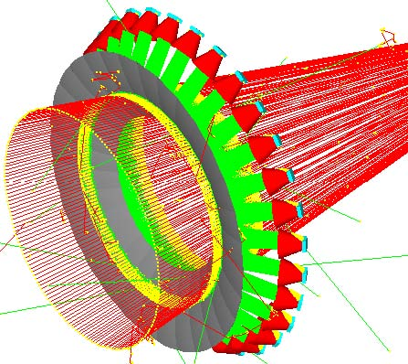
SIDIS Pion Cherenkov counter
Positive pions
Radiator: C₄F₈O at 1 .5 atm at 20 ⁰C
Useful momentum range: 2.5-7.5 GeV
Kaon rejection goal ~ 100?
Photodetectors: maPMTs tiled 3x3=9 per sector with a total of 30 sectors
maPMTs array per sector shielded with a mu-metal cone that is reflective to enhance the angular acceptance.
Mirrors: one spherical mirror per sector. Al+MgF₂ reflective coating
Optics optimized for both positive and negative pions
Tank considered a pressure vessel
Negative pions

Slide 18
Light collection efficiency of Pion Cherenkovs
Negative Pions
Positive Pions

Slide 19
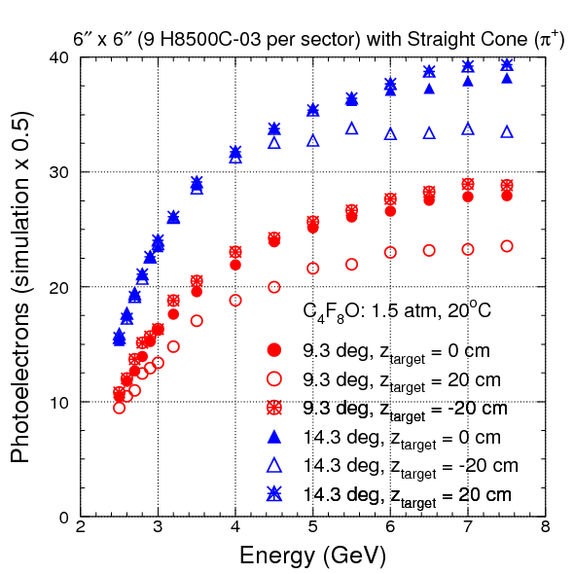
Projected performance of the SIDIS Pion Cherenkov
Positive Pions
Response for positive pions simulated with a safety factor of 0.5.

Slide 20
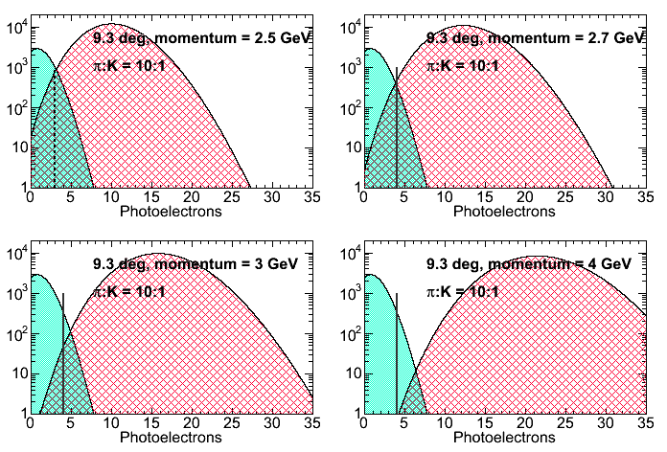
Pion Cherenkov: Projected Performance
pion efficiency: 99.2%
kaon contamination: 0.8%
pion efficiency: 99.5%
kaon contamination: 0.3%
Hypothesis:
kaon:pion = 1:10
(from proposal)
PMT resolution: 1 p.e. (from measurements)
no input from other PIDs
kaons give at most 1 p.e. below threshold
3
4
4
4
pion efficiency: 99.9%
kaon contamination: 0.2%
pion efficiency: 100%
kaon contamination: 0.2%

Slide 21
Mirrors: Quote from Composite Mirrors Applications

Slide 22
Distributions of photons on the photodetector
Coincidence between quadrants was tried successfully in a test, however, the reduction (a factor of 10) saturates due perhaps to cross talk between quadrants (to be checked)
Distribution of photons lead to a possible coincidence scheme of independents maPMTs within one sector to reduce random background

Slide 23
Partial Cost Estimate
 | SIDIS/PVDIS e⁻ Cherenkov | SIDIS π Cherenkov
Mirrors/coating*** | $277 K x 2 = $554 K | $277 K
PMTs* | $3,000 K x 124 = $372 K | $3,000 x 279 = $837 K
Cones** | $41 K x 2 = $82 K | $47 K
Gas system
Tank
2.2 M
* we assume PVDIS will reuse PMTs from SIDIS
** quote for straight cones for the electron Cherenkovs and for parabolic cones for the pion Cherenkov
*** quote from CMA for CFRP mirrors (coating included)

Slide 24
Summary
Presented a reference design for the electron and pion Cherenkov detectors of SoLID
Realistic simulations with good safete margins. Projections of performance are sound given past experience.
Transverse magnetic field effects can be mitigated with mu-metal shielding while the longitudinal ones are not an issue
PMT option reference design offers many advantages:
Proven technology
Easy recovery due to multiplicity
E&M or other background mitigation possible using coincidences between maPMTs within a sector
Long term maintenance of mirror reflective properties possible.
No dramatic performance expected from gas impurities.
Still to be done:
Define the electronics logic and readout.
Build a prototype of a 3x 3 photo-detector array including mu-metal shielding.
Build a prototype of one sector with mirror mounts, photo-detector mounts etc..
Design, build and test the optical alignment procedure
Test the prototype at Idaho or Mainz in a high luminosity environment
Specify the mechanical design of the pion Cherenkov pressure vessel
Another option explored: LAPPD
https://lappdtrac.uchicago.edu/

