Slide 1
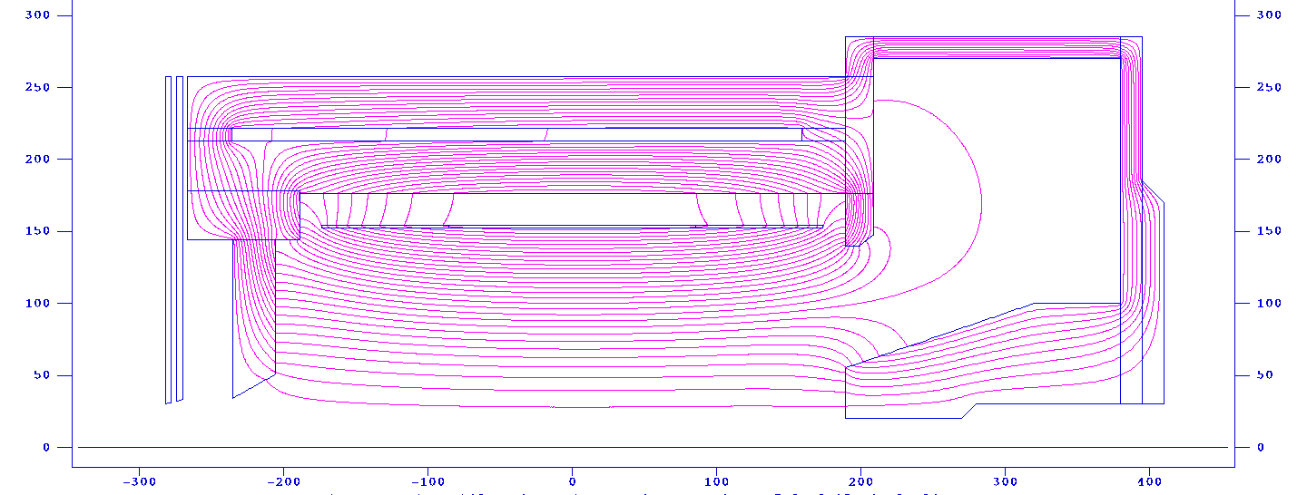
The SoLID Solenoid
Endcap Donut
Spacer
Barrel Yoke Outer
Spacer
Collar Downstream
Paul E. Reimer
14 September 2012
SoLID Collaboration Meeting
Magnet: What do we need?
Will an available coil fit our needs?
The CLEO coil
Cost Estimate
Barrel Yoke Inner
Collar Upstream
Endcap Bottom
Coil
shield
Front Piece
Endcap Nose
Much (all) of this work has been done by my collaborators, including Zhiwen Zhao, Eugene Chudukov and a team of JLab engineers (next talk)
This work is supported in part by the U.S. Department of Energy, Office of Nuclear Physics, under Contract No. DE-AC02-06CH11357.

Slide 2
Solenoid Size restrictions
Or, if we were starting from scratch and designing a new magnet, what would we want?
Back-of-the-envelope arguments
26º
17º
14º
Outer barrel
35º
22º
Beam line
SIDIS Target
(must be outside of solenoid or very well shielded)

Slide 3
Solenoid Size restrictions
Smaller calorimeter (either more dense or fewer rad lengths)
Smaller radius and hence shorter length
Still need angular coverage
Larger barrel-forward gap
Acceptance hole
Allows for longer or deeper colorimeter
Shift barrel-forward gap
Small effect for reasonable shifts
26º
17º
14º
Outer barrel
Beam line
SIDIS Target
(must be outside of solenoid or very well shielded)

Slide 4
Solenoid Size restrictions
14º line cannot hit solenoid i.e. radius/length > tan(14º)
Barrel Calorimeter should be able to intercept 17-26º without hitting 14º line
Calorimeter thickness (as seen by track) for π/e differentiation is about 40 cm
Minimum barrel radius of approximately 90 cm
Minimum barrel length of approximately 360 cm
26º
17º
14º
Outer barrel
Beam line
SIDIS Target
(must be outside of solenoid or very well shielded)

Slide 5
Choice of Solenoid
Field:
Resolution:
The Q² and x resolution requirements (from PVDIS) dictate the desired energy resolution that was found to be σ_{E’}/E’ < 3%.
Coupling this with the tracking resolution dictate the minimum acceptable field.
Simulations have shown that a solenoid with 1.5T central field and 6 planes of 500μm resolution tracking can meet this criteria.
Not the only solution, but shown to work.
Trade off more field ⇔ less tracking resolution
Cost of fabricating a new magnet coil is approx. $8M based on Hall D

Slide 6
Magnet Comparison
 | BaBar | CLEO | ZEUS | CDF | Glue-X | Other
Cryostat Inner Rad | 150 cm | 150 cm | 86 cm | 150 cm |  | Whatever we need
Length | 345 cm | 350cm | 245cm | 500 cm
Cent Field | 1.49T | 1.5T | 1.8T | 1.47T
Yoke Aval? | Yes | Yes | No | No
Variation in Current density with z? | Current Density in central 50% is ½ that in end 25% | Current Density in central 50% is 1/1.04 that in end 25% | Current density 25% more current at ends | No | Yes
Amp-Turns | 5.1 M A-T | 4.2 M A-T
Available | Probably Not?? | Probably | Probably Not--Mainz | Needs $1M repair and possible Expt at Fermilab | Perhaps | $8M??

Slide 7
Magnet Comparison
 | BaBar | CLEO | ZEUS | CDF | Glue-X | Other
Cryostat Inner Rad | 150 cm | 150 cm | 86 cm | 150 cm |  | Whatever we need
Length | 345 cm | 350cm | 245cm | 500 cm
Cent Field | 1.49T | 1.5T | 1.8T | 1.47T
Yoke Aval? | Yes | Yes | No | No
Variation in Current density with z? | Current Density in central 50% is ½ that in end 25% | Current Density in central 50% is 1/1.04 that in end 25% | Current density 25% more current at ends | No | Yes
Amp-Turns | 5.1 M A-T | 4.2 M A-T
Available | Probably Not?? | Probably | Probably Not--Mainz | Needs $1M repair and possible Expt at Fermilab | Perhaps | $8M??

Slide 8
Now Look in Detail at the CLEO Coil: Will it work?

Slide 9
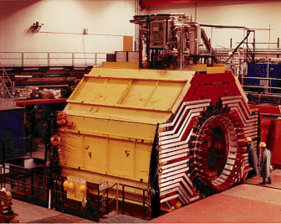
CLEO-II
Coil is divided into 3 sections, each section has two layers
Coil total 1282 turns. Upstream: 166; Central: 309; Downstream: 166 turns per layer. The current density in the end sections is 4% higher than in the middle section.
Max current is 3266A and average current density of 1.2MA/m, this reach 1.5T field
2 collars holding 4 coil rods
Barrel flux return is provided by 3 layers of iron separated by spacers

Slide 10
From CLEO-II to SoLID (reused parts)
Reuse coil and cryostat
Reuse two layers of barrel yoke and spacer w/upstream ends unchanged, cut the downstream ends (75cm).
Reuse the upstream collar.
Modify the downstream collar or make a new one to satisfy the acceptance requirement. Make sure the coil rods can still be supported by two collars under axial force
All other parts of yokes are new.
Endcap Donut
Barrel Yoke Outer
Spacer
Spacer
Collar Downstream
Barrel Yoke Inner
Collar Upstream
Endcap Bottom
Coil
shield
Front Piece
Endcap Nose

Slide 11
From CLEO-II to SoLID (new parts)
Endcap donut: 15cm thick and has 15cm clearance to Hall A floor (10 feet high)
Endcap bottom: two 15cm plates
Endcap nose: flat at back to give clearance for SIDIS forward angle EC and has slope at front to give clearance for Cherenkov.
Collar downstream: 20cm thick and can be in one piece
Front Piece: 30cm thick and can move along z to adjust force on coil
Target Shielding: a few 4 cm thick plates with gaps in between.
PVDIS 36º
PVDIS 21º
SIDIS 26º
SIDIS 14.7º
SIDIS 8º
SIDIS 2º
PVDIS 3.5º

Slide 12
Magnet Forces
With asymmetric end caps, need to consider how forces on the coils are balanced
Region | Type |  | Mag. force (t) | Weight (t)
2 | Upstream subcoil |  | 298.5
3 | Central subcoil |  | 4.1
4 | Downstream subcoil |  | -303.4
Study by Eugene Chudukov
see https://userweb.jlab.org/~gen/jlab12gev/cleo_mag/
Can tune force on coils by moving the Upstream Endcap
Also studied forces while ramping magnet

Slide 13
Magnet Forces
Region | Type |  | Mag. force (t) | Weight (t)
5 | Barrel ring 1 |  | 125.8 | 190
6 | Barrel ring 2 |  | 122.2 | 230
7 | Coil collar 1 |  | 109.6 | 21
8 | Upstream endcap | new | 188.6 | 12
9 | Upstream spacers |  | 0.8 | 3
10 | Downstream spacers |  | 8.4 | 3
11 | Downstream endplate 1 | new | 165.9
12 | Downstream endplate 2 | new | -277.7
13 | Downstream endplate 3 | new | -126.0
14 | Enclosure barrel | new | -5 | 36
15 | Enclosure endcap | new | -268.3 | 30
16 | Enclosure cone | new | 26.9 | 50
17 | Shielding plate 1 | new | 0.2 | 10
18 | Shielding plate 2 | new | 0.0 | 10
19 | Enclosure endcap 2 | new | -74.9 | 16
Study by Eugene Chudukov
see https://userweb.jlab.org/~gen/jlab12gev/cleo_mag/

Slide 14
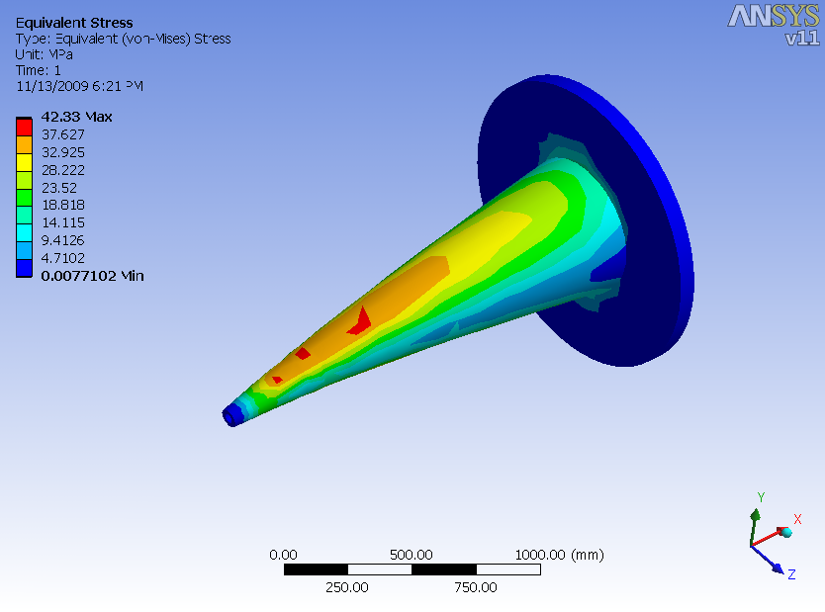
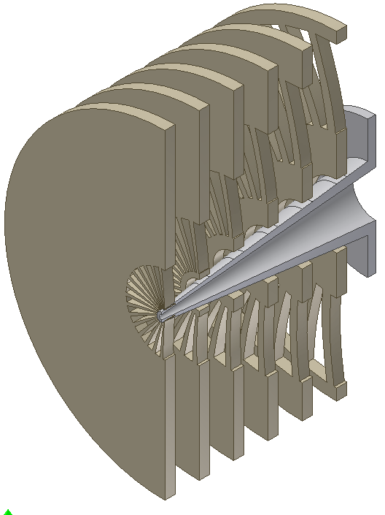
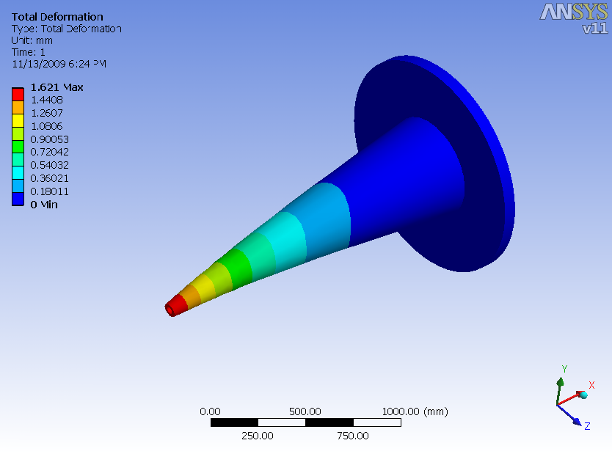
Baffle cantilevered support
Material = 6061-T6 Aluminum
Allowable stress in bending = 186MPa
(Allowable stress is reduced by factor of 2 in vicinity of welds)
Preliminary FEA results on support
Max Von Mises stress = 42MPa
deflection at tip = 1.6mm

Slide 15
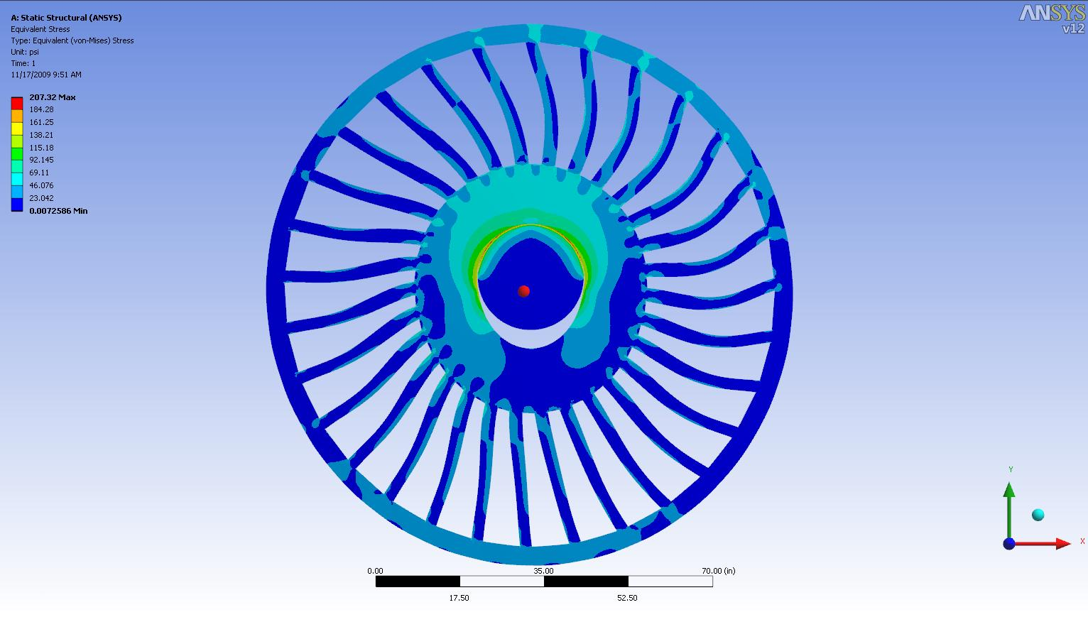
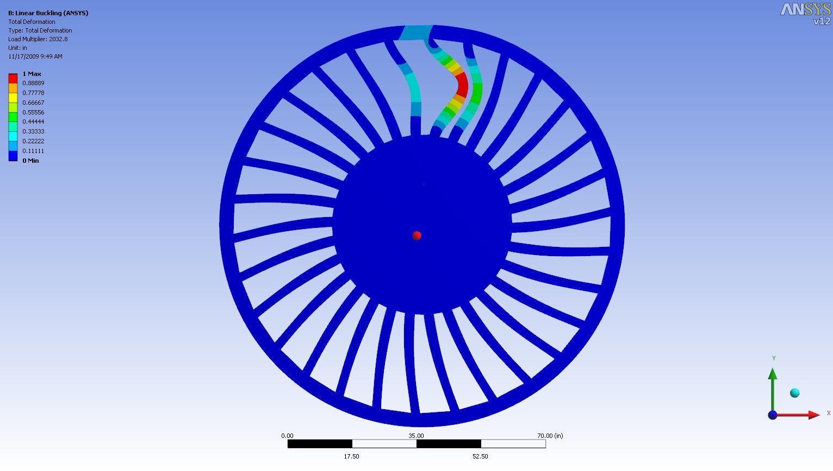
Analysis of baffle 6
Baffle supported by contact
Stresses are low ~ 60psi
Buckling safety factor ~2000!
Support
Deformations exaggerated
First Buckling mode

Slide 16
Does it Fit?

Slide 17
Does it Fit?
Yes—just don’t put it on a tall platform to move into the hall

Slide 18
Cost
Item |  | Cost (k$) | Effort (FTE) | Basis
Move Coil
 | Disassemble |  | 5 | Cornell Est
 | Shipping to Jlab | $240 |  | $0.12/lb
Magnet Yoke
 | Modifications | $860 | 1.2 | $6/lb
 | Upstream Endcap | $677 | 0.5 | $4.5/lb
 | Downstream Endcap | $875 | 0.8 | $4.5/lb
 | Detector Extension | $660 | 0.2 | $6/lb
Magnet Support |  | $350 | 0.4 | 50% est
Detector Support |  | $500 | 1 | 50% est
Controls |  | $300 | 0.3
Cryo mods |  | $500 | 2
Subtotal |  | $5,000 | $1,200
Need better basis for this cost based on actual parts to be fabricated
Is cost driver really weight of raw material?
Can we use existing iron—Fermilab?

Slide 19
Conclusions
24º
17º
14º
CLEO magnet will produce the desired acceptance and resolution for both SIDIS and PVDIS
Cost of acquiring the CLEO coil is approx $240k + 5 FTE + 35% contingency = $1M
Outer barrel
Beam line
SIDIS Target
(must be outside of solenoid or very well shielded)
Cost driver overall magnet is additional iron for flux return. Max est. approx $6M plus contingency—working on better estimates based on actual design
Forces on with asymmetric endcaps can be balanced.
Baffles can be supported w/o deflection and creep

Slide 20
Epilogue--BaBar
Initial design was done around BaBar coil
20% more Amp-Turns than CLEO
Larger gradient in turn density than CLEO, shaping field better
BaBar Coil was “committed” to Italy, but now may be available.
Should we pursue the BaBar coil?
Robin Wines just presented several person-months of engineering effort
Additional person-months of effort in Monte Carlo
Is “Better” the enemy of “good”?

