Slide 1
Update/Overview of SoLID
Jian-ping Chen
SoLID Collaboration Meeting
Sept. 14-15, 2012

Slide 2
Compelling Physics Cases for SoLID
SoLID: large acceptance, capable of handling high luminosity
(up to~10³⁹ with baffle, up to ~10³⁷ without baffle)
Ideal for precision Inclusive-DIS (PVDIS) and SIDIS experiments
Possibility also for exclusive reactions
Five Experiments Approved ( 4 with “A” rating, 1 A- rating):
PVDIS, E12-10-007
SIDIS: E12-10-006 (He3-T), E12-11-007 (He3-L), E12-11-108 (p-T)
J/Psi: E12-12-006
The collaboration has done an excellent job making compelling physics cases to the community.
Should continue: present talks in conferences and other occasions
New Ideas:
Other possibilities

Slide 3
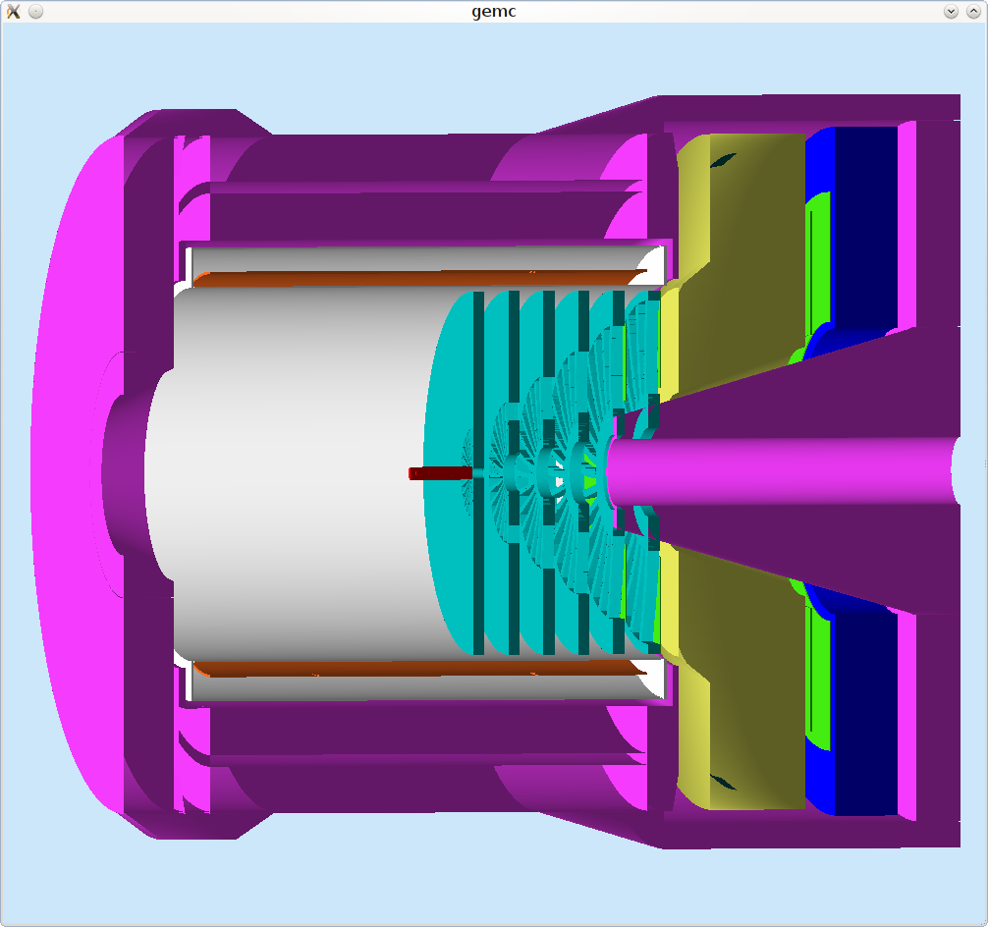
SoLID- PVDIS Configuration
EM Calorimeter
(forward angle)
Cherenkov
GEM
Baffle
Target
GEM
CLEO II Coil and Yoke

Slide 4
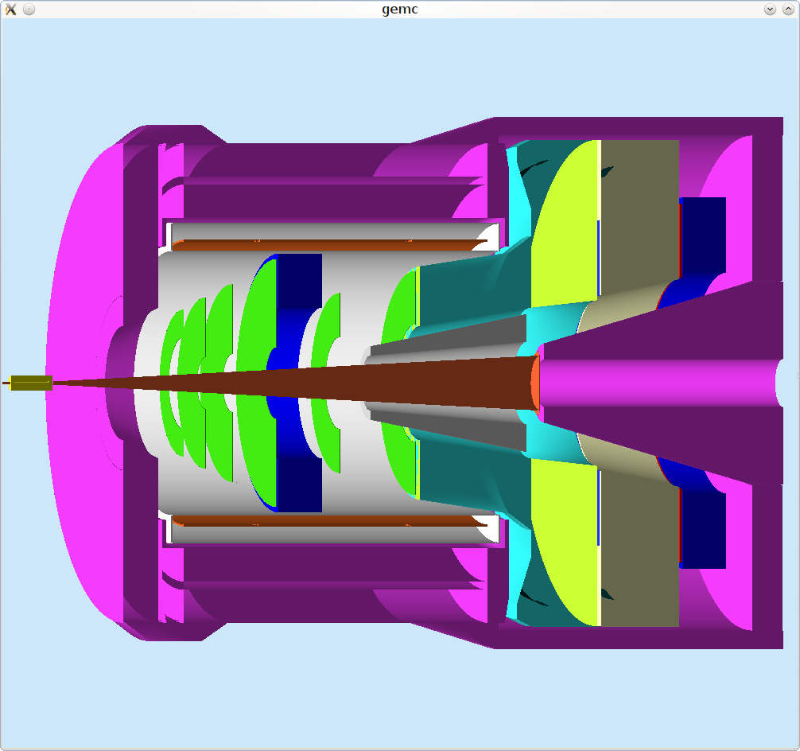
SoLID- SIDIS Configuration
EM Calorimeter
(forward angle)
EM Calorimeter
(large angle)
GEM
MRPC
Target
Collmator
CLEO II Coil and Yoke
Light Gas
Cherenkov
Heavy Gas
Cherenkov

Slide 5
1st Dry Run: 6/13-14/2012
(slide from last meeting/dry run 6/13)
Magnet: CLEO magnet (discuss next meeting)
Simulations: including baffle design (Seamus’ talk)
background (Lorenzo’s talk)
tracking (Ole’s)
GEMs: Chinese collaboration progress (discuss next meeting)
US side progress/ R&D / tests (Nilanga’s talk)
Cherenkov: PMT (Zein-Eddine’s talk)
HBD (Tom’s talk)
EM calorimeters: Design/simulation/tests (Xiaochao’s talks)
MRPC: Tsinghua U, experience from STAR, beam test (discuss next meeting)
DAQ: Design/plan (Alexandre’s talk)
Polarimetry: Compton (Kent’s talk)
Atomic Moller (Kurt’s talk)
Targets: (Discuss next meeting)
Cryotarget: coordinated design effort, G0 as starting point
Pol. 3He: convection cell progress
Pol. NH3: new transverse magnet design

Slide 6
(Very Rough) Cost and A Plan to Move Forward
(slide from last meeting/dry run 6/13)
One option: split and mix
Chinese contribution,
NSF/MRI, Modest DOE/MIE,
JLab capital equipment,
Sharing readout systems amongst Halls
Magnet: extraction/transport/refurbish/infrastructure: ~$3-5 M
JLab
GEMs ~ $4-5 M
(Anticipate) Mainly Chinese Collaboration
Cherenkov ~$3-4 M
Collaboration: MRI or MIE
EM Calorimeter: $3-5 M
Collaboration: MRI / MIE
DAQ/Trigger electronics 3-4 M
JLab Physics Division sharing among 4 halls.

Slide 7
SoLID Status Update (I)
Magnet:
Progress/work done on fit CLEO magnet to Hall A (Robin’s talk)
Cost estimation
Possibility of BaBar (again)
Very rough cost estimation on full project (Javier/Rolf)
With rough estimation of manpower
from 12 GeV experience (parts:manpower = 60%: 40%)
Additional cost of Hall infrastructure etc. ($3M?)
Contingency (35%)
Total is similar to a Hall D
Without GEMs/Electronics → near ~$30 M

Slide 8
SoLID Status Update (II)
The collaboration has done an excellent job making compelling physics cases.
Continue: present talks in conferences and other occasions
How to move forward with the SoLID project
Significant cost/large project: will likely need a large MIE/DOE
Other source of funding will be very helpful (foreign, NSF)
Manpower
Current situation
NSAC sub-committee: discussion executing 2007 LRP
Election year uncertainty
Schedule
Director’s review
SoLID principles to meet with DOE
Preparation
Follow the charge
Move forward with the magnet
Towards “final” conceptual design
More detailed cost/manpower estimation
Keep up the momentum
Organization / Responsibilities (discussion tomorrow)

Slide 9
Subsystems/Responsibilities
(slide from last meeting/dry run 6/13)
Overall coordination: (J.P. Chen/H. Gao/P. Souder)
Calibration: (P. Souder/X, Qian)
Magnet/Support/Simulations (Argonne/Duke/UVa/Umass)
Magnet (JLab Engineering Div./ Argonne, P. Reimer)
Detector supporting structure (Duke, H. Gao)
General simulation (UVa, Z. Zhao/ Umass, S. Riordan)
Neutron background simulation (Syracuse, L. Zana)
Tracking (UVa/Chinese/others)
GEM detectors (UVa, N.Liyanaga,/Chinese collaboration)
Tracking software (JLab/O. Hansen/ Caltech, X. Qian/ Umass, S. Riordan)
Gas Cherenkov(Temple/Duke/Stony Brook)
Light gas Cherenkov (S. Malace/H. Gao, Z. Meziani, T. Hemmick)
Heavy Gas Cherenkov (S. Malace/H. Gao Z. Meziani)
EM Calorimeter (UVa/Los Alamos/W&M)
Forward angle (UVa, Z.Zhao, X. Zheng/ W&M, D. Armstrong)
Large angle (Los Alamos, J. Haung, X. Jiang/ Duke, M. Meziane, H. Gao)
TOF with MRPC (Tsinghua, Y. Wang/Duke, H. Gao/JLab, A. Camsonne)
DAQ and Trigger (JLab, A. Camsonne, Y. Qiang/Umass, R. Miskimen)
Polarimeters: Compton (UVa, K. Paschke/JLab, S. Nanda)
Atomic Moller (Mainz, F. Mass, K. Aulenbacher/ W&M, W. Deconinck)
Targets (JLab, J.P. Chen/JLab cryotarget group, D. Meekins)
Infrastructure (JLab, Hall A engineer/design team, R. Wines)
More groups are joining (UIUC, J.C. Peng, MIT, S. Gilad, …)

