Slide 1
Conceptual design of TOF and beam test results
Wang Yi
Department of Engineering Physics
Tsinghua University, Beijing, China

Slide 2
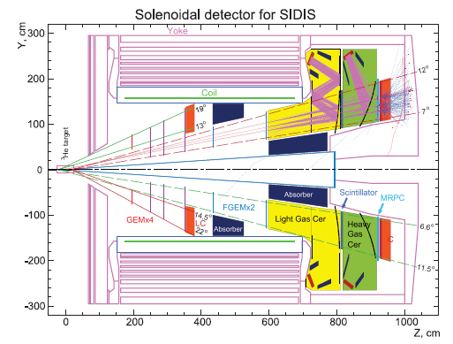
Outline
Conceptual design of TOF
  TOF and MRPC
  Experiment Overview
Beam Test Setup
  Layout
  Preparation
  Some Details on Setup
Results & Conclusion
  Test Results
  Comparison
  Conclusion

Slide 3
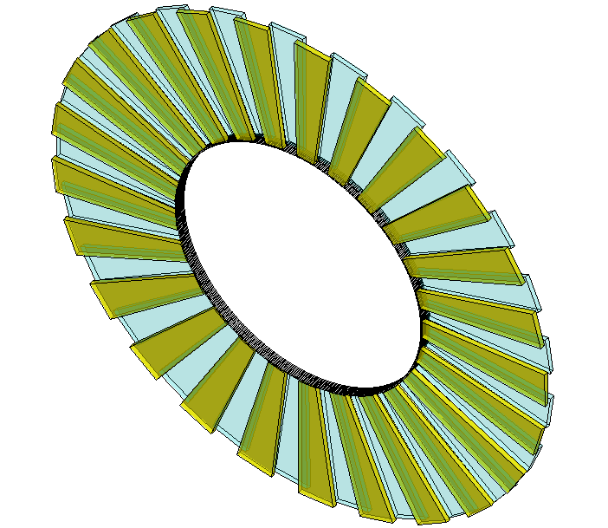
1.Conceptual design of SOLID-TOF
The MRPC is developed for the TOF of SoLID
Main Requirements for TOF:
  π/k separation up to 2.5GeV/c
  Time resolution < 80ps
  Rate capability > 10kHz/cm²
MRPC TOF wall we designed contain 150 MRPC modules in total, with 50 gas boxes and 3 counters in each box, covering the area of 10m².
MRPC3
28cm
MRPC2
16cm
100cm
MRPC1
Total channel ~3300
The MRPC module we tested is the prototype of smallest one.

Slide 4
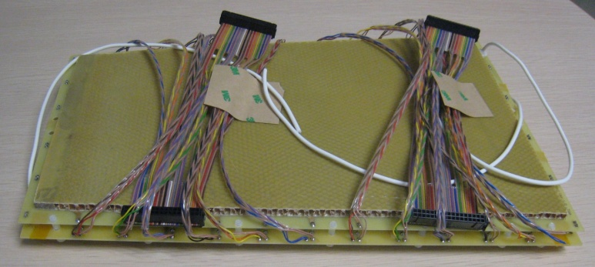
1.Introduction: MRPC module
The prototype of high rate MRPC modules with low resistivity glass electrodes can work under the flux of 100kHz/cm² in previous test in HZDR and GSI.
Low resistivity glass is black in color, and the volume resistivity can reach ~10¹⁰Ω.cm. (For float glass, the volume resistivity is ~10¹²Ω.cm)
Volume resistivity: ~10¹⁰Ω.cm

Slide 5
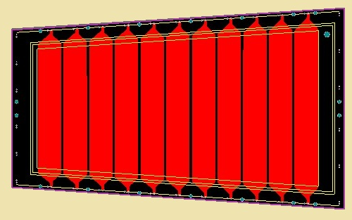
1.Introduction: MRPC module
Gas Mixture(Pre-mixed) | Freon 90% iso-butane 5% SF6 5%
Working Voltage | ±6800V
Electrical field | ~108.8kV/cm
171mm
219mm
The design of MRPC readout
Interval | 3mm
Strip width | 25mm
Readout mode | Differential
363mm
Dimensions
 | Length/mm | Width/mm | Thickness/mm
Gas gap | - | - | 0.25×10
Inner glass | 320 | 130-171 | 0.7
Outer glass | 330 | 138-182 | 1.1
Mylar | 335 | 153-198 | 0.18
Inner PCB | 350 | 182-228 | 1.6
Outer PCB | 350 | 172-218 | 0.8
Honeycomb | 330 | 153-198 | 6
Mylar
Outer glass
Inner glass
Inner PCB
Outer PCB
Honeycomb

Slide 6
TOF electronics
Fast preamplifier：
Maxim3760 (RICE Univ.)
Ninos (TOT) (ALICE)
Padi (TOT) (GSI)
CAD (TOT)(Tsinghua)
QDC (CAEN, 25fC/bin)
TDC
HPTDC (ALICE, 25ps/ch)
GET4 (GSI, 25ps/ch)
FPGA TDC (GSI and other)
DAQ

Slide 7
Comparison of different FEE
 | CAD-1.0 | PADI-1 | NINO-25 | NINO-13
Peaking time | ~1ns | <1ns | 1ns | 0.6ns
Linear range | 1000μA^{*1} | -60-60μA^{*1} | 0-100fC^{*2} | 0-100fC^{*2}
Time jitter | <20ps, rms^{*3} | <15ps, rms^{*4} | 10-25ps, rms | 6-25ps, rms
Power consumption | 10mW/ch | <30mW/ch | 30mW/ch | 5mW/ch
Input type | S.E. | DIFF. | DIFF. | DIFF.
Input impedance | 50-70Ω | 48-58Ω | 30-100Ω | 30-100Ω
Discriminator threshold | 263μA^{*1} | 10-400μA^{*1} | 20-100fC^{*2} | 20-100fC^{*2}
CMOS process | 0.35μm | 0.18μm | 0.25μm | 0.13μm
*1: for current pulse with 0.3ns rise time, 1-2ns FWHM, and 0.3ns fall time
*2: for square current pulse with 200ps width
*3: for 200μA input current
*4: for 100μA input current
7

Slide 8
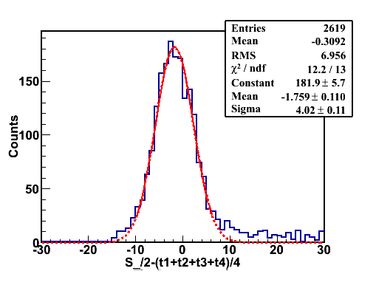
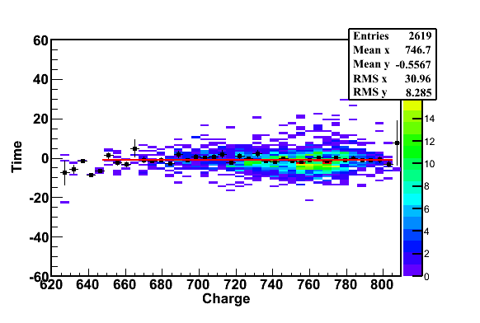
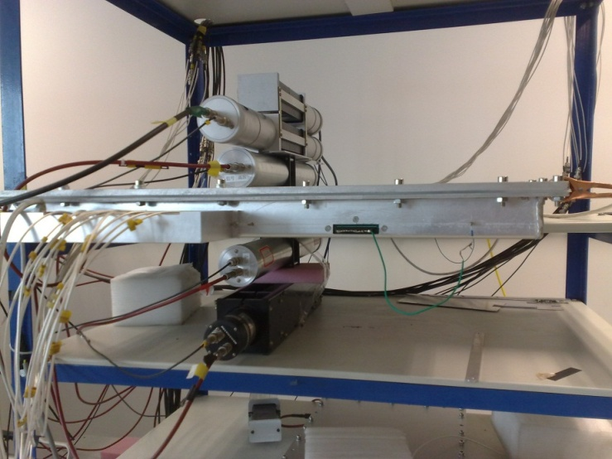
Cosmic test
Cosmic ray test@Tsinghua August, 2011
PMT0
PMT1
PMT2
MRPC
PMT3
PMT4
Cosmic Ray Muon
Efficiency > 95% @ 96kV/cm (6.0kV)
Time resolution: ~ 52ps

Slide 9
2.Beam test: Experiment Overview
The experiment last out totally 3 months, contains several process. The MRPC is tested both with cosmic ray and beam.
Brief Timetable :
The MRPC material is activated, which increases dark current and noise signal, as the test goes.
We got the time resolution of 80ps
Setting Up Feb 7th- Apr 7th | Preparation(Feb 7th-Mar 26th) |  |  | Setting in Hall A(Mar 26th-April 10th)
 | MRPC module and electronics; Placing High Voltage cable &gas supply; Work on DAQ and Decoding program; Pre-test with cosmic ray. |  |  | Set up test system in Hall A; Upgrading of DAQ system; Finish cable connection; Pre-test with beam.
Beam Test May 12th-May 17th | May 12th | May 13th | May 14th |  | May 15th | May 16-17th
 | Begin the test; Voltage Scan. Detector is 10m from Target with shield. | Replace LTD with CFD; continue test. Add T0 into calibration. | Place the MRPC 5m from Target with shield. Add scaler. |  | Test continue. Voltage scanning. | Take out the shield and continue testing

Slide 10
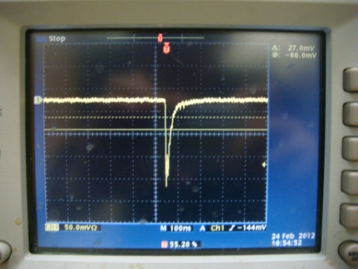
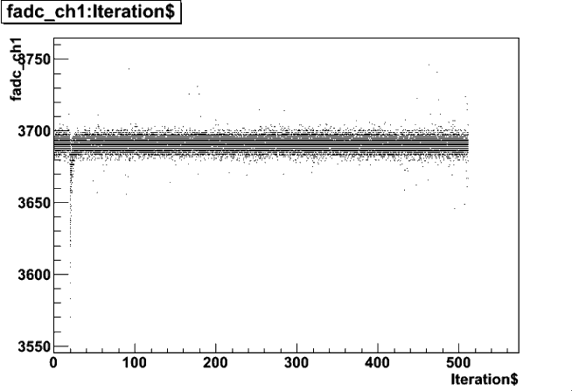
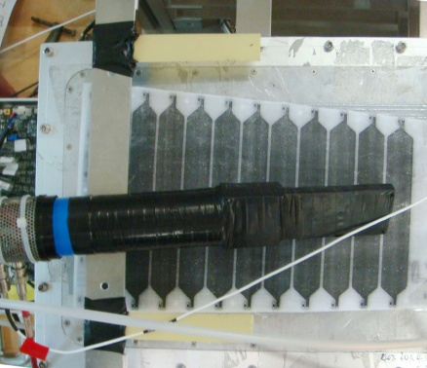

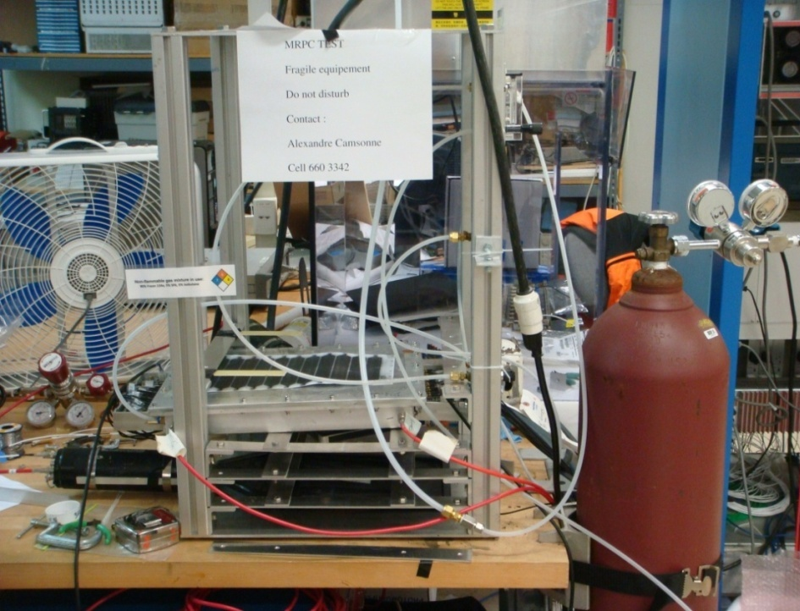
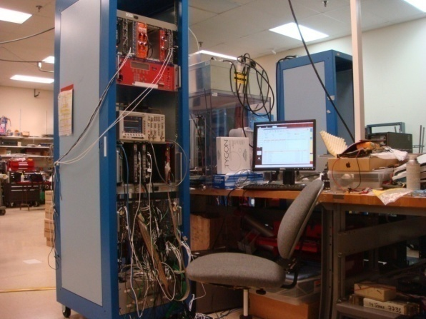
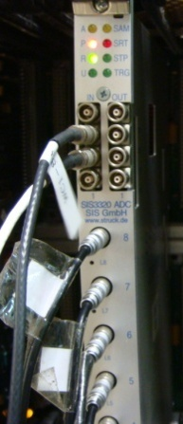
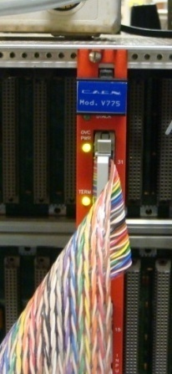
3.Beam Test Setup: Preparing
Signal
Trigger
&
Trigger
·
PMT0
Stop
·
sis3320
Flash ADC
·
MRPC
6 ADC
Channels
Pre-Amp
Pre-Amp
6 ADC
Channels
90% Freon
5% iso-butane
5% SF6
6 TDC
Channels
6 TDC
Channels
LTD
775
TDC
PMT1
Gas Out
DAQ
10

Slide 11
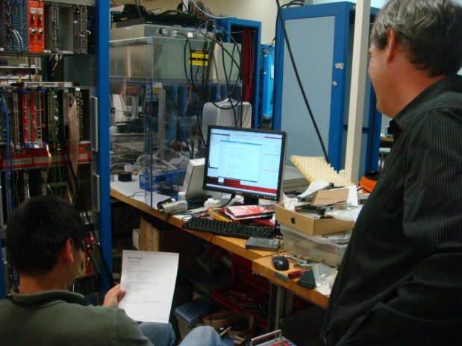
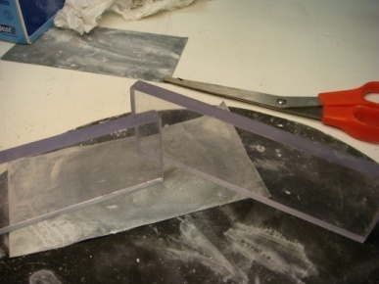
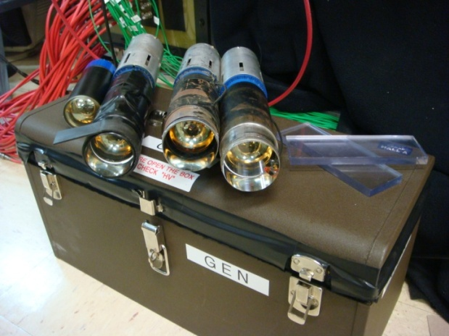
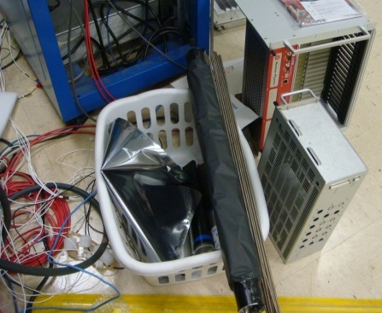
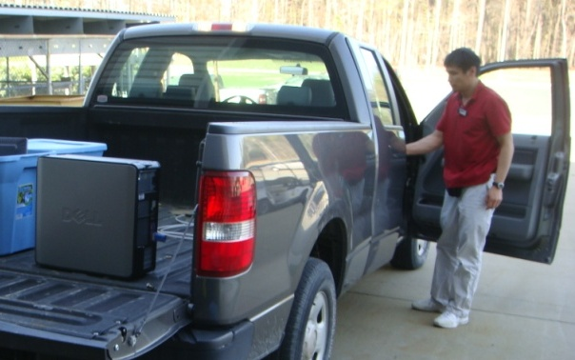
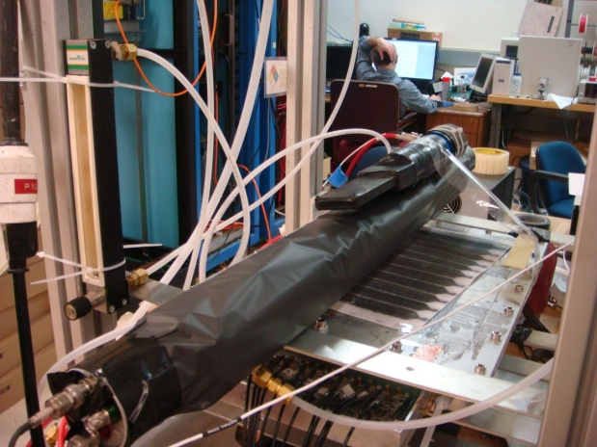
4.Beam Test Setup: In Hall A
Fast Scintillator (5 ×15 cm² )
Trigger Area : 5 × 10 cm²
&
·
Trigger
Trigger
Delay
Stop
PMT0
PMT1
PMT2
·
sis3320
Flash ADC
·
Amp
MRPC
6 ADC
Channels
Pre-Amp
Pre-Amp
6 ADC
Channels
(Delay)
90% Freon
5% iso-butane
5% SF6
6 TDC
Channels
6 TDC
Channels
(Delay)
LTD
775
TDC
PMT3
PMT4
Gas Out
DAQ
Taking all stuffs to Hall A

Slide 12
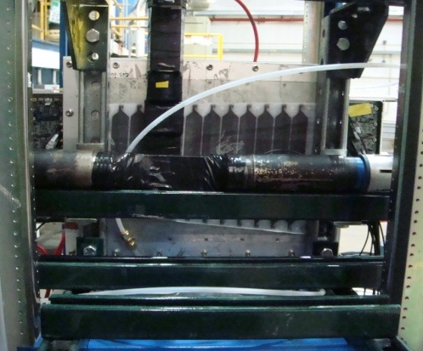
4.Beam Test Setup: In Hall A
What is the beam like?
  2.5 GeV electrons hitting the target
  Uniformed particle(electron) and photon irradiation
  Large background and high flux
Schematic top view of the test setup
Shield
High Energy e-
T0
PMT0
PMT1
PMT3
PMT1
PMT2
T1
T2
Target
PMT0
PMT2
PMT4
Trigger Area : 5 × 5 cm²
Front View
Top View
 | Distance & Shielding | Current
Before May 13th | 10m , shielded | ~500-3500nA
May 13th – 16th | 5m, Shielded | ~8uA
After May 16th | 5m, not shielded | ~15uA
Time calibration of 4 PMTs: ~300ps

Slide 13
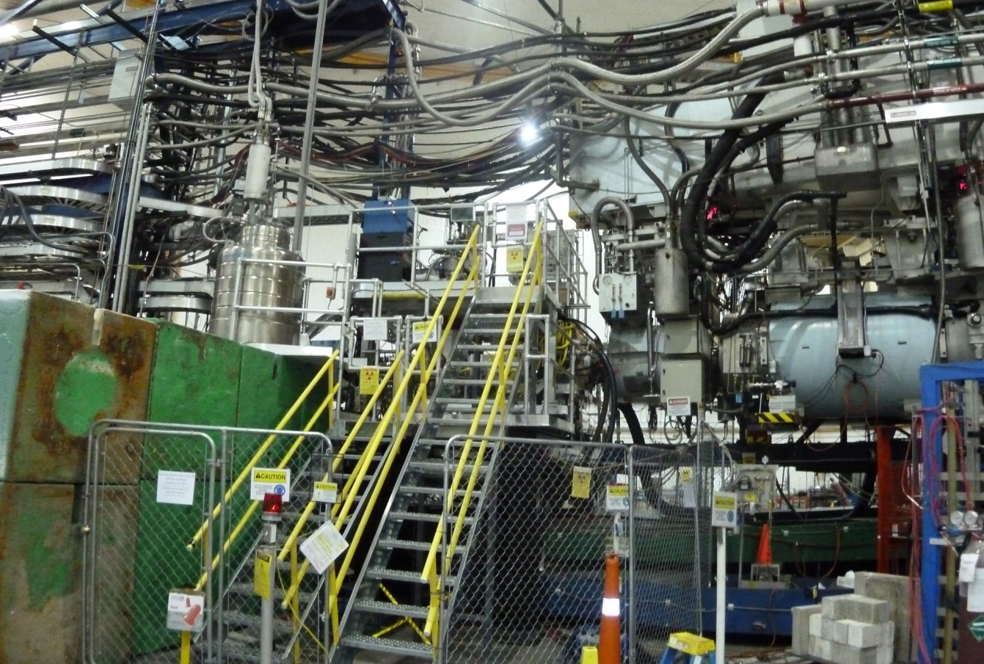
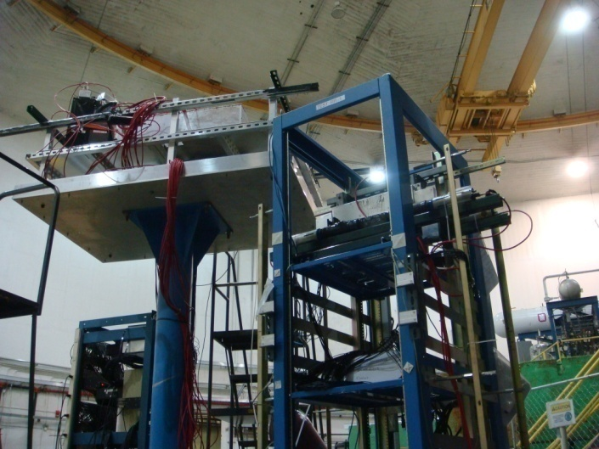
4.Beam Test Setup: In Hall A
Target
Shield
MRPC

Slide 14
4.Beam Test Setup: Upgrade
Improvements
  The stop signal is changed to delayed T_0
  LTD is replaced with CFD
Add “T0” into calibration
&
Trigger
Trigger
·
PMT0
Delay
Stop
PMT1
PMT2
·
sis3320
Flash ADC
·
Amp
MRPC
6 ADC
Channels
Pre-Amp
Pre-Amp
6 ADC
Channels
(Delay)
90% Freon
5% iso-butane
5% SF6
6 TDC
Channels
6 TDC
Channels
(Delay)
CFD
775
TDC
PMT3
PMT4
Gas Out
Use CFD for trigger
DAQ
Time calibration of 4 PMTs: ~100ps

Slide 15
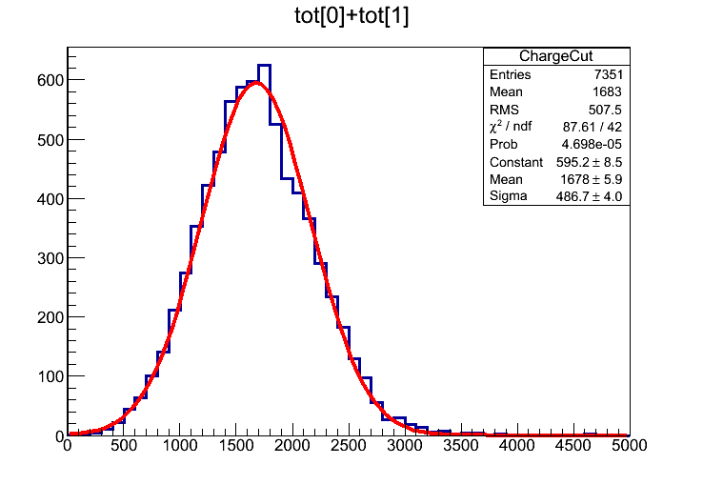
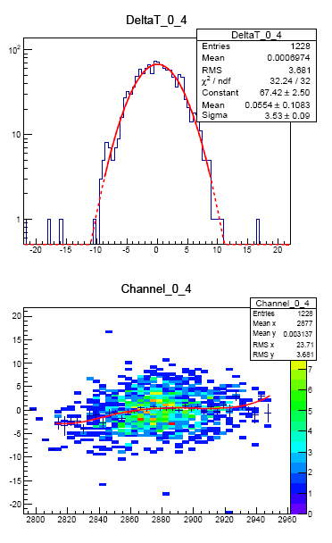
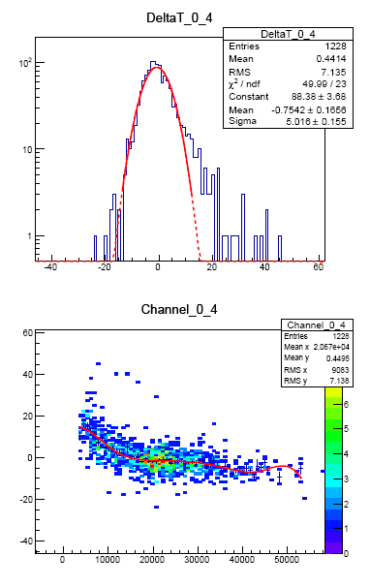
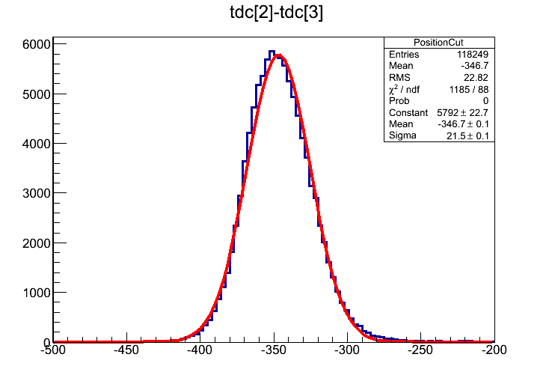
5.Results & Comparison: Calibration
Example: r175
Operated on May 13th
High Voltage: ±6800V
Condition: 10m from
target, shielded
Charge Cut：2 σ
Position Cut：2 σ
PMT before calibration
MRPC before calibration
4 calibrations

Slide 16
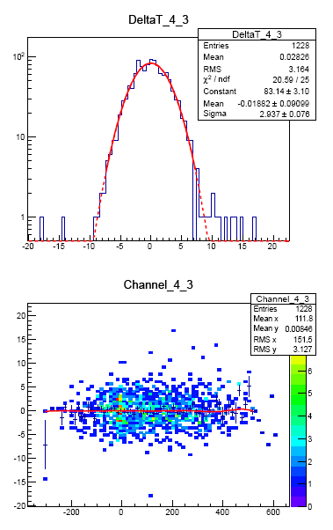
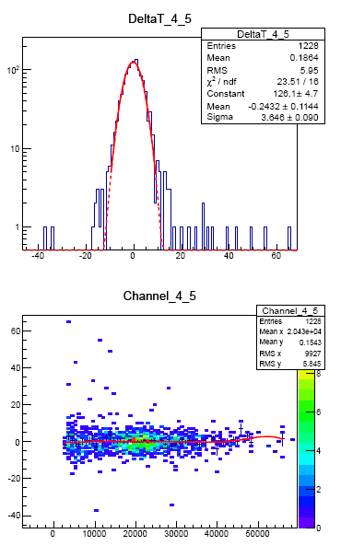
5.Results & Comparison: Calibration
Example: r175
Operated on May 13th
High Voltage: ±6800V
Condition: 10m from
target, shielded
Time resolution: 76ps
σ-PMT = 2.937(102.8ps)
σ-MRPC = 3.646(127.6ps)
σ-MRPC = 2.16(75.6ps)
Calibration of PMT
Calibration of MRPC
In this test, T₀ is about 100ps, the time resolution is deteriorated.

Slide 17
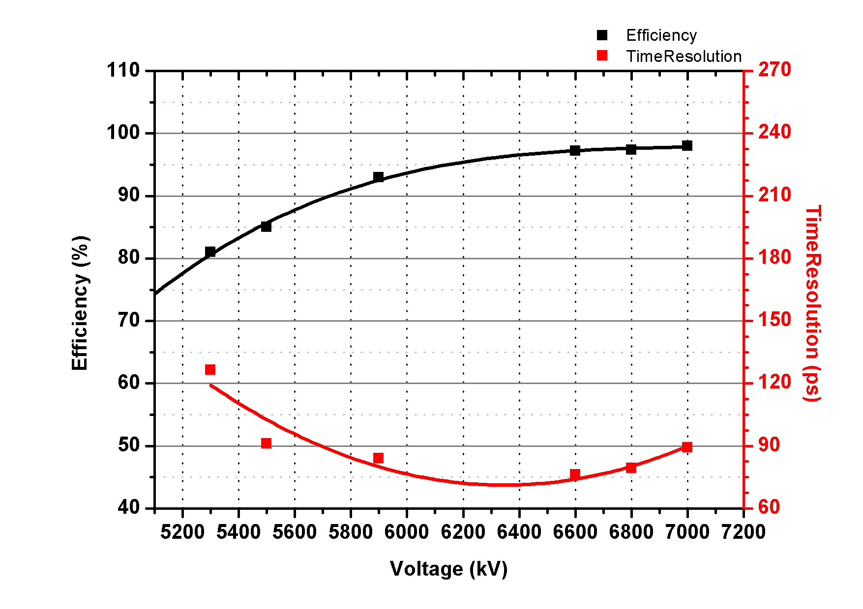
5.Results & Comparison: HV Scan
Efficiency: >95%
Time Resolution: ~75ps

Slide 18
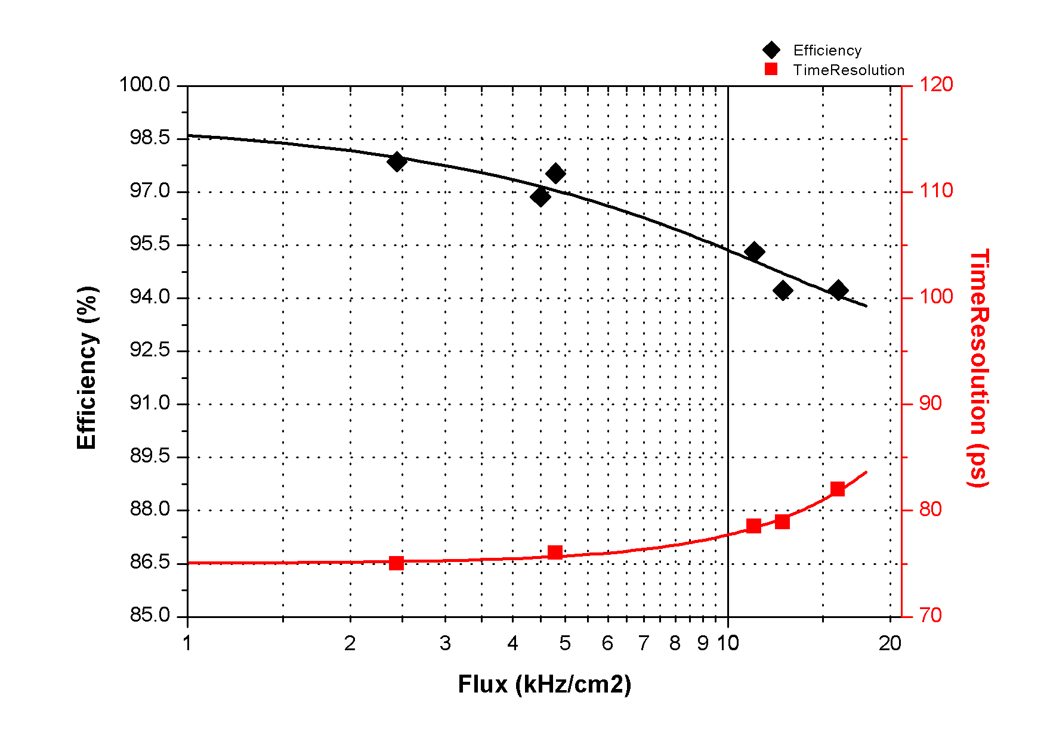
5.Results & Comparison: Rate Scan
Voltage: 6800V
Flux:11kHz/cm²
Efficiency:~95%
Time Resolution: 78ps
Flux:16kHz/cm²
Efficiency:~95%
Time Resolution: 82ps

Slide 19
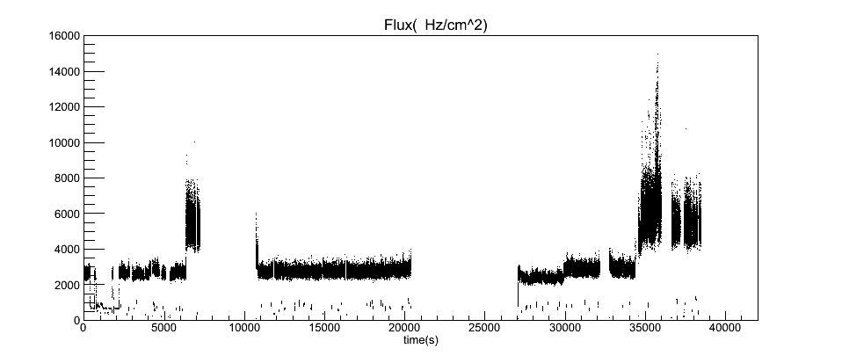
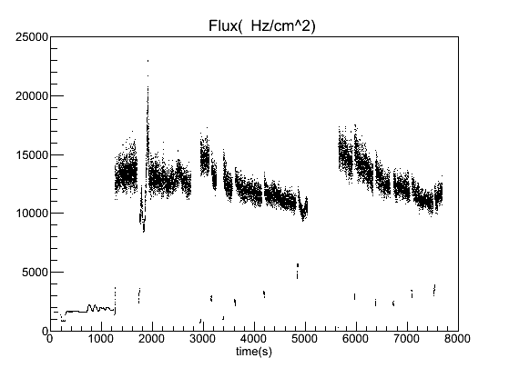
5.Results & Comparison: Flux vs. Time
Run188, 6800V (5m to target, shielded)
12kHz/cm²
6kHz/cm²
2.5kHz/cm²
Run193, 6800V (5m to target, not shielded)
During a run, flux is not on a stable level, which from less than 3kHz/cm² to 16kHz/cm².
We can observe the performance by selecting data from different flux.
16-18kHz/cm²
14-15kHz/cm²

Slide 20
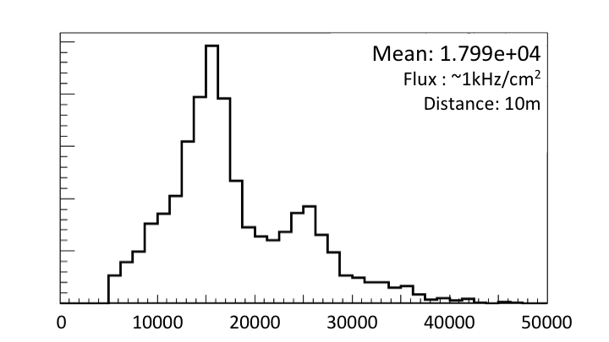
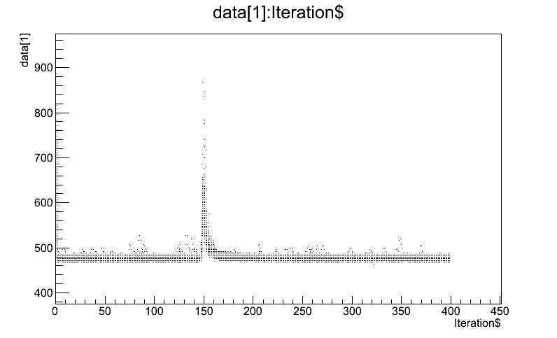
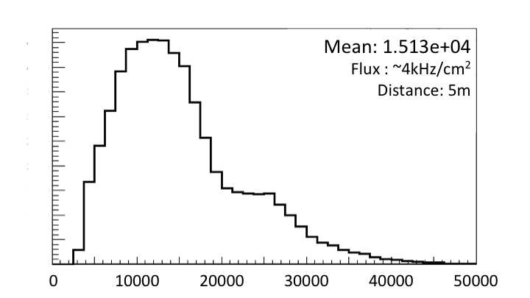
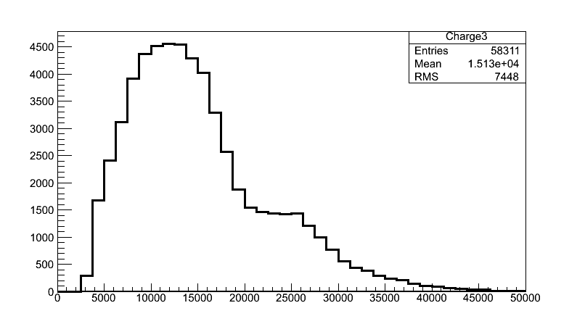
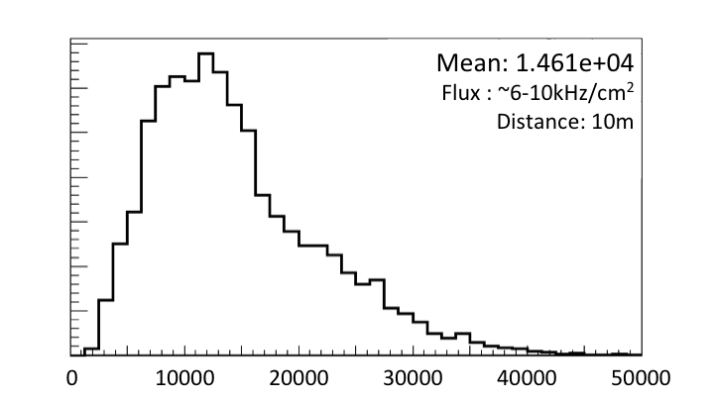
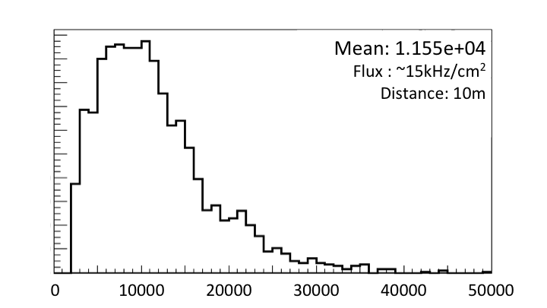
5.Results & Comparison : Charge Distribution
Signal
Base Line
Charge spectrum at different rate
Significant reduction of charge distribution can be seen as the background rate increases.
The reduction of electrical field is caused mainly by both background irradiation and electron beams.
Rate capability of the counter is higher than 15kHz/cm².

Slide 21
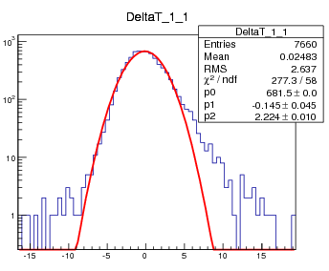
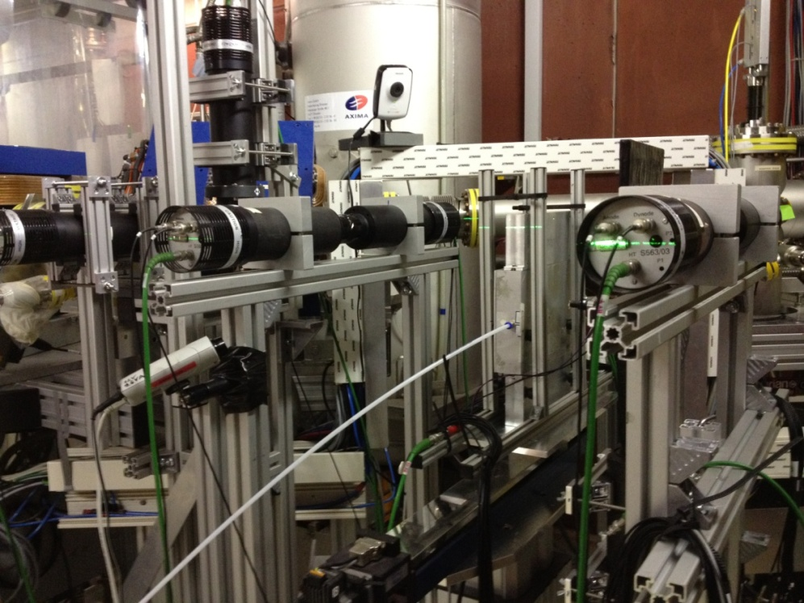
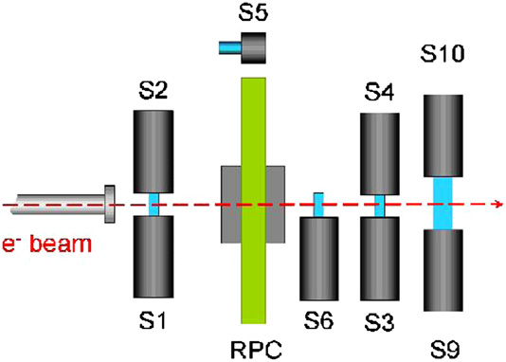
5.Results & Comparison : Beam Test
Beam Test@HZDR June, 2012

Slide 22
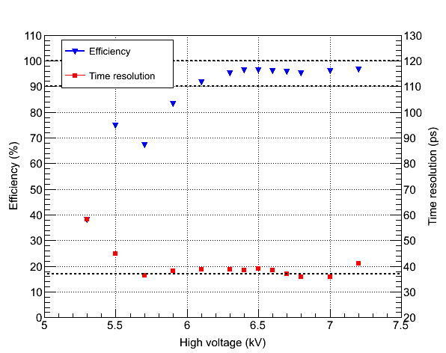
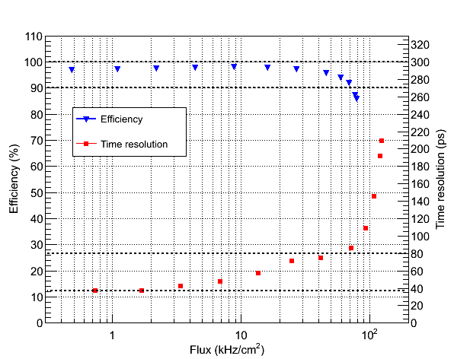
5.Results & Comparison : Beam Test
Beam Test@HZDR June, 2012
Time Resolution < 40ps
HV scan
Rate scan
22

Slide 23
6.Conclusions
Performance of MRPC is measured. The time resolution can reach 70-80ps and the efficiency is higher than 95%. The flux is up to 16kHz/cm².
The MRPC module is placed within 10m to the Target for 2 months, without significant performance deterioration. This means that the module can withstand long time irradiation.
The Irradiation is uniformed. During Test, the current is large even when the rate is not very high, which means the photon or neutron background irradiation is very strong.

Slide 24
Thank you!
End

