Slide 1
Reviewer’s Comments
From the dry run

Slide 2
Responses from
Kees
Steve Wood
Eugene
Cardman
Mack
Kistenev
Pavel

Slide 3
General
Budget Comments
Need project manager
Include labor and contingency
Consistency
Everyone use the same apparatus (We are headed that way) Cartoons didn’t go over well.
Timing of talks: Need rehearsal for review

Slide 4
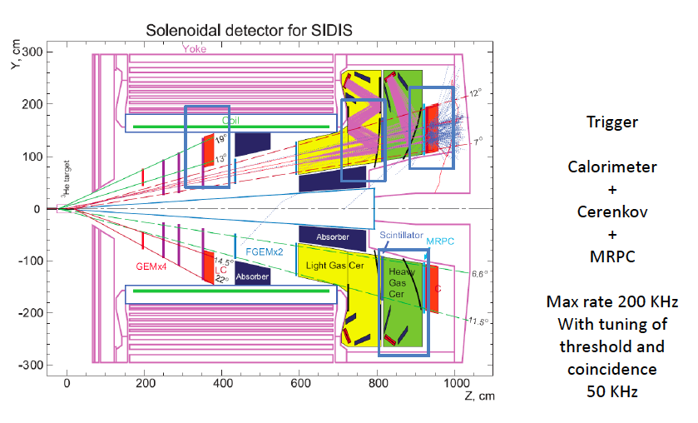
Helpful figure

Slide 5
Not Helpful
Where’s their
Sense of humor???

Slide 6
How to Proceed
Need (ppt?) file of all official pictures that may appear in more than one talk.
File gets frozen before rehearsal.
All talks use the same pictures.

Slide 7
Magnet
Even with coil, it is expensive.
There are serious engineering issues.
Therefore, detailed design and cost estimate must be a high priority.
See magnet talks.

Slide 8
Cerenkov
Many interesting ideas for optimizing PMT’s
Need background rates to compare with dark current.
Need prototyping
Super-Bialkali cathode, UV Glass??

Slide 9
Shashlyk
New Pre-Rad options?
Improve pion rejection?
Readout options?
Concern about clear fibers.

Slide 10
Polarimetry
Does it belong? YES (Major PVDIS systematic)
Eugene endorsed our errors.

Slide 11
GEM’s, Tracking, and Simulations
Reviewers list and our list are similar.

Slide 12
Hardware Timing Issues
Each detector has different timing properties.
How are these time constants handled in the DAQ with its own time constants (Filters??).
Can timing be used to reduce backgrounds? (Exploiting the pulsed beams structure?)
What gate widths do we use to estimate accidentals?

Slide 13
Pavel’s Suggestions
Does PVDIS need cooling?
Activation?
Radiation Monitors
Had many ideas
that I hadn’t
thought of.

Slide 14
Little Discussion of Systematic Errors
Calibrations
Rate dependence
Where do these topic belong?
Separate presentation?

