Slide 1
Update on GEMs
(Chinese Collaboration)
Yi Zhou
University of Science & Technology of China
SoLID Collaboration Meeting, Jlab, USA, Sep. 14 ~ Sep.15, 2012

Slide 2




Four Chinese Groups
China Institute of Atomic Energy (CIAE)
Lanzhou University
Tsinghua University
University of Science & Technology of China (USTC)

Slide 3
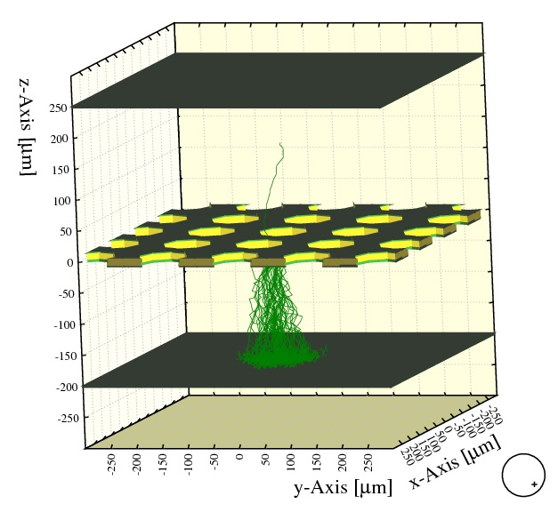
GEM Simulation
Maxwell + neBEM for the electric field calculation.
Garfield + Magboltz + Heed for the Calculation of electron transportation in Gas.
We simulated the Spatial Resolution, Gain, Electron Transparency of gem foils, and the Counting Rate.
Avalanche in a Single-Foil GEM Detector

Slide 4
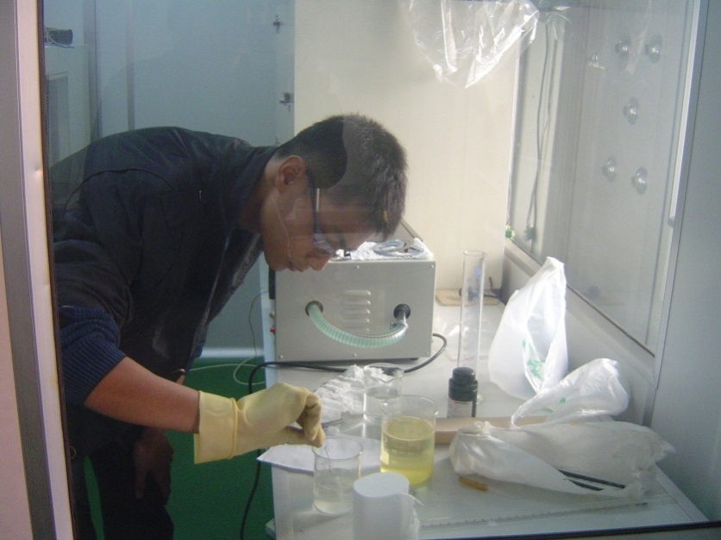
Further study for GEM foil
Using etching liquid to etch nuclear pore foil (Kapton foil)
Study the influence of the recipe of etching liquid and etching temperature to the etching rate

Slide 5
Near Future work Plan
APV25 electronics are ready to test
Ordering GEM raw foil from CERN
A professor from CERN RD51 visited CIAE group to discuss future collaboration on GEM detector.

Slide 6
Update 1 of GEM R&D in THU
Working out a practical method to determine the intrinsic position resolution(Already accepted by NIM)
⁵⁵Fe(Surface source)
(1), When w ≈40, 50,60,70,80μm,
with the ratio as the x axis, with the σ²_{tot} as the y axis.
(2), Fit the graph with linear-function, we can get
Replace w² with n:
therein, n means the counting rate
Linear fit to σ²_{tot} – n, then get the σ_{GEM}
σ_{GEM}=56 ±15μm

Slide 7
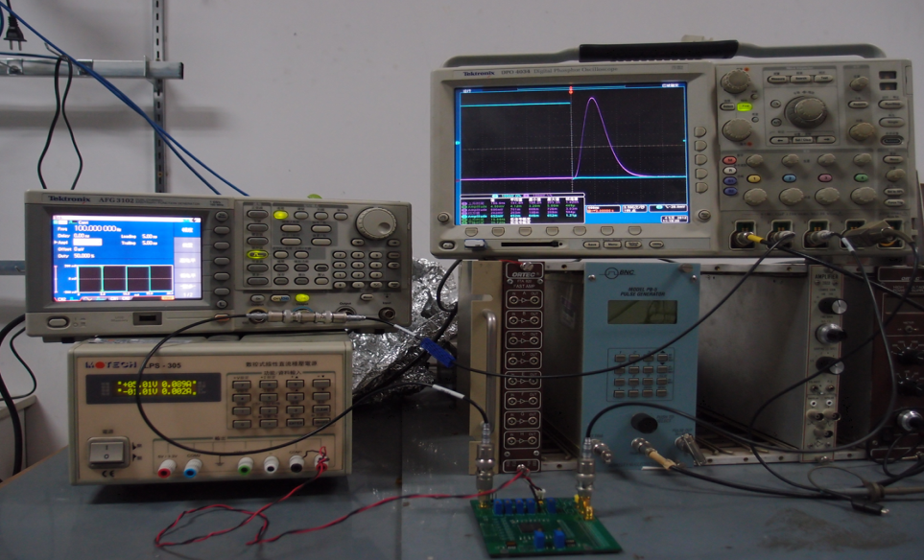
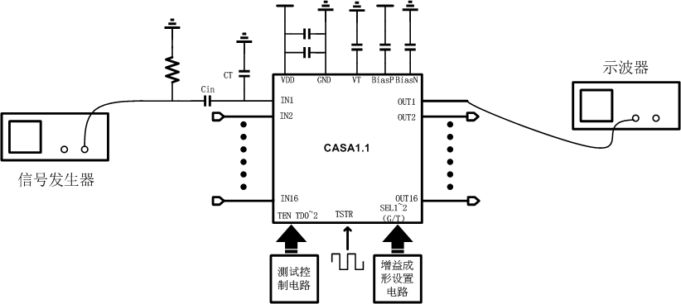
Update 2 of GEM R&D in THU
ASIC-based FEE manufactured and tested
(In collaboration with Department of Engineering Physics in THU)
There are 16 Channels on each CASA FEE card. In the static test, it show us very good linearity and very low noise.

Slide 8
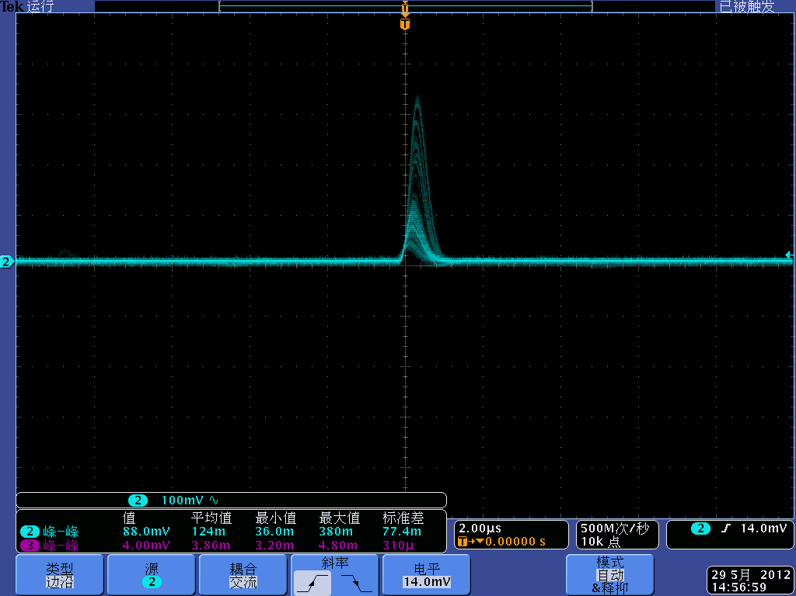
Update 2 of GEM R&D in THU
ASIC-based FEE manufactured and tested
(In collaboration with Department of Engineering Physics in THU)
Am-241 test by using the CASA FEE + TPC GEM

Slide 9
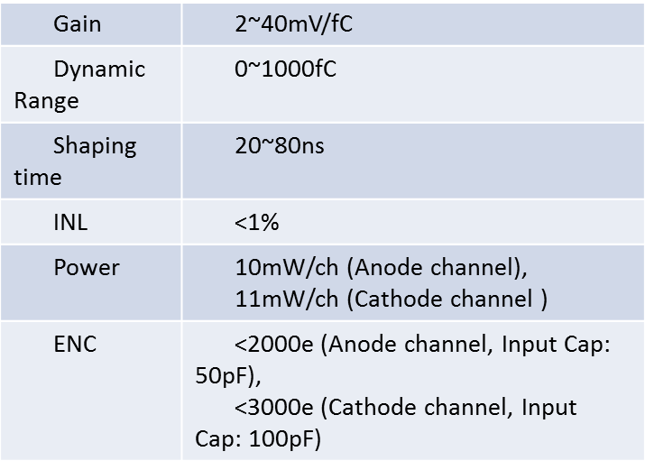
Update 2 of GEM R&D in THU
ASIC-based FEE manufactured and tested
(In collaboration with Department of Engineering Physics in THU)
CASA1.1 matches the performance as in the table:
α Energy spectrum with Am-241

Slide 10
Near Future work Plan
ASIC-based FEE test with GEM detector
Inter-foil and inter-strip effects on the GEM performance (to gain experience for larger detector)
Larger area GEM prototype (on the arrival of large GEM foil)

Slide 11
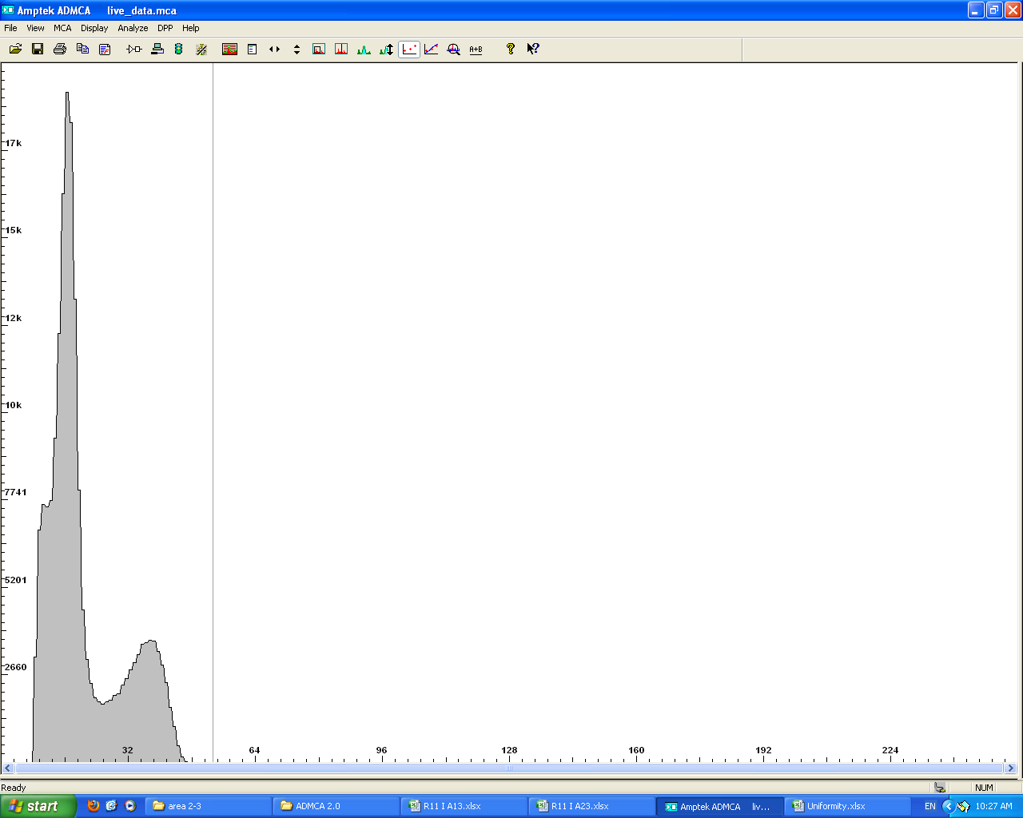
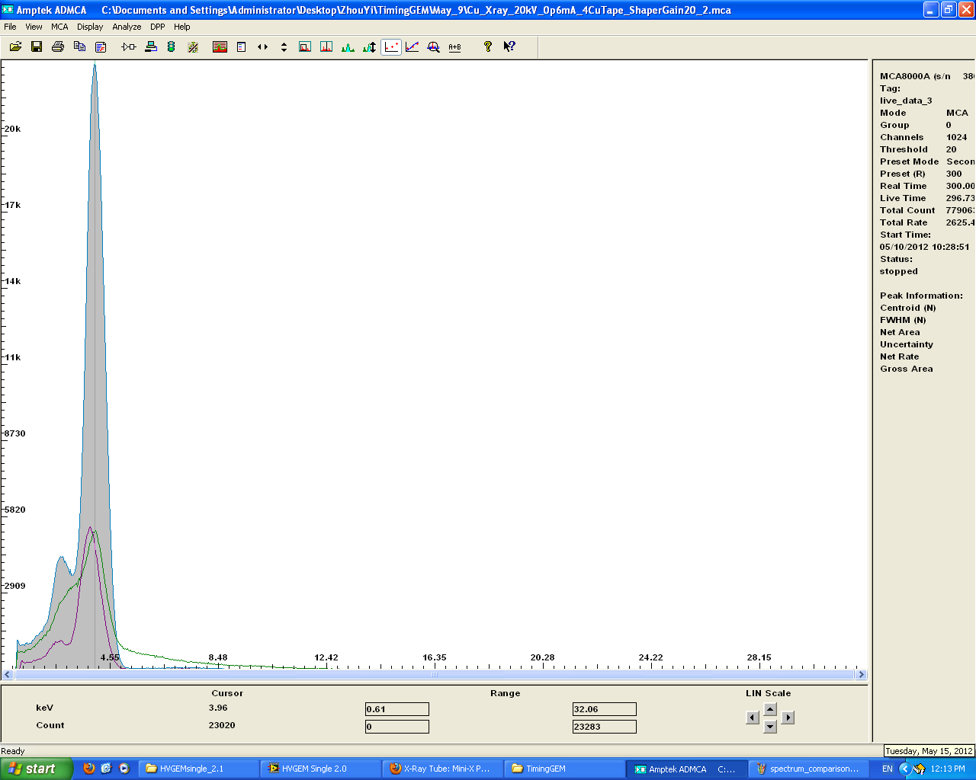
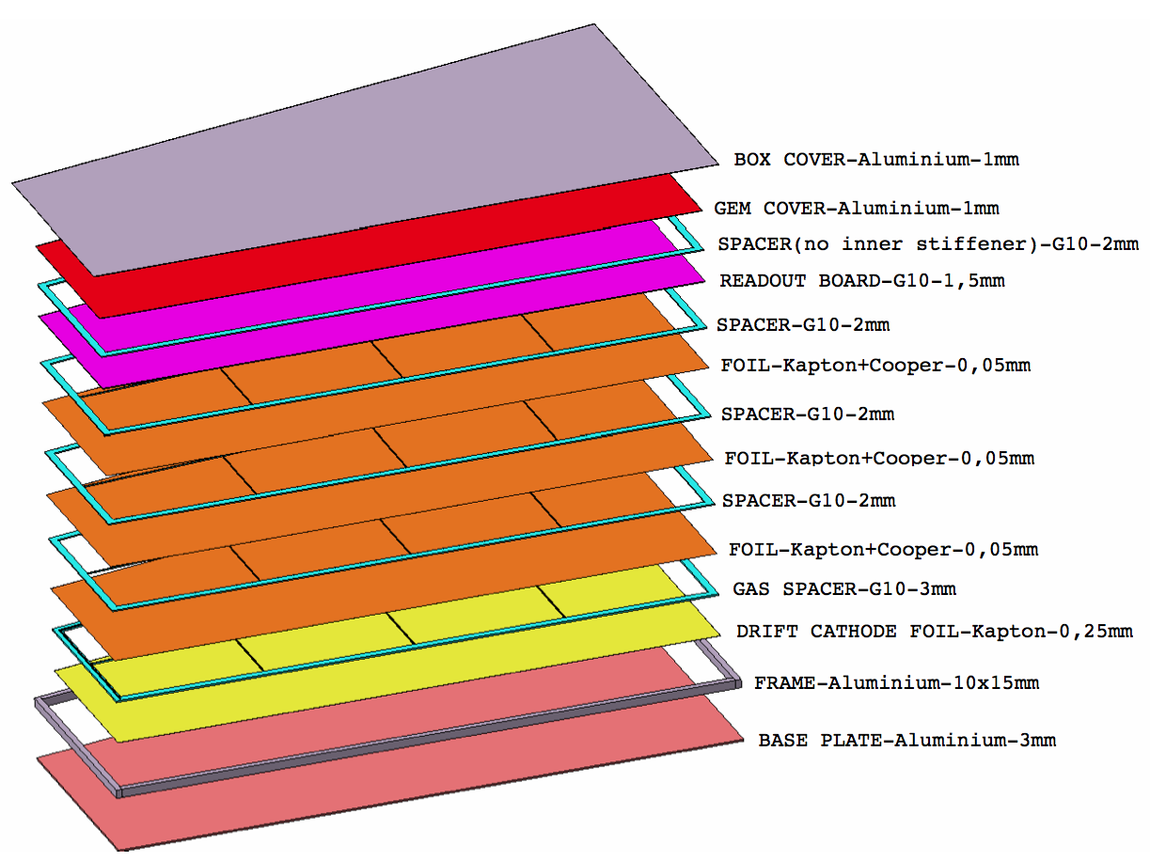
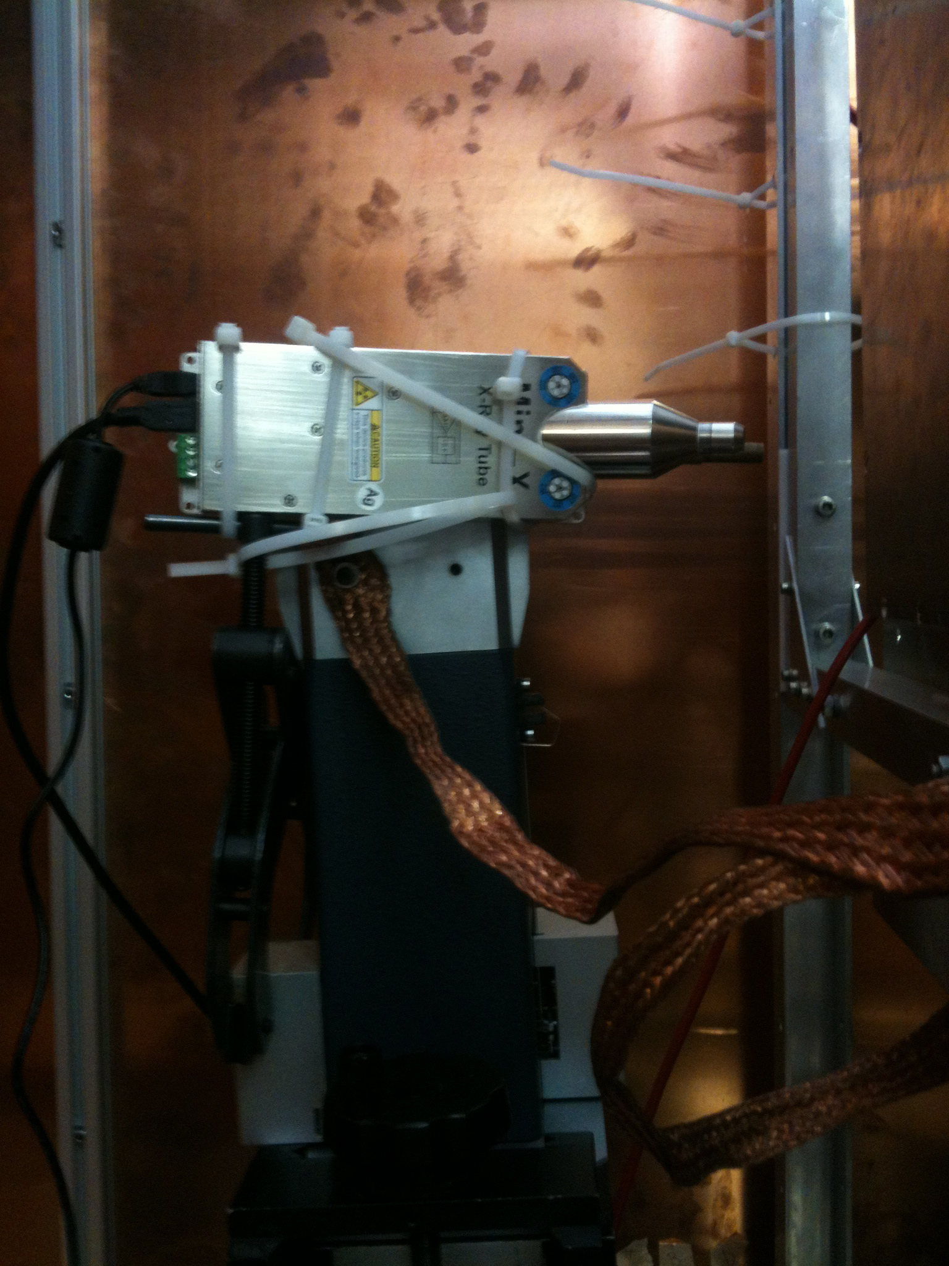
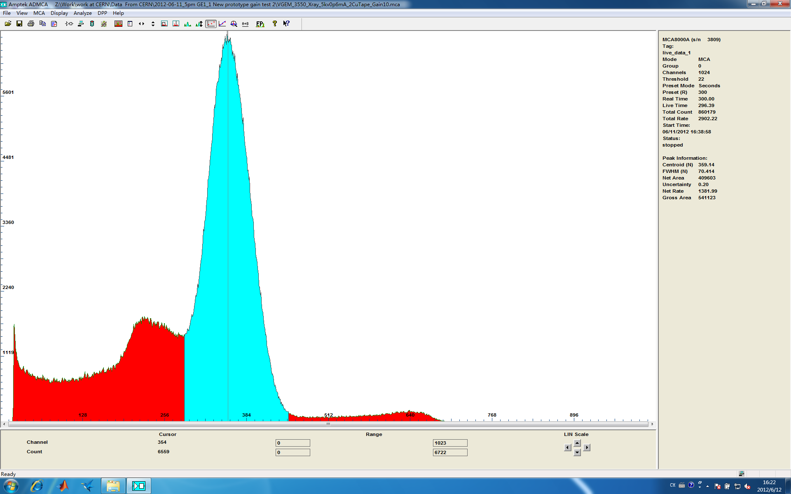
Problems caused by the detector cover(Drift)
May be caused by the copper on the drift electrode
Copper X-ray
Peak due to the bremsstrahlung effect
from the Al sheet(covering the chamber)
Cu X ray: 20kV/0.6mA, 4Cu Tapes, Rate=2590Hz
Mini X: 20kV/5uA
Cu X ray: 20kV/0.6mA, 5Cu Tapes, Rate=649Hz
3mm Al sheet
Bremsstrahlung effect will cause problems in
gain calibration;
If the Kα line of the metal on drift is less than the X-ray energy, the energy transfer effect will give us a wrong peak on the energy spectrum;
To decrease the Bremsstrahlung caused by the
material of the drift electrode, we can open
windows(Blind Vias) on the drift PCB;
Using low energy X-rays for gain calibration to avoid
the energy transfer effects;

Slide 12
The Charging up effect of the GEM detector
VGEM(V): 335-335-290
Field(kV/cm): 2.1-3.0-3.0-3.2
VGEM(V): 350-345-295
Field(kV/cm): 2.2-3.1-3.1-3.3
VGEM(V): 360-355-305
Field(kV/cm): 2.3-3.2-3.2-3.4
VGEM(V): 370-365-315
Field(kV/cm): 2.3-3.3-3.3-3.5
Rate changed by adjusting the current of the X-ray tube

Slide 13
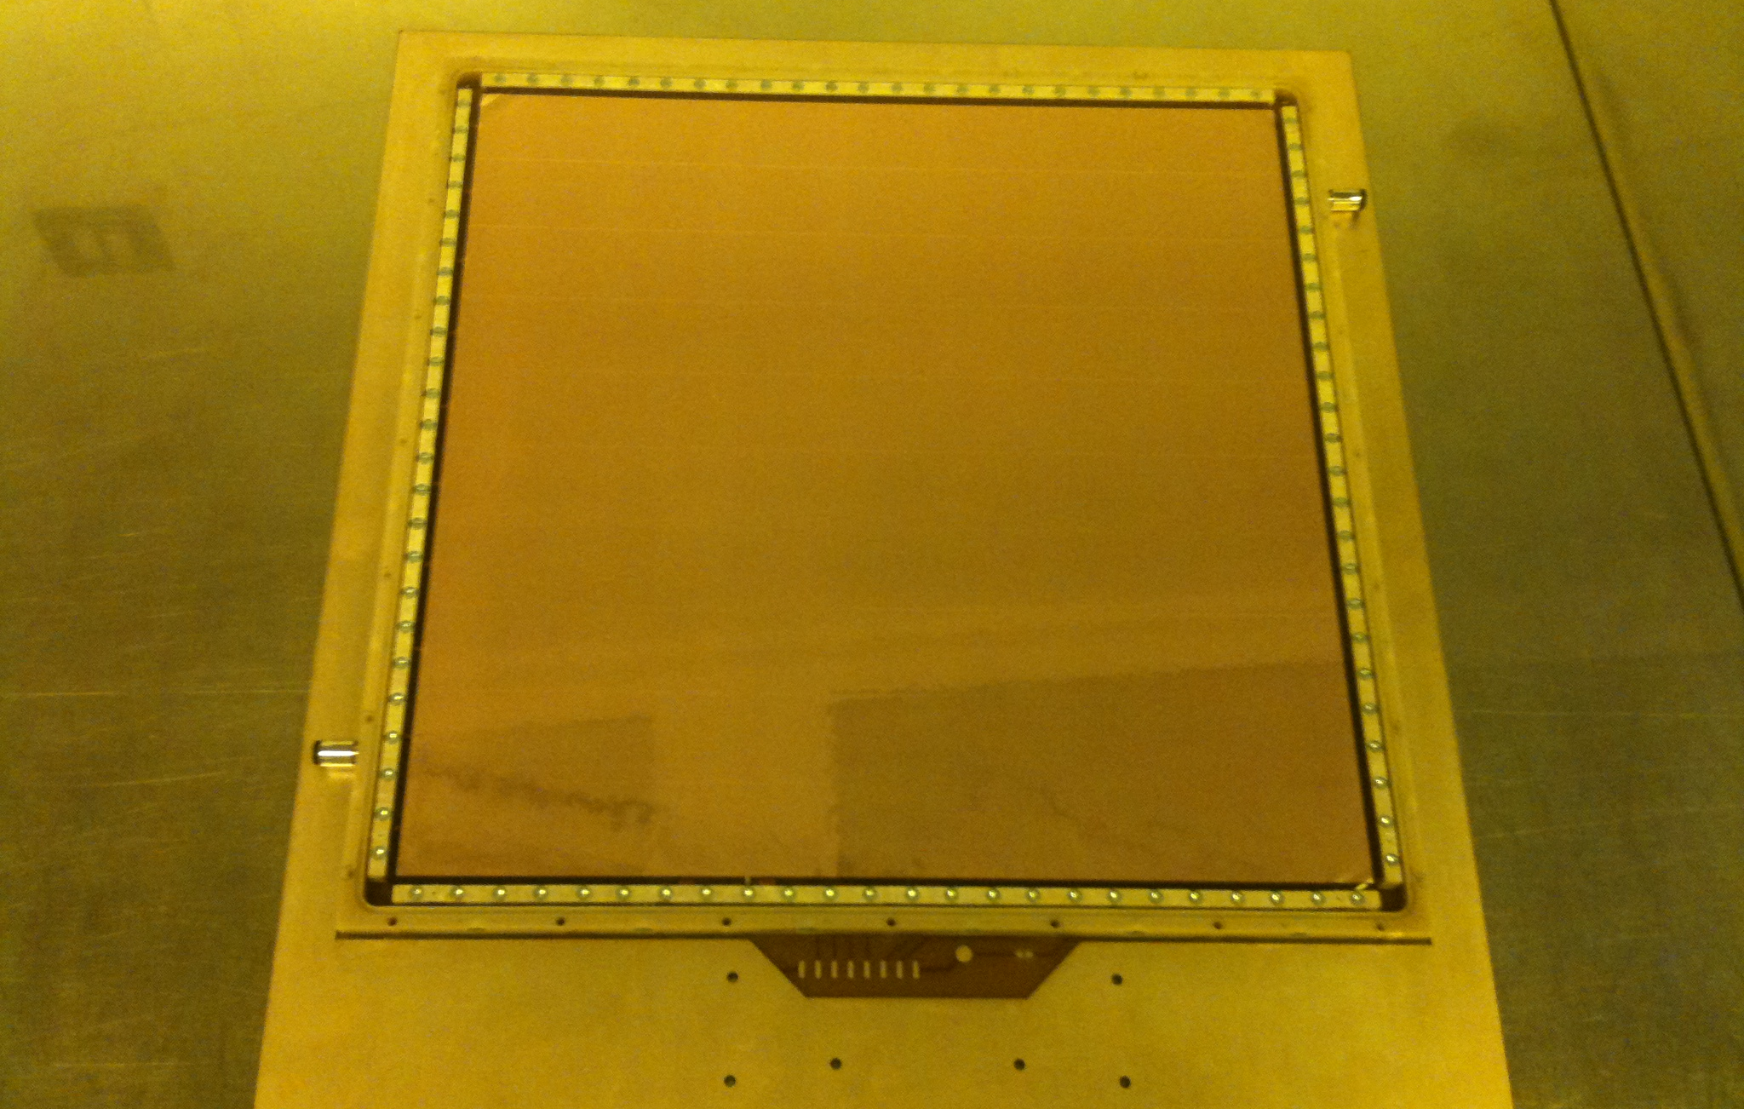
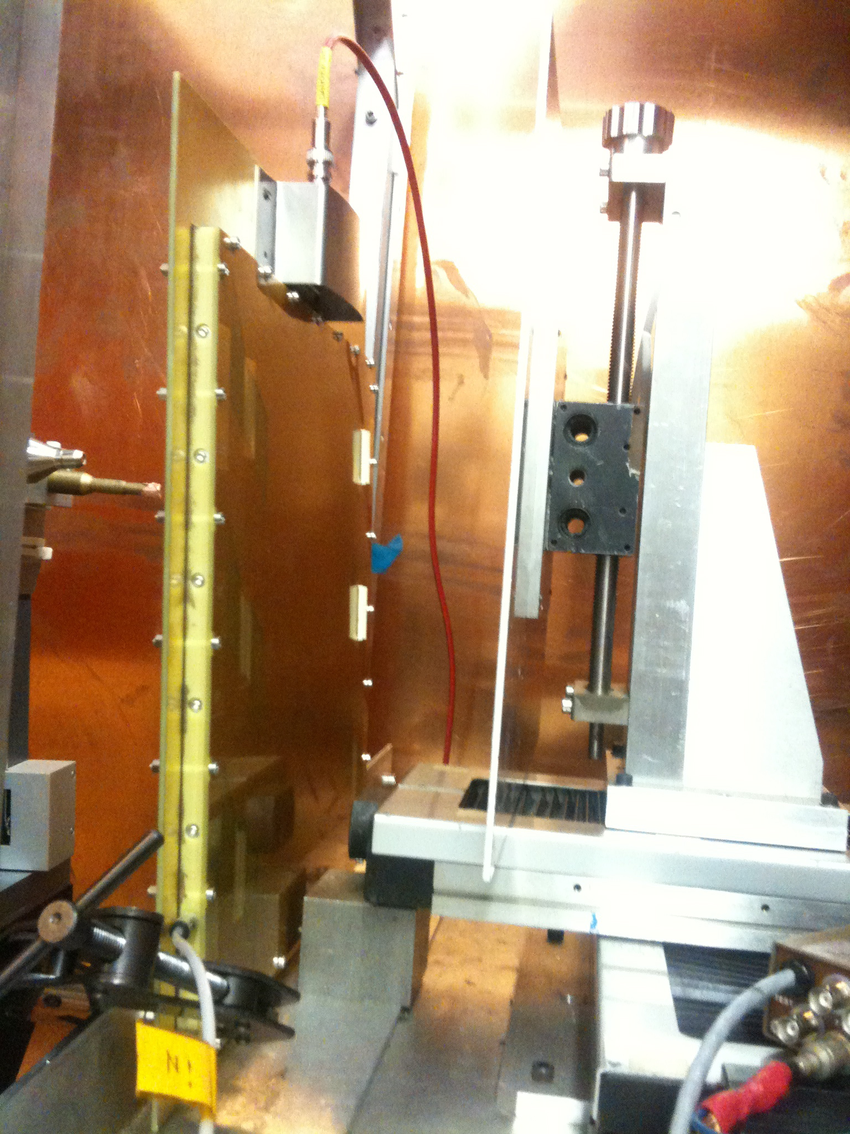
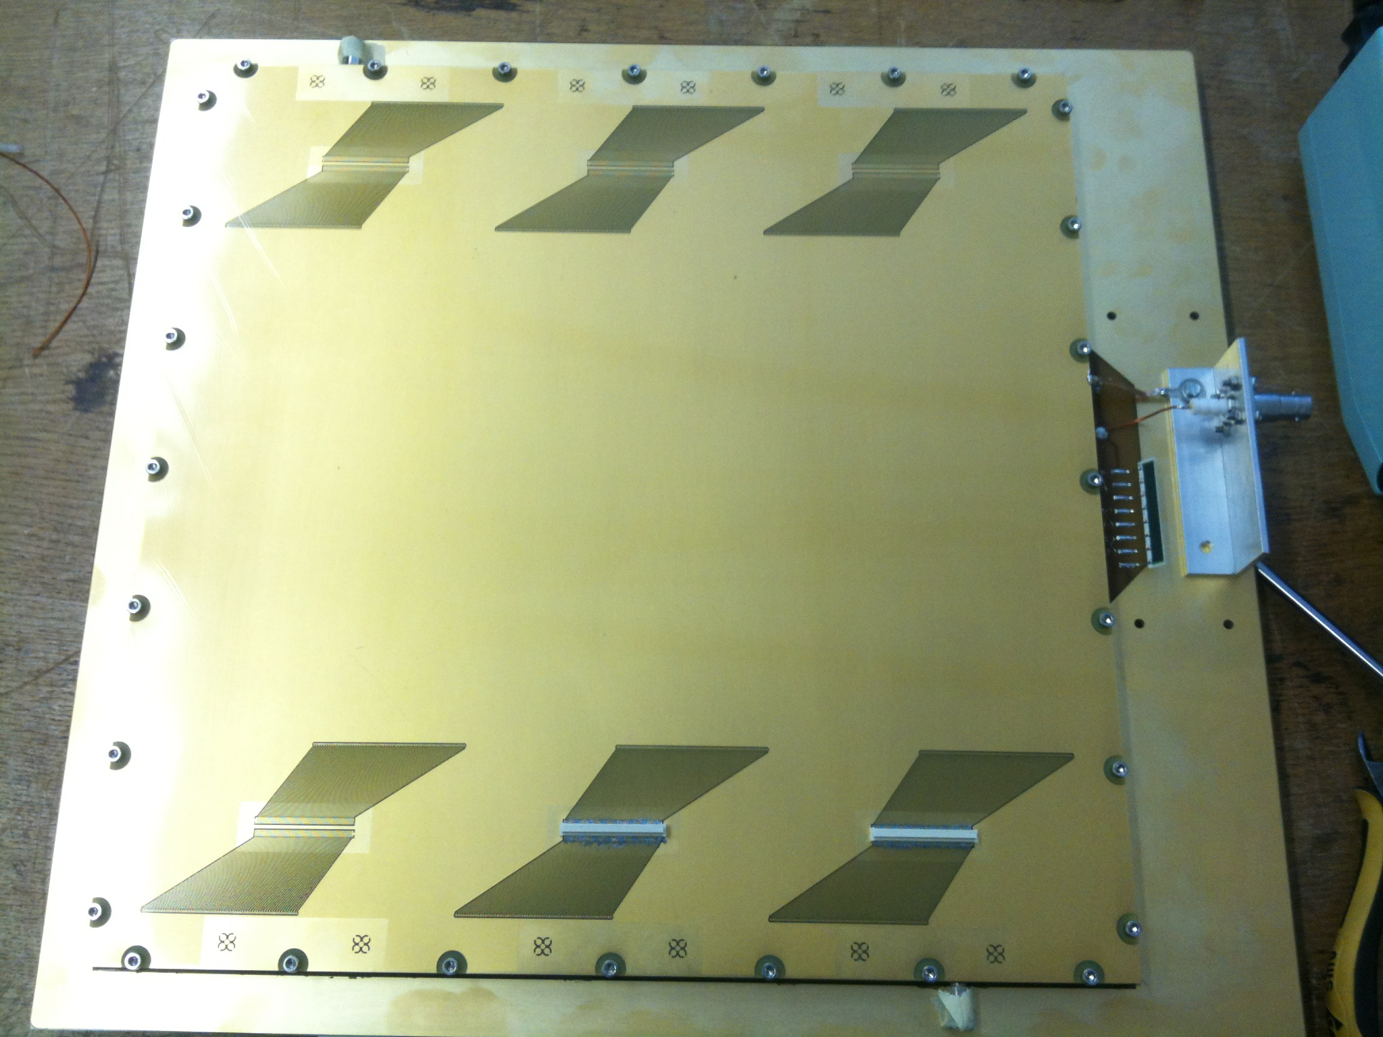
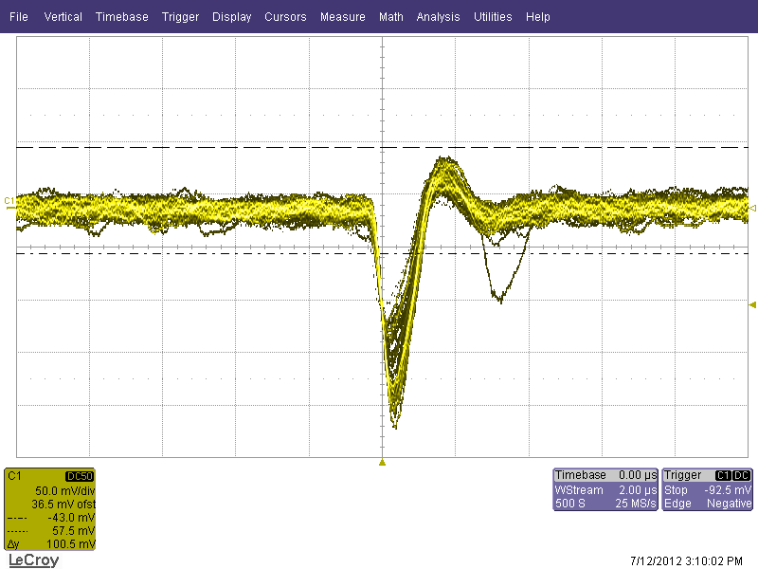
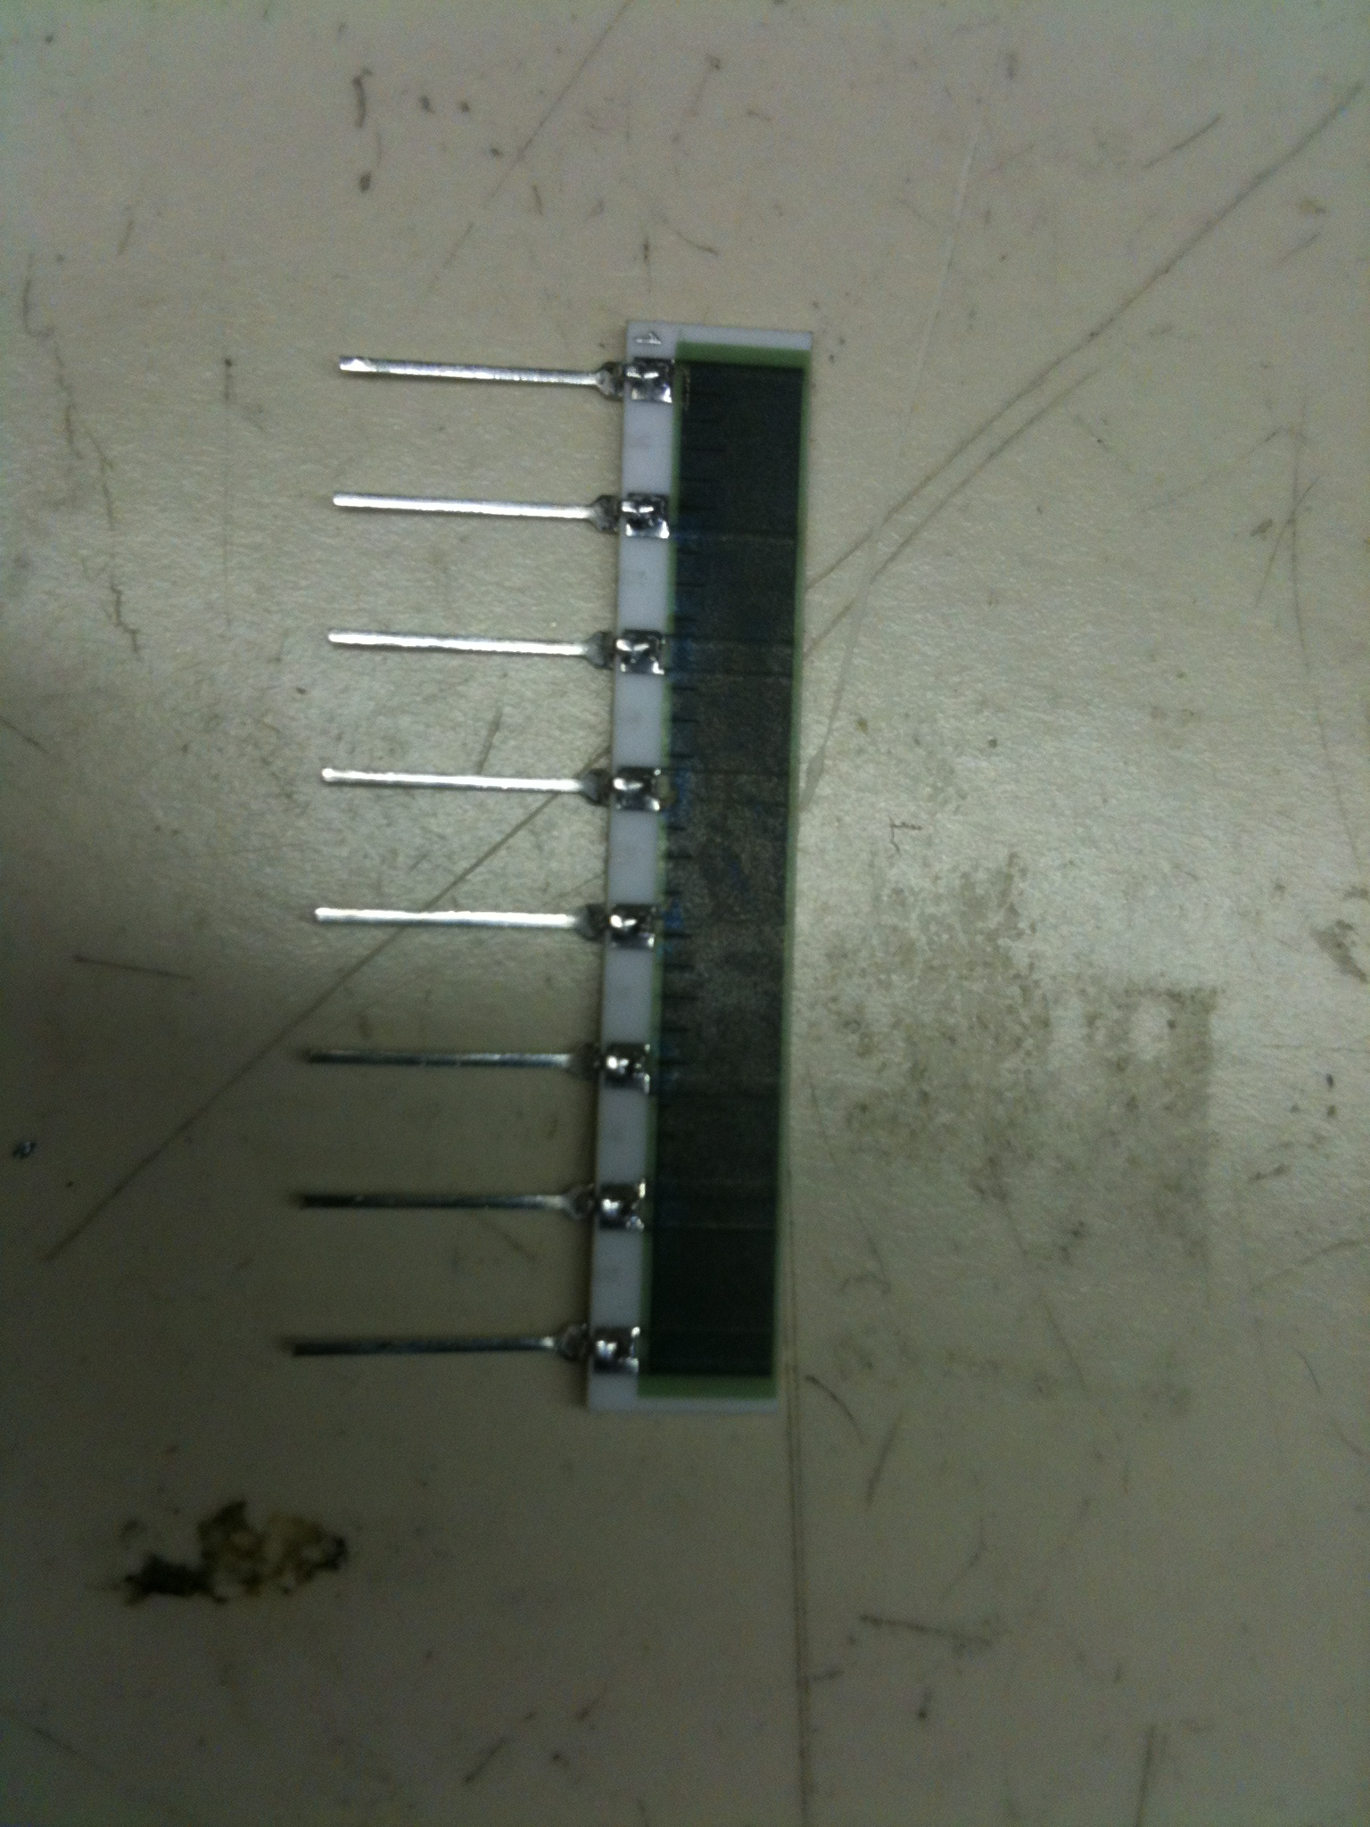
30cm×30cm GEM (Order from CERN)

Slide 14
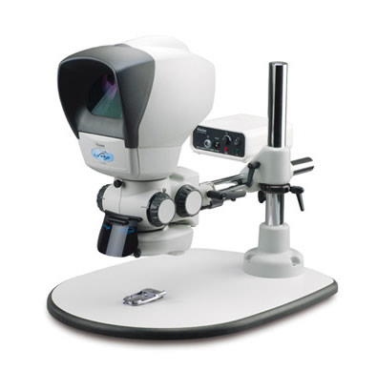
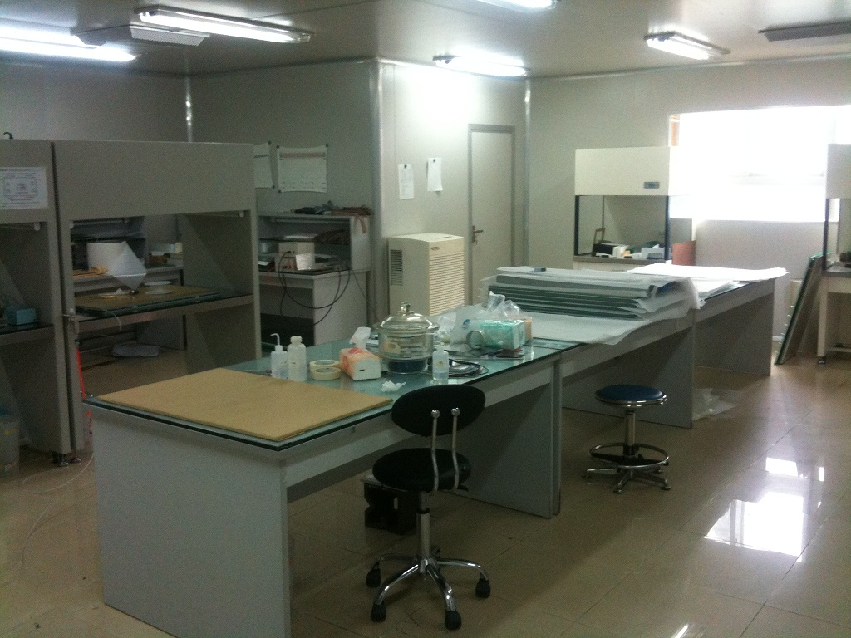
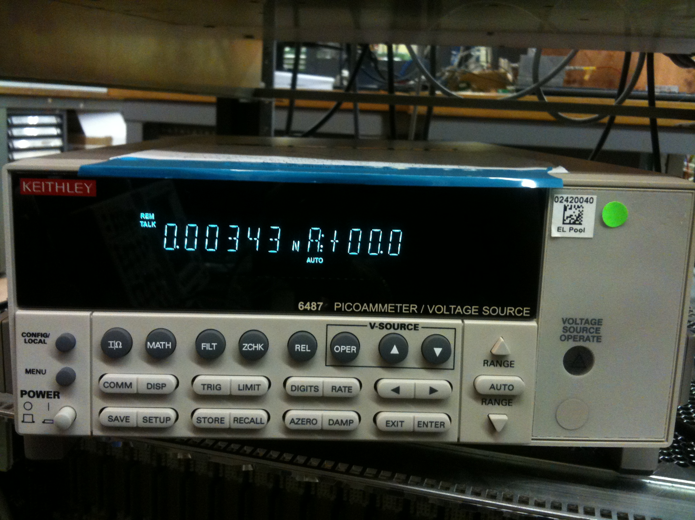
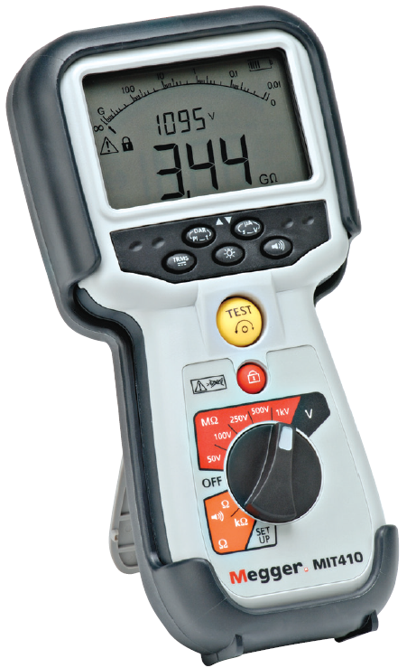
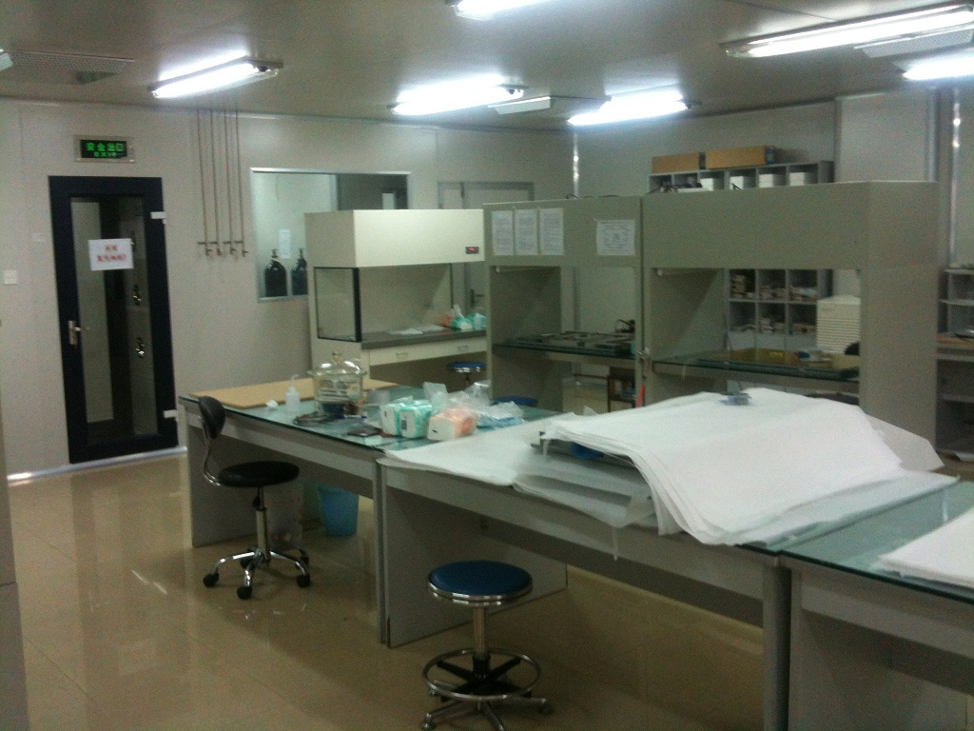
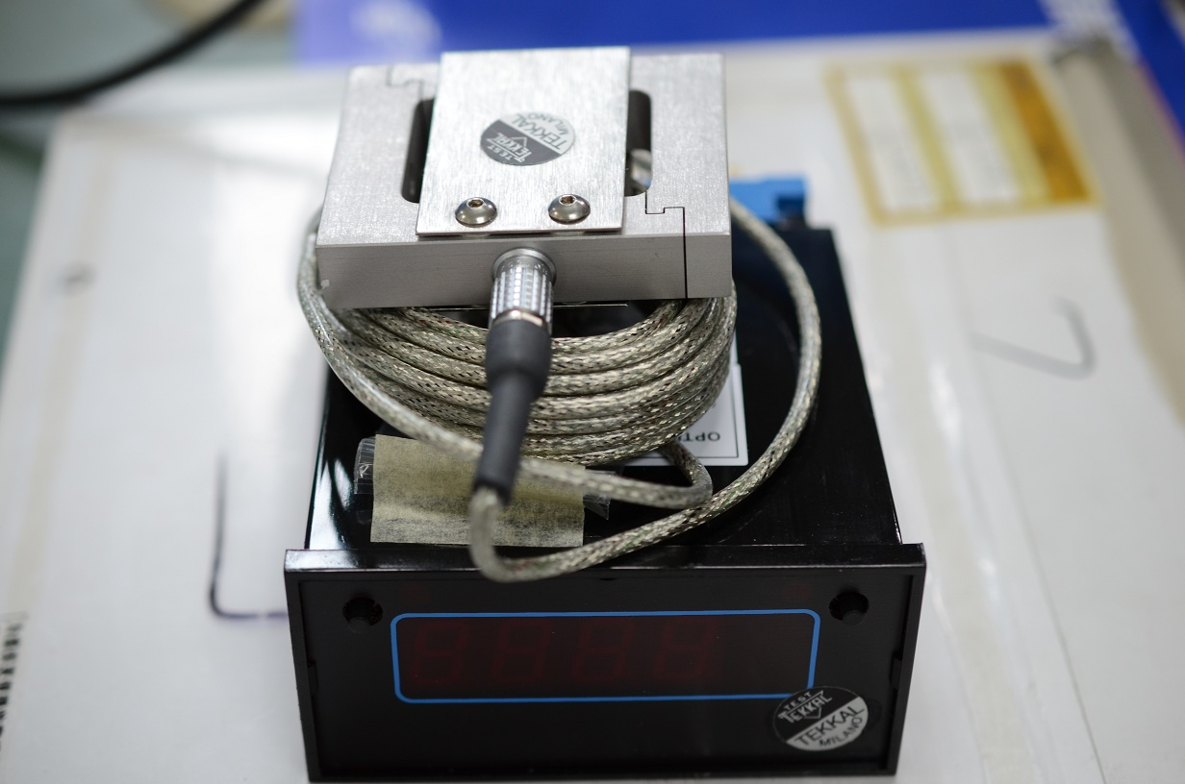
Preparation for Large Area GEM Project
6 GEM foils(30cmX30cm) have been ordered from Rui.
Insulation Resistance
and Continuity Tester

Slide 15
Near Future Work Plan
Build a test platform for the 30cmX30cm GEM detector(from CERN);
Continue working on the charging up effect;
Design and build a 30cm×30cm GEM
at USTC;
Thank You

