Slide 1
HBD Update (brief!)
TK Hemmick

Slide 2
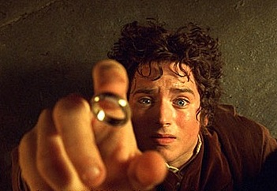
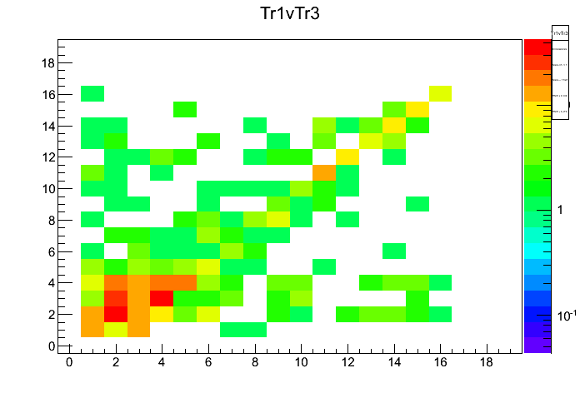
Spring Test: VERY few tracks
Avoiding the shadow of the local beam dump and other obstacles moved HBD out to about 40 degrees.
Overwhelmingly 4-scintillator-trigger is false coincidence.
Actual coincidence is pion dominated.
New algorithms for noise suppression recover majority of noisy events.
Frodo and the One Ring
~100 tracks, 2Mevts
Thomas’ Ring?

Slide 3
EIC R&D Panel
Tracking/PID “consortium” requests $794,365 over two years.
SoLID Collaborators: (shared postdoc)
Stony Brook University, (TKH…) $153,404
University of Virginia, (Nilanga, Kondo, …) $107,580
Thomas Jefferson National Lab (Alexandre) <stuff>
ONLY major request recommended for full finding.
Fiscal Year Phase trouble:
Year One $$$ split over fiscal year (October).
Invest mostly in new Postdoc until October.
NOTE: EIC designs have light & heavy Fwd RICH.
No one is yet funded for heavy RICH R&D.

Slide 4
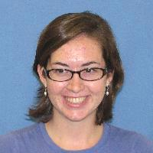
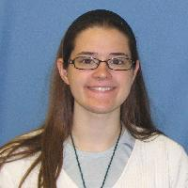
Beam @...DESY?
Want a beam instead of scattered *(@)!
Options:
DESY (electrons, good access)
CERN (mixed beam, good access)
SLAC (electrons, poor access)
Shipping a live CsI-GEM???
Jeb Ferrucci: Fed Ex “Custom Critical”.
Changes:
Segmented GEM to eliminate failures.
Detect Trips w/ capacitively coupled chain.
Hex-shaped pads & new software.
GS: Stephanie Zajac
UGS: Marie Blatnik
UGS: Carl Cheung

Slide 5
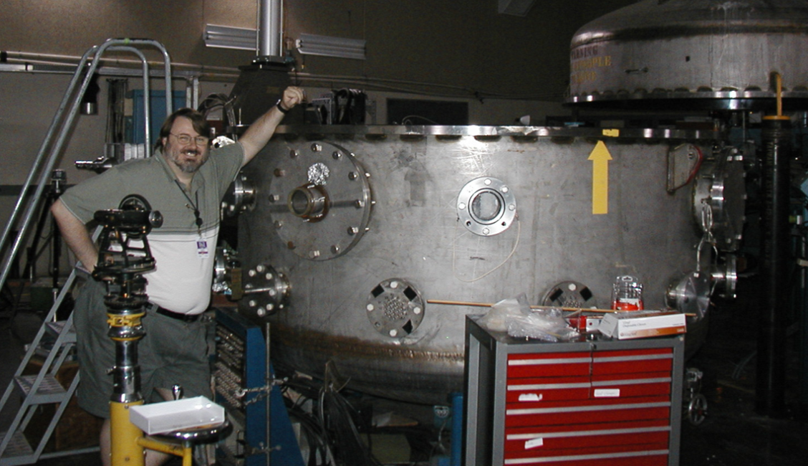
Mirror Makers
Big Mac Chamber:
8’ diameter
6’ tall
Currently:
Completed clean-out of “scattering stuff”.
Repaired large cryo-pump
2 x 10⁻⁶ Torr
Orders for electron gun, power supply, thickness monitor, etc… must wait for fiscal year boundary.

