Slide 1
Pulse Shape Discrimination
TK Hemmick

Slide 2
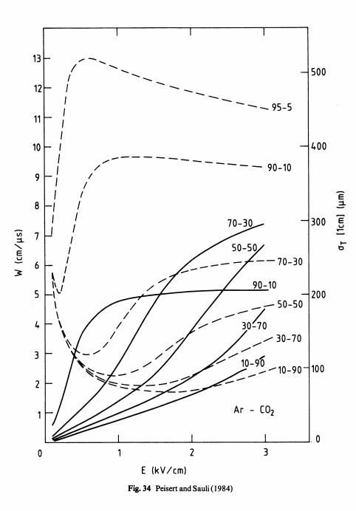
Ar-CO₂ Drift Velocity
Typical drift gap:
300 Volts
2 mm
1.5 kV/cm
Drift Velocity
5 cm/μsec
40 nsec duration
Enlarge drift gap!
1 cm gap
200 nsec pulse duration

Slide 3
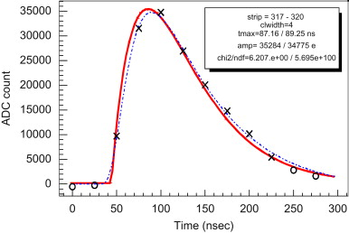
Background vs Signals
1 cm drift
350
400
450
500
Photons and Neutrons
Impulse response.
Electrons and Pions (MIPs)
Ionization Trail

Slide 4
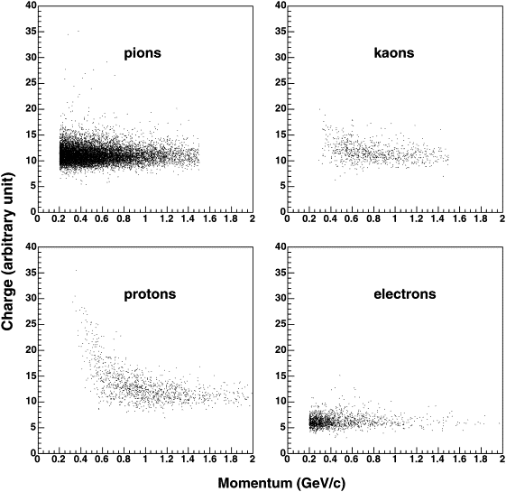
“Time Expansion Chamber”
At 2 cm drift (6 planes) this is called “Time Expansion Chamber”
It is used in PHENIX and ALICE.
Provides e/pi separation at low momentum.
Information is already there in SoLID!

