Slide 1
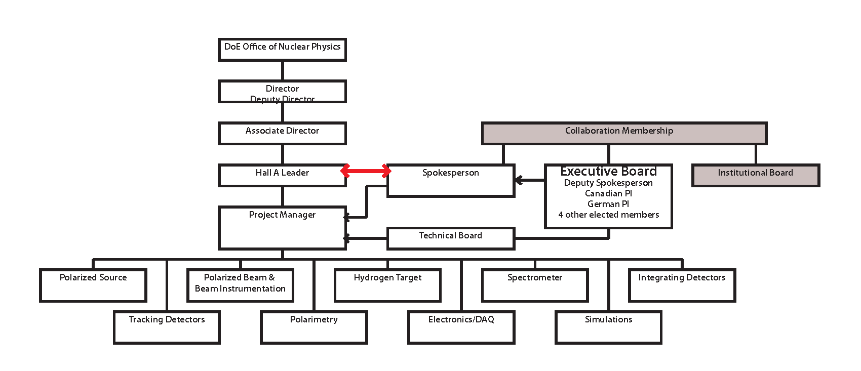
Proposed SoLID Organization Structure
Chair EB
GEM-US
Calorimeter Forward
Light Cherenkov
Heavy Cherenkov
Baffles/ Support
Magnet
GEM-China
Calorimeter Large Angle
Reconstruction/
Analysis Software

Slide 2
Institutional Board
Name: Institutional Board? steering committee? or something else?
Function: making major policy decisions
  membership,
  organization election
  publication policy
  speakers board
  by-laws
  …
Proposal:
consists of spokespeople, principles of major contributing groups
(at one FTE level?)
  smaller groups can combine

Slide 3
Executive Board and Chair
Function: EB making decisions on scientific, financial and organizational choices and provide oversight on all matter pertaining to day-to-day preparation and operation of SoLID.
Chair of EB oversees all aspects of the SoLID collaboration and is the principle contact between the collaboration and the lab management/DOE. Will provide oversight and inputs to PM for SoLID project. Together with PM, responsible for performance and assessment of all subsystems.
Proposal: Initial members be the senior spokespeople plus the PM as ex-officio. Paul Souder (PVDIS), Haiyan Gao (SIDIS), Zein-Eddine Meziani (J/Psi), Jian-ping Chen (PM, ex-officio)
Paul Souder as 1st Chair.

Slide 4
Project Manager
Function: When SoLID becomes a project with CD milestones, PM will be In charge of executing the project and report to DOE via JLab management. The collaboration will provide advice and oversight, and member of the collaboration will work under PM in various roles to execute the project. For example, all subsystems will be separate WBS items and its coordinators will report to PM.
PM has the authority and responsibility to manage the SoLID project to the approved scope, cost and schedule.
PM is appointed by JLab management with input from the collaboration and with the endorsement of the EB.
Proposal:
suggest to have Jian-ping Chen as PM.

Slide 5
Technical Board
TB will have a group of (usually senior) collaborators who represent the full range of required technical expertise. This group will be appointed by EB. In addition, TB will include PM and project engineers as and when they are appointed.
Function: Advise PM on all aspects of the Project including change in cost, scope or schedule.
TB membership can be periodically adjusted by the EB as the situation warrants.
Chair of TB will be PM. All EB members who are not already in TB are ex-officio members, along with the Hall leader.
Proposal: Initial members be:
Jian-ping Chen (Chair), Paul Souder, Haiyan Gao, Zein-Eddine Meziani, Paul Reimer, Eugene Chudakov, Nilanga Liyanage, Xiaochao Zheng, Zhengguo Zhao, Xiaodong Jiang, Alexandre Camsonne, Tom Hemmick, Xin Qian.

Slide 6
Sub-Systems (in the chart)
Proposal: to have in most cases one principle and one deputy
Magnet: Paul Reimer / Zhiwen Zhao? / Engineer?
GEM-US: Nilanga Liyanange / Kondo Gnanvo
GEM-China: Zhengguo Zhao / Xiaomei Li
Forward Calorimeter: Xiaochao Zheng / Zhiwen Zhao
Large Angle Calorimeter: Dave Armstrong? / Jin Hunag
Light Cherenkov: Zein-Eddine Meziani / Michael Paolone
Heavy Cherenkov: Haiyan Gao / postdoc
DAQ/Electronics: Alexandre Camsonne / Rory Miskimen
Simulation/Background: Seamus Riordan / Lorenzo Zana
Baffle Supporting Structure: Seamus Riordan? / ?
Reconstruction/Analysis Software: Ole Hansen / ?

Slide 7
Sub-Systems (not in the chart)
MRPC: Yi Wang / ?
Calibration/Integration: Robert Michaels / Xin Qian
HBD: Tom Hemmicks / ?
Polarimetry: Kent Paschke / Wouter Deconinck
Cryo-target: Dave Meekins? / Jian-ping Chen
Polarized 3He Target: Jian-ping Chen / Jin Huang?
Polarized Proton Target: Chris Keith? / Don Crabb?
Hall Infrastructure Modification: Robin Wines? / ?
Anything Else?
Other groups: UIUC, MIT, …

