Slide 1
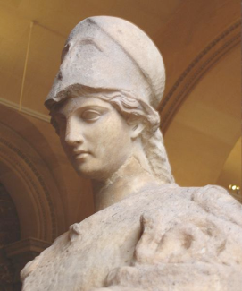
Near Threshold Electroproduction of J/ψ at 11 GeV
Zhiwen Zhao (UVa)
Kawtar Hafidi (ANL), Z.-E. Meziani (Temple)
Xin Qian (Caltech) , Nikos Sparveris (Temple)
for
the ATHENNA Collaboration

Slide 2
Outline
Introduction
Physics Motivation
The Proposed Experiment
Projected Results

Slide 3
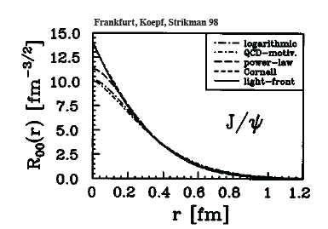
J/ψ as probe of the strong color fields in the nucleon!
J/ψ is a charm-anti-charm system
Little (if not zero) common valence quark between J/ψ and nucleon
Quark exchange interactions are strongly suppressed
Pure gluonic interactions are dominant
Charm quark is heavy
Typical size of J/ψ is 0.2-0.3 fm
pQCD at work

Slide 4
Interaction between J/ψ-N
New scale provided by the charm quark mass and size of the J/ψ
OPE, Phenomenology, Lattice QCD …
High Energy region: Pomeron picture …
Medium/Low Energy: 2-gluon exchange
Very low energy: QCD color Van der Waals force
Prediction of J/ψ-Nuclei bound state
Brodsky et al. ….
Experimentally no free J/ψ are available
Challenging to produce close to threshold!
Photo/electro-production of J/ψ at JLab is an opportunity

Slide 5
Physics Motivation
This proposal is about exploring and understanding some aspects of the strong regime of QCD
Probes strong gluonic interaction between two color neutral objects J/ψ and the nucleon
Uses J/ψ to probe color fields in the nucleon (minimal quark exchange)
Tests the production mechanism of J/ψ in a nucleon
Probes the conformal anomaly of low energy interaction J/ψ – N
A unique opportunity by exploring the threshold region and taking advantage of the high luminosity of CEBAF and the new energy reach namely 11 GeV
Statements from experts in the field!
”Low-energy J/psi-N interaction is a probe of the scalar gluon form factor of the nucleon. This quantity is of fundamental importance since it is related to conformal anomaly of QCD and to the origin of the nucleon's mass”.
Dima Kharzeev (Stony Brook)
“I am very enthusiastic about the physics of J/psi production at JLab”
refer to:http://www-public.slac.stanford.edu/sciDoc/docMeta.aspx?slacPubNumber=SLAC-PUB-14985
Stan Brodsky (SLAC, Stanford)
Summary of NPCFiQCD Workshop
http://quarks.temple.edu/~npcfiqcd

Slide 6
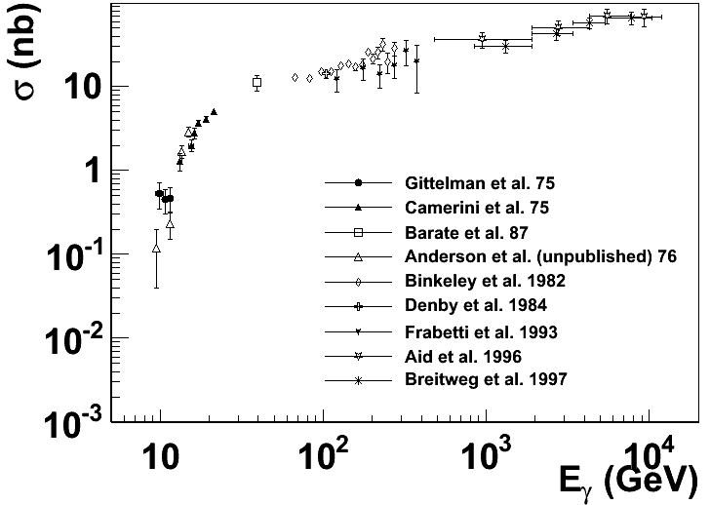
Experimental status
More data exist with inelastic scattering on nuclei, such as A-dependence.
Not included are the most recent results from HERA
H1/ZEUS at large momentum transfers and diffractive production with electro-production
SLAC, Cornell, Fermilab, HERA …
The physics focus is this threshold region

Slide 7
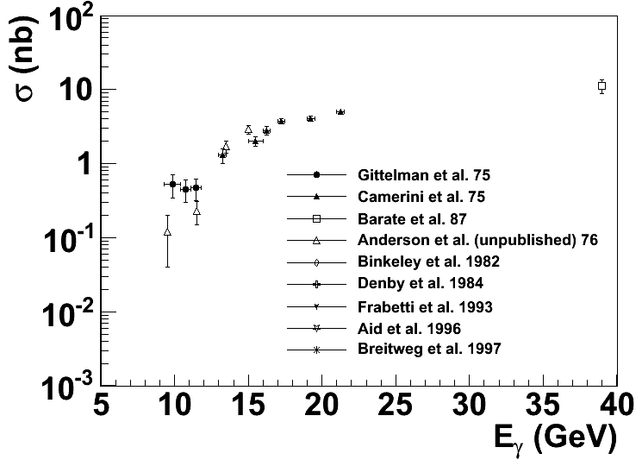
Near Threshold
Enhancement ?
?
Intense experimental effort (SLAC, Cornell … )
shortly after the discovery of J/ψ
But near threshold not much since (36 years till now)

Slide 8
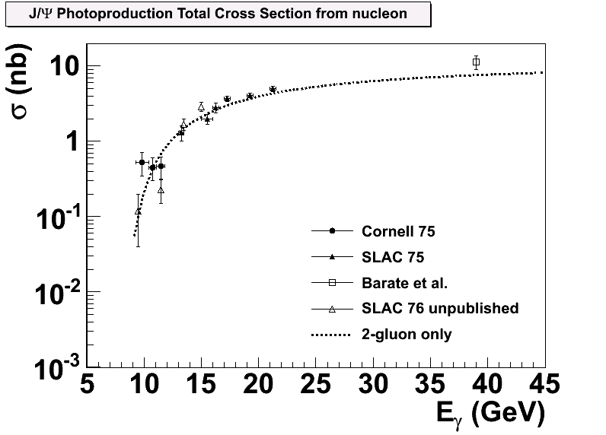
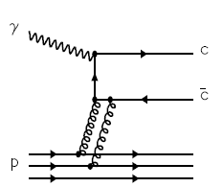
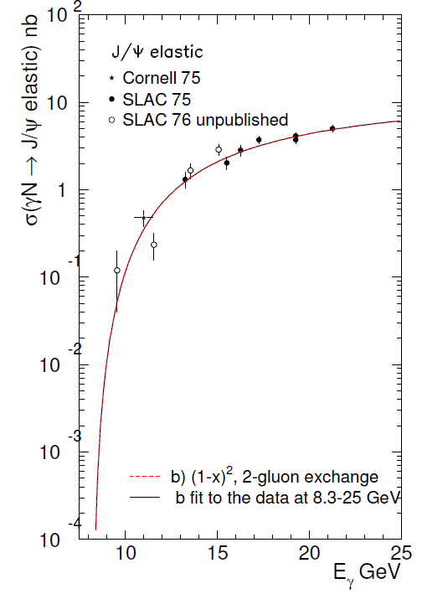
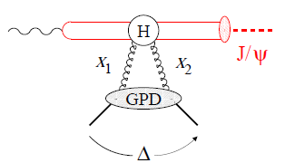
Reaction Mechanism
Models-I: Hard scattering mechanism (Brodsky, Chudakov, Hoyer, Laget 2001)
?
Models -II: Partonic soft mechanism (Frankfurt and Strikman, PRD 66, 031502 [2002])
2-gluon Form Factor
Notes:
Slides, Slides, cartoon behavior plots,
Emphasize Luminosity/quality of CEBAF + capability of SoLID
F. F. form factor (see like)

Slide 9
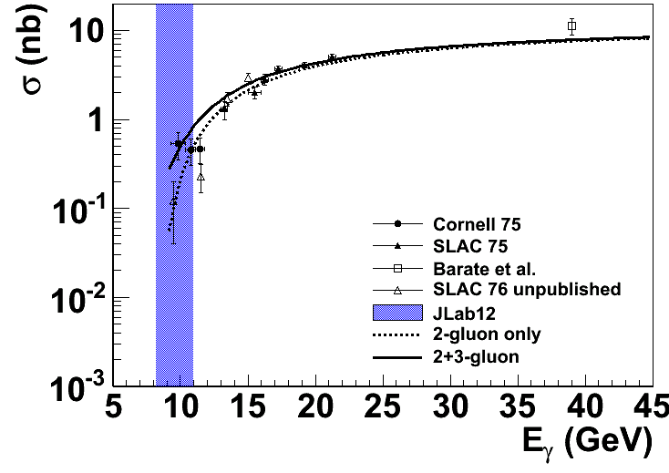
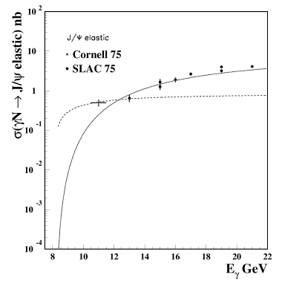
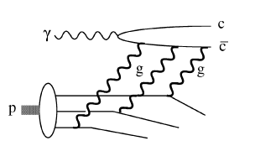
Reaction Mechanism
Models (I): Hard scattering
(Brodsky, Chudakov, Hoyer, Laget 2001)
Add in 3-gluon scattering
?

Slide 10
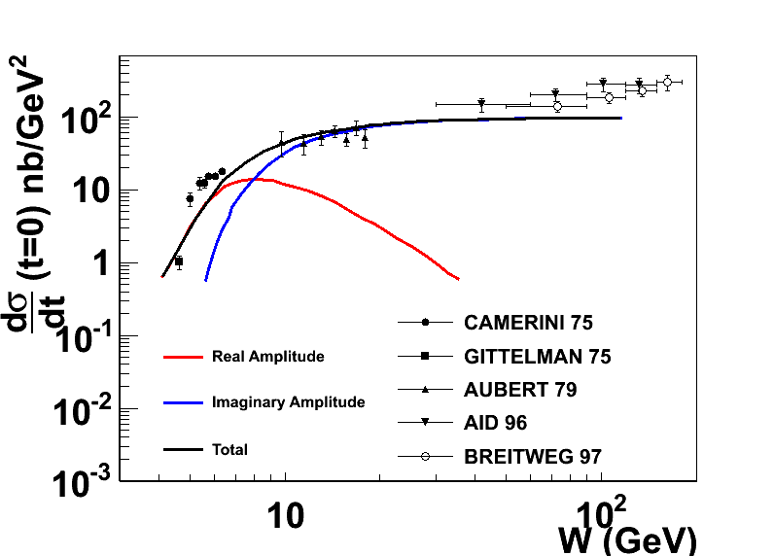
Reaction mechanism with FSI?
D. Kharzeev. Quarkonium interactions in QCD, 1995
D. Kharzeev, H. Satz, A. Syamtomov, and G. Zinovjev, Eur.Phys.J., C9:459–462, 1999
Imaginary part is related to the total cross section through optical theorem
Real part contains the conformal (trace) anomaly
Dominate the near threshold region
A measurement near threshold could shed light on the conformal anomaly
Notes:
Add the reference of the figure.

Slide 11
Conformal (Trace) Anomaly
Trace of energy momentum tensor
“Beta” function energy evolution of strong
interaction coupling constant
CM frame
[X. Ji PRL 74 1071 (1995)]
Trace Anomaly
Gluon Energy
Quark Energy
Quark Mass

Slide 12
This Experiment
Measure the t dependence and energy dependence of J/ψ cross sections near threshold.
Probe the nucleon strong fields in a non-perturbative region
Search for a possible enhancement of the cross section close to threshold
Shed some light on the conformal/trace anomaly
Establish a baseline for J/ψ production in the JLab energy range!
Bonuses:
Decay angular distribution of J/ψ
Interference with Bethe-Heitler term (real vs. imaginary)
Future Plans:
Search for J/ψ-Nuclei bound state
J/ψ medium modification

Slide 13
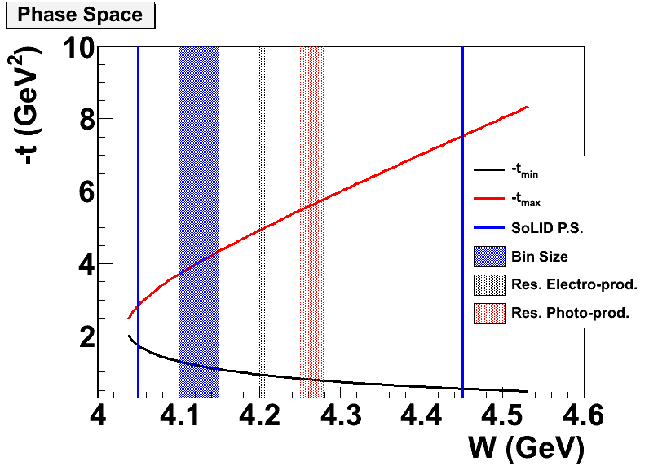
Electroproduction vs Photoproduction
Better resolution near threshold
use of a tagged photon beam
Larger coverage in t
Lower radiation budget
Less background (full exclusivity)
Near threshold

Slide 14
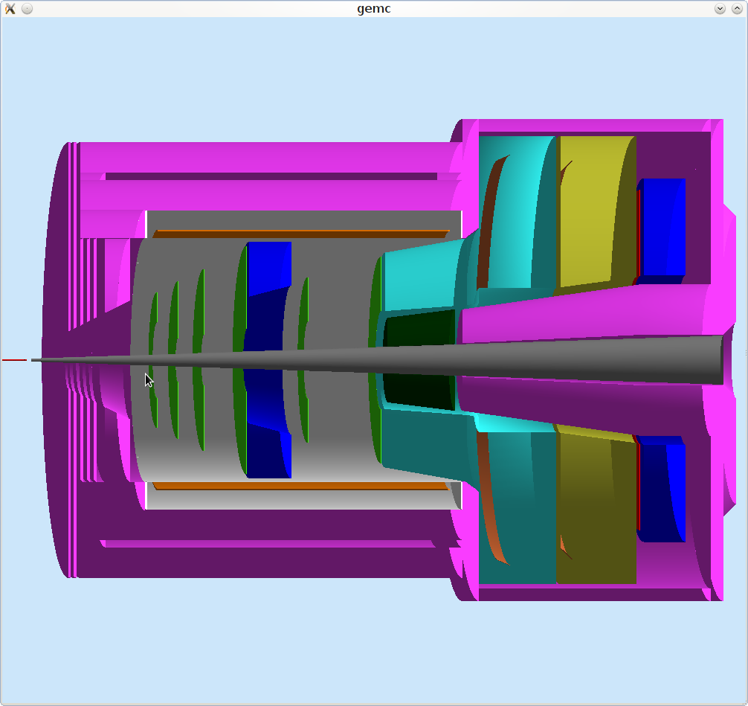
SoLID CLEO J/ψ
EM Calorimeter (forward angle)
EM Calorimeter (large angle)
GEM
Recoil Proton
MRPC
Target
Collimator
Decay e⁻/e⁺
Scattered electron
CLEO coil and yoke
Gas Cherenkov
Symmetric acceptance for e⁺ and e⁻

Slide 15
Experimental Condition
50 days of 3 beam on a 15 cm long LH₂ target at
10 more days include calibration/background run
Main Trigger: Triple coincidence of e⁻e⁻e⁺
Additional trigger double coincidence (e⁺e⁻)
 | Time (Hour) | Time (Day)
LH2 at 11 GeV | 1200 | 50
Dedicated Al dummy run | 72 | 3
Optics and detector check out | 72 | 3
Special low luminosity | 96 | 4
Total | 1440 | 60

Slide 16
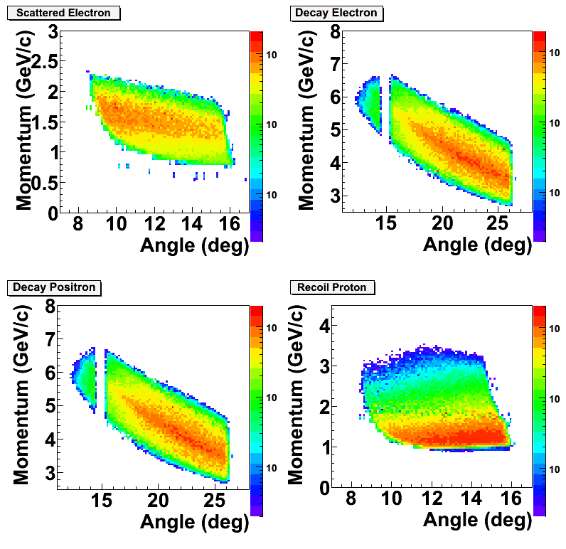
PID and Acceptance
Scattered electron:
Gas Č + Calorimeter @ forward angle
Decay electron/Positron:
Calorimeter only at large angle
Gas Č + Calorimeter at forward angle
Recoil proton:
100 ps TOF: 2 ns separation between p/K @ 2 GeV/c
~ 8m flight path
with 50 ns coincidence window.
Main trigger rate is below 1 kHz, two particle trigger about 30kHz
Comparing to ~50 kHz design trigger rate for SIDIS.

Slide 17
Impact on SoLID design
The goal is to make SoLID J/ψ compatible with SoLID SIDIS
no change to magnet and yoke to avoid sensitive magnetic force balance and other mechanical issues.
possible 10% area increase for GEM
Target position will be determined by FOM (work in progress)
e- e+ from J/ψ favor large angle
scattering e- favors forward angle

Slide 18
Event Counts @ 1x10³⁷ in 50 days
3-fold no proton:
2g-only: 2.1 k events
2g + 3g: 8.08 k events
4-fold coincidence:
2g-only: 0.68 k events
2g + 3g: 2.9 k events
3-fold
4-fold

Slide 19
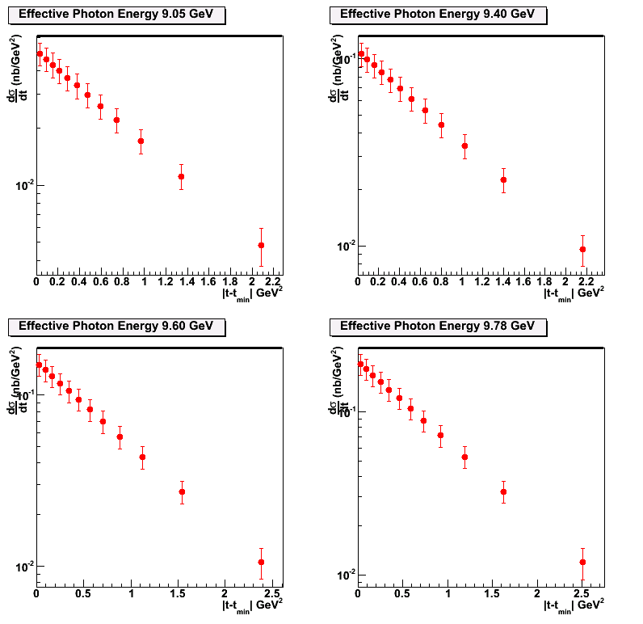
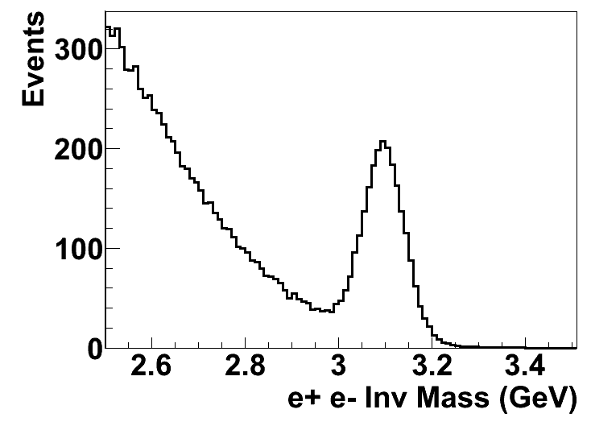
Projections of dσ/dt with 2-g model
Data will be first binned in t at different W (or effective photon energy) to study the t-dependence of the differential cross section
9.05 GeV
9.40 GeV
50 Days
9.60 GeV
9.78 GeV

Slide 20
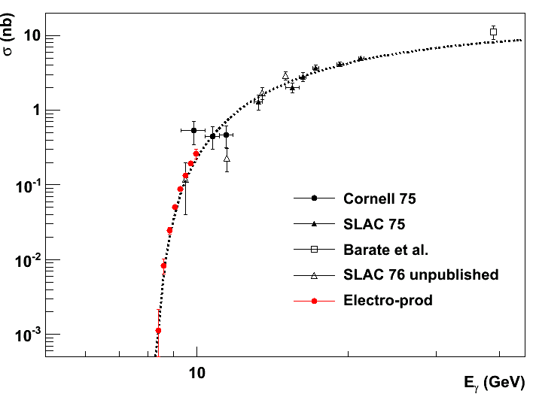
Projection of Total Cross Section
With < 0.01 GeV energy resolution in W and 8 energy bins in W to
study the threshold behavior of cross section.

Slide 21
Bonus: photoproduction

Slide 22
Cross Section Validation
 | Bethe-Heitler | ω | ρ | φ | η
Cross Section | 0.1 ub | 1ub | 1ub | 50 nb | 10 ub
Decay Channel and BR | e⁺e⁻ 1.0 | e⁺e⁻ 7.30 10⁻⁵ | e⁺e⁻ 4.71 10⁻⁵ | e⁺e⁻ 2.97 10⁻⁴ | γγ 0.39
Compared to J/ψ | >10 | x2 | x1 | x0.5 | Large
SoLID capability | good | good | good | good | good
e+p elastic channel: (2.2 and 4.4 GeV beam)
SoLID Optics Calibration Channel for electrons
SIDIS charged pion (also DIS)
SIDIS program, comparing with Hall C measurements

Slide 23
Systematic Budget
Acceptance Effect: 10% for triple coincidence
Detector and Trigger Efficiency <2%
Target Luminosity: <2%
Contribution from Al wall <1%
Dummy run + target vertex Cut
Background Contamination ~0.5%
B-H background + Random Coincidence (measured directly)
Goal: 10-15% cross section measurements

Slide 24
backup

Slide 25
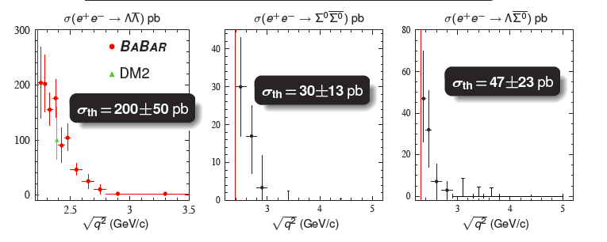
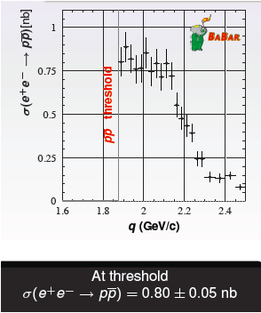
Threshold Enhancement is not rare!
Summary of NPCFiQCD Workshop
http://quarks.temple.edu/~npcfiqcd

Slide 26
Rates Estimates
Used equivalent photon approximation
is the virtual photon flux and is the Jacobian
Cross section is based on fits to data at high W within the 2-gluon exchange model

Slide 27
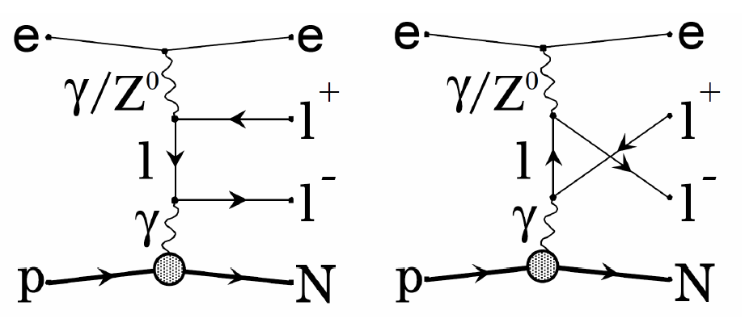
Physics Background
Due to large mass of J/ψ and near-threshold kinematics, little physics background
The main background is Bethe-Heitler term
B-H process calculated with GRAPE-Dilepton program. Compared with 2-gluon model assuming no threshold enhancement.
The t-dependence background level is acceptable.

Slide 28
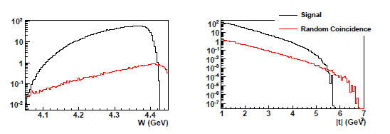
Random Coincidence Background
Studied with Pythia and can be subtracted.
Largest contribution coming from J/ψ photoproduction in random coincidence with a scattered electron.
With the same 2-gluon model, we calculated the random coincidence rate after all cuts and a 6 ns window.
Do not expect a problem either from physics (B-H) or random coincidence background!

Slide 29
ATHENNA Collaboration
J. Arrington, N. Baltzell, A. El Alaoui, D. F. Geesaman, K. Hafidi (Co-spokesperson), R. J. Holt, D. H. Potterveld, P. E. Reimer (Argonne National Laboratory, Argonne, IL)
X. Qian (Co-spokesperson) (California Institute of Technology, Pasadena, CA)
K. Aniol (California State University, Los Angeles, CA)
J. C. Cornejo, W. Deconinck, V. Gray (College of William & Mary, Williamburg, VA)
X. Z. Bai, H. X. He, S. Y. Hu, S. Y. Jian, X. M. Li, C. Shan, H. H. Xia, J. Yuan, J. Zhou, S. Zhou (China Institute of Atomic Energy, Beijing, P. R. China)
P. H. Chu, H. Gao, M. Huang, S. Jawalkar, G. Laskaris, M. Meziane, C. Peng, Q. J. Ye, Y. Zhang, X. F. Yan (Duke University, Durham, NC)
P. Markowitz (Florida International University, Miami, FL)
A. Afanasev (The George Washington University, Washington, DC)
F. J. Jiang, H. J. Lu, X. H. Yan (Huangshan University, Huangshan, P. R. China)
J. B. Liu, W. B. Yan, Y. Zhou, Y. X. Zhao (University of Science and Technology of China, Hefei, P. R. China)
K. Allada, A. Camsonne, J.-P. Chen, E. Chudakov, J. Gomez, M. Jones, J. J. Lerose, B. Michaels, S. Nanda, P. Solvignon, Y. Qiang (Jefferson Lab, Newport News, VA)
M. Mihovilovič, S. Širca (Jožef Stefan Institute of University of Ljubljana, Slovenia)
G. G. Petratos, A. T. Katramatou (Kent State University, Kent, OH)
Y. Cao, B.T. Hu, W. Luo, M. Z. Sun, Y.W. Zhang, Y. Zhang (Lanzhou University, Lanzhou, P. R. China)
T. Holmstrom (Longwood University, Farmville, VA)
J. Huang, X. Jiang (Los Alamos National Laboratory, Los Alamos, NM)
J. Dunne, D. Dutta, A. Narayan, L. Ndukum, M. Shabestari, A. Subedi, L. Ye (Mississippi State University, Mississippi State, MS)
E. Cisbani, A. d. Dotto, S. Frullani, F. Garibaldi (INFN-Roma and gruppo collegato Sanitá and Italian National Institute of Health, Rome, Italy)
M. Capogni (INFN-Roma and gruppo collegato Sanitá and ENEA Casaccia, Rome, Italy)
V. Bellini, A. Giusa, F. Mammoliti, G. Russo, M. L. Sperduto, C. M. Sutera (INFN-Sezione di Catania, Catania, Italy)
D. Y. Chen, X. R. Chen, J. He, R. Wang, H. R. Yang, P. M. Zhang (Institute of Modern Physics, Lanzhou, P. R. China)
C. E. Hyde (Old Dominion University, Hampton, VA)
L. El Fassi, R. Gilman (Rutgers University, Piscataway, NJ)
S. Choi, H. Kang, H. Kang, Y. Oh (Seoul National University, Seoul, Korea)
P. Souder and R. Holmes (Syracuse University, Syracuse, NY)
W. Armstrong, A. Blomberg, D. Flay, E. Fuchey, M. Paolone, N. Sparveris (Co-spokesperson), Z.-E. Meziani (Co-spokesperson/Contact), M. Posik, E. Schulte (Temple University, Philadelphia, PA)
K. Kumar, J. Mammei, S. Riordan (University of Massachusetts, Amherst, MA)
T. Badman, S. K. Phillips, K. Slifer, R. Zielinski (University of New Hampshire, Durham, NH)
H. Badhdasaryan, G. D. Cates, M. Dalton, D. Day, D. Keller, V. V. Nelyubin, K. Paschke, A. Tobias, Z. W. Zhao (Co-spokesperson), X. Zheng (University of Virginia, Charlottesville, VA)
F. R. Wesselmann (Xavier University of Louisiana, New Orleans, LA)

