Slide 1
Update/Overview of SoLID
Jian-ping Chen, Jefferson Lab
SoLID Collaboration Meeting
Dec. 14-15, 2012

Slide 2
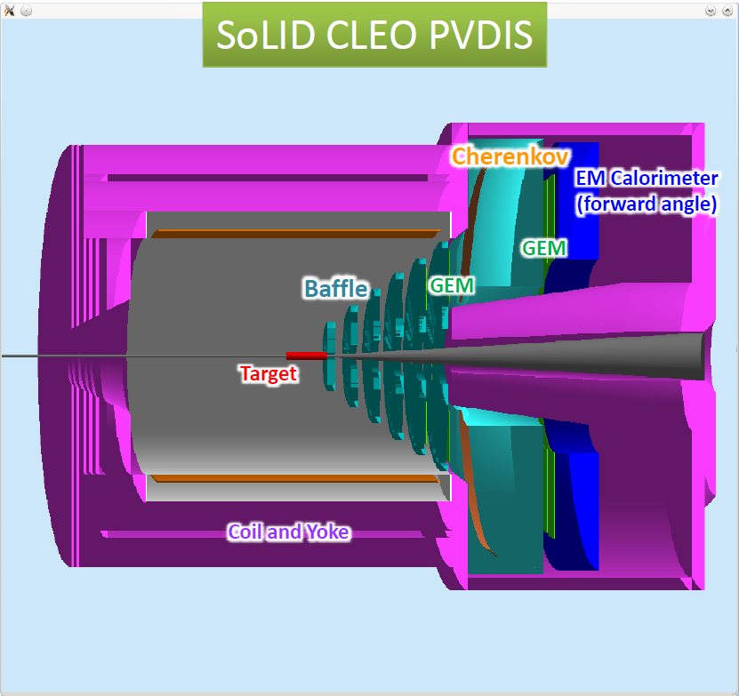
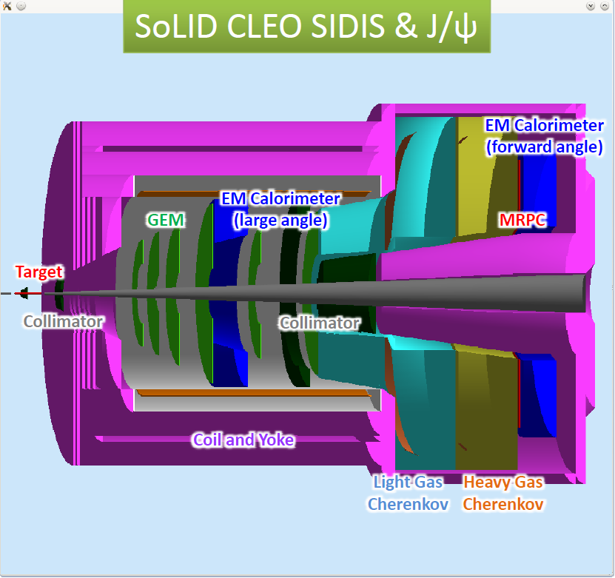
Physics Program for SoLID
SoLID: large acceptance, capable of handling high luminosity
(up to~10³⁹ with baffle, up to ~10³⁷ without baffle)
Ideal for precision Inclusive-DIS (PVDIS) and SIDIS experiments
Excellent for selected exclusive reactions (ex. J/Psi)
Five high impact experiments approved ( 4 with “A” rating, 1 A- rating):
PVDIS, E12-10-007
SIDIS: E12-10-006 (He3-T), E12-11-007 (He3-L), E12-11-108 (p-T)
J/Psi: E12-12-006

Slide 3
SoLID Status Update
Magnet:
Continue work with CLEO magnet /support
Study BaBar option and comparison
Simulations: Baffle, GEM/tracking/DAQ inputs, …
Background, neutrons
Detectors: “finalize” conceptual design
Light Cherenkov, support, PMT (Temple+),
backup:HBD (Stonybrook)
Heavy Cherenkov, support (Duke+)
Calorimeters (UVa/Los Alamos+)
GEMs (UVa+): Large size, Readout, R&D with SuperBB
GEMs- China: foil production, medium size, readout
MRPC (Tsinghua+)
DAQ (JLab/UMass): concern GEM readout size
solution (with de-convolution, 1 sample)
Other sub-systems: Targets
Beam Polarimetry, …
Whit/Zhiwen
Seamus/Lorenzo
Micheal
Tom
Mehdi/Gary
Jin
Nilanga
Yuxiang
Yi W.
Yi Q.
Dave/Chris
Kent

Slide 4
Rough Cost Estimations
JLab ($M) Collab Note
cost labor cost labor
Magnet: 5 1.1 3.9 1.1 iron cost
Based on CLEO magnet, BaBar option is being evaluated
GEMs: 5.1 3.4 2.5 1.7 *
(Anticipate) Mainly Chinese Collaboration
Calorimeter: 5.7 3.8 6.2 1.3 labor cost
Cherenkov-e: 1 0.7 1.5 0.5
Cherenkov-π: 1 0.7 1.5 0.5
DAQ/elec 4 2.7 2.5 1 *
JLab Physics Division sharing
Infrastructure 1.8 0.3 1.8 0.3
Subtotal 23.5 12.7 19.9 6.4
36.2 26.2
Contingency 35%
Total 48.8 35.5
Total-GEMs-Electronics: the amount to request funding from DOE/NSF
28.3 25
(not include: MRPC (Tsinghua U), baffles, targets, beam polarimeter, beam line chicane)

Slide 5
SoLID Status Update (cont.)
Charge for Director’s Review (Rolf’s talk last meeting)
1st draft of technical write-up on SoLID
http://solid.physics.umass.edu/~seamus/solid_techprop.pdf
JLab input to NSAC sub-committee
SoLID funding profile 2015-2017, request US funding ~$35M
Schedule
Director’s review (a couple months?)
Discuss with DOE (a few months)
Submit MIE (2013?)
CD process (2013-2015?)
Preparation
“Freeze” the conceptual design (this meeting)
Move forward with the magnet (make decision on Babar option)
Design support structure, integration, configuration change-over
More detailed cost/manpower estimation
Sub-system responsibilities / R&D needs
Finalize the technical document
Full dry run (late January?)
Resources: attract more collaborators, other sources of funding

Slide 6
Organization
Execute committee:
J.P. Chen, H. Gao, Z.E. Meziani, P. Souder
Chair: P. Souder
Projector Manager:
J. P. Chen
Technical Committee:
Jian-ping Chen (Chair), Paul Souder, Haiyan Gao, Zein-Eddine Meziani, Paul Reimer, Eugene Chudakov, Nilanga Liyanage, Xiaochao Zheng, Zhengguo Zhao, Xiaodong Jiang, Alexandre Camsonne, Tom Hemmick, Xin Qian.
Subsystems

Slide 7
Sub-Systems
Magnet: Paul Reimer / Zhiwen Zhao
GEM-US: Nilanga Liyanange / Kondo Gnanvo
GEM-China: Zhengguo Zhao / Xiaomei Li
Forward Calorimeter: Xiaochao Zheng / Zhiwen Zhao
Large Angle Calorimeter: Jin Hunag / W&M?
Light Cherenkov: Zein-Eddine Meziani / Michael Paolone
Heavy Cherenkov: Haiyan Gao / Mehdi Meziane
DAQ/Electronics: Alexandre Camsonne / Rory Miskimen
Simulation/Background: Seamus Riordan / Lorenzo Zana
Baffle Supporting Structure: Seamus Riordan
Reconstruction/Analysis Software: Ole Hansen/?
MRPC: Yi Wang
Calibration/Integration: Robert Michaels / Xin Qian
HBD: Tom Hemmicks
Polarimetry: Kent Paschke / Wouter Deconinck
Cryo-target: Dave Meekins / Jian-ping Chen
Polarized 3He Target: Jian-ping Chen/Patricia Solvignon
Polarized Proton Target: Chris Keith / Don Crabb
Hall Infrastructure Modification: Robin Wines

