Slide 1
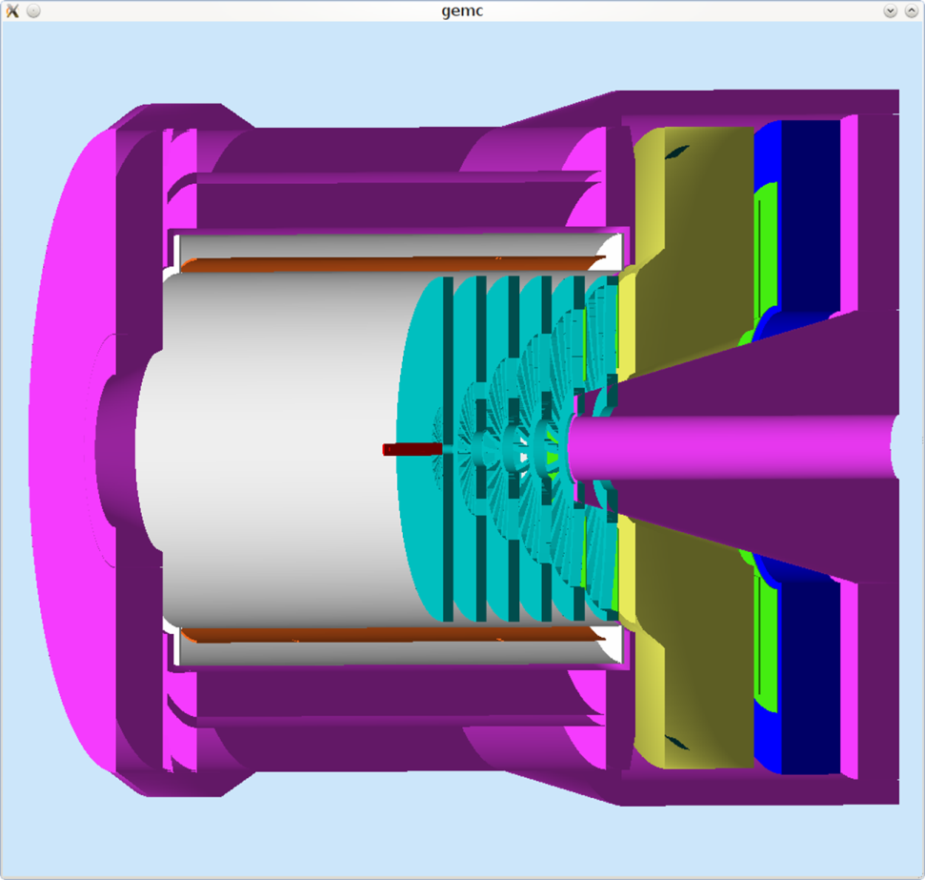
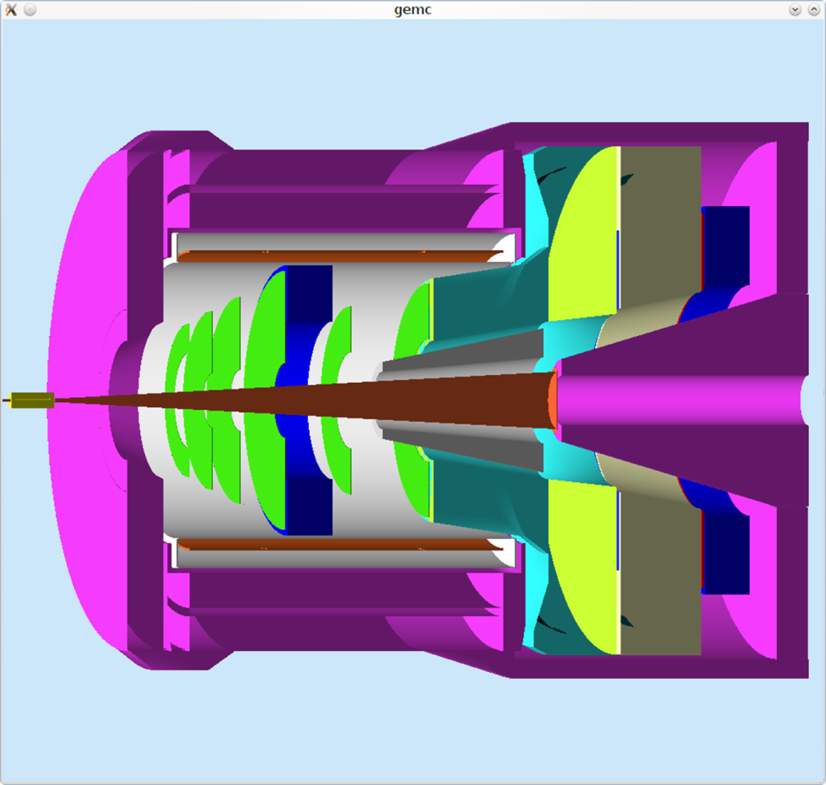
HBD Light RICH -- BRIEF
T.K. Hemmick

Slide 2
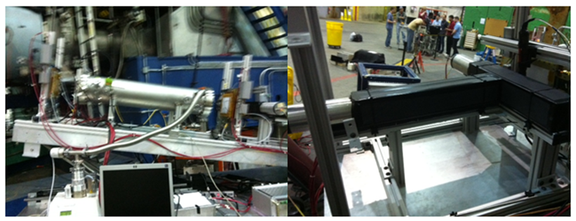
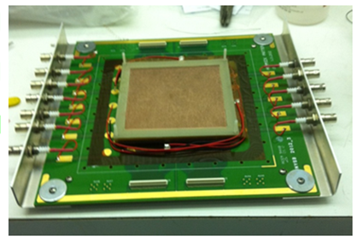
Forward CsI RICH Progress.
Spring tests disappointing:
2 million events w/ 15 tracks…none electrons.
Test beam requested at SLAC March 2013

Slide 3
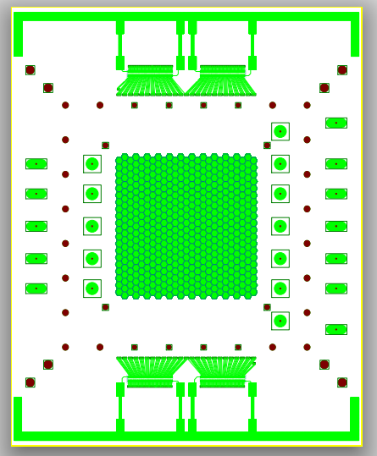
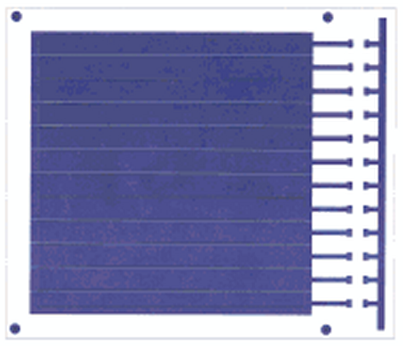
Changes for SLAC
New GEM foils…multiple strips like PHENIX.
Second pad plane…hexagons to see rings.
New trip detection system:
Capacitive coupling off resistor chain.
Integrated with PHENIX HBD HV relays.

Slide 4
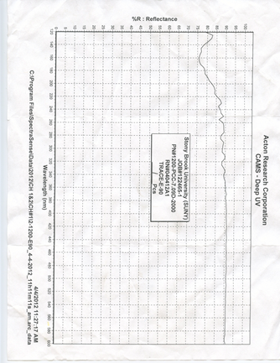
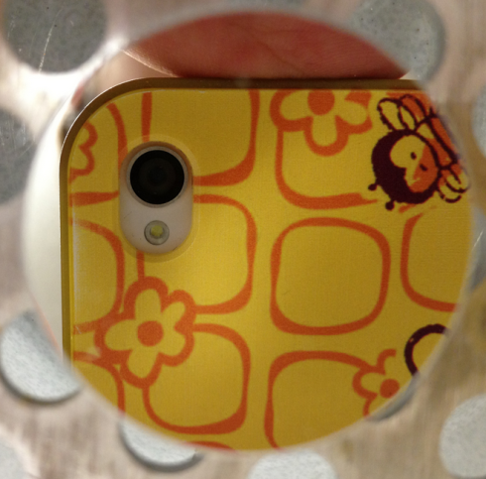
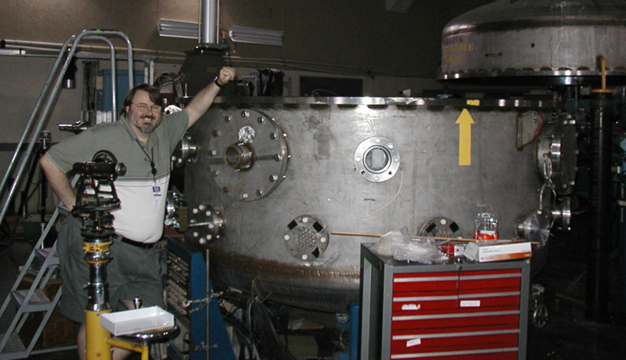
Mirror Developments
90
80
Cherenkov photon yield primarily at small λ.
Deep UV mirrors use 250 Aº MgF₂ overcoat to act as dielectric mirror.
Plans:
Year 1: Develop in-house manufacture of small mirrors.
Year 2: Scale up to use Big Mac
First in-house mirror made!
Reflectivity tests pending at BNL.
Commercial mirror
120
200

Slide 5
Backups

Slide 6
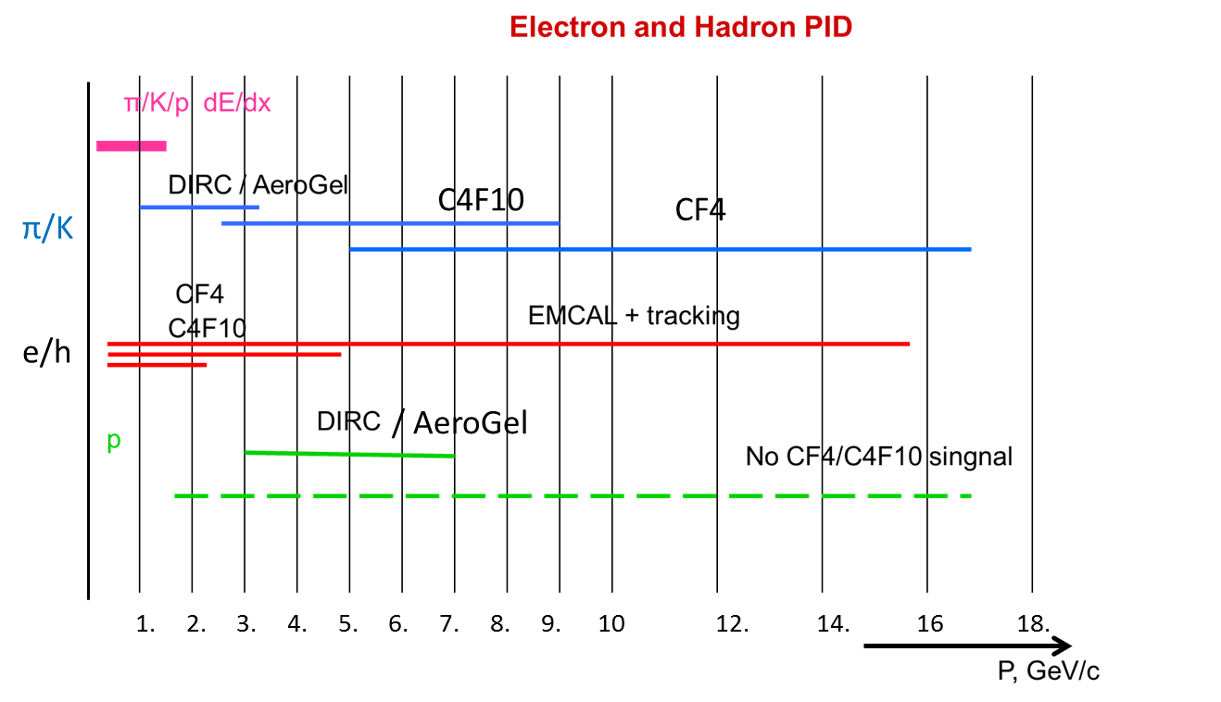
Forward RICH
RICH particle ID involves a limited dynamic range of momenta set by gas index of refraction.
The highest momenta rely on the lowest n.
Our R&D targets the highest momenta with a CsI photo-cathode RICH.
Major Issue: Reflectivity of mirrors deep in the UV.

