Slide 1
Engineering/Design Update on the SoLID Magnet
Whit Seay
14 December 2012

Slide 2
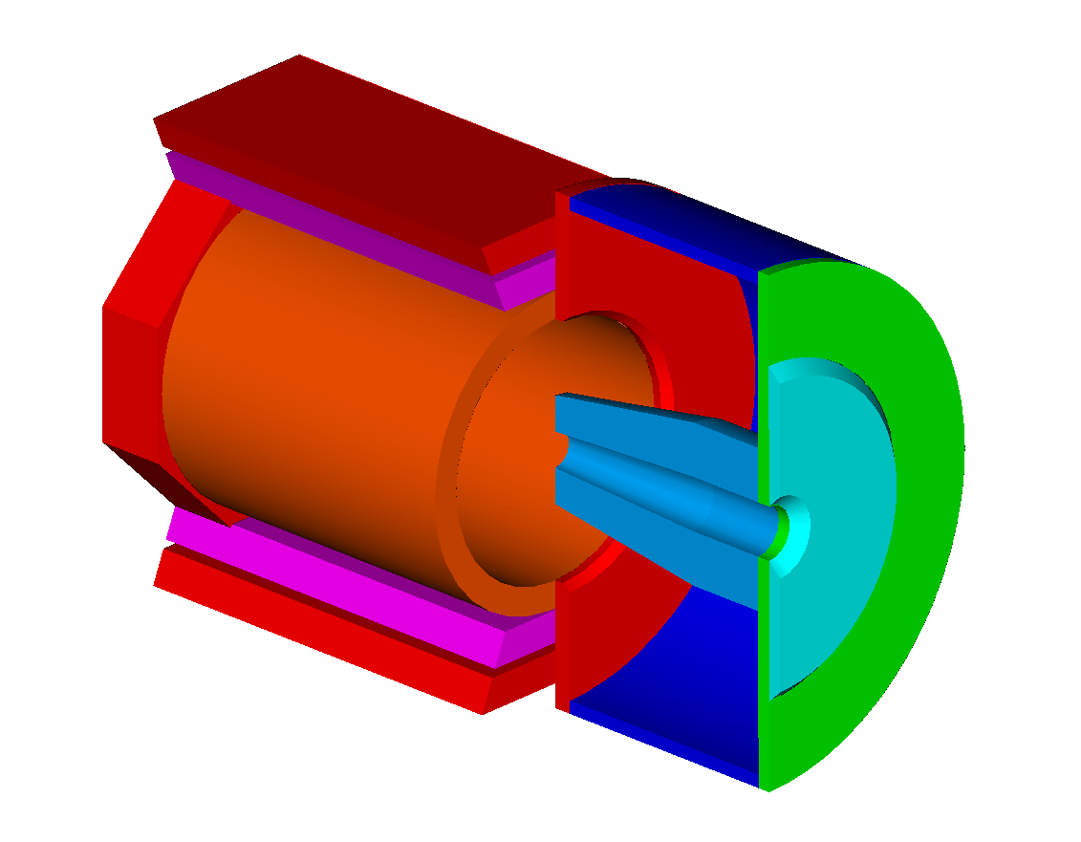
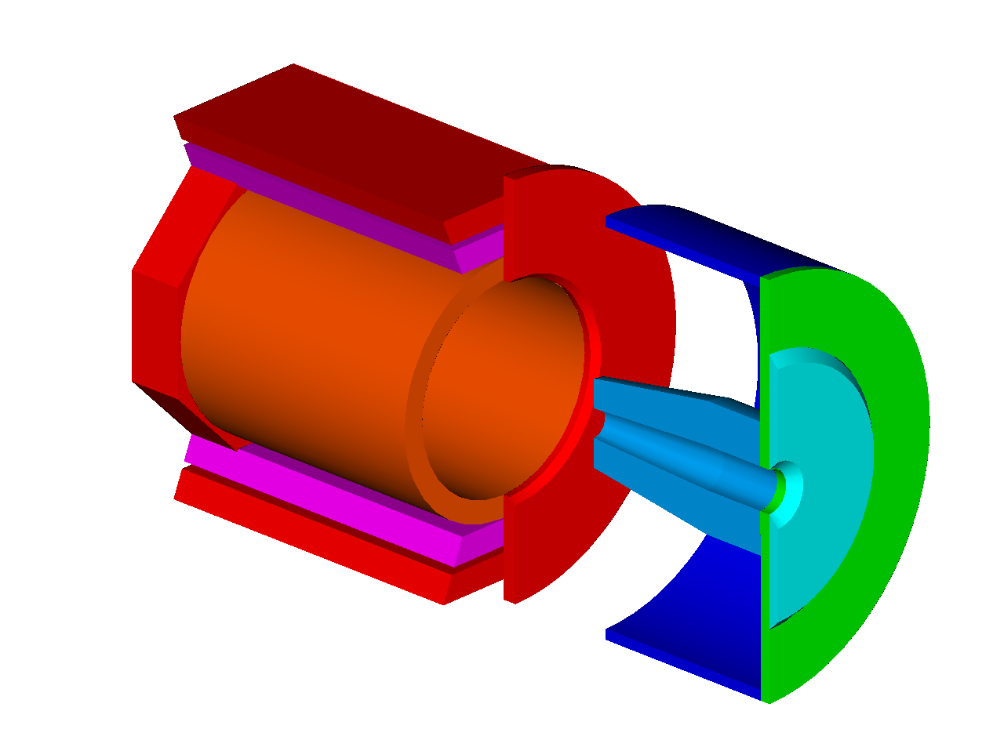
Detector Housing (Hut)
2 piece design with cylindrical outer shell attached to an endcap that splits along the centerline on the vertical plane
The nose will mount to the endcap in a cantilever arrangement
The hut will roll downstream for clearance (if necessary) and then each half moved apart in the lateral direction

Slide 3
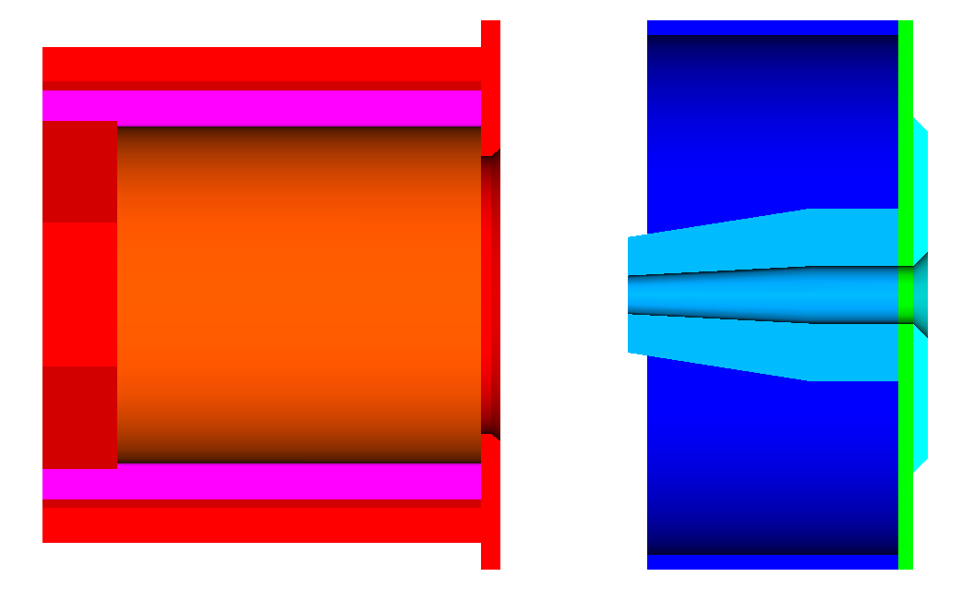
SoLID PVDIS
Non-magnetic support frame
Cherenkov
EM Calorimeter
(forward angle)
GEM
Baffle
target

Slide 4
SoLID SIDIS
Non-magnetic support frame
EM Calorimeter
(forward angle)
EM Calorimeter
(large angle)
MRPC
target
GEM
Note: Support frame inside of cryostat for detectors and target more difficult with BaBar.
Light Gas
Cherenkov
Heavy Gas
Cherenkov

Slide 5
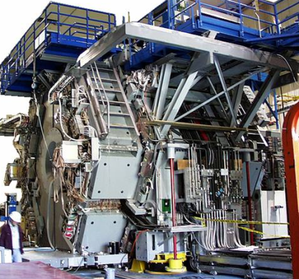
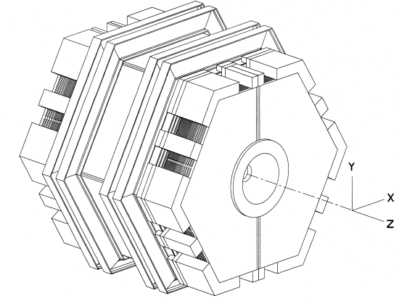
BaBar Magnet Study and Cost Estimate
Received some technical drawings on Dec. 5th that was located on the Rutherford Appleton Lab’s website. These drawings have been added to the wiki page.
Two major hurdles to overcome to make BaBar work for SoLID
BaBar’s centerline is at a minimum 18” (457mm) too tall.
How to modify BaBar’s complex bolted construction and still be structurally sound.
Arch
Door
Doors
Cradle
Barrel

Slide 6
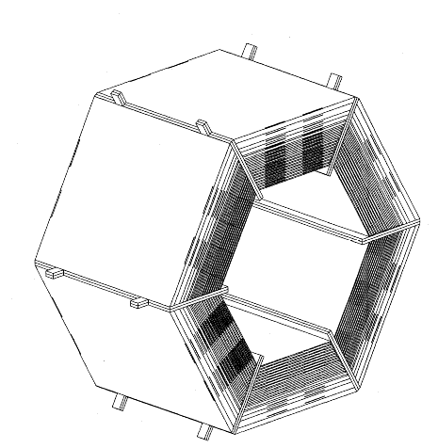
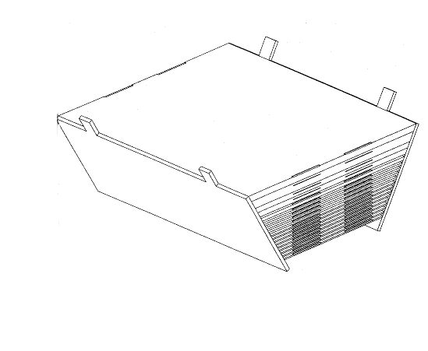
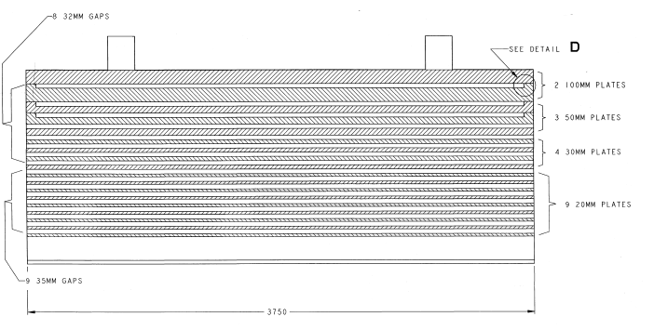
Barrel Flux Return
Six individual wedge sections
Wedge section consist of outer and inner wedge assemblies
Each assembly has layers of plates welded to outer side plates
Layered plates are welded along their entire 12’ length to side plates
Side Plate

Slide 7
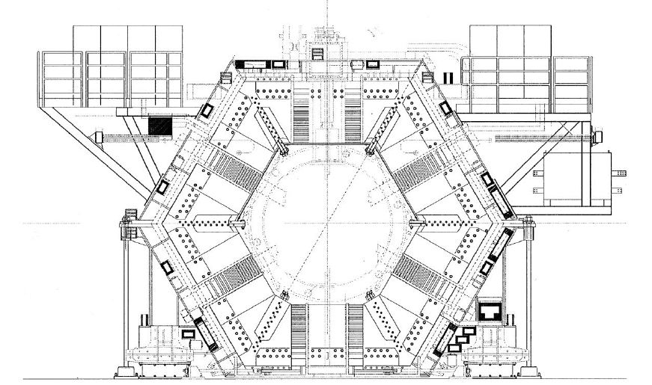
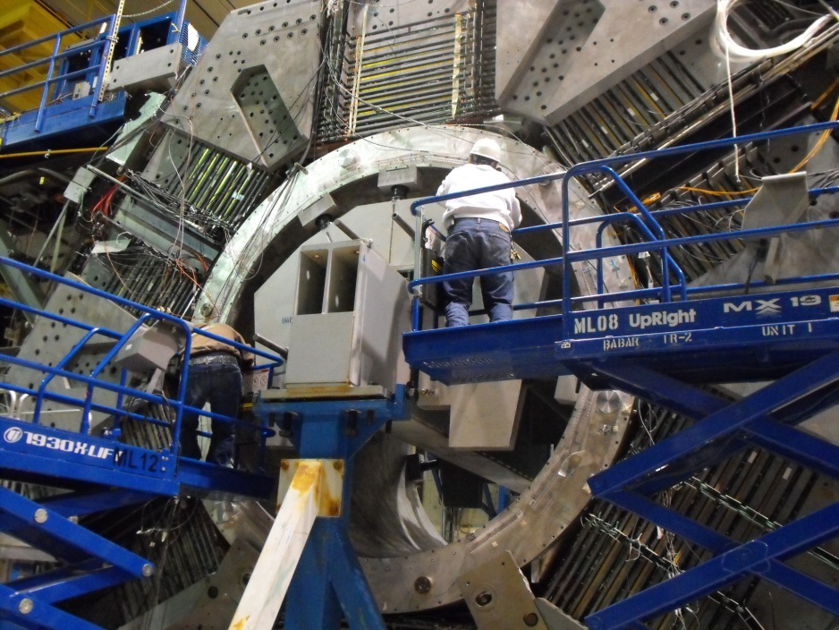
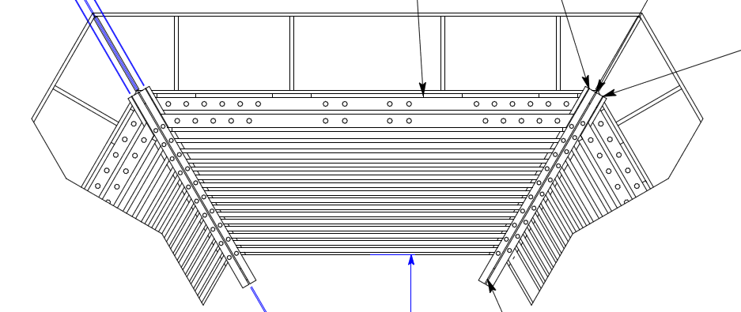
Corner Connections of the Barrel
3500

Slide 8
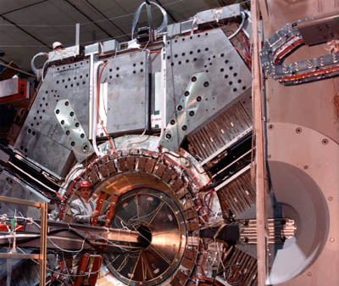
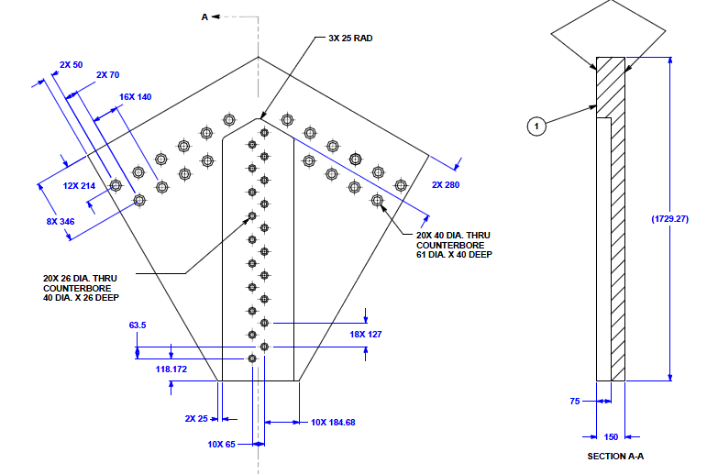
Gap Plates
Gap plates are used to shore up the corners of the barrel assembly by tying two sections together and distribute the weight of the inner wedge assembly to the outer wedge assembly.
They also appear to be used to secure the cryostat into position.
2 MT

Slide 9
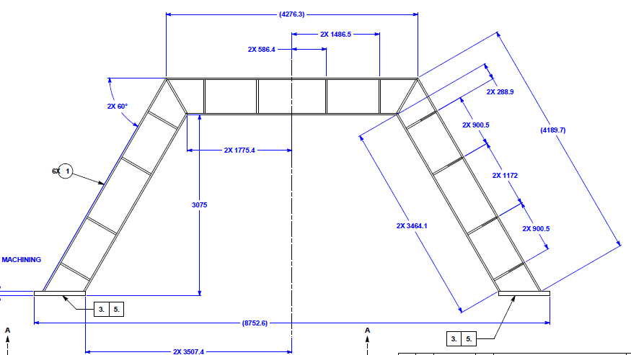
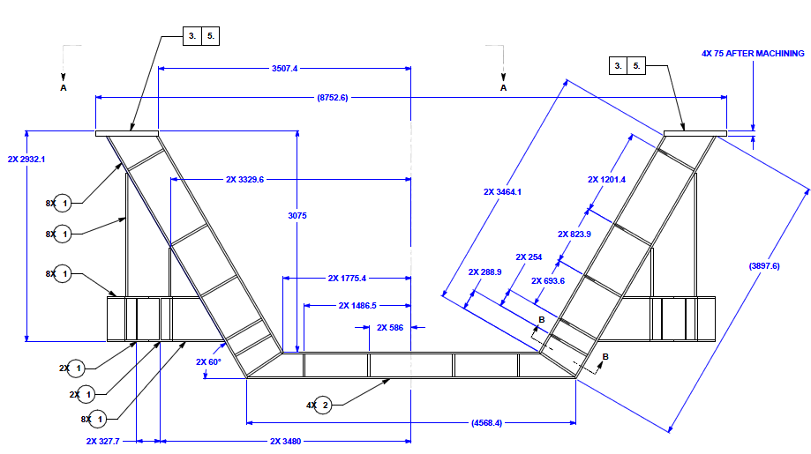
Barrel Support Frame
Cradle is one large weldment designed to carry the entire weight of the barrel and transfer that weight to the floor.
The arch bolts on top of the cradle and is used to hang the upper three sections of the barrel iron.
Cradle weight = 22 MT
W24 X 145 I-beams main section
W14 x 146 cross member
ARCH ASSEMBLY
CRADLE ASSEMBLY

Slide 10
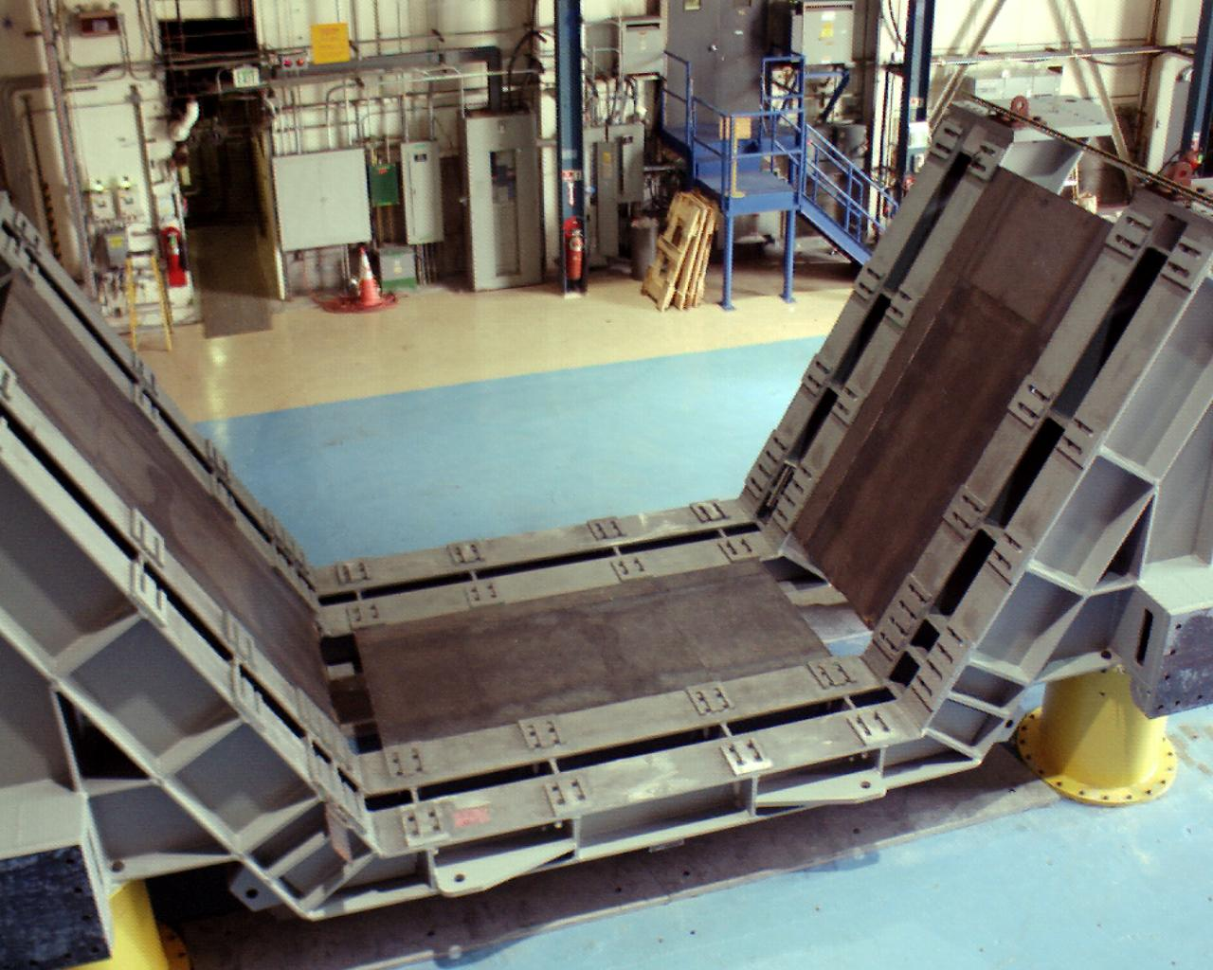
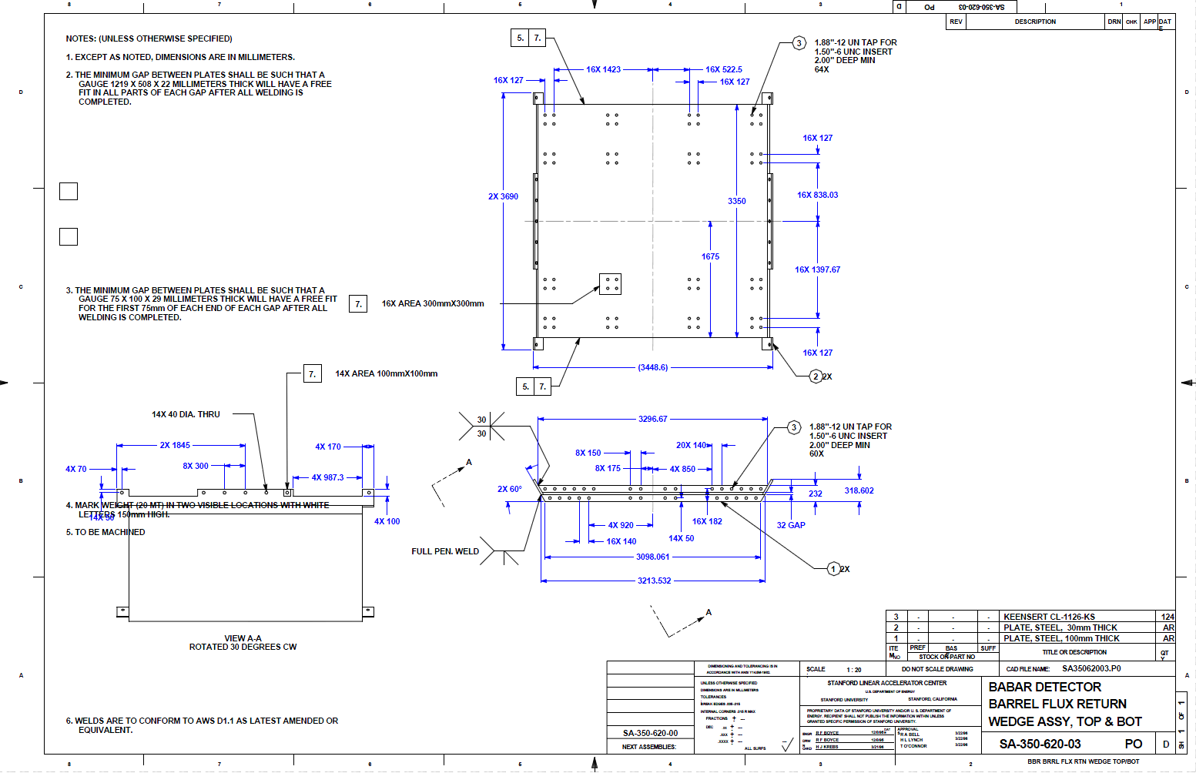
Wedge Mounting Detail
(QTY 64 or more) 1-1/2” dia. bolts used to mount each wedge to the frame

Slide 11
Cradle Modification
One possible method to reduce the height would be to remove the cross member from the bottom of the cradle. This still does not get us enough reduction in height and removal of iron from the outside of the barrel will still be required.
This would greatly reduce the structural integrity of the cradle and a considerable effort would be needed to design and evaluate this modification.
Propose replacing the W14 x 146 with a shorter I-beam to regain some of the support back. No suggestions on which size at this point.
The bottom barrel section will have to be evaluated to ensure that it can hang from the two adjacent barrel sections.
The mounting holes for the barrel sections to the cradle/arch would be mismatched when the barrel is shifted down.
CRADLE ASSEMBLY
Approx. cut line

Slide 12
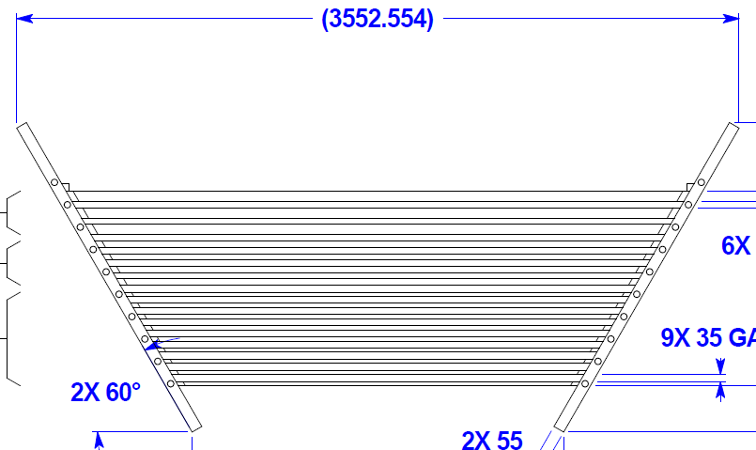
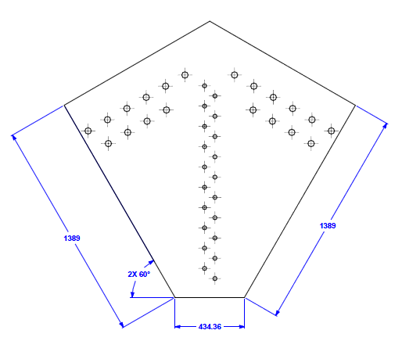
Removal of Several Layers of
Iron from the Barrel Sections
Remove several of the inner layers and modify the width of the outer wedge to fit in their place.
Trim the side plates for the new height.
Modify/cut the gap plates.
Outer Wedge
Approx. cut line
Wedge Assembly
Trim Side Plates
Remove Several Layers
Inner Wedge

Slide 13
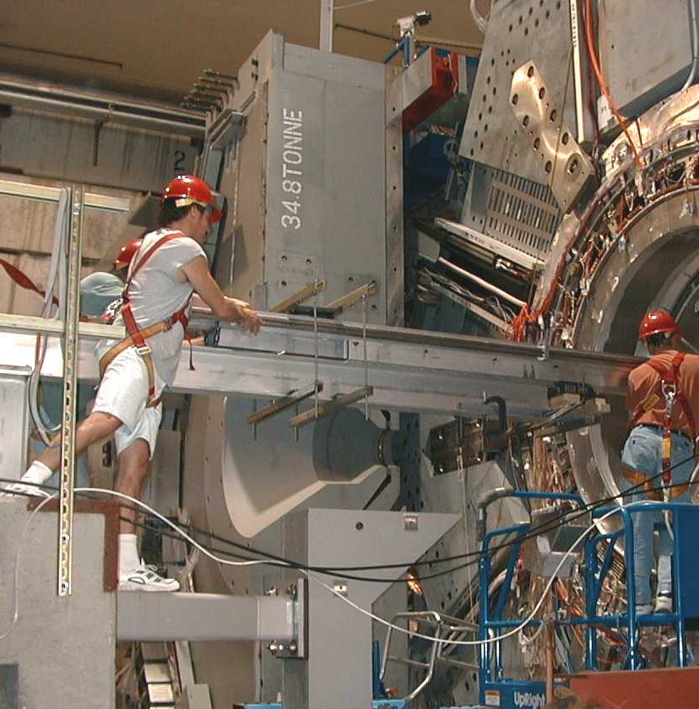
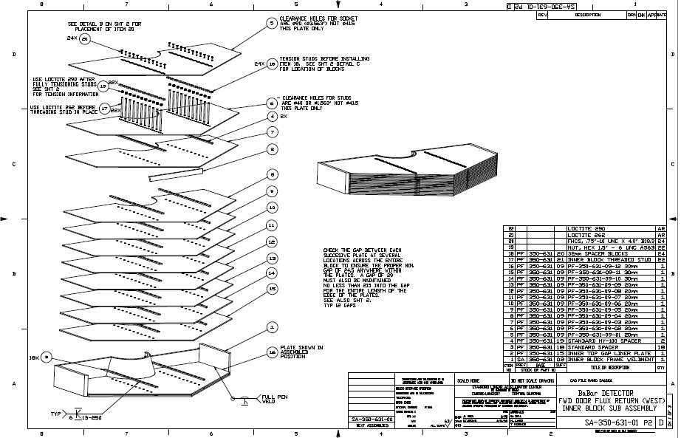
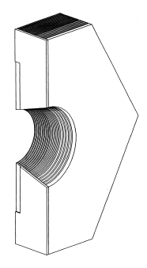
Forward and Rear Door Design
Multilayer stack of iron plates bolted and welded to outer shell
Each door is two piece with an inner and outer assembly
Front and rear door design similar but not identical

Slide 14
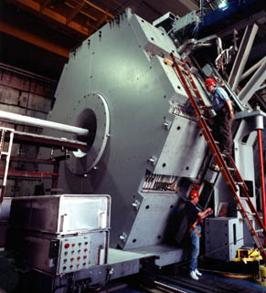
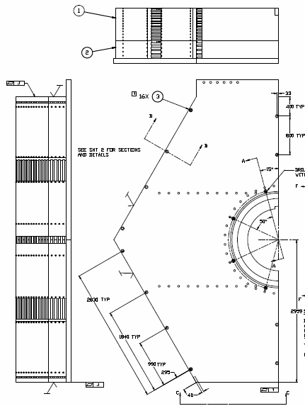
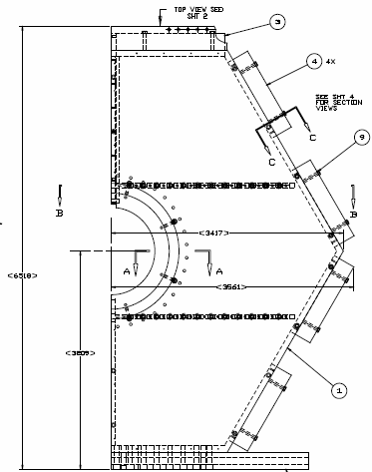
Two Piece Door
Doors are held together by large flux bars bolted to the outside of the door sections

Slide 15
Initial Assessment of BaBar Cost
The complexity of BaBar will make modifying it for SoLID considerably more difficult
2X more hours for engineering/design than CLEO
The amount of cutting, machining, and welding seems significant. Could erode anticipated savings over CLEO.
1.5 – 2.0X the hours for installation (depends on how the pieces have to be broken down for transport and modified before installation)
Further study needs to be conducted to see what modifications are needed to make the BaBar doors work for SoLID. This is especially true for the doors that will be used as an endcap on the detector housing. The doors are two pieces which are bolted and welded together. If machining/cutting is required on the doors then the cost of this work vs. procuring new material for the endcaps could erode any cost savings we are hoping to get.
The cost of the detector housing is not factored in other than the comparison of the endcaps. (BaBar doors vs. new material for CLEO)

Slide 16
Comments
Questions?

Slide 17
Additional slides

Slide 18
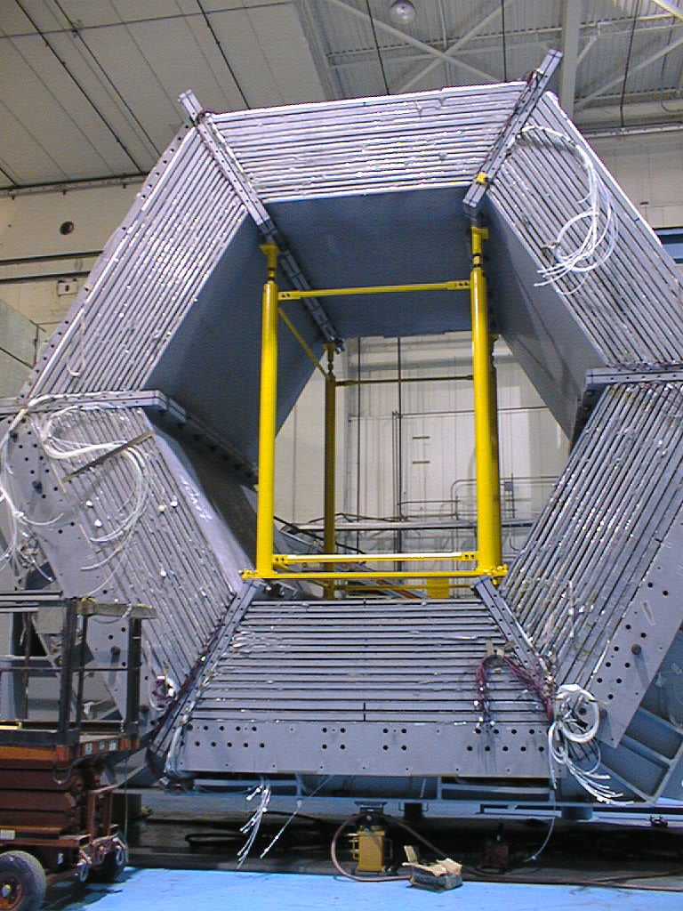
Barrel Section Installation

Slide 19
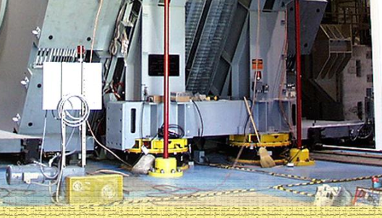
Vertical Adjustment
Assuming we will need the ability to adjust height of entire magnet vertically for proper alignment
“Jacks” appear to be bolted to the floor plates
Floor prep in Hall A?

Slide 20
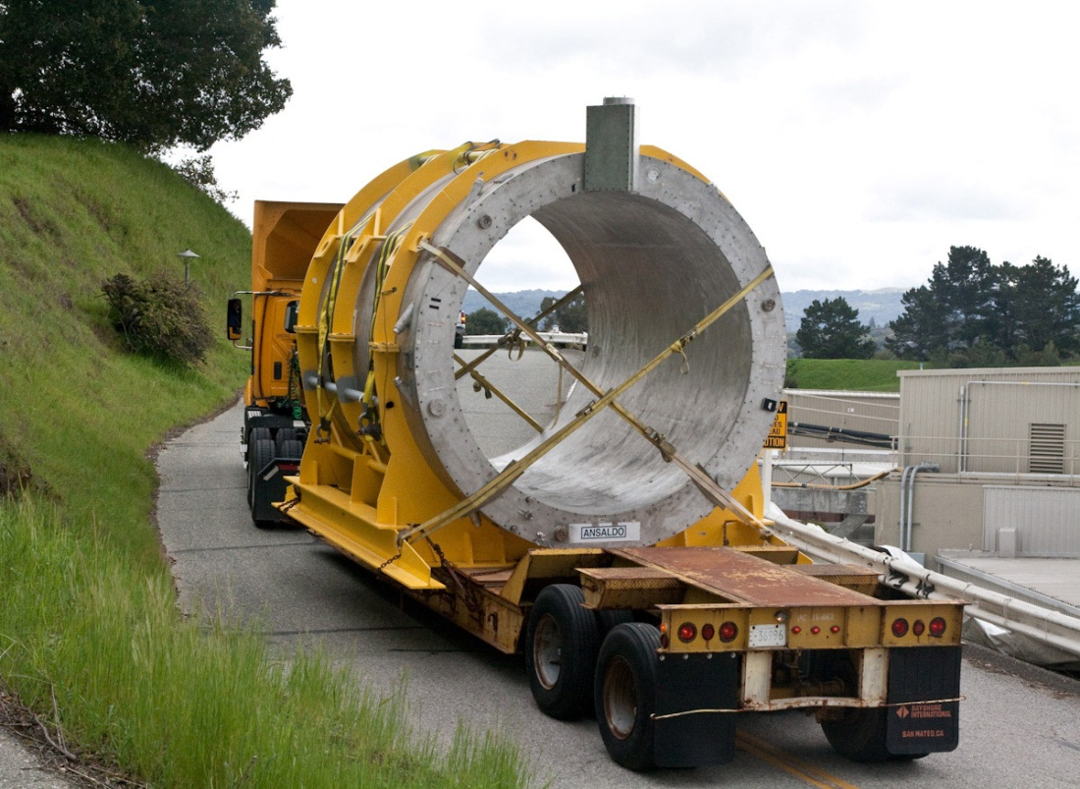
Cryostat Transport
Both cryostats will fit into the hall (barely!)
A custom transport trailer will be needed to wheel the cryostats down the truck ramp and fit under the top of the hall opening. Rigging companies might have something of this nature available.

Slide 21
Transportation Cost
Standard shipping limitations on US interstate highways
80,000 lbs gross vehicle weight – tractor, trailer, and payload (everything)
102” width
Height restrictions are set by individual states but can be as low as 13’ – 6”
Bigger loads require oversize permits and or overweight permits
These are issued by each state – can be charged by the pound over or per mile
Once a certain weight is reached specialized hauling equipment is required

Slide 22
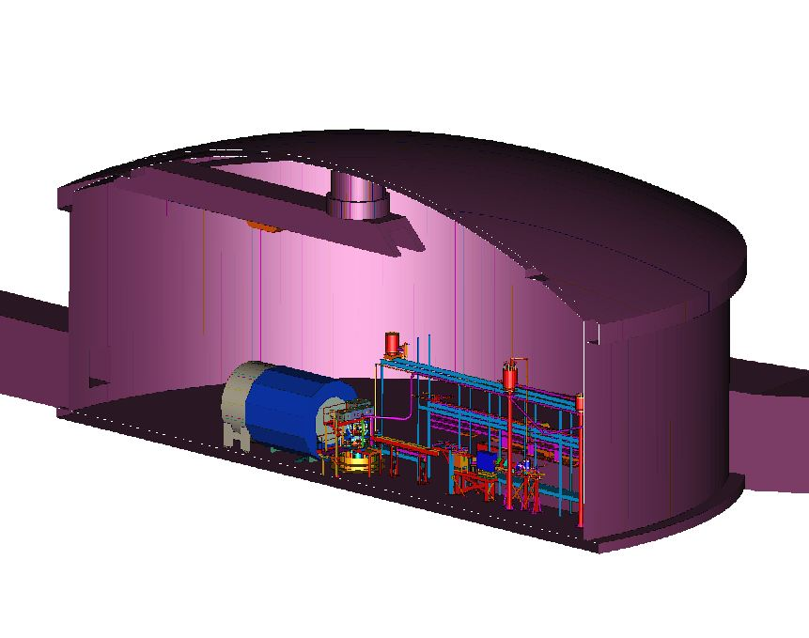
SoLID Location on Hall Floor
Where are HRS-L and HRS-R ?
to be determined

Slide 23
Estimate
Modified Parts K$ Eng/Des FTE
-Barrel Yoke Pieces 360 0.2
(24 pieces to be diamond wire cut)
New Parts
-Upstream Front Cap 677 0.5
(shield, front piece) 16’dia x 1.3’
$4.5/lb 75 tons
-Downstream End Cap 875 0.8
(bottom, nose) 4’dia x 5’, 19’dia x 1’
$4.5/lb 97 tons
-Detector Extension 660 0.2
(donut) 55 tons
$6/lb
-Downstream coil collar & hardware 500 1.0
-Magnet Support 350 0.4
(8 200 ton jacks + frame)
-Detector supports (design unknown) 500 1.0
-Shipping Cornell to Jlab 240
TOTAL $4.2M 4.1 FTE

