Slide 1


Experimental Requirements
Xin Qian
Caltech
Thanks inputs from Jian-Ping, Bob Michael, Paul and Haiyan.

Slide 2
Physics Program of SoLID
Parity Violation DIS: Quark Axial charge, Charge Symmetry Violation …
  Inclusive DIS
SoLID-Spin: Nucleon Spin, Tensor Charge, TMD, Quark OAM …
  Semi-inclusive Deep
  Inelastic Scattering (SIDIS)
SoLID-J/ψ: Nucleon Mass, Non-perturbative gluons
  Exclusive Process

Slide 3
Requirement of PVDIS
  Large scattering angle, x-range 0.25→0.75,
  W>2.0 GeV, factor of 2 in Q² range for each x
  ~5x10³⁸ N/cm²/s at 11 GeV to reach better than 1% error in each bin → Radiation hardness
  10⁻³ uncertainty in
  pion contamination
  DAQ: ~ 15 kHz per
  sector → 450 kHz
  in total.
  Precision polarimetry
  0.4%
  Precise kinematics calibration
Errors (%) for A_{PV} for bins in Q² and X. Total 120 days at 11 GeV and 60 days at 6.6 GeV for 50 uA and p_{e} = 0.85.
Standard model test
Charge symmetry violation
Higher twist
Sea
quaks

Slide 4
Concerns raised by Paul
HERMES calorimeter paper:
  Resolution
  Achieved pion rejection
What is the rate dependence in pion rejection factor?
What is the effect of pile-up?
Radiation load on detectors:
  How much power is deposited at various angle and on various elements?

Slide 5
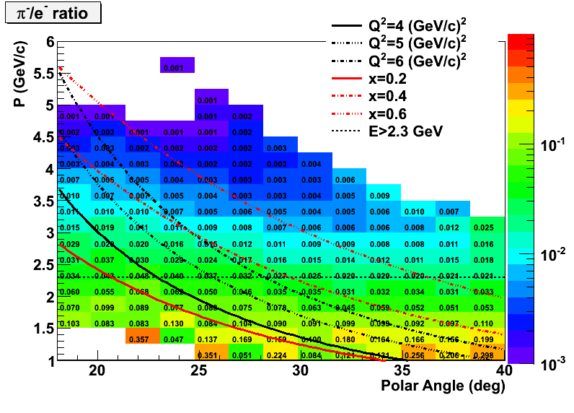
Preliminary Combination of E&M calorimeter and Gas Cerenkov (GC)
More realistic estimation in GC, multi-variable-analysis in E&M calorimeter to further reduce π/e ratio
Need measurement of pion asymmetry

Slide 6
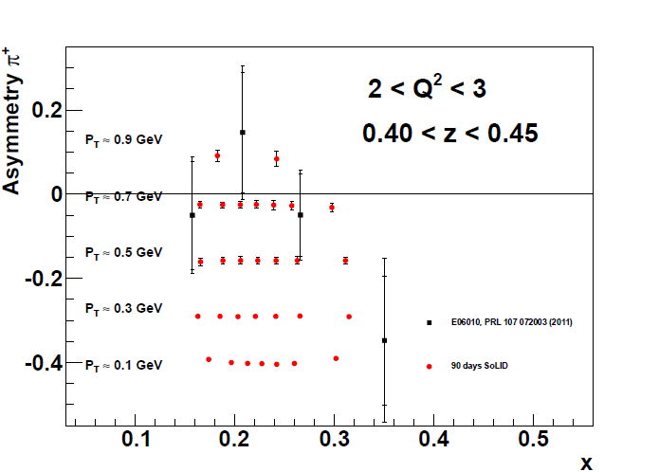
Projections on Collins Asymmetry (90 Days)
Collins 1/48 bins
4-D Mapping of Asymmetries
Similar for Sivers, DSA of 3He, less requirement for proton
Goal: <10% Tensor Charge, for each bin, we require
<0.2% stat. on neutron → <3e-4 on raw asymmetry
6% relative sys. + ~0.1% absolute sys. (neutron)

Slide 7
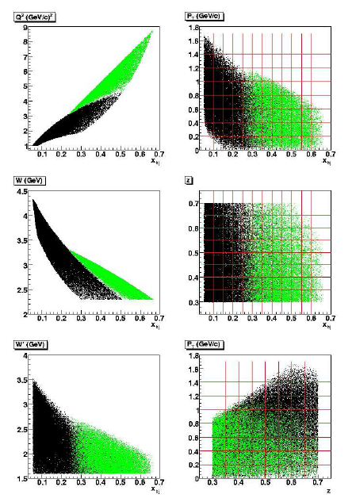
Requirement of SIDIS
Kinematics Coverage:
  0.05 ~ 0.6 in x (valence)
  0.3 ~ 0.7 in z (factorization region)
  P_{T} up to ~ 1 GeV (TMD Physics)
  Fixed target → Q² coverage 1-8 GeV² (~ 2 GeV² in ΔQ² at fixed x)
Polarized ³He Target:
  Unpolarized ~ 10³⁷ N/cm²/s
  ~ 60% higher polarization
  Fast spin flip (<20 mins)
Polarized NH3 Target:
  Unpolarized ~ 10³⁶ N/cm²/s
  ~70% higher polarization with spin flip

Slide 8
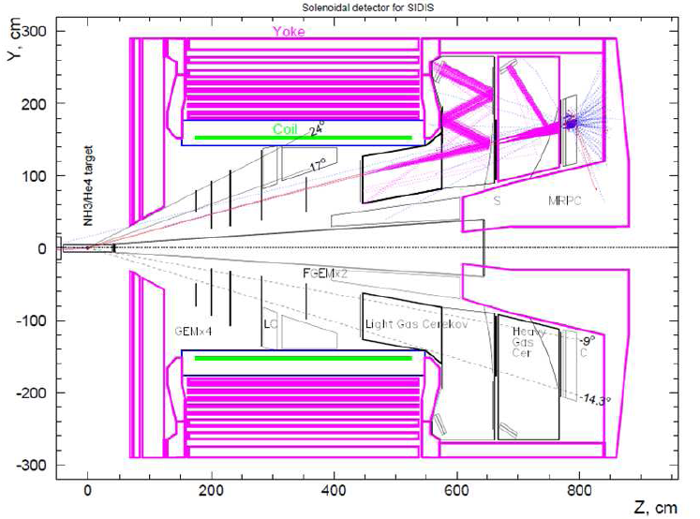
Requirement of SIDIS
DAQ:
  ~ 3kHz Physics Coincidence
  ~ 100 kHz Single electron
  ~ 60 kHz Coincidence
  Limits: 300 MB/s to tape.
Electron PID:
  <1% Pion contamination (asymmetry point of view)
Pion PID:
  <1% Kaons and Protons
  <1% electron contamination

Slide 9
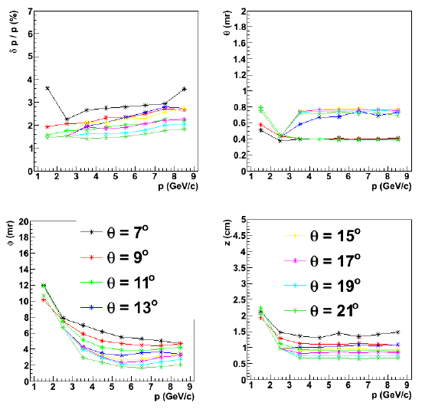
Requirement of SIDIS
Optics of Reconstruction:
  < a few % in δP/P.
  < 1 mr in polar angle.
  < 10 mr in azimuthal angle
  ~ 1-2 cm vertex resolution
  Similar precision required
  MC results supported a factor of 2-3 better
  performance

Slide 10
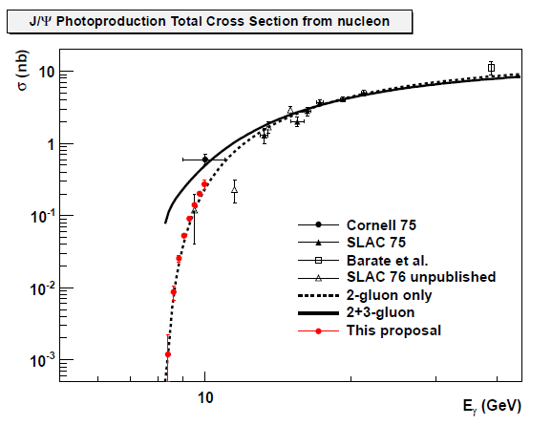
Projection of SoLID-J/ψ
4-fold coincidence:
  2g-only: 0.68 k events
  2g + 3g: 2.9 k events
3-fold no proton:
  2g-only: 2.1 k events
  2g+3g: 8.08 k events
Goal: <10% Cross section measurement

Slide 11
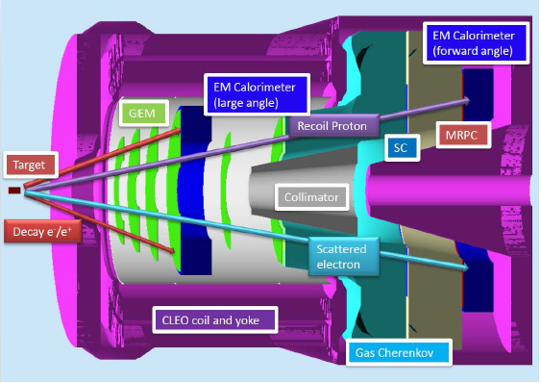
Requirement of J/ψ
11 GeV + 15 cm Proton Target
Luminosity: >= 10³⁷ N/cm²/s
DAQ: Triple Coincidence Trigger
  scattered electron, decay electron and decay positron from J/ψ ~ 3 kHz
PID: E&M calorimeter for decay e⁻/e⁺
additional gas Cerenkov for scattered e⁻ MRPC-TOF for recoil proton
Notes:
Add one slide about the solution of Xs

Slide 12
Cross Section Validation (Leptonic+Photon)
 | Bethe-Heitler | ω | ρ | φ | η
Xs | 0.1 ub | 1ub | 1ub | 50 nb | 10 ub
Decay Channel and BR | e⁺e⁻ 1.0 | e⁺e⁻ 7.3e-5 | e⁺e⁻ 4.71e-5 | e⁺e⁻ 2.97e-4 | Γγ 0.39
Compared to Jpsi | >10 | X2 | x1 | X0.5 | Large
SoLID capability | good | good | good | good | good
Other Channels: SIDIS channel, e+p elastic for optics calibration, Exclusive Channel ( neutral pions, Omega and Rho) also missing mass technique.

Slide 13
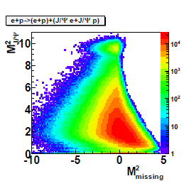
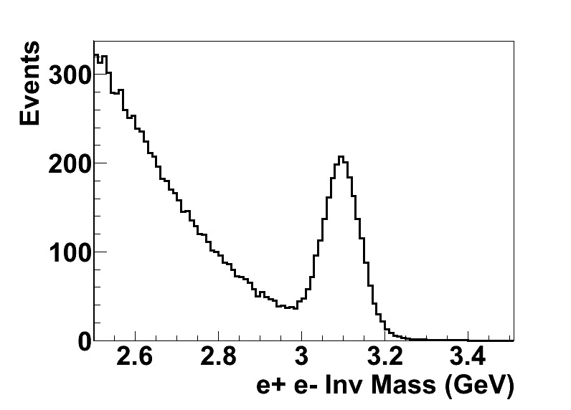
Requirement of J/ψ
Detector resolution: δP/P<2%, δθ~0.6mr
δφ~6mr, and δz_{vertex}~1cm essential for background reduction

Slide 14
 | PVDIS | SIDIS | J/ψ
Luminosity (N/cm²/) | ~5x10³⁸ → Radiation Hardness + Baffle design + pileup | <=10³⁷ Sheet of flames in proton-SIDIS | More than10³⁷ →detector requirement
PID | 10⁻³ uncertainty in pion contamination → GC + E&M | MRPC + HG → π E&M + LC → e | MRPC→Proton
Detector Resolution/Calibration | Q² | Angular and momentum | Absolute momentum
Polarimetry | 0.4% in beam polarization | >60% 3He >70% NH3 spin flip & yoke design | N/A
DAQ | ~30x15 kHz total trigger rate | ~100 kHz trigger rate, GEM pad readout? | Triple coincidence
Online Farm → Tracking/optics | Essential to reduce file size | Essential to keep coincidence | Important at higher luminosity
Systematic uncertainty | <0.5% relative | Abs. 1e-3 (neutron) + 6% relative | <10% Xs measurement

Slide 15
Detector Requirement
E&M calorimeter: ~100:1 Pion rejection
Light Gas Cerenkov ~1000:1 Pion rejection
GEM position resolution: ~ 100 um (10 degree readout)
  GEM pad readout in trigger?
Heavy Gas Cerenkov: >10:1 Kaon rejection
MRPC TOF: 80 ps timing resolution
Color Legend: PVDIS, SIDIS, J/ψ
Magnetic field: → ~2% momentum resolution
Yoke design: force limit on coils

Slide 16
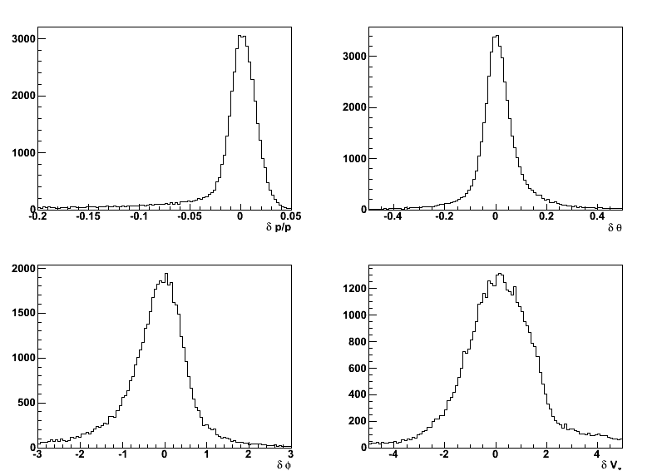
Starting Model of Optics
Along z, the trajectory is a circle.
With Radius R, and distance along z
  One can get P_{T}/P_{L} -> polar angle
  Combine R and magnetic field, one can get P_{T} -> P
  Azimuthal angle can be determined at the point when the particles enter magnetic field + theta angle
  Vertex can be determined by
  unfolding the trajectory +
  polar angle + hit positions.
With MC, we can
do optics (input/output
known)

Slide 17
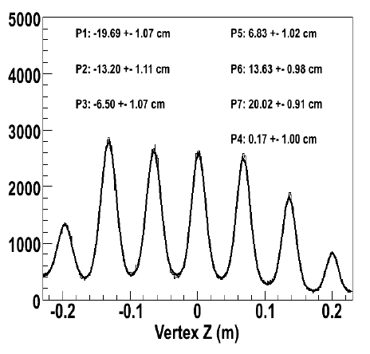
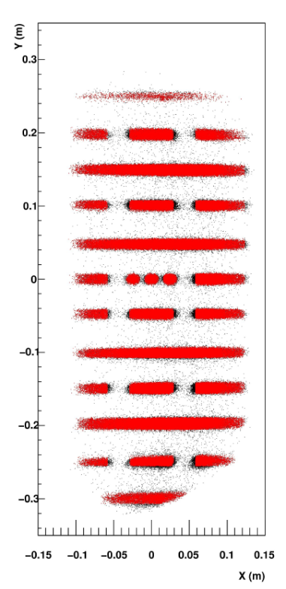
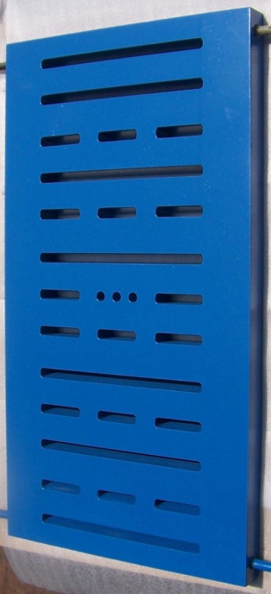
Initial Idea
Similar to BigBite:
Multi-Carbon foils
for vertex reconstruction.
Sieve for angular calibration
e-p elastic scattering
for momentum
calibration
at 1 and 2 pass.
Need lower mag.
field setting for
SoLID
Other ideas?
BigBite Sieve Slit

Slide 18
Optics Working Plan
Current Optics Model is good for director review etc.
Future working plan includes:
  Design the detailed optics working plan (beam energies/current, beam time, target, settings, and checks)
  Generate simulated data to demonstrate optics reconstruction according to optics working plan.
  We MUST achieve this before data taking, since tracking needs this information as input (online).

Slide 19
System Integration
Electron ID: Light Gas Cerenkov + E&M calorimeter (PVDIS)
Pion ID: Heavy Gas Cerenkov + MRPC (SIDIS)
Yoke Design + Target/phase space (SIDIS + J/ψ)
DAQ + online farm with tracking ability
  Fast GEM calibration, also calorimeter calibration
  Quick optics calibration, essential input to tracking
Detector reconfiguration between PVDIS and SIDIS+J/ψ
Detector reconfiguration for proton-SIDIS due to sheet of flames

