Slide 1
Status of MRPC-TOF
Wang Yi
Department of Engineering Physics
Tsinghua University, Beijing, China

Slide 2
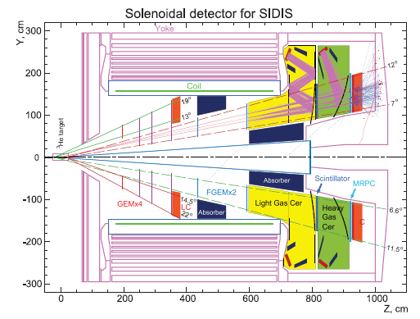
Outline
Conceptual design of TOF
Beam test results
  Layout
  Preparation
  Some Details on Setup
Conclusion
  Test Results
  Comparison
  Conclusion

Slide 3
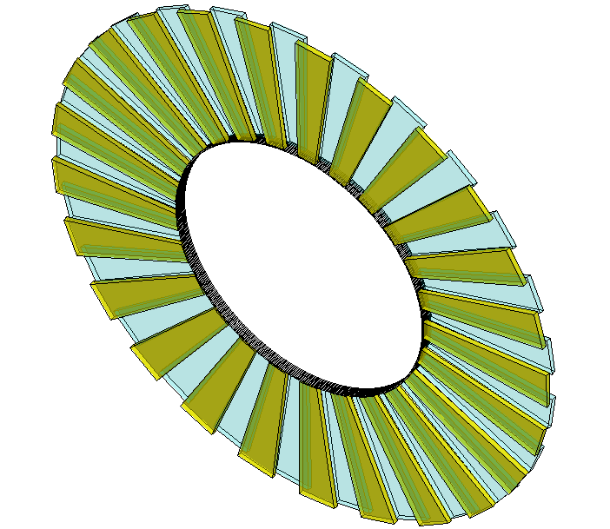
1.Conceptual design of SOLID-TOF
The MRPC is developed for the TOF of SoLID
Main Requirements for TOF:
  π/k separation up to 2.5GeV/c
  Time resolution < 80ps
  Rate capability > 10kHz/cm²
MRPC TOF wall we designed contain 150 MRPC modules in total, with 50 gas boxes and 3 counters in each box, covering the area of 10m².
MRPC3
28cm
MRPC2
16cm
100cm
MRPC1
Total channel ~3300
The MRPC module we tested is the prototype of smallest one.

Slide 4
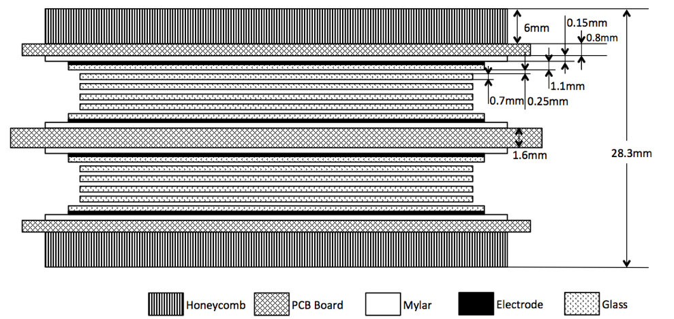
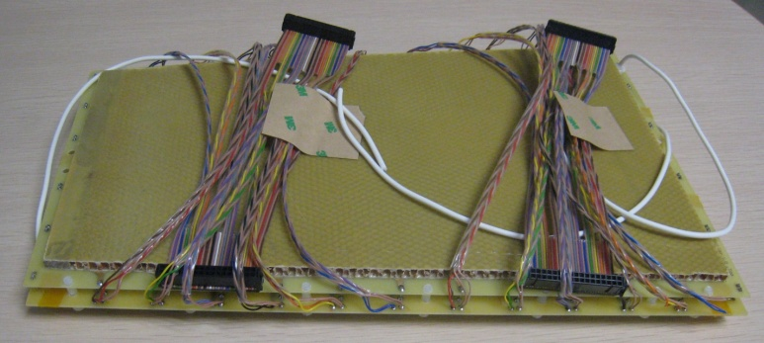
1.Introduction: MRPC module
The prototype of high rate MRPC modules with low resistivity glass electrodes can work under the flux of 60kHz/cm² in previous test in HZDR and GSI.
Low resistivity glass is black in color, and the volume resistivity can reach ~10¹⁰Ω.cm. (For float glass, the volume resistivity is ~10¹²Ω.cm)
Volume resistivity: ~10¹⁰Ω.cm

Slide 5
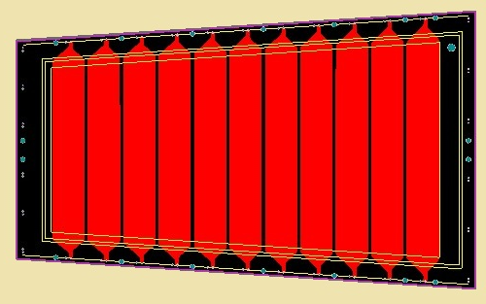
1.Introduction: MRPC module
Gas Mixture(Pre-mixed) | Freon 90% iso-butane 5% SF6 5%
Working Voltage | ±6800V
Electrical field | ~108.8kV/cm
171mm
219mm
The design of MRPC readout
Interval | 3mm
Strip width | 25mm
Readout mode | Differential
363mm
Dimensions
 | Length/mm | Width/mm | Thickness/mm
Gas gap | - | - | 0.25×10
Inner glass | 320 | 130-171 | 0.7
Outer glass | 330 | 138-182 | 1.1
Mylar | 335 | 153-198 | 0.18
Inner PCB | 350 | 182-228 | 1.6
Outer PCB | 350 | 172-218 | 0.8
Honeycomb | 330 | 153-198 | 6
Mylar
Outer glass
Inner glass
Inner PCB
Outer PCB
Honeycomb

Slide 6
TOF electronics
Fast preamplifier：
Maxim3760 (RICE Univ.)
Ninos (TOT) (ALICE)
Padi (TOT) (GSI)
CAD (TOT)(Tsinghua)
QDC (CAEN, 25fC/bin)
TDC
HPTDC (ALICE, 25ps/ch)
GET4 (GSI, 25ps/ch)
FPGA TDC (GSI and other)
DAQ

Slide 7
Comparison of different FEE
 | CAD-1.0 | PADI-1 | NINO-25 | NINO-13
Peaking time | ~1ns | <1ns | 1ns | 0.6ns
Linear range | 1000μA^{*1} | -60-60μA^{*1} | 0-100fC^{*2} | 0-100fC^{*2}
Time jitter | <20ps, rms^{*3} | <15ps, rms^{*4} | 10-25ps, rms | 6-25ps, rms
Power consumption | 10mW/ch | <30mW/ch | 30mW/ch | 5mW/ch
Input type | S.E. | DIFF. | DIFF. | DIFF.
Input impedance | 50-70Ω | 48-58Ω | 30-100Ω | 30-100Ω
Discriminator threshold | 263μA^{*1} | 10-400μA^{*1} | 20-100fC^{*2} | 20-100fC^{*2}
CMOS process | 0.35μm | 0.18μm | 0.25μm | 0.13μm
*1: for current pulse with 0.3ns rise time, 1-2ns FWHM, and 0.3ns fall time
*2: for square current pulse with 200ps width
*3: for 200μA input current
*4: for 100μA input current
7

Slide 8
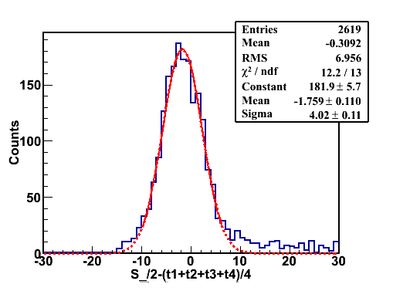
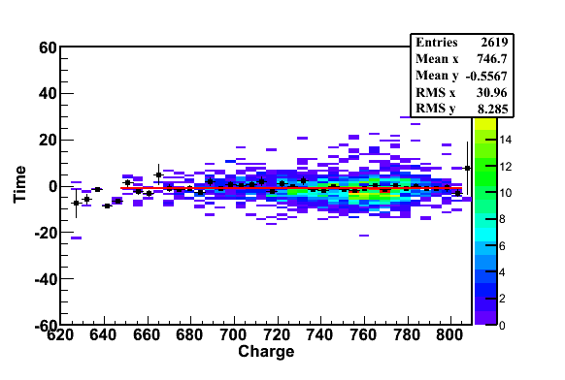
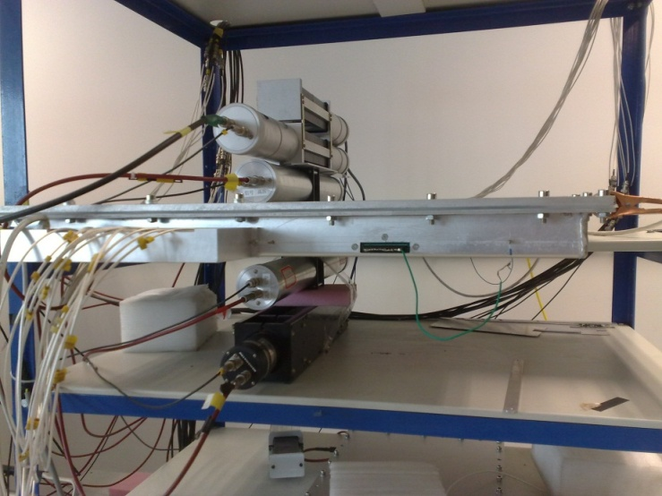
Cosmic test
Cosmic ray test@Tsinghua August, 2011
PMT0
PMT1
PMT2
MRPC
PMT3
PMT4
Cosmic Ray Muon
Efficiency > 95% @ 96kV/cm (6.0kV)
Time resolution: ~ 52ps

Slide 9
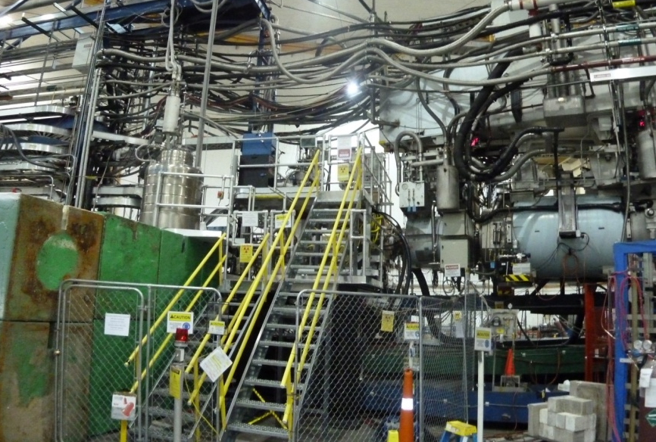
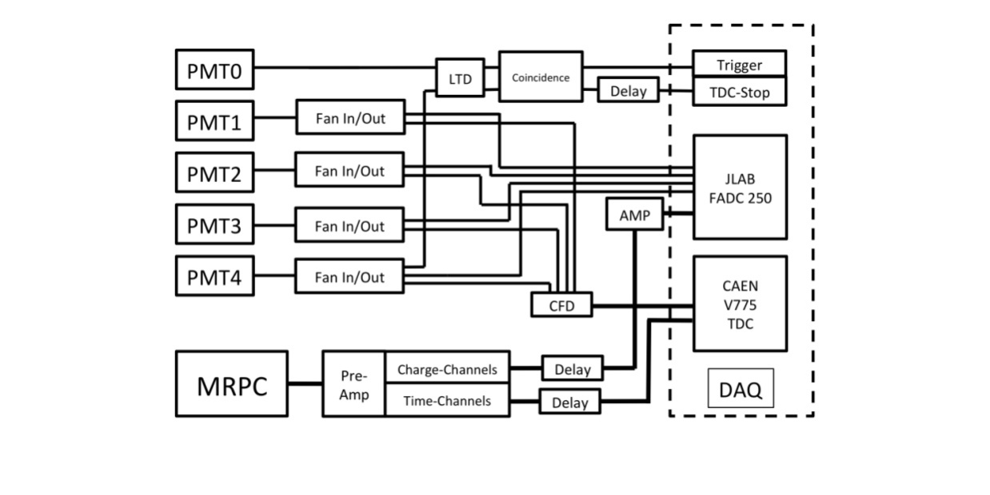
2.Beam test @ Hall A
Shield
High Energy e-
PMT1
PMT3
Target
PMT0
PMT2
PMT4
Top View
Target
Test setup
The diagram of DAQ system

Slide 10
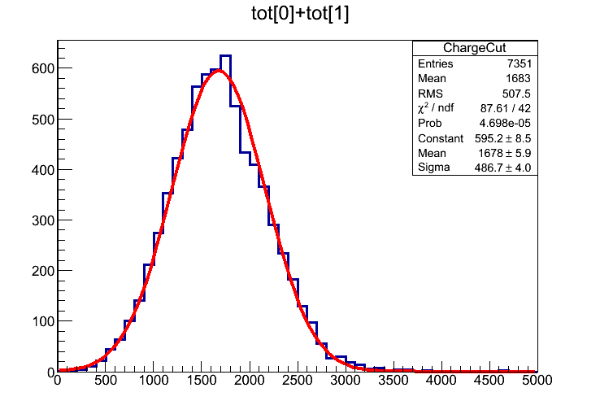
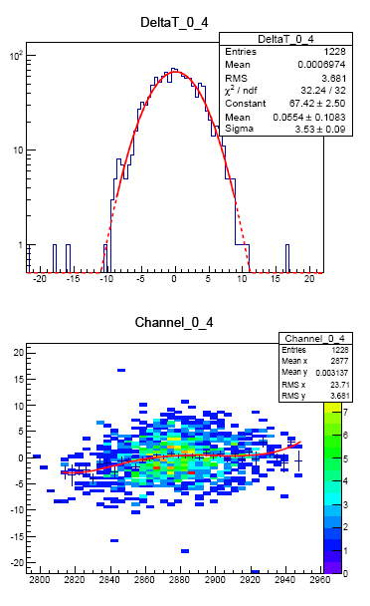
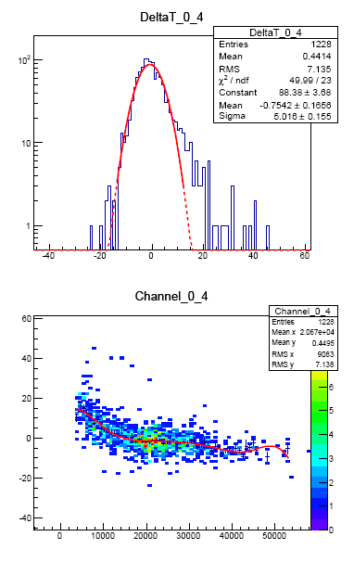
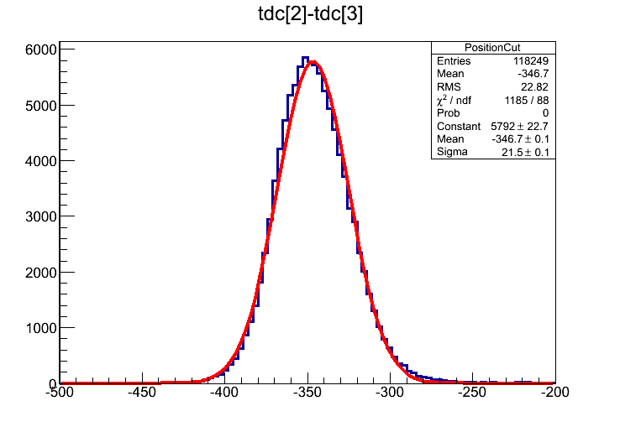
5.Results & Comparison: Calibration
Example: r175
Operated on May 13th
High Voltage: ±6800V
Condition: 10m from
target, shielded
Charge Cut：2 σ
Position Cut：2 σ
PMT before calibration
MRPC before calibration
4 calibrations

Slide 11
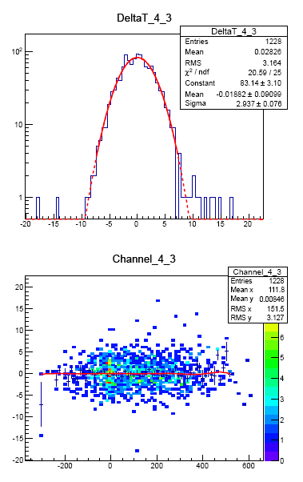
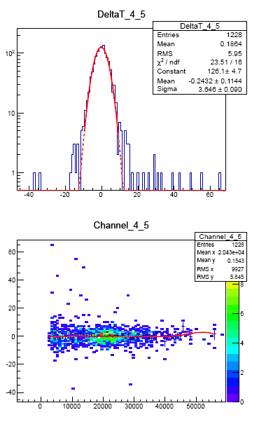
5.Results & Comparison: Calibration
Example: r175
Operated on May 13th
High Voltage: ±6800V
Condition: 10m from
target, shielded
Time resolution: 76ps
σ-PMT = 2.937(102.8ps)
σ-MRPC = 3.646(127.6ps)
σ-MRPC = 2.16(75.6ps)
Calibration of PMT
Calibration of MRPC
In this test, T₀ is about 100ps, the time resolution is deteriorated.

Slide 12
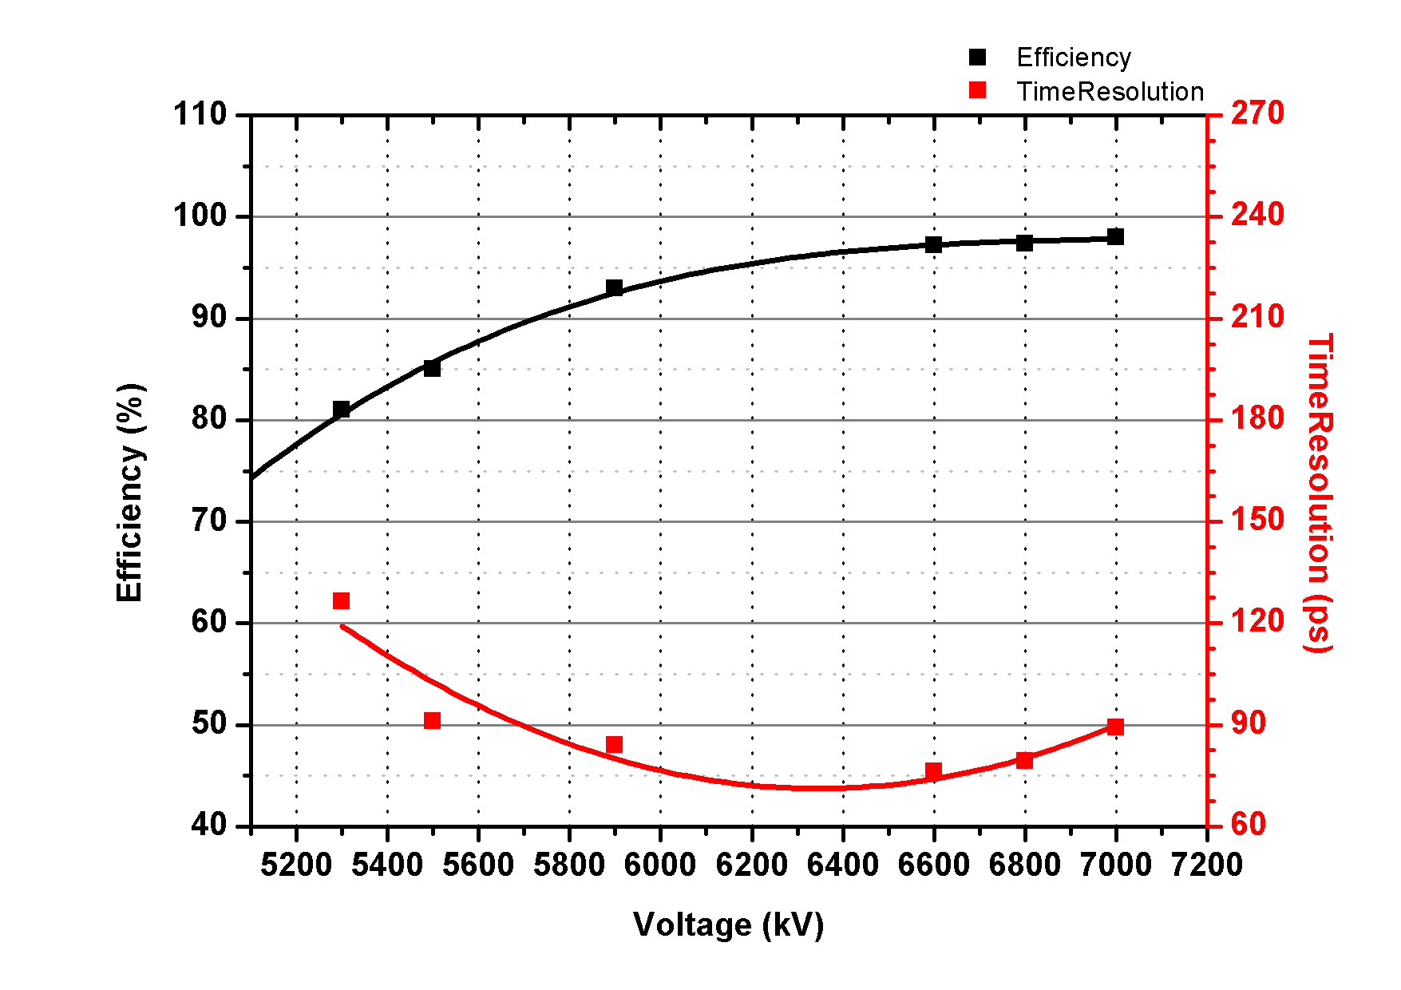
5.Results & Comparison: HV Scan
Efficiency: >95%
Time Resolution: ~75ps

Slide 13
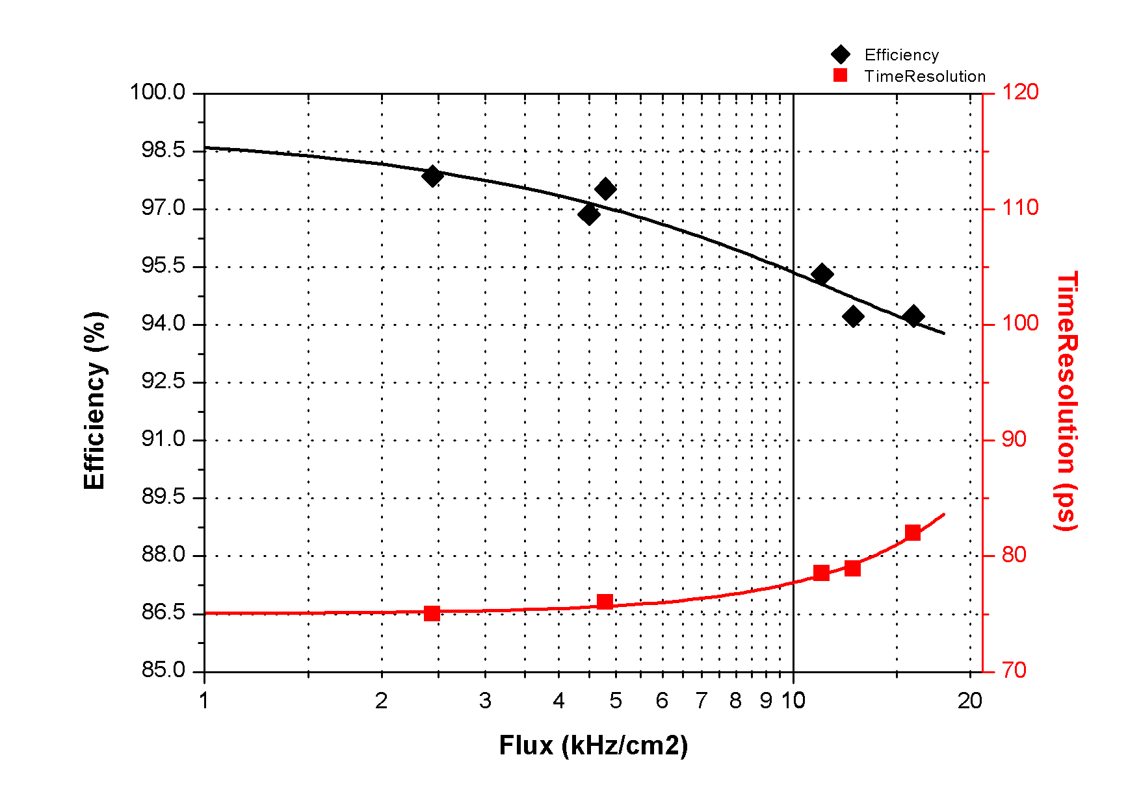
5.Results & Comparison: Rate Scan
Voltage: 6800V
Flux:11kHz/cm²
Efficiency:~95%
Time Resolution: 78ps
Flux:16kHz/cm²
Efficiency:~95%
Time Resolution: 82ps

Slide 14
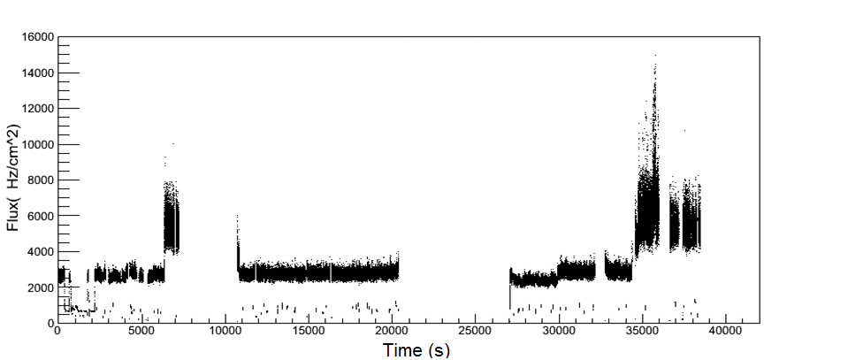
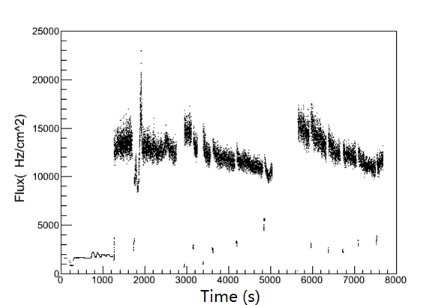
5.Results & Comparison: Flux vs. Time
Run188, 6800V (5m to target, shielded)
12kHz/cm²
6kHz/cm²
2.5kHz/cm²
Run193, 6800V (5m to target, not shielded)
During a run, flux is not on a stable level, which from less than 3kHz/cm² to 16kHz/cm².
We can observe the performance by selecting data from different flux.
16-18kHz/cm²
14-15kHz/cm²

Slide 15
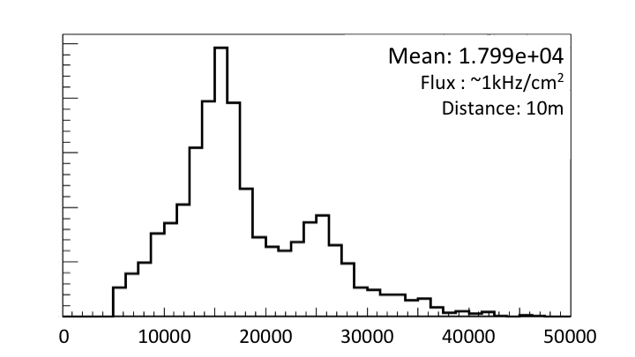
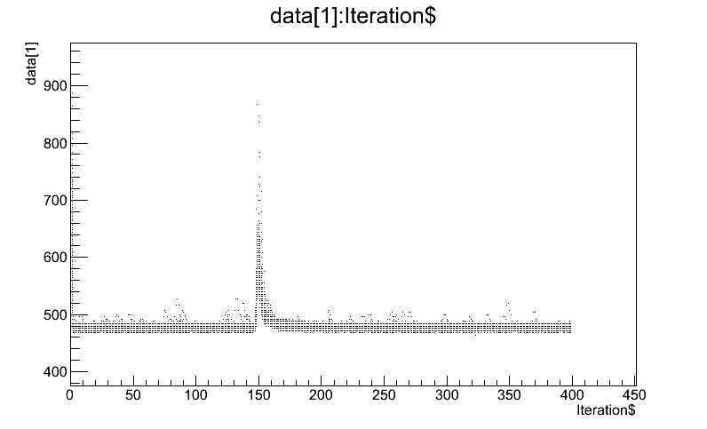
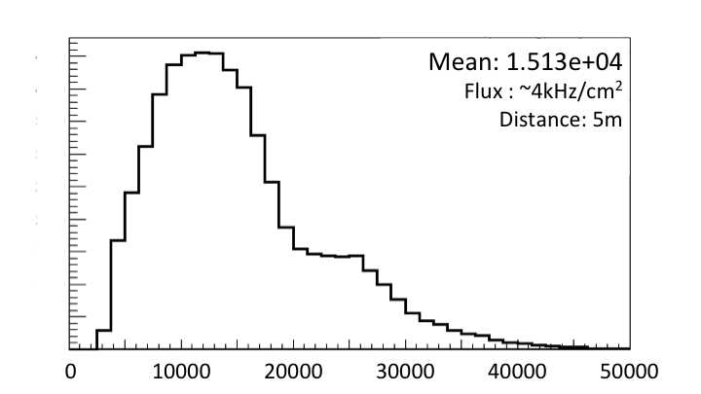
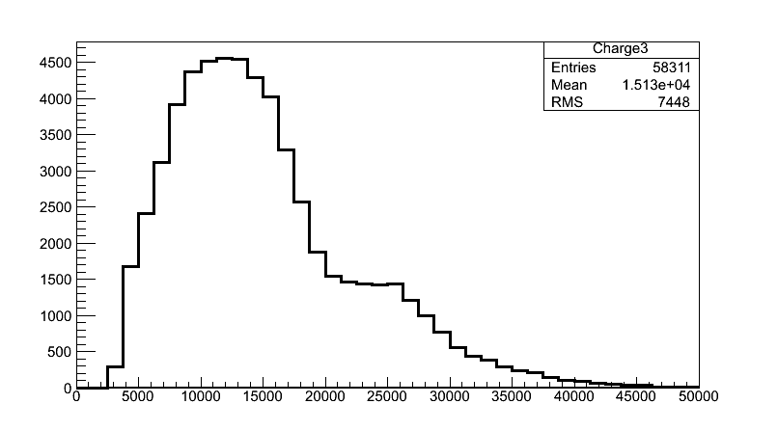
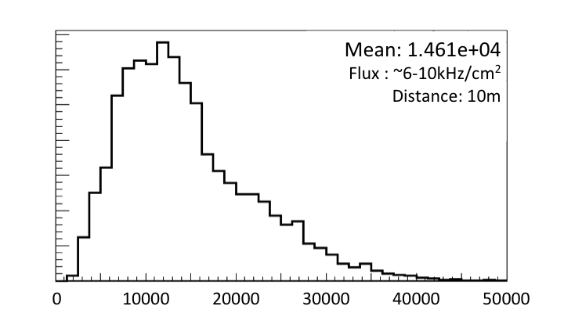
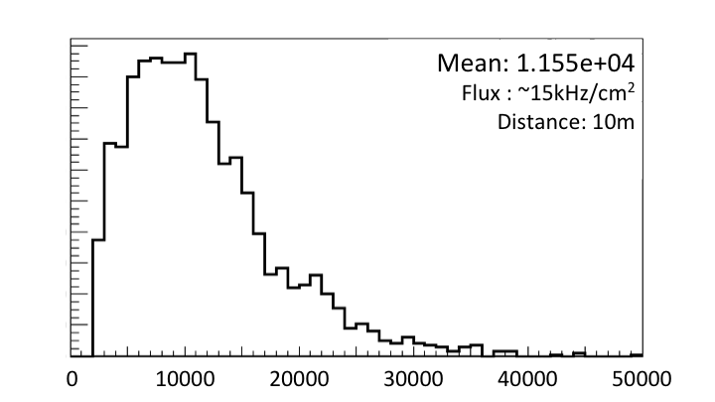
5.Results & Comparison : Charge Distribution
Signal
Base Line
Charge spectrum at different rate
Significant reduction of charge distribution can be seen as the background rate increases.
The reduction of electrical field is caused mainly by both background irradiation and electron beams.
Rate capability of the counter is higher than 15kHz/cm².

Slide 16
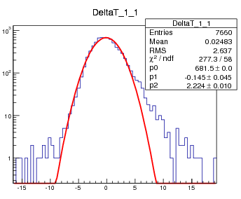
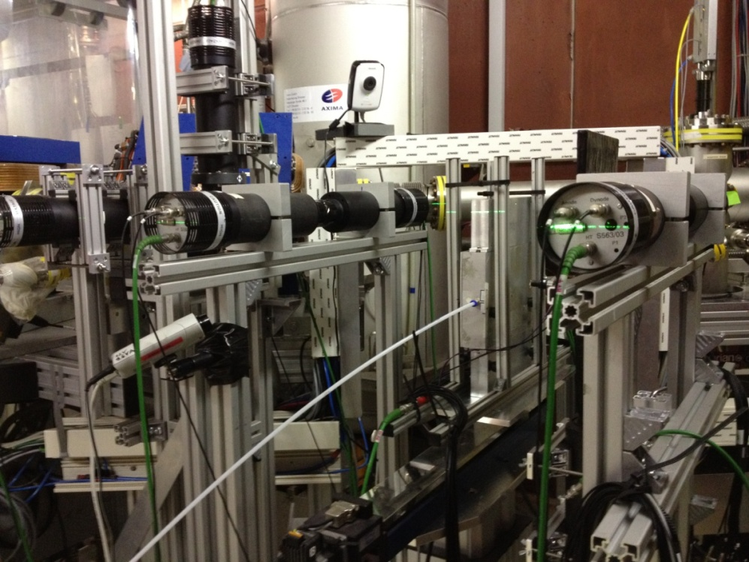
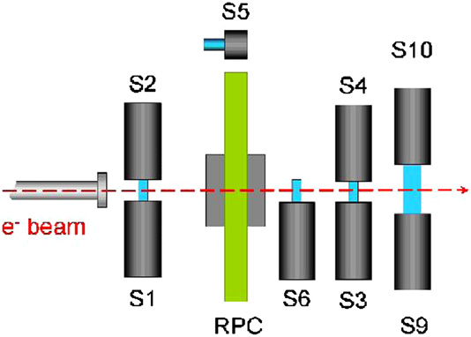
5.Results & Comparison : Beam Test
Beam Test@HZDR June, 2012

Slide 17
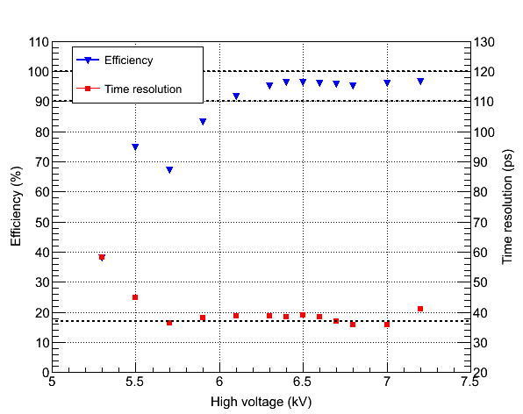
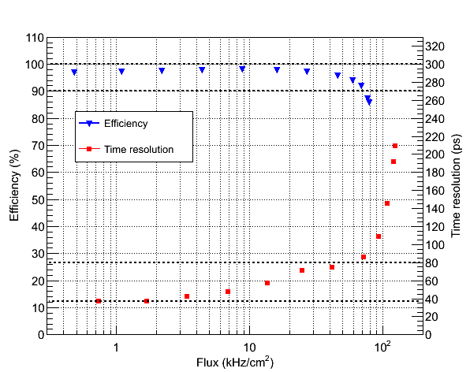
5.Results & Comparison : Beam Test
Beam Test@HZDR June, 2012
Time Resolution < 40ps
HV scan
Rate scan
17

Slide 18
6.Conclusions
Performance of MRPC is measured. The time resolution can reach 70-80ps and the efficiency is higher than 95%. The flux is up to 16kHz/cm².
The MRPC module is placed within 10m to the Target for 2 months, without significant performance deterioration. This means that the module can withstand long time irradiation.
The Irradiation is uniformed. During Test, the current is large even when the rate is not very high, which means the photon or neutron background irradiation is very strong.

Slide 19
Thank you!
End

