Slide 1
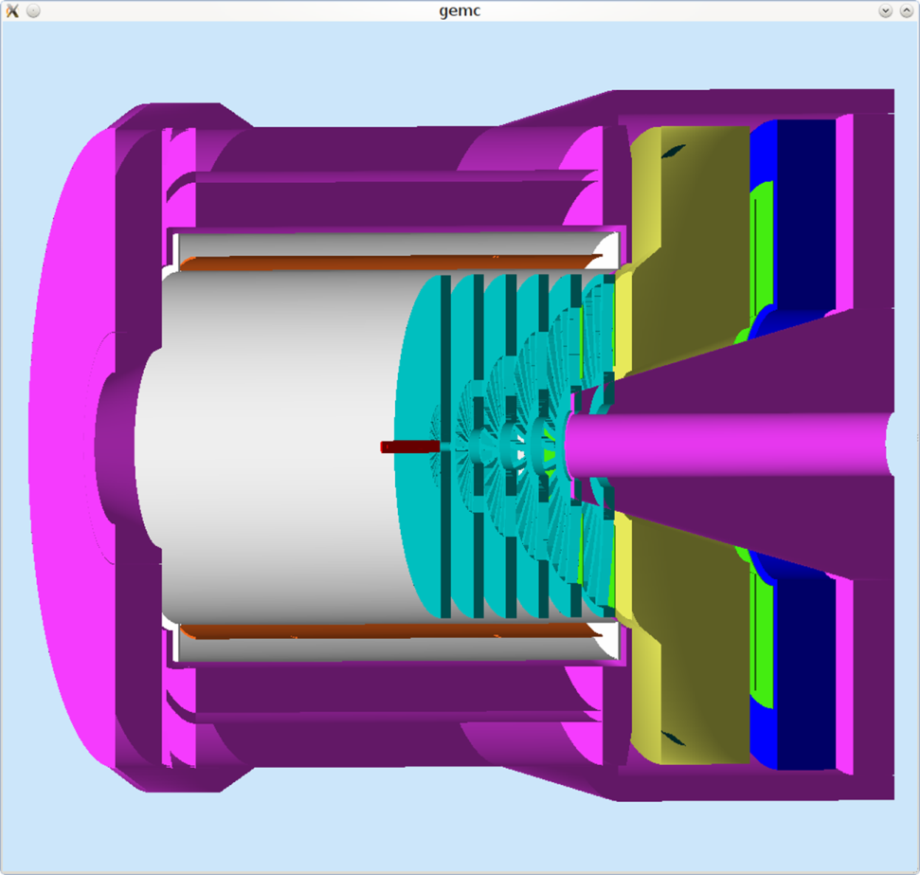
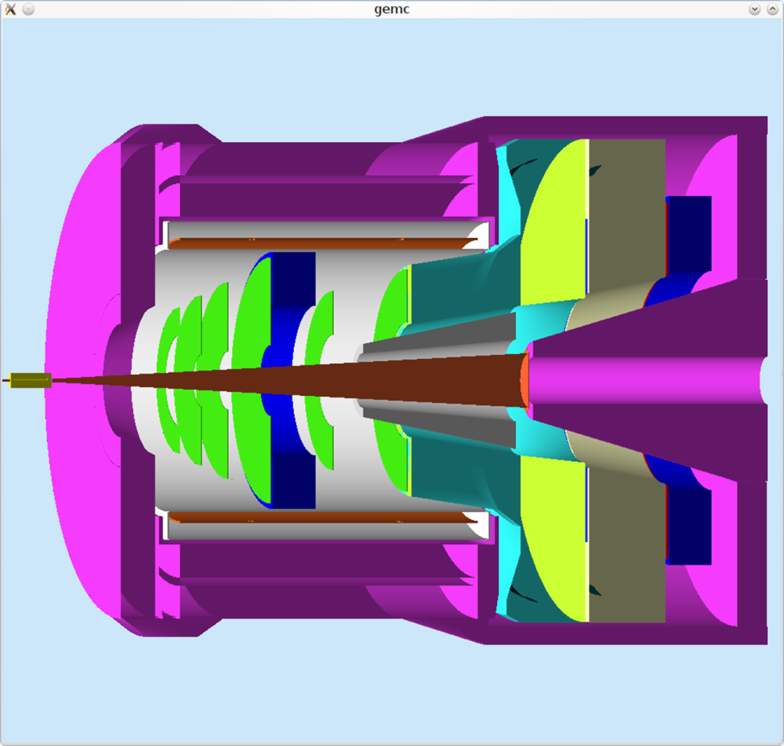
Track Vectoring
T.K. Hemmick

Slide 2
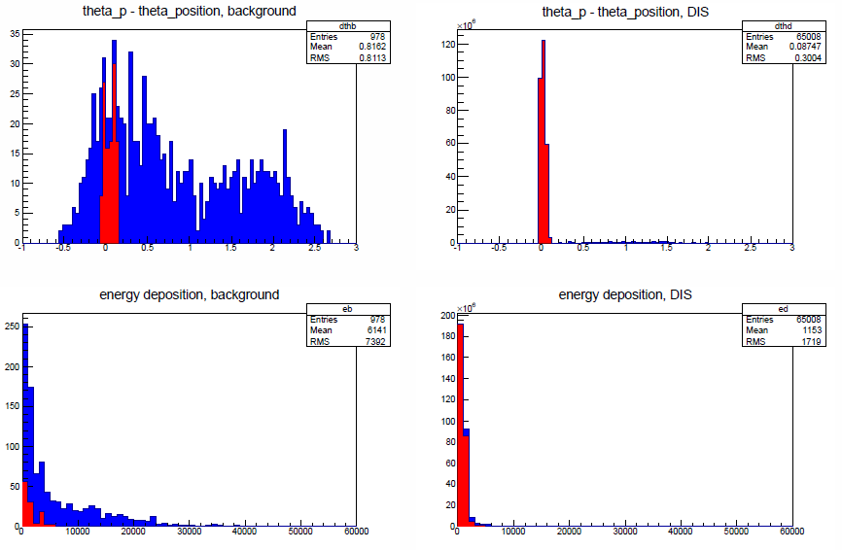
Background in SoLID Trackers
Bkg non-Projective
Signal Projective
BKG Large Signal
Signal MIP
Studies by Richard Holmes.
PVDIS w/no baffles…

Slide 3
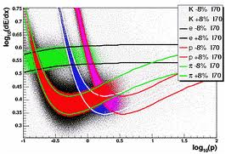
How to measure both?
Mesh
Primary Charge
Fluctuation
Drift Gap
17mm
GEM 1
Transfer 1
1.5mm
GEM 2
Transfer 2
1.5mm
GEM 3
X-Y Strips
Induction
2mm
Pitch: 400um
Preamp/Shaper
E-deposit measurements plagued by Landau Tail.
Measure more samples on the track.
Use a “truncated mean” to refine dE/dx.
ALSO does e/pi separation at low momentum.
Thick collection gap = track vector.

Slide 4
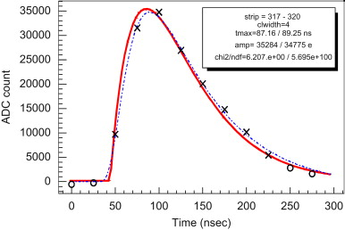
Downside: Data Size
Ghost of Tracks Yet to Come
signal
Extra data
Orig. data
Signal:
--Starts on time
--Ends on time
--Single channel
Ghost of Tracks Past
A detector “layer” comes from the pre-amp shaping time.
Simple model: Detector is like layers
“Synchronous” Background: Data up, occupancy same.
“Asynchronous” Background: Data up, Occ up
Possibly untenable due to high background rates.
Requires quantitative analysis

Slide 5
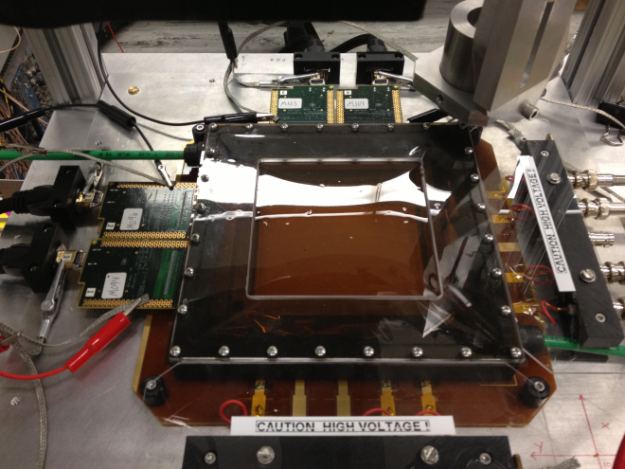
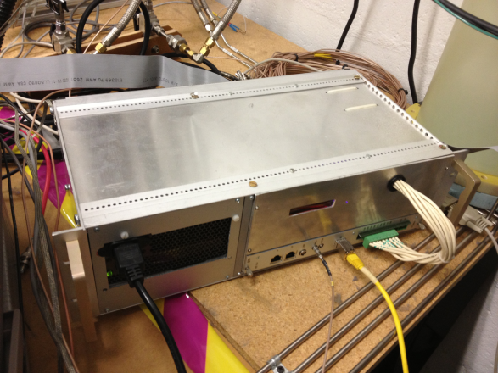
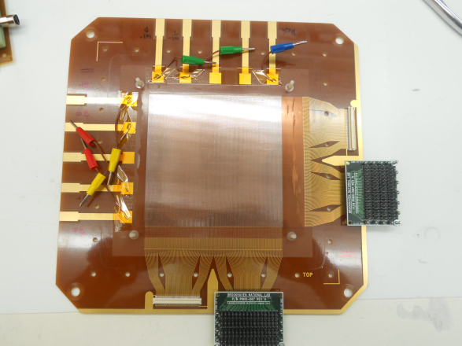
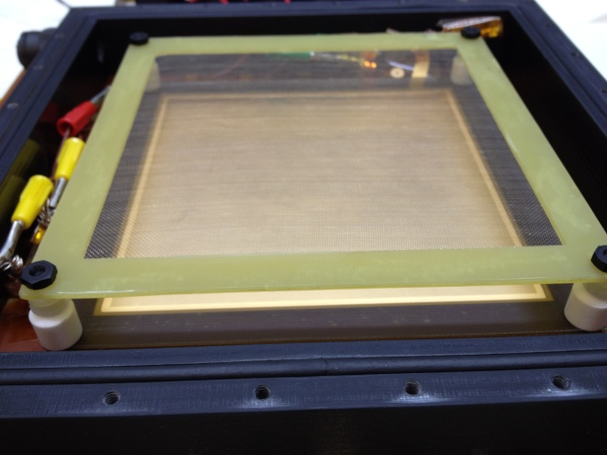
Mini-Drift GEM Det. + SRS Readout
Y
X
Std. 10x10cm CERN 3-GEM Det.
ArCO2 (70/30)
Gain ~ 6500
~17mm Drift Gap
Drift Time ~600ns
SRS /512 channels APV 25
30 x 25ns Time Samples
Martin Purschke’s newly
developed RCDAQ
affords high flexibility
COMPASS style Readout:
256 x 256 X-Y Strips
~10cm x 400um pitch
Mesh
Primary Charge
Fluctuation
Drift Gap
17mm
GEM 1
Transfer 1
1.5mm
GEM 2
Transfer 2
1.5mm
GEM 3
X-Y Strips
Induction
2mm
Pitch: 400um
Preamp/Shaper

Slide 6
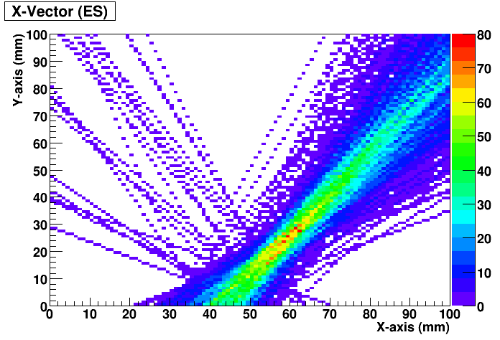
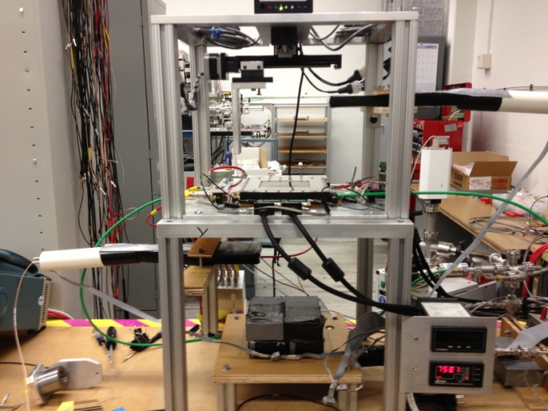
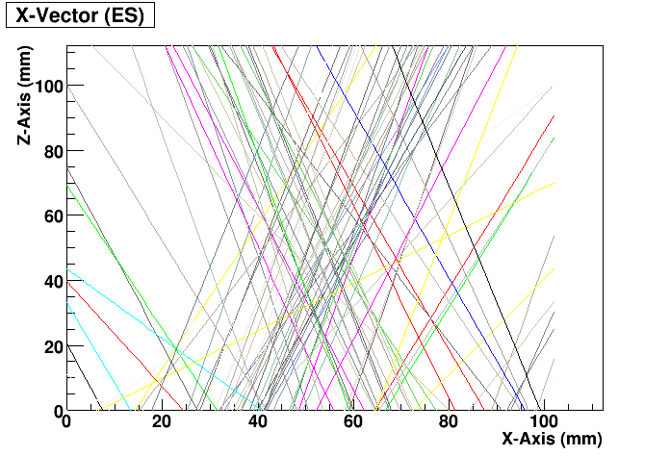
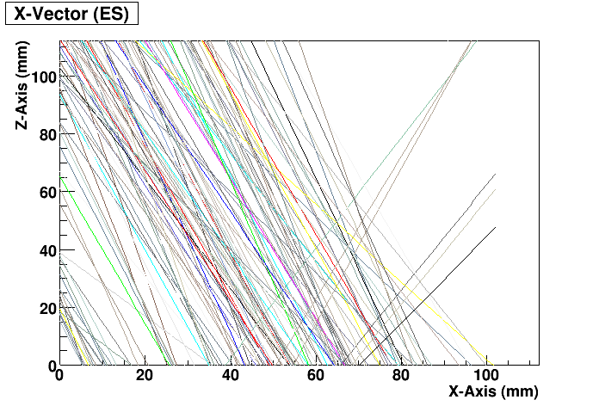
Preliminary Bench-Top Measurements
GEM trigger doesn’t provide precise timing, so rely on ability to measure the first pad fired as a measure of t_zero
Det. requirements: high gain, low noise, low diffusion gas
Use timing from ADC to reconstruct z-coord. of track
Reconstructing Low Energy Sr90 β⁻ Tracks
Brass Source Holder
Sr-90
~50mm
Reconstructed Vectors
1.00mm hole
Tungsten Collimator
1nF
GEM TRIGGER
Reconstructing Cosmic Ray Tracks
Reconstructed Vectors
Top Scintillation Counter
Y-Vector
GEM Detector
Y-axis
X-Axis
Y-Axis
Bottom Scintillation Counter
Y-Axis (mm)

Slide 7
Measuring Tracks at CERN Beam Test
Test Beam Set Up at ENH1-H6 SPS Beam
Jura
L1
178
TOP VIEW
410
X
Freiburg frame
(π⁺, +120GeV/c)
1250
Tmm2
T1
T3
T5
T7
Tmm5
XY
205
irradiated
veto
Sci
2
41
R17A
XY
Beam profile
wire chamber
726
XY
X
X
X
X
XY
x
XY
XY
X
X
X
X
XY
s1
s256
s640
5
z
-θ
26
26
26
15
y
s128
finger
Sci (SA)
s256
s1
s1
5
170
Si3
Si6
Si1
SC
SB
Z1
3-GEM
Mini-Drift on
Rotating Table
Tmm3
T2
T4
T6
T8
Tmm6
Y-inverted
SB
R17B
SD
Saclay
10-12 Layer Micromegas Telescope
Si Tracking System
Saleve
Si Tracker
120GeV/c
π+
MM Telescope
Mini-Drift GEM

Slide 8
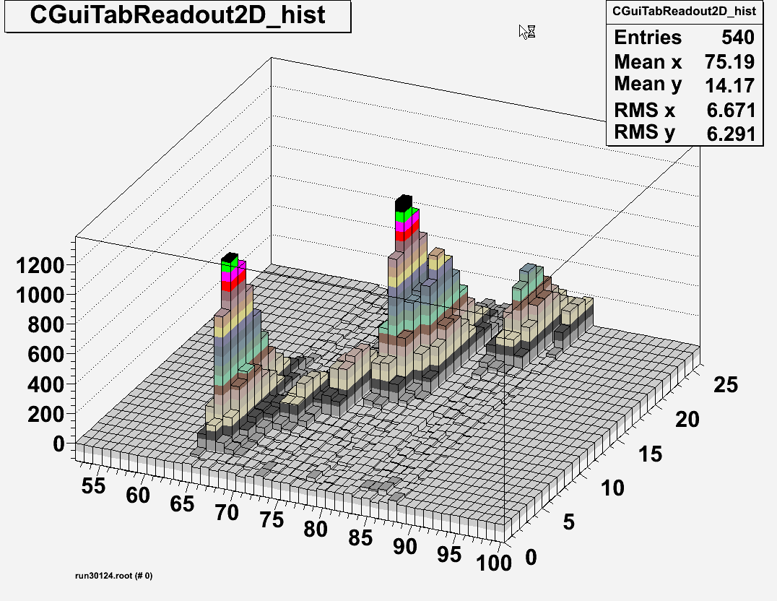
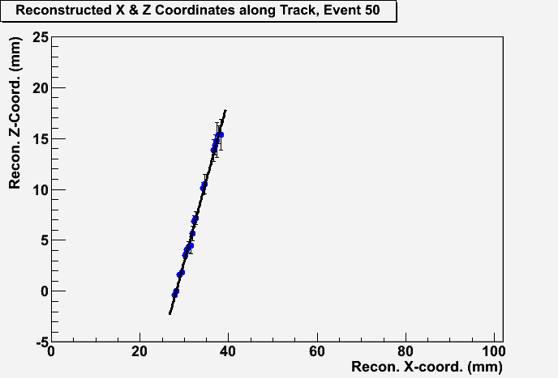
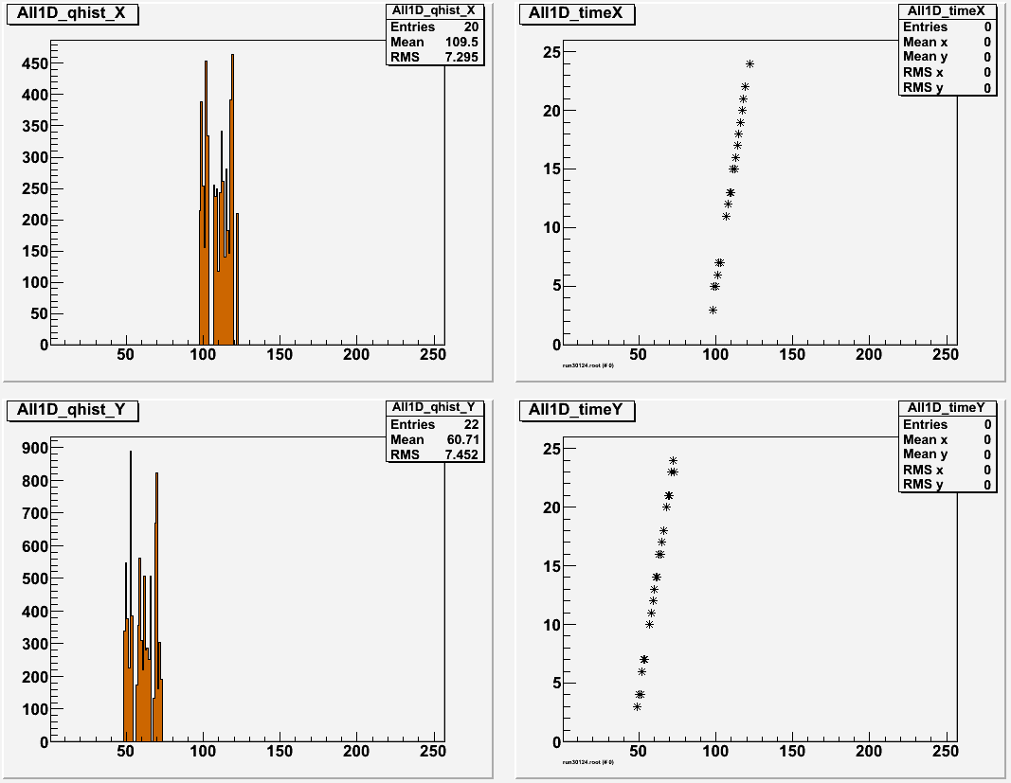
Beam Test Results (40 deg. Tracks)
Reconstructed Track from 1 Event
Raw Strip Signal
The charge arrival time for each strip is determined by the time profile of the raw signal. The z-coord. is then reconstructed by taking the product of the arrival time and the drift velocity of the detector gas.
The x_coord. is taken as the center of each strip.
The vector is determined from a linear fit to the reconstructed (x, y) pairs for the event.
~Strip Charge
25ns Time Sample
Strip
Reconstructed Track Segment
Tot. Charge at each fired Strip
Strip Charge Arrival Time

Slide 9
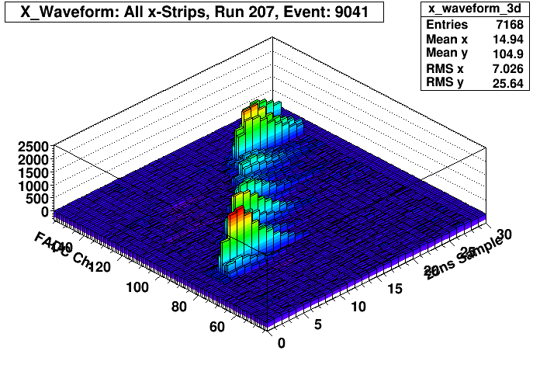
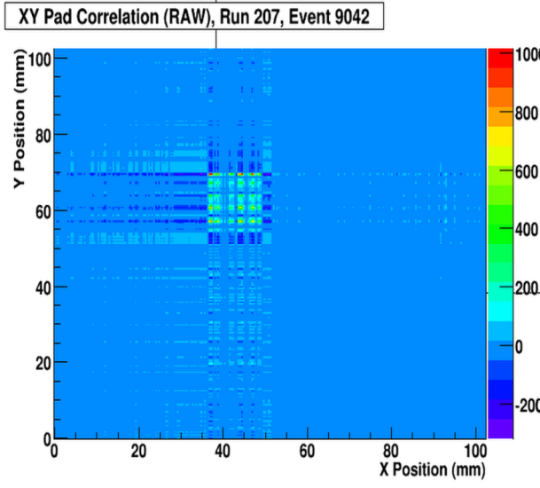
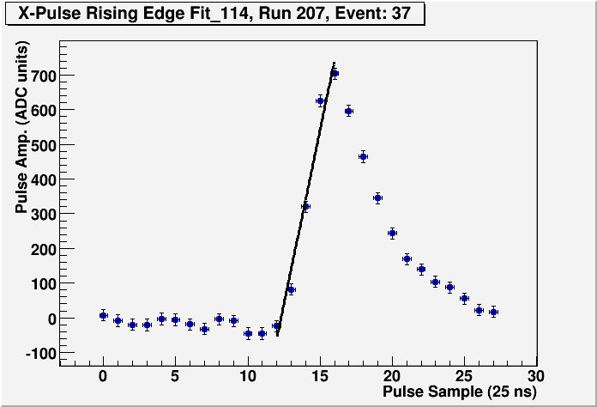
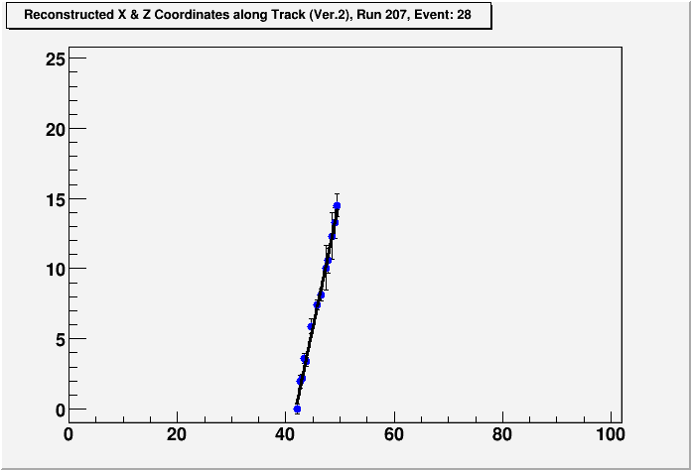
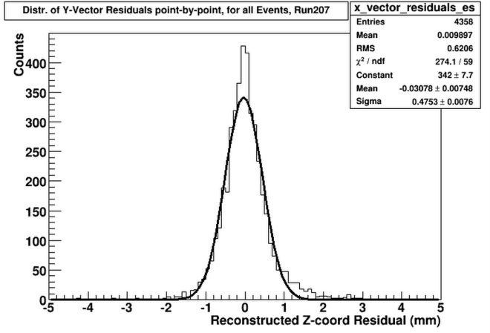
Data Processing
Raw Data: Waveforms in Time
Vector Signature: “Charge square”
Vector Recon. Z-residual < 0.5mm
Linear Fit to determine arrival time = x-int.
30 samples x 25ns = 750ns window
Vector Recon:
X -coord. = middle of pad
Y-coord. = drift time * Drift Vel.
Fit (x,z) points to line
Propagated Errors:
Angle: ~+/-18mrad
Charge arrival time: ~+/-1.8ns

Slide 10
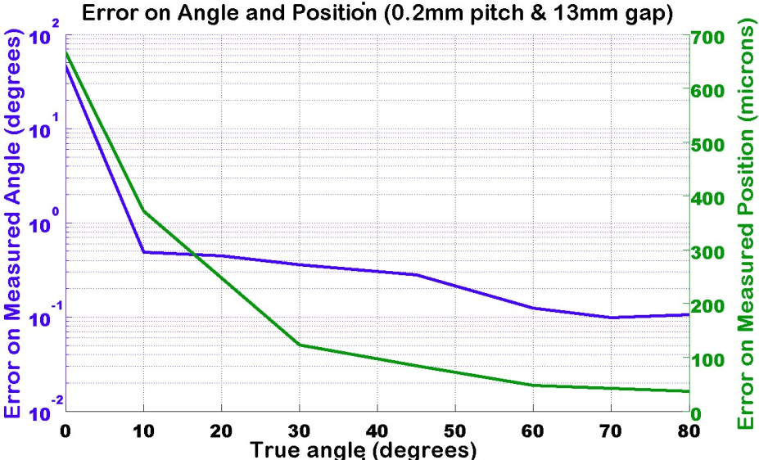
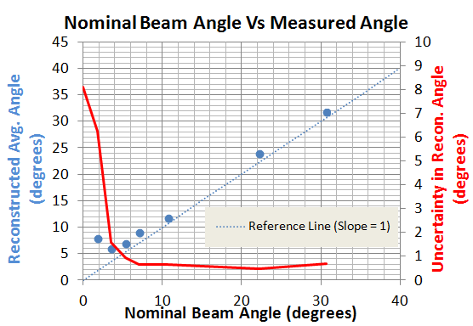
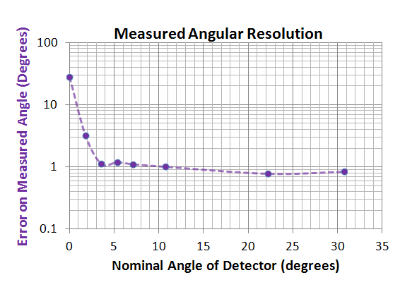
Angular Resolution
A first look at the Angular Resolution
MC Simulation of Angle and Position Resolution
Track Recon. Fails
(Rely on Charge Centroid)
As a first attempt to determine the angular and position resolution, we do so without the aid of a reference track, determined by the high precision reference detectors within the beam test set up.
The angular resolution is determined here by simply taking the spread in the distribution of the reconstructed vector angle. This is known to be a reasonable approximation since the beam divergence is minimal.
Uncertain Boundary
Track Recon. Successful
T. Cao, Stony Brook
Preliminary Results
Preliminary Results

Slide 11
Summary
Great idea for synchronous background rejection.
Ghosts of bunches past:
Stubs appear to “end early”.
Ghosts of bunches future:
Stubs appear to “begin late”.
Quantitative question:
Does it hurt, does it help?

