Slide 1
Update on EM Calorimeters
Jin Huang (LANL), also for
Mehdi Meziane (Duke), Paul Reimer (ANL),
Zhiwen Zhao (UVa), Xiaochao Zheng (UVa)

Slide 2
Overview

Slide 3
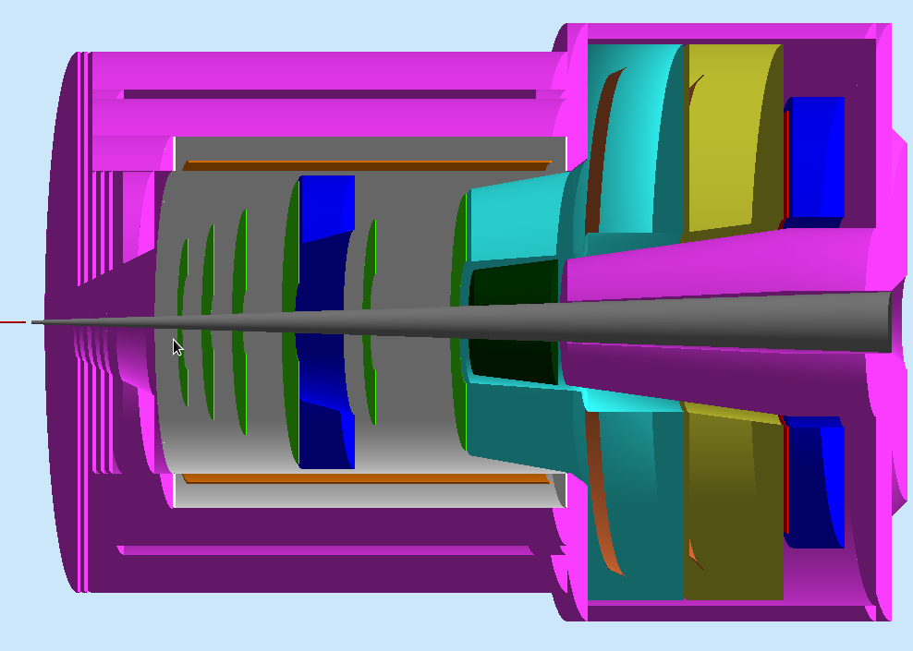
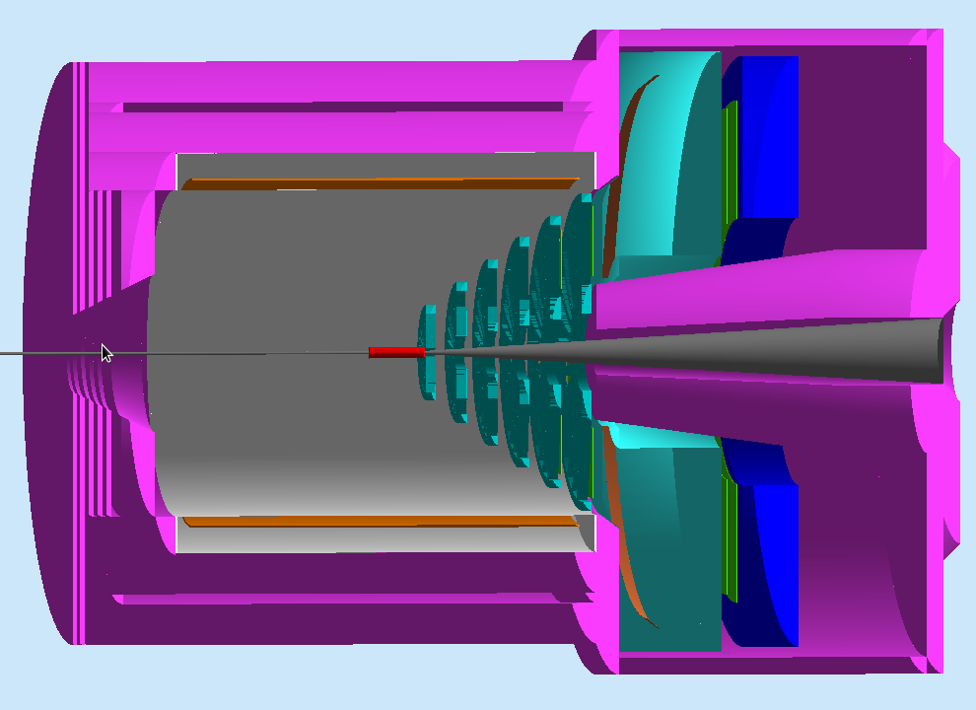
SoLID EM Calorimeter Overview
PVDIS forward angle
SIDIS forward angle
SIDIS large angle
SoLID EM Calorimeters | Polar Angle (degree) | P (GeV / c) | Max π / e | Cerenkov Coverage | Area (m²)
PVDIS Forward-Angle | 22 - 35 | 2.3 – 6 | ~ 200 | <3-4 GeV/c | ~17
SIDIS Forward-Angle | 8-15 | 1 -7 | ~ 200 | <4.7 GeV/c | ~11
SIDIS Large-Angle | 17-24 | 3 - 6 | ~20 | None | ~5

Slide 4
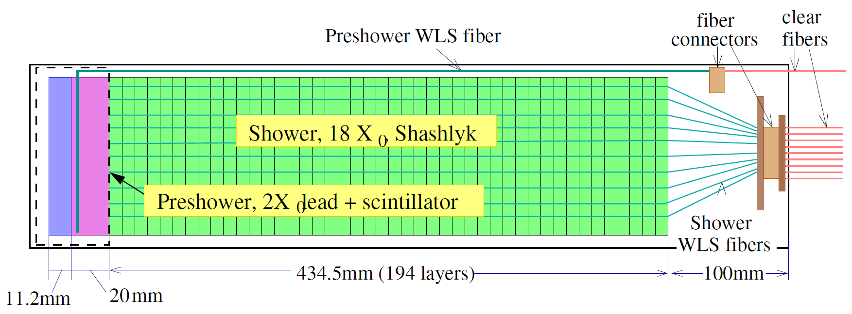
Default design for calorimeter modules
Preshower – HERMES/LHCb style passive radiator + scintillator design
2 X0 lead radiator + 2 cm scintillator tile w/ WLS readout
Shower – COMPASS style Shashlyk calorimeter design
Layer structure : 0.5 mm lead + 1.5 mm scintillator + 0.12 mm gap x 2
X₀ = 24cm, R_{M} ~ 5 cm, 194 layers, 43 cm in depth

Slide 5
Shower – quick review
Choice of technology
Shashlyk design was chosen based on advantage of radiation resistance + cost + ease of readout
Features
Pb/Scint ratio 1:3 (V) : chosen to reach <5%/√E energy resolution and ~100:1 pion rejection
Scintillator thickness of 1.5mm: based past designs to balance sampling fineness VS lateral light transmission loss
Total length of 20 X₀ : contain 98% of shower and maximize pion-electron difference → MIP = 270 MeV (real) / 320 MeV (reconstructed)
Lateral size of 10x10 cm²: max size allowed (to reduce $$) before position resolution significantly deteriorates (σ~1 cm after cor.)

Slide 6
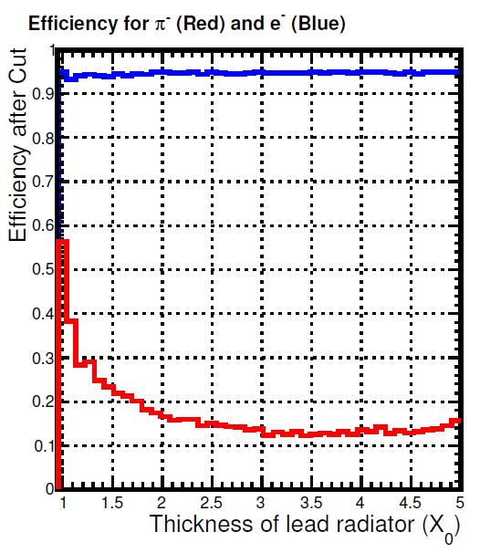
Preshower – quick review
Choice of technology
HERMES/LHCb style VS full Shashlyk design, former is much easier to readout and high in radiation resistance
Features
Absorber of 2 X₀ lead :
Thinner – loose preshower rejection
Thicker – loose shower resolution
Scanned for 1.5, 2 and 3 X₀; 2 X₀ serve SoLID best
Scintillator of 2 cm:
MIP = 4 MeV, electron cut ~ 3 MIP

Slide 7
Design Updates - Layout Update

Slide 8
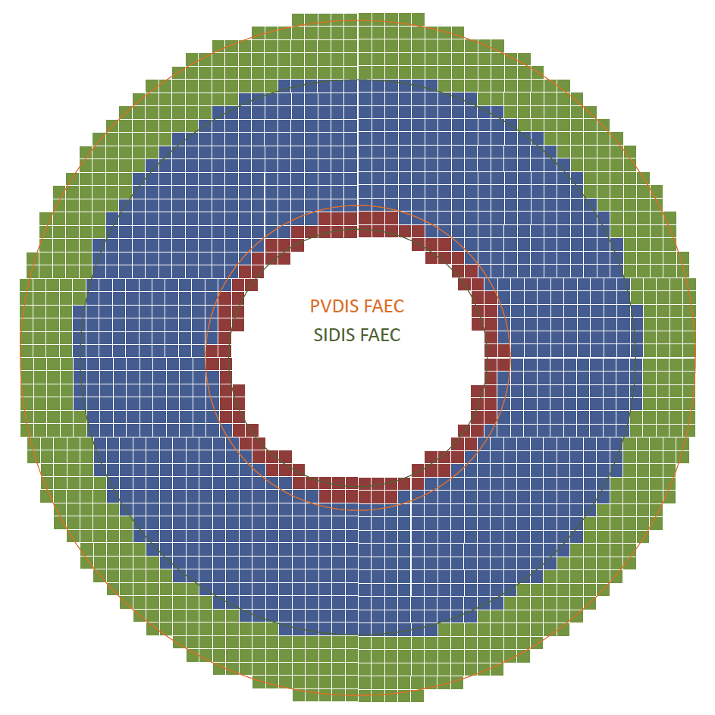
SIDIS and PVDIS FAEC (beam view)
Both can share supporting structure, only need to move along beam direction to change configuration
Supporting structure needs to be made from 100cm to 261cm
261cm
118cm
100cm
215cm
PVDIS FAEC (green + blue)
SIDIS LAEC (blue + red)

Slide 9
Ideas to minimize SIDIS LAEC Acceptance gap
We want to cover full azimuthal angle and leave no gap between modules, so module can not be tilted and need to be along Z axis
Prefer having short outer module so that the outer module area can cover more and inner module area can cover less
Inner module need to be special shape to avoid blocking acceptance. One way to solve it is to have smaller 5x5cm (like COMPASS) module with various length
600mm
assume 600mm full module length
Blue: LAEC acceptance angle
Orange : angle between inner and outer
10x10x60cm module
Outer module
(500mm in radius)
24º
5x5x41cm
inner module
(150mm in radius)
17.5º
5x5x22cm
600mm
14.7º
Reviewed using G4 simulation next few pages

Slide 10
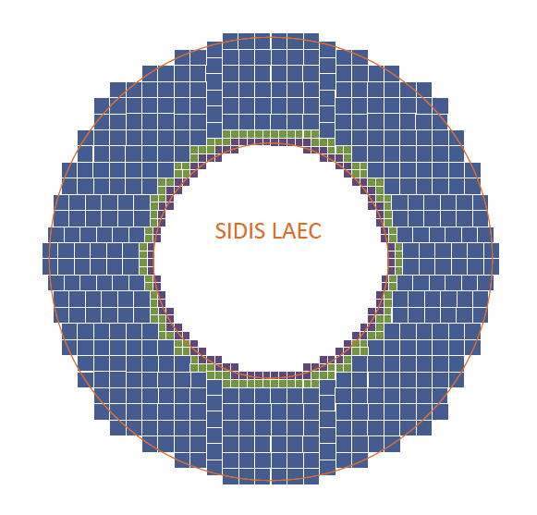
SIDIS LAEC (beam view)
Type I (10x10cm) module in blue, type II (5x5cm long) module in green, type III (5x5cm short) module in purple.
Supporting structure needs to be made from 75cm to 140cm
140cm
75cm

Slide 11
Design Updates - Edge effects for LAEC

Slide 12
LAEC layout in G4 Simulation

Slide 13
LAEC in full standalone G4 Simulation Track transportation provided by GEMC, CLEO field

Slide 14
How much does inner modules help?
LAEC catch 80% of shower
Go freely to forward acceptance
Minor improvement
Stand conf. 404 10x10 cm² modules
+ 116 5x5 cm² inner modules

Slide 15
Design Updates - Shower cluster size cut

Slide 16
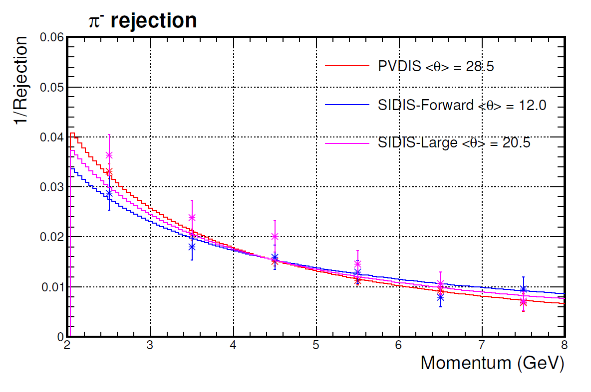
Previously showed pion rejection
94% electron eff.
PID selection used 3-D cut on PS, e/p and momentum
PS and e information come from sum signal in all non-zero modules
Enemy here is very specific: almost fully absorved hadronic shower with high energy deposition

Slide 17
Shower area difference
Electron shower
Hadronic shower (e/p>80%)
R spread (mm)
R spread (mm)
Φ - spread (mm)
Φ - spread (mm)
Notice the difference in color scale

Slide 18
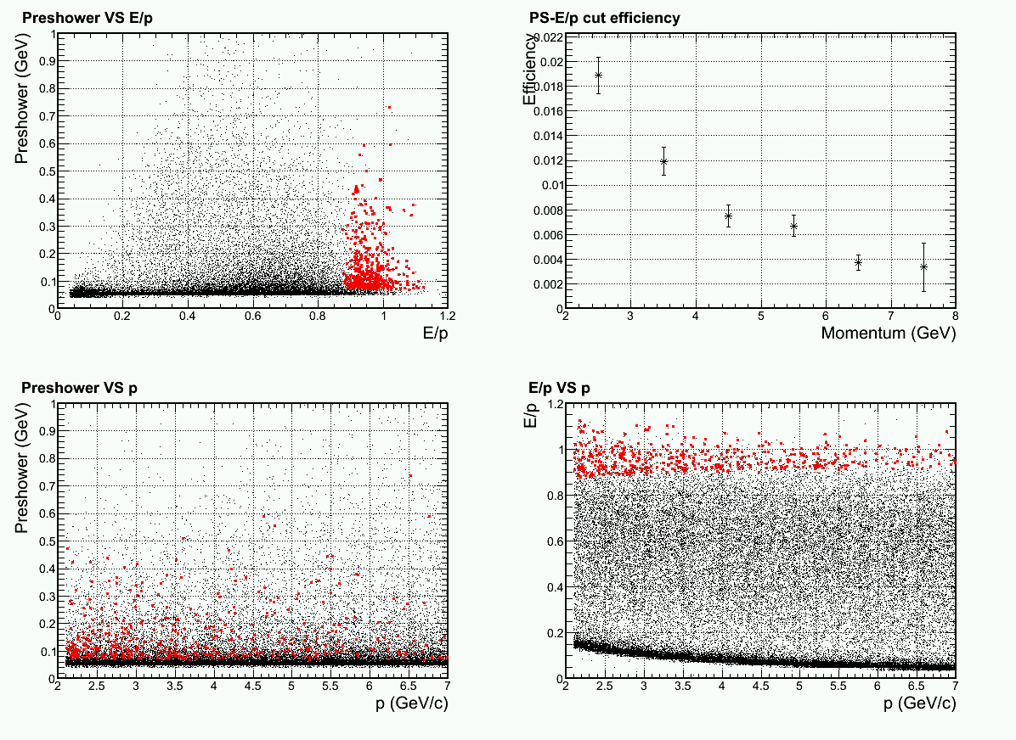
Apply additional cut to limit max size of cluster around track projection
Limit cluster to be not larger than 3x3 modules around track projection to shower central depth
Minor cut on EM shower but effectively removed hadronic showers of very high energy deposition
w/ >=94% electron eff.
Pion
Miss identified
BIG improvement @ high p end
Flat phase space in PVDIS
acceptance

Slide 19
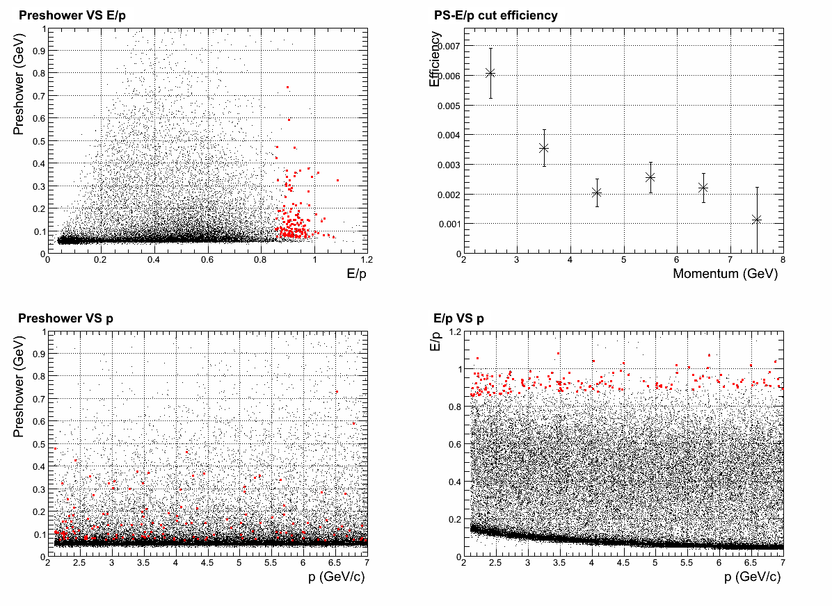
Can it be further improved?
Further limit cluster to be not larger than 2x2 modules around track projection to shower central depth
Now loose ~5% of EM shower, but hadron shower cuts faster
Change cut and maintain
>=94% electron eff.
All hadron rej. better than
100:1
Pion
Miss identified
Flat phase space in PVDIS
acceptance

Slide 20
Design Updates - Radiation dose

Slide 21
What’s new
LHCb/HERMES preshower, instead full Shashlyk preshower
As shown before, the preshower scintillator receive most of the radiation, due to the low energy backgrounds
This part radiation dose are now absorbed in 2X0 absorber, and we just see its EM tail now
Especially, lead absorber effectively kill all low energy electron background
New background distribution updated by Zhiwen
SIDIS:
With target collimator (suppress background by 4)
First large angle simulation
PVDIS: have option to remove direct photon sight (expected to be removed in the final baffle design)
Dominating background, photons 1-10 MeV
After preshower, which attenuate them a lot, they still penetrate ~10 layers in Shashlyk

Slide 22
PVDIS – current baffle (with direct γ)
γ dominate
But attenuated quickly
Layer #1 is 2cm preshower scint.

Slide 23
PVDIS – preview for a baffle w/o direct γ
γ get reduced by ~5
π⁻ become important here
Layer #1 is 2cm preshower scint.

Slide 24
SIDIS – Forward
γ dominate
But attenuated quickly
Layer #1 is 2cm preshower scint.

Slide 25
SIDIS – Large-Angle
γ dominate
But attenuated quickly
Layer #1 is 2cm preshower scint.

Slide 26
Light Readout

Slide 27
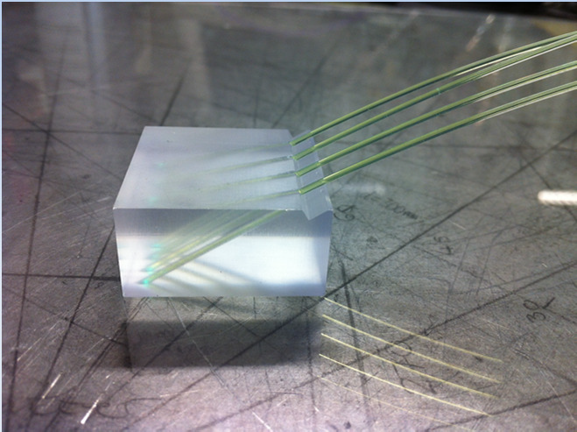
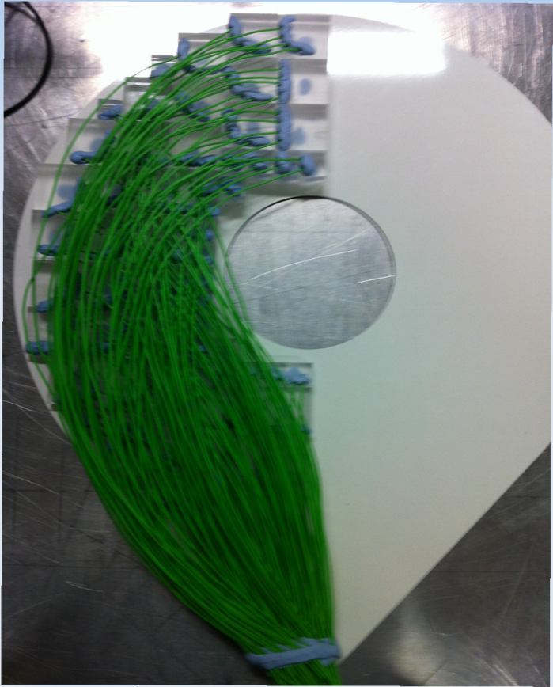
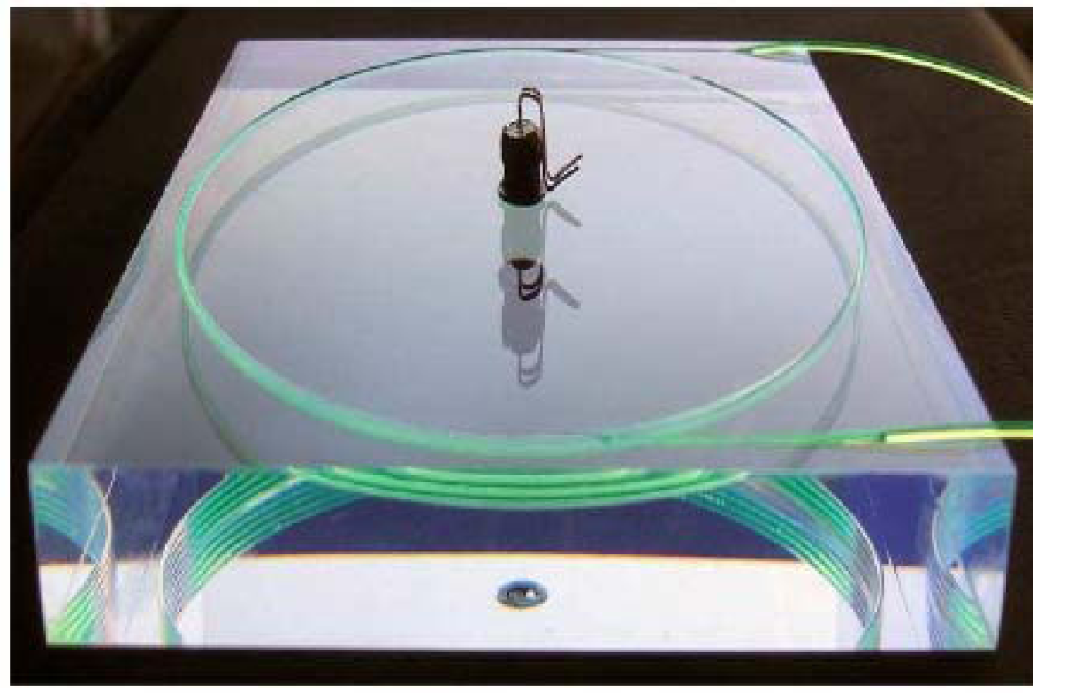
WLS fiber in scintillator pad
Drill on scintillator and glue WLS in
Used by LHCb etc.
Will use by CLAS12 FT-Hodo
CLAS12 FT-Hodo
LHCb Preshower

Slide 28
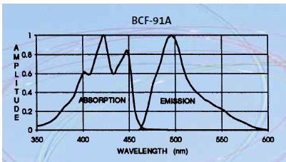
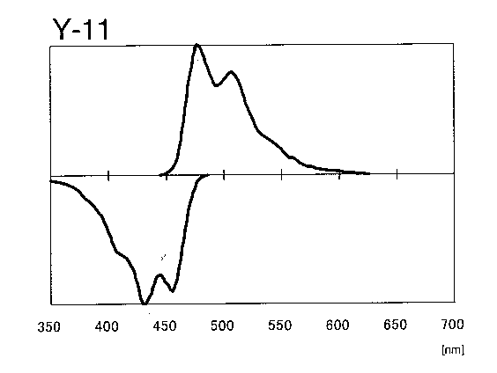
Fiber
WSL fiber in shower, 100/module
Bicron BCF-91A
multi-clad, 1/e length >3.5m
1mmD, bend 20cmD (?)
$0.87/m
less rad hard
WLS fiber in preshower pad, 1-2/module
KURARAY Y-11(200)MS
multi-clad, 1/e length >3.5m
0.5mmD, bend 5cmD
$1/m
more rad hard
Clear fiber for both, 101-102/module
Bicron BCF-98
$1/m

Slide 29
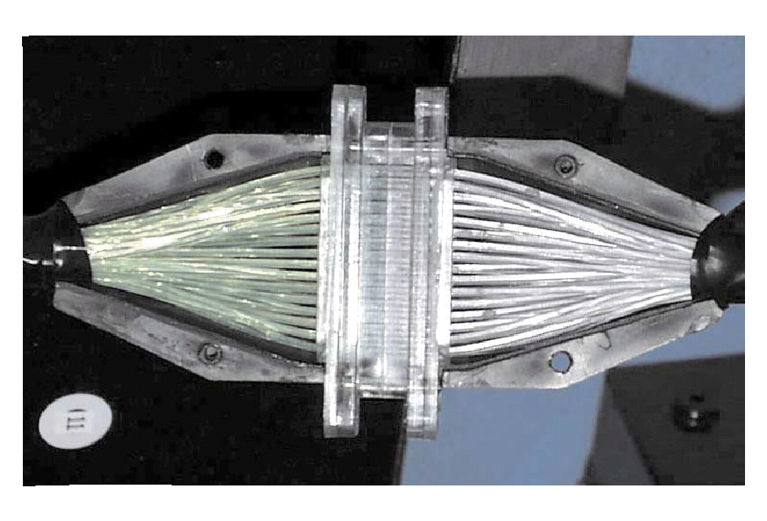
Fiber connection
Shower will use 1-1 bundle fiber connector.
Used in previous experiments (LHCb, Minos)
custom made fiber connector $175/module, quote by LEONI
Preshower will use comercial 1-1 single fiber connector, a few $ each.
LHCb shower
fiber bundle to PMT connector, cost estimate $25/module

Slide 30
Readout
PMT option - Hamamatsu R3998-02
28mmD Bialkali Photocathode
$600 each
Used by CLAS TPE calorimeter which has COMPASS module
As our baseline design
APD/SiPM option
High resistance to magnetic field
Need to be careful due to high neutron background
Contacting vendor for high radiation resistance designs (sensor + amp.)
Estimating neutron background @ photon detectors

Slide 31
Budget Update

Slide 32
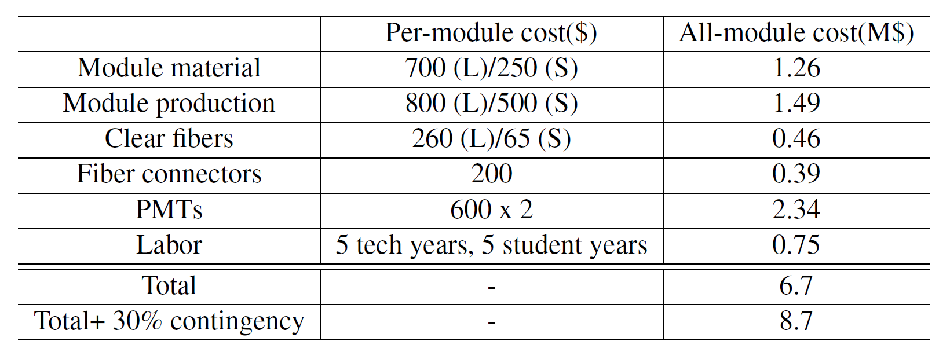
Budget table – calorimeter group version
+ Prototyping ~ 0.3 M$
Lab estimate : 5.7 (base)+3.8 (Labor)
JP : 6.2 (base) + 1.3 (Labor)

Slide 33
What we need

Slide 34
What we need
Engineering support (Zhiwen)
Support structure
How to do maintenance and install it back
Inquiries
IHEP (Xiaochao)
Fiber connection (Mehdi)
Photon detectors (Zhiwen)
Background effect (Jin)
Event mixing with signal and background simulation
Prototyping

Slide 35
Support structure ideas
Overview
One support for LAEC, one support
for FAEC
Only a few cm gap between outer radius of SIDIS LAEC and inner radius of cryo, is it enough?
Only a few cm gap between outer radius of FAEC and inner radius of nose cone, is it enough?
Need to consider the supporting with overall magnet cryo and yoke structure.
“super” Modules
Group 1-3 row of modules into supermodule
shift supermodule’s horizontal position to make layers

Slide 36
backup

Slide 37
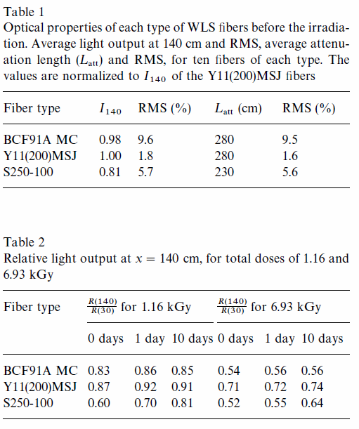
WLS radiation hardness

Slide 38
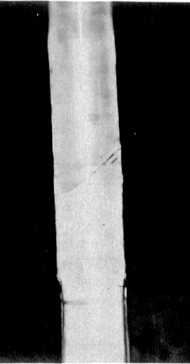
Fiber connection (Backup option)
Fiber splicing
Robust connection and excellent transmission (2%)
CLAS12 Forward Tagger Hodoscope will fuse WLS and clear fiber. Commercial vendor has been contacted and They are also developing their own method.
We will collaborate with them to examine the labor and cost requirement.
joint

