Slide 1
SoLID Magnet Update
Zhiwen Zhao (UVa), Paul Reimer (ANL),
Many Thanks to Eugene Chudakov, Xin Qian, Jian-Ping Chen,
Whit Seay, Robin Wines, Javier Gomez, Will Oren, Rolf Ent
SoLID Collboration Meeting
2012/12

Slide 2
Outline
Requirement
Magnet Choice
CLEO
BaBar
Summary

Slide 3
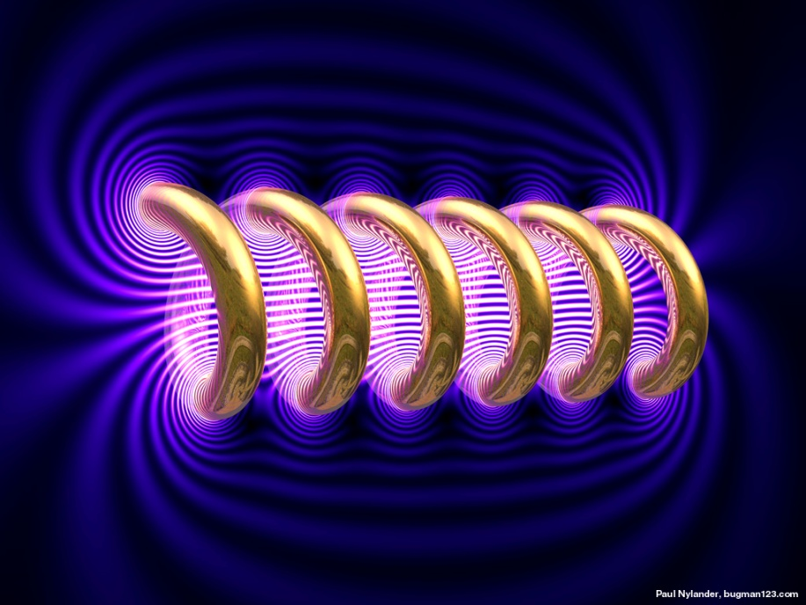
Requirement
General
Large acceptance and high luminosity
Solenoidal magnet leaves large room for detectors and swipes away low energy background downstream.
Hall A beam line height 3.05m (10 feet)

Slide 4
Requirement
PVDIS (22-35º, e⁻)
The target can be placed within solenoid
Solenoid radius needs to be 1-2m. Small radius will make the target is too close to magnet exit and not enough room for baffle.
field > 1T to ensure enough defection of 2-6GeV with 1-2m so that baffle can be made with not too small segmentation
35º
22º
Outer barrel
Beam line
PVDIS Target

Slide 5
Requirement
SIDIS (8-24º, e⁻ and hadron)
Both polarized targets need to be outside of field and the fringe field for SIDIS-3he < 30G
Forward angle detectors need enough distance for tracking, Cherenkov, TOF and calorimeter. A Solenoid needs to be 3-4 m long for tracking and it can’t be too long to reduce forward angle detectors acceptance and thus limit the hadron detection.
Large angle detectors need small distance so it won’t exceed beamline height limit. Therefore it has to stay within solenoid, the solenoid radius needs to be 1-2m to accommodate detectors.
24º
16º
15º
8º
Large angle EC
Outer barrel
Beam line
SIDIS Target
(1-2m away from entrance)

Slide 6
Requirement
J/ψ (8-26º, e⁻,e⁺ and p)
Similar to SIDIS
Small field will help low energy scattered e- acceptance at forward angle
24º
16º
15º
8º
Large angle EC
Outer barrel
Beam line
J/ψ target
(1-2m away from entrance)

Slide 7
Magnet Choice
CLEO/BaBar alike: 1.4m radius, 3.5m length
Large enough inner radius
Medium field 1.5T and medium length
24º
16º
15º
8º
35º
22º
Large angle EC
Outer barrel
Beam line
PVDIS Target
SIDIS, J/ψ Target
(1-2m away from entrance)

Slide 8
Magnet Choice
Shorter magnet: 1.4m radius, 1.75m length
PVDIS should be ok after move target further upstream.
SIDIS forward tracking need stronger field 2-3T.
SIDIS target needs to be further away due to larger fringe field. This in turn will reduce large angle coverage.
Combining SIDIS forward and large angle won’t help.
35º
20º
24º
16º
15º
8º
Large angle EC
Outer barrel
Beam line
PVDIS Target
SIDIS, J/ψ Target
(1-2m away from entrance)

Slide 9
Magnet Comparison
 | BaBar | CLEO | ZEUS | CDF | Glue-X | Other
Cryostat Inner Rad | 142 cm | 145 cm | 86 cm | 150 cm |  | Whatever we need
Length | 345 cm | 350cm | 245cm | 500 cm
Cent Field | 1.49T | 1.5T | 1.8T | 1.47T
Yoke Aval? | Yes | Yes | No | No
Variation in Current density with z? | Current Density in central 50% is ½ that in end 25% | Current Density in central 50% is 1/1.04 that in end 25% | Current density 25% more current at ends | No | Yes
Amp-Turns | 5.1 M A-T | 4.2 M A-T
Available | Yes | Yes | Probably Not--Mainz | Needs $1M repair and possible Expt at Fermilab | Perhaps | $8M??

Slide 10
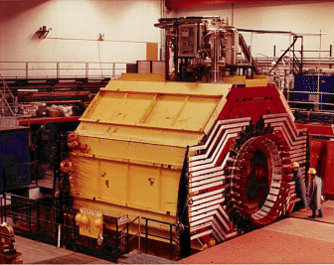
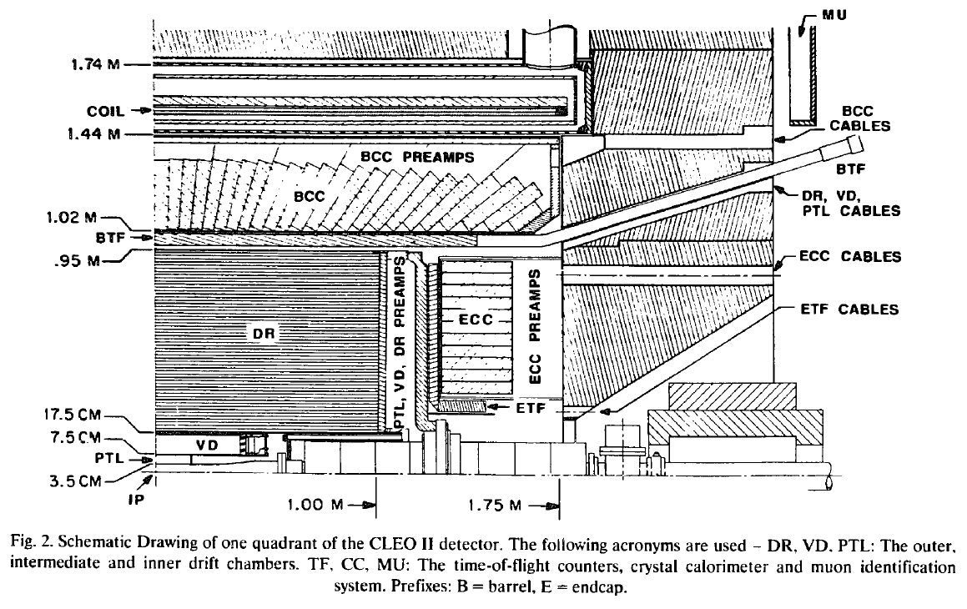
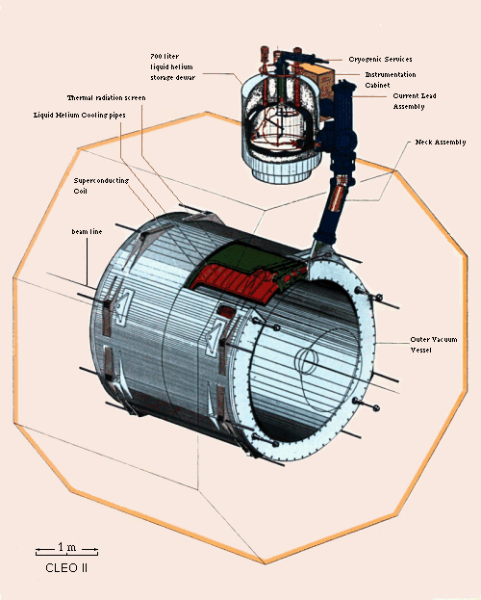
CLEO
CLEO-II magnet was built in early 1980s by Oxford in England.
Coil is divided into 3 sections, each section has two layers
Coil total 1282 turns. Upstream: 166; Central: 309; Downstream: 166 turns per layer. The current density in the end sections is 4% higher than in the middle section.
Max current is 3266A and average current density of 1.2MA/m, this reach 1.5T field

Slide 11
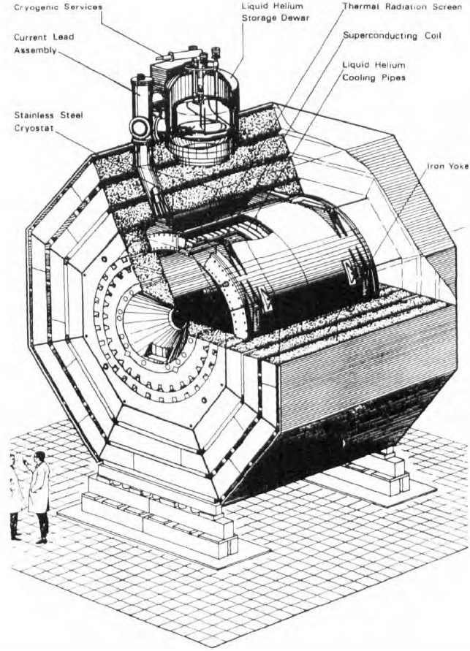
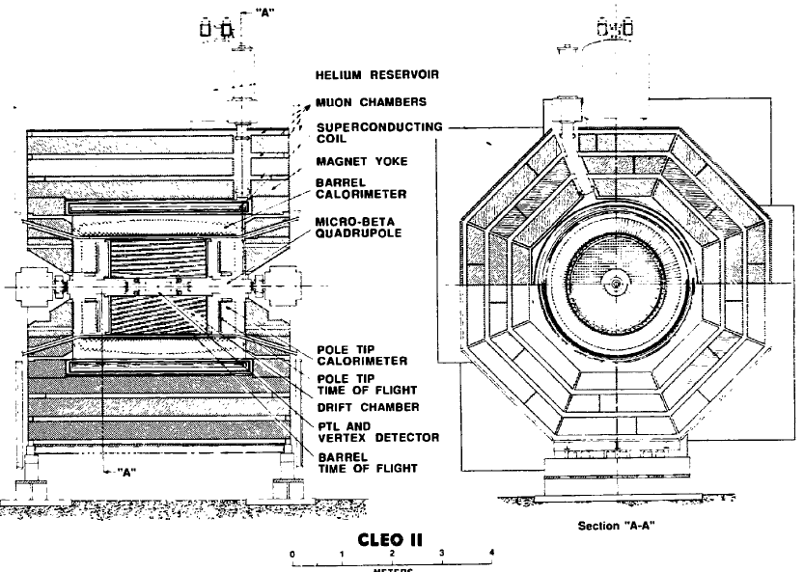
CLEO
Barrel flux return is provided by 3 layers of iron separated by spacers
It’s in octagon
2 collars supports barrel irons and holding 4 coil rods in horizontal direction.

Slide 12
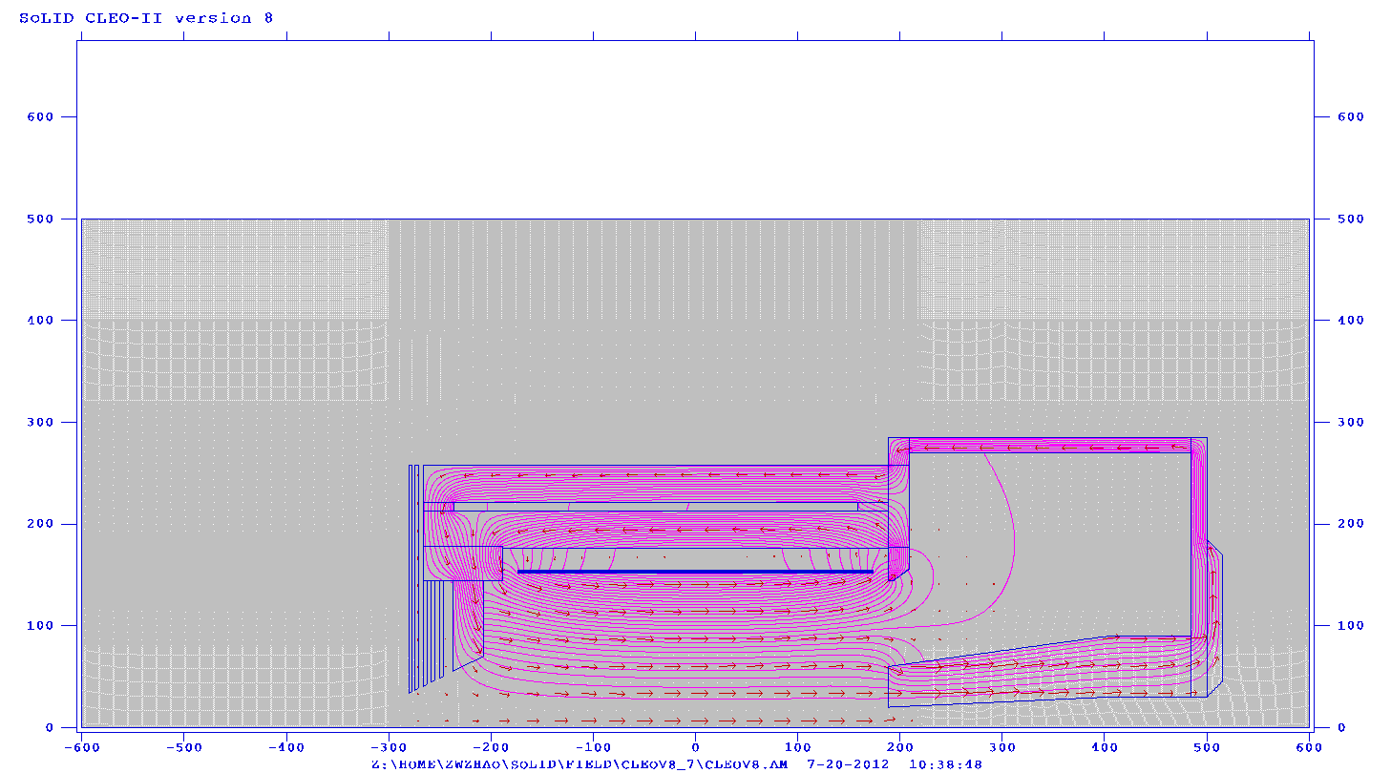
From CLEO-II to SoLID (reused parts)
Reuse coil and cryostat
Take two layers of barrel yoke and spacer, keep the upstream ends unchanged, cut the downstream ends (75cm) to our need.
Take the upstream collar unchanged, and cut the downstream collar or make a new one to satisfy the acceptance requirement. Make sure the coil rods can still be supported by two collars under axial force
All other parts of yokes are new.
Endcap Donut
Barrel Yoke Outer
Collar Downstream
Endcap Bottom
The parts from CLEO-II is in the red box
Spacer
Barrel Yoke Inner
Spacer
Collar Upstream
Coil
shield
Front Piece
Endcap Nose

Slide 13
From CLEO-II to SoLID (new parts)
All new parts need to be customized made.
But it’s unclear if they will be made of newly machined iron ($6/lb) or we can get some unused CLEO-II iron machined (cost?)
We might try to use some “stock” parts to save machining cost.
Endcap donut: 15cm thick and has 15cm clearance to HallA floor (10 feet high)
Endcap bottom: two 15cm plates
Endcap nose: flat at back to give clearance for SIDIS forward angle EC and has slope at front to give clearance for cherenkov.
Collar downstream: 20cm thick and can be in one piece
Front Piece: 30cm thick and can move along z to adjust force on coil
shielding: a few 4cm thick plates with gaps in between.
Endcap Donut
Barrel Yoke Outer
Collar Downstream
Endcap Bottom
The parts from CLEO-II is in the red box
Spacer
Barrel Yoke Inner
Spacer
Collar Upstream
Coil
shield
Front Piece
Endcap Nose

Slide 14
SOLID CLEO Acceptance
PVDIS physics requires opening angle from 22 - 35º
target at z= 10cm
geometry openings is 21 - 36º
clearance to endcup nose at endcup entrance (z=189cm) is 12cm for 22º and 8cm for 21º
clearance to endcup donut at forwardangle EC back (z=370cm) is 10cm for 35º and 5cm for 35.5º
beamline opening angle at endcup bottom is 3.5º
SIDIS physics requires opening angle from 8 - 24º, JPsi physics requires opening angle from 8 - 26º
target at z= -350cm
geometry openings is 7.5 – 26.3º
clearance to endcup nose at endcup entrance (z=189cm) is 15cm for 8º
clearance to endcup nose at forwardangle EC front (z=405cm) is 15cm for 8º
beamline opening angle at endcup bottom is 2º
PVDIS 36º
SIDIS 26º
SIDIS 14.7º
PVDIS 21º
SIDIS 8º
SIDIS 2º
PVDIS 3.5º

Slide 15
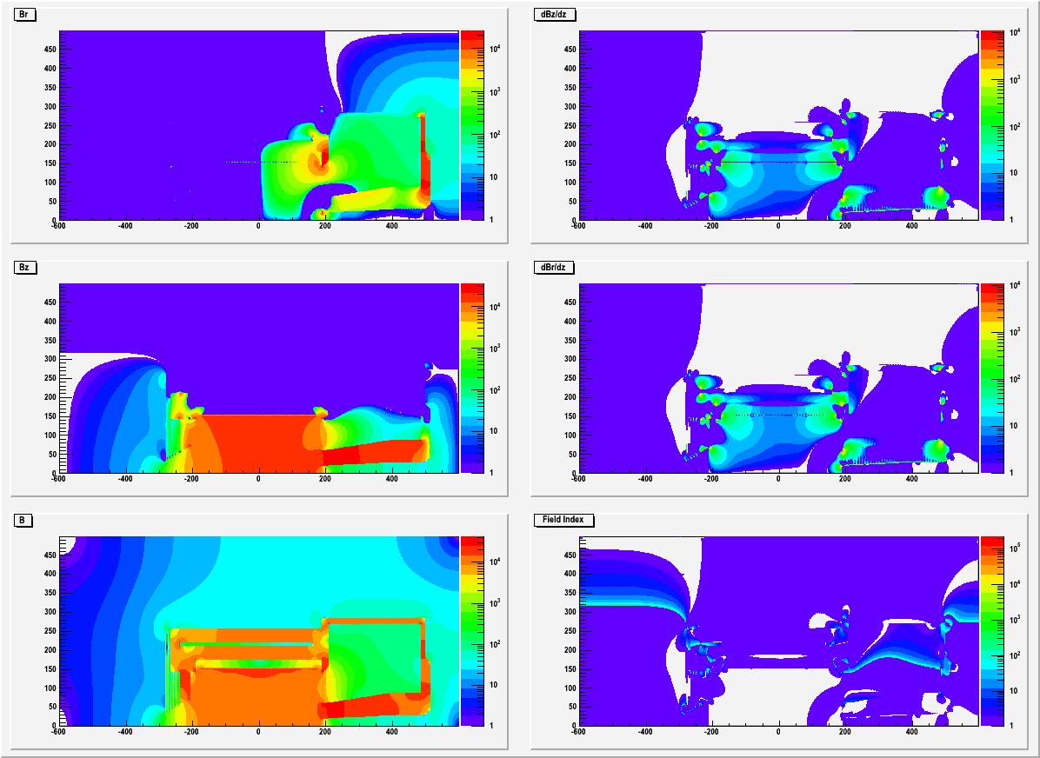
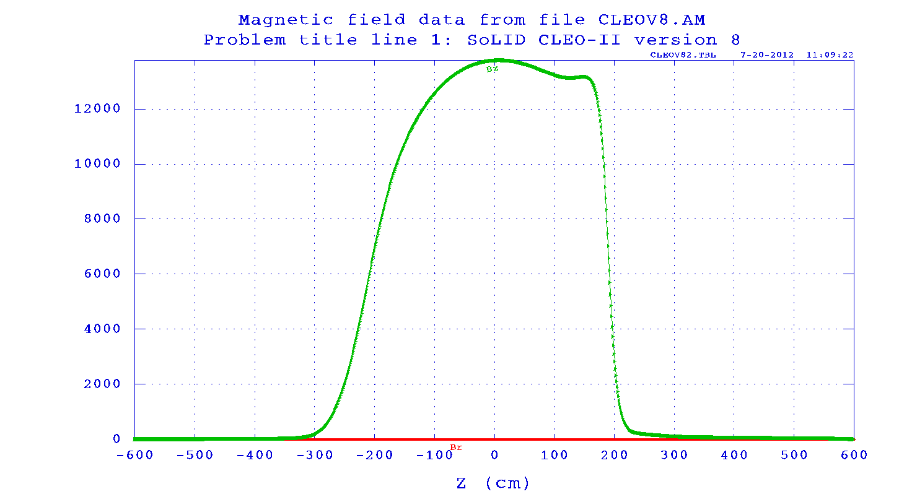
SoLID CLEO Field
CLEO-II can still reach 1.48T Bz
SoLID CLEO only reaches 1.38T Bz, due to large opening and asymmetric yoke design. Unlikely CLEO-II can run higher current (?)
The iron of the endcap nose could be saturated with >2T field.
The radial field Br can reach a few 1000G where PVDIS GEM plane 1 and 2 are.
The field drops to a few 100G in endcap. They are <200G where Cherenkov readout is.
Br
Bz
Bz along beamline
B

Slide 16
SoLID CLEO Force on coil
unit in t | upstream | middle | downstream | total
inner 2piFz | 154.1 | 3.6 | -159.1 | -1.4
outer 2piFz | 154.7 | 3.5 | -159.6 | -1.4
Total 2piFz | 308.8 | 7.1 | -318.7 | -2.4
inner Fr/radian | 87.9 | 170.2 | 87.2 | 345.3
outer Fr/radian | 24.8 | 54.5 | 24.2 | 103.5
Total Fr/radian | 112.7 | 224.7 | 111.4 | 448.8
Axial force on coil and cell cylinder are squeezing from both sides and it can be balanced under 10t.
could leave some net force to avoid accidental force direction change.
Preferred direction is negative so upstream collar (unchanged from CLEO-II) can take the force (?)
Moving the front piece in z to adjust force (moving upstream, the positive force increase, vice verse.) with gradient 3-5t/cm (It’s very sensitive)
Radial force are on the Aluminum shell cylinder
From Eugene “If all the force goes to the shell, the azimuthal tension is about 30MPa. The yield limit of aluminum is about 100MPa (to be verified for 4°K)”
305.4
6.3
-316.5
front piece

Slide 17
SoLID CLEO Force on yoke (axial force only)
2piFz (unit in t) represents the axial force integrated over the whole part in 2pi.
positive direction in black, negative direction in Red
The opposite force meets at two locations where the endcup connects.
Some analysis of potential problems with the coil and yoke mechanical integrity should be done.
no calculation of the radial force yet.
-20.3
171.2
122.9.
-269.0
8.1
0.7
-238.4
110.2
108.6
-119.2
0.008
-79.6
0.2
165.5
0.7
0.2
38.9
0.04

Slide 18
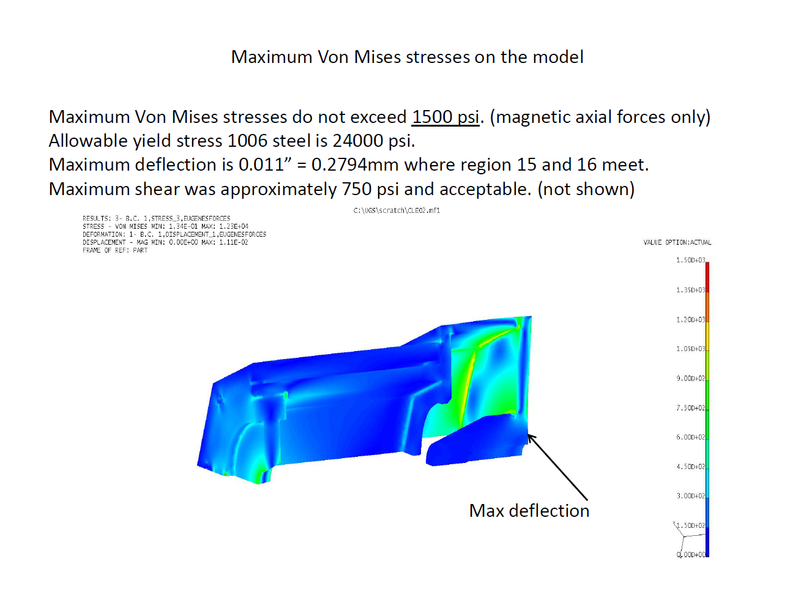
SoLID CLEO: FEA study of axial force
Static weight are ignored for now.
by Whit Seay

Slide 19
SoLID CLEO Yoke weight
assume steel density is 7.9g/cm3 , weight unit is in t
material from CLEO-II 376t
new material 200t ($2.7M if assume $6/lb machined iron)
total 576t
7.4
57
195
30
3
3
17
154
21
4.4
5
10.4
6
12.5
2
2
40
2

Slide 20
SoLID CLEO: Fringe field at SIDIS pol He3 target location
Z (cm) | Bz(G) | Br(G) | dBz/dr (mG/cm) | dBr/dz (mG/cm) | dBz/dz (mG/cm) | dBr/dr (mG/cm)
-330 | 46.1 | 0.7 | 40 | 40 | 1500 | 744
-350 | 27.3 | 0.3 | 12 | 12 | 500 | 288
-370 | 19.1 | 0.1 | 4 | 4 | 300 | 142
Multilayer of iron plates and gaps have good shielding effect
The distance between first shielding plate to the target coil is a few cm.
pol He3 holding field is 25G and we need field gradient below 100mG/cm
We need additional shielding or correction coil.
Pol He3 target
2 Helmholtz coils
Longitudinal R=75.8cm
Vertical R=66.7cm

Slide 21
SoLID CLEO: Fringe field at SIDIS pol He3 target location (with correction coil)
Z (cm) | Bz(G) | Br(G) | dBz/dr (mG/cm) | dBr/dz (mG/cm) | dBz/dz (mG/cm) | dBr/dr (mG/cm)
-330 | -0.4 | 0.11 | 42 | 42 | 170 | -106
-350 | 1.6 | 0.05 | 7 | 7 | -100 | 54
-370 | 0.8 | 0.08 | 4 | 4 | 164 | -81
Add a pair correction coil at the same position of longitudinal coil with current -3465A and -645A
No effect on the force on solenoid coil
Both field and field gradient are reduced
It can be tweaked further and there can be other ideas.
Pol He3 target
2 Helmholtz coils
Longitudinal R=75.8cm
Vertical R=66.7cm

Slide 22
SoLID CLEO summary
We have a preliminary design
It can be improved with more input from engineering
Some barrel yoke are reused, no problem to fit with Hall A beamline height.
Study by Eugene Chudukov https://userweb.jlab.org/~gen/jlab12gev/cleo_mag

Slide 23
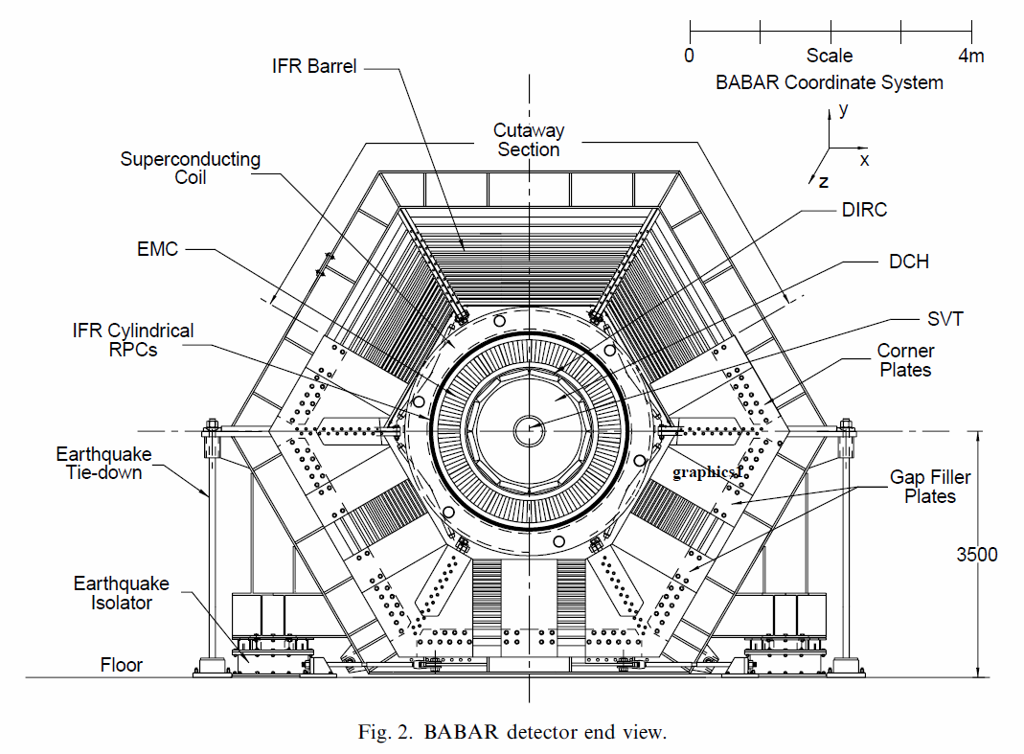
BaBar
The magnet was built in 1990s by Ansaldo Energia in Italy
Its setup has 9GeV e⁻ come from left, 3.1GeV e⁺ come from right
Yoke is in hexagon shape
 | Length (mm) | Radius (mm)
Coil | 3513.5 | 1509.8 – 1550.6
Cryo | 3850 | 1420 -1770
Barrel flux return | 3750 | 1820 - 3041
Side plate | 3750 | 1902.5 – 3290.5
Support ring | 328 | 3100 – 3728.4
Flux bar (barrel) | 200 | 3041 - 3209
Upstream flux return | 1144 | 1020 - 2859
Downstream flux return | 1144 | 710/1564 - 2859
Gap plate | 150 | 1820 - 3209
Flux bar (door) | 1144 | 2859 - 3209

Slide 24
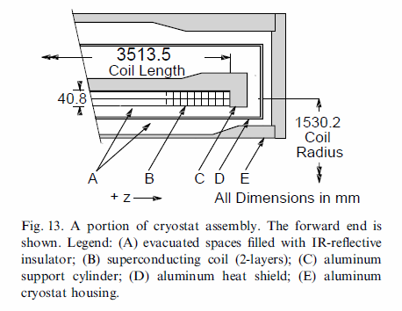
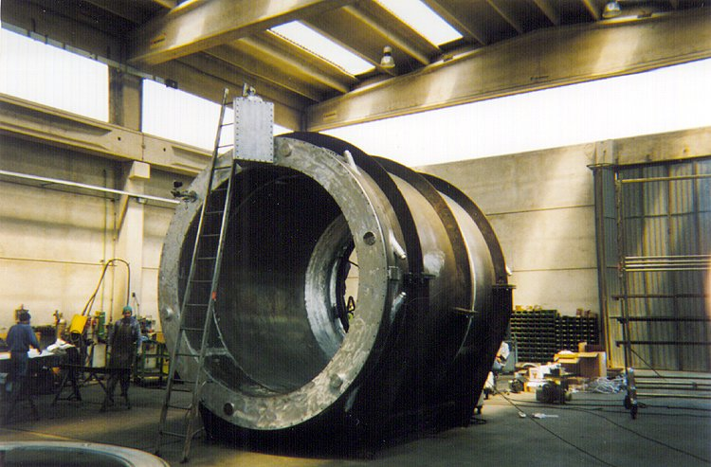
Coil
Radius 1509.8 – 1550.6mm
Length 3513.5mm,
3 sections, middle is twice long as each of two ends.
Turn 1067, double layer
For 1.5T field, run with 4596A, total 4903932A. this is nominal operation current.
For 1.58T field, run with 4826A, total 5149342A. This is tested operation current.
Need more info from BaBar
Can it run higher current?
How is the coil supported? By the 6 poles in Cryo?
Cryo
Use thermosyphone, chimney at upstream end
Chimney radius 2145mm
Length 3850mm, 80mm longer than CLEO 3870mm
Outer radius 1770, 10mm larger than CLEO 1760mm

Slide 25
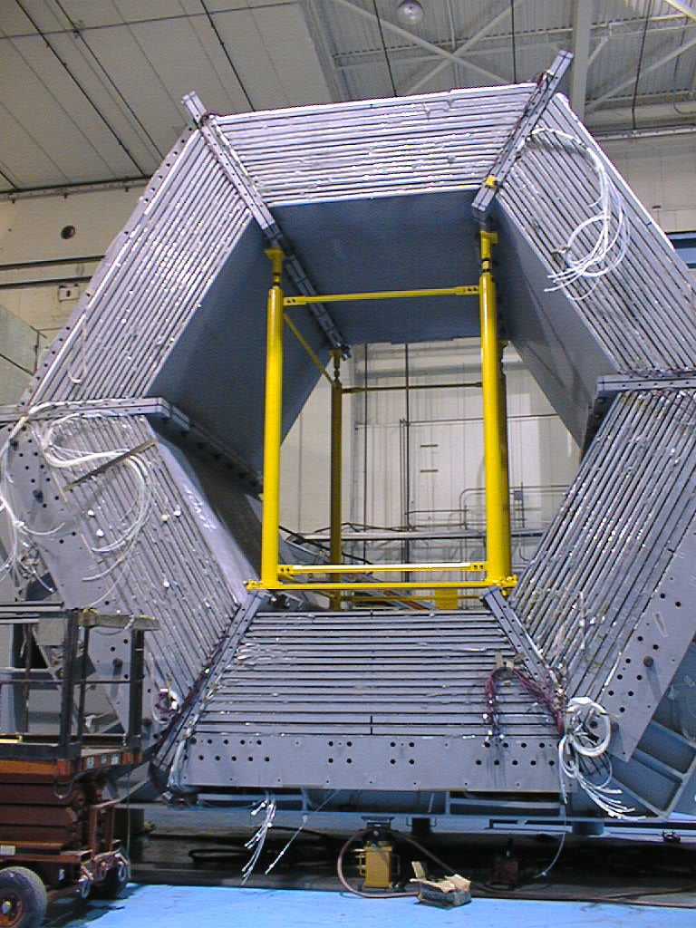
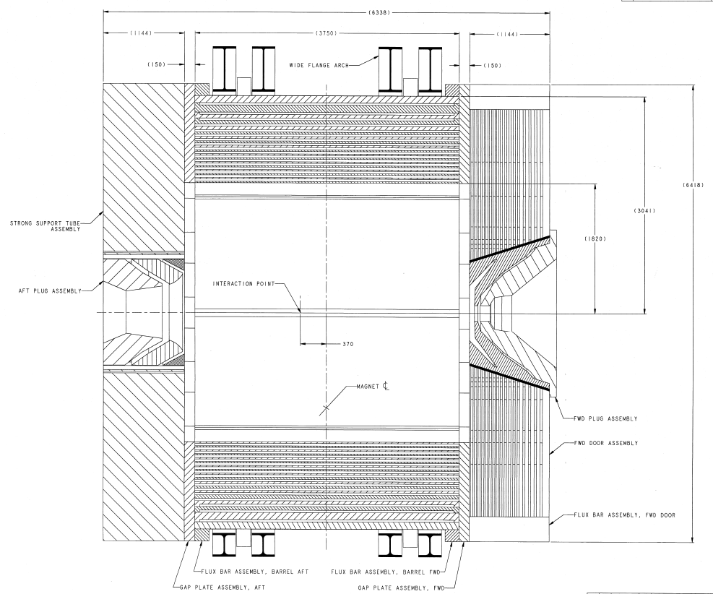
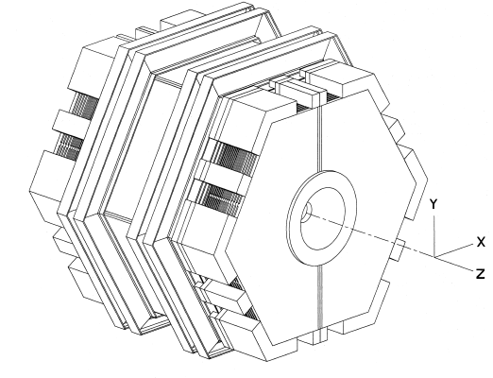
BaBar Flux return and support
Flux bar (barrel)
Need Cut bottom to fit
Barrel supporting ring
End door supporting
Remove most outer layer of barrel flux return
Support ring
Side plate
Gap plate
Flux bar(door)
Constrain of Hall A beam line height 3048mm (10 feet)
Cut line

Slide 26
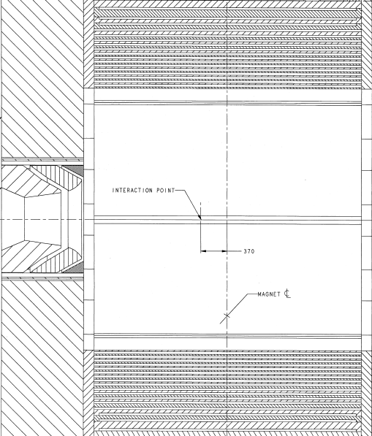
SoLID BaBar
New Parts in solid color
Old parts in boxes
Polar angle acceptance are similar to CLEO
May use BaBar barrel flux return after removing the most outer layer.
May use BaBar upstream and downstream flux return as partial SoLID front piece and endcap. How much change is needed?
The bottom of various support structures need cut to fit Hall A beam line height
~35º
~ 14.5º

Slide 27
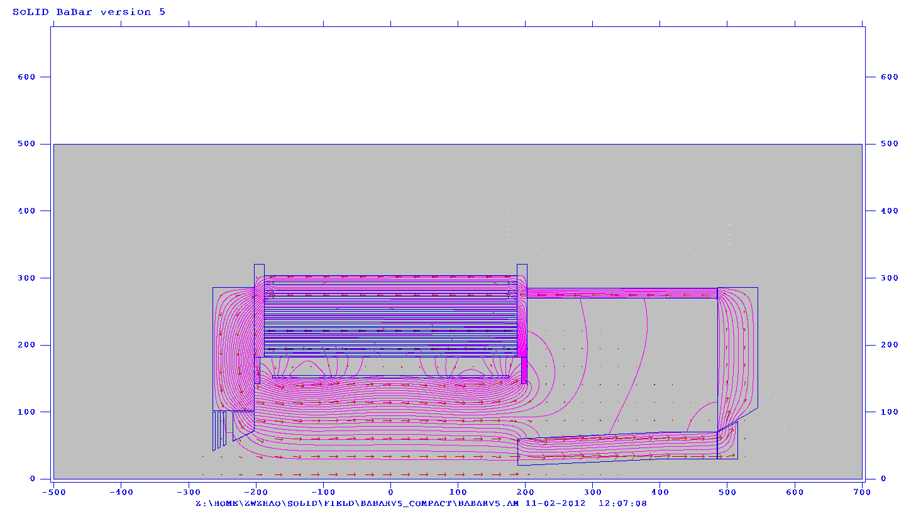
Yoke weight
Steel density is 7.9g/cm3 , weight unit is in metric t
SoLID BaBar could save about 92t iron. Assume machined steel cost $4.5/lb, total could save $0.9M
SoLID BaBar
material from BaBar 543t
new material 108t
total 651t
57
26
276
26
106
109
2.6
2.6
4
1
4
1
35
1
7.4
57
SoLID CLEO
195
30
3
3
17
material from CLEO-II 376t
new material 200t
total 576t
154
21
4.4
5
10.4
6
12.5
2
2
40
2

Slide 28
SoLID BaBar summary
The initial look shows that BaBar can be used for the same physics.
It can be improved with more input from engineering and more info from BaBar
It could reuse more yoke than CLEO, which means potential savings.
The modification cost could be significant though.

Slide 29
Summary
Our default design is based on CLEO
BaBar could be alternative
Cost difference needs more input from engineering.

