Slide 1

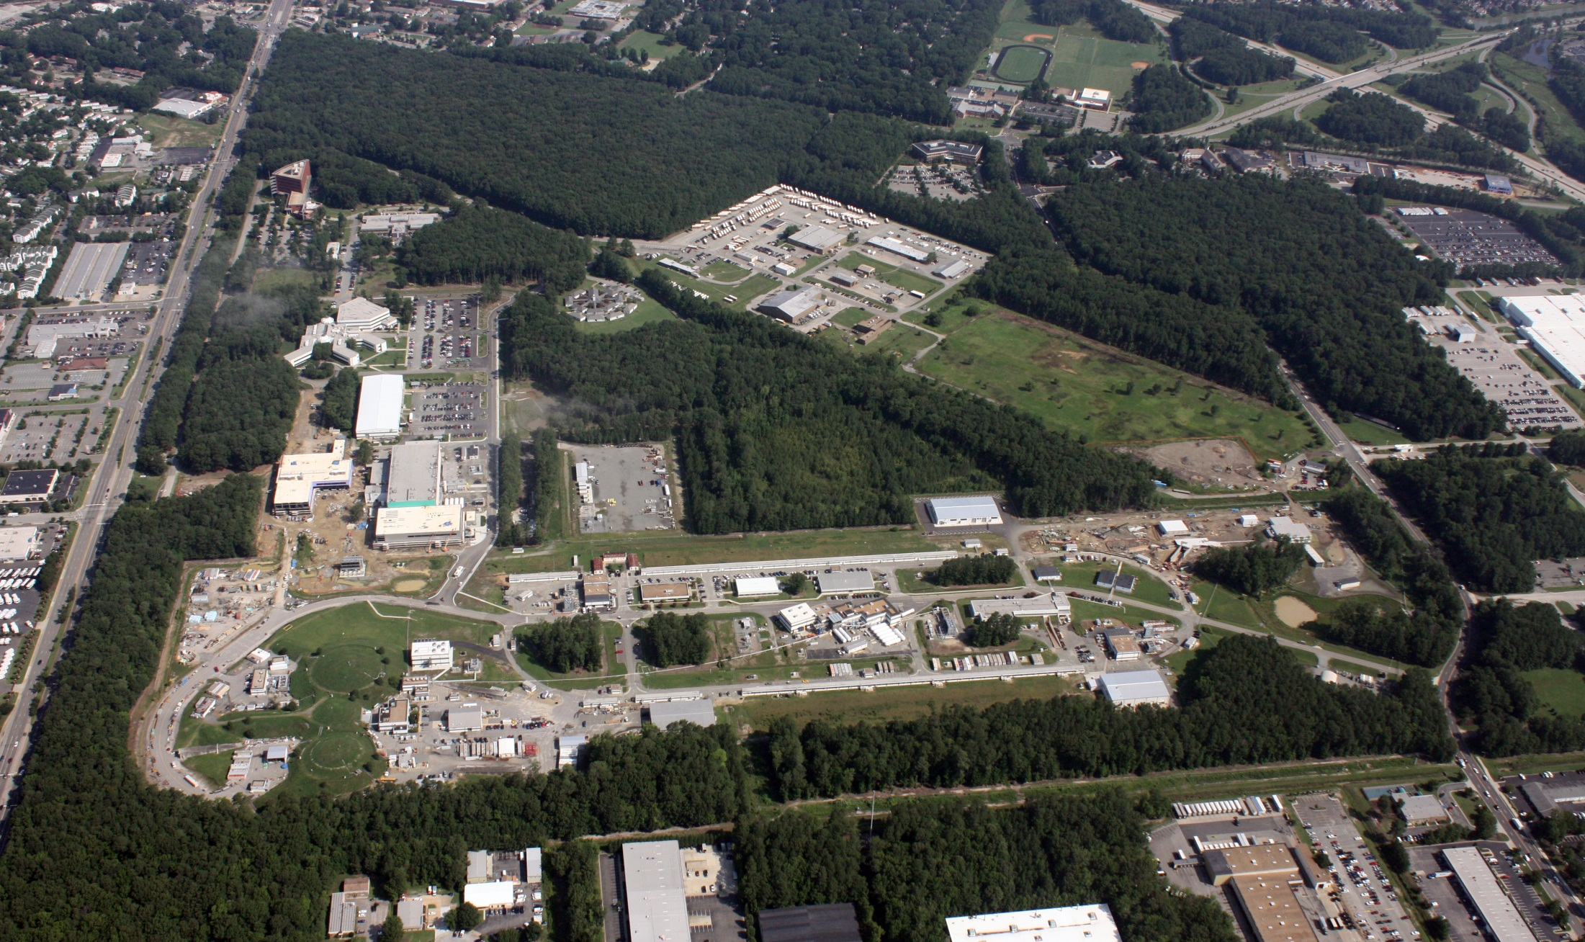
Jefferson Lab Update
Bob McKeown
Presentation to SoLID Collaboration
March 22, 2013

Slide 2
Outline
12 GeV Project Status
PAC40
Tribble Report
NSAC Facilities Subcommittee

Slide 3
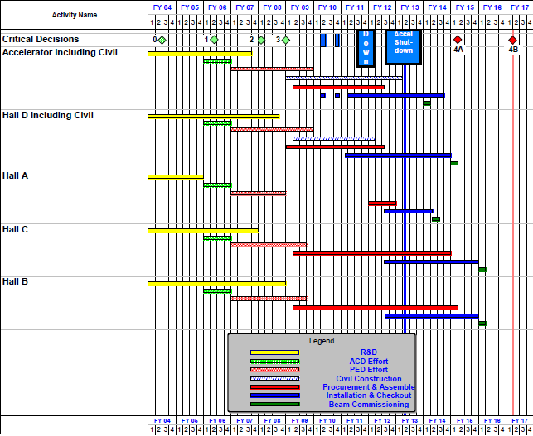
12 GeV Upgrade Project Schedule
FY12: reduction of $16M
FY13: Pres Request – no restoration
Rebaseline in progress
    Present expectation (subject to rebaseline review):
    12 16-month installation
    May 2012 - May Sept 2013
    Hall A commissioning start Oct 2013 Feb 2014
    Hall D commissioning start
    April 2014 Oct 2014
    Halls B & C commissioning start Oct 2014 Oct 2015
    Project Completion Dec 2016
Next DOE Project Review
May, 2013

Slide 4
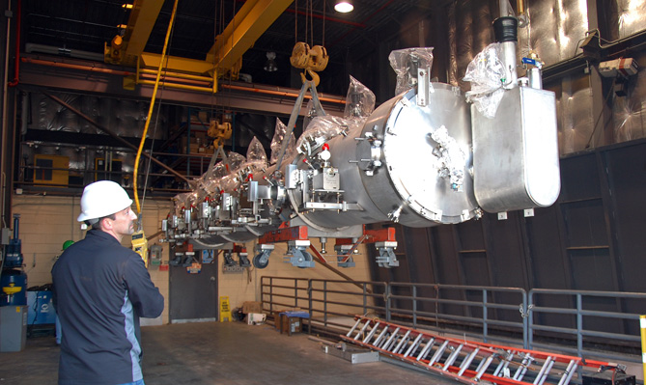
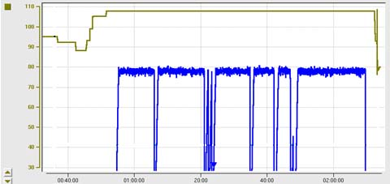
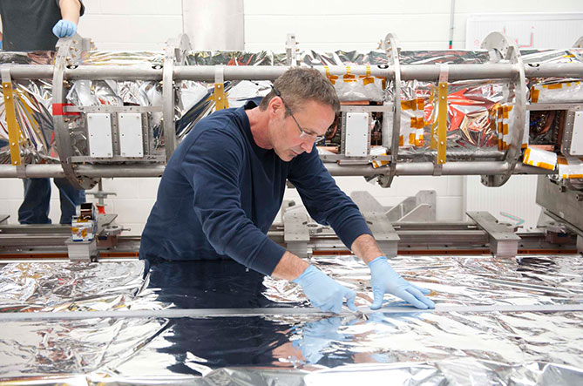
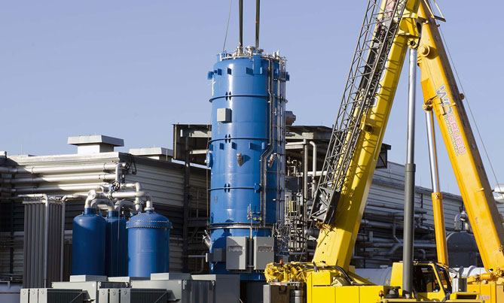
12 GeV Upgrade – Accelerator Progress
High gradient cryomodule performance
demonstrated in tunnel
◻ Met research beam spec. of 108 MeV @ 465 μA
Six (of 10) new cryomodules installed in tunnel
Central Helium Liquefier-2 commissioning underway
317 (of 347) arc magnets reworked; 286 re-installed
Accelerator construction 87% complete
Third C100 Cryomodule
transferred to tunnel
C100 Cryomodule Energy Gain – May 18th
108 MeV
– 200
98 MeV
– 150
ENERGY GAIN (MeV)
Beam Current/pass (μA)
– 100
– 50
Final CM construction
TIME (in 20 minute increments)
CHL-2
installation

Slide 5
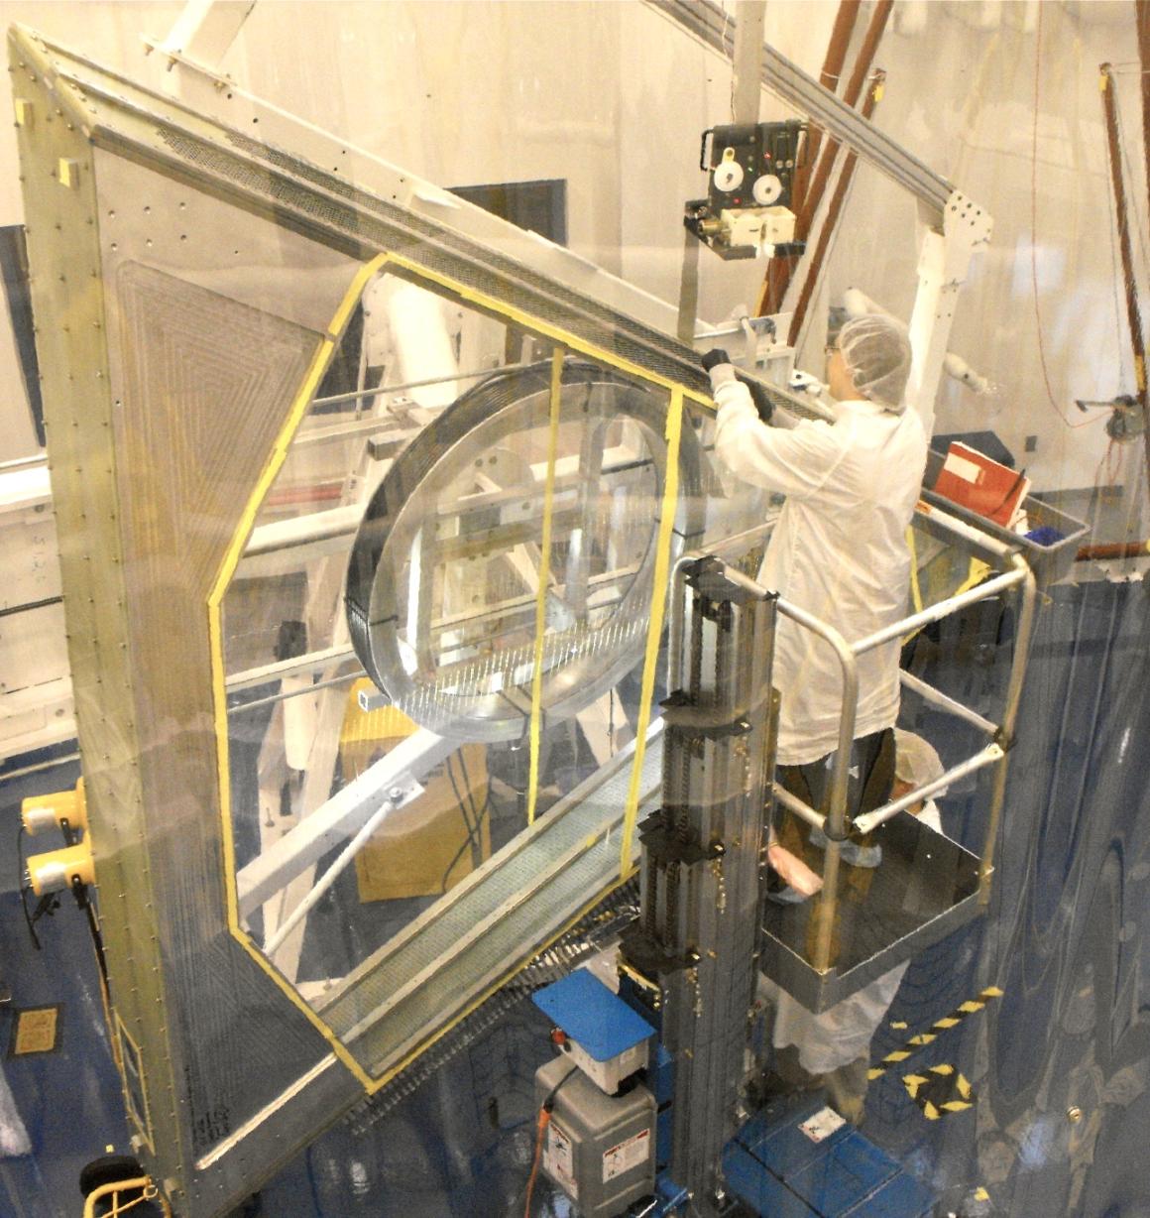
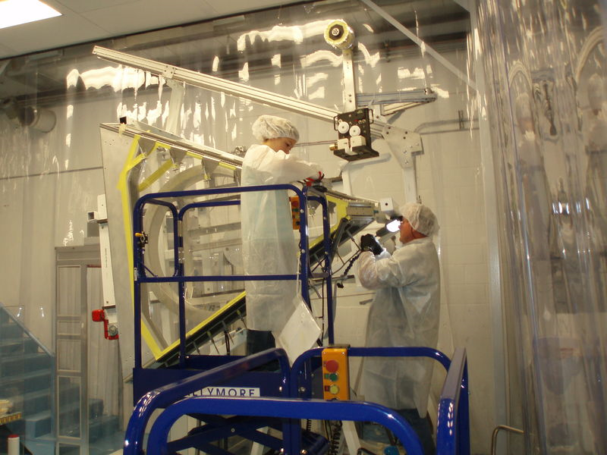
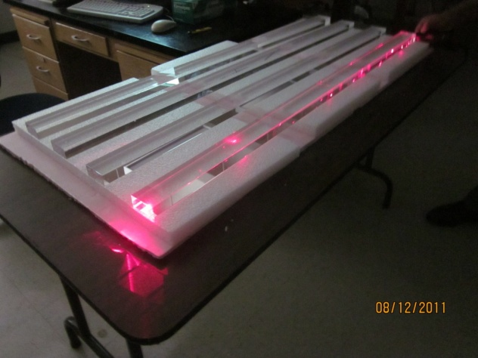
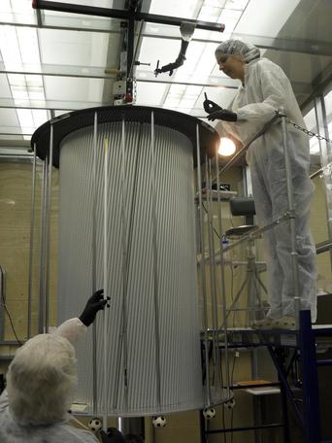
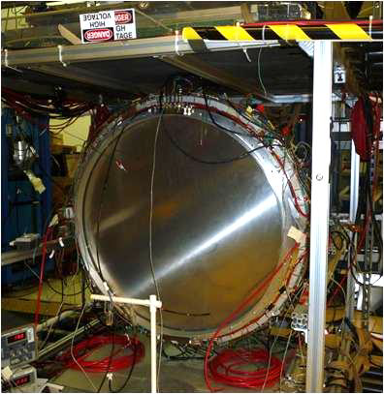
12 GeV Upgrade – Detector Highlights
All major detector systems under construction
Hall B Drift Chamber
Region 2
(Old Dominion U)
Hall B Drift Chamber
Region 1
(Idaho State U)
Hall C Quartz Hodoscope
NCA&T
Hall D Central Drift Chamber
(Carnegie Mellon)
Hall B PCAL
(JLab/Ohio Univ)
Hall D Forward Drift Chamber
JLab

Slide 6
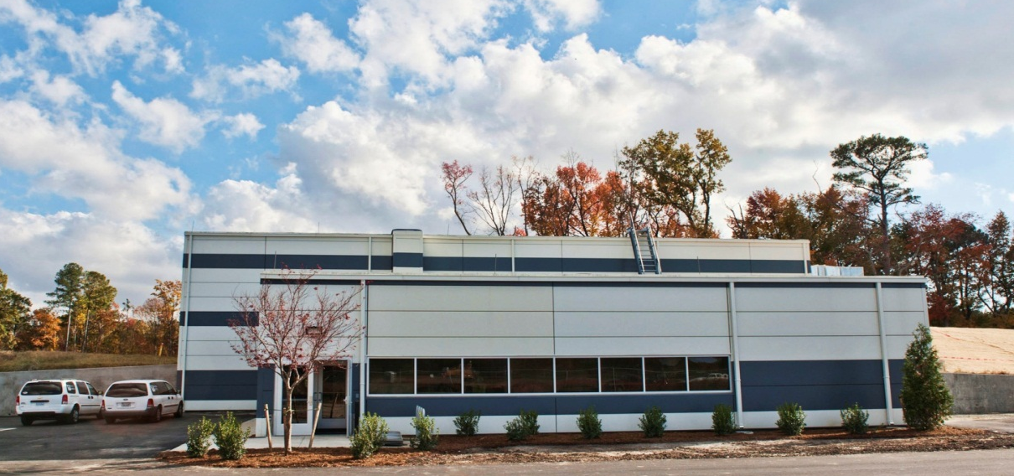
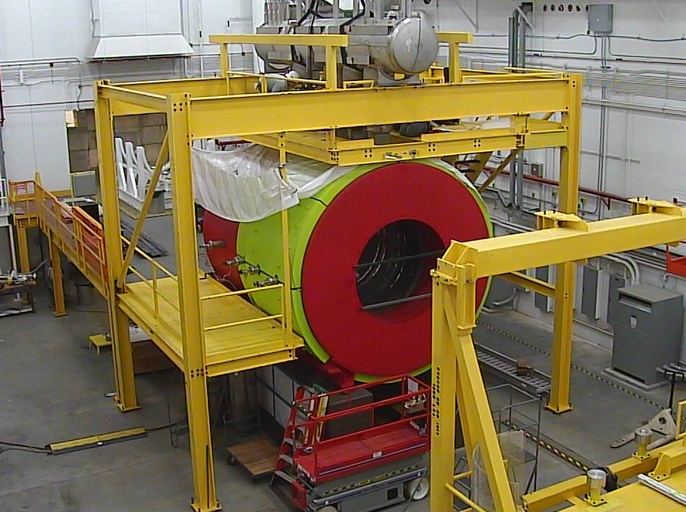
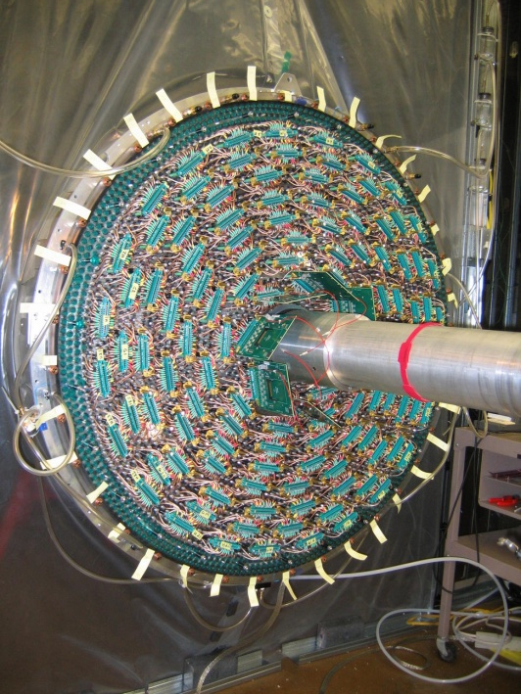
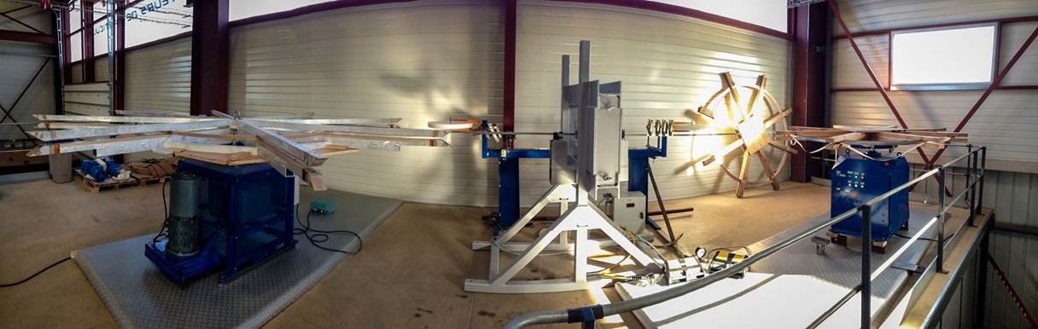
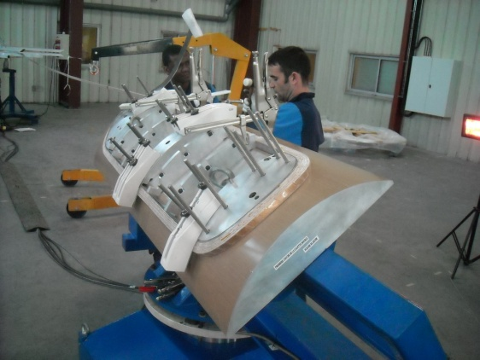
12 GeV Project Status
Hall D & Counting House
Hall D Interior
Hall D Drift Chamber
SC Magnet Conductor Press
Installation in all 4 Halls has begun
Challenges with superconducting magnets for experiments
  All 7 magnets under contract
  Schedule delay a concern for two contracts
  Hall D solenoid cool-down is underway
Upgrade Project 73% Complete, 85% Obligated
Accelerator commissioning begins October 2013
Beam to Hall A in 2nd Quarter of FY14
Beam to Hall D in 1st Quarter of FY15
Hall C Dipole
Magnet Coil

Slide 7
PAC40
Proposals due Monday May 6, 8AM EDT.
New approval guidance
“New proposals will be recommended for approval only if they represent high quality physics within the range of scientific importance represented by the previously approved 12 GeV proposals.”
New parallel running procedure
- intent is to encourage proposal of “run groups”
- summary of additions to existing run group
(PAC to comment)

Slide 8
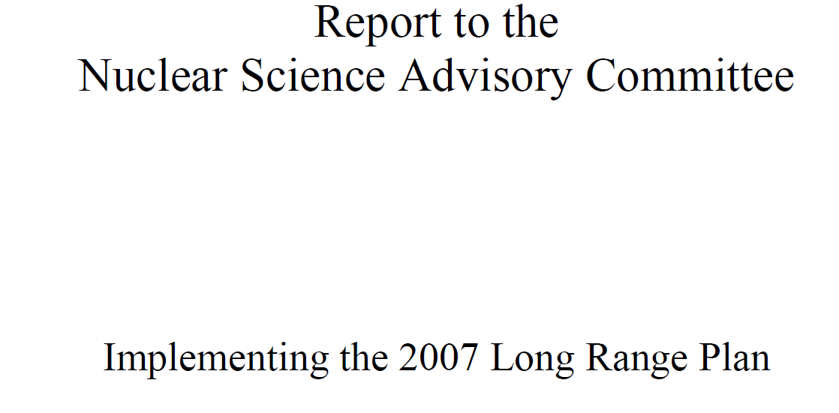
http://science.energy.gov/~/media/np/nsac/pdf/20130201/
2013_NSAC_Implementing_the_2007_Long_Range_Plan.pdf

Slide 9
Budget Options
Starting with President’s FY2013 request,
three options considered:
• Flat-flat funding
• Cost of Living
• Modest Growth

Slide 10
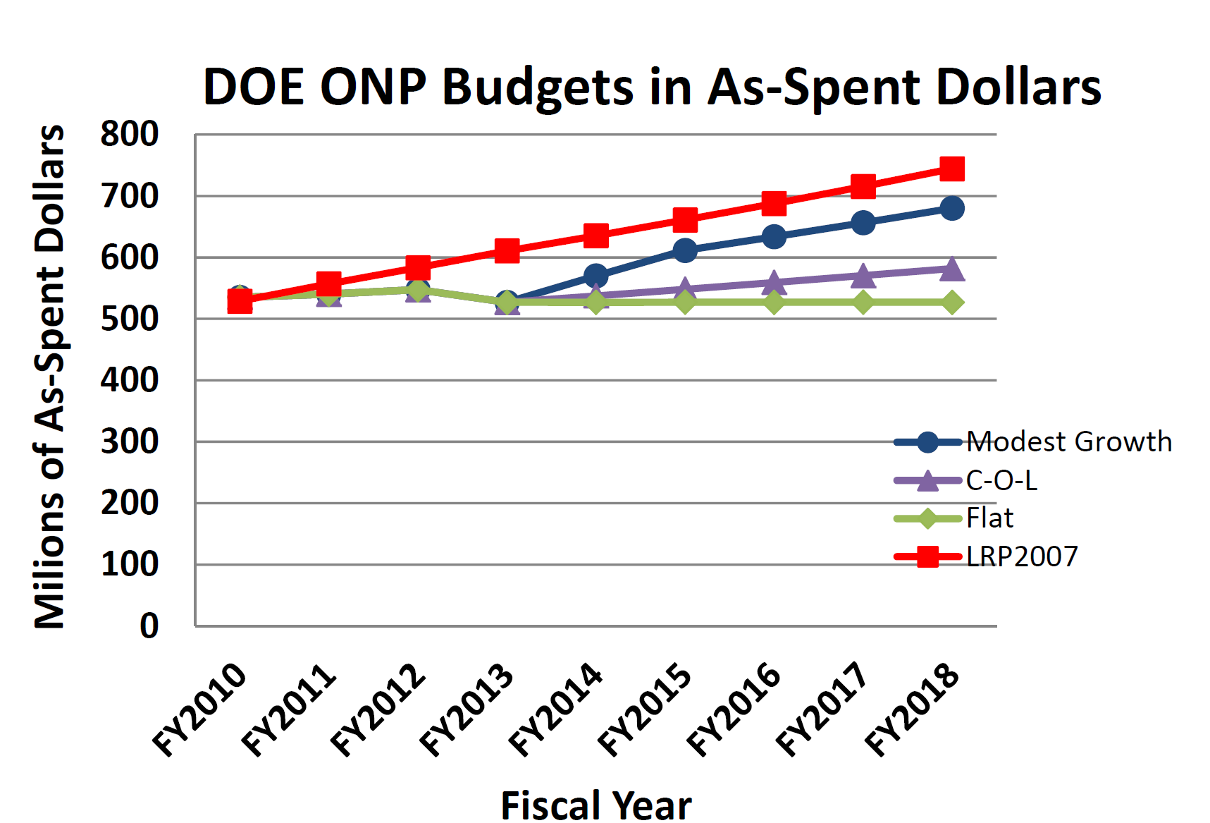

Slide 11
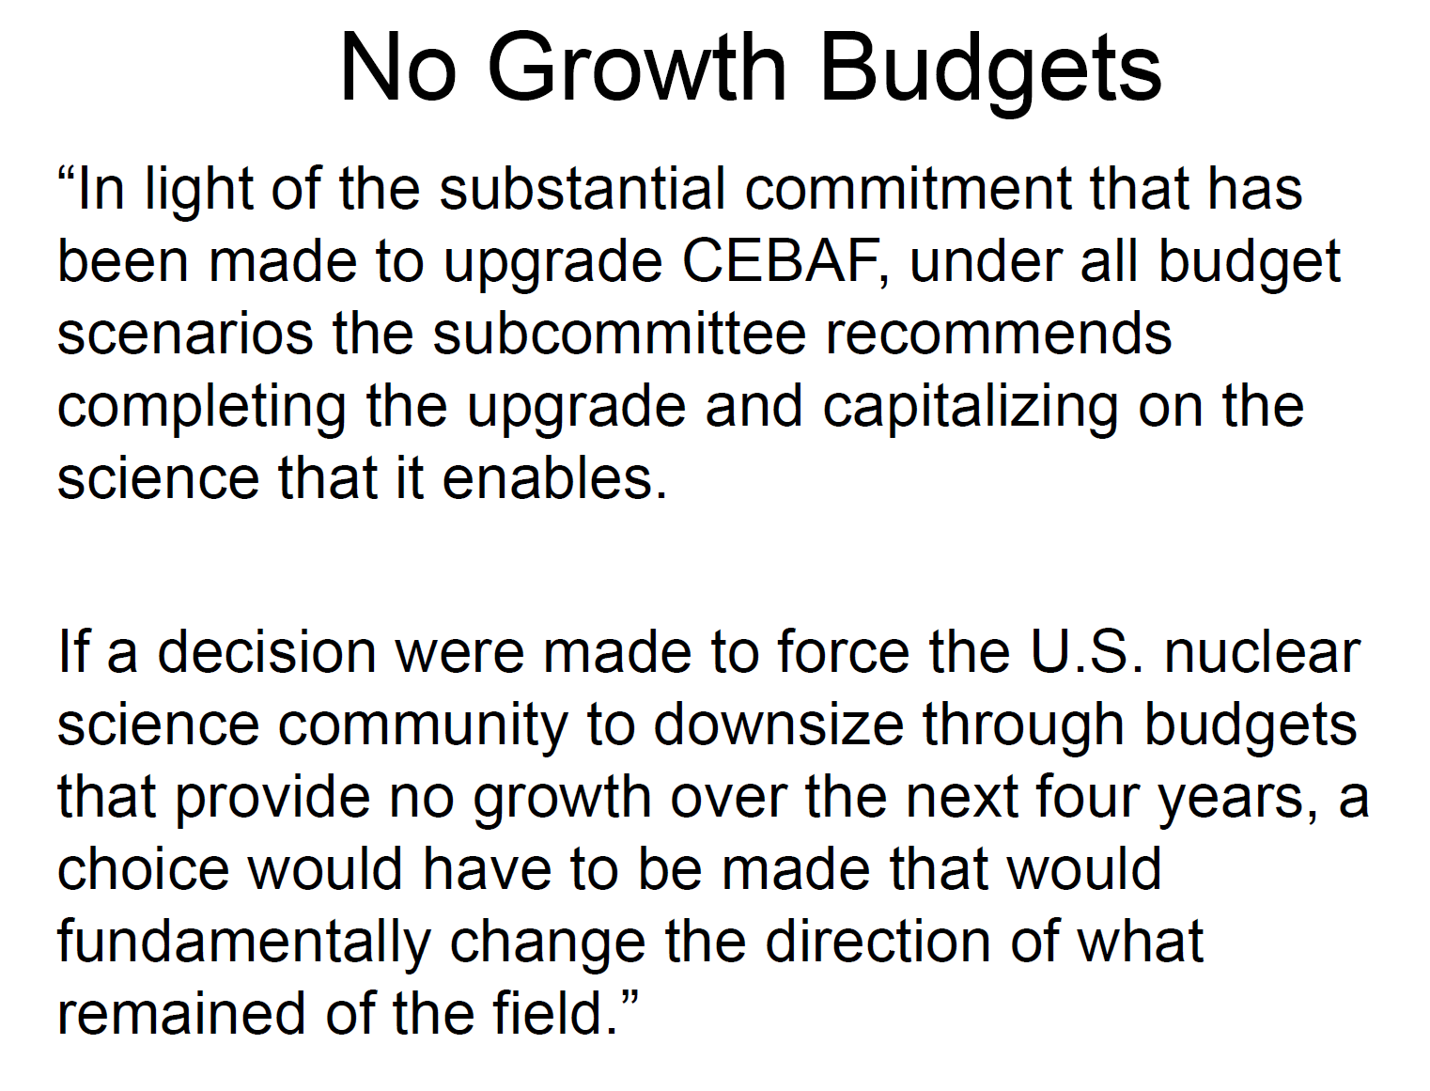

Slide 12
No growth (cont’d)
“Because of the superb science lost in either shutting down RHIC or terminating construction on
FRIB, the committee was not able to make a choice based on scientific merit alone. Based on
additional considerations of timing of the budget crisis relative to the status of the ongoing construction initiative, the subcommittee vote, while closely split, resulted in a slight preference for the choice that proceeds with FRIB. This choice secures the significant non-ONP contributions that are critical to the cost-effective construction of FRIB, ensures a leading position for the U.S. in the central area of nuclear structure and nuclear astrophysics based on FRIB's unprecedented science capabilities.”

Slide 13
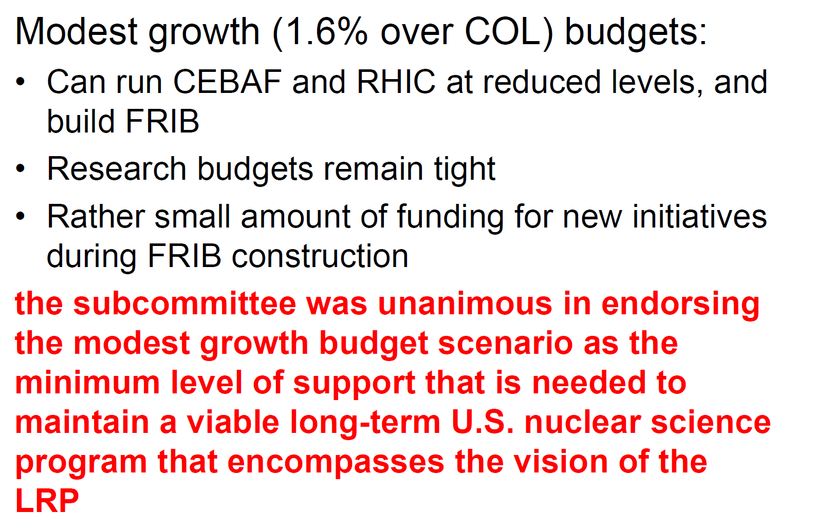

Slide 14
Implications for JLab
The NP community will be advocating for the modest growth scenario
- we hope for good ops budget
For no growth – closure of RHIC
- healthy ops budget for Jlab?
- MEIC vs eRHIC?

Slide 15
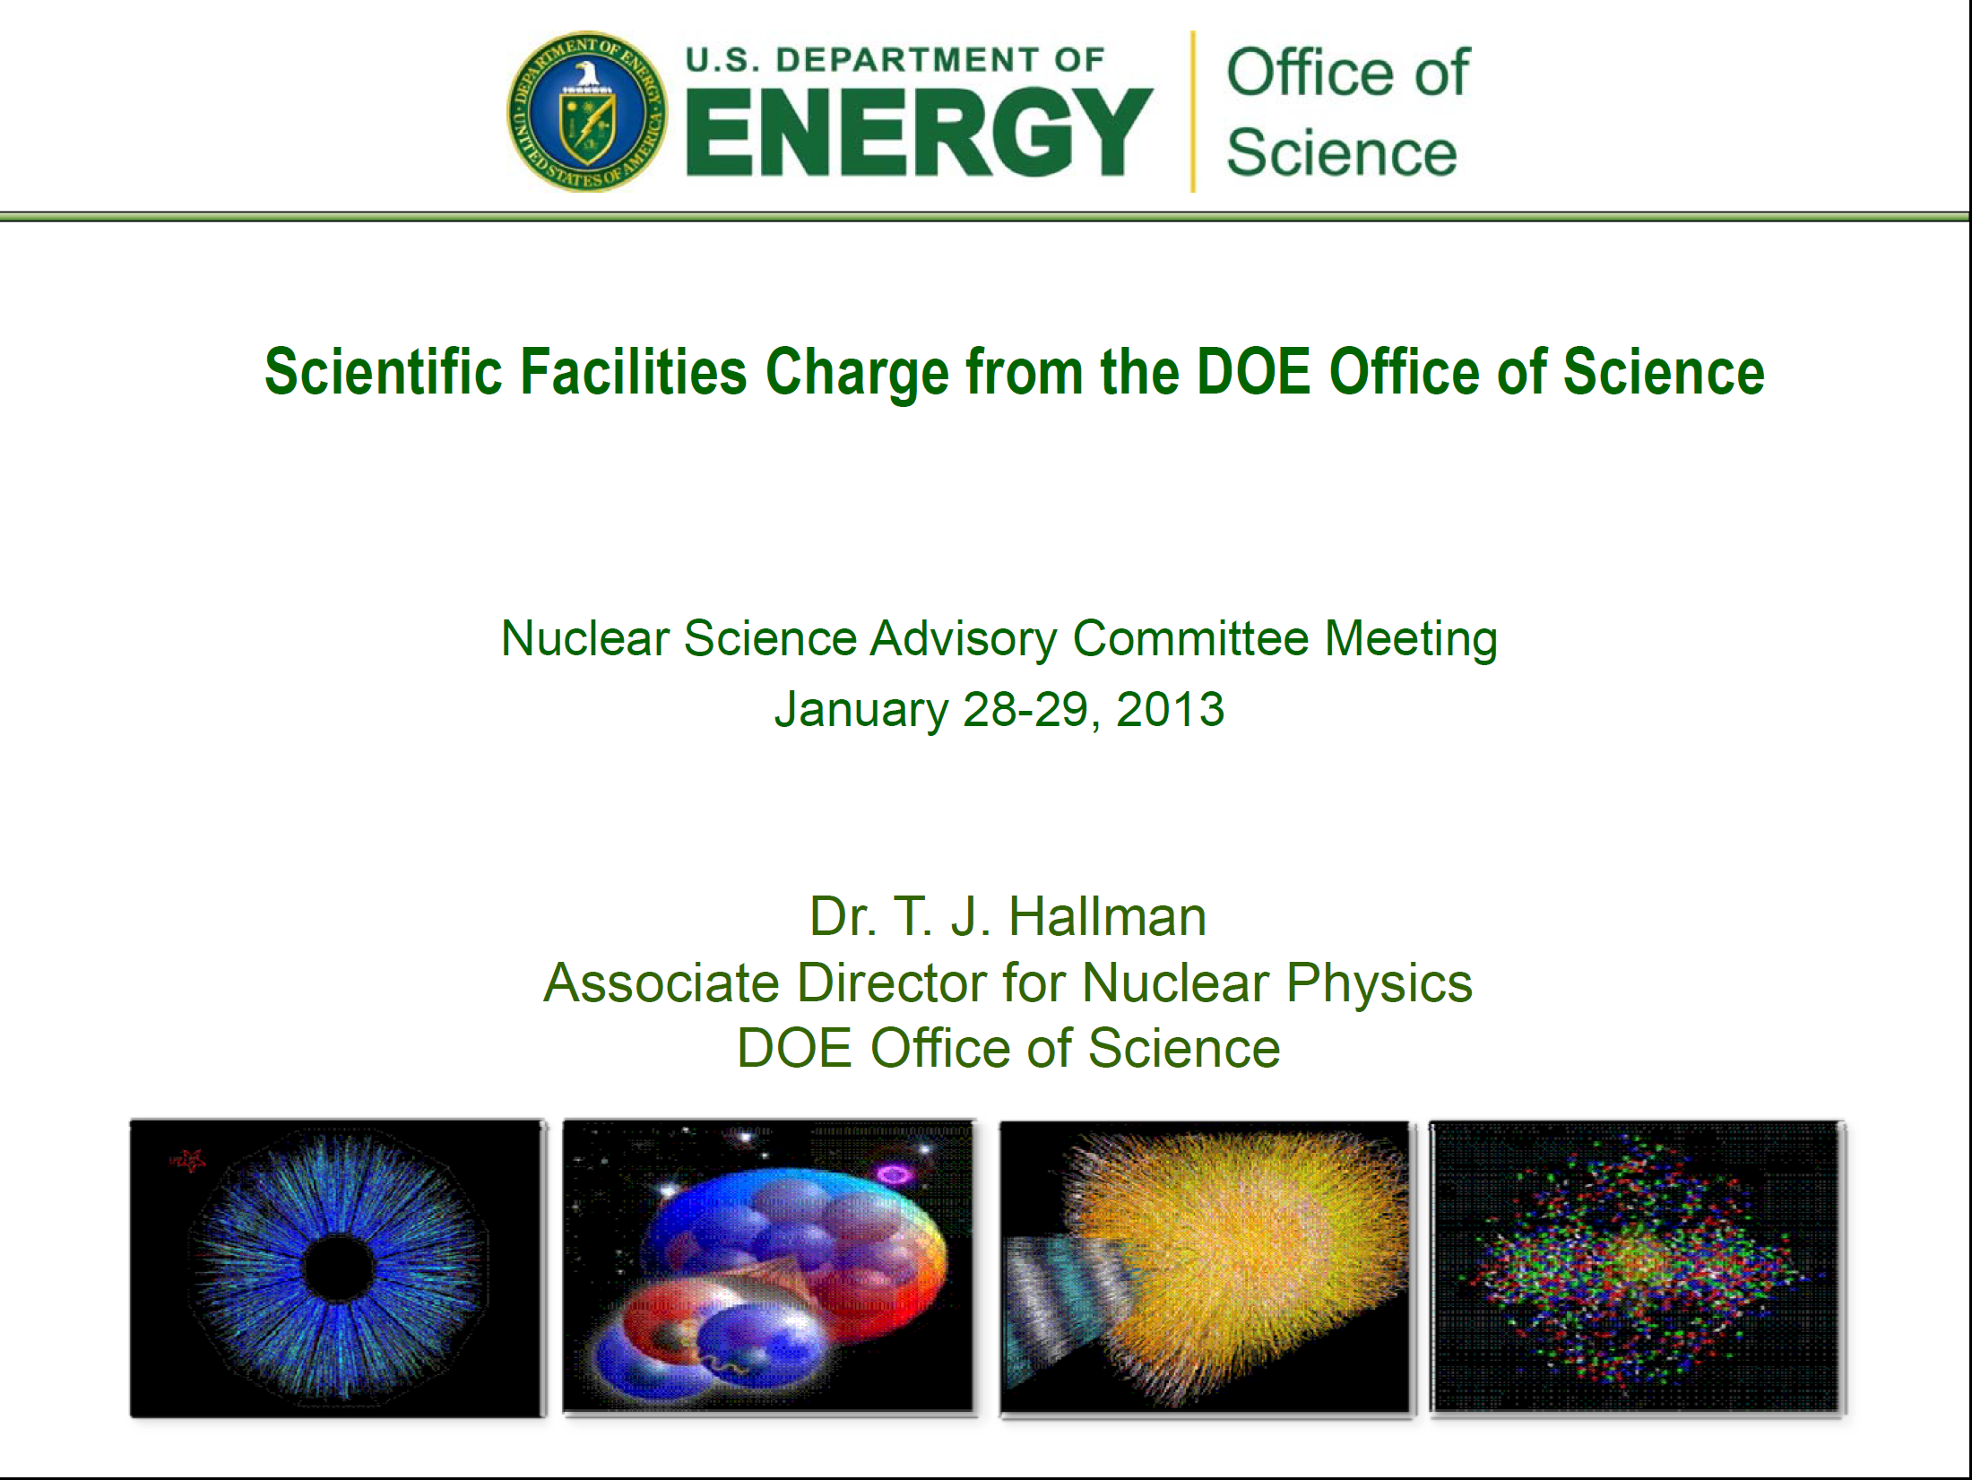

Slide 16
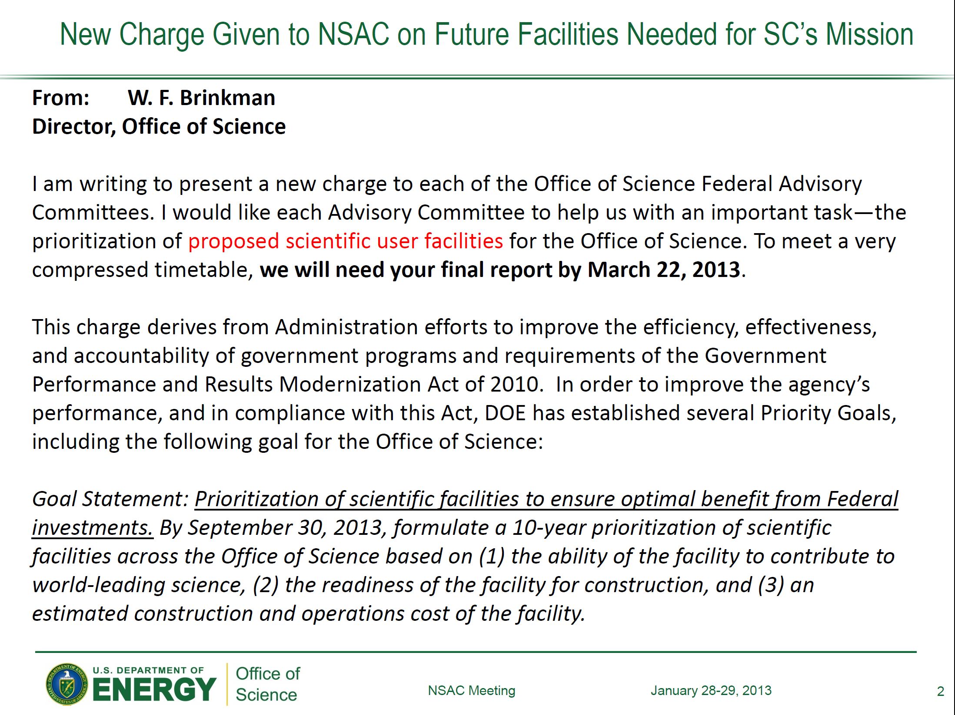

Slide 17
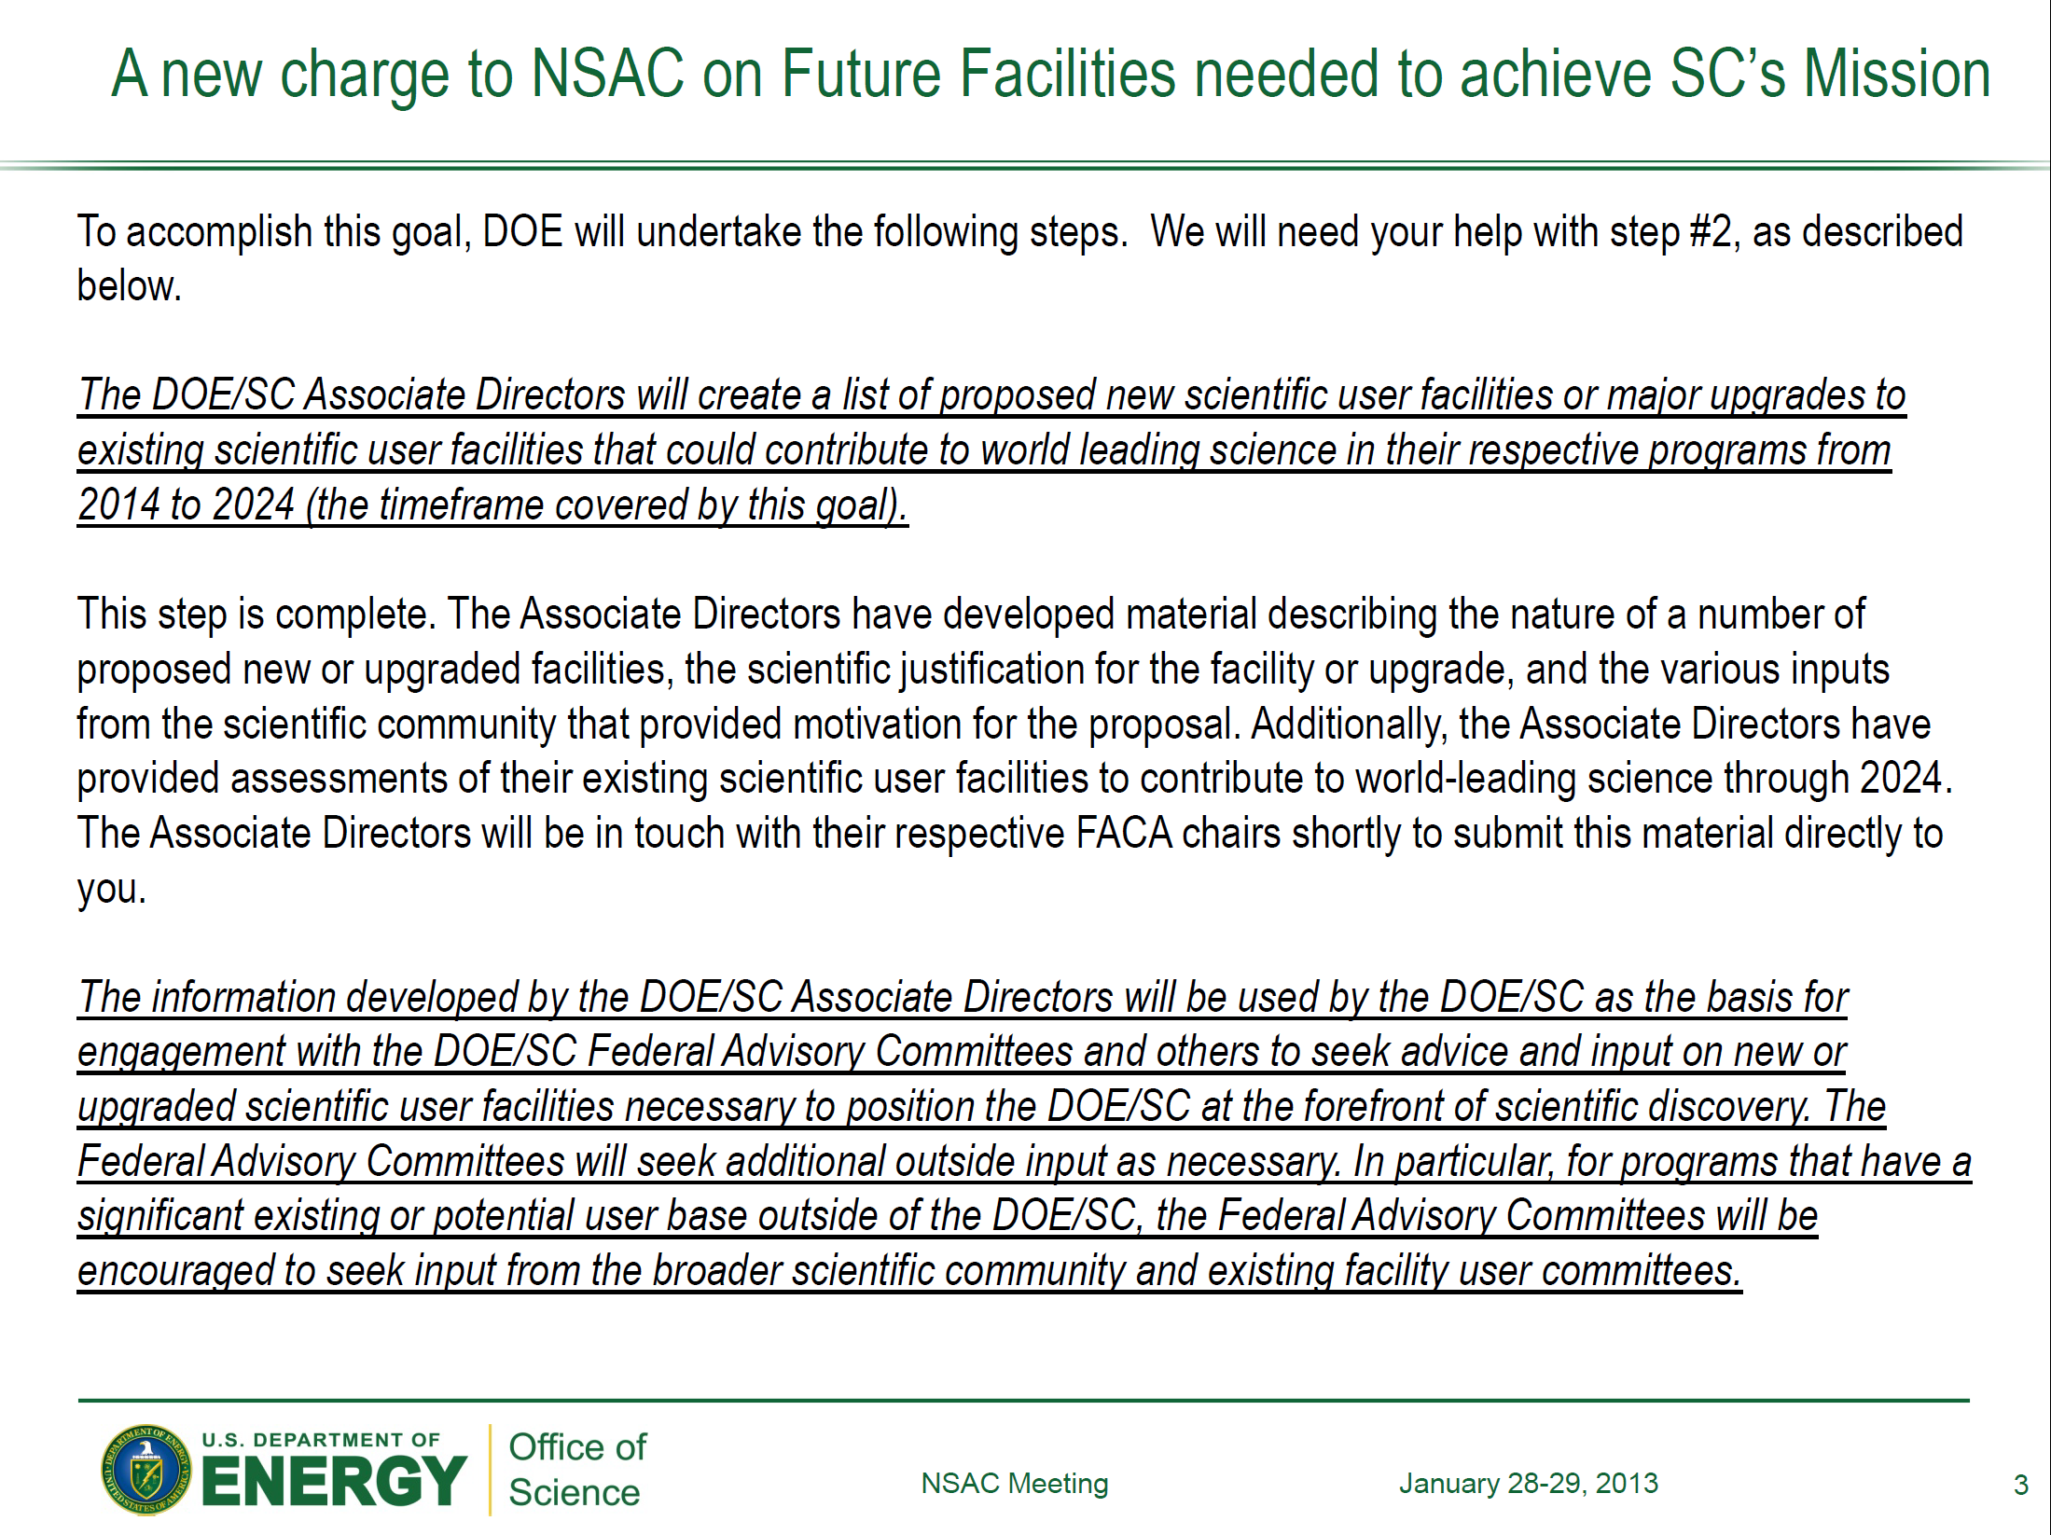

Slide 18
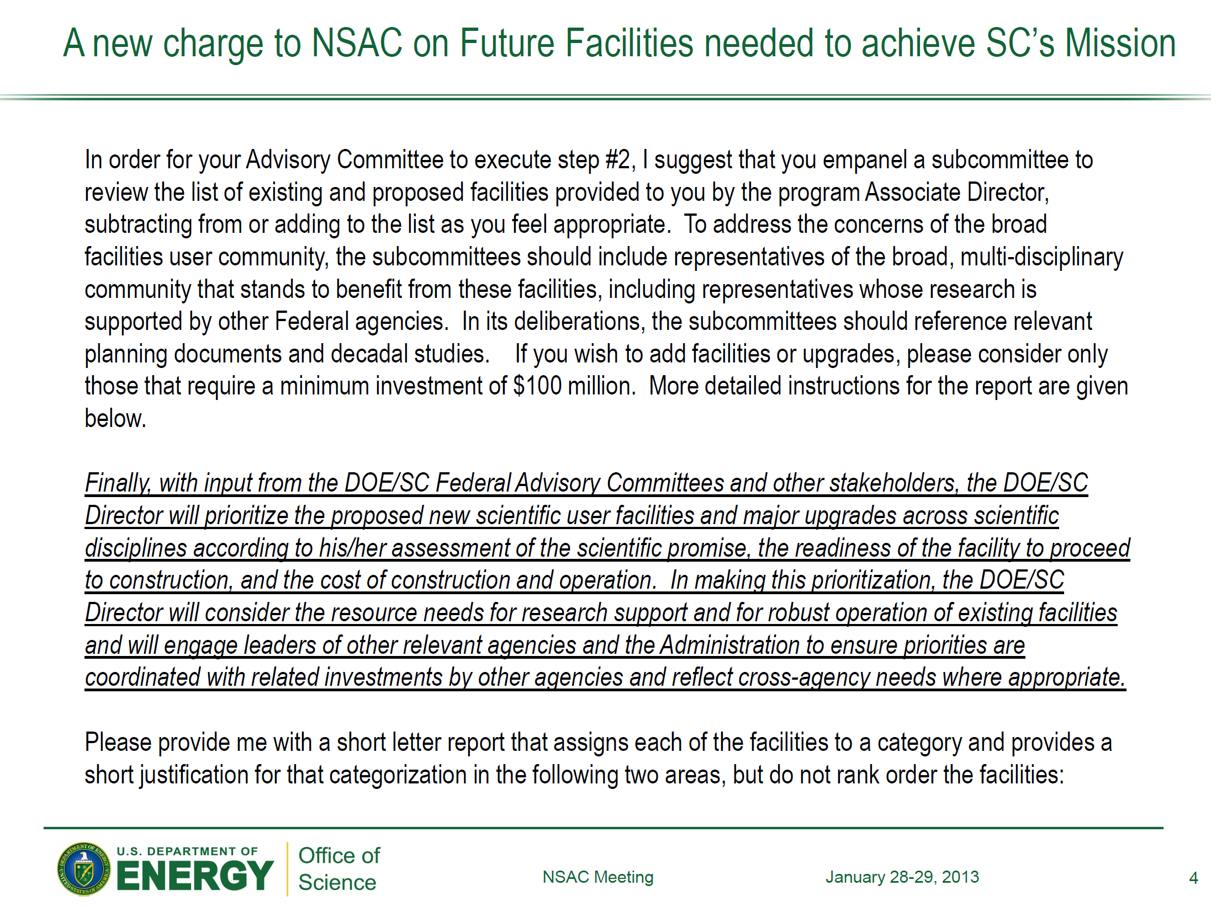

Slide 19
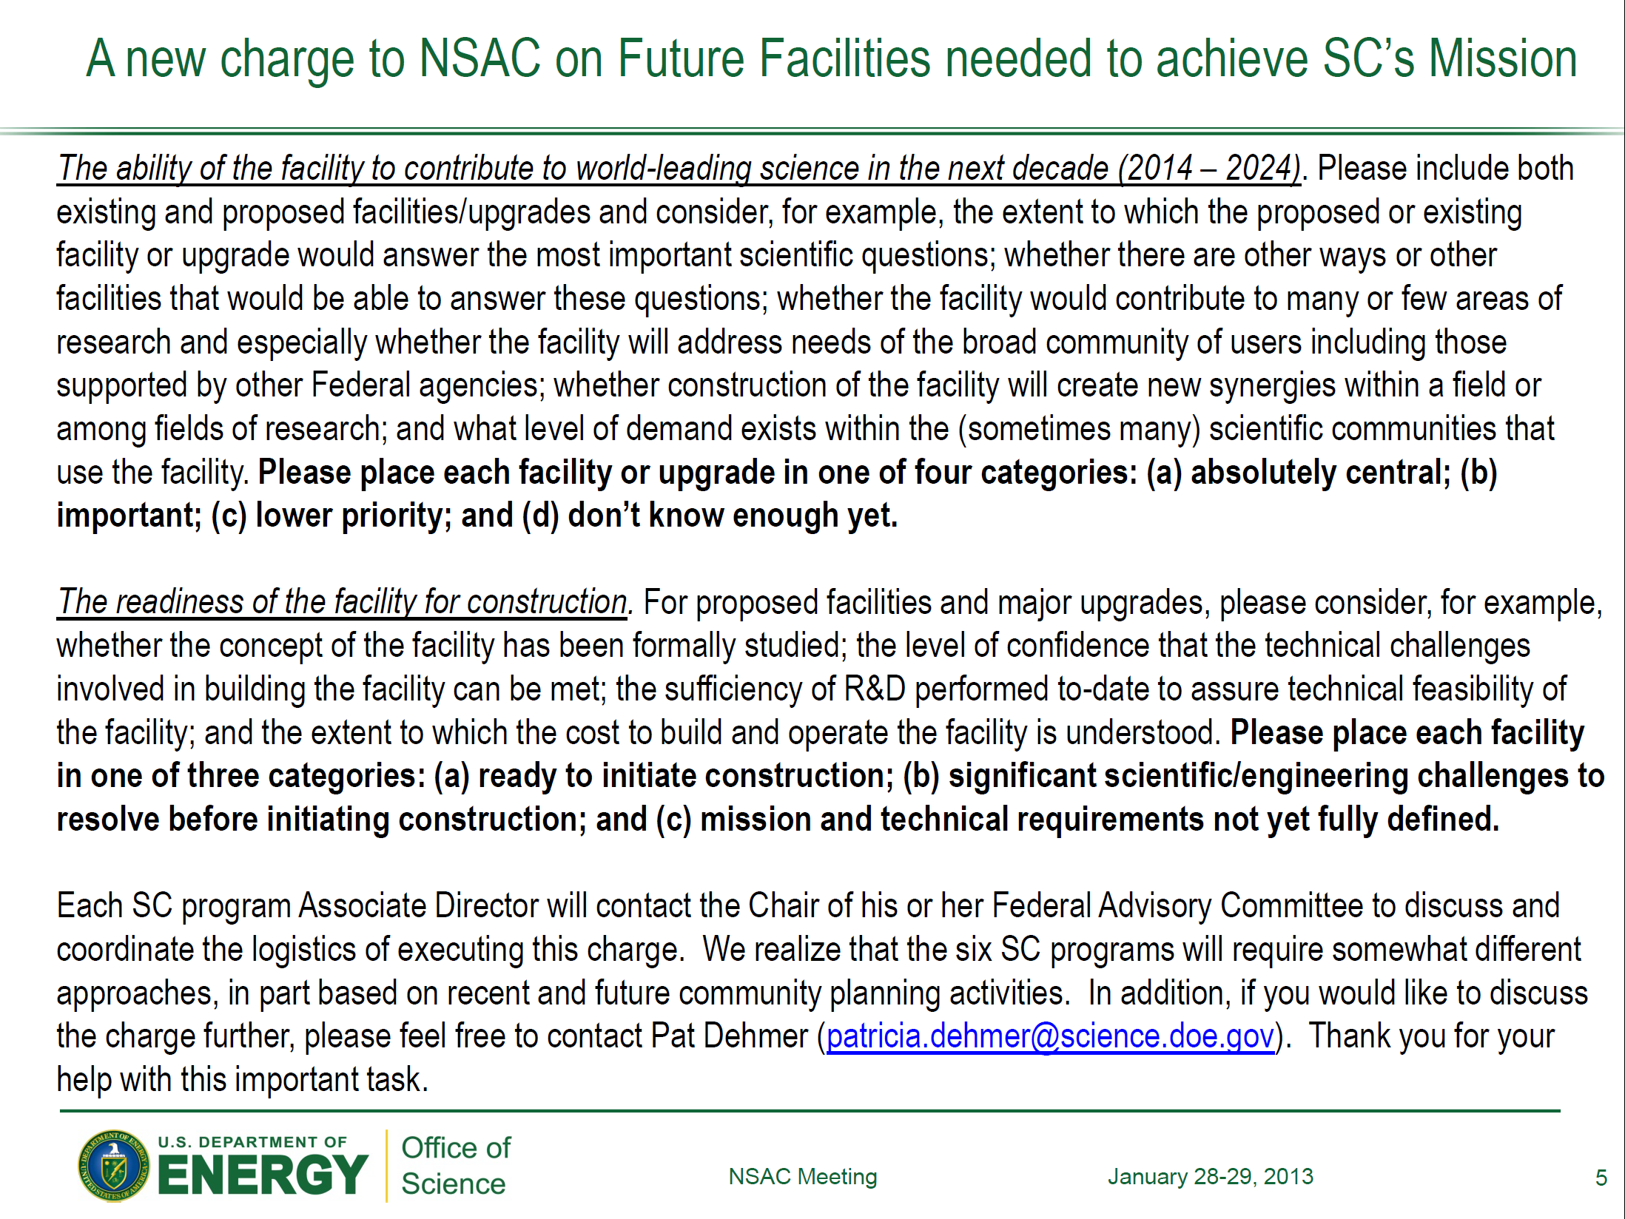

Slide 20
NSAC Subcommittee on Facilities
Robert Redwine MIT Chair
Doug Beck Illinois - UC
James Beene ORNL
Brian Cole Columbia
Carl Gagliardi Texas A&M
Donald Geesaman ANL ex officio
Rod Gerig ANL
Keith Griffioen William and Mary
Kim Lister Massachusetts – Lowell
Zein-Eddine Meziani Temple
Don Rej LANL
Hamish Robertson Washington
James Symons LBNL
Primary meeting Feb 15-16 in DC area.
Report to NSAC by 28 February for consideration at March 8-9
NSAC meeting

Slide 21
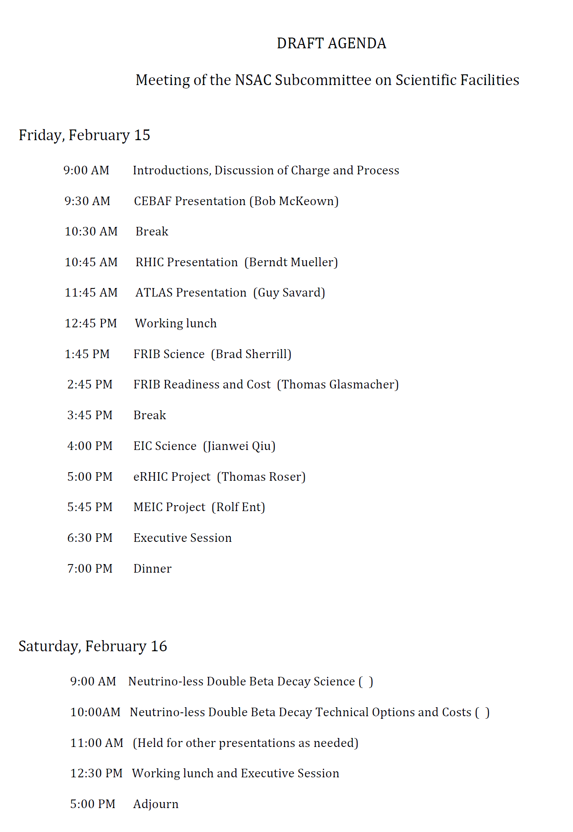
DRAFT Agenda

Slide 22
DRAFT Agenda

Slide 23
From Program Offices
NP
FRIB
1T 0νββ
EIC
BES
APS upgrade
SNS 2nd target station
LCLSII
NGLS
HEP
Hi Lum LHC Accelerator
Hi Lum LHC detectors - ATLAS
Hi Lum LHC detectors - CMS
Higgs Factory
Japanese ILC Accelerator
Japanese ILC Detectors
Mu2e
LBNE
Project X Accelerator
Project X Detectors
Nu Storm
LSST
G3 Dark Matter
Next Generation Dark Energy

Slide 24
MEIC Layout – make use of large ion booster
Ion
source
Booster
(3 to 25 GeV/c)
Three Figure-8 rings
stacked vertically
SRF linac
Pre-booster
SC magnet ion collider ring (20-100 GeV)
electron collider ring
(3-12 GeV)
Three vertically stacked rings:
3 to 12 GeV electron
(resistive magnets)
Up to 25 GeV/c proton
(resistive magnets)
Up to 100 GeV/c proton
(SC magnets)
Medium-energy IPs with
horizontal beam crossing
Injector
12 GeV CEBAF
Have opportunity to do the MEIC in phases
Initial collisions utilizing the booster reduces the risk of electron cooling, and provides a test bed for MEIC
  Requires lower electron energies (13.6 MeV vs. 4.3 MeV Fermilab cooler)
  Added benefit: use of low-tech resistive magnets

Slide 25
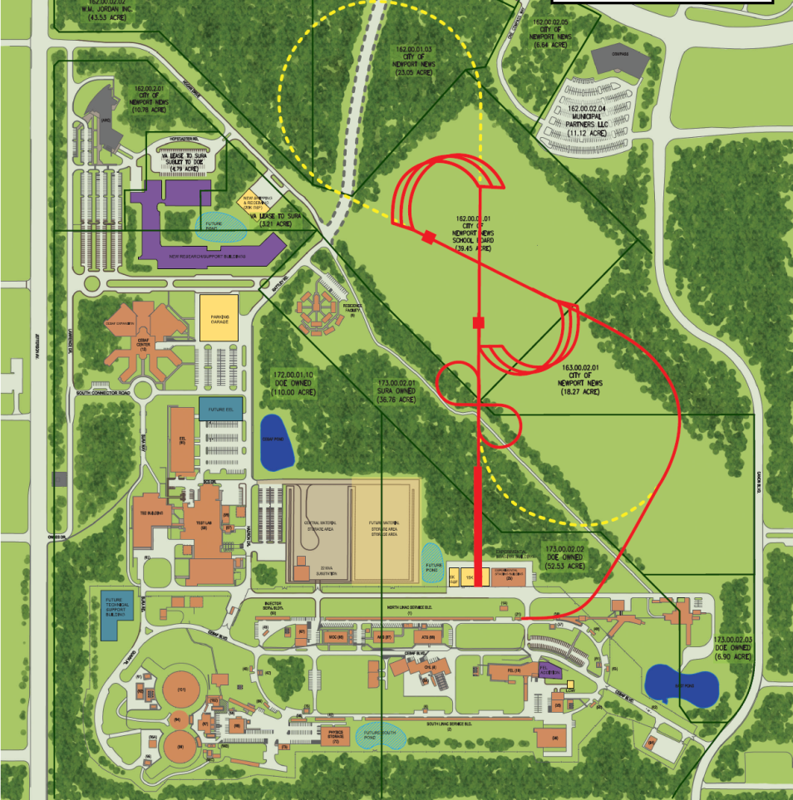
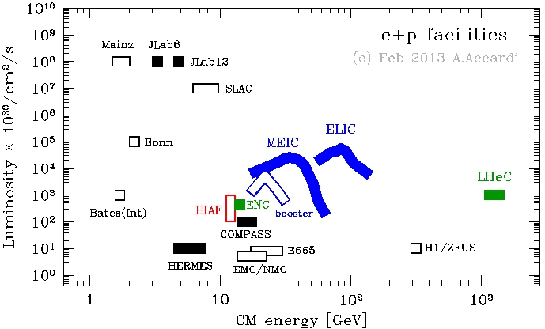
MEIC Cost & Realization
Stage-II
EIC
MEIC
MEIC cost range = 600M$ - 1100M$ (FY13$)
flexible depending on level of capability
does not include 100M$ detector allowance
opportunities for international contributions
operations cost range: 100-150M$/year
(based on scaled CEBAF and RHIC)
Electron cooling
IP
)
)
IP
600M$ 1100M$
600: e-N up to √s = 35 GeV
700: e-N up to √s = 54 GeV
850: e-A up to √s = 54 GeV
1000: e-A up to √s = 70 GeV
1100: full design luminosity
EIC
10³⁴

Slide 26
EIC Realization Imagined
Activity Name | 2010 | 2011 | 2012 | 2013 | 2014 | 2015 | 2016 | 2017 | 2018 | 2019 | 2020 | 2021 | 2022 | 2023 | 2024 | 2025
12 GeV Upgrade
FRIB
EIC Physics Case
NSAC LRP
EIC CD0
EIC Machine Design/R&D
EIC CD1/Downsel
EIC CD2/CD3
EIC Construction
Assumes endorsement for an EIC at the next NSAC Long Range Plan
Assumes relevant accelerator R&D for down-select process done around 2016

Slide 27
Rankings
“The ability of the facility to contribute to worldleading
science in the next decade”
(a) absolutely central; (b) important; (c) lower priority;
(d) don’t know enough yet
“The readiness of the facility for construction”
(a) ready to initiate construction; (b) significant
scientific/engineering challenges to resolve before
initiating construction; (c) mission and technical
requirements not yet fully defined

Slide 28
Current Facilities
Current Facility | Science
ATLAS | a
CEBAF | a
RHIC | a

Slide 29
CEBAF
Physics goals include studies of nuclear structure, the structure of hadrons, quark
confinement, quark hadronization, fundamental forces and symmetries,
theory and computation, superconducting accelerator science, and related
subjects such as medical imaging.
CEBAF uses parity‐violating electron scattering to address a variety of important
questions.
With upgrade in progress, the facility will operate with 4 experimental halls, each
with unique capabilities.
12‐GeV upgrade is 73% complete; first beam to Hall A in 2nd quarter of FY14.
Additional detector systems that are needed to fully exploit the physics potential
include MOLLER (parity violation) and SoLID (high luminosity and acceptance).
A large user group has proposed and had approved 7 years worth of high‐priority
physics experiments using CEBAF.
We rank the Physics importance of CEBAF as “absolutely central”.

Slide 30
Proposed Facilities
Proposed Facility or Project | Science | Readiness
EIC | a | b
FRIB | a | a
NLDBD | a | b

