Slide 1
Update on SoLID
Jian-ping Chen, Jefferson Lab
SoLID Collaboration Meeting
March 22-23, 2013

Slide 2
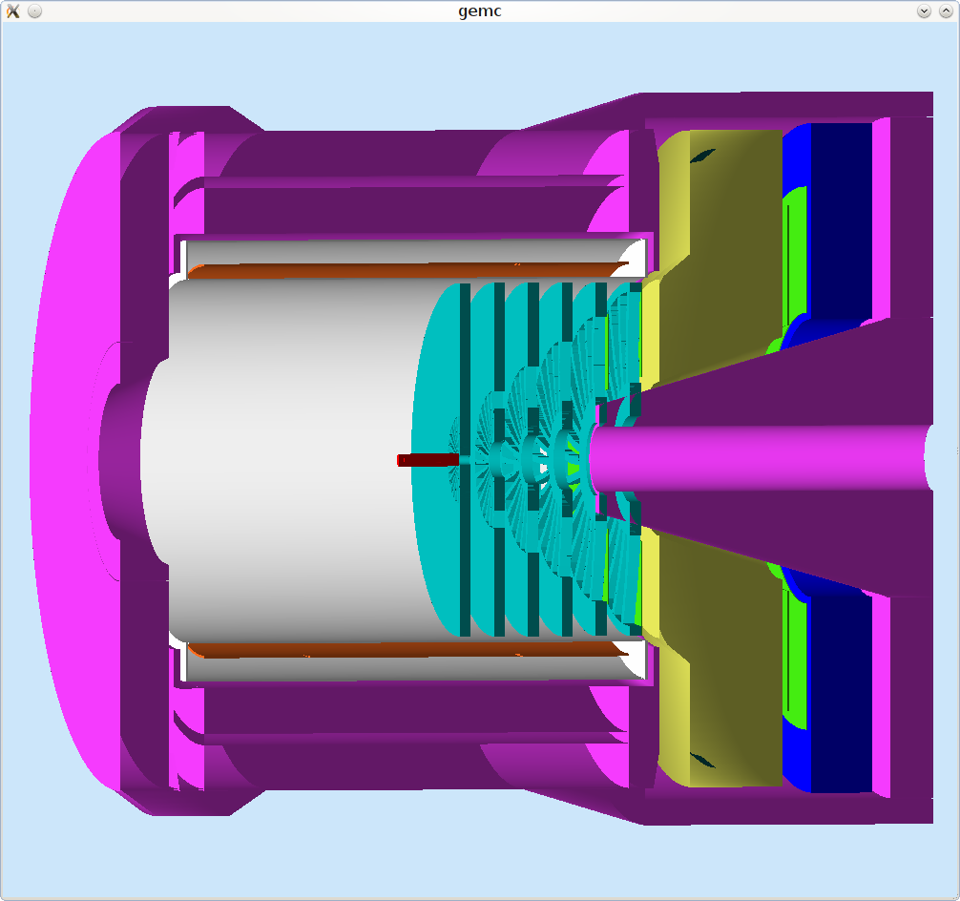
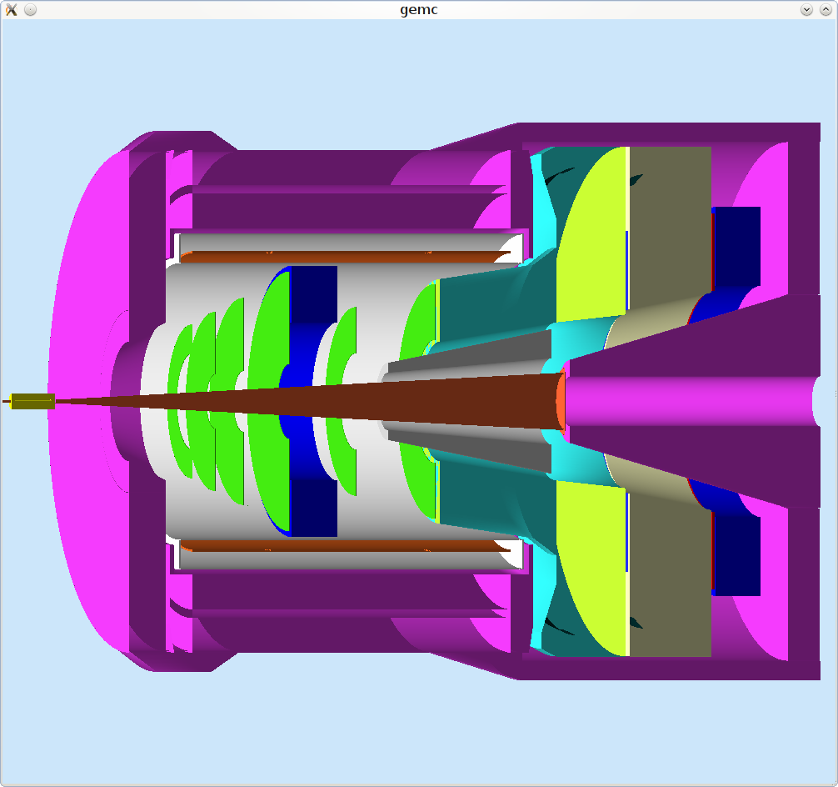
Physics Program for SoLID
SoLID: large acceptance, capable of handling high luminosity
(up to~10³⁹ with baffle, up to ~10³⁷ without baffle)
Ideal for precision Inclusive-DIS (PVDIS) and SIDIS experiments
Excellent for selected exclusive reactions (ex. J/Psi)
Five experiments approved (4 with “A” rating, 1 A- rating):
PVDIS, E12-10-007
SIDIS: E12-10-006 (He3-T), E12-11-007 (He3-L), E12-11-108 (p-T)
J/Psi: E12-12-006

Slide 3
SoLID Status Update
Main items from last meeting
EM calorimeter
1) Support (Paul Reimer’s talk)
2) Pile-ups from background, preshower design (Xiaochao’s talk)
3) Scintillator plane before preshower
Cryotarget for PVDIS (Dave’s talk)
1) Motion range vs. opening at the magnet entrance
2) Scattering chamber/downstream window
3) Residual polarization of deuteron target
Technical Document Write-up and Cost Estimation
1) Major subsystem, conceptual design mostly complete
2) 0th draft available
3) Check, proofreading, iterations in progress
4) Ready to discuss with physics division in ~one month?

Slide 4
SoLID Status Update (II)
Magnet:
Continue work with CLEO magnet /support
Site visit by Will Oren, lots of useful information,
Formal request?
Progress in all other subsystems:
GEMs readout R&Ds (UVa+):
GEMs- China: foil production progress
DAQ test stand setup
MRPC (Tsinghua+) , publication of test results
Both Cherenkov’s (Temple/Duke)
Tracking
Beam Polarimetry: progress with Compton
New idea for hadron PID: high resolution TOF (Yi Qiang’s talk)

Slide 5
Milestone, Schedule
Technical write-up ready to be released: ~ 1 month?
Director’s review: this summer (August?)
Discuss with DOE: in a few months?
Submit MIE/MRI: Late 2013?
CD process: 2013-2015?
Pre-R&D: now

