Slide 1
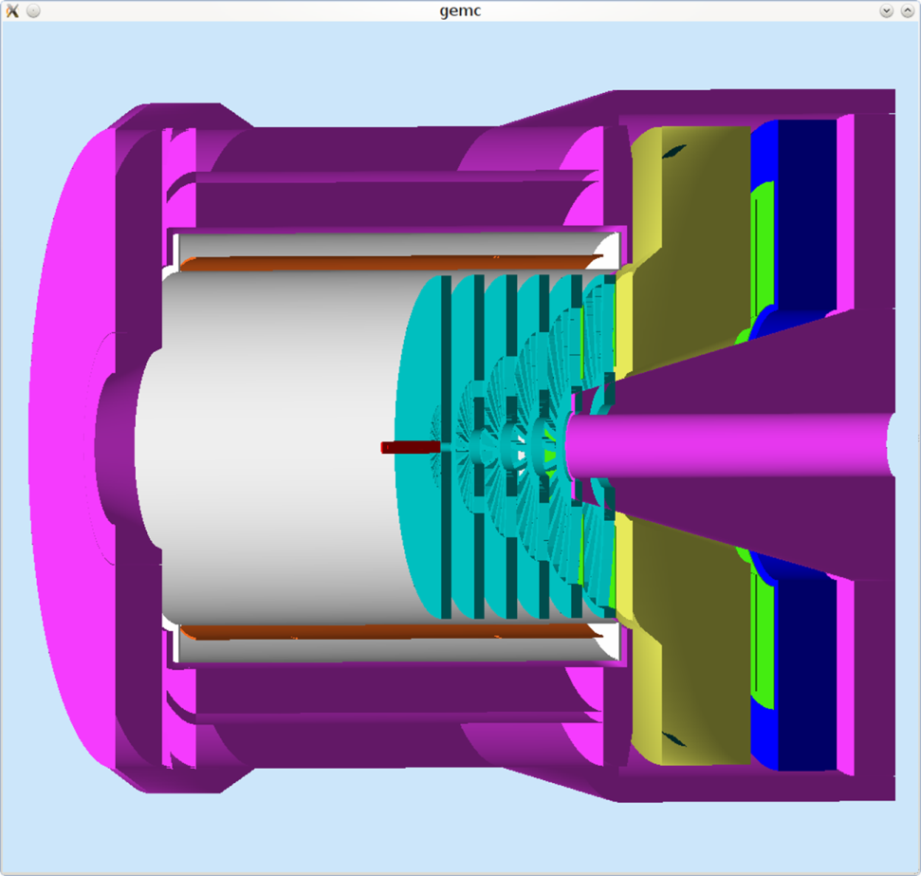
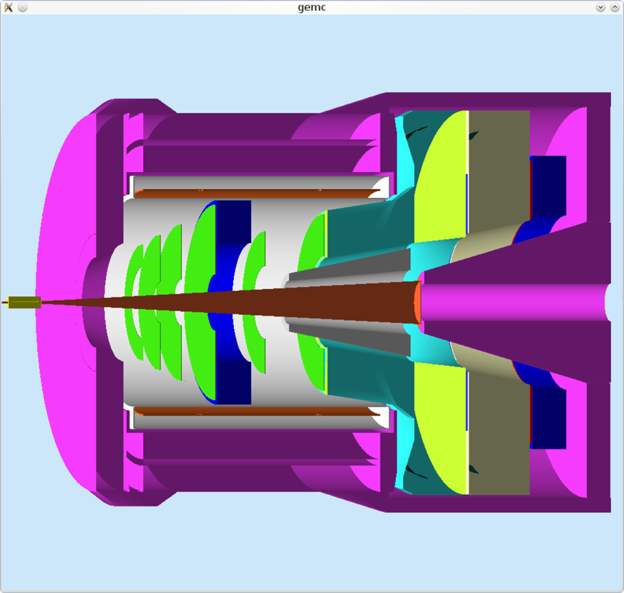
HBD -- BRIEF
T.K. Hemmick

Slide 2
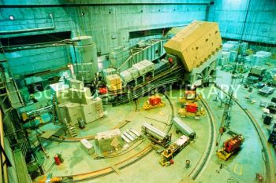
Preparation for Next Test Beam
End Station A
SLAC ESTB (End Station Test Beam)
Back ~1/3 of SLAC for light source.
120 Hz
“moderate” beam
5 Hz (minimum) pickoff → Target → ESA (~1 e/pulse)
We are 1st outside users--first beam arrives Tuesday(?)
Our run = May 1st or shortly thereafter.
Glory Days

Slide 3
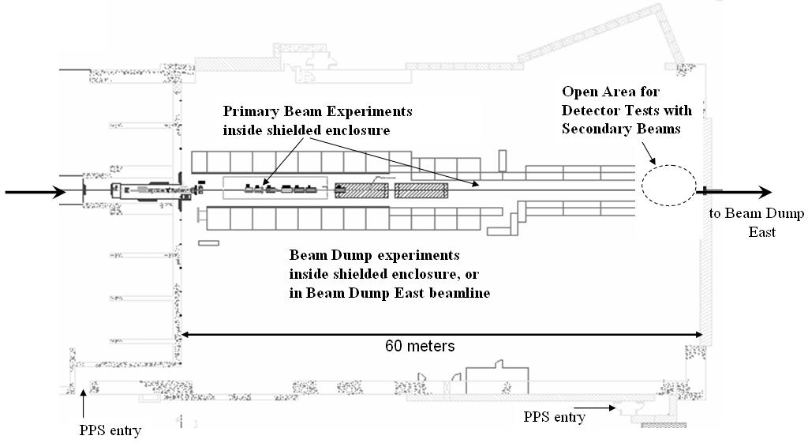
ESA Experimental Area
Beam
ESTB Beam Dump

Slide 4
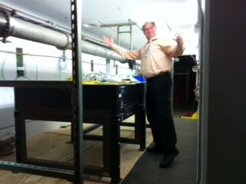
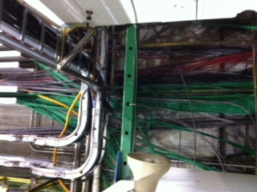
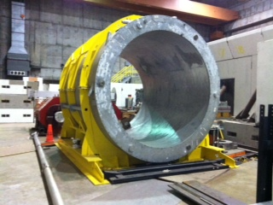
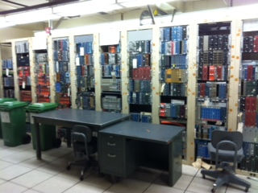
Today…Junk Pile (useful for test beam)
Flexible
Much old stuff to borrow.
Technical staff
Can I sell you a used magnet?

Slide 5
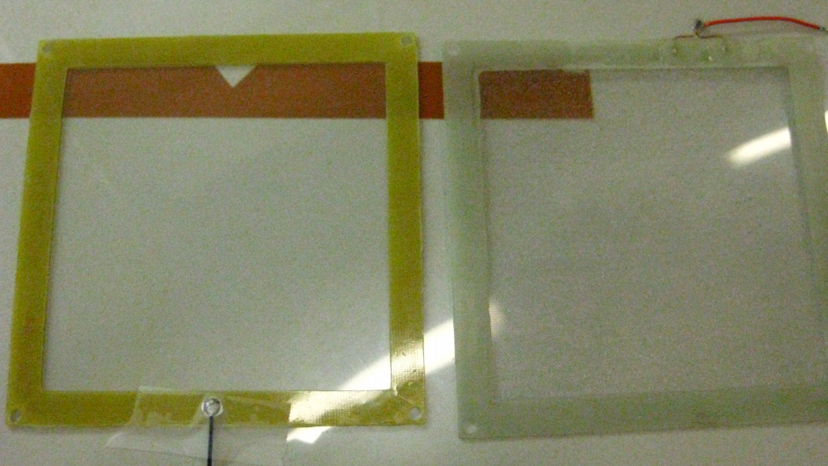
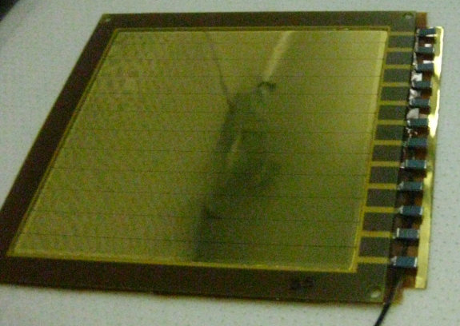
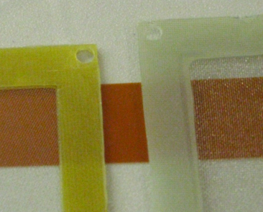
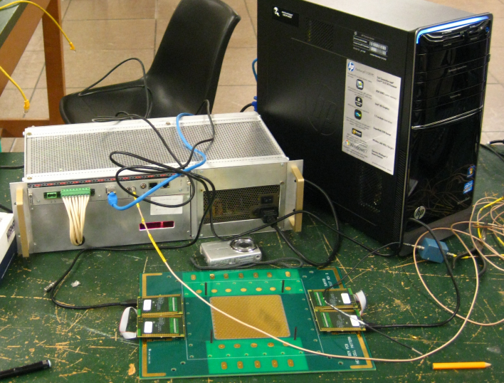
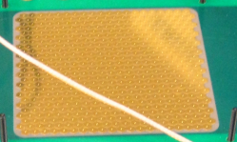
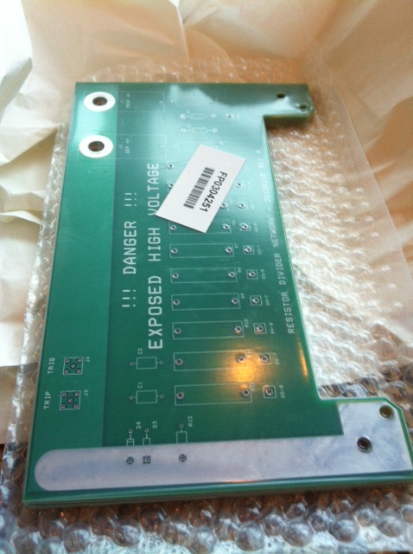
We’re ready…
New Mesh
88% Transparent
New Segmented GEMs
New HV Chain
New SRS DAQ System
New Pad Plane -- Hexes
Spark Detection
GEM stack assembled & running w/o CsI.
Evaporate mid→late April (effort & $$$ to keep fresh)

Slide 6
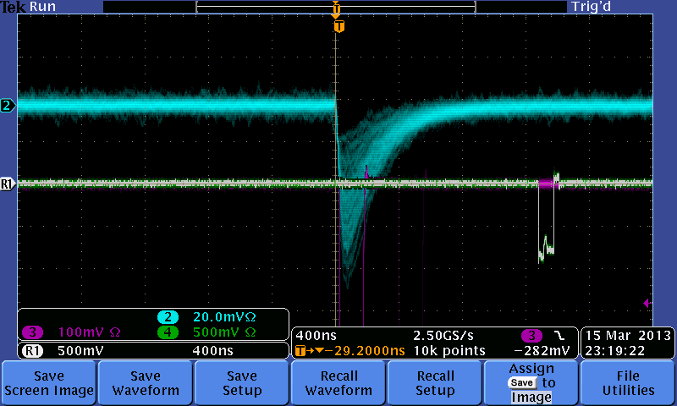
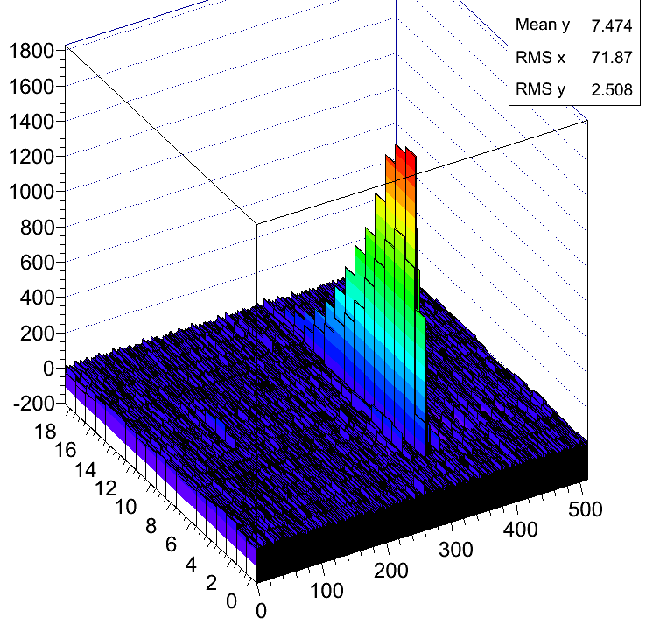
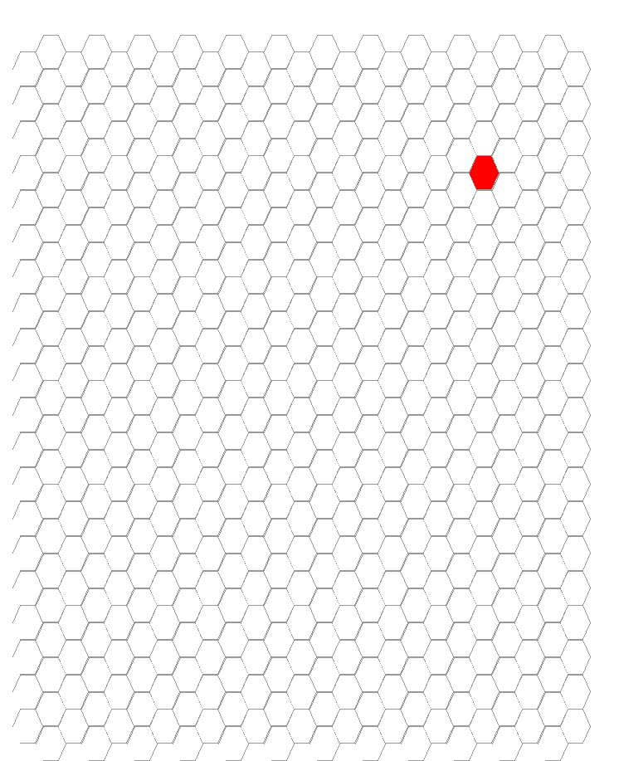
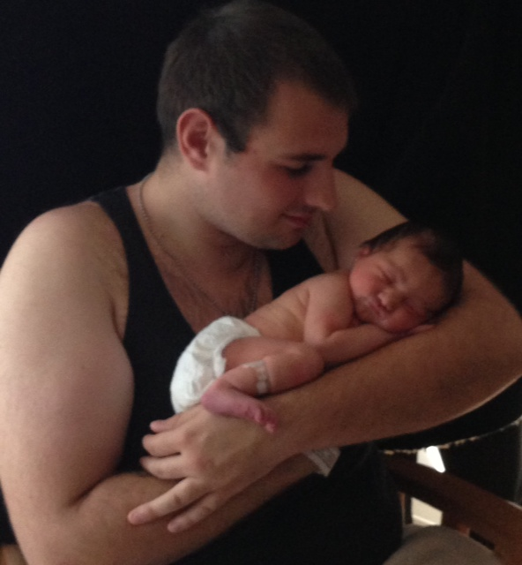
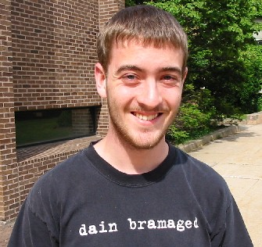
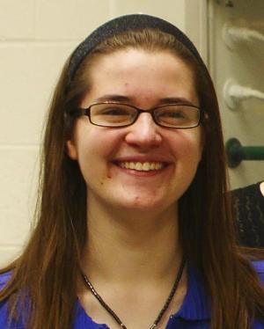
Summary – Our Baby is Ready!
⁵⁵Fe – pickoff Bottom GEM
Single ⁵⁵Fe Event
Event Display
DAQ Talks…
Son
Granddaughter
To PhD Program
Stephanie
Marie

Slide 7
Backups

Slide 8
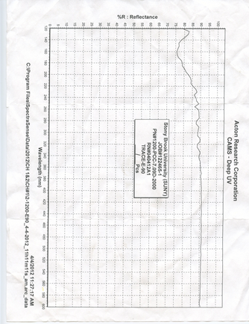
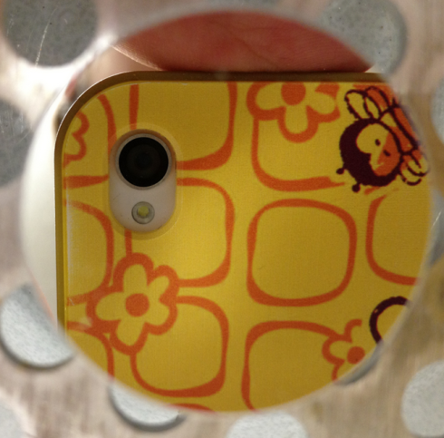
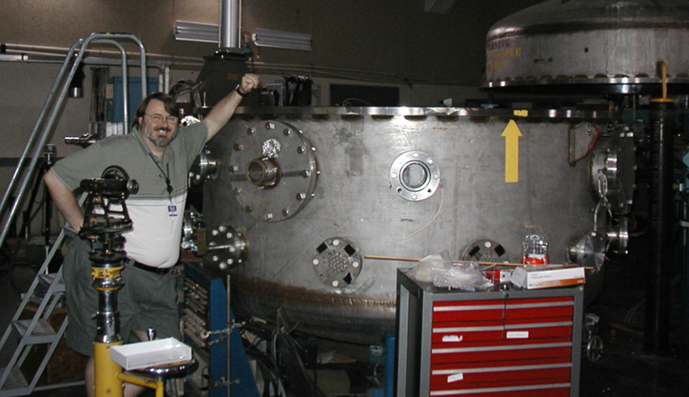
Mirror Developments
90
80
Cherenkov photon yield primarily at small λ.
Deep UV mirrors use 250 Aº MgF₂ overcoat to act as dielectric mirror.
Plans:
Year 1: Develop in-house manufacture of small mirrors.
Year 2: Scale up to use Big Mac
First in-house mirror made!
Reflectivity tests pending at BNL.
Commercial mirror
120
200

Slide 9
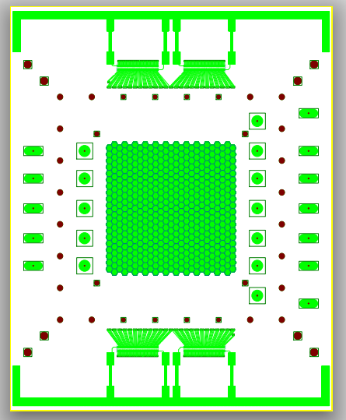
Changes for SLAC
New GEM foils…multiple strips like PHENIX.
Second pad plane…hexagons to see rings.
New trip detection system:
Capacitive coupling off resistor chain.
Integrated with PHENIX HBD HV relays.

Slide 10
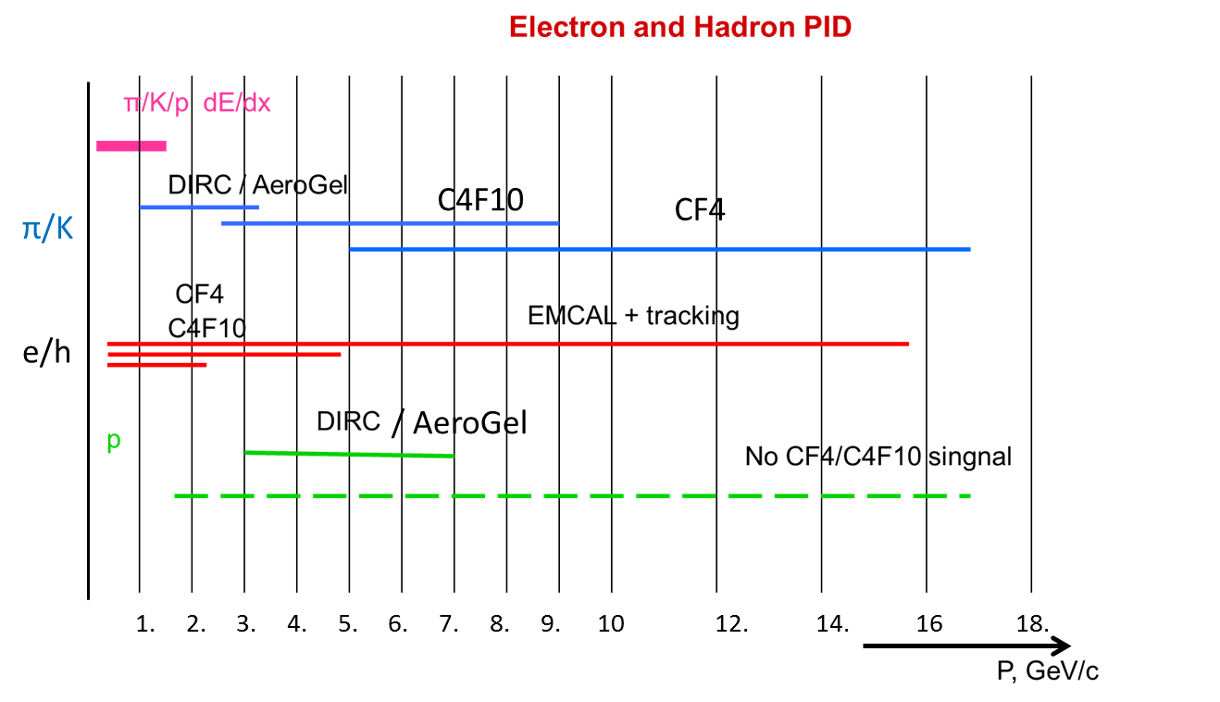
Forward RICH
RICH particle ID involves a limited dynamic range of momenta set by gas index of refraction.
The highest momenta rely on the lowest n.
Our R&D targets the highest momenta with a CsI photo-cathode RICH.
Major Issue: Reflectivity of mirrors deep in the UV.

