Slide 1
SoLID Calorimeter Support Structure
Paul E. Reimer and Vic Gaurino
22 March 2013
This work is supported in part by the U.S. Department of Energy, Office of Nuclear Physics, under Contract No. DE-AC02-06CH11357.

Slide 2
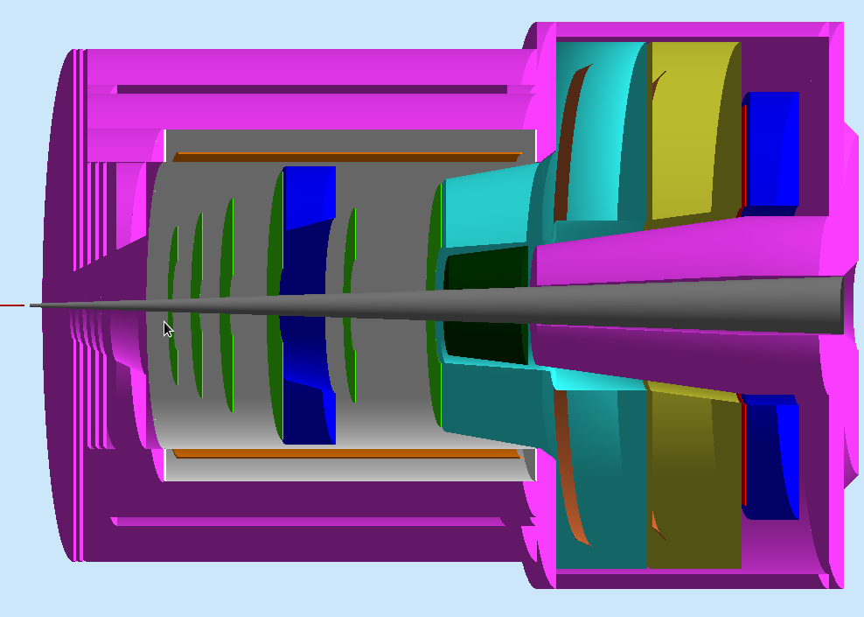
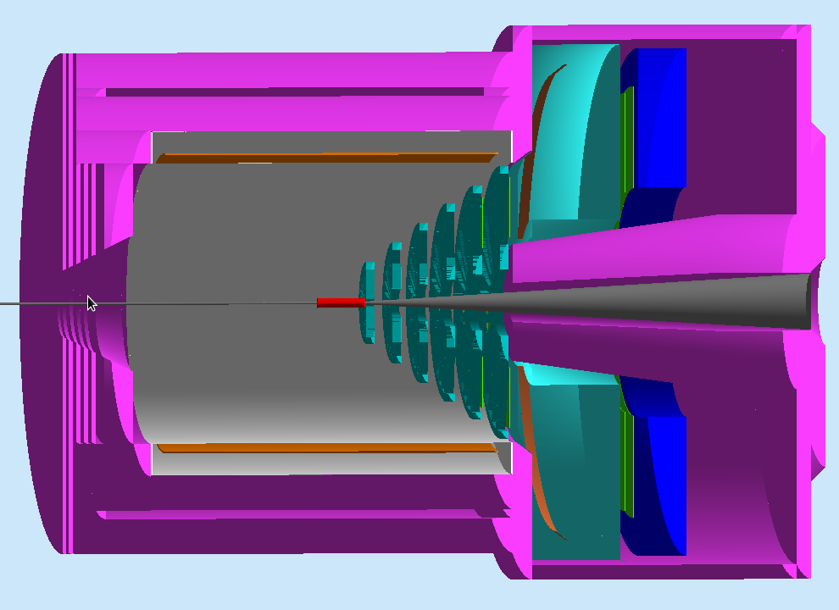
SoLID EM Calorimeter Overview
Slide borrowed from Jin Huang’s presentation at an earlier SoLID collaboration meeting
PVDIS forward angle
SIDIS forward angle
SIDIS large angle
SoLID EM Calorimeters | Polar Angle (degree) | P (GeV / c) | Max π / e | Cerenkov Coverage | Area (m²)
PVDIS Forward-Angle | 22 - 35 | 2.3 – 6 | ~ 200 | <3-4 GeV/c | ~17
SIDIS Forward-Angle | 8-15 | 1 -7 | ~ 200 | <4.7 GeV/c | ~11
SIDIS Large-Angle | 17-24 | 3 - 6 | ~20 | None | ~5

Slide 3
Slide borrowed from Jin Huang’s presentation at an earlier SoLID collaboration meeting

Slide 4
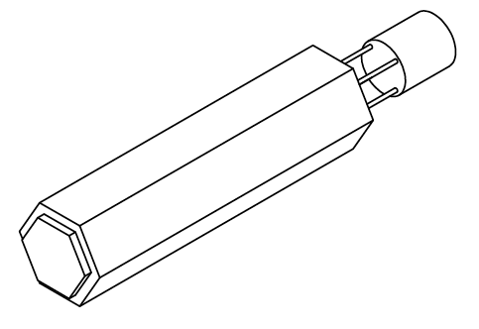
Module Shape
Switched to Hexagonal modules
Better for radially oriented support structure
Kept Front surface area the same
Almost—allowances for
Support sag
Manufacturing tolerance
Light tight wrapping

Slide 5
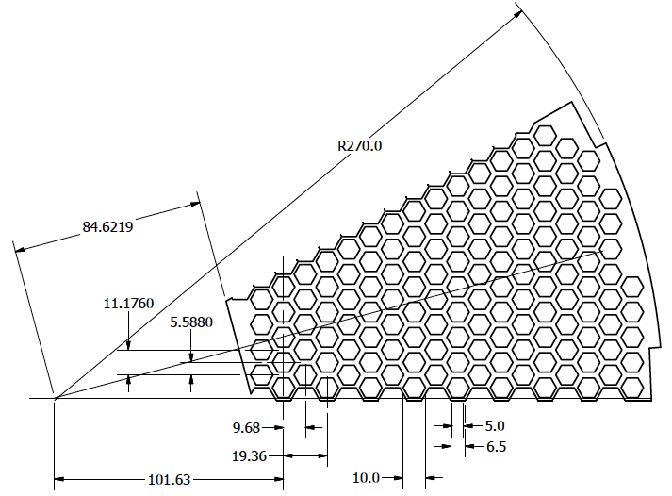
Layout of endplate 2:30 sector
Rail Mount
Mount “wedges” on rails at outer raidus
Configuration change
Not moving modules forward-barrel
Just slide on rails
Moving modules forward-barrel
Remove from endcap
restack calorimeter modules

Slide 6
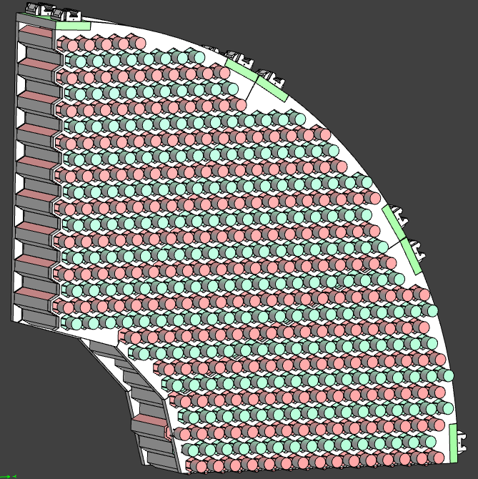
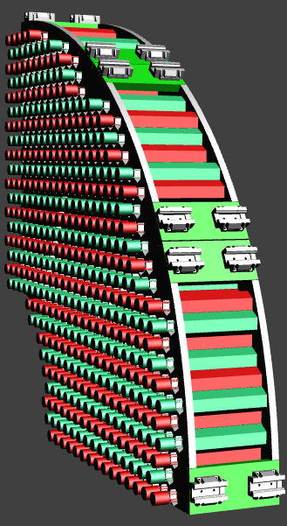
Assembly of 3 Wedges
Rail Slides
Beam
Beam

Slide 7
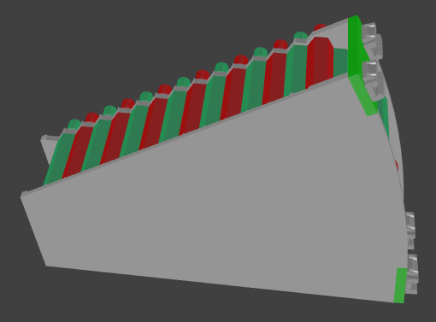
Plate Thickness
40 mm thick
Beam
20 mm thick

Slide 8
Wedge-wedge interface
At interface between wedges, need to allow wedges to slide past each other
Forces each end plate to be different
(there are symmetry axes though)

Slide 9
Deflection calculation
0.59mm

Slide 10
Barrel Mounting
Similar design, but cut at different radii
Open question: What will support the rails in the barrel?

Slide 11
Cost
Item |  | Cost Each | No. | Total
Upstream Endplate
 | setup | $1,000.00
 | material | $2,000.00
 | shop time | $1,000.00
 | total |  | 1 | $4,000.00
Downstream Endplate
 | setup | $500.00
 | material | $2,000.00
 | shop time | $1,000.00
 | total |  | 1 | $3,500.00
Inner end piece |  | $200.00 | 1 | $200.00
Outer end piece |  | $300.00 | 2 | $600.00
Rail Bearing |  | $500.00 | 4 | $2,000.00
Rails |  | $400.00 | 2 | $800.00
Wedge total |  |  |  | $11,100.00
Total cost |  |  |  |  | 12 | $133,200.00
Vic: “I think this is a pretty high end estimate.”
Next step is to take drawings to shop and get better estimates
Barrel will add another $80k

Slide 12
Conclusions
We have support structure
Still can be optimized
Cost:
thickness of materials
Shop estimates
Trade off on upstream vs downstream endplate thickness

