Slide 1
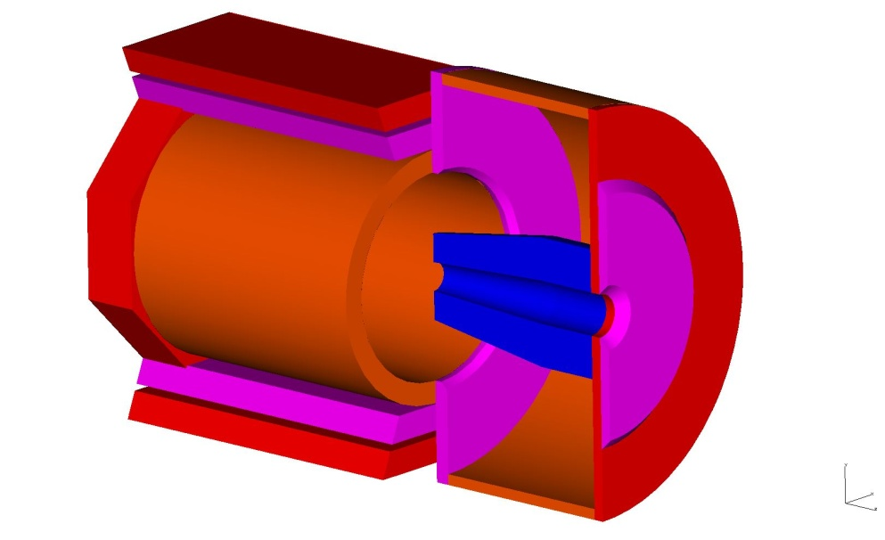
SoLID Collaboration Meeting
Magnet Support and Infrastructure
Whit Seay
March 22, 2013

Slide 2
Magnet Support and Infrastructure
Target to magnet spacing
Magnet position in the hall
Electrical requirements
Cryo Requirements
Detector housing concepts
Some initial stress analysis

Slide 3
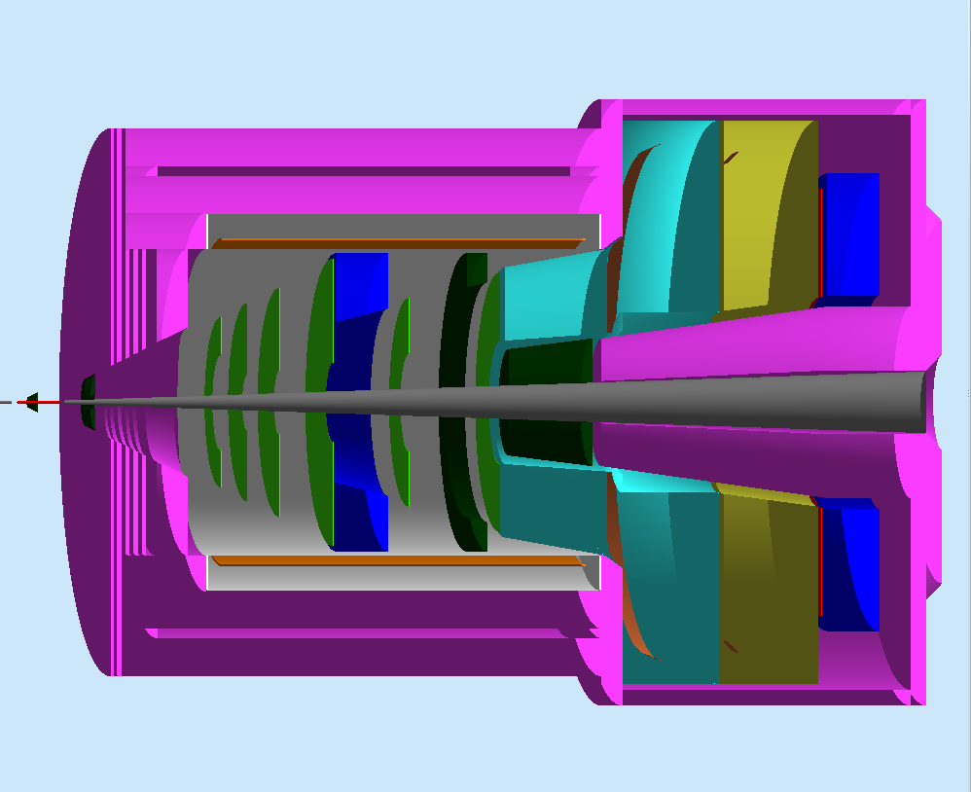
Center to center distance of target and magnet
(SIDIS)
350 cm between target center and magnet center.
Magnet and target will have to be shifted a minimum of 115 cm downstream to prevent front of magnet from interfering with HRS bearing assembly.
HRS spectrometers parked at 90° angle to the beamline.
350 cm

Slide 4
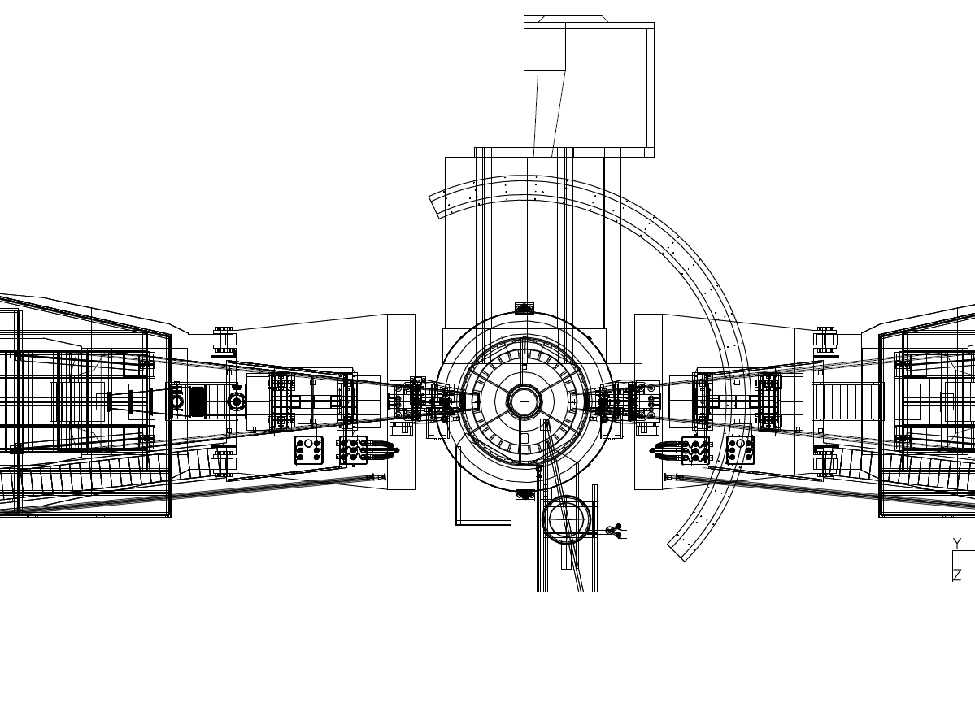
Without the 115 cm shift downstream

Slide 5
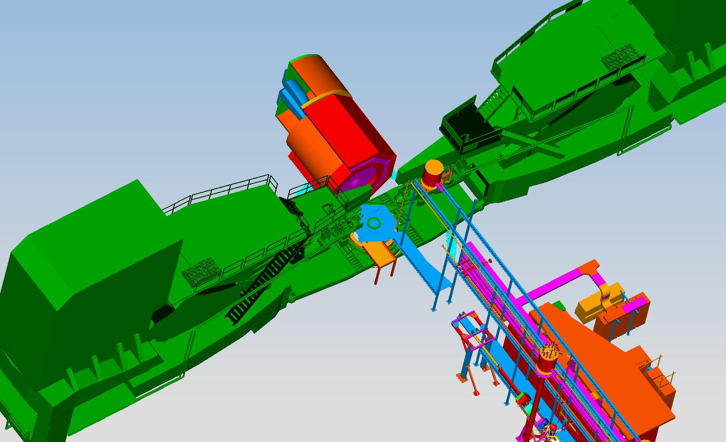
Magnet shifted 115 cm downstream

Slide 6
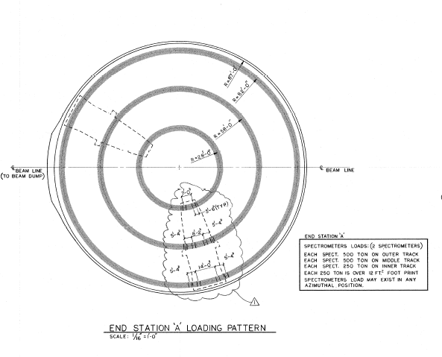
Floor loading
SoLID footprint
24’ long x 19’ diameter
1000 tons
500 ton
28’
500 ton
250 ton
82’
- Each 250 ton is over 12 ft² foot print
- Additional 150 PSF
Live load over entire area
58’

Slide 7
Electrical and cryo requirements
The projected electrical power load is 1.6MVA, maximum current for magnet at 3266A. The present power consumption for Hall A is less than 1 MVA. So upgrade to the Hall substation to have 2 MVA is required. (Moeller Experiment has included the cost ($300k)for this in their MIE)
The CLEO-II magnet is designed to have a low cryogenic heat load with passive cooling. The HRS arms will not be operational during SoLID, so it is expected that the refrigeration heat load will be less than needed for HRS. Further analysis is needed to include the target refrigeration requirements (~1KW).

Slide 8
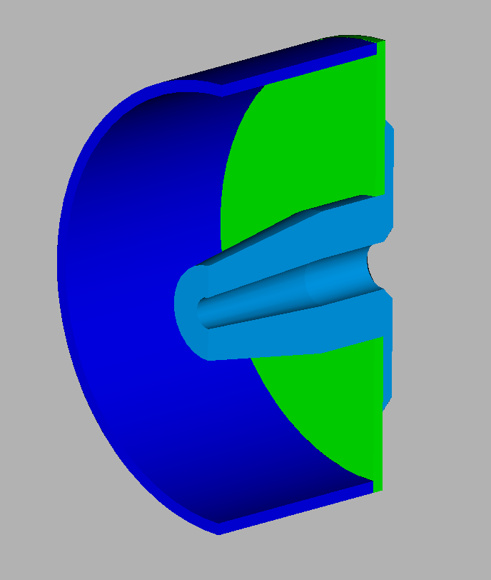
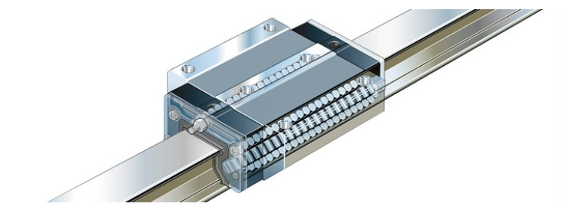
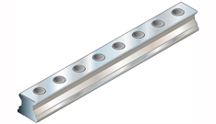
Detector mounting system for stacking detectors in one piece detector hut half
Several off the shelf options exist that would allow the detectors to be slid in from the front on rails. Below is one option. Rails are made of stainless steel and bolted along the length into the outer shell.

Slide 9
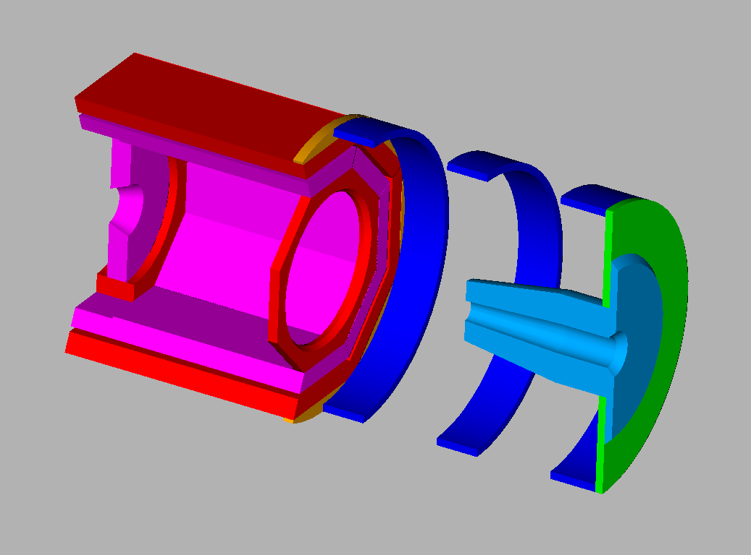
Multiple section detector hut
Will require each section to have its own outer support frame
Frames will be tied into track system and used for stability
Would gain access front and back of detectors (except rear detector?)
This is the concept “on paper” only
Structural feasibility has not been looked at
Compatibility between various experiments will also have to be studied

Slide 10
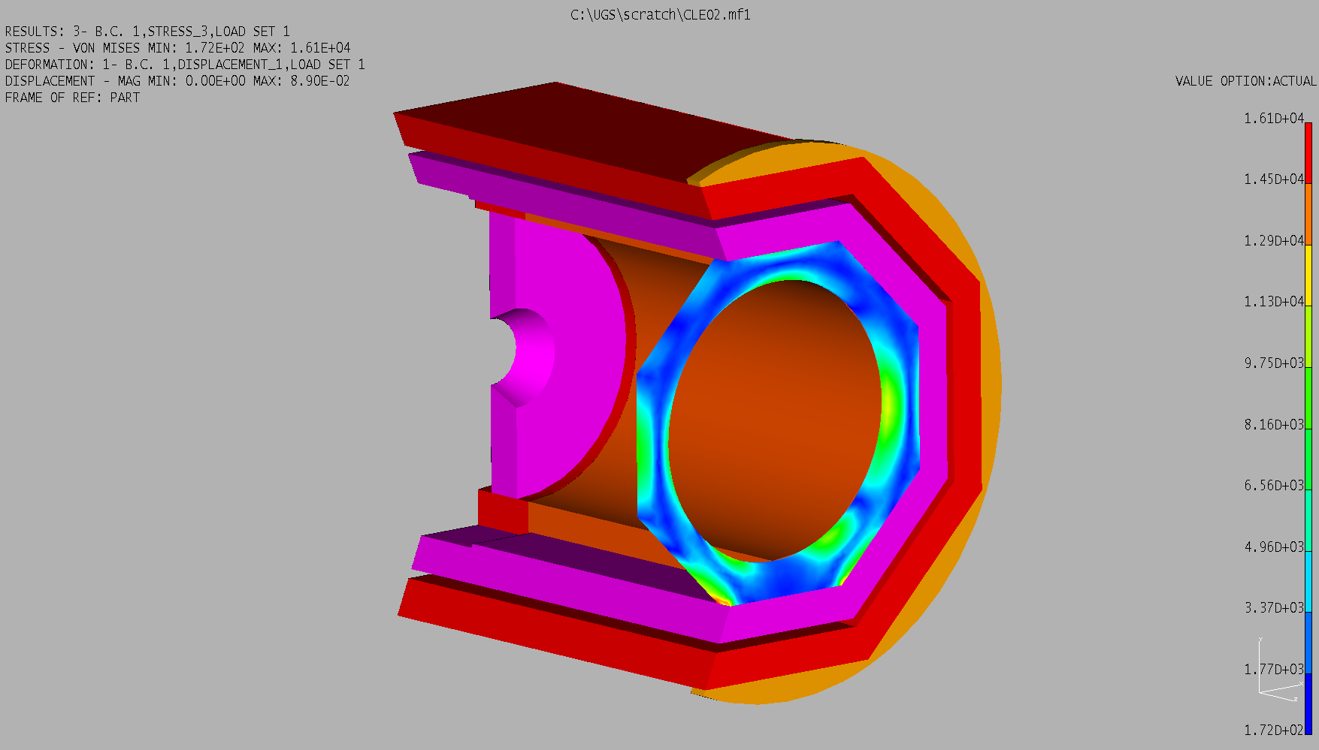
New downstream coil collar
Allowable stress foe 1008 hot rolled steel = 14820 psi
Peak stress due to rigid constraint at the bottom is the only overstress. Conservative simple restraint.
Buckling not checked – will be retained by the slabs.
Forces due to gravity only

Slide 11
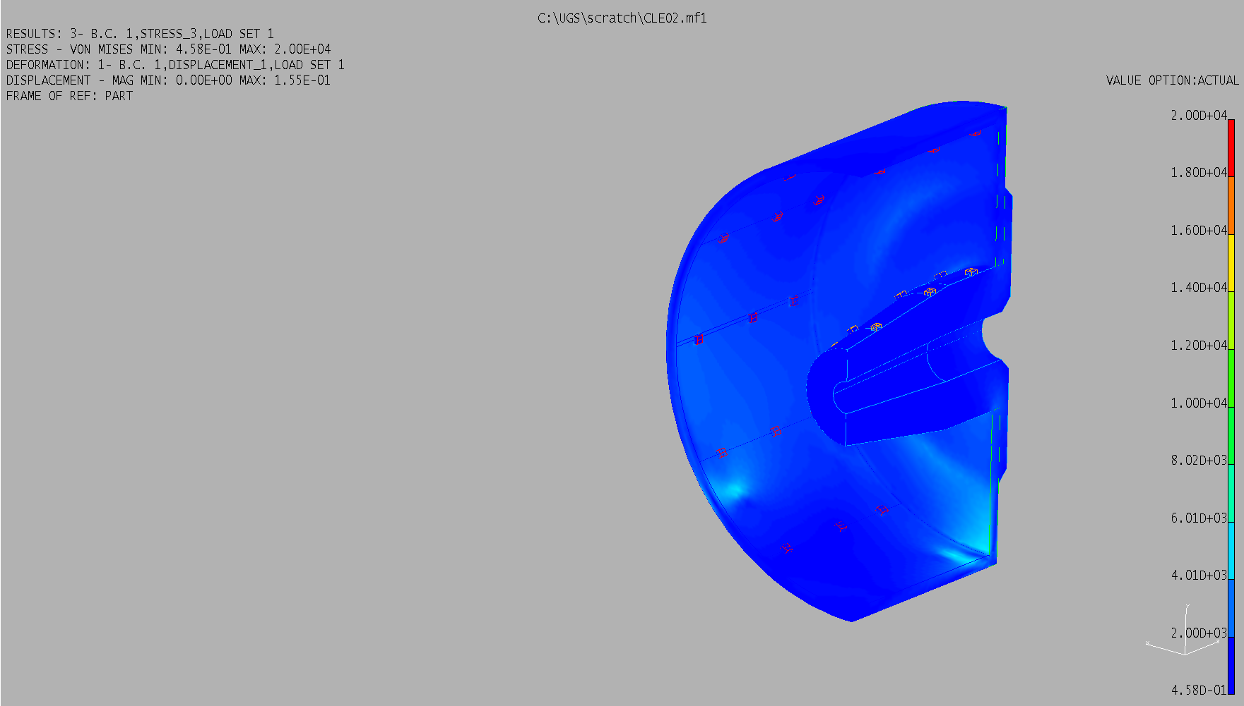
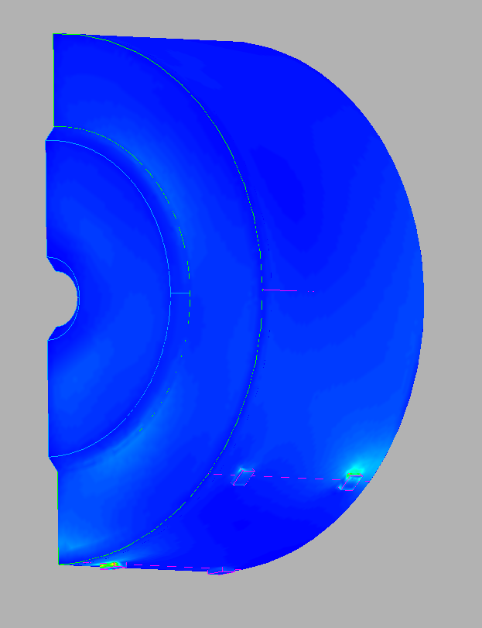
Detector hut stress analysis
Half of detector weight placed on the outer shell and half on the nose
Forces due to gravity only
Only overstress is from rigid constraint
Light gas Cherenkov = 6 metric t
Heavy gas Cherenkov = 8 metric t (assumed)
Calorimeter = 23 metric t
W forward angle absorber = 13 metric t
Inside
Outside

Slide 12
