Slide 1
Current Status of Experimental Requirement in Technical Document
Xin Qian
Caltech

Slide 2
Introduction
Consistent plots for each configuration (Zhiwen)
Two tables summarize key features and detector requirements
We should clarify requirements vs. limitations

Slide 3
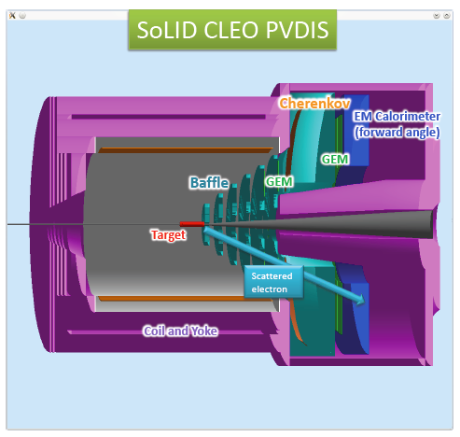
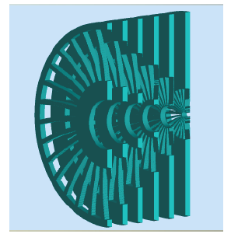
SoLID-PVDIS

Slide 4
Key Information
Phase Space:
20→35 degrees
1.5 → 5.0 GeV (include 6.6 GeV running)
0.2<x<0.8
2 < Q² < 12 GeV²
Luminosity 5x10³⁸ LH2 1.3x10³⁹ LD2
~0.5% relative statistical uncertainties
Requirements:
0.4% beam polarimetry
<0.5% pion contamination determination
<0.5% Q² calibration
Baffle + radiation hardness
DAQ rate:
15 kHz x 30 sectors
Signal: ~ 8 kHz DIS electron per sector

Slide 5
Comments about requirement
The physics requirement is straight forward
Should not be mixed with limitations
See the example below:
Requirement: ~8 kHz DIS electron rate per sector
Be included in the data after L3 (to tape)
No direct requirement on L1 trigger
Limitations to be considered in the design
APV25: 3 sample readout → 90 kHz maximum
1 Sample: 280 kHz
Crate data transfer limit: 20 kHz → 140 MB < 300 MB
2 Crates → 600 MB
Iterations needed, interactions among different sub-groups

Slide 6
One Word about Safety Margin
Safety margin is linked to the requirement:
Example: Know the pion contamination to <0.5% level
Assume 200:1 pion/e ratio → 2.5e-5 knowledge in rejection factor by combining calorimeter and gas Cerenkov
Guideline: gas Cerenkov 500:1 rejection Calorimeter 100:1 rejection
Calorimeter working group does the design
With assumptions in background rate, performance, segmentations and …, one can reach 100:1
The safety margin should be estimated from the evaluation of assumptions
Uncertainty of assumptions should be clearly stated and listed

Slide 7
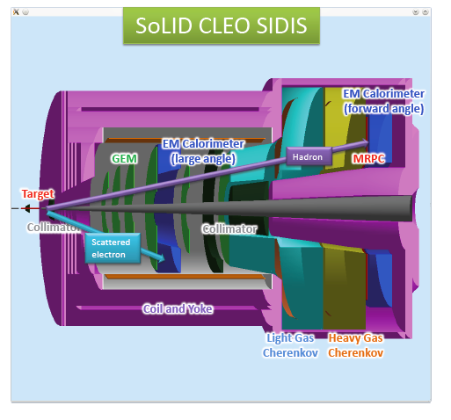
SoLID SIDIS

Slide 8
Key Information
Kinematics Coverage:
0.05 ~ 0.6 in x (valence)
0.3 ~ 0.7 in z (factorization region)
P_{T} up to ~ 1 GeV (TMD Physics)
Fixed target → Q² coverage 1-8 GeV² (~ 2 GeV² in ΔQ² at fixed x)
Polarized ³He Target:
Unpolarized ~ 10³⁷ N/cm²/s
~ 60% higher polarization
Fast spin flip (<20 mins)
PID:
<1% Pion contamination
<1% Kaon contamination
DAQ:
~ 3kHz Physics Coincidence
~ 120 kHz Single
~ 80 kHz Coincidence

Slide 9
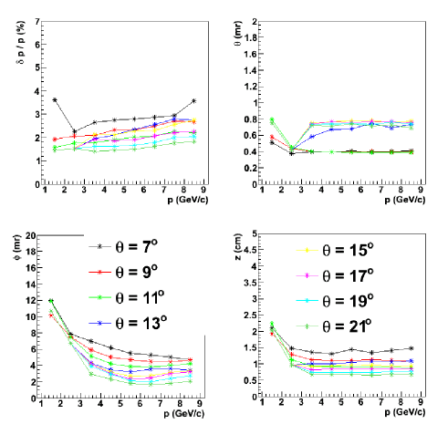
Detector Resolution
Include multiple scattering from target, air, and GEM chambers

Slide 10
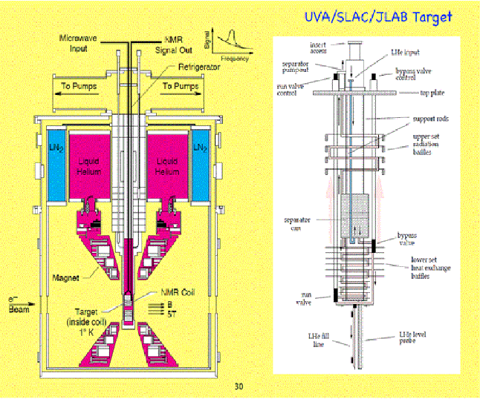
SoLID-proton-SIDIS
Polarized NH3 Target:
Unpolarized ~ 10³⁶ N/cm²/s
~70% higher polarization
Spin flip
Do we have a plot with better quality?

Slide 11
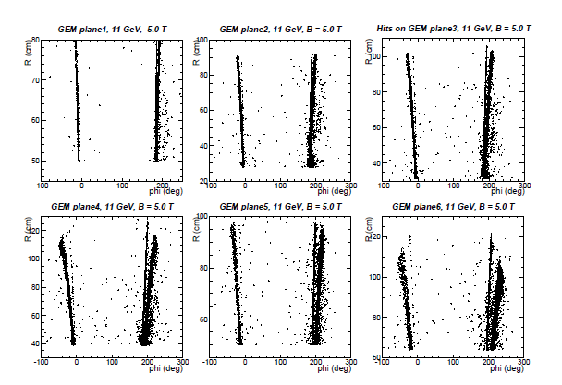
Sheet of Flames
How to better illustrate this one?
Shielding or/and removing detectors!

Slide 12
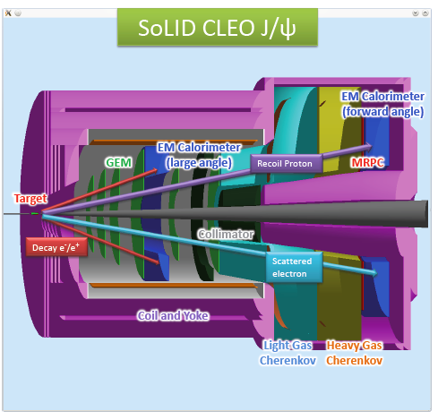
SoLID J/Psi
Similar design as SIDIS
DAQ: Triple Coincidence Trigger
scattered electron, decay electron and decay positron from J/ψ ~ 3 kHz
3 clusters in calorimeters

Slide 13
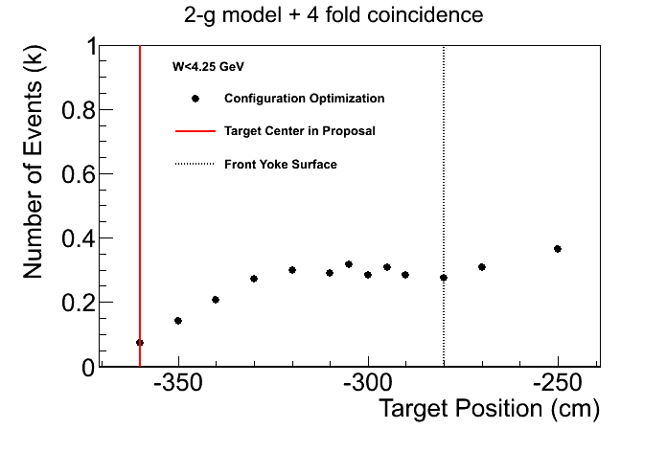
Configuration Optimization (Zhiwen)
E_{γ} < 9.15 GeV
CLEO configuration:
Assume J/ψ target center at -300 cm, require ~ 4.5% increment in GEM area
No additional changes to SIDIS configuration
Factor of 3 increment in FOM
Potential conflict between yoke and target chamber

Slide 14
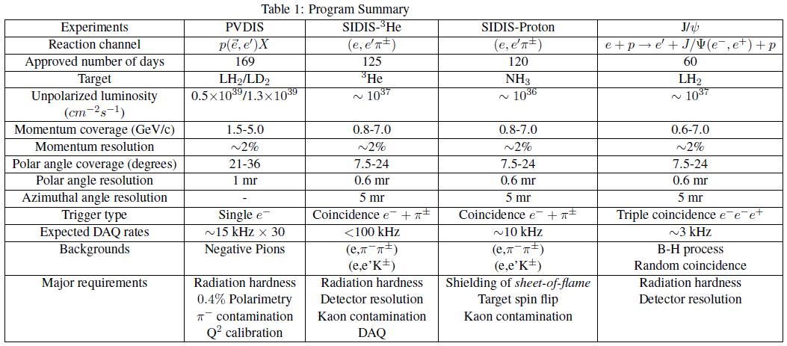
Program Summary
Missing anything?

Slide 15
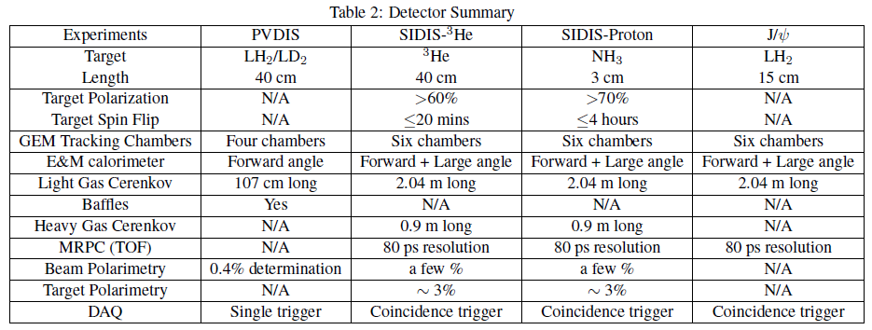
Detector Summary
Missing anything?
Geometry of Calorimeter and GEMs?

