Slide 1
Integration
R. Michaels, X. Qian
Attempted Definition :
Combine (integrate) detectors to verify the apparatus meets all physics needs (e.g. PID)
System-wide issues ( e.g. subsystem integration,
switchover between experiments )
Calibrations & Commissioning Plans

Slide 2
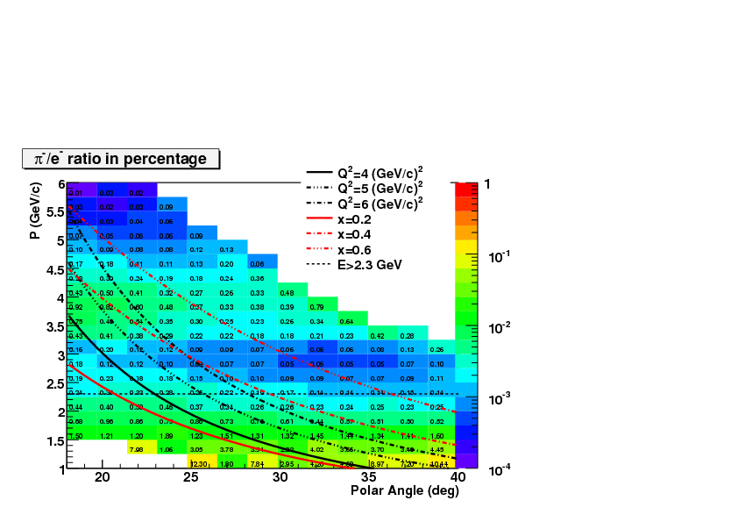
Example: Combined pi/e ratio from Cerenkov & Calorimeter
for PVDIS as function of polar angle and momentum
Section 19.1 Solid Tech (Mar 20, 2013)
Goal: error in pion contamination < 10⁻³
0.02 %
Work done by
Xin Qian
Mike Paolone
Jin Huang
0.2 %
1.5 %

Slide 3
Some Issues
Need a model for the trigger / DAQ
Several ways to measure deadtime
Rate dependence of pion rejection & pileup effects
Radiation & power from beam
Calibrations -- see Rich’s talk (next) and Xin’s talk from Dec 14
That’s it for now
Sect. 19, SoLID Tech

