Slide 1



Timelike Compton Scattering with SoLID
Zhiwen Zhao
For TCS collaboration
2013/03/23

Slide 2
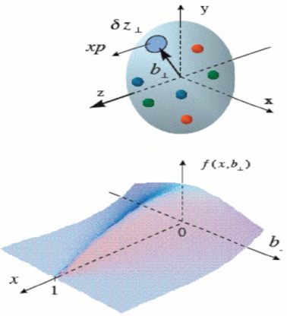
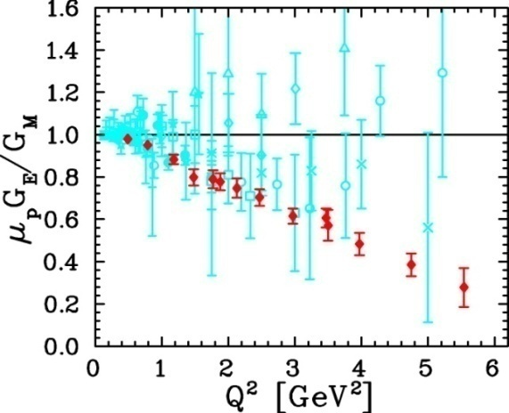
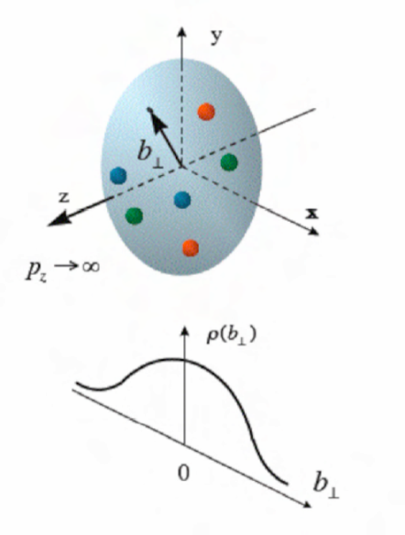
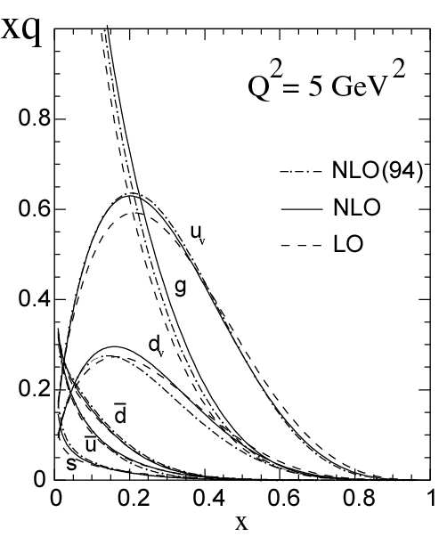
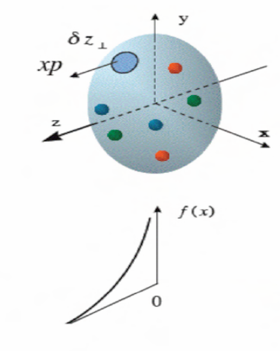
Generalized Parton Distribution (GPD)
A unified descriptions of partons (quarks and gluons) in the momentum and impact parameter space
Elastic form factors Transverse spatial distributions
Parton Distribution Functions Longitudinal momentum distributions

Slide 3
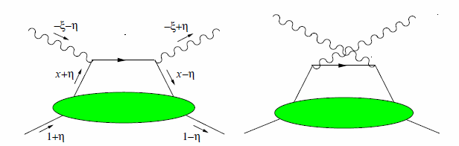
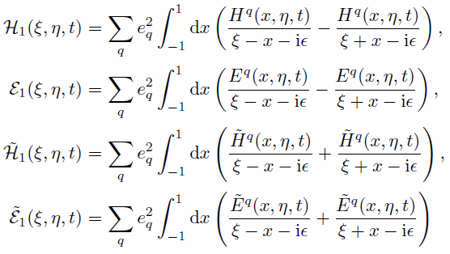
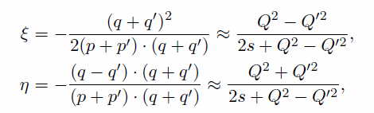

General Compton Process accessing GPDs
γ(q) + p(p) → γ(q′) + p(p′)
Compton Form Factor (CFF)
E.R. Berger et al. Eur. Phys. J. C 23, 675–689 (2002)

Slide 4
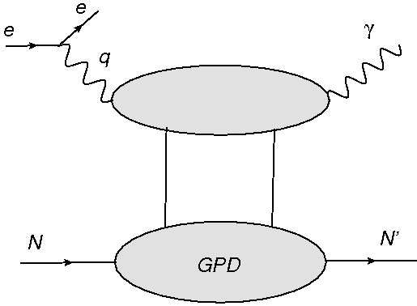
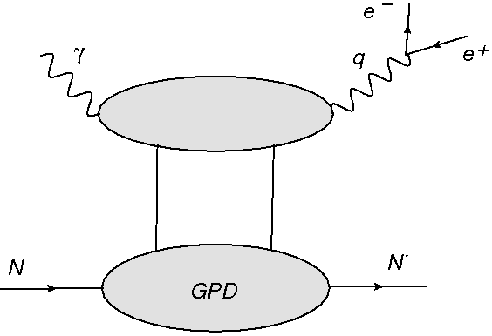
DVCS and TCS access the same GPDs
Spacelike Deeply Virtual Compton Scattering
Timelike Compton Scattering
γ*p → γ p′
γ p → γ*(e⁻ e⁺) p′
“The amplitudes of these two reactions are related at Born order by a simple complex conjugation but they significantly differ at next to leading order (NLO)”
“ The Born amplitudes get sizeable O(α_{s}) corrections and, even at moderate energies, the gluonic contributions are by no means negligible. We stress that the timelike and spacelike cases are complementary and that their difference deserves much special attention.”
H. Moutarde et al. arXiv:1301.3819, 2013

Slide 5
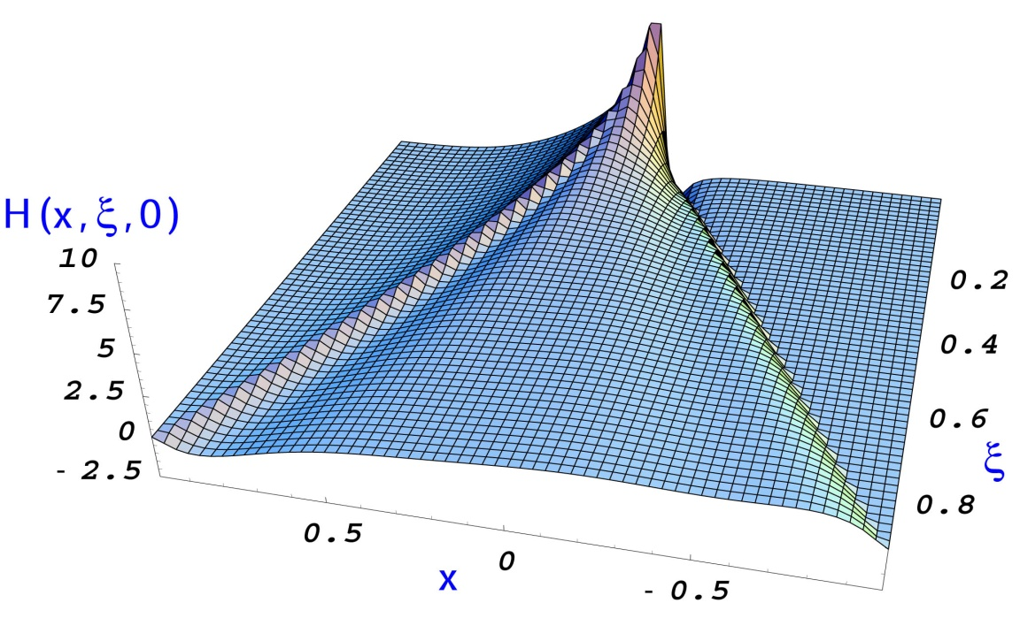
General Compton Process
accessing GPDs
(Im, x=ξ)
DVCS: spin asymmetries
(TCS with polarized beam)
(Re)
TCS: azimuthal asymmetry
DVCS: charge asymmetry
(Im, x ≠ ξ, x < |ξ| )
Double DVCS
(|Im|²+|Re|²)
DVCS: cross section

Slide 6
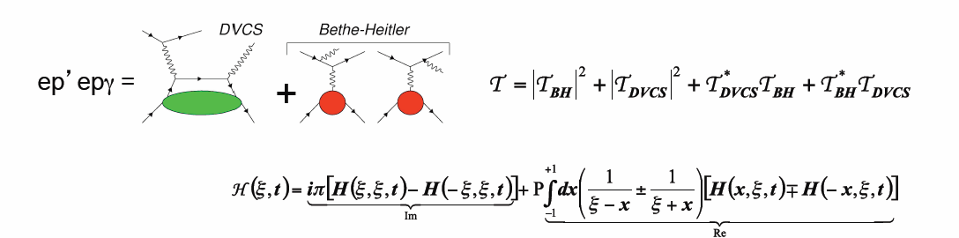
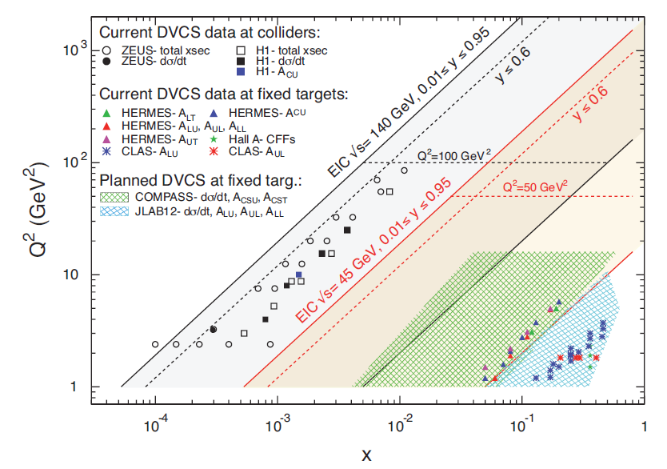
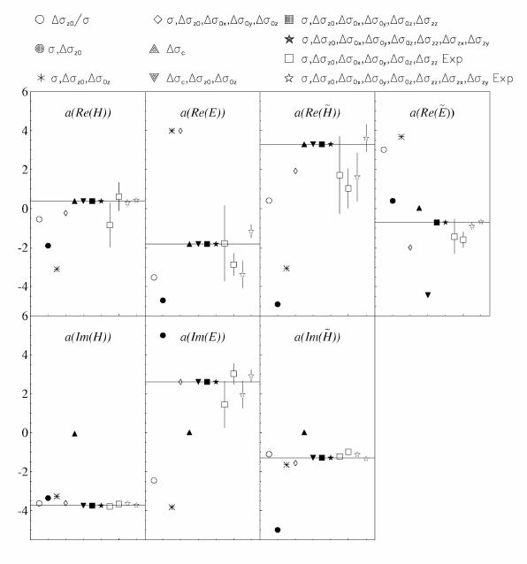
DVCS
An overview of existing and planned measurements of DVCS
Global fit to the DVCS data
M. Guidal, Eur.Phys.J. A37, p319 (2008)

Slide 7
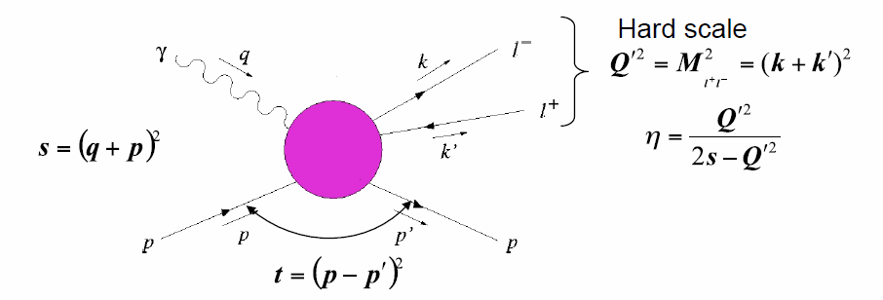




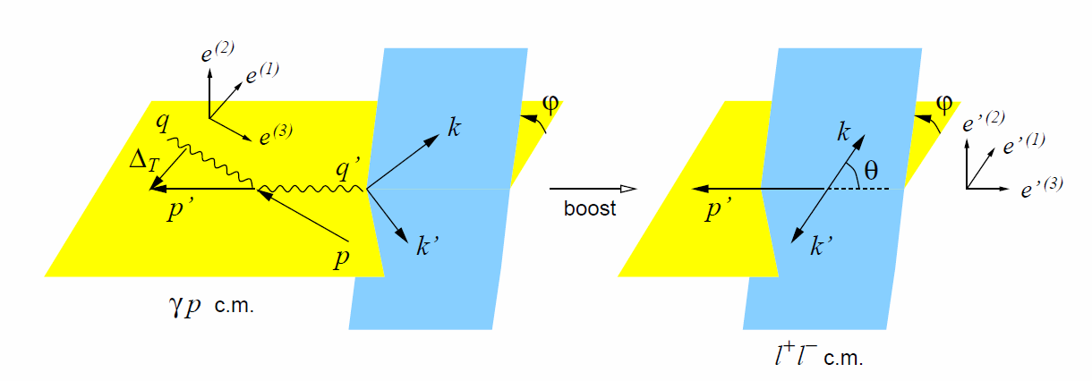
TCS
Information on the real (imaginary) part of the Compton amplitude can be obtained from photoproduction of lepton pairs using unpolarized (circularly polarized) photons
TCS
DVCS

Slide 8
Timelike Compton Scattering (TCS)
γ p → p′ γ*(e⁻ e⁺)
Test spacelike-timelike correspondence and the universality of GPDs
  Input for global analysis of Compton Form Factors
  access through azimuthal asymmetry of lepton pair
Explore GPDs of quarks and gluons at different kinematics

Slide 9
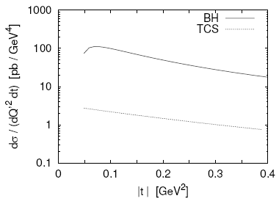
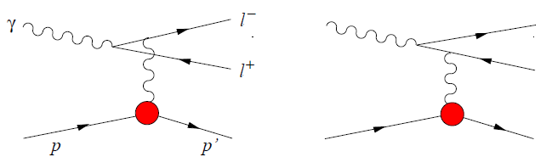
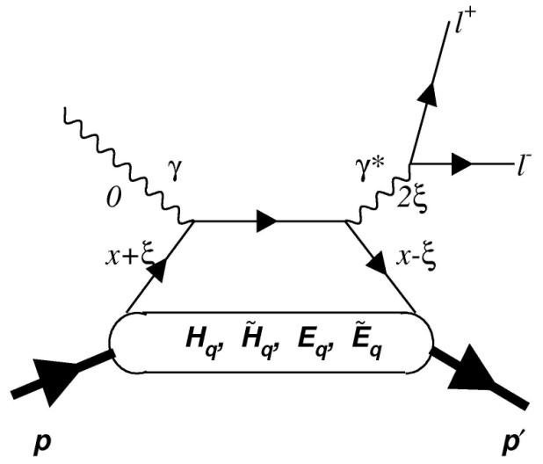
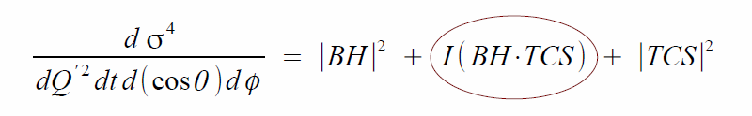
TCS and Bethe-Heitler (BH) Interference
BH
TCS
E. Berger et al., Eur. Phys. J. C23, 675 (2002)
For lepton charge conjugation, TCS and BH amplitudes are even, while the interference term is odd
Therefore, direct access to interference term through angular distribution of the lepton pair (cosine and sine moments)

Slide 10
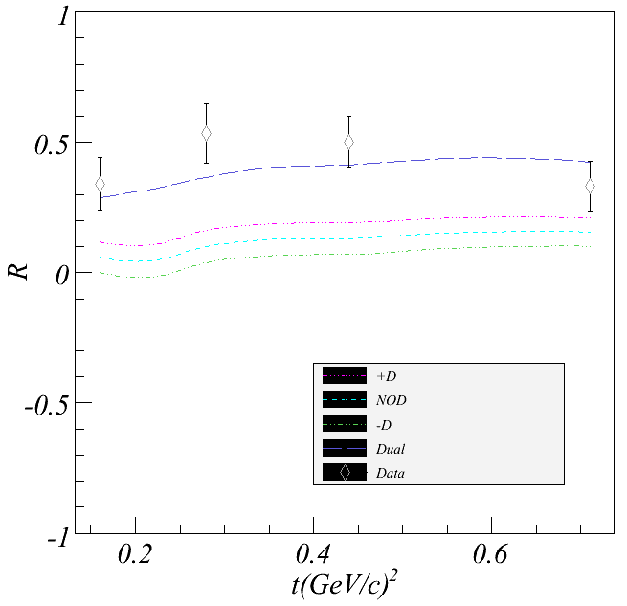
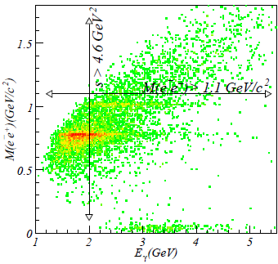
TCS at JLab 6GeV
Cosine moment of weighted cross sections
6 GeV data were important for developing methods
But its kinematics are limited to M_{e+e-} < 2 GeV
R can be compared directly with GPD models
Comparison of results by R. Paremuzyan et al from CLAS e1-6/e1f with calculations by V. Guzey.
Analysis of CLAS g12 with tagged real photons is ongoing

Slide 11
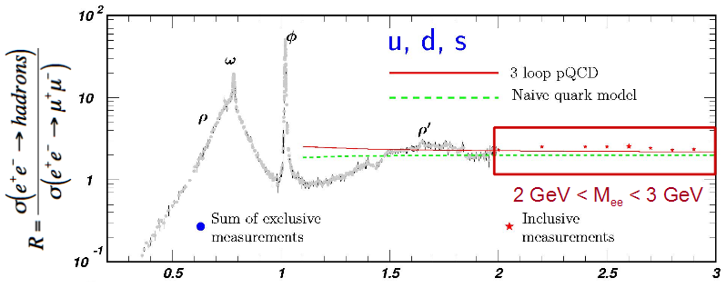
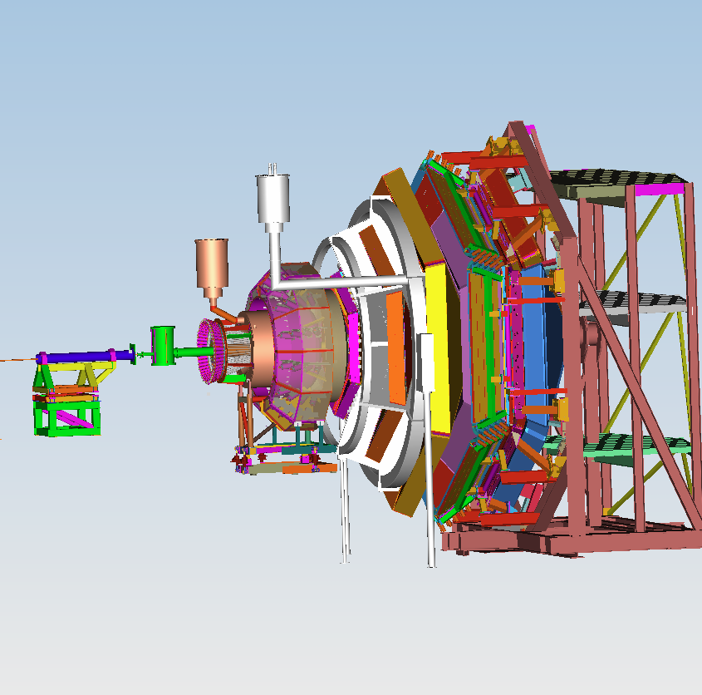
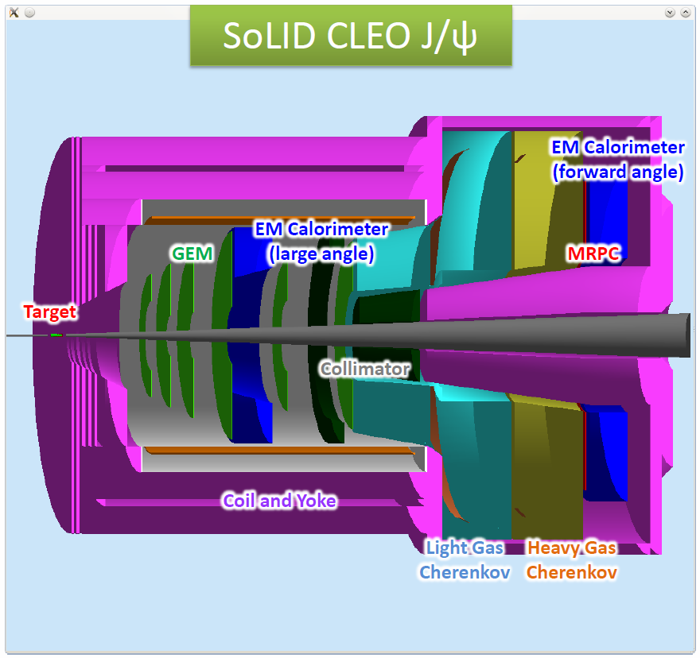
TCS at JLab 12GeV
11 GeV beam extends s to 20GeV²
M_{e+e-} (Q') reaches about 3.5GeV and this allows the access to the resonance free region from 2GeV to 3GeV
τ can reach from 0.2 to 0.6, eta reaches from 0.1 to 0.45
Higher luminosity and thus more statistics for multi-dimensional binning
CLAS12

Slide 12
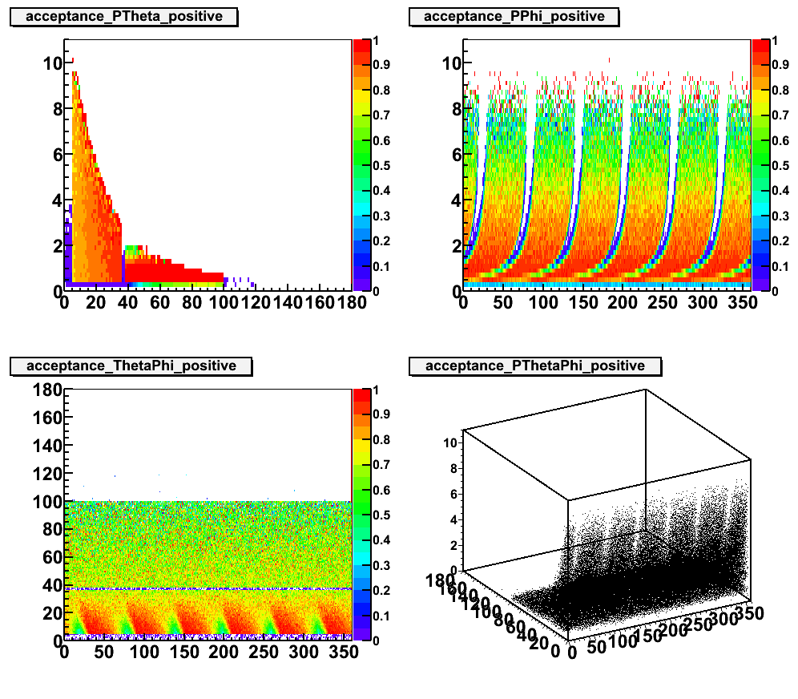
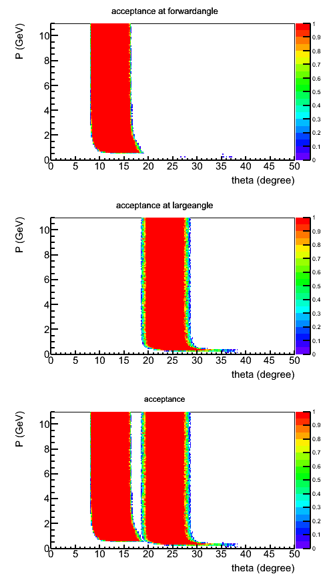
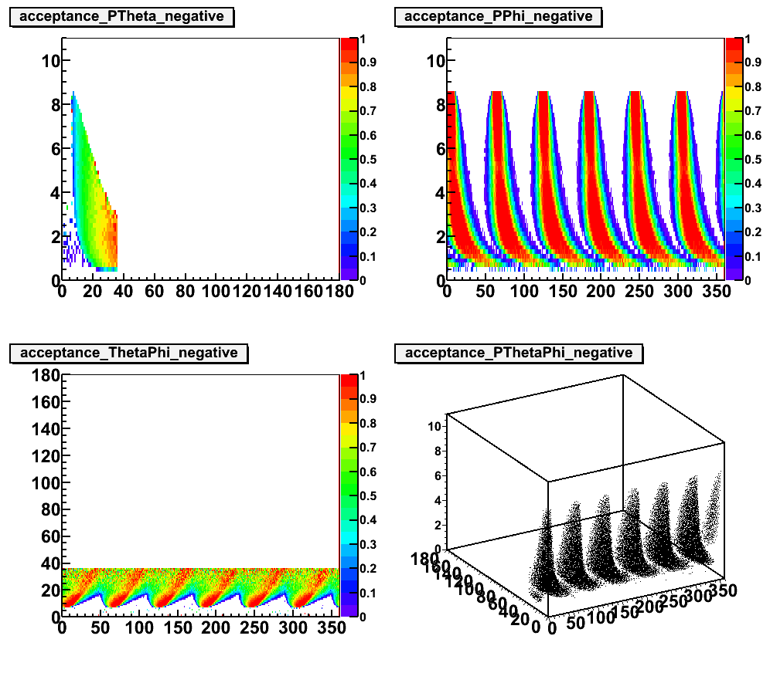
CLAS12 and SoLID: Acceptance
 | CLAS12 | SoLID
e⁻ and e⁺ coverage | θ(5º – 36º) φ (~ 80% full) Asymmetric | θ(8º – 17º) θ(18º – 28º) φ(full) Symmetric
proton coverage | θ(5º – 36º) Θ(38º – 125º) φ (~ 80% full) | θ(8º – 17º) θ(18º – 28º) φ(full)
Luminosity | 10³⁵/cm²/s | 10³⁷/cm²/s
CLAS12 positive
CLAS12 negative
SoLID positive and negative

Slide 13
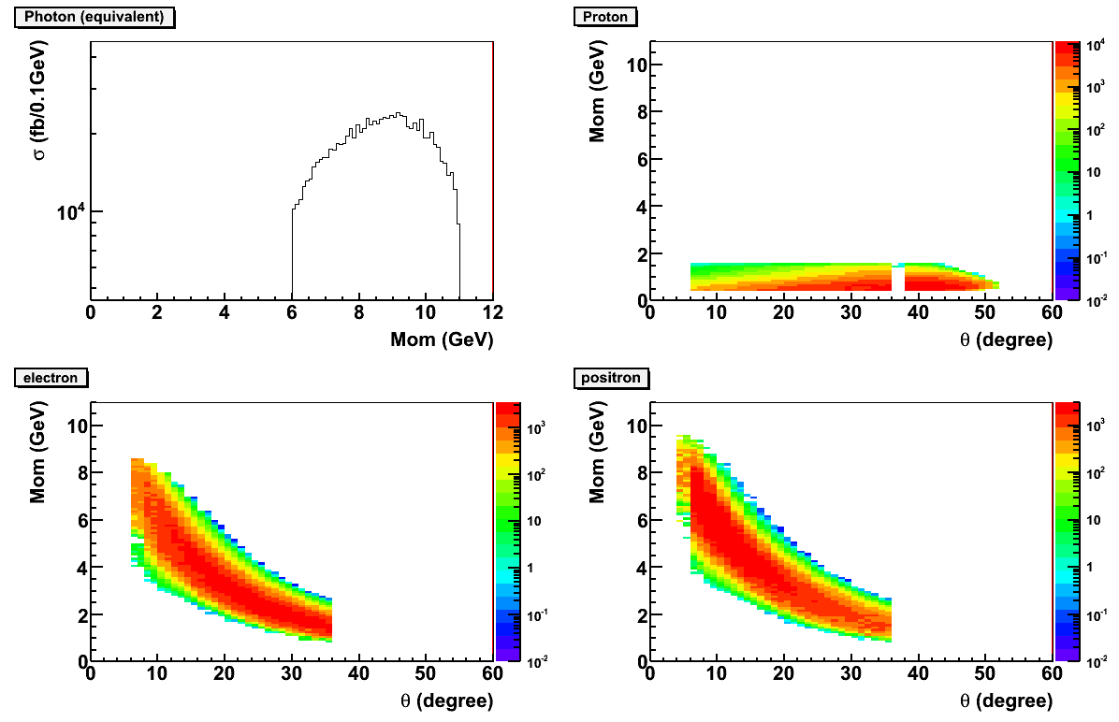
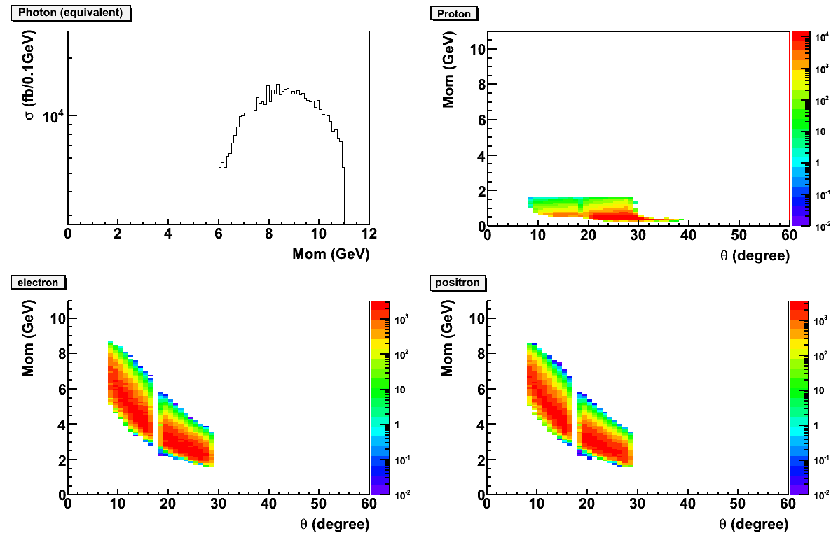
CLAS12 and SoLID: BH Detection (Lab Frame)
BH events in the resonance free region are used for simulation
CLAS12 and SoLID have similar overall coverage
CLAS12 acceptance is slightly larger SoLID, but within a factor of 2
CLAS12
SoLID

Slide 14
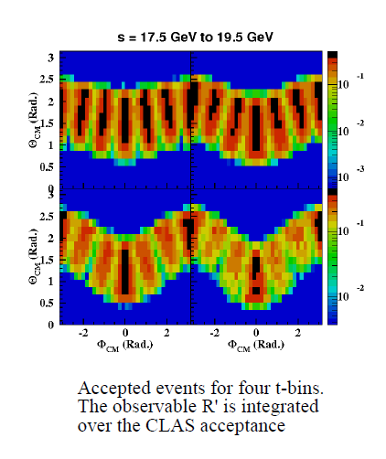
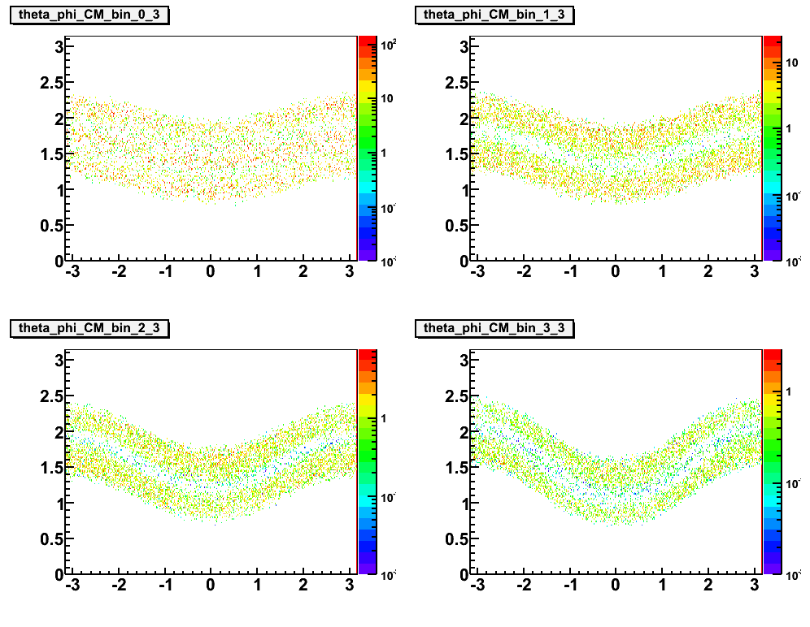
CLAS12 and SoLID: BH Detection (γ* CM Frame)
4GeV² < Q’2 < 9GeV²
17.5GeV² < s < 19.5GeV²
4 t-bins within 0.1GeV² < t < 0.9GeV²
CLAS12 has φ structure which has to be corrected by acceptance
SoLID is smooth over φ, but has θ gap
CLAS12
SoLID

Slide 15
Approved ep → e'pe⁺e- program for CLAS12
Proposal | Physics | Contact | Rating | Days | Group | Energy | Target
E12-06-108 | Hard exclusive electro-production of π0, η | Stoler | B | 80 | 119 days + 20 days with reversed torus field | 11 GeV | Liquid H₂
E12-06-112 | Proton’s quark dynamics in SIDIS pion production | Avakian | A | 60
E12-06-119 | Deeply Virtual Compton Scattering | Sabatie | A | 80
E12-09-003 | Excitation of nucleon resonances at high Q2 | Gothe | B+ | 40
E12-11-005 | Hadron spectroscopy with forward tagger | Battaglieri | A- | 119
E12-12-001 | Timelike Compton Scatt. & J/ψ production in e+e- | Nadel-Turonski | A- | 100 +20
E12-12-007 | Exclusive φ meson electroproduction with CLAS12 | Stoler, Weiss | B+ | 60
Unpolarized proton target will be first to run
Experiment E12-12-001 for e+e- physics was approved at the last PAC meeting
Spectroscopy (119 PAC days) and e+e- (100+20 days) experiments drive the total beam time for proton running (119+20 days), which can be shared by all.
Approved beam time corresponds to more than a year of actual running

Slide 16
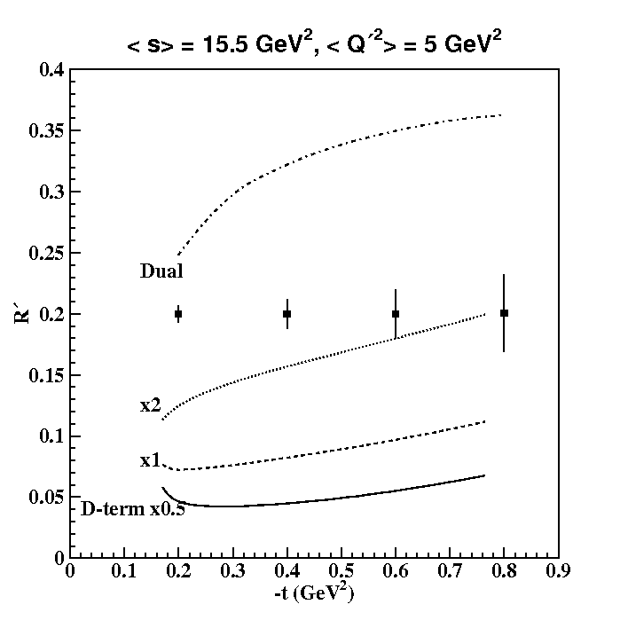
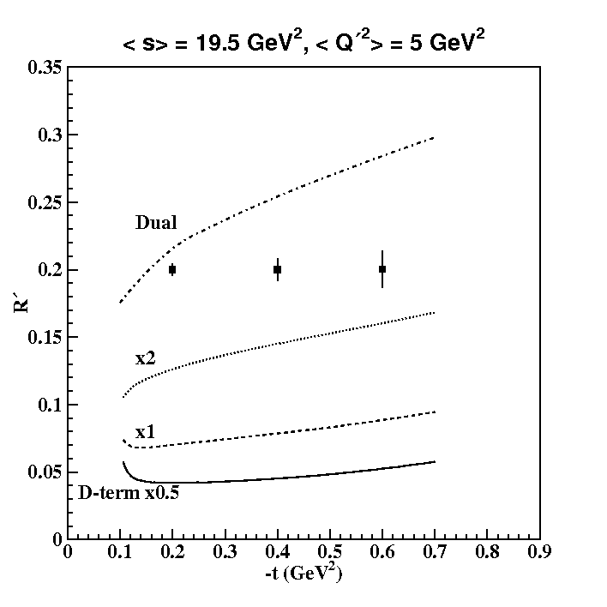
TCS at JLab 12GeV Projected Result
, with 100 time more luminosity, should have about factor of 50 more events than CLAS12 under same running time
CLAS12 and SoLID will run at different time and be well complementary
SoLID
CLAS12
Statistical uncertainties for 100 days at a luminosity of 10³⁵ cm⁻²s⁻¹
Uncertainties for cosine moment R', integrated over the CLAS12 acceptance, for two bins in photon energy, for the lowest Q'² bin above the ρ' resonance.
Different values of the D-term are only shown for the double distribution

Slide 17
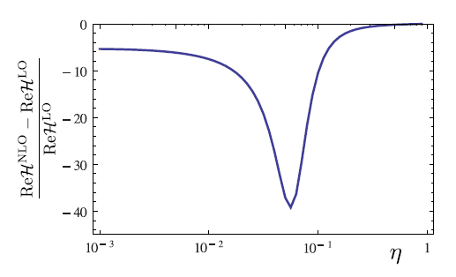
SoLID TCS
(preliminary) estimated 500k events for 1e37cm⁻²s⁻¹ lumi and 50 days
Higher statistics enables multi-dimension binning (Q2, s, t , eta… )
  e.g. study the change over eta and search for NLO (gluonic)
(0.1 , 0.45)

Slide 18
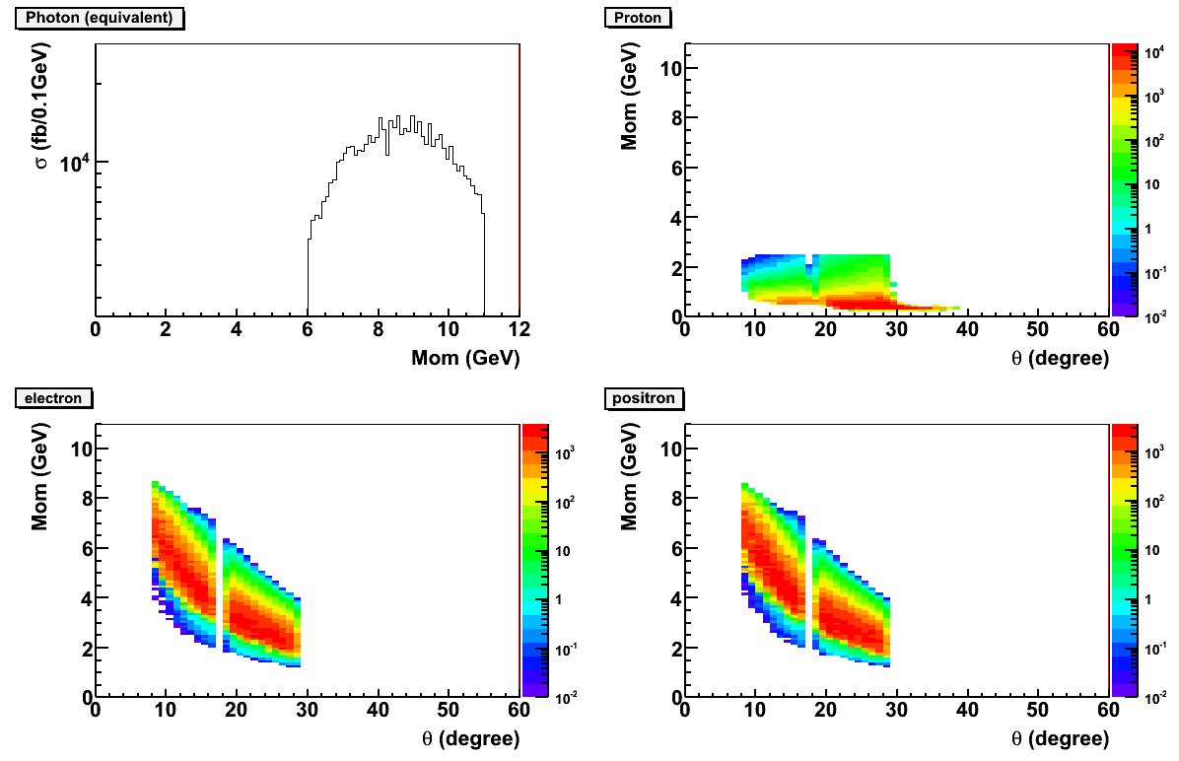
SoLID JPsi and TCS
JPsi setup
  15cm LH2 taget 300cm upstream from solenoid coil center.
  3uA current, 1e37/cm2/s luminosity for 50 days
  forward angle coverage about 8-16 degree, large angle coverage about 17-28 degree
  Trigger on scattered e- at forward angle and decay lepton pair
  at forward and large angle
TCS setup
  Same final particles with JPsi, possible to run in parallel
  Detect proton instead of scattered e-
  Add a TOF plane at large angle for proton pid
  Trigger on decay lepton pair only
0.2GeV< P_proton < 2.5GeV

Slide 19
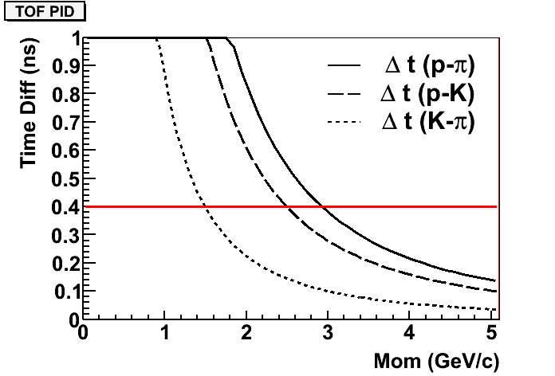
  TOF at large angle
Add a TOF plane before large angle EC
The minimum flight distance is about 245cm from target
Assume 5sigma separation for different particles and 80ps time resolution, then “red” line shows the cut at 400ps
The proton identification can reach at least 2.5GeV
  proton pion separation at 3.0GeV
  Proton kaon separation at 2.5GeV
  Kaon pion separation at 1.5GeV

Slide 20
Things to do
Resolution study
Background and rate (large angle TOF)
Trigger study
….

Slide 21
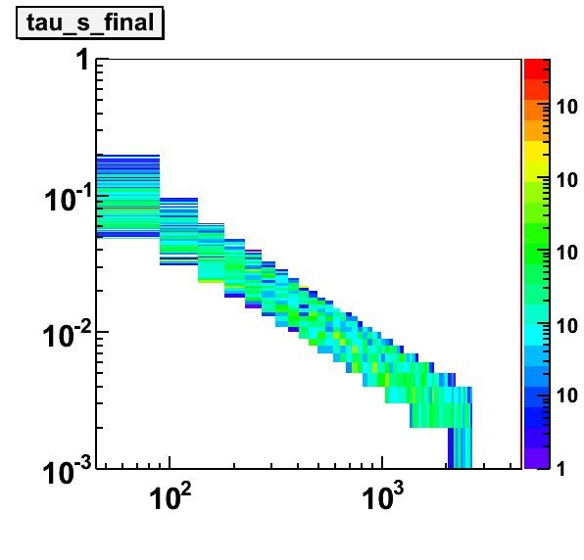
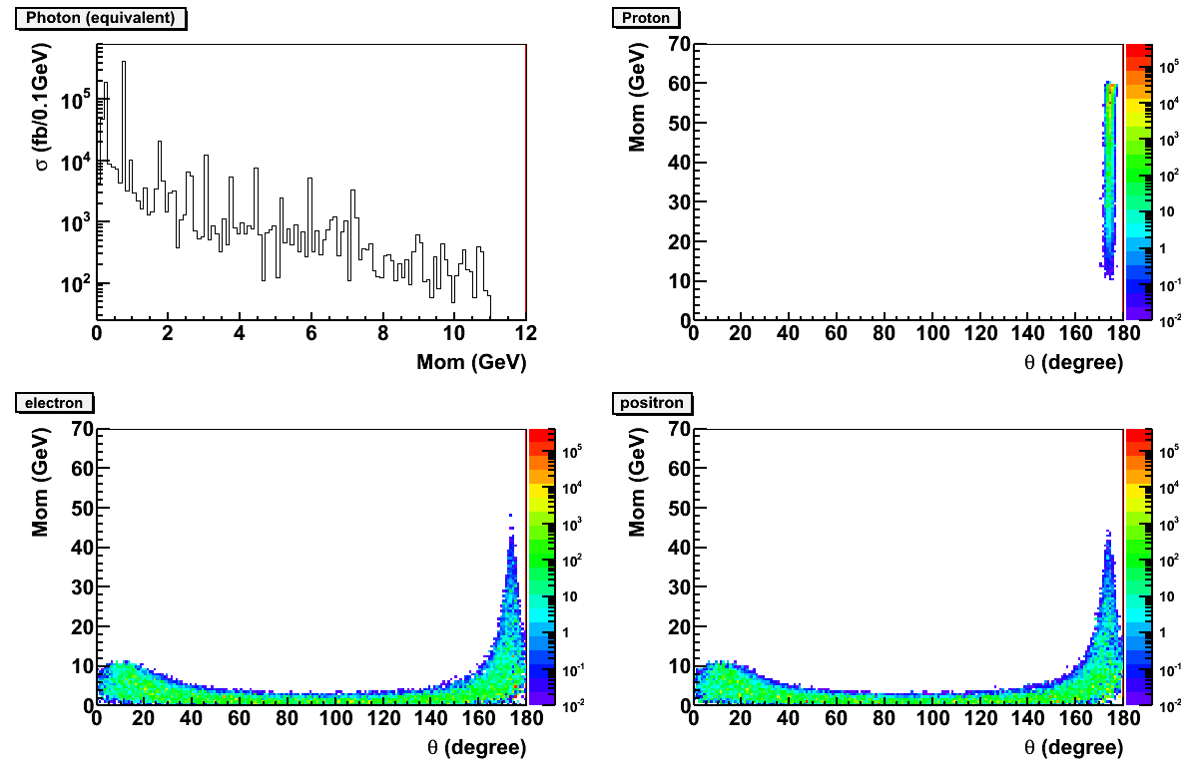
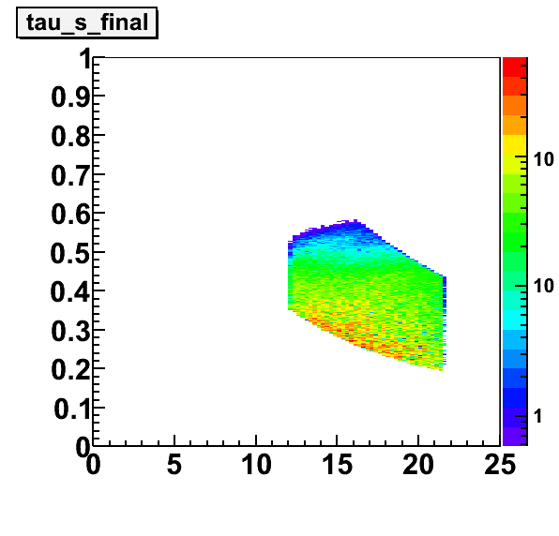
TCS at MEIC
60 GeV p
JLab 12GeV reaches 0.2 for τ explores valence quarks.
MEIC reaches 10⁻³ for τ and will explore the sea quarks and gluons.
11 GeV e⁻
6º
BH at resonance free region used for simulation
Quasi- real scattering electron goes forward
Recoild proton goes backward
Decay leptons have large coverage in the middle
τ
MEIC
s (GeV²)
τ
SoLID
s (GeV²)

Slide 22
Summary
Dilepton production at JLab 12GeV
  J/ψ production near threshold for gluonic interaction
  Timelike Compton Scattering (TCS) for GPD
CLAS12 and SoLID can form a complementary program and will make important contributions in the field
The program can continue at MEIC/EIC

Slide 23
Backup TCS

Slide 24



TCS crosssection

Slide 25
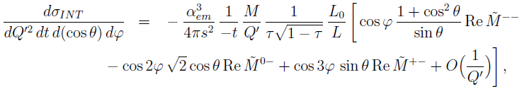
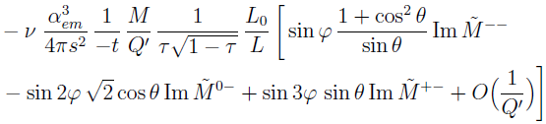
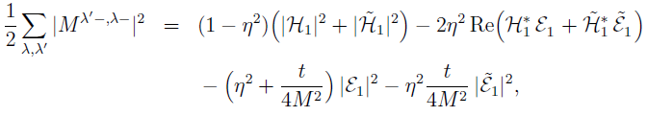
Interference term
In terms of helicity amplitudes:
ν: circular polarization of incoming photon also gives access to imaginary part

Slide 26
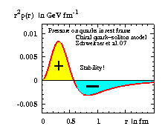
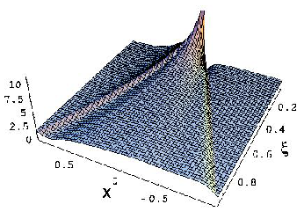
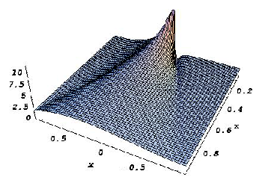
The D-term and the pressure balance in the nucleon
GPD with D-term
GPD without D-term
The D-term contributes only to the real part of the Compton amplitude

Slide 27
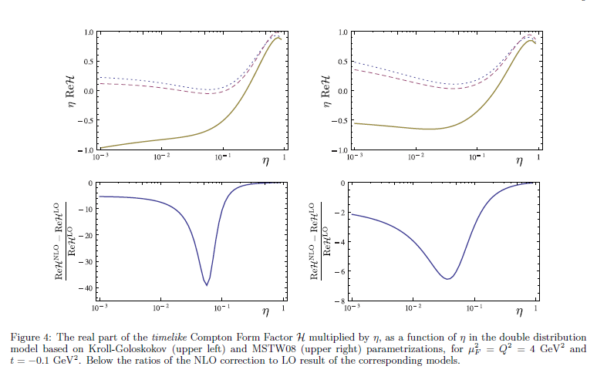
TCS NLO

Slide 28
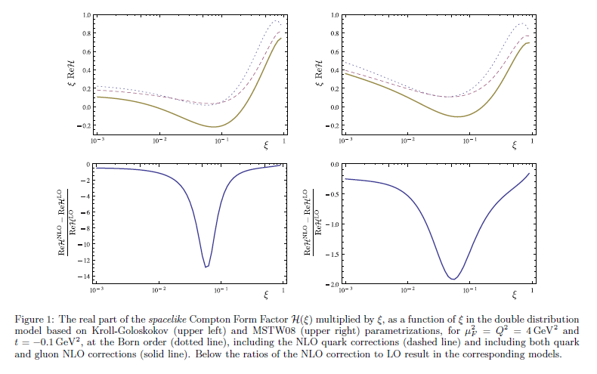
DVCS NLO

Slide 29
Bacup jpsi

Slide 30
Introduction
Dilepton production can be used to probe
  strongly interacting quark-gluon plasma (RHIC)
  gluon distribution in nucleon (HERA)
  Drell-Yan, resonances ...
Dilepton production at JLab 12GeV
  J/ψ production near threshold for gluonic interaction
  Timelike Compton Scattering (TCS) for GPD

Slide 31
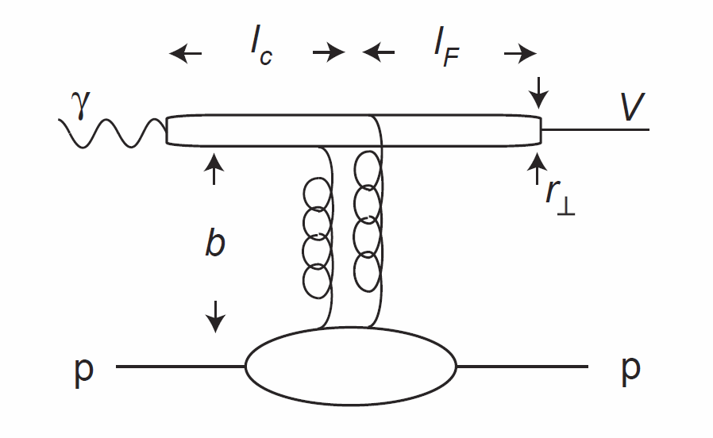
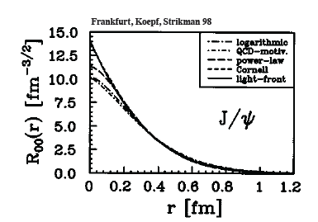
J/ψ Production on Neuclon
Width: 93 KeV
Probe strong color field
in nucleon
J/ψ is a charm-anti-charm system
  Little (if not zero) common valence quark between J/ψ and nucleon
  Quark exchange interactions are
  strongly suppressed
  Pure gluonic interactions are dominant
Charm quark is heavy
  Typical size of J/ψ is 0.2-0.3 fm
  Impact distance b ~ 1/m_{c} ~ 0.1fm
31

Slide 32
Interaction between J/ψ-N
New scale provided by the charm quark mass and size of the J/ψ
  OPE, Phenomenology, Lattice QCD …
High Energy region: Pomeron picture …
Medium/Low Energy: 2-gluon exchange
Very low energy: QCD color Van der Waals force
  Prediction of J/ψ-Nuclei bound state
    Brodsky et al. ….
Experimentally no free J/ψ are available
  Challenging to produce close to threshold!
  Photo/electro-production of J/ψ at JLab is an opportunity

Slide 33

Experimental Status
More data exist with inelastic scattering on nuclei, such as A-dependence.
Not included are the most recent results from HERA
H1/ZEUS at large momentum transfers and diffractive production with electro-production
SLAC, Cornell, Fermilab, HERA …
Intense experimental effort (SLAC, Cornell … )
shortly after the discovery of J/ψ
But near threshold not much since. JLab 12GeV has the
access now.

Slide 34




Reaction Mechanism
Model-I: Hard scattering mechanism (Brodsky, Chudakov, Hoyer, Laget 2001)
Model -II: Partonic soft mechanism
(Frankfurt and Strikman, PRD 66, 031502 [2002])
2-gluon Form Factor
34

Slide 35




Reaction mechanism
Model-III: soft mechanism, final state interaction?
D. Kharzeev. Quarkonium interactions in QCD, 1995,
D. Kharzeev, H. Satz, A. Syamtomov, and G. Zinovjev, Eur.Phys.J., C9:459–462, 1999)
Imaginary part is related to the total cross section through optical theorem
Real part contains the conformal (trace) anomaly which Dominate the near threshold region
  A measurement near threshold could shed light on the conformal anomaly which accounts for a portion of proton mass
  X. Ji PRL 74 1071 (1995)
Notes:
Add the reference of the figure.

Slide 36
Hungry for Data from JLab 12GeV
11GeV beam and luminosity upgrade enable the measurement of the energy and t dependence of J/ψ cross sections near threshold
CLAS12
E12-12-001
approved for 120 days
E12-12-006
approved for 60 days

Slide 37
CLAS12 and SoLID: Acceptance
 | CLAS12 | SoLID
e⁻ and e⁺ coverage | θ(5º – 36º) φ (~ 80% full) Asymmetric | θ(8º – 17º) θ(18º – 28º) φ(full) Symmetric
proton coverage | θ(5º – 36º) Θ(38º – 125º) φ (~ 80% full) | θ(8º – 17º) θ(18º – 28º) φ(full)
Luminosity | 10³⁵/cm²/s | 10³⁷/cm²/s
CLAS12 positive
CLAS12 negative
SoLID positive and negative

Slide 38


SoLID J/ψ Detection
Possible to detect all 4 final particles, fully exclusive production
Recoil Proton
Scattering e-
proton
P (GeV)
Decay e⁻/e⁺
Scattered electron
Decay e-
Decay e+
θ (degree)

Slide 39



Electroproduction vs Photoproduction
Better resolution near threshold
  use of a tagged photon beam
Larger coverage in t
Lower radiation budget
Less background (full exclusivity)
Near threshold
Electroproduction is very important
Electroproduction
Photoproduction

Slide 40


CLAS12 J/ψ Projection
exclusive J/ψ production
Statistical uncertainties for 100 days at a luminosity of 10³⁵ cm⁻²s⁻¹
Open squares: s = 21.05 – 21.55 GeV²
Filled triangles: s = 19.05 – 19.55 GeV²
Filled squares: s = 17.55 – 18.05 GeV²
Uncertainties for the total cross section assuming the most conservative prediction
t-dependence in narrow bins of s for a total cross section given by the lower curve on the left

Slide 41


SoLID J/ψ Projection
50 days of 3μA beam on a 15 cm long LH₂ target
at luminosity 10³⁷/cm²/s
t-dependence of the differential
cross section
  With < 0.01 GeV energy resolution in W and 8 energy bins in W to
  study the threshold behavior of cross section

Slide 42
J/ψ at JLab 12GeV
Its production near threshold will be explored with both photoproduction and electroproduction
Good energy resolution and large statistics can constrain models and shed lights on the gluonic interaction
CLAS12 and SoLID will run at different time and be well complementary

Slide 43
Backup JPsi

Slide 44

Conformal (Trace) Anomaly
  Trace of energy momentum tensor
  “Beta” function energy evolution of strong
  interaction coupling constant
CM frame
[X. Ji PRL 74 1071 (1995)]
Trace Anomaly
Gluon Energy
Quark Energy
Quark Mass

Slide 45
Cross Section Validation
 | Bethe-Heitler | ω | ρ | φ | η
Cross Section | 0.1 ub | 1ub | 1ub | 50 nb | 10 ub
Decay Channel and BR | e⁺e⁻ 1.0 | e⁺e⁻ 7.30 10⁻⁵ | e⁺e⁻ 4.71 10⁻⁵ | e⁺e⁻ 2.97 10⁻⁴ | γγ 0.39
Compared to J/ψ | >10 | x2 | x1 | x0.5 | Large
SoLID capability | good | good | good | good | good
e+p elastic channel: (2.2 and 4.4 GeV beam)
  SoLID Optics Calibration Channel for electrons
SIDIS charged pion (also DIS)
  SIDIS program, comparing with Hall C measurements

Slide 46
Systematic Budget
Acceptance Effect: 10% for triple coincidence
Detector and Trigger Efficiency <2%
Target Luminosity: <2%
Contribution from Al wall <1%
  Dummy run + target vertex Cut
Background Contamination ~0.5%
  B-H background + Random Coincidence (measured directly)
Goal: 10-15% cross section measurements

Slide 47


Rates Estimates
Used equivalent photon approximation
is the virtual photon flux and is the Jacobian
Cross section is based on fits to data at high W within the 2-gluon exchange model

Slide 48


Physics Background
Due to large mass of J/ψ and near-threshold kinematics, little physics background
  The main background is Bethe-Heitler term
B-H process calculated with GRAPE-Dilepton program. Compared with 2-gluon model assuming no threshold enhancement.
The t-dependence background level is acceptable.

Slide 49

Random Coincidence Background
Studied with Pythia and can be subtracted.
  Largest contribution coming from J/ψ photoproduction in random coincidence with a scattered electron.
  With the same 2-gluon model, we calculated the random coincidence rate after all cuts and a 6 ns window.
Do not expect a problem either from physics (B-H) or random coincidence background!

Slide 50


Slide 51

ATHENNA Collaboration
J. Arrington, N. Baltzell, A. El Alaoui, D. F. Geesaman, K. Hafidi (Co-spokesperson), R. J. Holt, D. H. Potterveld, P. E. Reimer (Argonne National Laboratory, Argonne, IL)
X. Qian (Co-spokesperson) (California Institute of Technology, Pasadena, CA)
K. Aniol (California State University, Los Angeles, CA)
J. C. Cornejo, W. Deconinck, V. Gray (College of William & Mary, Williamburg, VA)
X. Z. Bai, H. X. He, S. Y. Hu, S. Y. Jian, X. M. Li, C. Shan, H. H. Xia, J. Yuan, J. Zhou, S. Zhou (China Institute of Atomic Energy, Beijing, P. R. China)
P. H. Chu, H. Gao, M. Huang, S. Jawalkar, G. Laskaris, M. Meziane, C. Peng, Q. J. Ye, Y. Zhang, X. F. Yan (Duke University, Durham, NC)
P. Markowitz (Florida International University, Miami, FL)
A. Afanasev (The George Washington University, Washington, DC)
F. J. Jiang, H. J. Lu, X. H. Yan (Huangshan University, Huangshan, P. R. China)
J. B. Liu, W. B. Yan, Y. Zhou, Y. X. Zhao (University of Science and Technology of China, Hefei, P. R. China)
K. Allada, A. Camsonne, J.-P. Chen, E. Chudakov, J. Gomez, M. Jones, J. J. Lerose, B. Michaels, S. Nanda, P. Solvignon, Y. Qiang (Jefferson Lab, Newport News, VA)
M. Mihovilovič, S. Širca (Jožef Stefan Institute of University of Ljubljana, Slovenia)
G. G. Petratos, A. T. Katramatou (Kent State University, Kent, OH)
Y. Cao, B.T. Hu, W. Luo, M. Z. Sun, Y.W. Zhang, Y. Zhang (Lanzhou University, Lanzhou, P. R. China)
T. Holmstrom (Longwood University, Farmville, VA)
J. Huang, X. Jiang (Los Alamos National Laboratory, Los Alamos, NM)
J. Dunne, D. Dutta, A. Narayan, L. Ndukum, M. Shabestari, A. Subedi, L. Ye (Mississippi State University, Mississippi State, MS)
E. Cisbani, A. d. Dotto, S. Frullani, F. Garibaldi (INFN-Roma and gruppo collegato Sanitá and Italian National Institute of Health, Rome, Italy)
M. Capogni (INFN-Roma and gruppo collegato Sanitá and ENEA Casaccia, Rome, Italy)
V. Bellini, A. Giusa, F. Mammoliti, G. Russo, M. L. Sperduto, C. M. Sutera (INFN-Sezione di Catania, Catania, Italy)
D. Y. Chen, X. R. Chen, J. He, R. Wang, H. R. Yang, P. M. Zhang (Institute of Modern Physics, Lanzhou, P. R. China)
C. E. Hyde (Old Dominion University, Hampton, VA)
L. El Fassi, R. Gilman (Rutgers University, Piscataway, NJ)
S. Choi, H. Kang, H. Kang, Y. Oh (Seoul National University, Seoul, Korea)
P. Souder and R. Holmes (Syracuse University, Syracuse, NY)
W. Armstrong, A. Blomberg, D. Flay, E. Fuchey, M. Paolone, N. Sparveris (Co-spokesperson), Z.-E. Meziani (Co-spokesperson/Contact), M. Posik, E. Schulte (Temple University, Philadelphia, PA)
K. Kumar, J. Mammei, S. Riordan (University of Massachusetts, Amherst, MA)
T. Badman, S. K. Phillips, K. Slifer, R. Zielinski (University of New Hampshire, Durham, NH)
H. Badhdasaryan, G. D. Cates, M. Dalton, D. Day, D. Keller, V. V. Nelyubin, K. Paschke, A. Tobias, Z. W. Zhao (Co-spokesperson), X. Zheng (University of Virginia, Charlottesville, VA)
F. R. Wesselmann (Xavier University of Louisiana, New Orleans, LA)

Slide 52
TCS EIC

Slide 53


Dilepton Production at EIC
s = E_{cm}² (GeV²)
Q² ~ ysx
GPDs with J/ψ
GPDs with TCS, no need for positron beam like DVCS
y
C. Weiss
LHeC
Transverse gluon distribution from deep exclusive J/ψ electroproduction
EIC Stage II
(ELIC)
EIC Stage I
(MEIC)
JLab 12 GeV

Slide 54
TCS at MEIC
60 GeV p
JLab 12GeV reaches 0.2 for τ explores valence quarks.
MEIC reaches 10⁻³ for τ and will explore the sea quarks and gluons.
11 GeV e⁻
6º
BH at resonance free region used for simulation
Quasi- real scattering electron goes forward
Recoild proton goes backward
Decay leptons have large coverage in the middle
τ
MEIC
s (GeV²)
τ
SoLID
s (GeV²)

